Slide 1
RADIATION induced failures in LHC 28th June 2011
G. Spiezia (EN/STI/ECE) for RADWG/R2E

Slide 2
Outline
Strategy for the failure analysis
Information Collection
List of Failures per equipment
Summary
This is only a snapshot of the current situation. Full picture will be more clear in November after the R2E review

Slide 3
Analysis Strategy
Criteria to recognize a radiation failure:
Failure occurs during beam-on/ collisions/losses (source of radiation)
Failure is not reproducible in the lab or not clearly explained or recognized as ‘expected failure’
Failure signature was already observed during radiation tests (CNRAD and others – if any ...)
Failure frequency increases with higher radiation
Further check: cross correlation with radiation detectors response at the moment of the failure

Slide 4
Information collection and storing
First information source: e-logbook, 8h30 LHC meeting
High probability to miss failures which do not cause beam dump (Limitation1)
Follow up of the suspicious events with the equipment owner (continuous mail exchange)
What should be stored:
Location
Date-Time failure
Component
Consequence of the failure
Where:
RadWG list (see link)
TE/CRG list (see link)
TE/EPC list (see link)
TE/MPE list (see link)

Slide 5
Event Classification
Confirmed radiation-induced failure
To be confirmed
Limitations and uncertainty sources:
High probability to miss failures which do not cause beam dump
Risk to include not-radiation induced failures
Indirect failures on Equipment A due to equipment B. (e.g. Ethernet)

Slide 6
List of Failures
Collimation Control 2 Confirmed + 2 To be Confirmed
Location: Ujs at point 1 and 5
Type of failure: Abnormal reboot of the controller, memory corruption, Power supply failure
Consequence: Beam dump
Mitigation: Relocation/Shielding
More Details
Cryogenics Control (Cavern)PLCs: 3 Confirmed
Location:US85
Type of failure: PLC failures: 2 in QURCB cold box (same position) and 1 in the QURA
Consequence: Beam dump (one case)
Mitigation : Relocation
More Details: 1, 2

Slide 7
List of Failures
Cryogenics Control (Tunnel) 4 Confirmed +1 To be Confirmed
Location:UJ14, UJ56, UJ76
Type of failure: Profibus Interface ET200s, Sipart PA positioners
Consequence: Beam dump
Mitigation : Relocation
More Details: 1
Cryogenics Control and readout on WORLDFIP – 2 Confirmed
Location: Injection line TI2 (cell8L2-caused by a beam loss), RR53
Type of failure: Block of the FIP communication, Digital Isolator
Consequence: Beam dump (only for the Digital Isolator case)
Mitigation : Software update to mask the digital isolator SEU and physical strap of the isolator to avoid change of range
More Details: 1

Slide 8
List of Failures
Valve Controllers 0- Analysis on going ...
Location: US85
Type of failure: Trip of the valve positioners
Consequence:
Mitigation : Relocation already on going
Biometry 2 To be Confirmed
Location: Access port to UJ14 Uj16
Type of failure: Block of the access system
Consequence: Access to the tunnel delayed
Mitigation : Relocation

Slide 9
List of Failures
WIC 1 Confirmed
Location: Injection line TI8
Type of failure: Deported I/O module failure
Consequence: Beam dump
Mitigation : Crate already moved (no failure since then).
Power Converters 4 Confirmed 1 To be Confirmed
Location: UJ14, RR17, UA87, UJ43
Type of failure: AUX power supply failure(600A), AUX power supply(120A) (different signature)
Consequence: Beam dump
Mitigation: Shielding, Relocation, Redesign
More Details: 1, 2

Slide 10
List of Failures
UPS 2 To be confirmed
Location: UJ56, US85
Type of failure: IGBT failure or control card failure
Consequence: Beam dump
Mitigation: Relocation
More Details:
QPS 39 Confirmed (23 cases were detected but are transparent to the operation) 6 to be confirmed.
Location: LHC tunnel (93%), UJ14, Uj16, RR53
Type of failure: Digital Isolator, MicroFip block, DSP, SDRAM block
Consequence: Beam dump (6%), Lost of QPS ok(40%), Transparent to operation (50%). Magnet protection never lost
Mitigation: Firmware update for the digital isolator (already implemented in 20%), automatic reset of microfip, new design
More Details: 1

Slide 11
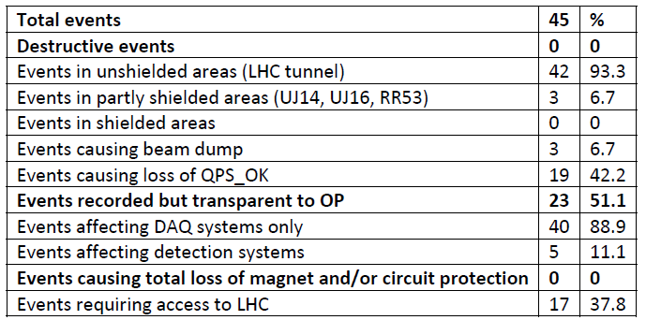
QPS –details to explain

Slide 12
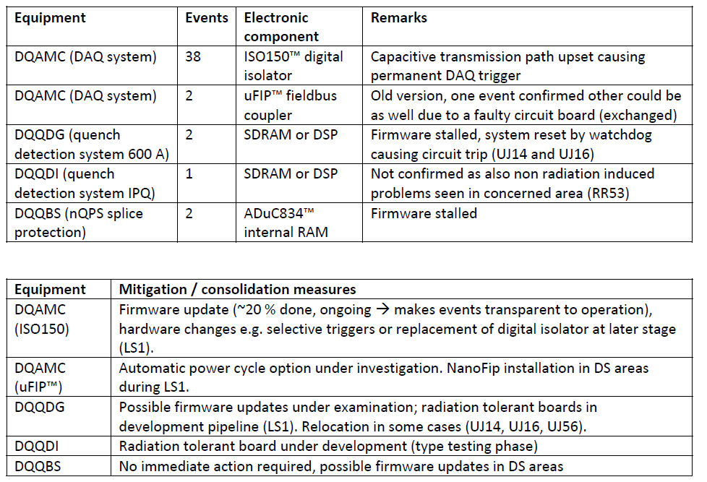
QPS- details on the failures

Slide 13
Continuous work ...
Events to follow up in the last weekend
PLC US85 -> + 1 case to be studied
Cryo UJ56 -> + 1 case to be studied
QPS uFIP -> Reiner talk for the details
60A PC -> Analysis is on going...

Slide 14
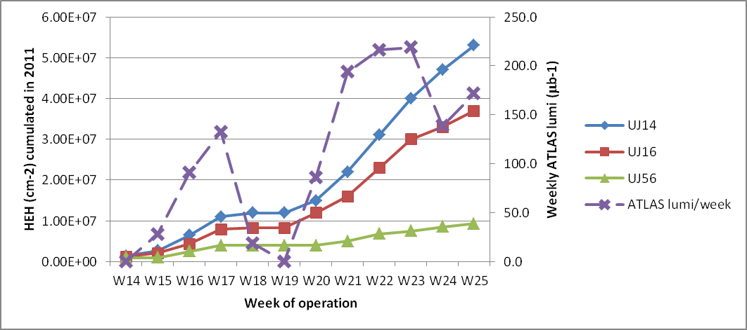
Failure rate over time
12 over 16 confirmed errors due to SEU happened in the weeks 16-23 (QPS is excluded)!

Slide 15
Summary
Beam Dump or ‘visible’ for operation
Shielded area | Tunnel
14 | 3 | Confirmed
11 | 3 | To be confirmed
Other
Shielded | Tunnel
 | 15 | Confirmed
Transparent to Operation
 | 23 | Confirmed
Detailed analysis for each case
Good visibility of events which caused the beam dump or remarkable stop
Other faults difficult to follow up (apart the detailed QPS analysis)
Snapshot picture (up to June 24th ). More statistics is required for a detailed analysis.
QPS analysis
Projection on the those data (!Many sources of uncertainty!):
If all the failures are confirmed: 31 errors →
If factor 50 is used to scale with Lumi and same beam conditions are assumed (optimistic case) →then one gets
1500 errors per year due to radiation.
Too many even if there is an error of a factor 10

Slide 16
Summary – back up
Beam Dump or visible LHC stop
Shielded area | Tunnel
14 | 2+1 | Confirmed
8+3 | 3 | To be confirmed
Other
Shielded | Tunnel
 | 15 | Confirmed
Transparent to Operation
 | 23 | Confirmed
QPS analysis

