Slide 1
Status of 1m beta* commissioning
Jan Uythoven for the LHC team

Slide 2
β* = 1 m in IPs 1 and 5: The Context
During MD period optics with β* = 1 m was tested using
Tight collimator settings
Reduced crossing angles from 120 μrad to 100 μrad
Beam was unstable during squeeze
During same MD period the physical aperture around the triplets in the IPs was found to be larger than initially assumed
Decision in LMC last week
Continue running with same collimator settings as before the TS
TCTs IR1, 5 and 8 @ 11.8 σ
Stay with the crossing angle of 120 μrad
Confirm the additional physical aperture
Start-up program after TS based on this

Slide 3
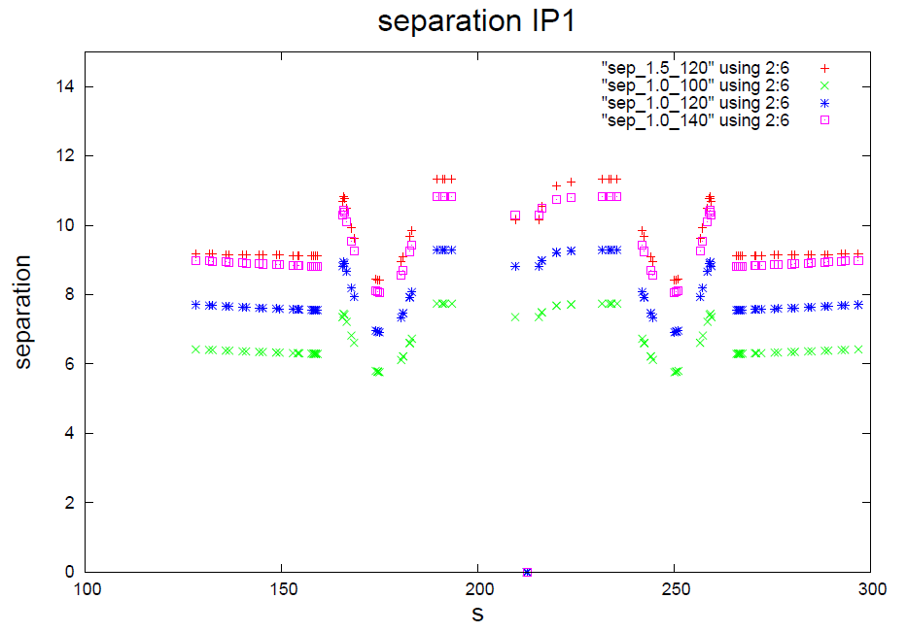
Beam-beam separation
Beam-beam separation down below 6σ for 100 μrad
With 120 μrad ~ equivalent to nominal (β* 0.55 m)
Triplet
Triplet
W. Herr
To keep same separation with β* = 1 m, need 140 μrad

Slide 4
The commissioning blocks
Configuration:
β* =1m, 120 μrad Xing angles.
IR3+6+7 collimators at standard settings, TCTs 11.8σ (IR1+5+8)
Block A: Aperture at 1m and 120 μrad
Block B: ALICE polarity reversal
Block C: Validation = loss maps
Block D: Intensity ramp up

Slide 5
Block A : aperture check
Fill 1: 1 probe/beam, checkout cycle.
b* 1 m and Xing angle 120 μrad.
Standard collimator settings IR6+7.
TCTs IR1/5 to be adapted to 120 μrad (setup on 100 μrad).
Fill 2: 2 nominals/beam, TCT alignment, orbit.
TCTs IR1/5 alignment on 120 μrad, separated and in collision.
Collision (re-)optimization with 120 μrad, reference orbit.
End with loss map (H+V) and asynch dump. TCTs are 11.8σ.
Fill 3: 1 probe/beam, aperture check @ 1 m.
Repeat aperture measurement at 1 m.
End with a loss map H, TCTs at 14σ.
Fill 4: 1 probe/beam, aperture check with loss map.
Loss map with TCTs at Xσ, X = 13…14.
4h
OK
6h
OK
OK, crossing plane separated beams missing* Q10-R1 ?
8h
5h
* Crossing plane separated not required * Q10 – R1 confirmed as ‘noise’

Slide 6
Block A: long range BB check
Fill 5: 84b with highly asymmetric BB filling pattern (also used for 1 m with 100 μrad).
Bring the beam up to collisions.
Verify stability and beam-beam effects.
6h
Trying again this afternoon

Slide 7
Block B : ALICE polarity
Step 1: adjust injection, reference.
ALICE on ‘old’ polarity.
Injection steering with 12b, then copy to probe and check it.
Step 2: revert ALICE polarity.
Check/correct orbit.
Check/steer injection oscillations with probe, repeat with nominal.
Step 2’: re-steer TI2 if necessary.
TDI coarse
TL setup, TCDI alignment and verification.
Step 3: TDI/TCLI alignment.
TDI/TCLI alignment with 1 nominal b.
Check TDI,TCLI setup – check protection.
Check injection 12b
2h
OK
4h
OK
12h
8h
OK

Slide 8
Block B : ALICE polarity continued
Step 4: TCTs IR2 at injection.
Setup TCTs in IR2 at injection.
Step 5: Checkout cycle, 2 probes/beam.
Check Xing angle IR2 along the cycle.
Correct orbit if necessary.
TCTs IR2 ‘open’.
Step 6: TCT IR2 alignment cycle, 2 nominal b/beam.
TCT alignment on flat top and in collision.
Collision orbit, reference.
Loss map H+V and asynch. dump.
(Step 7: TCT IR2 functions, positions and interlocks )
2h
OK
4h
OK
6h
OK
OK
Setting functions for the whole operational cycle were generated.

Slide 9
Block C
Validations (loss maps, asynch dump checks) – to be confirmed with collimation team (Dp/p)
Condition | Betatron H | Betatron V | Dp/p + | Dp/p - | Dump
Injection | DONE | REPEAT | DONE | DONE | OK
Flat top | DONE | DONE | --- | --- | REPEAT
Squeezed | DONE | DONE | --- | --- | DONE
Collisions | OK | X | X | OK | X
Finish coming night

Slide 10
Block D: Intensity ramp up
Proposed ramp up for stable beams:
48b – short fill
264 – short fill
480 – short fill
912 – long fill
1380 – finally !!
Could go for stable beams this Wednesday

Slide 11
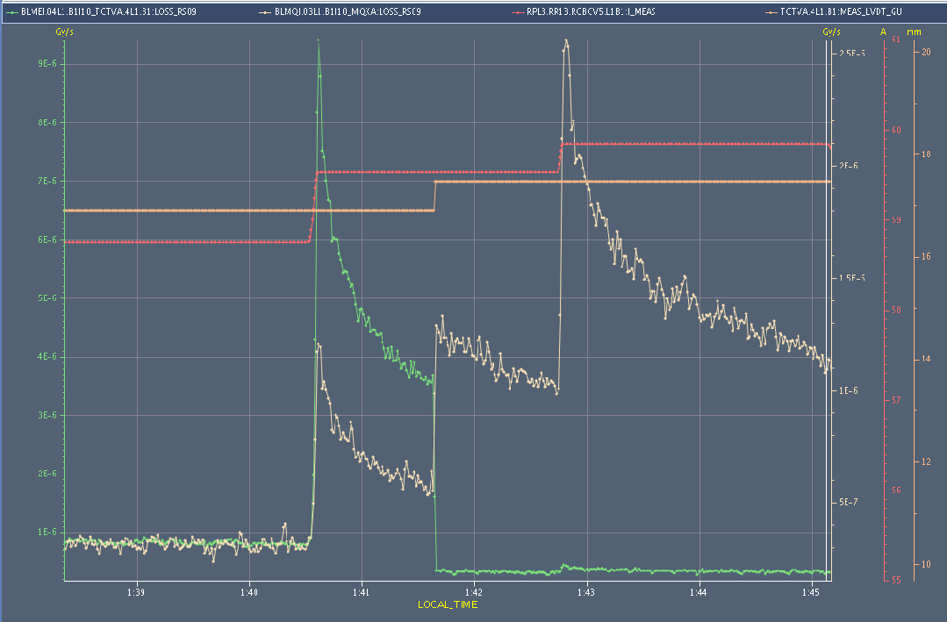
Probing TCT – Triplet aperture
At the step of TCT gap between 14.8 and 15.3 sigmas, the losses move from the TCT to the MQX (light-orange line).
BLM TCT
BLM triplet
TCT position
Corrector = aperture bump

Slide 12
Conclusions on Aperture so far
Aperture confirmed at 1 m – there is enough aperture for β*=1m & 120 µrad Xing angles, with around 2 sigma additional margin.
We can conclude that for the squeezed/separated case we found >16 sigmas in the separation plane. the crossing plane was only addressed in collision conditions.
IP1 (V): triplet at 14.8 -> 15.3 sigmas (collision and lumi scans IN) IP5 (H): triplet at 15.3 -> 15.8 sigmas (collision and lumi scans IN) IP1 (H): triplet at above 16.0 sigmas (squeezed, separated) IP5 (V): triplet at above 16.0 sigmas (squeezed, separated)
Betatron loss maps with TCTs at collision settings + 2sigma step out: Only small losses on the TCTs, and no losses on the triplets...
Loss maps show a peak in the Q10-R1. To be followed up.

Slide 13
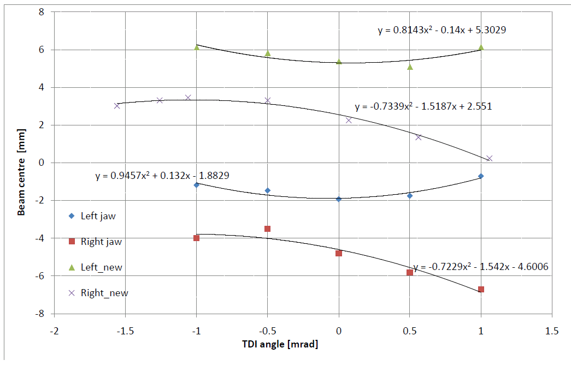
TDI alignment & angle set-up

