Slide 1
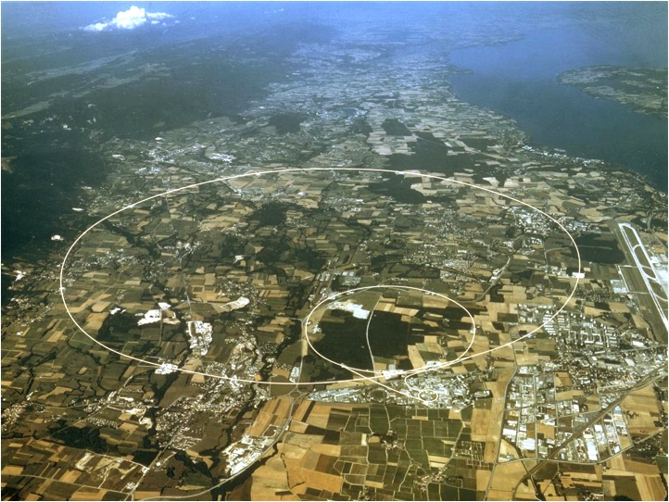
vertical crossing angle at IP8
R. Bruce, W. Herr, B. Holzer
Acknowledgement: S. Fartoukh, M. Giovannozzi, S. Redaelli, J. Wenninger
IP5
IP8
IP2
IP1
*

Slide 2
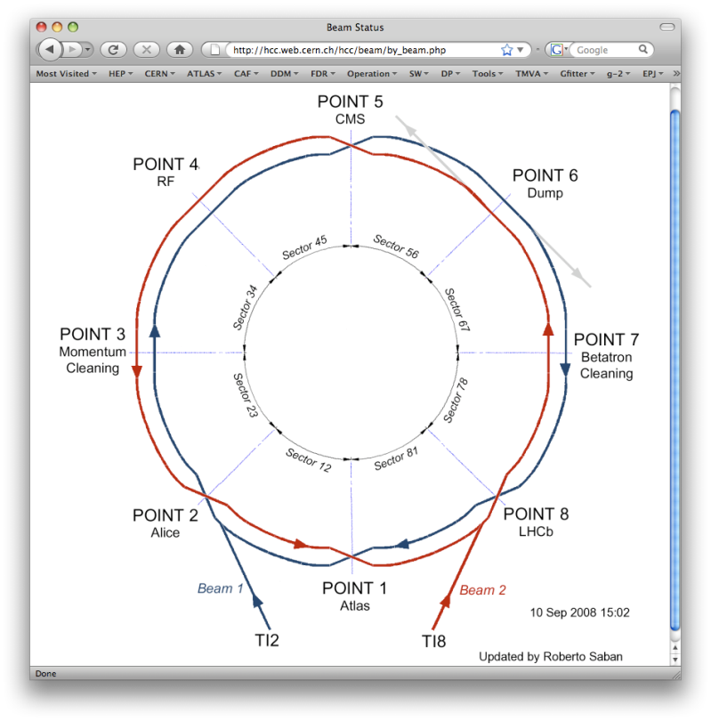
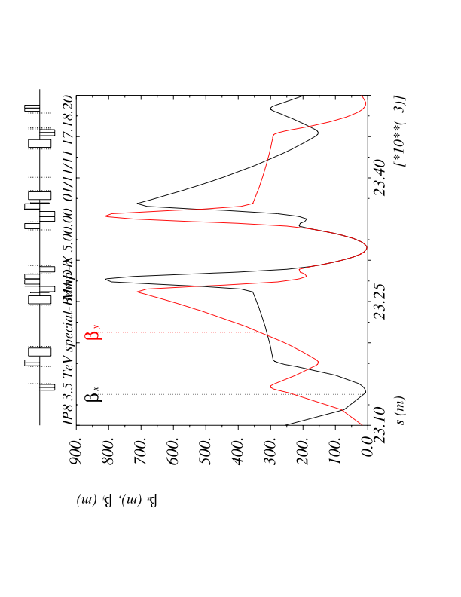
Beam / Machine Parameters:
E = 4 TeV
ε = 3μm
β* = 3m
The Problem: LHC-B and the
machine geometry
LHC-B running at negative field
is against the natural LHC geometry

Slide 3
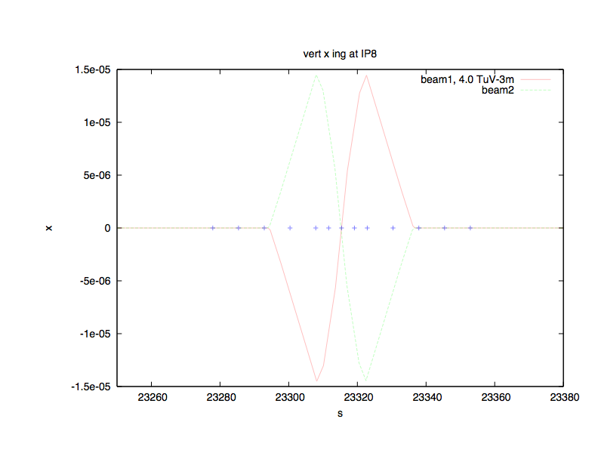
LHC-B Magnet & Compensator:
crossing angle at 4 TeV = +/- 236 μrad
parasitic encounters for 50 ns
... and 25ns
By adding an external crossing angle bump we have to avoid parasitic encounters
for both LHC-B polaristies.
Nota bene: LHC-B bump is compensated (i.e. closed) at +/- 21m, before the triplet.

Slide 4
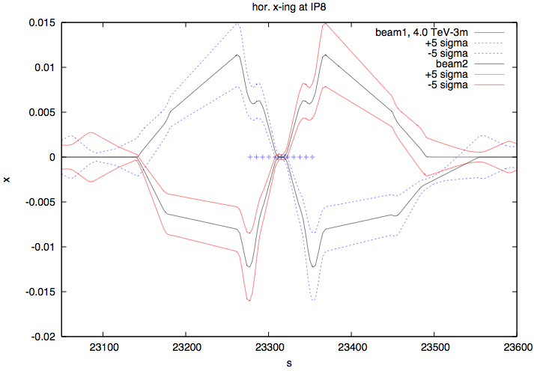
The problem: LHC_B at “wrong polarity”
Present Solution: the orbit effect (in hor. plane) has to be compensated by a strong external horizontal crossing angle bump.
“external bump” created to compensate
the LHC-B effect θ = +/- 250 μrad

Slide 5
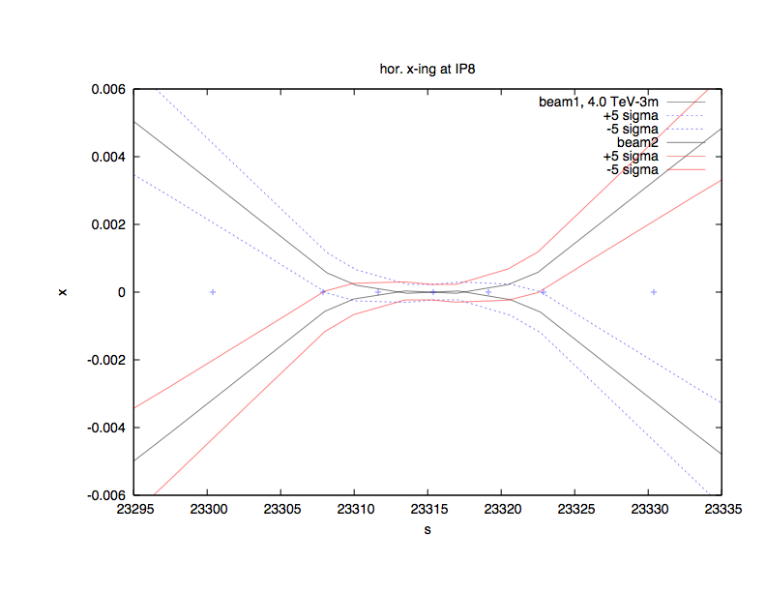
External bump zoomed in:
first paras. encounter at 25 ns
Consequence: net crossing angle different for the two polarities (external angle added and subtracted resp.)

Slide 6
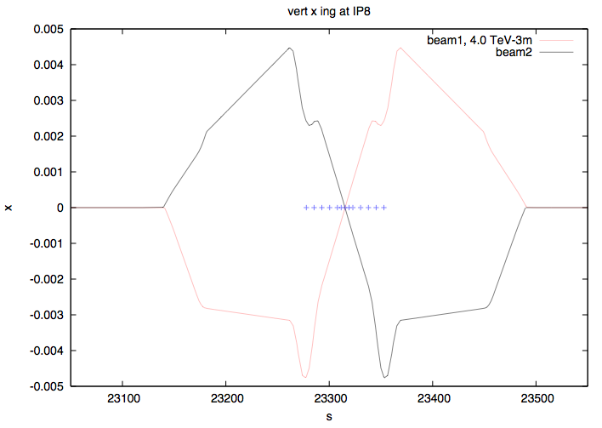
Proposed new Solution:
vertical external crossing angle bump:
crossing angle at 4 TeV = +/- 236 μrad
First proposal:
W. Herr and Y. Papaphilippou,
LHC Project Report 1009
Also MD4 2011
Coils:
acbcvs5.l8b1,
acbyvs4.l8b1,
acbyvs4.r8b1
acbyvs5.r8b1
and it
works !!
y
Problem ?? Aperture in the triplet according to beam screen orientation

Slide 7
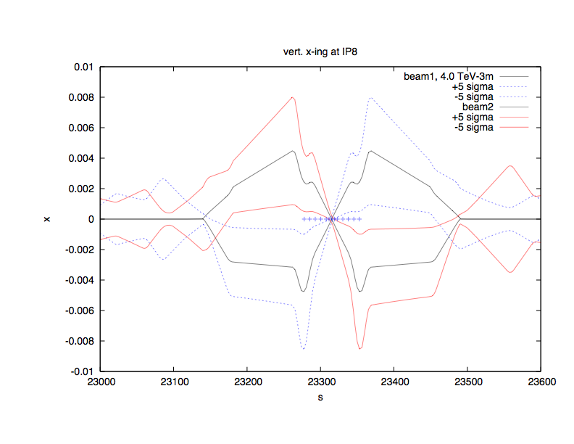
Proposed new Solution:
vertical external crossing angle bump:
crossing angle required at 4 TeV for sufficient separation
at the 1st paras. encounter (25ns !!) = +/- 100 μrad
y

Slide 8
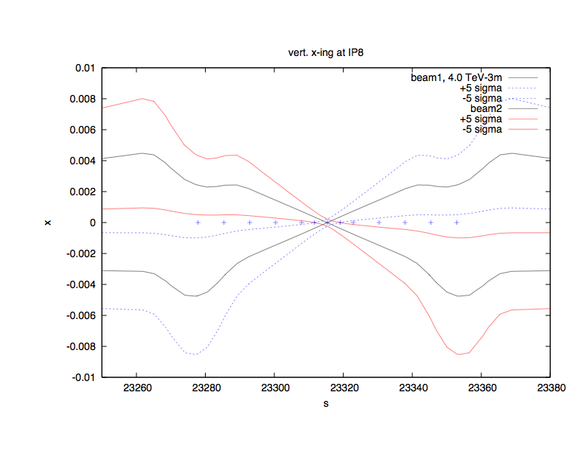
Proposed new Solution:
vertical external crossing angle bump:
at the 1st paras. encounter (25ns !!) = +/- 100 μrad
y
plot refers to 3 μm and +/- 5 σ beam envelope

Slide 9
Aperture estimates, top energy
beam screen orientation is optimised for external horizontal crossing angle
Aperture checked with scaling and n1method.
At top energy (3.5 TeV – 4 TeV will be better!):
Scaling:
Bottleneck in Q2
no local aperture measurements
done for IR8V!
Scaling measured global injection
aperture (~13 sigma) + 2 sigma to new configuration
(beta*=3m, 100 urad vertical angle)
Top-energy-aperture without tolerances for orbit and beta-beat = 21 sigma
Goes down to ~18 sigma with tolerances
A lot of margin!
450 GeV, beta*=11m, 170urad H
3.5 TeV, beta*=3m, 100urad V

Slide 10
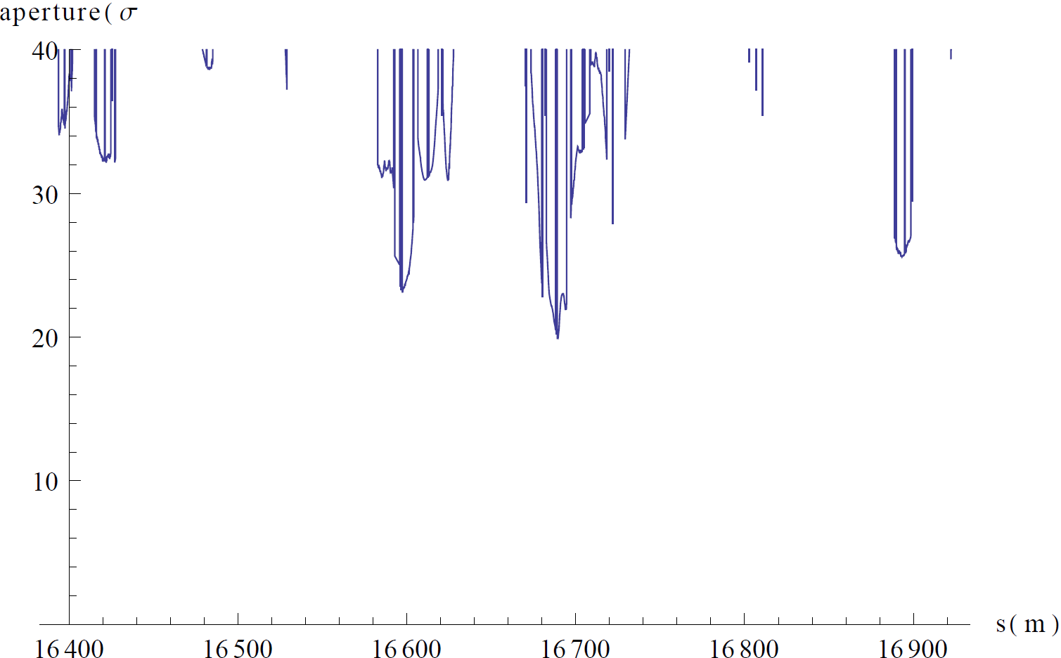
Aperture estimates, top energy
n1 method, no tolerances for orbit, beta-beat and off-momentum
Min n1=20 sigma => plenty of margin

Slide 11
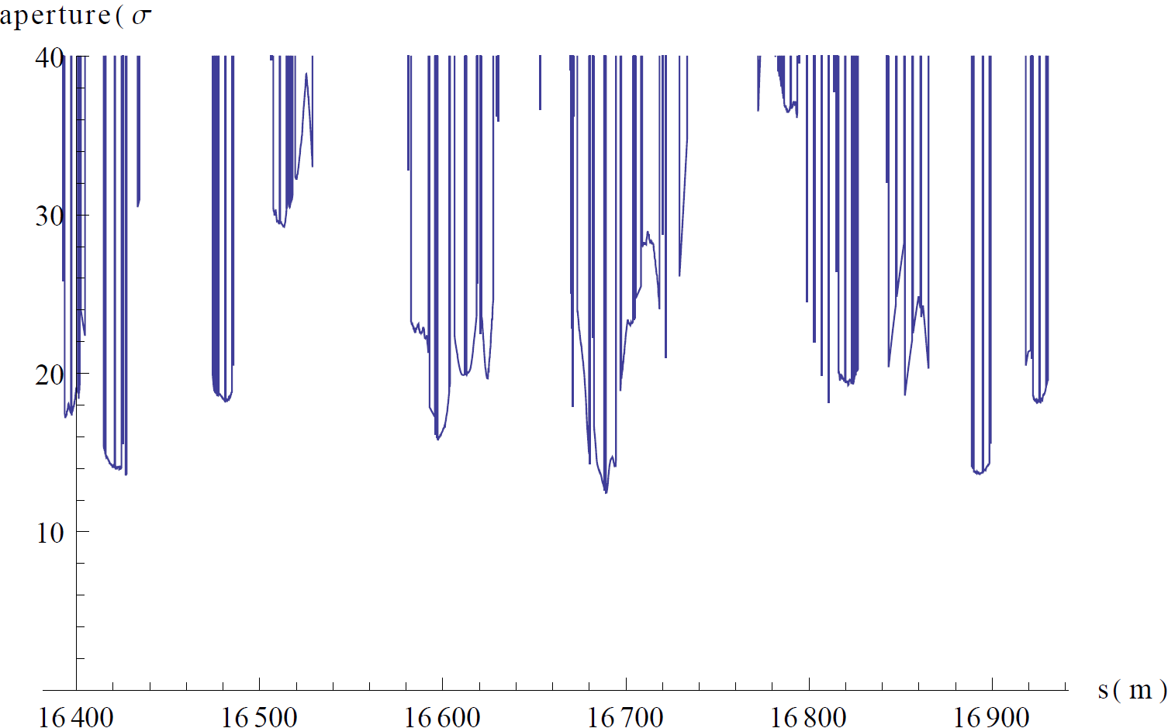
Aperture estimates, injection
n1 method, no tolerances for orbit, beta-beat and off-momentum
Min n1=13 sigma => same as from scaling
Roughly = global aperture at injection
Present TCT setting at injection = 13 sigma
Will be worse if separation is added!

Slide 12
Operational Considerations:
leveling & beam separation: must be established in a plane that is orthogonal to the plane of beam crossing.
  we will have to program a combination of horizontal and vertical bumps.
Injection: there is not much space for a vertical crossing angle
  ε = 1/γ
  IR8 triplet probably becomes global aperture bottleneck
  TCTs must be moved in and aperture carefully measured. Not ideal, feasibility to be checked when separation scheme is defined
Alternative:
keep the standard procedure until flat top (vertical separation & horizontal crossing during injection & ramp)
at flat top: apply in addition the vertical crossing
  reduce the horizontal external crossing to zero
  reduce the (diagonal !) separation bump to adjust the lumi
eventually: combine the points synchronously during the ramp ?

Slide 13
operational procedures at flat top:
1.) move beams in hor dorection towards the “diagonal”
2.) remove hor. crossing angle α_{x} , apply vert. crossing angle α_{y}
3.) bring beams into collision / level luminosity along the diagonal “n”
4.) Lumi-optimisation:
along “n”
along the orthogonal to “n”

Slide 14
squeeze
adjust
collisions
apply Δ_{x}
apply α_{y}
α_{x} -> 0
collide / level along n
ramp
injection
α_{x} reduced
Δ_{y} reduced
α_{x}, Δ_{y}

Slide 15
Summary
When spectrometer in LHCb is run at inverse polarity, the horizontal orbit of spectrometer + compensator goes against the “natural geometry” defined by recombination => parasitic collision point
Can be compensated by external crossing angle, but the net crossing angle is different depending on polarity
For 25 ns, the beam-beam separation at first parasitic encounter is too small
Proposed solution: vertical crossing angle. 100 urad sufficient for 10 sigma beam-beam separation at 25 ns (beta*=3m, 3.0 um emittance)
Aperture should give no problems at top energy
  But no local measurements done in IR8 V so far! Measurements required to avoid bad surprises
Aperture at injection more problematic but not impossible
Work still to be done:
  Decision on detailed gymnastics for how and when vertical crossing angle is introduced, as well as leveling and parallel separation
  Re-check aperture theoretically in worst-case configurations (separation on)
  Measure aperture

