Slide 1
INJECTION AND TRANSFER LINE STABILITY
L.Drøsdal
For the injection team

Slide 2
Stability issues
Shot-by-shot trajectory stability
Bunch-by-bunch trajectory variations
Transfer line drifts

Slide 3
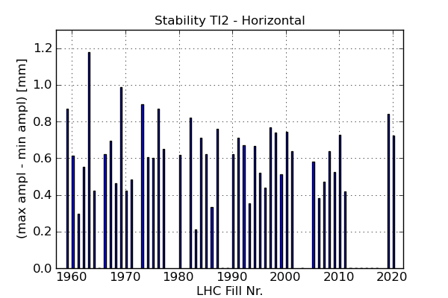
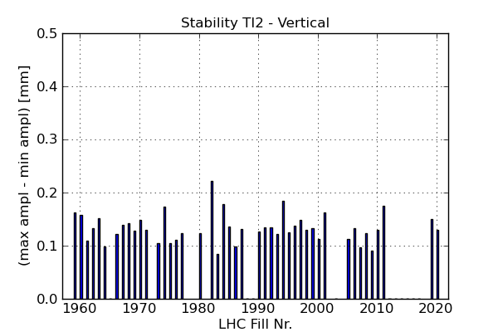
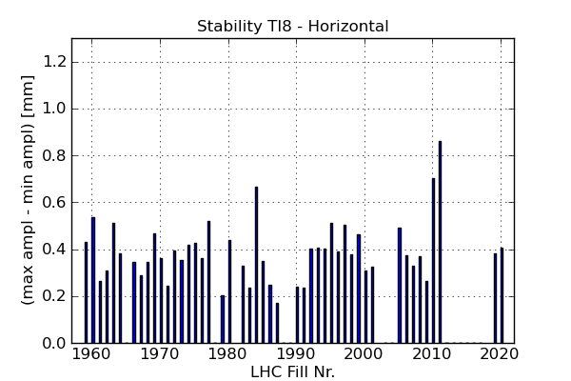
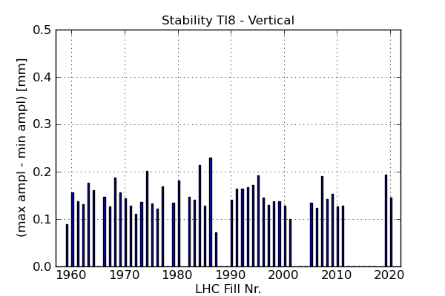
2011: Large shot-by-shot variations
60 fills in summer 2011: Large Horizontal variations, Vertical is good
Avg. = 0.622 mm
Max = 1.179 mm
Avg. = 0.133 mm
Max = 0.222 mm
TI 2
Avg. = 0.391 mm
Max = 0.863 mm
Avg.= 0.148 mm
Max = 0.229 mm
TI 8

Slide 4
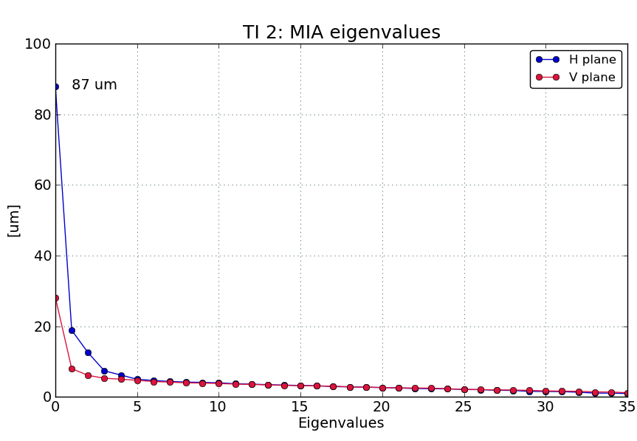
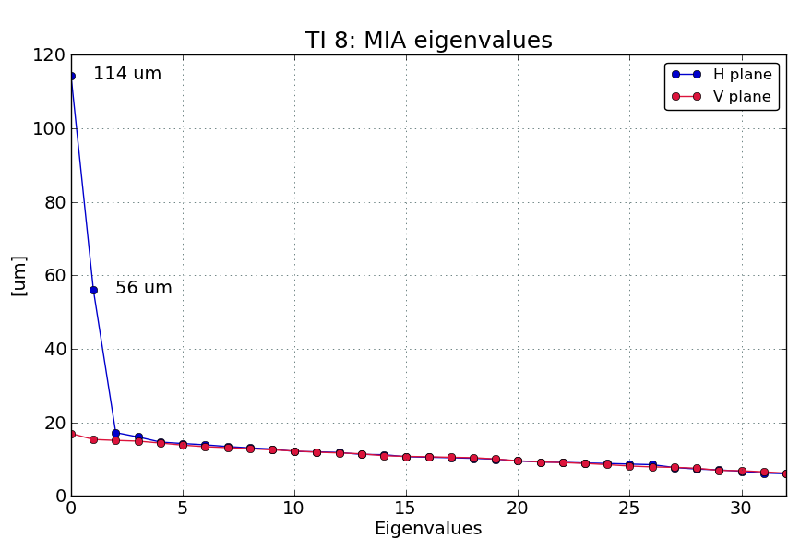
2011: Sources of instability
TI 2: 1 source matching the MSE → initiated investigations on power converter → power converter ripple reduced to half end of 2011
TI 8: 2 sources – MSE and MKE
Notes:
More on MSE improvements

Slide 5
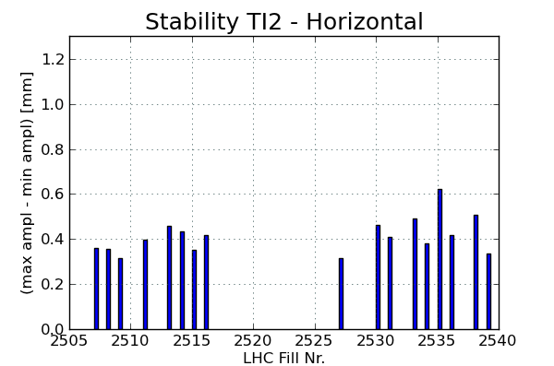
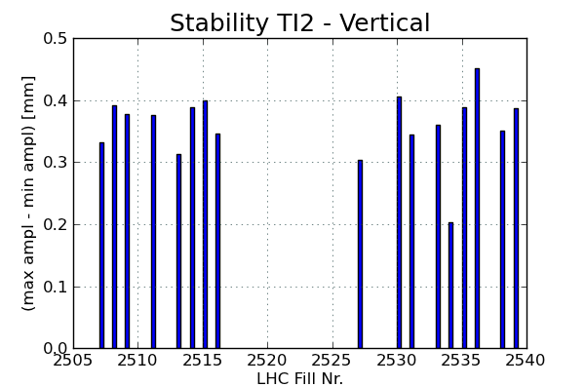
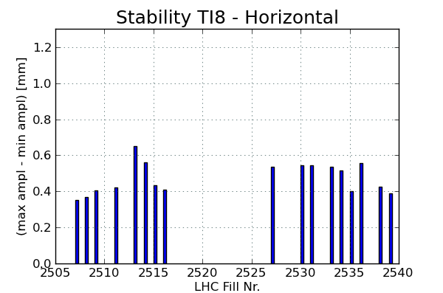
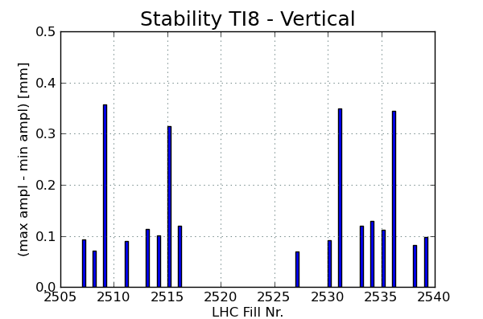
2012 stability
Horizontal TI 2 reduced, Vertical worse?; TI 8 the same.
Avg. = 0.413 mm
Max = 0.623 mm
Avg. = 0.360 mm
Max = 0.451 mm
TI 2
Avg. = 0.474 mm
Max = 0.651 mm
Avg.= 0.156 mm
Max = 0.358 mm
TI 8
Notes:
TI 2 has improved in the horizontal plane due to the work done on the MSE power converter, vertical seems worse, TI8 is the same (outliers)

Slide 6
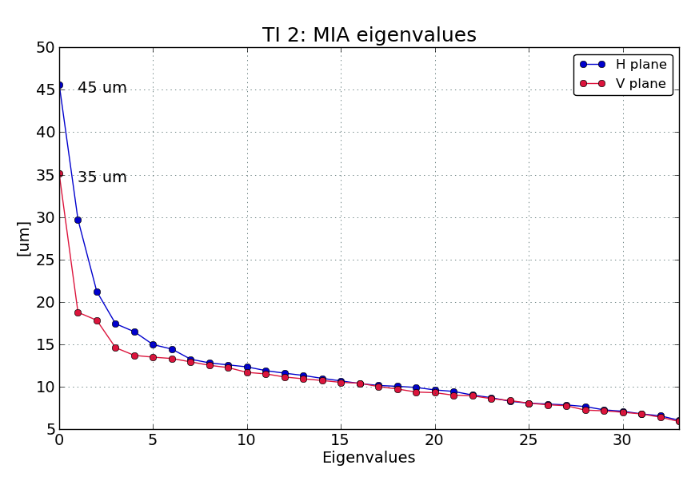
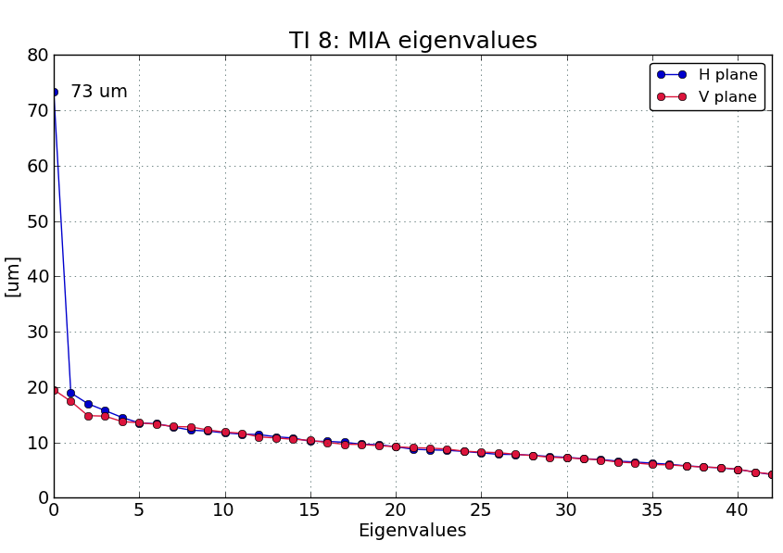
Stability study March 2012
TI 2: Source matching the MSE – strength reduced by factor 2
TI 8: MSE –same as before, MKE source is not present (study done at beginning of year).
MKE for TI 8 back again however now (CNGS?)
Notes:
TI2 MSE improved by a factor 2, still further improvements is under investigation, but from now it is more difficult..
TI8 MSE source stays the same, MKE source not present – possibly returned later, a new stability study is necessary!

Slide 7
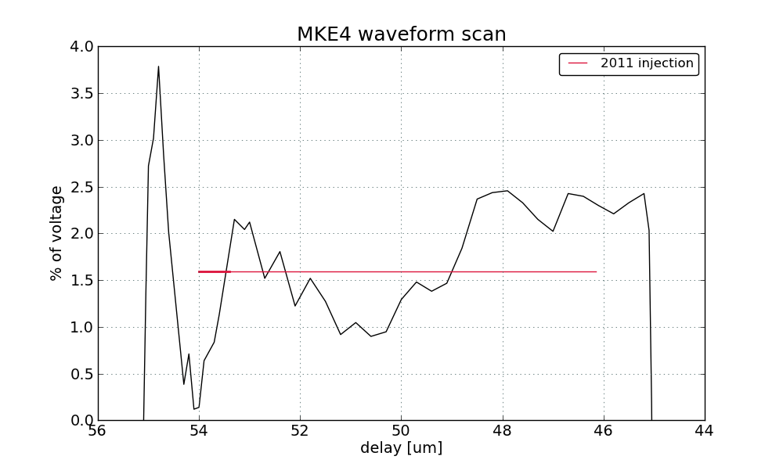
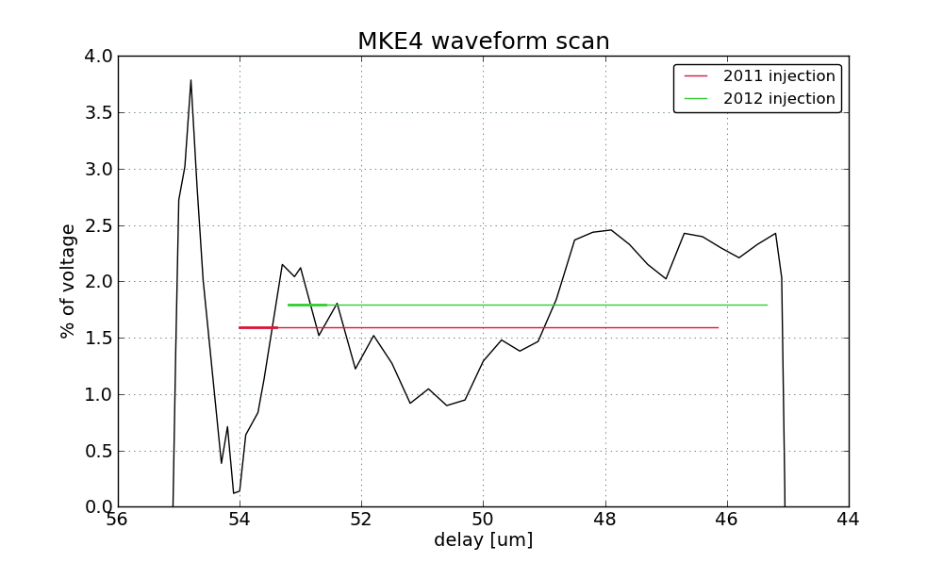
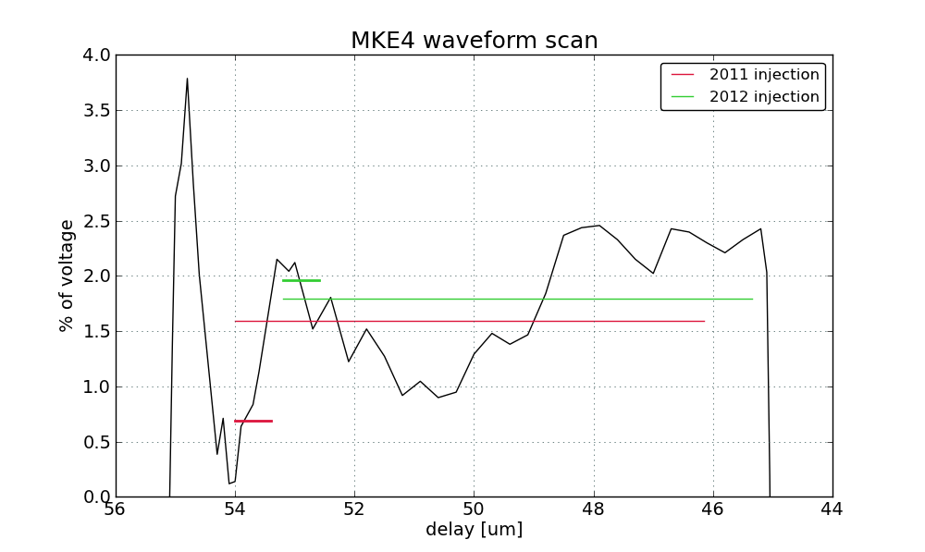
MKE 4 waveform
Bunch-by-bunch variations in the horizontal plane of TI 8 are caused by a large ripple on the MKE 4 waveform
Kicker delay changed for 2012: 54 μs → 53.1 μs
Waveform not flat, but 12 bunches more representative
12 bunch injection is more representative
Notes:
Still bad, Waveform could not be improved during shutdown, possibly LS1

Slide 8
Injection oscillations TI 8 H
3 April 2012 – first 144 bunch injections: Injection oscillations are good, small ripple
2 weeks later: MKE waveform ripple much more extreme → needs further investigation
(Influence of CNGS cycles?)

Slide 9
Transfer Line Drifts
→ Model Independent Analysis (MIA) to search for sources:
Fill 2458 (first 144 bunch injections) to 2539 (MD start), INJPHYS injections ~1 month
Use saved YASP trajectories, effect of applied corrections are calculated and removed
MIA is applied on the difference trajectories for stability study
Studies are still ongoing..

Slide 10
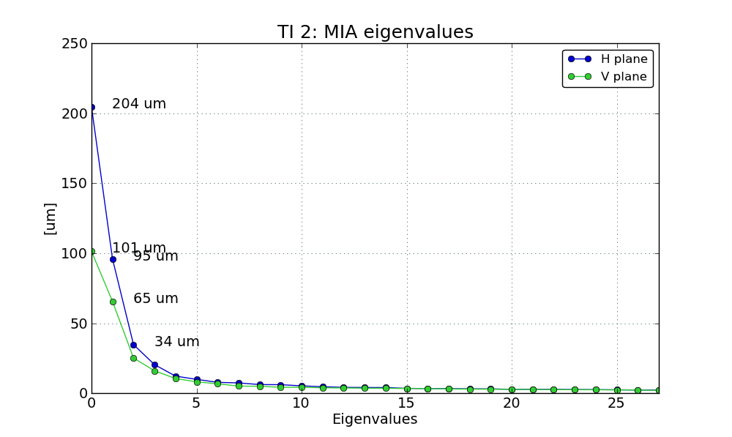
Preliminary TI 2 results
Long term variations:
Many sources!!
MSE is only one of them
Large drifts also in the vertical plane!

Slide 11
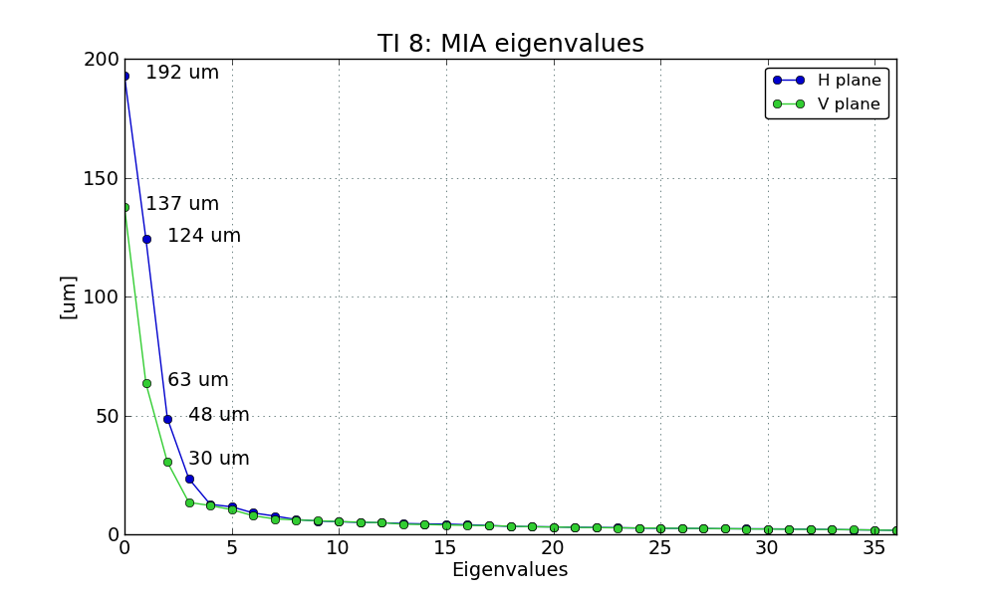
Preliminary TI 8 results
Possible matches in horizontal plane: MKE, MSE, MBHA
Search for sources ongoing..
Large drifts also in the vertical plane!

Slide 12
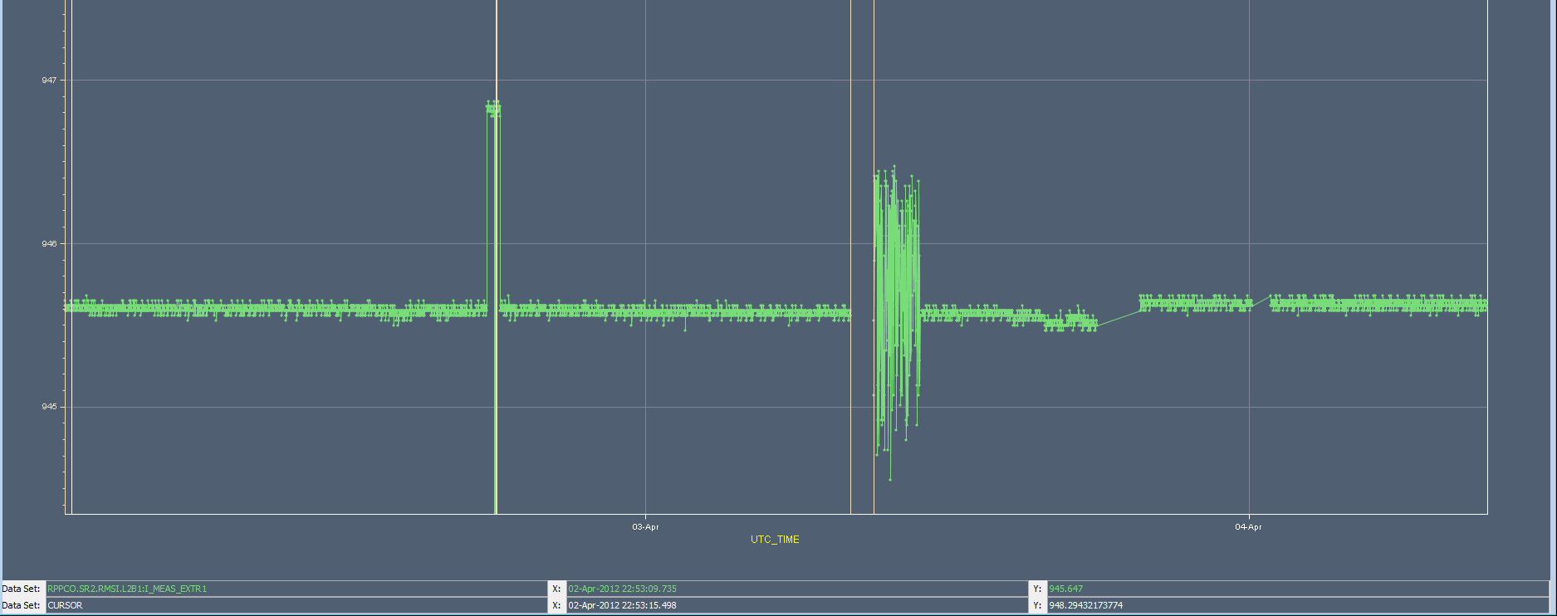
The 2012 newcomer: MSI point 2
Symptom: Trajectory bump at the end of the line(collimators), which is only correctable by the MSI
Cause: Hysteresis? (FMCM test) → precycle will be prepared on pilot cycles
Cause: Is there also noise? Logged current variations sometimes larger than at other times – corresponding kick in the order of our corrections
MSI logged current
Noise introduced by
what?
Trim of ~ 10 urad
Was removed again

Slide 13
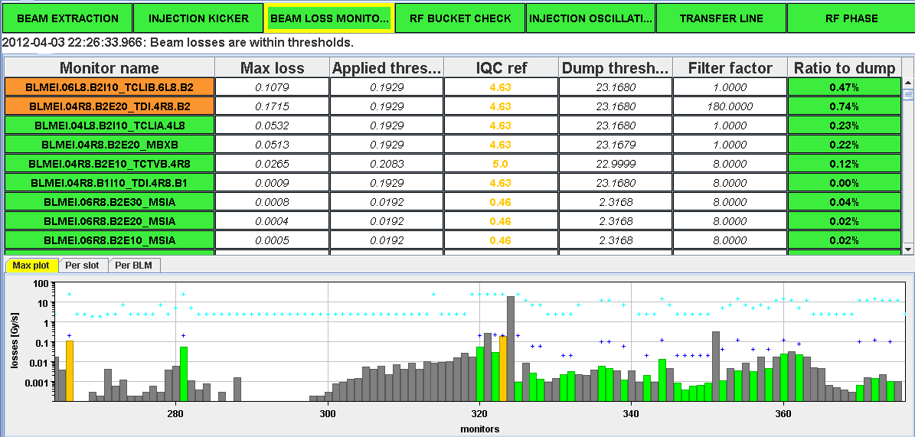
IQC BLM applied thresholds
}
1-12 bunches injected: IQC Ref x 12/288
> 12 bunches injected: IQC Ref x nBunches/288
From 2011 → 2012:
Same for 144 bunches
Tighter for fewer bunches
Noticed: not all types of losses scale with number of bunches, will be monitoring it

Slide 14
Summary
Stability of the MSE in TI 2 has been improved
Power converter team is continuing the effort: goal decrease ripple by another 50 %. Any results will be finally also moved to TI 8 MSE.
Shot-by-shot stability issue of the MKE in TI 8 not present in stability study in March, but seems to have returned → further studies necessary
MKE delay changed → steering on 12 bunches is now more representative for 144 bunch injection
First drift studies show drifts in both planes, many sources → under investigations
Problems at MSI point 2 discovered → will be pre-cycled. Noise investigations ongoing

