Slide 1
Energy Matching
J. Wenninger

Slide 2
Energy matching (1)
In the ideal situation:
The orbits should be centered radially both in the LHC and in the SPS (→ RF frequencies).
The field of the SPS at 450 GeV should be matched to the LHC injection field. The first turn of the beam in the LHC should then be centered radially.
In reality the circumference ratio LHC/SPS is not exactly 27/7 and it is not possible to center the orbits in both machines (frequencies are locked!).
Center in the LHC, SPS orbit radially off.
Differences in fields between ring1 and ring2 can be tuned with the horizontal orbit correctors (add/subtract some bending).
Toolbox in the steering application.

Slide 3
Energy matching (2)
If the fields of SPS / LHC drift with respect to each other, the drift is corrected with the hor. correctors in the LHC.
Changing the field in the SPS would imply re-tuning a large number of cycles – try to avoid this.
We do not want to change the LHC RBs.
If the circumference ratio LHC/SPS varies, centering the orbit radially in the LHC results in a change of the injected beam energy.
Earth tides affect both rings in the same way (same relative circumference change) – should be transparent.
OK !

Slide 4
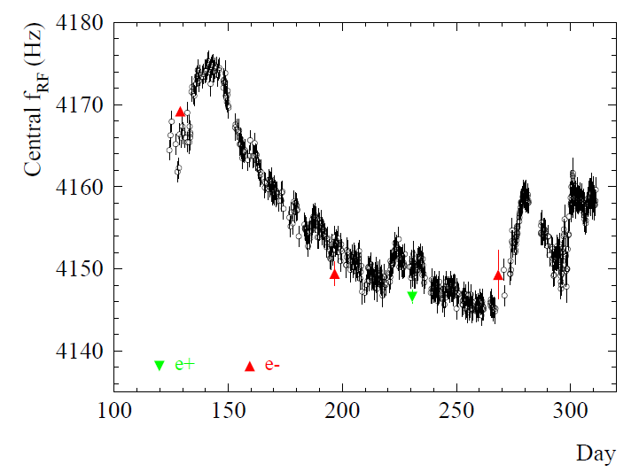
LHC/LEP circumference
The LEP ring (and therefore also LHC?) was subject to seasonal circumference changes.
LEP Δf swing ~30 Hz/ 352 MHz
⇒ LHC swing ~35 Hz ⇒
ΔC = 2.3 mm
LEP 1999

Slide 5
Energy matching – the first hours
First matching LHC-SPS was done just after a few injections into S23 in August 2008.
SPS energy was too low: -0.33% → improved to -0.07%.

Slide 6
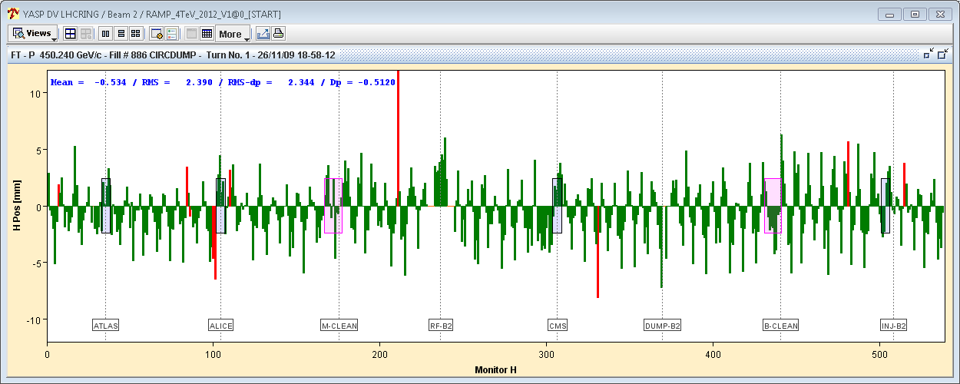
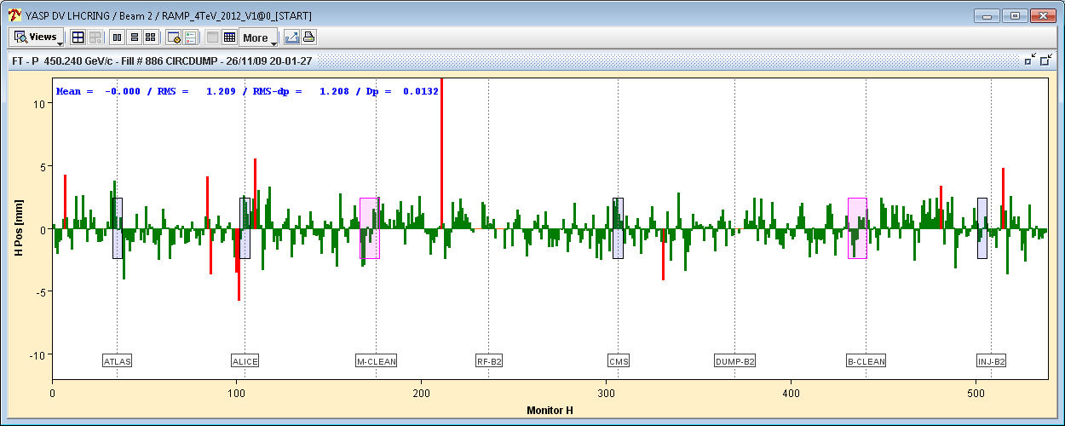
Energy matching – the first run
Matching of the SPS field to the LHC was done in November 2009.
LHC CO centered with LHC RF frequency ⇒ First turn not centered.
SPS flat top field adjusted to center the trajectory on first turn in LHC.
FT offset ~ -0.05%
Correction of SPS field on flat top
(+ inj. oscillations)
Since November 2009 the SPS flat top field has been held constant
(at least the setting !)

Slide 7
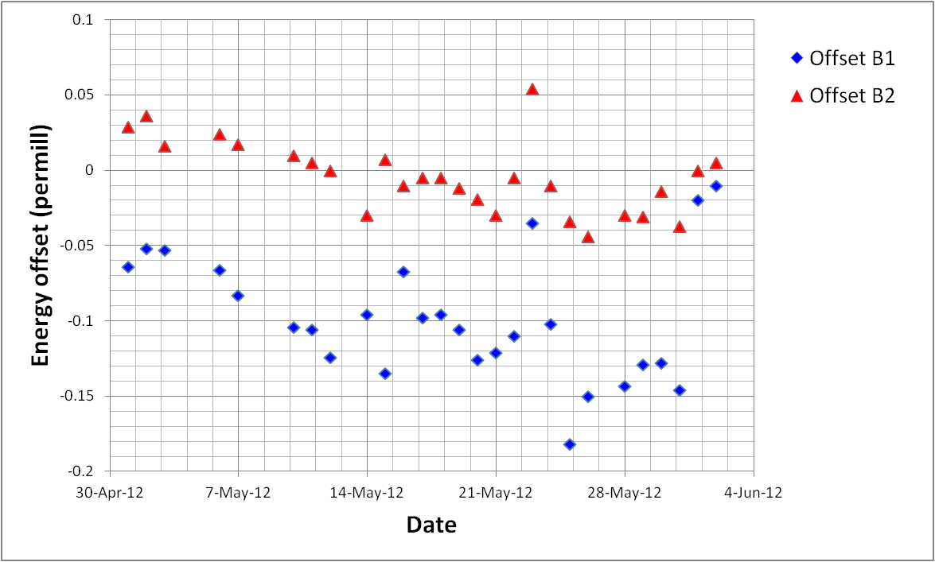
Energy offset evolution - May 2012
Energy matched with CODs at startup in March 2012.
Second half of May, large synchro loop errors, problems with capture.
It fact the energy offsets drifted down by ~ -7x10⁻⁵ in May.
Energy offset is defined as radial offset of the beam on the first turn.
Estimate for B1 based on S23, for B2 based on S78.
Off-center injection
Re-matched

Slide 8
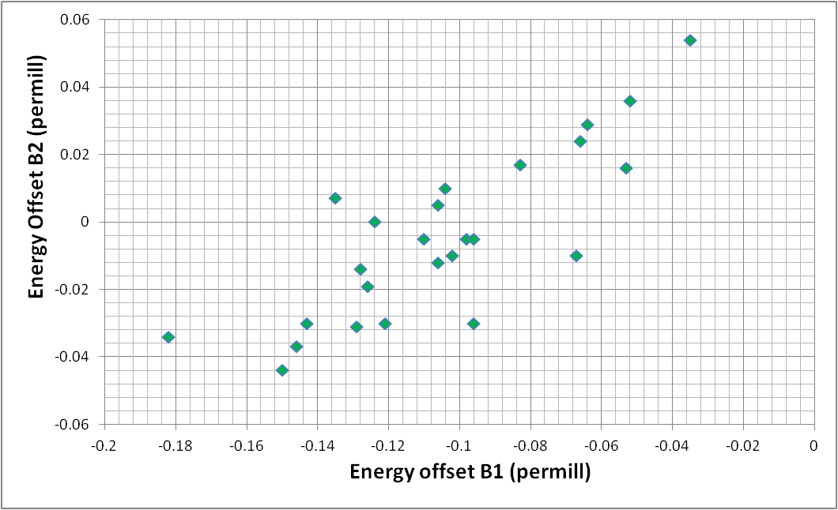
Correlation of the beams
B1-B2 well correlated – some outliers.
SPS flat top field, LHC injection field, large LHC circumference change…
Slope = 1
Typical spread during filling

Slide 9
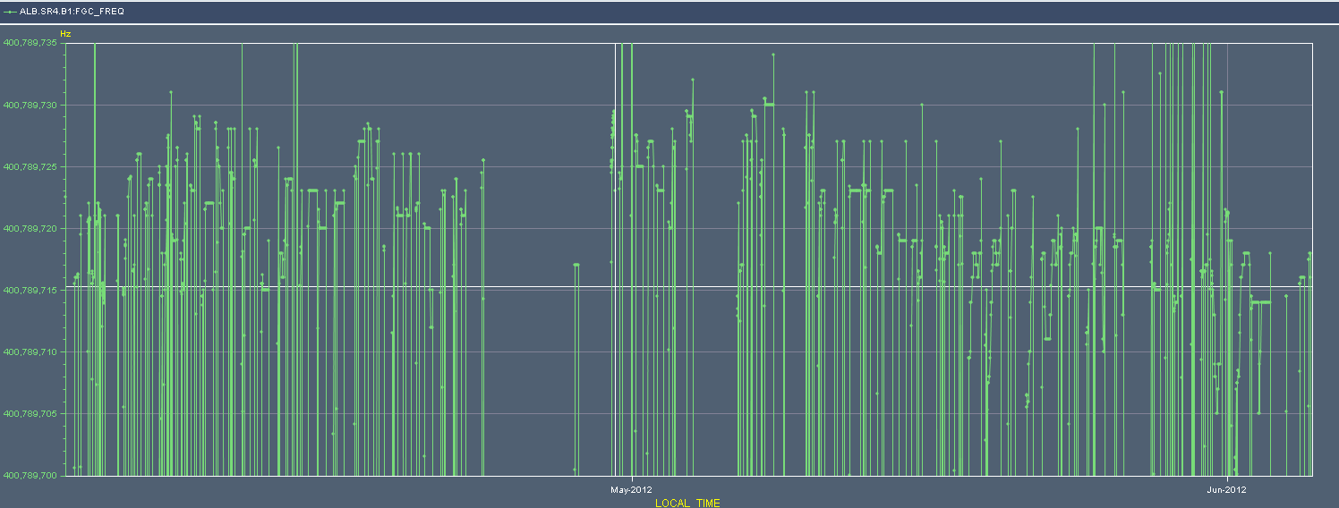
RF frequency at 4 TeV
Evolution of the RF frequency (including RT trims) in April-May exhibits a shift of -10 Hz in May ⇒ circumference increase.
But not really large enough to explain the change of the injected beam energy.
~10 Hz
01.04.12
01.05.12
01.06.12

Slide 10
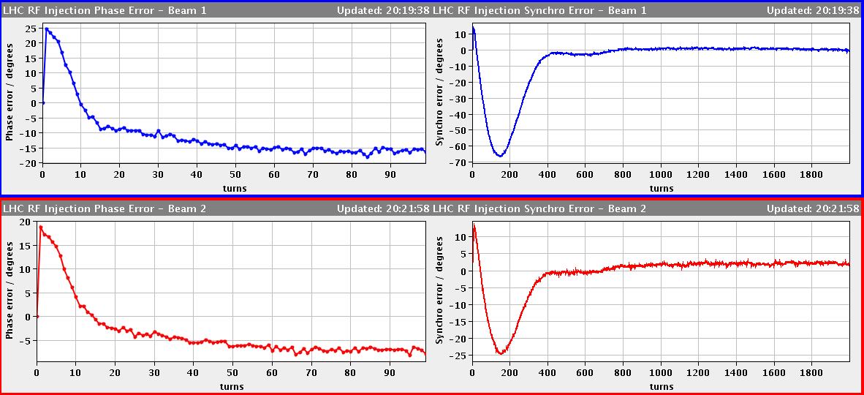
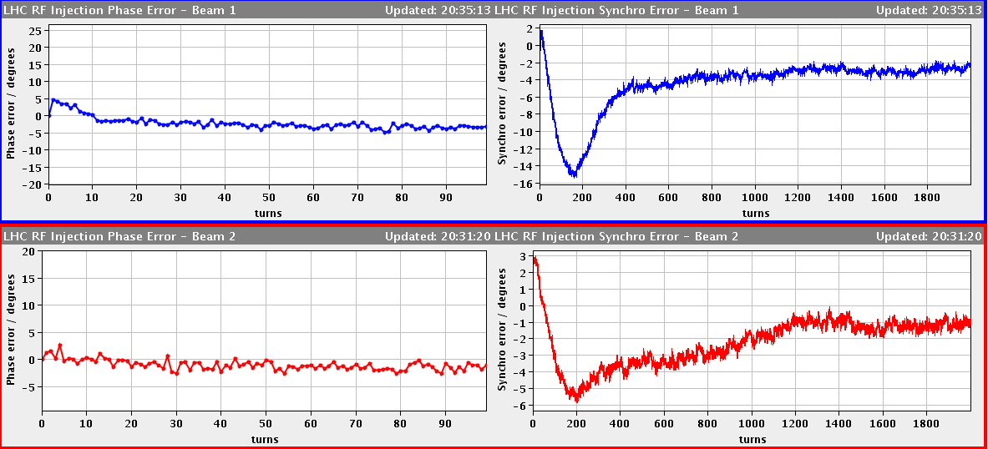
Correction of energy - synchro error
Initial error:
B1: -65 deg
B2: -25 deg
Rule of thumb
-25 deg ⇔ trim of -10⁻⁴
Δp/p trim with HCODs:
B1: -2.5x10⁻⁴
B2: -10⁻⁴
Final error:
B1: -14 deg
B2: -6 deg

Slide 11
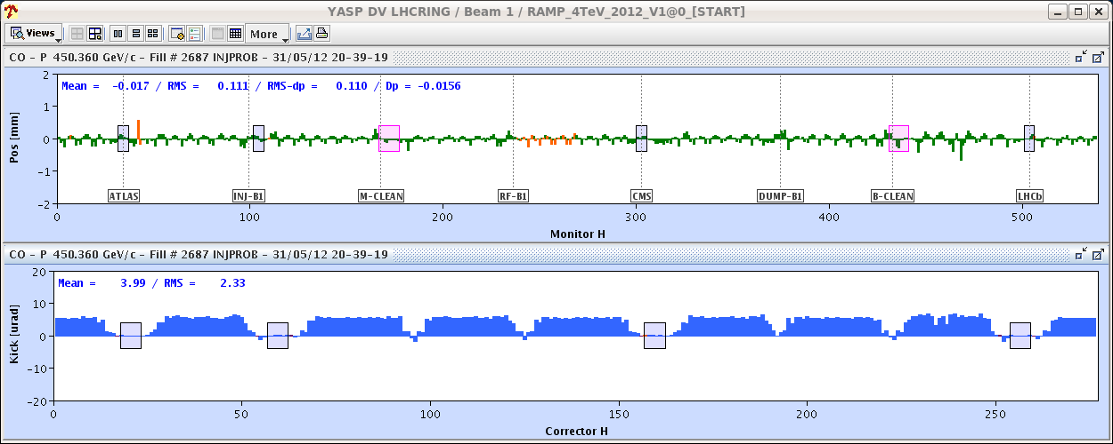
Orbit correctors
Corrector changes for B1(and residual orbit error, before correction by OFB).
The trim applies the energy change combined with a rough correction of the orbit perturbation.
The first turn well centered after adjustment based on syncho error.
Max kick~ 5 μrad

Slide 12
Effect of CODs
Captured beam: the energy changes through the orbit lengthening due to the correctors (horizontal dispersion D_{x} × kick θ)
Injected beam: energy change through the change in field integral
Estimated energy change, 0.6x0.25 = 0.15 per-mill, consistent with observed shift of the first turn.
Definition used in YASP

Slide 13
Side-effects
As a side effect, the tunes are changed through the natural chromaticity.
ΔQ ~ -0.03 for B1, ~-0.015 for B2.
Tune and H cod trims incorporated into ramp, trims come out over 35 seconds.
Same range as snapback.

Slide 14
Conclusion
In May the injected beam energy shifted down for both beams by some -7x10⁻⁵. Origin is not known.
For some days injection was done with off-centered closed orbit – worked rather well !
Energy was re-matched last week using HCODs.
The procedure is rather straightforward (help available in YASP), main point to watch out for is the trim incorporation.

