Slide 1
Aperture measurements
R. Bruce
R.W. Assmann, M. Giovannozzi, G. Mueller, S. Redaelli, D. Wollmann
Acknowledgement:
C. Alabau Pons, R. de Maria, S. Fartoukh, J. Wenninger, G. Vanbavinckhove

Slide 2
Outline
Global aperture measurements
Method
Results
Local measurements of IR triplet aperture
Method
Results
Conclusions
Future work

Slide 3
Global measurements – emittance blowup technique with collimator scan
Start with all collimators are retracted, provoke beam losses by crossing the 3rd order resonance (measurements done per beam and plane)
Signals on BLMs recorded to identify aperture bottleneck
Primary collimators (TCPs) closed in steps, losses provoked on each step
When main loss peak moves to the TCP the aperture is shadowed
The known gap of the TCP used as aperture estimate
For method see R. Assmann, presentation in Commissioning working group
TCP
Aperture
Aperture
TCP
BEAM
BEAM

Slide 4
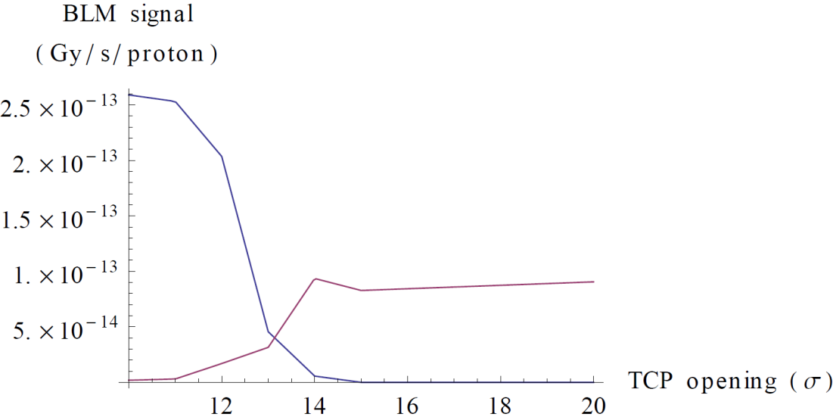
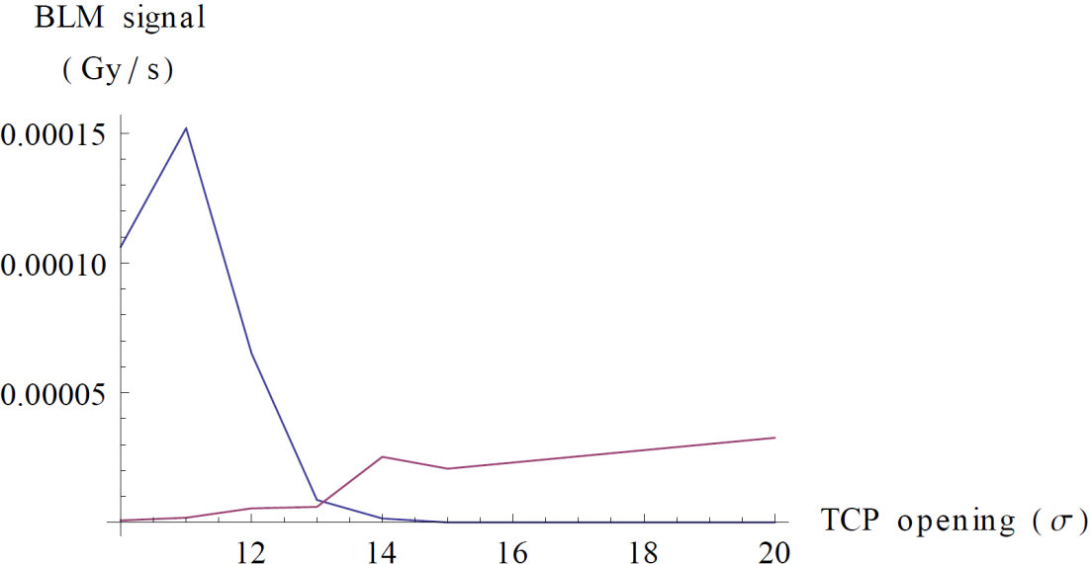
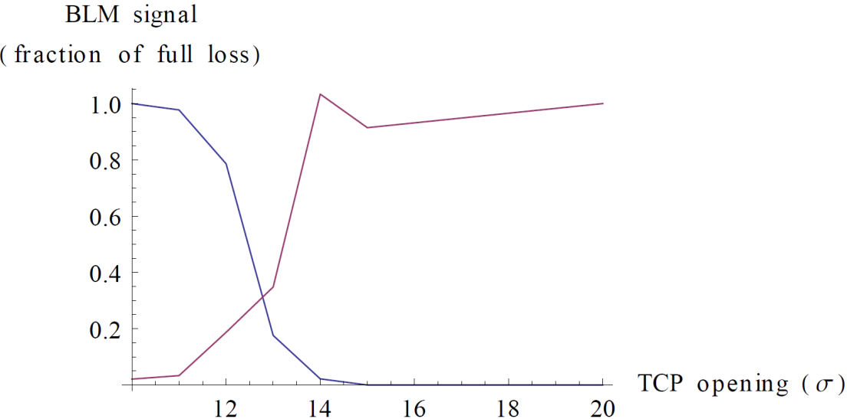
Global measurements – method
Example: B2 ver BLM signals as function of TCP opening
Aperture calculated with 3 methods
No normalization
Normalized to intensity loss
Normalized to intensity loss and max signal with no shadow
Method 2, Aperture=13.1σ
TCP
Q4R6
Method 1, Aperture=13.1σ
Method 3, Aperture=12.8σ
TCP
TCP
Q4R6
Q4R6

Slide 5
Global measurements - results
Location of bottlenecks found
Aperture found (σ)
 | H | V
B1 | Q6R2 | Q4L6
B2 | Q5R6 | Q4R6
log book, 1s BLM integration
 | H | V
B1 | 12 | 13
B2 | 12.5 | 13.1
5s BLM integration time
Method 1: no normalization
 | H | V
B1 | 11.4 | 13
B2 | 13 | 13.1
Method 2: normalizing by intensity loss
 | H | V
B1 | 11.7
B2 | 13 | 13.1
Method 3: normalizing by intensity loss and response
 | H | V
B1
B2 | 12.9 | 12.8
Locations consistent with 2010
2010
 | H | V
B1 | 12.5 | 13.5
B2 | 14 | 13

Slide 6
Local measurements - method
All collimators retracted
Global aperture known from previous measurement
Orbit bump with known amplitude introduced in steps triplet
Losses at global bottleneck and triplet monitored with BLMs
Loss peak moves to triplet when it shadows global aperture
Triplet aperture = global aperture + orbit excursion
Triplet
Triplet
Global bottleneck
Global bottleneck
BEAM
BEAM
BEAM

Slide 7
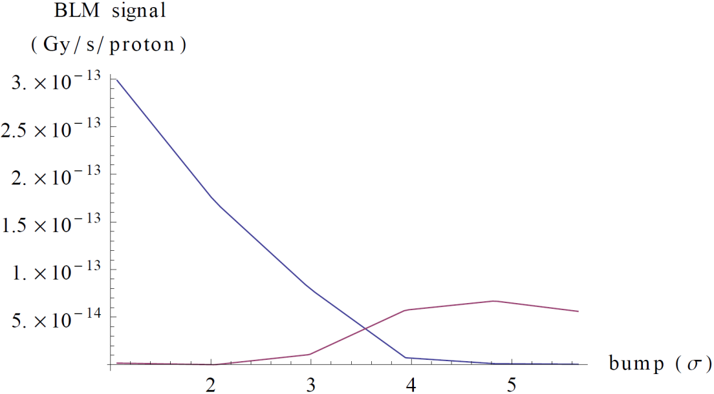
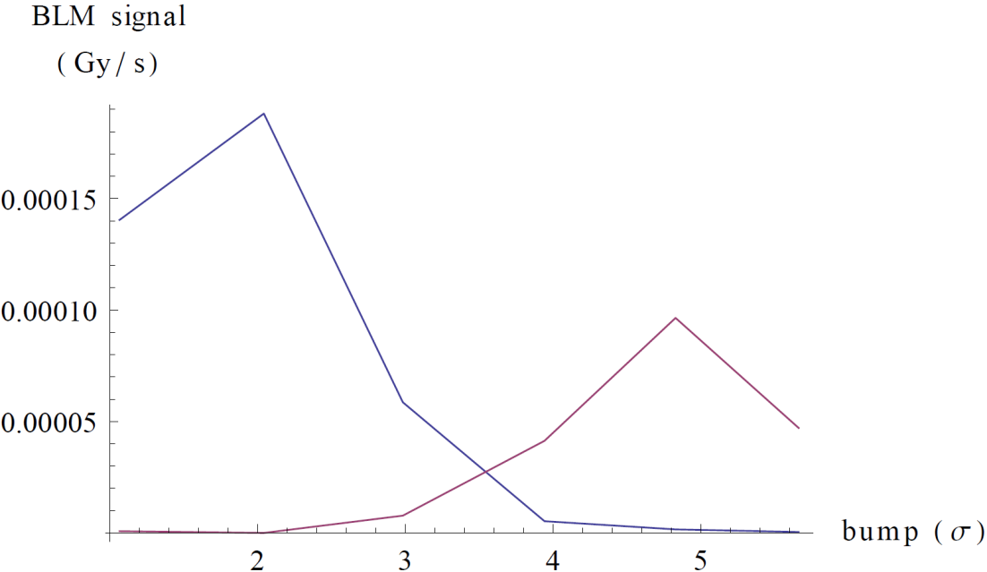
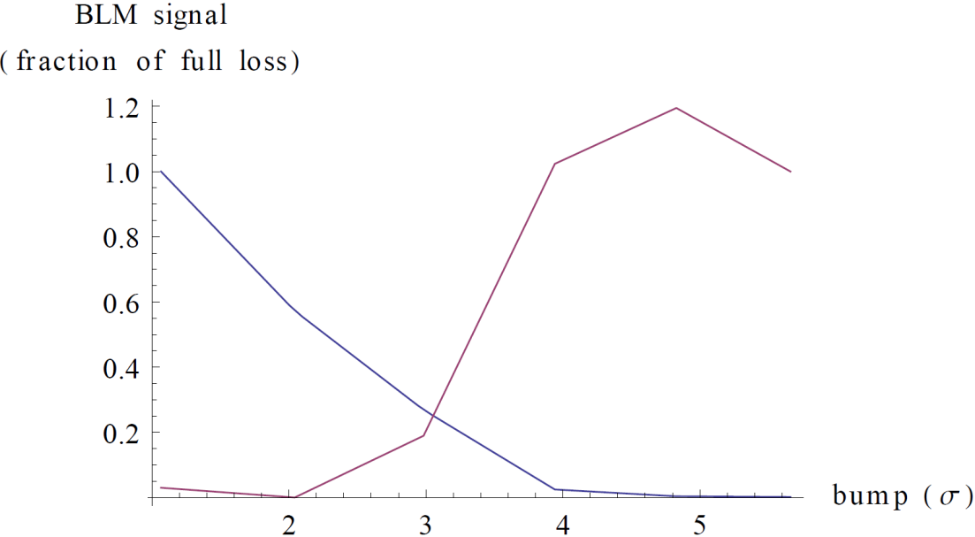
Local measurements - method
One measurement per beam per IP per plane
Only crossing plane considered
Example: IR1 B1 V
Method 2, Aperture=16.5σ
Q4L6
Q2R1
Method 1, Aperture=16.5σ
Method 3, Aperture=16σ
Q4L6
Q4L6
Q2R1
Q2R1

Slide 8
Local measurements - results
IR1 triplet V |  |  | IR5 triplet H |  |  | IR2 triplet V |  |  | IR8 triplet H
log book, 1s BLM integration |  |  | log book, 1s BLM integration |  |  | log book, 1s BLM integration |  |  | log book, 1s BLM integration
B1 | 16 |  | B1 | 15.5 |  | B1 | 14.5 |  | B1 | 16
B2 | 15 |  | B2 | 17 |  | B2 | 15 |  | B2 | 16
5s BLM integration time |  |  | 5s BLM integration time |  |  | 5s BLM integration time |  |  | 5s BLM integration time
Method 1 |  |  | Method 1 |  |  | Method 1 |  |  | Method 1
B1 | 16.5 |  | B1 | 15.2 |  | B1 | 14.6 |  | B1 | 15.5
B2 | 15.3 |  | B2 | 17.7 |  | B2 | 16.4 |  | B2 | 15.5 | (at TCTVB.4R8, not in triplet)
Method 2 |  |  | Method 2 |  |  | Method 2 |  |  | Method 2
B1 | 16.5 |  | B1 | 15.2 |  | B1 | 14.7 |  | B1 | 15.5
B2 | 15 |  | B2 | 17.8 |  | B2 | 16.8 |  | B2 | 15.7
Method 3 |  |  | Method 3 |  |  | Method 3 |  |  | Method 3
B1 | 16 |  | B1 | 15.1 |  | B1 | 14.6 |  | B1 | 15.6
B2 | 16.2 |  | B2 | 17.3 |  | B2 | 16.4 |  | B2 | 15.6
Method 1: no normalization
Method 2: normalizing by intensity loss
Method 3: normalizing by intensity loss and response

Slide 9
Summary of triplet aperture measurements
Aperture in crossing plane (σ) | B1 | B2
IR1 V | 16 | 15-16
IR5 H | 15 | 17
IR2 V | 14.5 | 15-16.5
IR8 H | 15.5 | 15.5
assumed | 2010
 | H | V
B1 | 14.5 | 15.5
B2 | 16 | 15
IR1 and IR5 relevant
Measured triplet aperture in IR1/5 up to 1 σ larger than assumed in Evian
Detailed analysis taking into account orbit, beta-beat etc still to be done
Triplet aperture from n1 using nominal tolerances: ~8.9 σ (M. Giovannozzi)
Discussion with concerned parties on tolerances in n1 model needed

Slide 10
Conclusion
Global aperture measurements show the same bottlenecks as last year’s measurement
Found global aperture: 11.5-13 σ
Global aperture seems worse than 2010 by up to 1.5 σ
Some open questions (strange data points etc) – need to look into logging data
Local scans in triplets performed
Triplet aperture measured to above 15 σ
Equal or up to 1 σ larger than assumed 2010
Detailed analysis of implications for β* still to be done
All apertures expressed in terms of σ at primary collimator
Beta-beat @ TCP < 6% (input from G. Vanbavinckhove)
Around 1 σ uncertainty

Slide 11
Future work
Local triplet aperture measurements with dilluted pilot beam at squeeze and top energy
Define a beam edge using the primary collimator, then increase bump amplitude in triplet until a loss is observed. Same method as in 2009.
Aperture measurement in the dispersion suppressor downstream of IR7
Gives response of BLM at location of highest cleaning inefficiency
Comparison with the method used in 2009 also at injection

