Slide 1

update on UFOs:
2012 Observations,
Studies and Extrapolations
LBOC
  Tobias Baer
  July, 24th 2012
Acknowledgements: M.J. Barnes, C. Bracco, F. Cerutti, B. Dehning, L. Ducimetière, A. Ferrari, N. Fuster Martinez,
N. Garrel, A. Gerardin, B. Goddard, M. Hempel, E.B. Holzer, S. Jackson, M.J. Jimenez, V. Kain, A. Lechner,
V. Mertens, M. Misiowiec, R. Morón Ballester, E. Nebot del Busto, A. Nordt, S. Redaelli, J. Uythoven, B. Velghe,
V. Vlachoudis , J. Wenninger, C. Zamantzas, F. Zimmermann, …

Slide 2
Content
1. Introduction and Arc UFO Observations
2. MKI UFO Observations
4. Outlook and Mitigation Strategies
3. Energy Extrapolation

Slide 3
Content
1. Introduction and Arc UFO Observations
2. MKI UFO Observations
4. Outlook and Mitigation Strategies
3. Energy Extrapolation

Slide 4
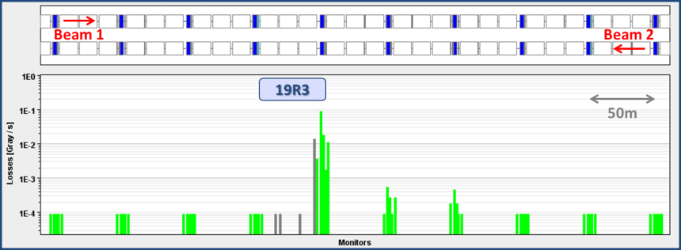
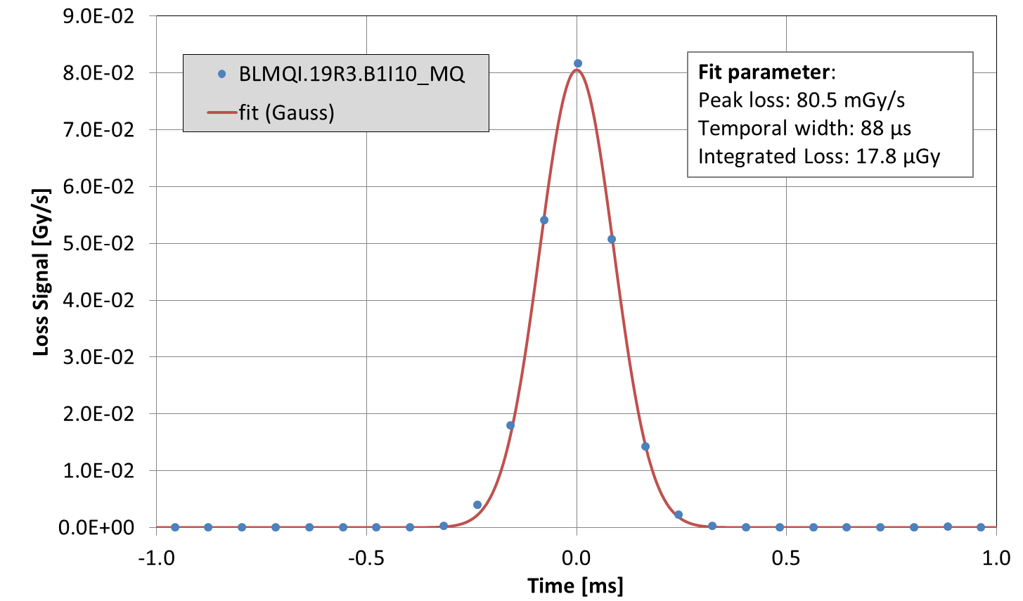
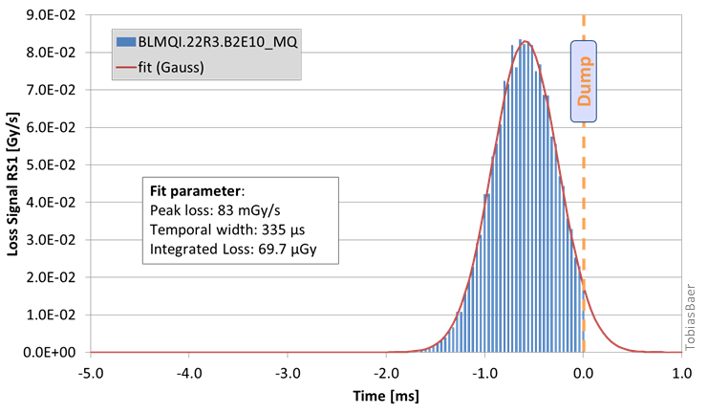
Introduction
39 beam dumps due to (Un)identified Falling Objects.
17 dumps in first half of 2011. Then mitigation by increase and optimi- zation of BLM thresholds.
4 dumps in 2012 (3 at MKIs for B1)
16,000 candidate UFOs below BLM thresholds found in 2011.
≈ 8,000 candidate UFOs below BLM thresholds in 2012 so far.
additional BLMs
Spatial and Temporal loss profile of UFO at 4TeV on 08.04.2012 (7% of BLM dump thresholds).

Slide 5
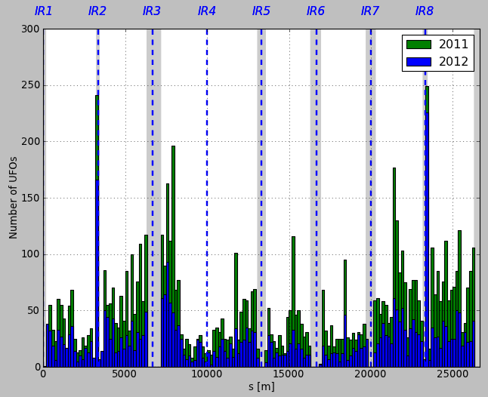
Spatial UFO Distribution
Distribution very similar to 2011.
Many UFOs around MKIs.
Some arc cells with significantly increased number of UFOs:
19R3 B1, 25R3 B2, 28L6 B2, 28R7 B2, …
MKI
MKI
19R3
2011: 7668 UFOs at 3.5 TeV.
2012: 3719 UFOs at 4 TeV.
Signal RS04 > 2∙10⁻⁴ Gy/s.
Gray areas around IRs are excluded from the analysis.

Slide 6
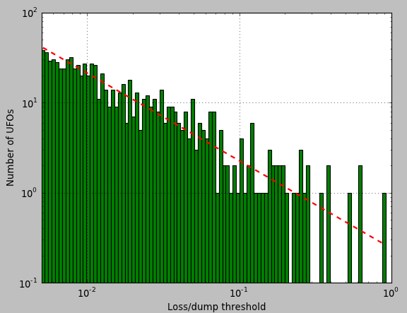

Arc UFO Size
44 UFOs over 10% of dump threshold in 2012 so far (at 4 TeV).
2845 arc UFOs (≥ cell 12) at 4 TeV in 2012 until 17.07.2012.
10% of BLM dump threshold
$$∝x^{−0.97}$$

Slide 7
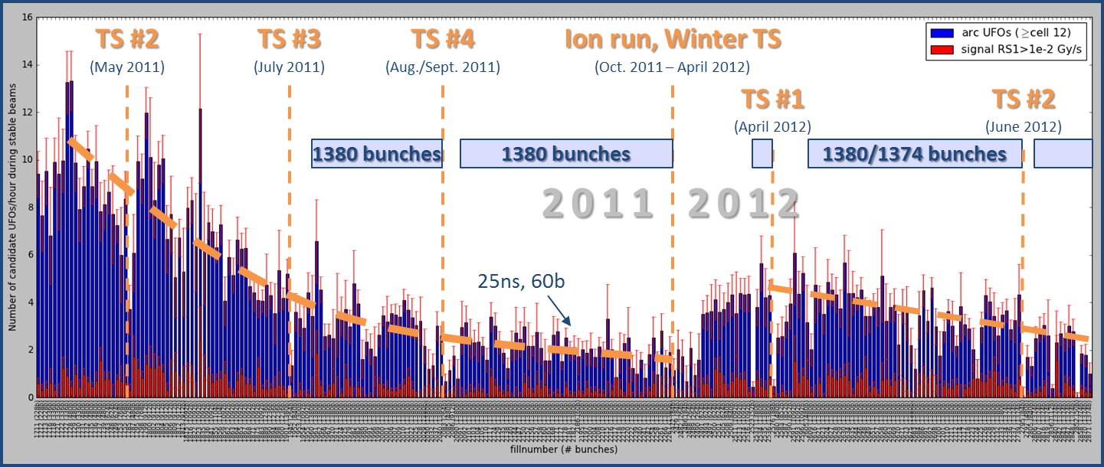
Arc UFO Rate
2011: Decrease from ≈10 UFOs/hour to ≈2 UFOs/hour.
2012: Initially, about 2.5 times higher UFO rate compared to October 2011. UFO rate decreases since then.
7535 candidate arc UFOs during stable beams between 14.04.2011 – 23.07.2012. Fills with at least 1 hour stable beams are considered. Signal RS04 > 2∙10⁻⁴ Gy/s.
5836 candidate arc UFOs during stable beams since 14.04.2011. Fills with at least 1 hour stable beams are considered. Signal RS04 > 2∙10⁻⁴ Gy/s.

Slide 8
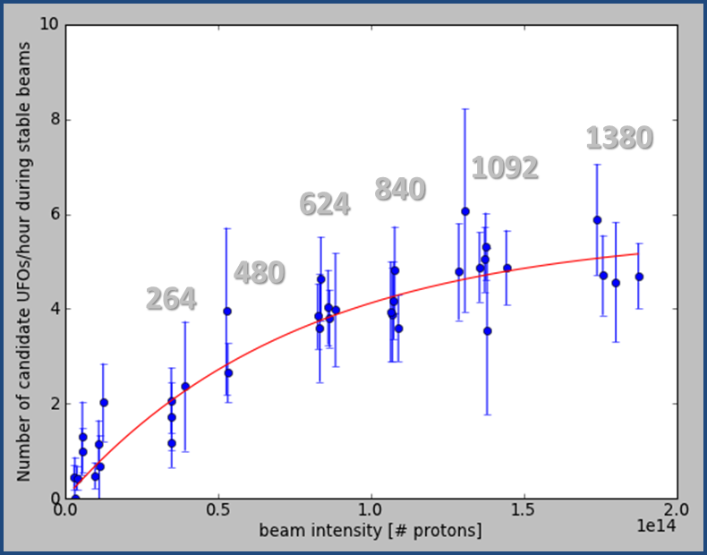

Intensity Dependency
For low intensities: UFO rate $∝$ Intensity,
saturates at high intensities.
consistent with previous analysis (cp. E. Nebot, IPAC’11).
500 candidate UFOs during stable beams with a signal in RS04 > 2∙10⁻⁴ Gy/s. 28 fills with at least 1 hour in stable beams in the first quarter of 2012 are considered. The beam intensity is computed as the maximum intensity per fill, averaged over both beams.

Slide 9
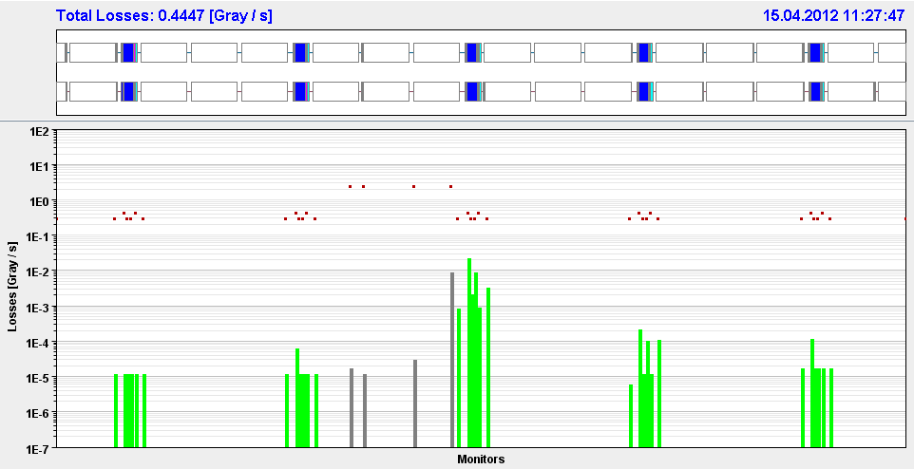
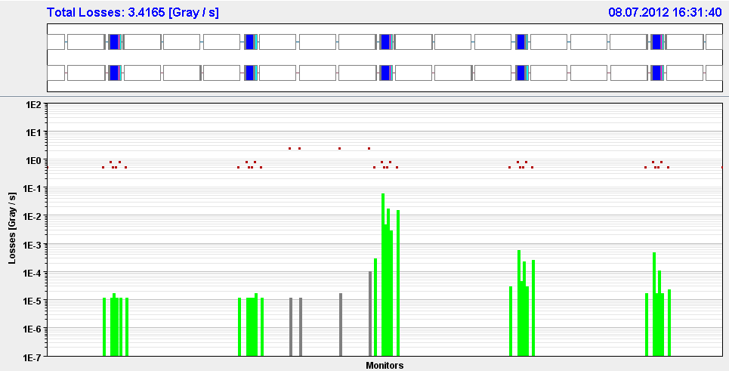
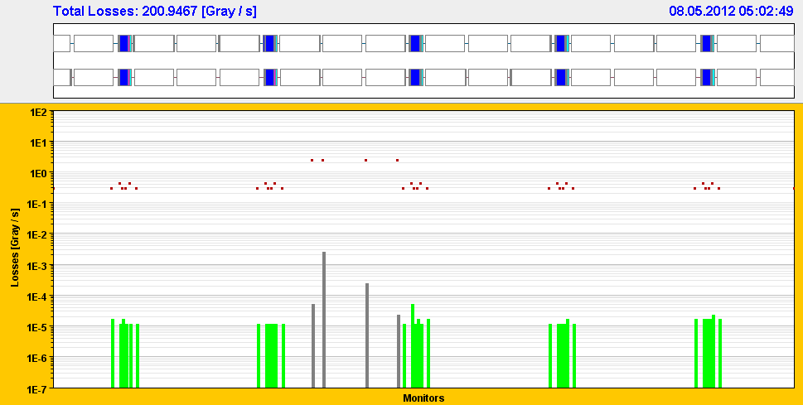
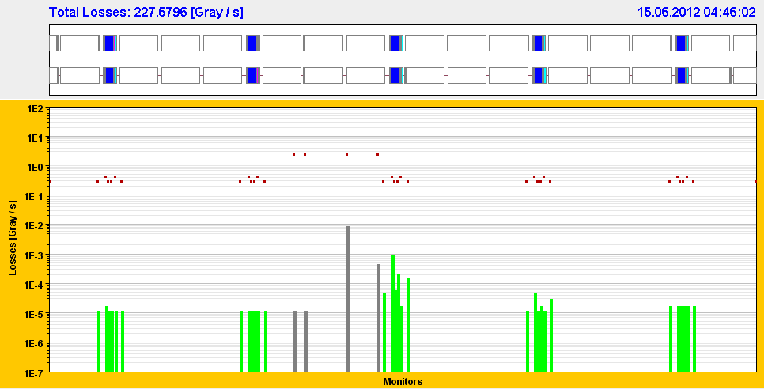
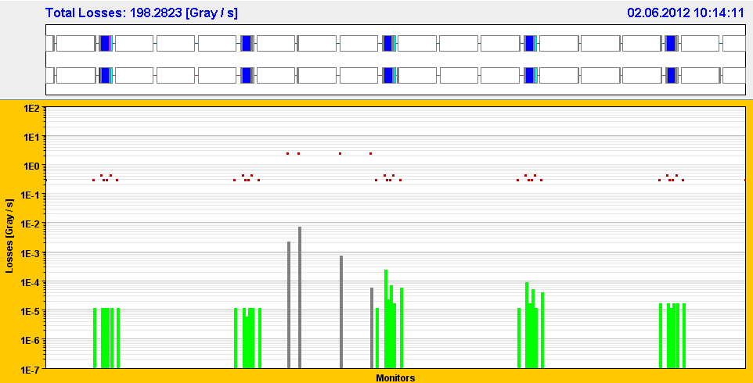
UFOs in cell 19R3
Additional BLMs in cell 19R3 to determine UFO location.
19R3
19R3
19R3
UFOs with different spatial loss pattern were observed in cell 19R3, suggesting that the UFOs originate from various position across the cell.
cp also A. Lechner et al., Quench Test Strategy Working Group, May 2012
19R3
19R3

Slide 10
Content
1. Introduction and Arc UFO Observations
2. MKI UFO Observations
4. Outlook and Mitigation Strategies
3. Energy Extrapolation

Slide 11
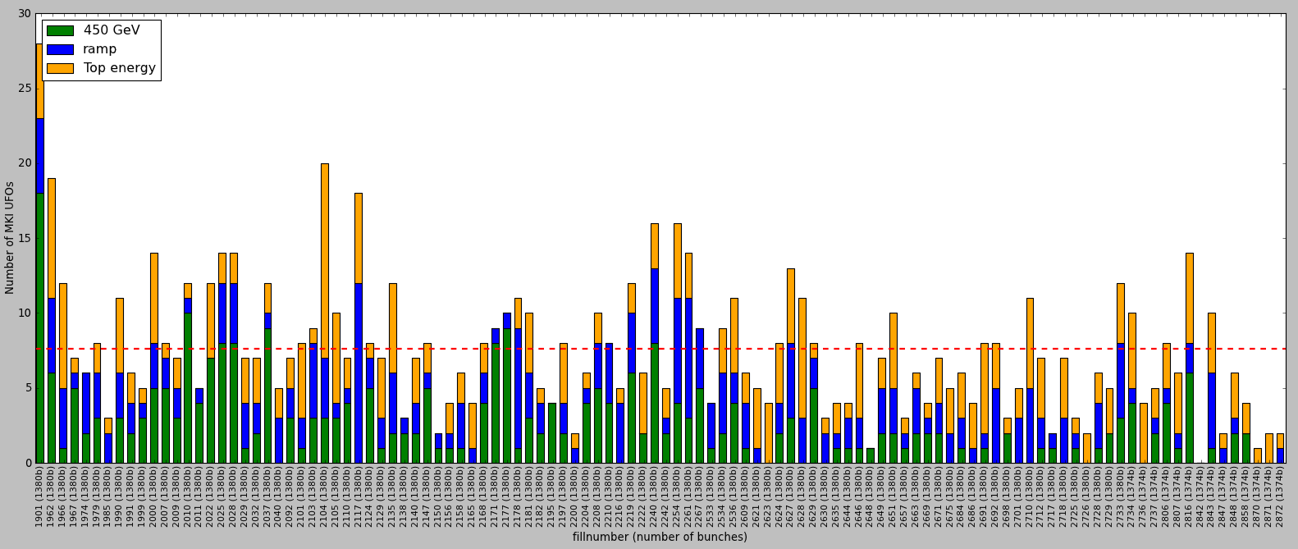
Number of MKI UFOs
No clear conditioning effect obvious for MKI UFOs.
On average: 7.6 (± 4.4) MKI UFOs per fill.
(3.0 at MKIs in Pt. 2 and 4.6 at MKIs in Pt. 8)
Ion run, winter TS
840 UFOs around injection kicker magnets in Pt. 2 and Pt.8. Fills with 1374/1380 bunches and at least 3 hours of stable beams are considered.
2011
2012

Slide 12
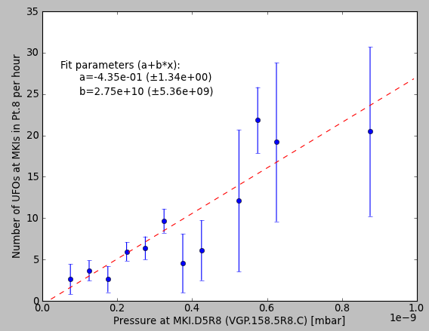
Vacuum Correlation
Positive correlation between pressure at MKI and MKI UFO rate.
Similar indications also from scrubbing runs and 2012 UFO MD.
5.1σ statistical significance of positive correlation.
141 MKI UFOs in Pt. 8 between last injection of beam 2 and beginning of ramp for 178 fills with 1374/1380 bunches until 23.07.2012.

Slide 13
Content
1. Introduction and Arc UFO Observations
2. MKI UFO Observations
4. Outlook and Mitigation Strategies
3. Energy Extrapolation

Slide 14

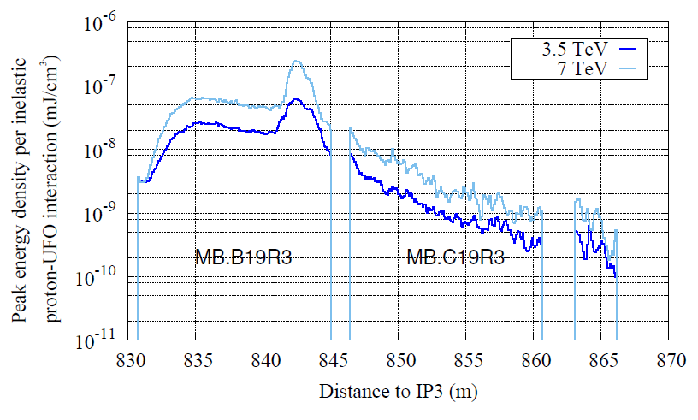
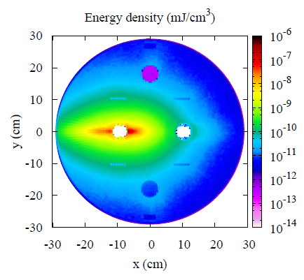
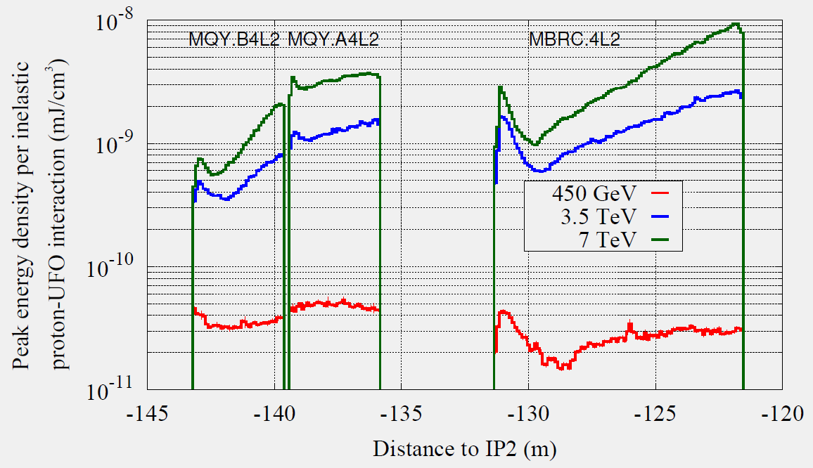
Energy Dependence
UFO amplitude: At 7 TeV about 3-4 times higher than at 3.5 TeV. From FLUKA simulations and wire scans during ramp.
BLM thresholds: Arc thresholds at 7 TeV are about a factor 5 smaller than at 3.5 TeV.
UFO rate: No energy dependence assumed. cp. E. Nebot et al., IPAC‘11, TUPC136
For UFO at Pos #1
x4
At indicated longitudinal position for UFO at 7 TeV.
Beam direction: out of screen.
x3
BLM 1
Courtesy of A. Lechner and the FLUKA team.
BLM 2
courtesy of A. Lechner and the FLUKA team.
BLM 3
Peak energy density simulated by FLUKA for an UFO in MKI.D5R8.

Slide 15
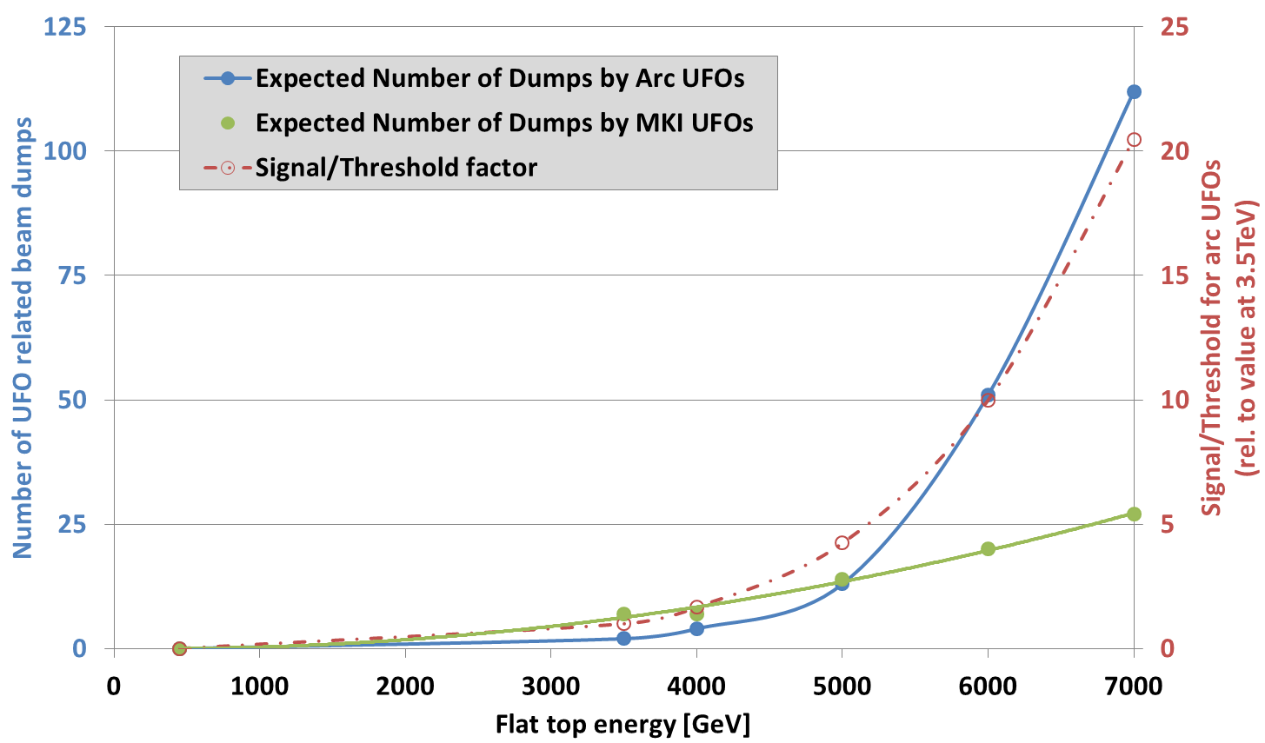
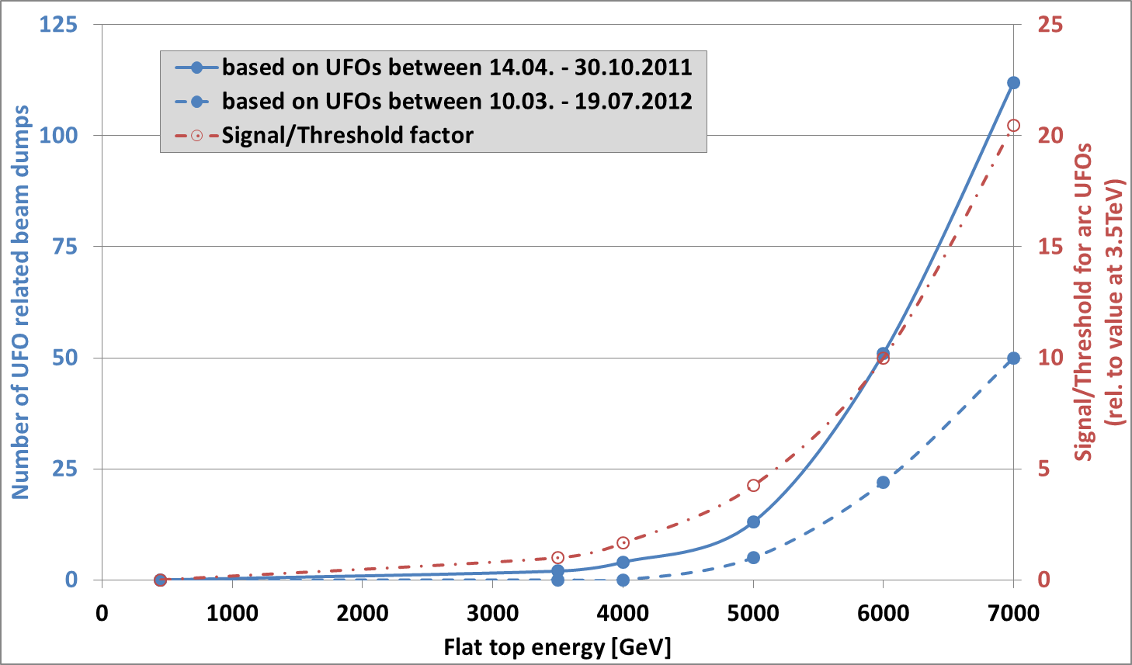
Energy Extrapolation Arc UFOs
  Extrapolation to 7 TeV:
  BLM Signal/BLM Threshold is about 20 times larger than at 3.5 TeV.
  Based on 2011 data: 112 UFO related beam dumps.
  Based on 2012 data: 50 UFO related beam dumps so far.
  In total 2 dumps by arc UFOs observed (since 2011).
Based on the applied threshold table from 01.01.2012 (for 2011 data) and 19.07.2012 (for 2012 data). Apart from the beam energy, identical running conditions as in 2011/2012 are assumed. Several unknowns are not included: margin between BLM thresholds and actual quench limit, 25ns bunch spacing, intensity increase, beam size, scrubbing for arc UFOs, deconditioning after long technical stops.

Slide 16
Content
1. Introduction and Arc UFO Observations
2. MKI UFO Observations
4. Outlook and Mitigation Strategies
3. Energy Extrapolation

Slide 17


Plans for 2012/13
Better localization of arc UFOs by mobile BLMs in cell 19R3.
FLUKA simulations for arc UFOs.
MadX simulations for UFOs (see Maria’s presentation).
Better temporal resolution of UFO events (dust particle dynamics).
80µs time resolution of BLM study buffer.
Bunch-by-bunch diagnostics with diamond BLMs.
  Study impact of 25ns operation.
  25ns high intensity (≈ 1000 bunches) beam for several hours at flat top.
  MKI UFO MD.
  25ns, e-cloud correlation, UFO production mechanism, particle dynamics.
Better localization of arc UFOs by mobile BLMs in cell 19R3.
FLUKA simulations for arc UFOs.
Better temporal resolution of UFO events (dust particle dynamics).
80µs time resolution of BLM study buffer.
Bunch-by-bunch diagnostics with diamond BLMs.
  Study impact of 25ns operation.
  25ns high intensity (≈ 1000 bunches) beam for several hours at flat top.
  MKI UFO MD.
  25ns, e-cloud correlation, UFO production mechanism, particle dynamics.
(systematic analysis ongoing)
(see Maria‘s presentation)
  scheduled, but due to many (unrelated) technical problems with limited success.
From Chamonix 2012
Possibility of dust particle inspection during LS1?

Slide 18
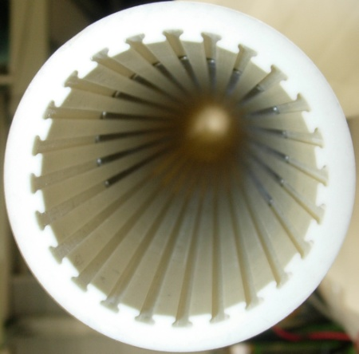
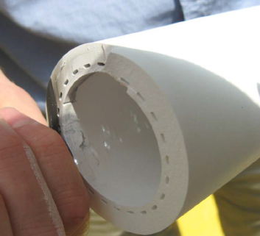
Mitigation Strategies
  MKI UFOs:
  Change MKI.D5R8 in TS#3 (heating problems).
  better cleaning, reduced E-field due to 19 screen
  conductors (instead of 15).
  Cr₂O₃ coating.
  reduces SEY, increased voltage hold-off, seals surface.
  Screen conductor wires beyond surface (not feasible?).
  very difficult to manufacture.
  Arc UFOs:
  Increase BLM thresholds towards quench limit.
  Wire scanner quench test.
  ADT quench test.
  Test in 2012 by increasing selected BLM thresholds???
  Different BLM distribution.
  could allow for increase of BLM thresholds.
  (A. Lechner et al., Quench Test Strategy Working Group, May 2012)

Slide 19
Summary
4 beam dumps due to UFOs in 2012 so far.
8,000 candidate UFOs below BLM dump thresholds observed in 2012 so far.
Arc UFO rate at beginning of 2012 ≈2.5 times higher than in October 2011. Arc UFO rate decreases since then.
No significant decrease of number of MKI UFOs per fill.
Energy extrapolation to 7 TeV:
2011 arc UFOs would have caused 112 beam dumps.
2012 arc UFOs would have caused 50 beam dumps so far.
Plans for 2012/13:
Better understanding of quench limit.
25ns studies.
Mitigation strategies for MKI UFOs under active investigation.
Replace MKI.D5R8 in TS#3.
An optimized BLM distribution can mitigate impact of arc UFOs.

Slide 20
Thank you
for your Attention
Tobias Baer
CERN BE/OP
Tobias.Baer@cern.ch
Further information:
T. Baer et al., “UFOs in the LHC: Observations, Studies and Extrapolations”, IPAC’12, THPPP086.
B. Goddard et al., “Transient Beam Losses in the LHC Injection Kickers from Micron Scale Dust Particles”, IPAC’12, TUPPR092.
A. Lechner et al., “FLUKA Simulations of UFO-Induced Losses in the LHC Arc“, Quench Test Strategy Working Group.
T. Baer et al., “UFOs in the LHC after LS1”, Chamonix Workshop 2012.
T. Baer et al., “UFOs in the LHC”, IPAC’11, TUPC137.
E. Nebot et al., “Analysis of Fast Losses in the LHC with the BLM System”, IPAC’11, TUPC136.
N. Fuster et al., “Simulation Studies of Macroparticles Falling into the LHC Proton Beam”, IPAC’11, MOPS017.

Slide 21
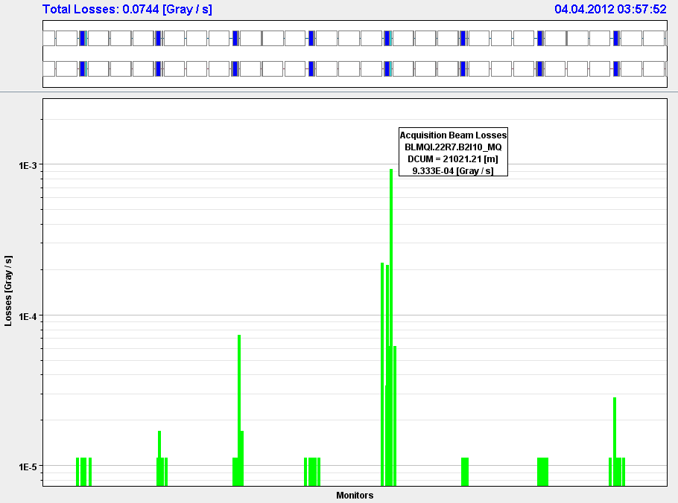
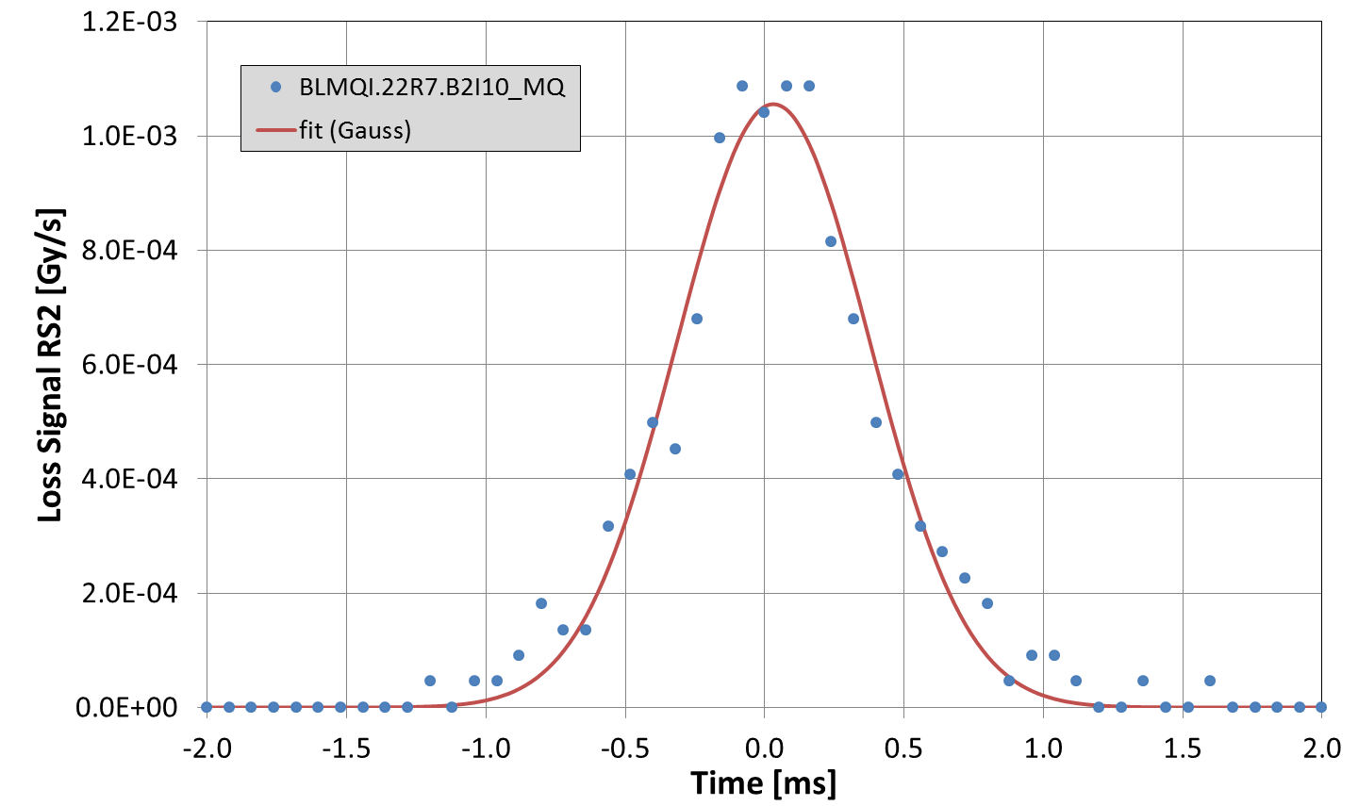
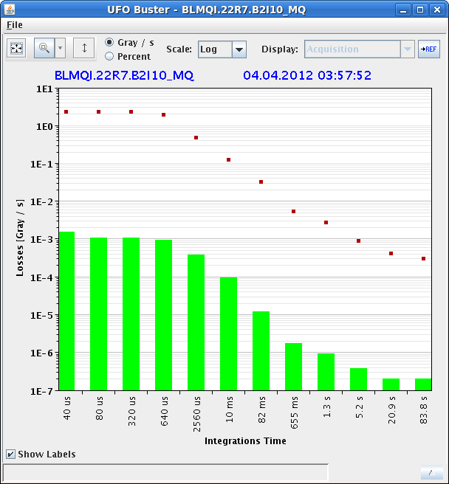
UFOs in 2012
Some arc UFOs already:
Event at 1091 GeV, 1.5·10¹² protons.
New in 2012: BLM turn-by-turn buffer.
Fit parameter:
Peak loss: 1.1·10⁻³ Gy/s
Temporal width: 346 µs
Integrated loss: 0.9 µGy

Slide 22
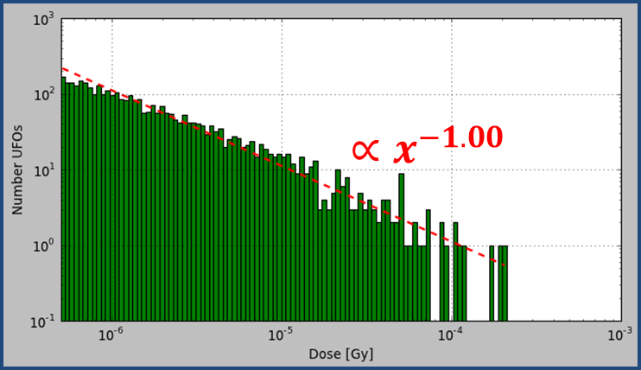
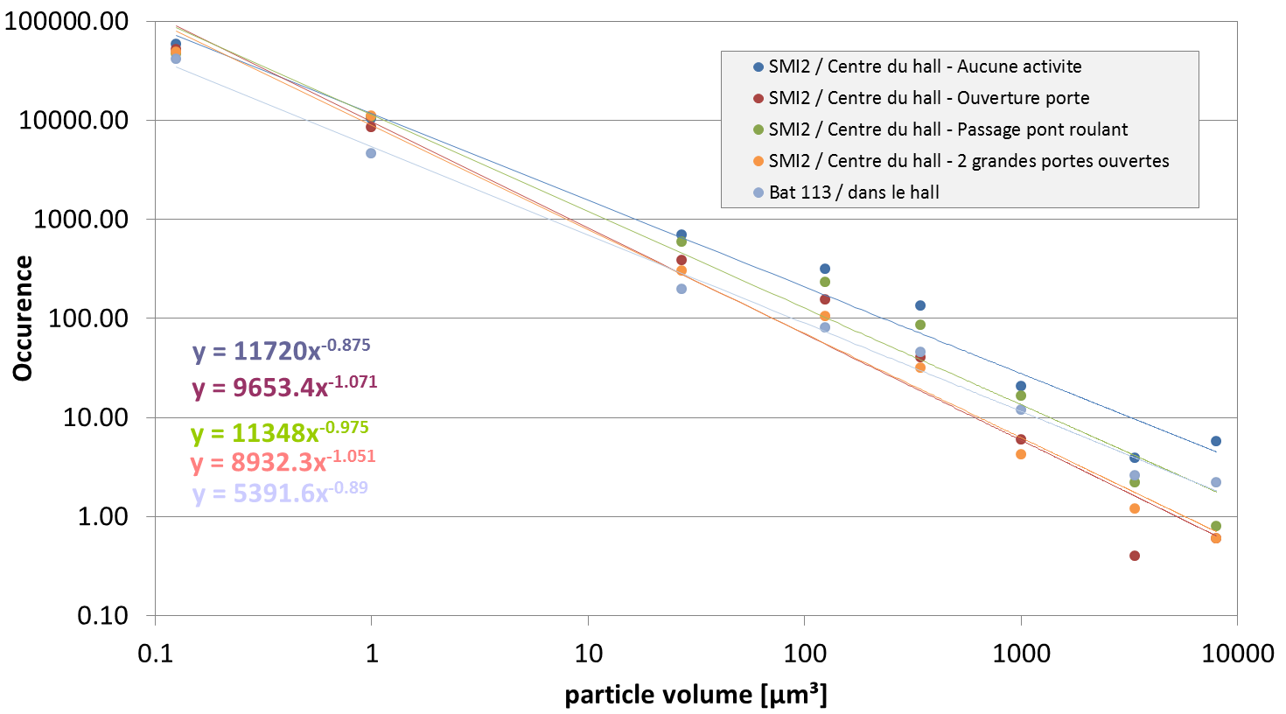

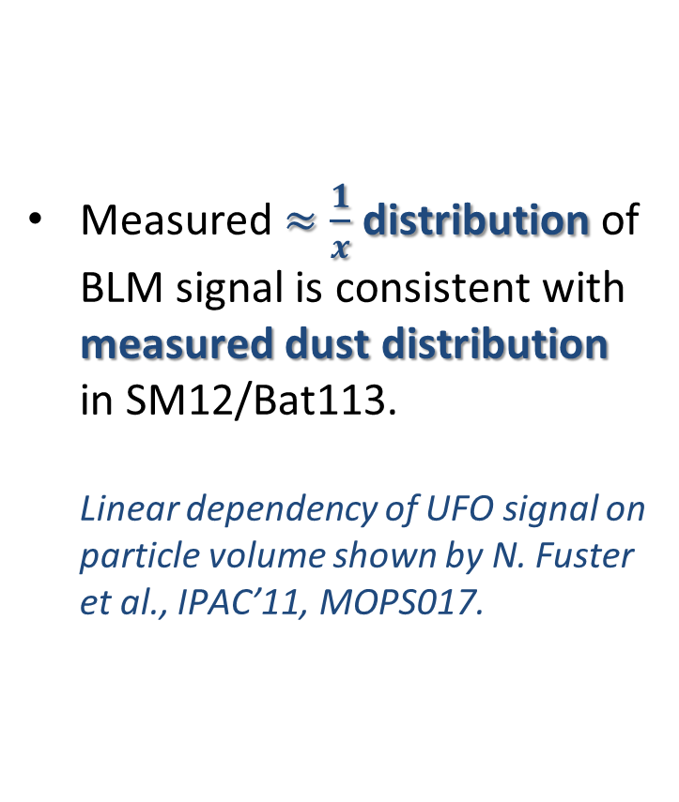
Below Threshold UFOs
Measured $≈\frac{1}{x}$ distribution of BLM signal is consistent with measured dust distribution in SM12/Bat113.
Linear dependency of UFO signal on particle volume shown by N. Fuster et al., IPAC’11, MOPS017.
4513 arc UFOs (≥cell 12) at 3.5 TeV with signal RS01 > 1∙10⁻³ Gy/s.
$$∝x^{−0.97}$$
courtesy of
J. M. Jimenez

Slide 23
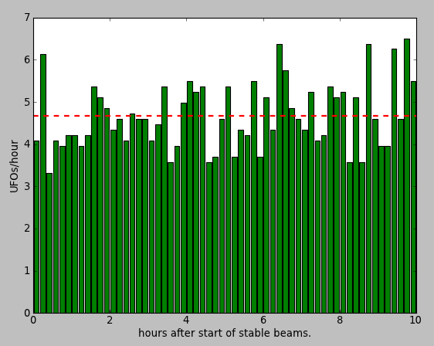

Intrafill UFO rate
The UFO rate stays constant during a fill.
3185 arc UFOs ($≥$cell 12) between 14.04. and 31.10.2011 during stable beams in 47 fills with at least 10 hours stable beams. Signal RS04 > 2∙10⁻⁴ Gy/s.

Slide 24
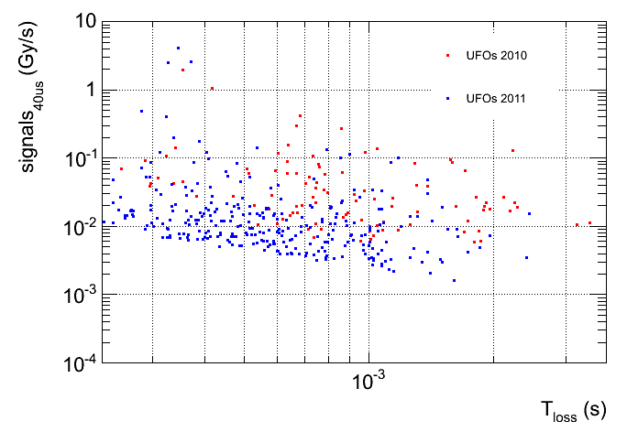
Peak Signal vs Loss Duration
Tendency that harder UFOs are faster.
courtesy of
E. Nebot

Slide 25
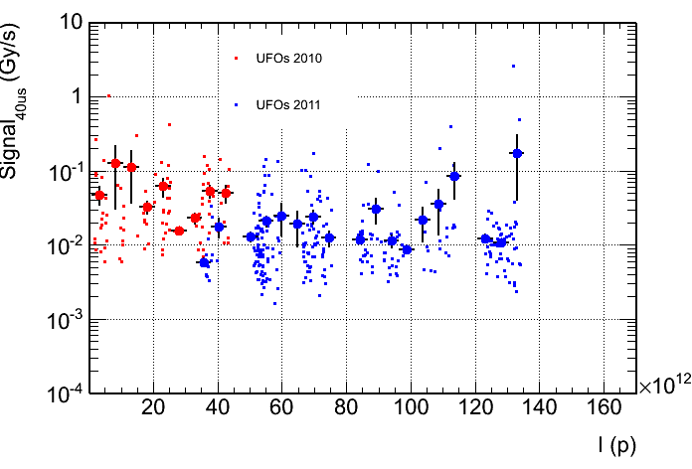
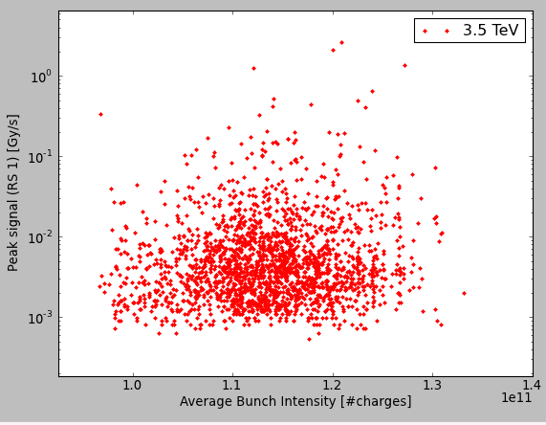
Peak Signal
No clear dependency of peak loss on intensity.
(cf. E.B. Holzer at Evian Dec. 2010)
No clear dependency of peak loss on bunch intensity.
courtesy of
E. Nebot

Slide 26
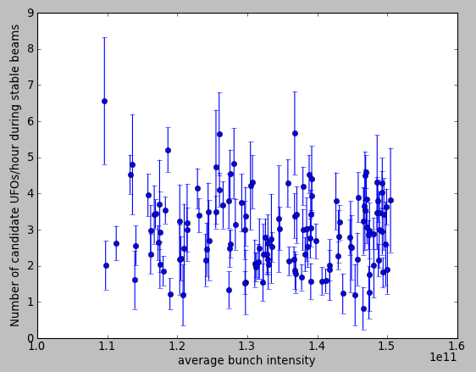
UFO rate vs Bunch Intensity
No dependency of UFO rate on bunch intensity.
Data for 3336 candidate arc UFOs during stable beams in 2011 and 2012 (until 19.07.2012). Fills with 1374/1380 bunches and at least 1 hour of stable beams are considered. Signal RS04 > 2∙10⁻⁴ Gy/s.

Slide 27
Content
1. Introduction and Arc UFO Observations
2. MKI UFO Studies and Observations
4. Outlook and Mitigation Strategies
3. Mid-Term Extrapolations

Slide 28
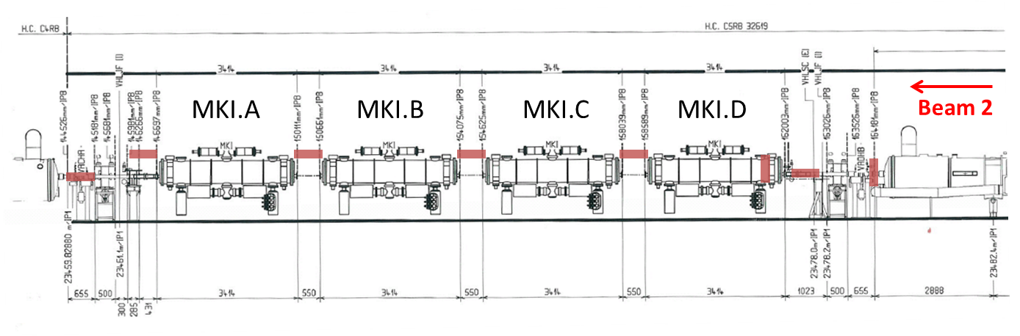
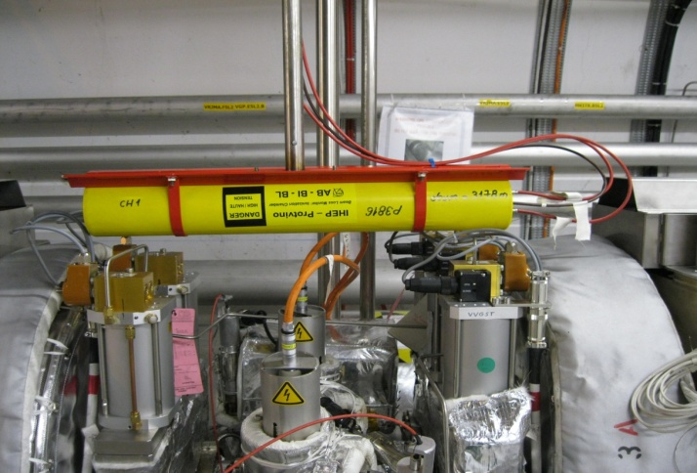
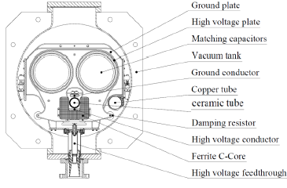
Layout of MKI Region
LHCb
Q4
Q5

Slide 29
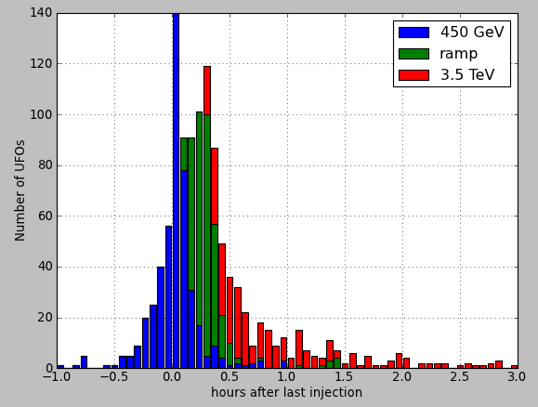
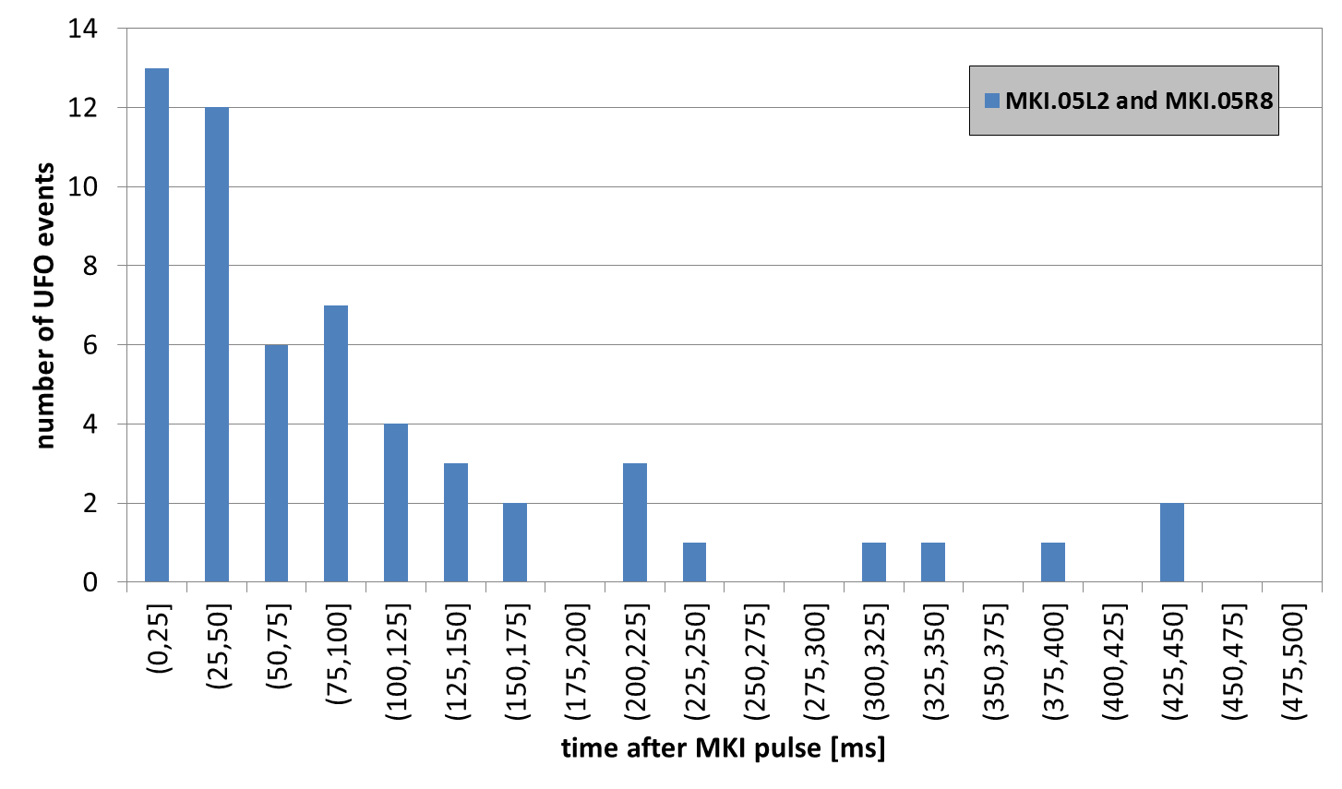
MKI UFOs
13 dumps due to MKI UFOs.
In total 2340 UFOs around MKIs
847 in Pt.2 and 1493 in Pt.8.
Temporal distribution:
Mainly within 30min after last injection.
Many events within a few hundred ms after MKI pulse, some cannot be explained by gravitational force alone (probably negatively charged macro particles).
(F. Zimmermann, 66th LIBD Meeting)
Positive correlation between MKI UFO rate and local pressure at 450 GeV.
(T. Baer et al., Chamonix 2012)
1236 UFOs around MKIs for fills lasting at least 3 hours after last injection.

Slide 30
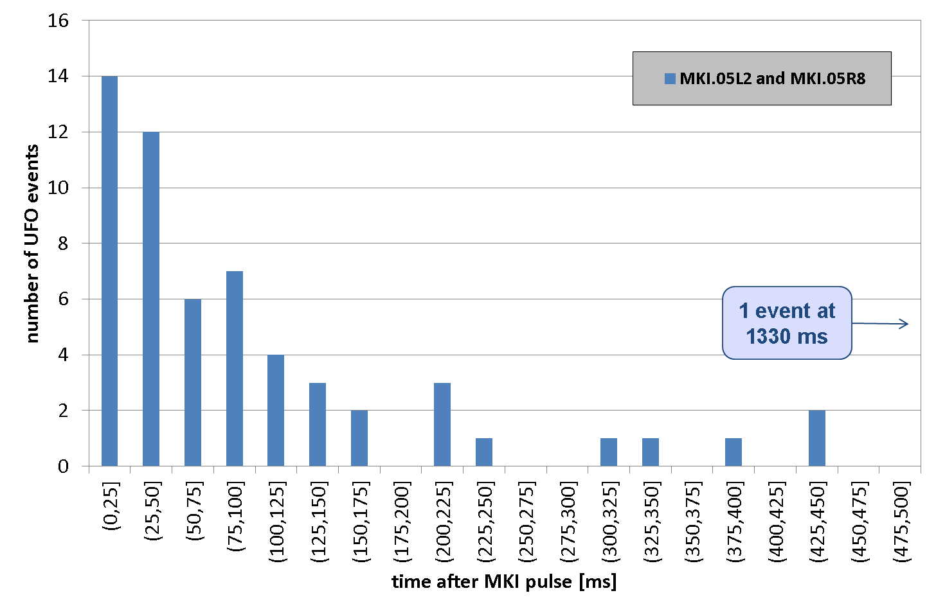
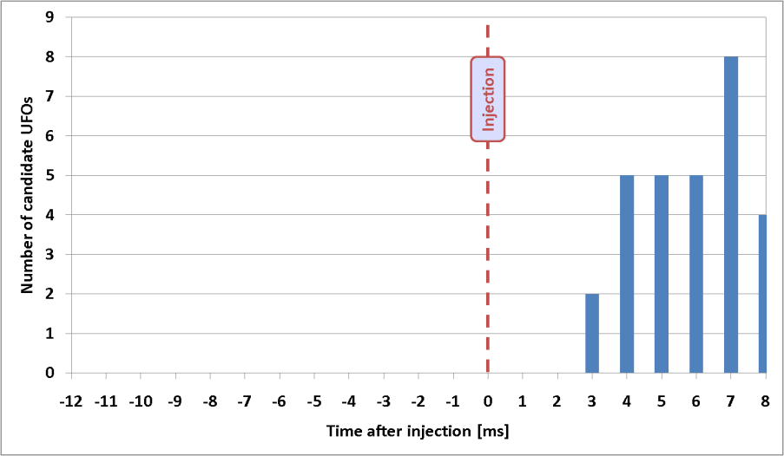
UFOs after MKI Pulse
Many events within a few hundred ms after MKI pulse.
First event 3ms after MKI pulse. Compared to 62ms for free fall from aperture.
Could be explained by negatively charged particles.
(F. Zimmermann at LIBD, 29th Nov. 2011)
T. Baer et al., CERN-ATS-Note-2012-018 MD
T. Baer et al., IPAC‘11, TUPBC137

Slide 31
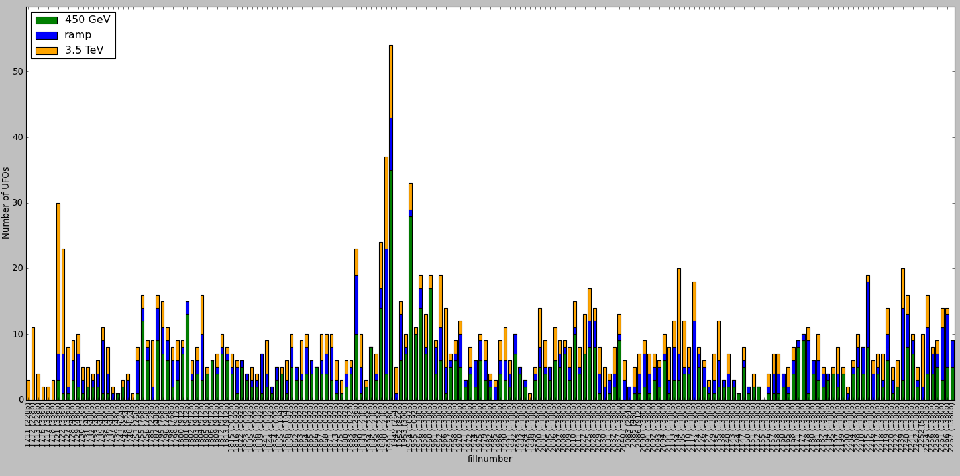
Number of MKI UFOs
No general conditioning effect obvious for MKI UFOs.
On average: 8.9 MKI UFOs per fill.
(3.4 at MKIs in Pt. 2 and 5.5 at MKIs in Pt. 8)
MKI UFO storms (Pt. 2)
1664 UFOs around injection kicker magnets between 14.04. and 31.10.2011 in Pt. 2 and Pt.8 for fills reaching stable beams with >100 bunches.
MKI Flashover (Pt. 8)

Slide 32
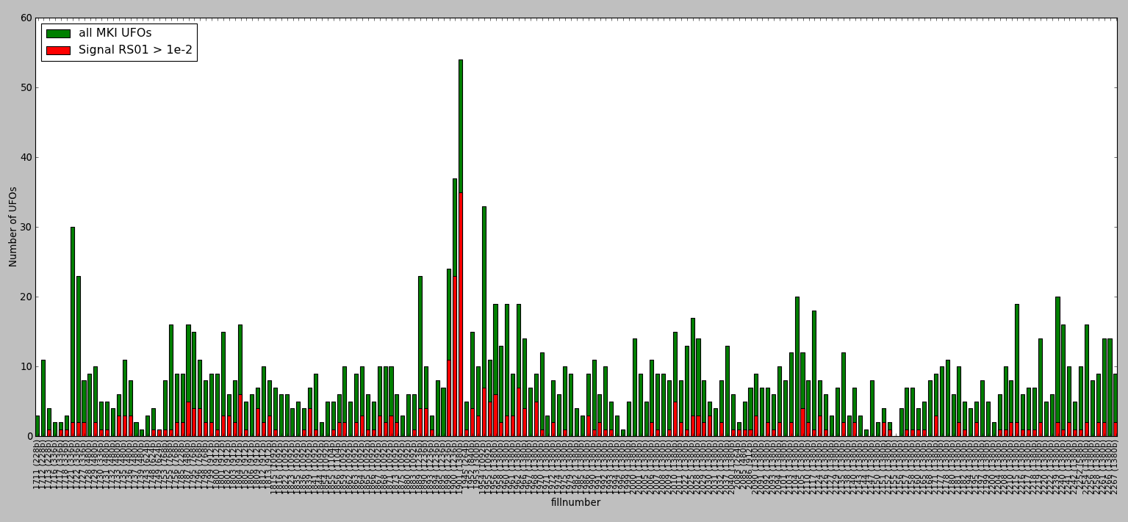
Number of MKI UFOs
During the UFO storms in July 2011 there was an increased number of UFOs with large signal. The cause is still not understood.
MKI UFO storms in Pt. 2
1664 UFOs around injection kicker magnets between 14.04. and 31.10.2011 in Pt. 2 and Pt.8 for fills reaching stable beams with >100 bunches.
After MKI flashover

Slide 33
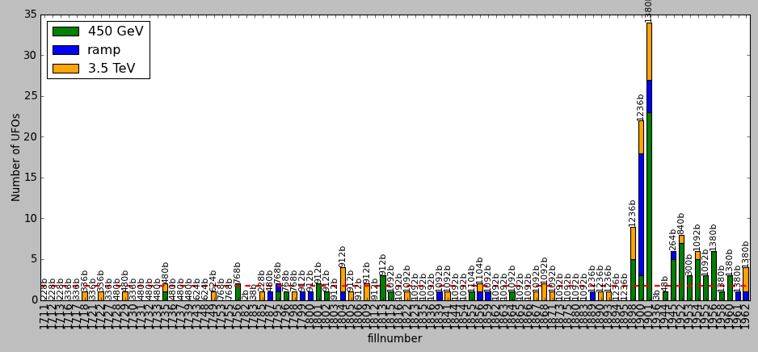
Vacuum Valve Movement
No correlation with closure of vacuum valves.
orange: Several valves closed, blue: VVGST.193.5L2 and VVGST.3.5L2 closed, green: status unknown for several valves.
MKI Beam 1
152 candidate UFOs around injection regions in Pt. 2 for fills reaching stable beams. Signal RS01 > 1∙10⁻² Gy/s.
VVGST.101.5L2.B VVGST.101.5L2.R VVGST.136.5L2.B VVGST.136.5L2.R VVGST.140.5L2.B VVGST.140.5L2.R VVGST.175.5L2.B VVGST.175.5L2.R VVGST.193.5L2.B VVGST.21.5L2.B VVGST.21.5L2.R VVGST.3.5L2.B VVGST.56.5L2.B VVGST.56.5L2.R VVGST.61.5L2.B VVGST.61.5L2.R VVGST.96.5L2.B VVGST.96.5L2.R
VVGST.101.5L2.B VVGST.101.5L2.R VVGST.136.5L2.B VVGST.136.5L2.R VVGST.140.5L2.B VVGST.140.5L2.R VVGST.175.5L2.B VVGST.175.5L2.R VVGST.193.5L2.B VVGST.21.5L2.B VVGST.21.5L2.R VVGST.3.5L2.B VVGST.56.5L2.B VVGST.56.5L2.R VVGST.61.5L2.B VVGST.61.5L2.R VVGST.96.5L2.B VVGST.96.5L2.R
VVGST.101.5L2.B VVGST.101.5L2.R VVGST.140.5L2.B VVGST.140.5L2.R VVGST.175.5L2.B VVGST.175.5L2.R VVGST.193.5L2.B VVGST.21.5L2.B VVGST.21.5L2.R VVGST.3.5L2.B VVGST.56.5L2.B VVGST.56.5L2.R VVGST.61.5L2.B VVGST.61.5L2.R VVGST.96.5L2.B VVGST.96.5L2.R
VVGST.101.5L2.B
VVGST.101.5L2.R
VVGST.136.5L2.B
VVGST.136.5L2.R
VVGST.140.5L2.R
VVGST.175.5L2.B
VVGST.175.5L2.R

Slide 34
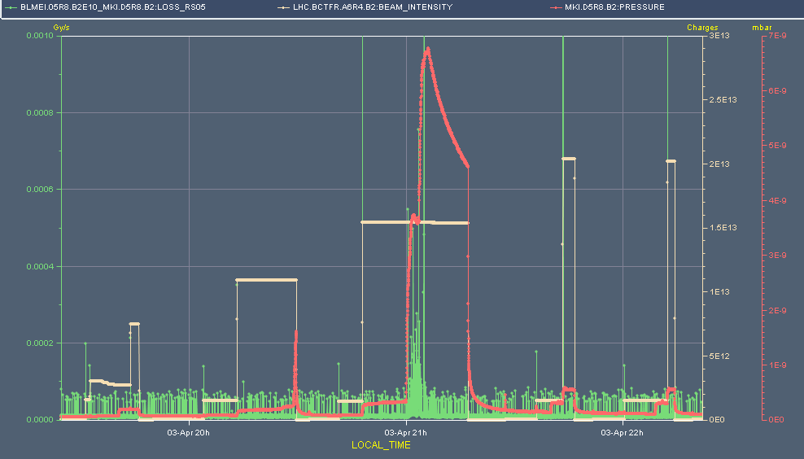
MKI UFOs
30 MKI UFOs already (mainly at MKI.D5R8).
Several MKI UFOs in correlation with vacuum increase.
Pressure
B2 intensity
UFOs
pressure interlock

Slide 35
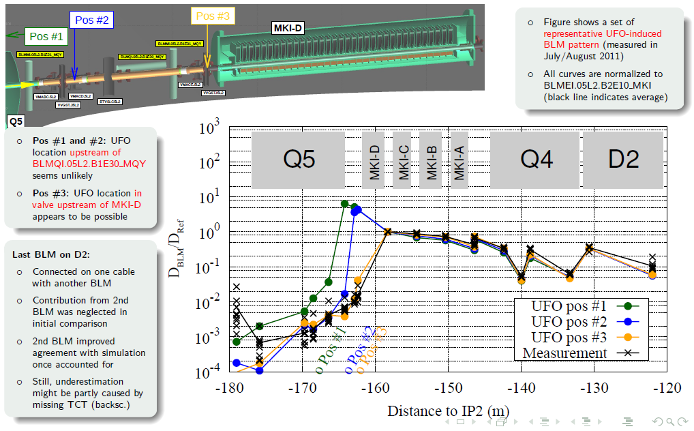
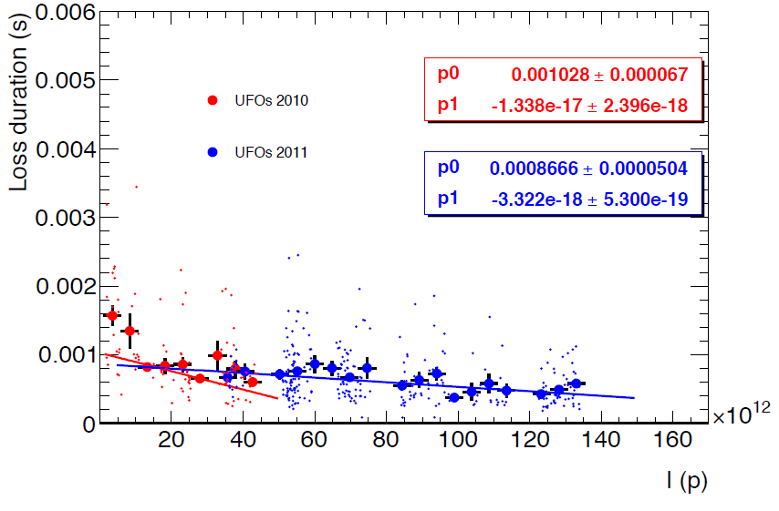
MKI UFO Studies
FLUKA: UFO location must be in MKIs (or nearby upstream).
(A. Lechner, 3rd LHC UFO Study Group Meeting)
Minimum particle radius of 40µm needed to explain large UFO event on 16.07.2011.
(T. Baer et al., Evian Workshop 2011)
Vibration measurements: Mechanical vibrations (≈10nm) of ceramic tube during MKI pulse.
(R. Morón Ballester et al., EDMS: 1153686)
Particle dynamics model: Many predictions. E.g. UFO duration is shorter for larger beam current.
(F. Zimmermann et al., IPAC’11, MOPS017)
courtesy of A. Lechner and the FLUKA team.
courtesy of E. Nebot IPAC’11, TUPC136.

Slide 36
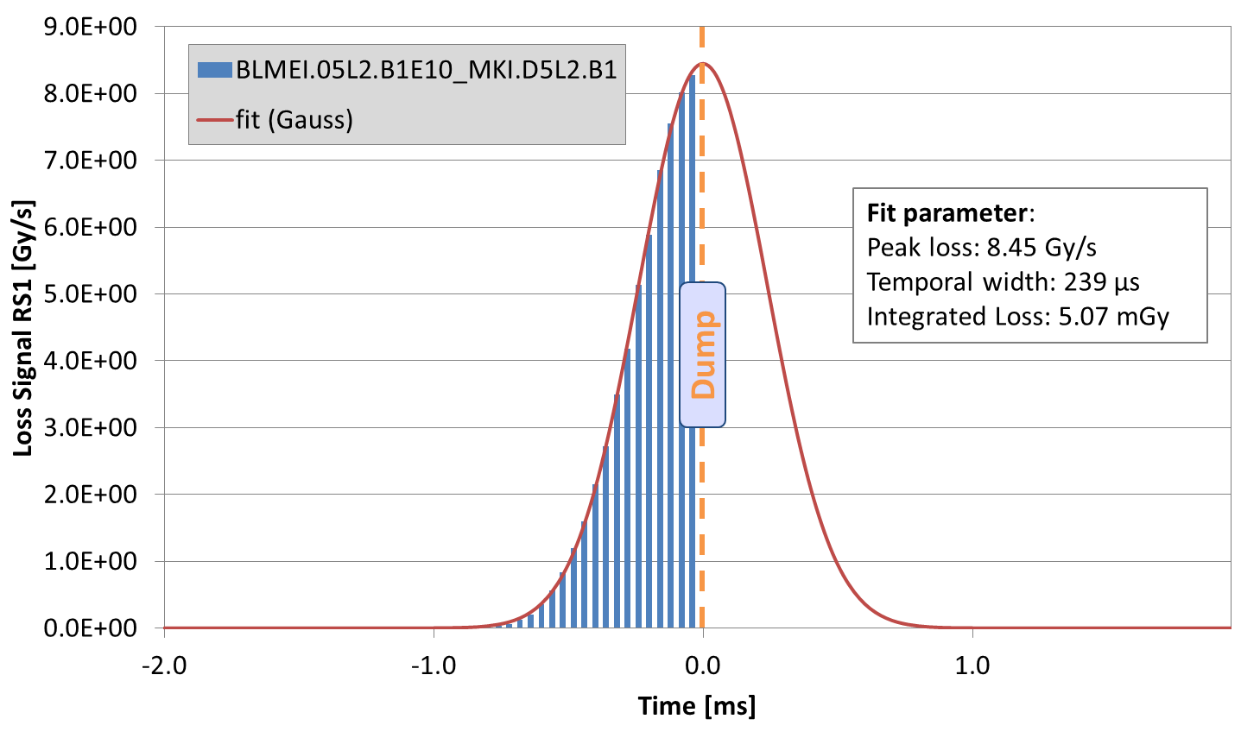

Macro Particle Size
From FLUKA simulations:
4.07·10¹¹ interactions per Gy at
BLMEI.05L2.B1E10_MKI.D5L2.B1
at 3.5 TeV.
Peak loss of 8.45 Gy/s
corresponds to 3.44·10¹²
interactions/s.
With (r << σ)
${\dot{N}}_{p, max}=\frac{N_{p}⋅f_{rev}}{2πσ_{x}σ_{y}}⋅\frac{A⋅u}{l⋅ρ}$
Radius of large UFOs must be at least ≈40µm.
Particle mass
UFO event on 16.07.2011 14:09:18
I=1.02·10¹⁴ protons, E=3.5 TeV,
with ԑ^{n}=2.5µm·rad, β_{x}=158.5m, β_{y}=29.5m, σ_{x}=325µm, σ_{y}=140µm.
Nuclear interaction length
Material | Resulting mass (A) | Radius of spherical object
Al (l=39.7cm, ρ=2700kg/m³) | 5.53·10¹⁷ | 43µm
Al₂O₃ (l=24.8cm, ρ=3970kg/m³) | 5.08·10¹⁷ | 37µm

Slide 37
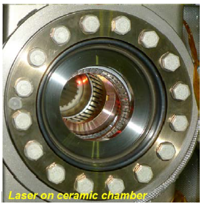

Vibration Measurements
Measurements carried out on spare MKI with kicker pulsing at full voltage under vacuum using accelerometers and laser vibrometers.
Many issues of electrical noise and spurious vibration (e.g. pumps)
When the kickers fire, a mechanical vibration in 60-300 Hz range is measured. The amplitudes are but very small (≈10 nm).
courtesy of
R. Moron Ballester, S. Redaelli
EDMS: 1153686

Slide 38
Macro Particles in MKIs
MKI.B5L2 (removed from LHC in winter TS 2010/11) was opened and inspected for macro particles including energy-dispersive X-ray spectroscopy (EDS).
Reference measurements:
clean room air: 100 particles on filter
new ceramic tube: 10‘000 particles on filter
5‘000‘000 particles on filter found during inspection of removed MKI.
Typical macro particle diameter: 1-100µm.
From EDS spectra: Most particles originate from the Al₂O₃ ceramic tube.
100µm
10µm
Al
O
courtesy of
A. Gerardin, N. Garrel
EDMS: 1162034

Slide 39
Content
1. Introduction and Arc UFO Observations
2. MKI UFO Studies and Observations
4. Outlook and Mitigation Strategies
3. Mid-Term Extrapolations

Slide 40
























25ns Operation
Heavy UFO activity during 25ns MDs (450 GeV). In 9.1/13.3 (B1/B2) hours with at least 1·10¹³ protons per beam:
159 MKI UFOs.
22 arc UFOs.
normal rate < 0.5 UFOs/hour.
(E. Nebot et al., IPAC‘11, TUPC136)
UFO cascade observed in 30L3 B2 (450 GeV)
12 UFOs at same location within
20 seconds.
Beam 2
30L3

Slide 41
Energy Dependence
UFO amplitude: At 7 TeV about
3-4 times higher than at 3.5 TeV From FLUKA simulations and wire scans during ramp. (see Antons presentation)
BLM thresholds: Arc thresholds
at 7 TeV are about a factor 5 smaller than at 3.5 TeV.
UFO rate: No energy dependence would be consistent with observations. (E. Nebot et al., IPAC‘11, TUPC136)
x3
BLM 1
BLM 2
BLM 3
Peak energy density simulated by FLUKA for an UFO in MKI.D5R8.
courtesy of A. Lechner and the FLUKA team.

Slide 42
Energy Extrapolation
  Based on UFOs recorded in 2011/12 (full cycle):
  Arc UFOs scaled to 7TeV:
  2011: 112 UFO related beam dumps.
  2012: 75 dumps.
  2 dumps observed at 3.5 TeV.
  MKI UFOs scaled to 7TeV:
  2011: 27 UFO related
  beam dumps.
  2012: 1 dump.
  11 dumps observed in 2011.
Based on UFO events between 14.04. and 31.10.2011 and the applied threshold table from 01.01.2012. For MKI UFOs, only the BLMs at Q4 and D2 are considered. The energy scaling applies only to events at flat top, but (for MKI UFOs) the full cycle is taken into account for the extrapolation. Identical running conditions as in 2011 are assumed. Several unknowns are not included: margin between BLM thresholds and actual quench limit, 25ns bunch spacing, intensity increase, beam size, scrubbing for arc UFOs.

Slide 43


Lead MKI UFOs
MKI UFO at MKI.D5R8.
10 % of threshold at MQML.10L8.
Losses are not as localized as for protons.
Highest loss is in the dispersion suppressor downstream of the IR (due to ion fragmentation).
MQML.10L8
(highest loss)
IP8
MKI (UFO location)
TCTH
Horizontal dispersion

Slide 44

UFO Model
Implemented in dust particle dynamics model, which predicts (among others):
Loss duration of a few ms.
Losses become faster for larger
beam intensities.
Al₂O₃ fragment of vacuum chamber.
Size: 1-100µm.
Detaching stimulated by vibration, electrical field during MKI pulse and/or electrical beam potential.
ceramic tube
e⁻
e⁻
e⁻
Metal strips for image currents
Interaction with beam leads to positive charging of UFO. Particle could be repelled by beam
19mm
Potentially charged by electron cloud
Beam
courtesy of
F. Zimmermann, N. Fuster
IPAC’11: MOPS017
Beam losses from inelastic nuclear interaction.
Beam loss rate as a function of time for different macroparticle masses. Beam intensity: 1.6·10¹⁴ protons.

Slide 45
Content
1. Introduction and Arc UFO Observations
2. MKI UFO Studies and Observations
4. Outlook and Mitigation Strategies
3. Mid-Term Extrapolations

Slide 46
QTSWG
Three strategies to learn about quench limit with UFO timescales:
Wire scanner quench test
  Advantage: Detailed FLUKA simulations exist, only way to asses directly difference between UFO and bump loss.
  Disadvantage: MBRB - only one spare, MBRB magnet (4.5 K) is special (QP3)
  different geometry than for the arc (FLUKA/G4).
Increase BLM thresholds in „good“ sectors
  Advantage: Real UFO quench.
  Disadvantage: Quench may not happen, UFO location and size not well controlled, reduced FLUKA/G4 accuracy for quench limit.
ADT quench test
  Advantage: Arc magnet used.
  Disadvantage: No direct testing of difference between UFO and bump loss.
courtesy of Mariusz Sapinski

Slide 47




Dumps by Arc UFOs in 2011
In 2011: Two dumps by arc UFOs.
Event on 29.05.2011 exceeded dump
threshold by about 60% (RS04, RS05, RS06).
Expected maximum loss without beam dump:
650% above dump threshold (RS6).
Proposal: Probe the quench limit (carefully) with UFO events.

Slide 48


Proposal for LMC
Not many large UFO events expected (2 arc UFOs above BLM thresholds in 2011), but a large event would provide very valuable information on the real quench limits.
Increase BLM thresholds for all arc BLMs in sectors 12, 34, 56, 67 by a factor 3.3.
(Proposed thresholds correspond to expected quench limit)
If a quench occurs: reduce BLM thresholds according to observations.
In May 2012 not fully supported by rMPP.
Thus not proposed to LMC.
A. Siemko, Chamonix Workshop 2012.

