Slide 1
Coupling Correction Using Injection Data
Tobias Persson, Rogelio Tomas

Slide 2
Outline
The aim of the project
How it works
Introduction to the terminology
The first couple of tests
The software
Outlook
Conclusion

Slide 3
The aim of the project
The aim of the project:
To provide a correction of the coupling.
In the first stage we use the injections oscillations from the normal BPMs.
The general idea:
We use the normal injection oscillations, recorded by BPMs, to measure the coupling.
Thanks to Verena Kain and Delphine Jacquet all the BPMs are now recorded for every injection.
We calculate the best settings for the coupling knobs in order to correct the coupling.

Slide 4
How it works
The injection oscillations are like kicks. We observe the oscillations around the closed orbit.
Injection data is
recorded
Clean the
Data using
svd
Preform an FFT
(using Sussix)
Calculate the
coupling amp
and phase
Finds the best
correction using SVD
*Large parts of the code is re-used and written by: Masamitsu Aiba, Rama Calaga, Ryoichi Miyamoto, Glenn Vanbavinckhove, Rogelio Tomas and other people collaborating with the OMC team.

Slide 5
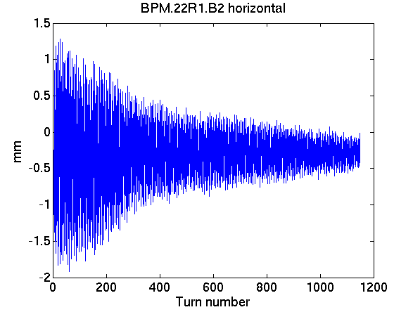
Injection data
Example of injection data from 20 of August ~15.00:
We usually use the first 600 turns for the FFT.

Slide 6
Introduction to the terminology
From the FFT-spectrum the f₁₀₀₁ is calculated along the ring.
The f₁₀₀₁is a complex quantity.
To calculate the f₁₀₀₁we need the relative amplitude between the main peak and the coupling peak. We also need the phase of the two peaks.
The is a global parameter and can be calculated as:
We also have the relation:

Slide 7
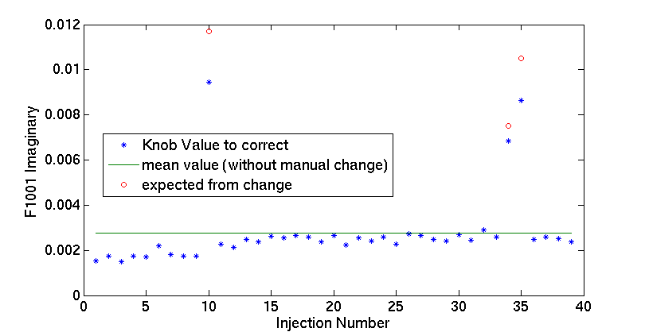
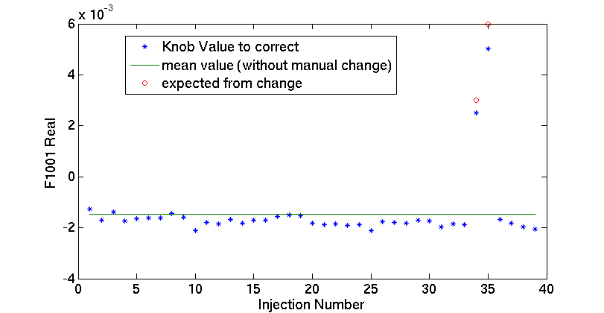
First test during the Non-linear MD (1)
Manual changes
Good opportunity since
we had a lot of injections
Only B2
Time between
injection is ~10min
Coupling was rather
Stable over the ~6h.
We changed manually
the knob setting for 3
injections

Slide 8
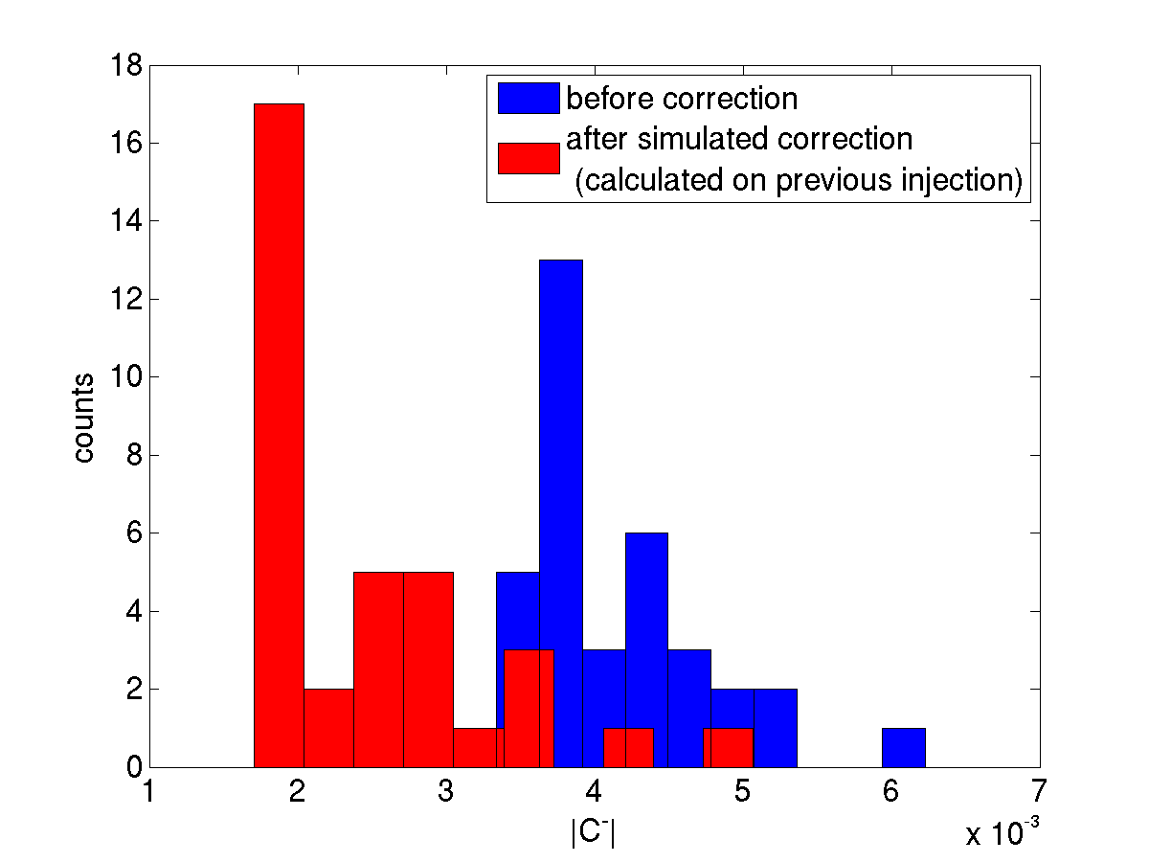
First test during the Non-linear MD (2)
Calculate correction
from injection: i
Apply correction to:i+1.
Simulate predicted
Cminus

Slide 9
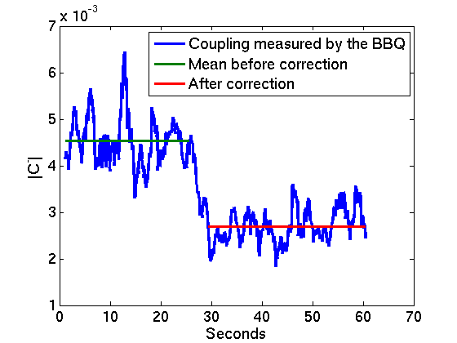
8 of August during normal operation
Coupling was well corrected from start.
We introduced manually some extra coupling before injection:
Δ imaginary = -0.006
Δ real:-0.007
From measurement:
Δ imaginary = -0.006
Δ real:-0.004
Thanks to Alick Macpherson for helping us during this test

Slide 10
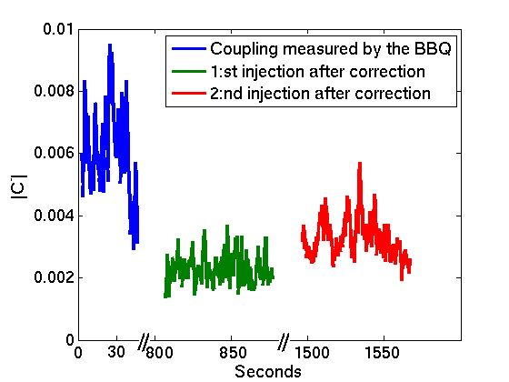
A real situation, 10 of August
Coupling was not well corrected for first injection.
Corrected it and measured for the two consecutive injections.
Beam dumped due to moving out collimators which were unmasked
Correction applied here
Beam dumped
due to
Unmasked RF

Slide 11
How it works at the moment
The software automatically detects the arrival of a new injection file and performs the calculation, which takes ~30-40s .
The calculations are done by a process which runs on a server.
In this way we minimize the waiting time.
The results are displayed using a user interface
Calculations Program
User Interface
Program
Calculations Program

Slide 12
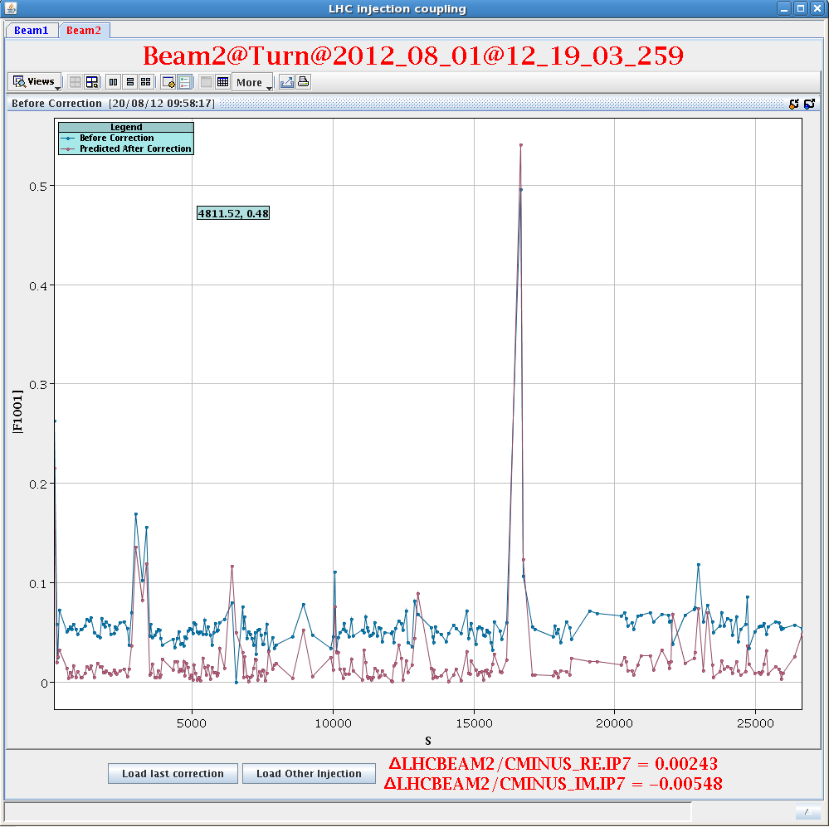
The user interface
Loads last
injection
when it starts.
If a new injection
arrives, just click
on : “load last
correction”
The changes to be inferred to the knob

Slide 13
Outlook
We can control the coupling at injection using the method explained.
However, at other state of the machine we have to either correct by hand or by kicking the beam.
The two BBQ (for each beam) seems to have the resolution needed to measure the needed properties to correct the coupling. The phase advance is profitable for Beam2, not beam1.
However, some difficulties:
Not synchronized
Not always big enough oscillations
Measures only at one place
Thanks to
Marek Strzelczyk for helping us how to read the BBQ signal‎

Slide 14
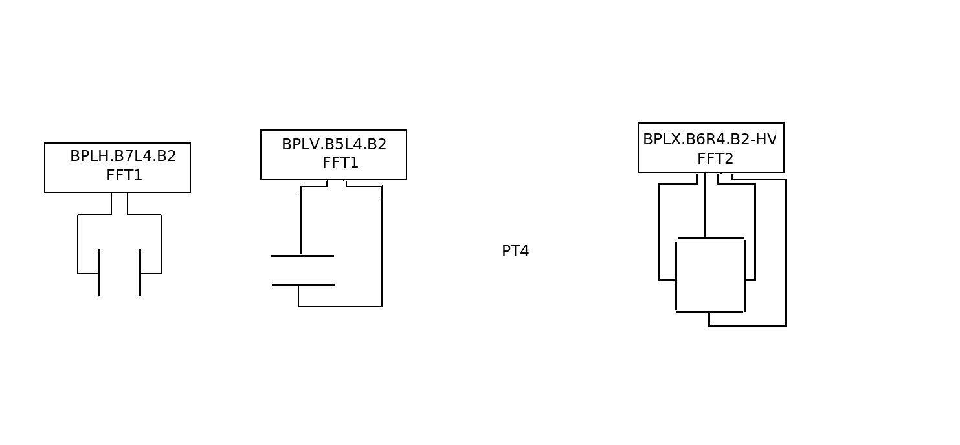
BBQ layout (beam 2)
Beam 2
Δx = 15.3°, Δy = 10.7°
Δy = 57.8°
Δx = 98.4°

Slide 15
Conclusion
The corrections work well for Beam 2
Still have to be checked for Beam 1.
Can speed up and improve the coupling corrections at injection.
The software is operational but there might still need some small improvements.
At the moment it takes ~30-40 seconds from injection until the correction is calculated.
Implement the possibility to send the corrections directly from the software. Would that be useful?

