Slide 1
Proposal to change bunch length during physics fills to assess beam induced heating after LS1
M. Barnes, P. Baudrenghien, A. Burov, S. Claudet, S. Jakobsen, T. Mastoridis, E. Métral, N. Mounet, F. Roncarolo, B. Salvant, E. Shaposhnikova, L. Tavian
Acknowledgements to the LHC OP team and coordinators

Slide 2
Agenda
End of fill test on Oct 5th
Proposal to reduce the bunch length in physics
Proposal for end of fill study to flatten the bunches

Slide 3
End of fill test on Oct 5th:
With P. Baudrenghien, T. Mastoridis, the TE/CRG team (S. Claudet, A. Gallon, L. Tavian) and the OP team (M. Pojer, L. Normann, R. Alemany and M. Albert), thanks to the LHC coordinators (G. Arduini and M. Lamont)
Cavity voltage was lowered to 10 MV and increased to 15 MV
Objectives:
assess the impact of bunch length on temperature of LHC equipment (did not expect to see much as the available range of bunch length is small with that method)
record beam spectrum change with voltage

Slide 4
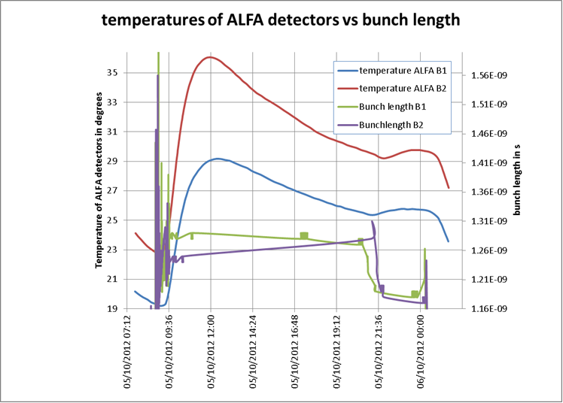
End of fill test on Oct 5th 2012: ALFA (data from ATLAS logging)
Significant impact on ALFA temperature !!!

Slide 5
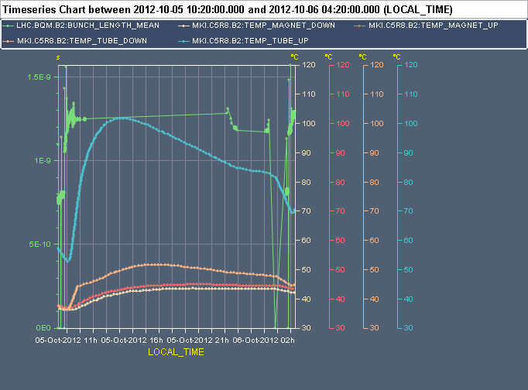
End of Fill test on Oct 5th: MKI8C temperatures
Change of slope observed after changing the bunch length observed for the tube_up temperature

Slide 6
End of fill test on Oct 5th: heat load to arc beamscreens (L. Tavian et al)
~-6 % on
bunch length (BL)
BIH ~BL⁻²
(power -2
dependence)
~+14 % on BIH
Clear step observed. Nothing observed for the critical standalone Q6R5.

Slide 7
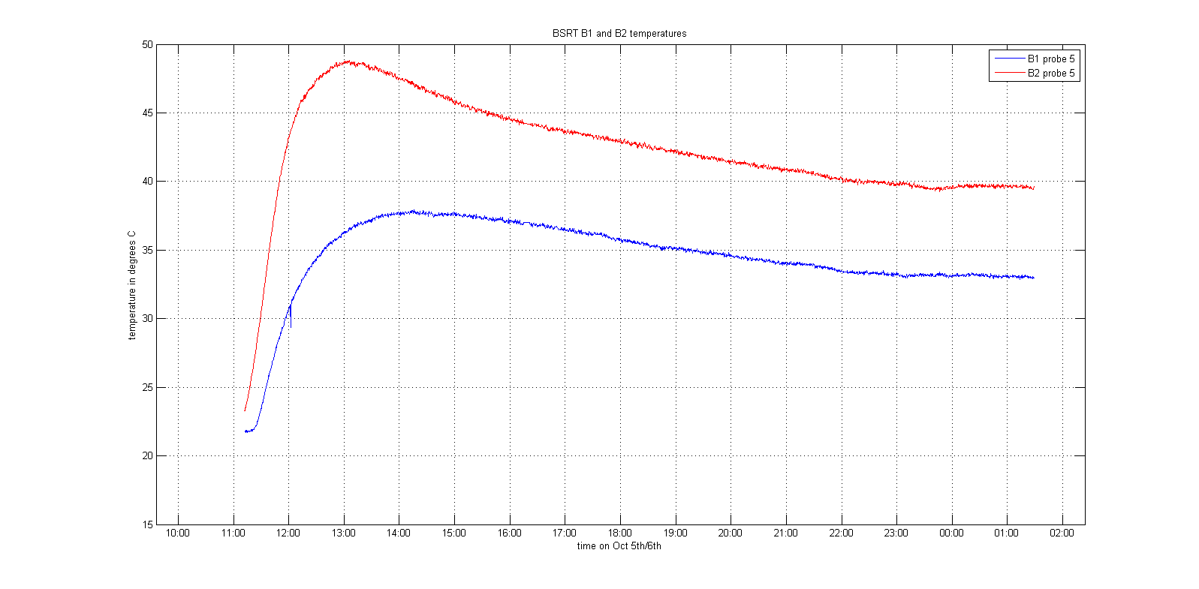
BSRT B1 and B2
Change B2
Change B1
Small change of slope at the moment of bunch length change (23:00 for B1 and 23:30 for B2)

Slide 8
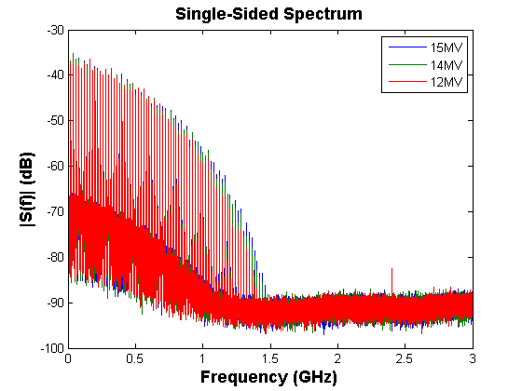
Preliminary conclusion:
- Even with small change of bunch length, we see effects on the temperature of several devices (ALFA, MKI, beam screens, BSRT). Not much was seen on collimators.
- Next step: understand whether this is predicted with the simulated impedances and the small change of spectrum acquired by the RF team
T. Mastoridis, P. Baudrenghien

Slide 9
1st Proposal

Slide 10
Proposal
Reduce the target bunch length after the ramp during physics fills (in small steps: ~ 50 ps per fill).
Why?
Assess the possibility to run with lower bunch length after LS1. What is the limit?
Bunch length was increased in mid-2011 to reduce beam induced heating.
What should be monitored?
Temperatures (in particular ALFA and beam screens)
Beam spectra
Risks?
Damage to ALFA detector, BSRT and other equipments → need to go in small steps
Not enough cooling power for beam screens → need to go in small steps
Maybe more transverse instabilities as discussed with the ABP/ICE team (we could also increase the bunch length for a few fills to check)
With the new diagnostics, the RF team observed that the beam spectrum is quite different from fill to fill. However the variations should become smaller with smaller bunch length.
Dump due to temperature interlocks (TCTVB, MKI, TCP)
Difficulty to compare two fills with many parameters changing. Need statistics.
Other considerations?

Slide 11
2nd proposal

Slide 12
Following Elena’s talk at LMC
Study the impact of flattened bunches with RF noise:
Potential interests:
Can enhance heating of unknown high frequencies while decreasing most known problematic sources of heating → very important to disentangle “broaband/narrow band” “high frequency/low frequency” contributions
Assess impact on transverse stability of these flat bunches (as discussed with the ABP/ICE team)
This study would require RF tests at injection (2h) and then end of fill studies.
Other considerations?

