Slide 1
LHC RF Status March 29, 2011
Acknowledgments to:
T. Argyropoulos and E. Shaposhnikova
for the calculations of capture loss and debunching following a klystron trip
P. Maesen
for the statistics on klystron/cavity problems
A.Boccardi and S. Bart Pedersen
for the help with the Abort Gap Monitor
LHC RF Status
Reported by P. Baudrenghien CERN-BE-RF

Slide 2
Longitudinal parameters last 4 weeks
SPS beam (same as in 2010)
1.5 ns (±0.1 ns) , 4σ length
Capture
Higher capture voltage than 2011. Set at 6 MV B1 (8 cavities) and 4.5 MV B2 (6 cavities)
Ramping
Linear voltage rise to 12 MV B1 and 9 MV B2
Emittance blow-up: same 1.2 ns setting as 2010.
Physics: Fixed 12 MV B1 and 9 MV B2
The dissymmetry between the two rings comes from 5B2 and 8B2 being off-line

Slide 3
Capture loss

Slide 4
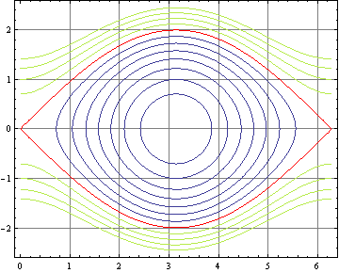
SPS-LHC Capture why increase the voltage?
Reproduced from LBOC presentation March 1st
SPS longitudinal parameters at transfer with 7.2 MV RF @ 200 MHz :
bucket: 3.0 eVs, +-10.6E-4 Δp/p
bunch: 4σ bunch length 1.5 ns, 0.51 eVs, +- 4.5E-4 Δp/p
Matched LHC capture voltage: 2.5-3.1MV @ 400 MHz.
LHC longitudinal parameters at transfer with 3.5 MV @ 400 MHz
Bucket: 0.94eVs, +-6E-4 Δp/p
Loss are small (< 1 %) but cannot be zero because
13.5 % of particles are outside the 2-D 4σ core
the SPS bucket is twice longer and 70% taller than the LHC bucket
4σ bunch
momentum
spread
4σ bunch length
Phase space trajectories in normalized phase space (φ, 1/Ω_{s} dφ/dt), 3.5 MV
SPS bunch length (4σ) 3.8 radian @ 400MHz (dark blue horiz. arrow)
SPS bunch height +- 1.5 in normalized
1/Ω_{s} dφ/dt unit
(dark green vert. arrow)
Capture loss is unavoidable because the SPS bucket is so much larger than the LHC bucket (3.0 eVs compared to 0.94 eVs) and a significant part of the bunch falls outside the 4σ region.
1 % capture loss confirmed by Theodoros Argyropoulos calculations

Slide 5
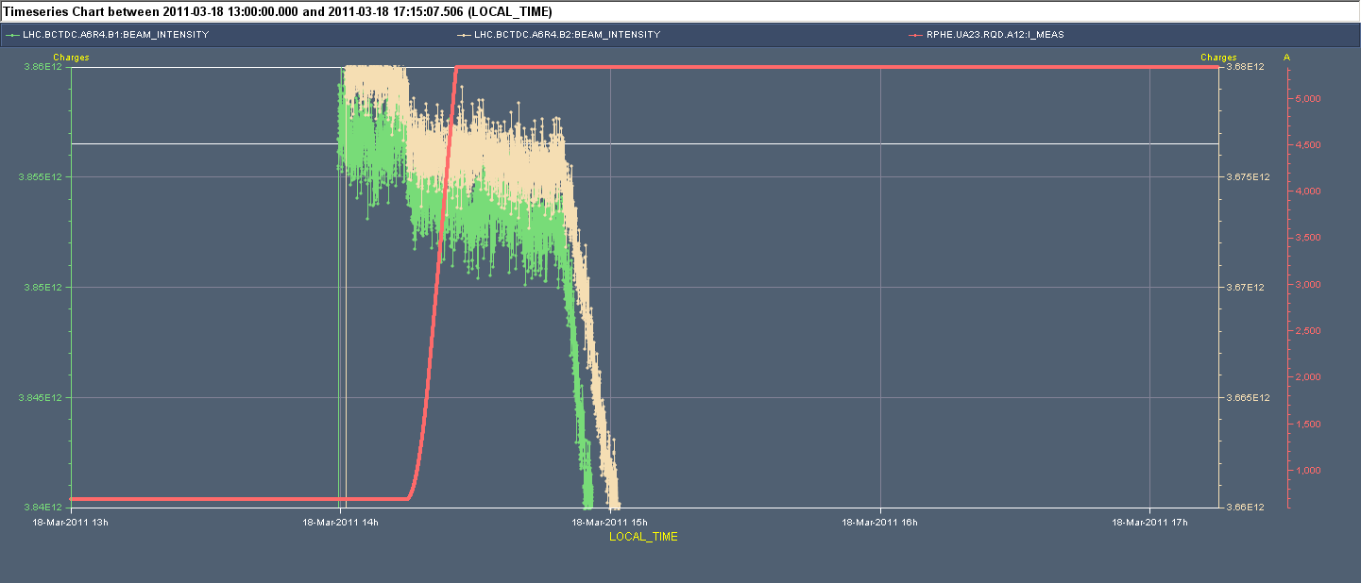
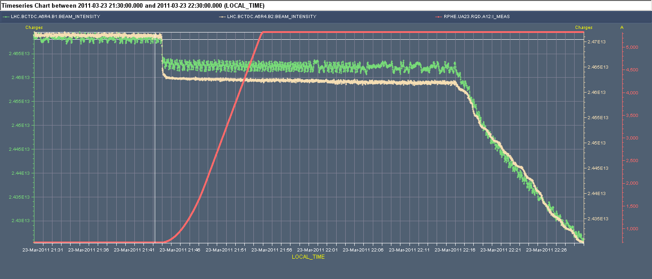
Measured capture loss 2011
Fill 1634, 32 nominal + 4 small/ring, March18. Capture loss < 5E9 for a total of 3.8 E12. Same for both beams.
0.13 %
200 nominal + 4 small/ring, March23. Capture loss
0.2 % B1
0.3 % B2
DCBct @ start ramp. Enlargement
Capture loss are small. Does OP see an improvement during filling, compared to last year’s situation. Effect of improved Longitudinal Blow-up in the SPS, Shielding efforts, Filtering of the BPMs, sunglasses at Alice and LHCb… should be presented soon. Next LBOC meeting?

Slide 6
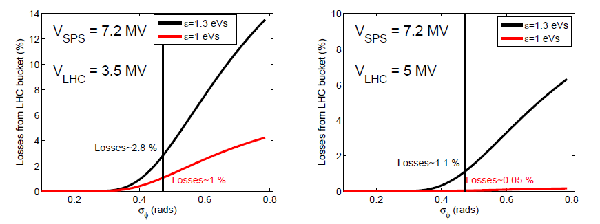
Expected capture loss (T. Argyropoulos)
Calculated losses from the LHC bucket after the injection from the SPS for VLHC=3.5 MV
(left) and 5 MV (right), and function of the SPS bunch length. The vertical line corresponds to = 0.4712 rads @ 200 MHz (1.5 ns bunch length @SPS).
Reproduced from: T. Argyropoulos, E. Shaposhnikova, Longitudinal parameters for a stationnary bucket, March 2, 2011. To be published.
1.3 eVs is the SPS bucket area just after the end of the controlled emittance blow-up. Assuming that the SPS bunch fills the available 1.3 eVs, calculations predict 1.1 % loss at injection.

Slide 7
Bunch lengthening in Physics

Slide 8
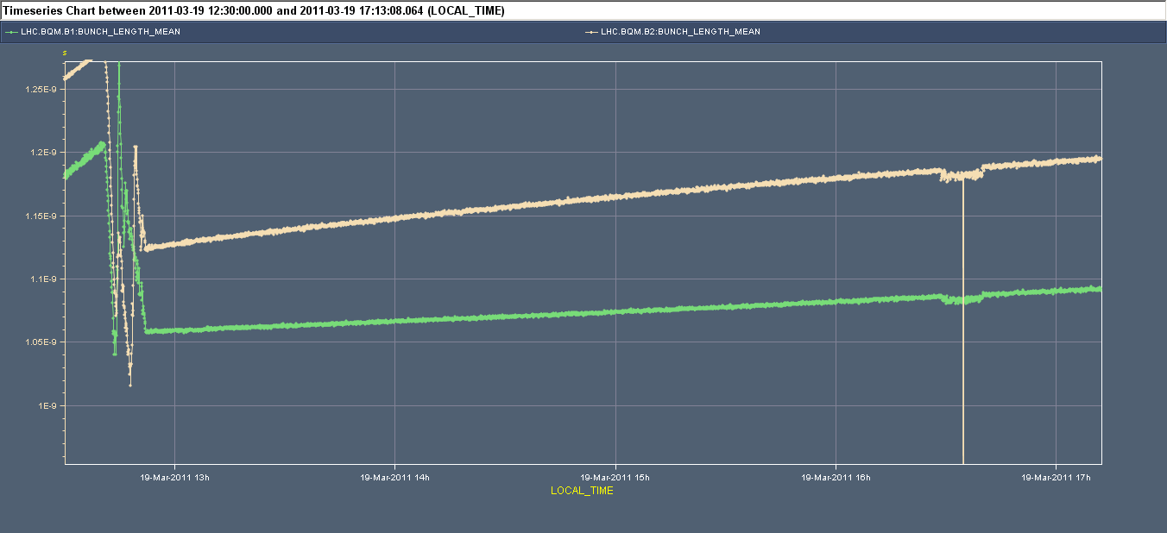
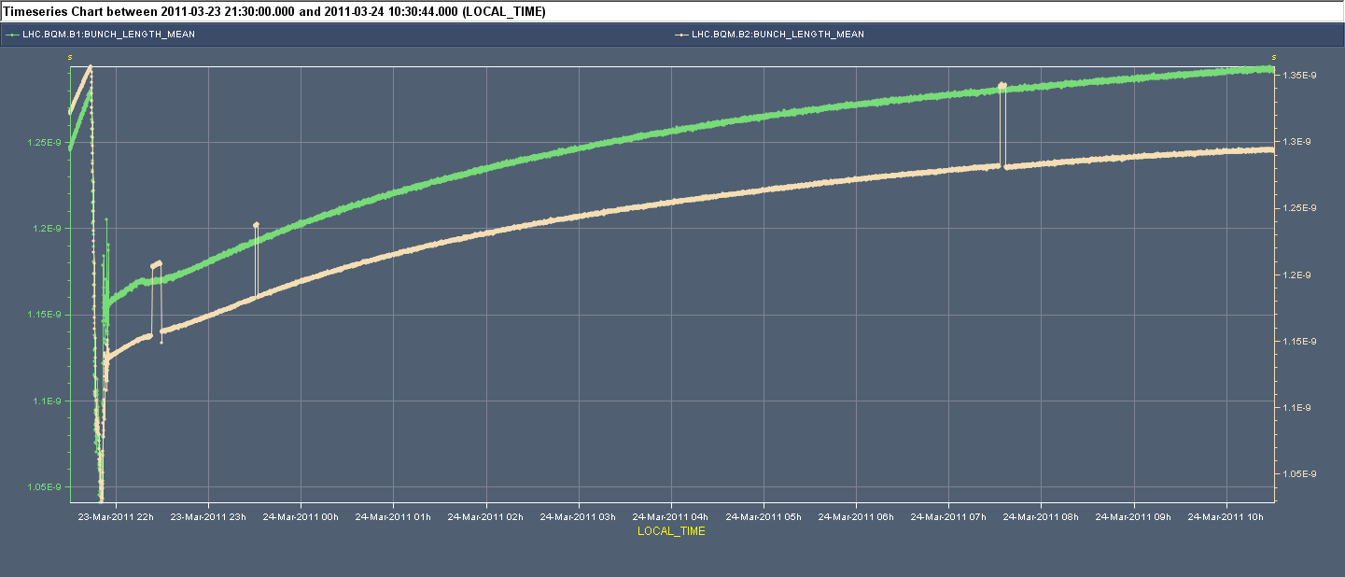
Measured bunch lengthening 2011
Fill 1637, 64 nominal/ring, March19. Bunch lengthening in physics
7.5 ps/hour B1 (12 MV)
17 ps/hour B2 (9 MV)
200 nominal + 4 small/ring, March23. Bunch lengthening in physics
10 ps/hour B1 (12 MV)
11 ps/hour B2 (9 MV)
Bunch Length Mean during Physics
In 2010, with 8 MV we observed ~ 15 ps/hour

Slide 9
Longitudinal Emittance Blow-up

Slide 10
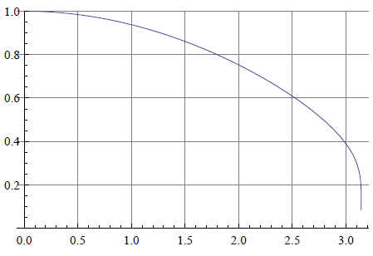
Longitudinal emittance blow up
Phase noise spectrum
Rectangular Phase Noise Power Spectral density that excites only the core
hit: 6/7 f_{s} < f < 1.1 f_{s}
corresponds to a 1.2 ns window in the core
and follow f_{s} along the ramp
from Hz to Hz
Algorithm to adjust the amplitude of the excitation x_{n} from a measurement of the instantaneous bunch length (mean) L_{n} and comparison to target L₀
Target bunch length L₀ originally set at 1.2 ns
Part of the bunch excited

Slide 11
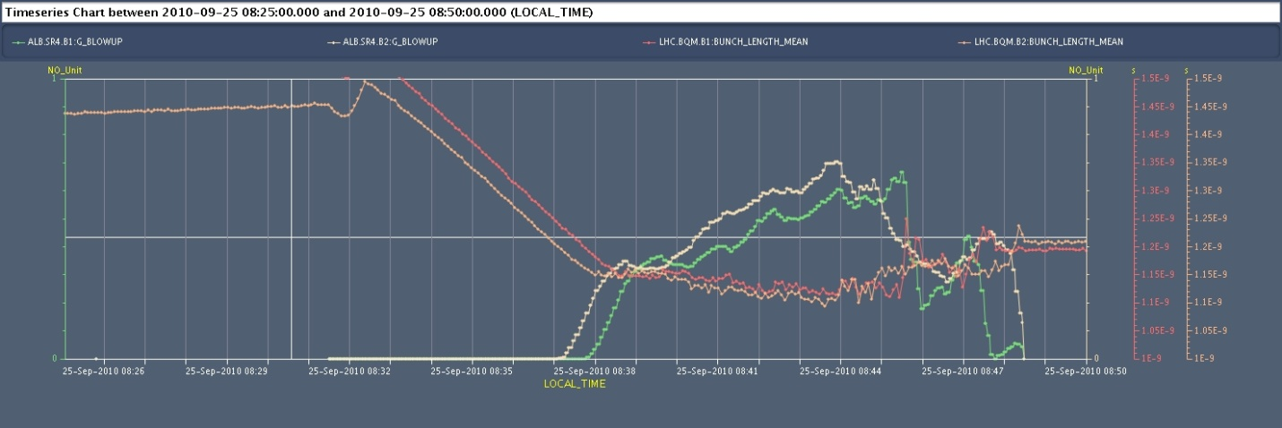
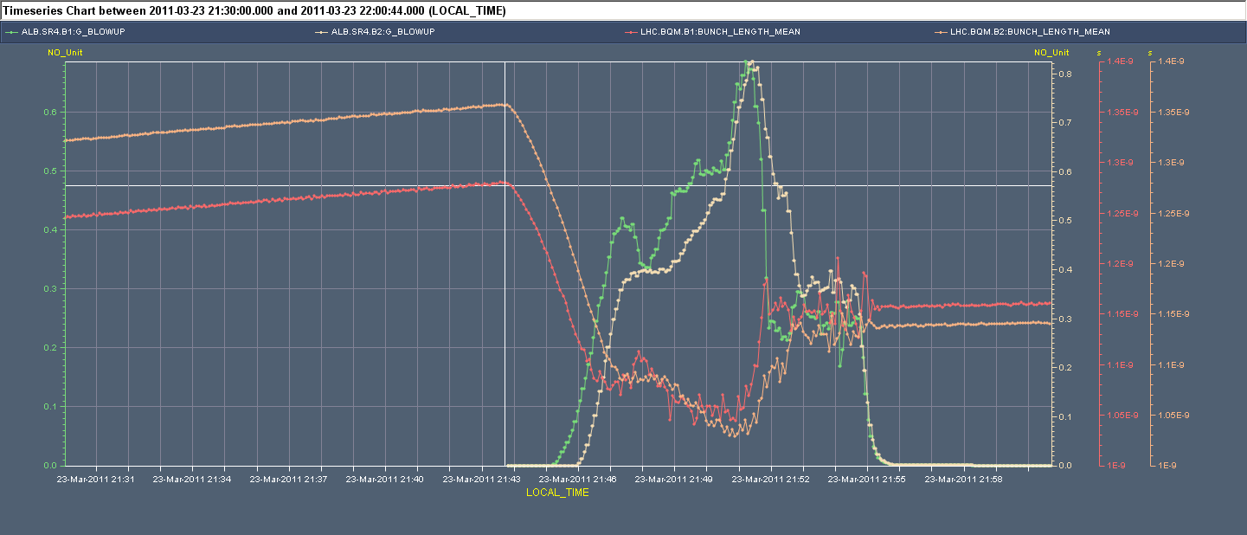
Why more tricky in 2011?
Situation 2010: Thanks to the matched capture the bunch shape is not changed much at injection. It is ~1.5 ns at the start of the ramp. The first part of the ramp proceeds smoothly without blow-up, with adiabatic bunch length reduction till it reaches the demanded 1.2 ns.
Bunch Length Mean and Noise Amplitude during Ramp
Situation 2011: Because the capture voltage is mismatched, the 1.5 ns long SPS bunch shrinks to ~1.25 ns after capture. With a 1.2 ns target value for bunch length, excitation must start immediately as soon as the ramp starts. We typically end-up a bit short of the demanded 1.2 ns.

Slide 12
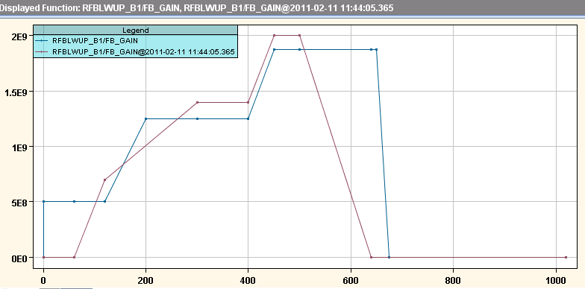
Fine-tuning 2011
The ramp is faster
The voltage increase is larger
The bunch length is shorter at the beginning of the ramp
We need a stronger excitation
Following a fast “explosion” of the bunch (in ~ 20s), the time-constant of the algorithm was reduced from a=0.8 (20 s) to a=0.64 (10 s). OK since.
Gain of the Blow-Up algo g, through the ramp: Non-zero from start ramp and kept max till end ramp

Slide 13
Klystron trip and Debunching

Slide 14
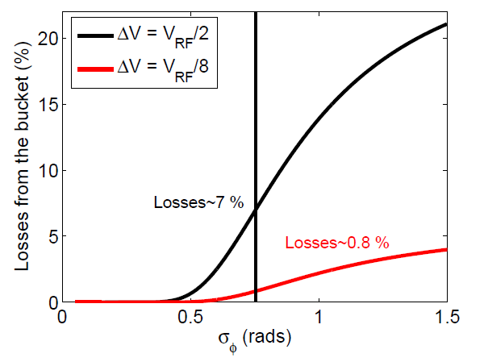
Expected loss (T. Argyropoulos)
Calculated losses from the LHC bucket following the loss of 1/8 or 1/2 the voltage., as a function of the LHC bunch length. The vertical line corresponds to = 0.754 rads @ 400 MHz (1.2 ns bunch length@LHC).
Reproduced from: T. Argyropoulos, E. Shaposhnikova, Longitudinal parameters for a stationnary bucket, March 2, 2011. To be published.
Calculations predict 0.8 % loss following the trip of 1 out of 8 klystrons.

Slide 15
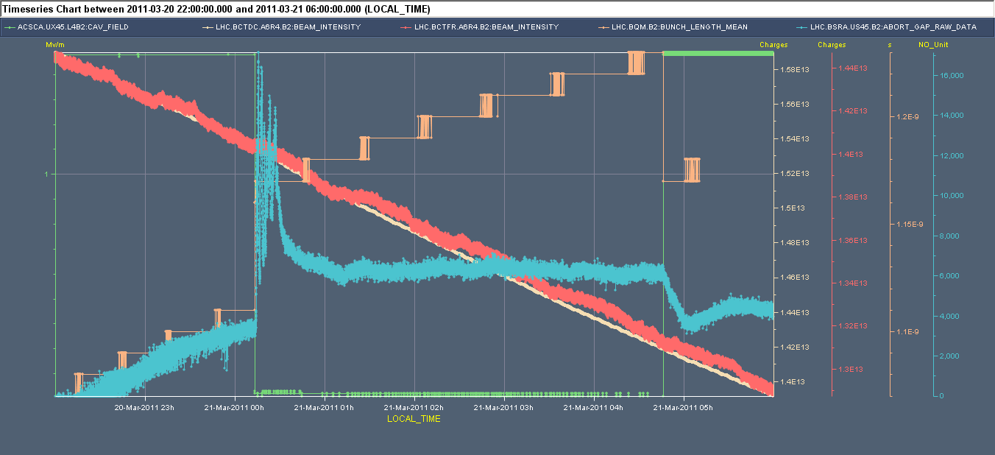
March 20-21
136 bunches per ring
1 klystron trip B2 after ~ 3 hours of physics, leading to 1/6 voltage reduction each time (9 MV -> 7.5 MV)
The abort gap intensity (blue) is measurable
The trip creates no visible loss in FastBct
The abort gap population peaks at 17000 units or ~1.5E9 p. It remains ~ 1E9 p for ~ 15 min (same cleaning time as in 2010). Assuming uniform line density around the machine 1E9 in abort gap corresponds to ~ 3E10 total
Compared to the 1.4E13 circulating, the klystron trip led to 0.15 % intensity lost out of the bucket
cav4B2 voltage (green), Bunch Length (brown), DC and Fast BCT (red and yellow), and Abort gap Raw (blue). Calibration: 9E4 p/digit
Observation 1:
Loosing 1/6 voltage
we loose 0.2 % total intensity out of the buckets
resulting in the equivalent 0.011 % peak abort gap intensity

Slide 16
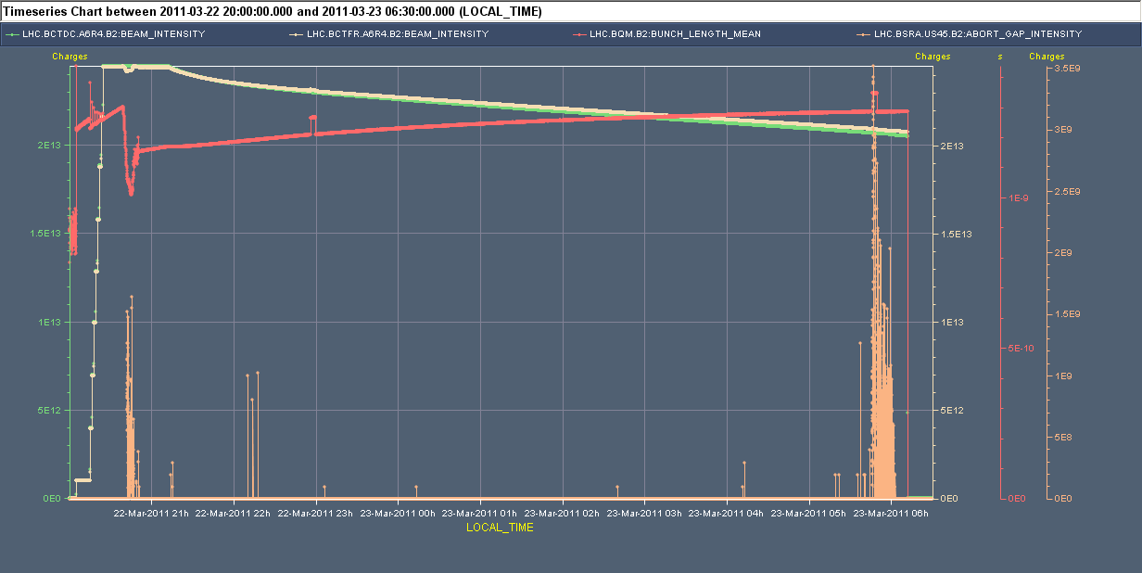
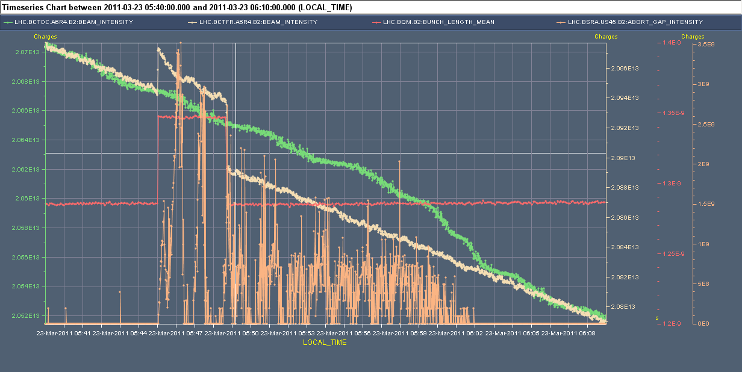
March 22-23
Fill 1645, 200 bunches per ring
2 klystron trips B2 in ~ 9 hours of physics, leading to 1/6 voltage reduction each time (9 MV -> 7.5 MV)
The first trip happens after 2 hours of physics only with bunch length 1.2 ns. The abort gap intensity (orange) is not measurable
The second trip with a 1.3 ns long bunch, after ~ 9 hours of physics create visible loss (FastBct) ~ 3E10 particles lost out of 2E13 or 0.15 % loss.
Also measurable abort gap intensity peaking at 3.5E9. Compared to the 2.1E13 circulating, that is a peak abort gap intensity equal to 0.017 % total intensity.
Observation 2:
Loosing 1/6 voltage towards the end of physics
we loose 0.15 % out of the buckets
resulting in the equivalent 0.017 % peak abort gap intensity

Slide 17
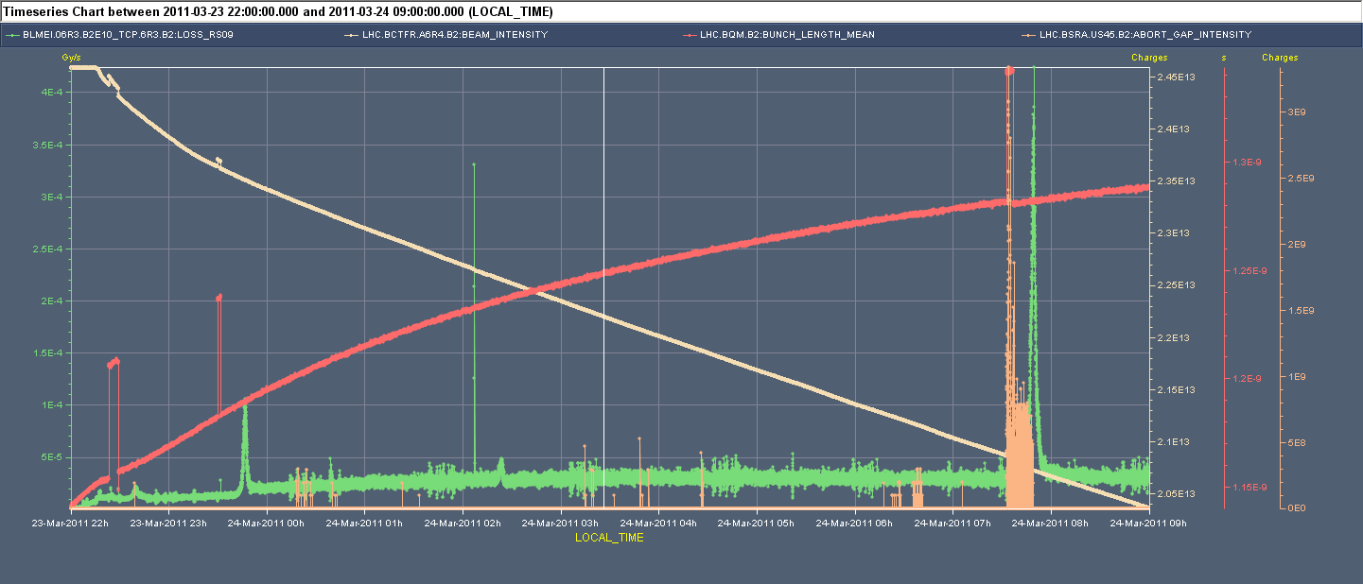
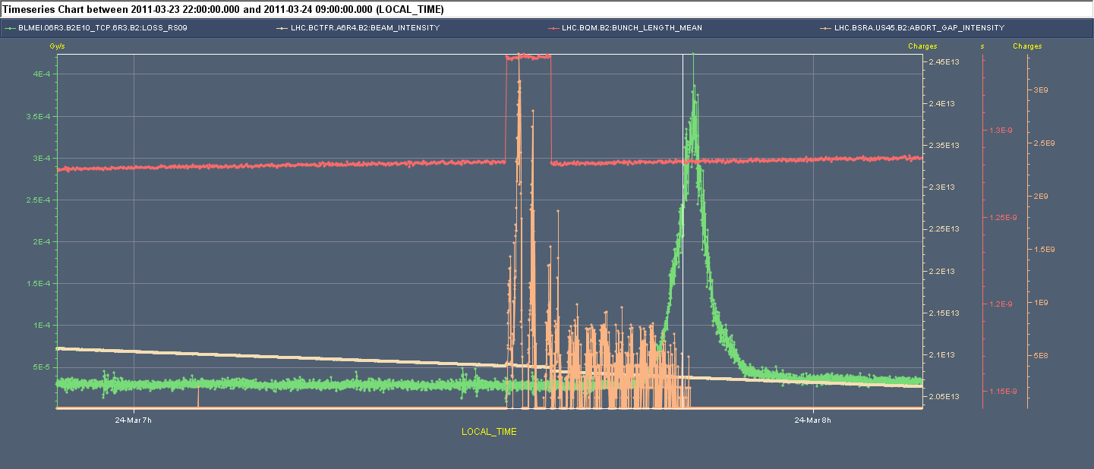
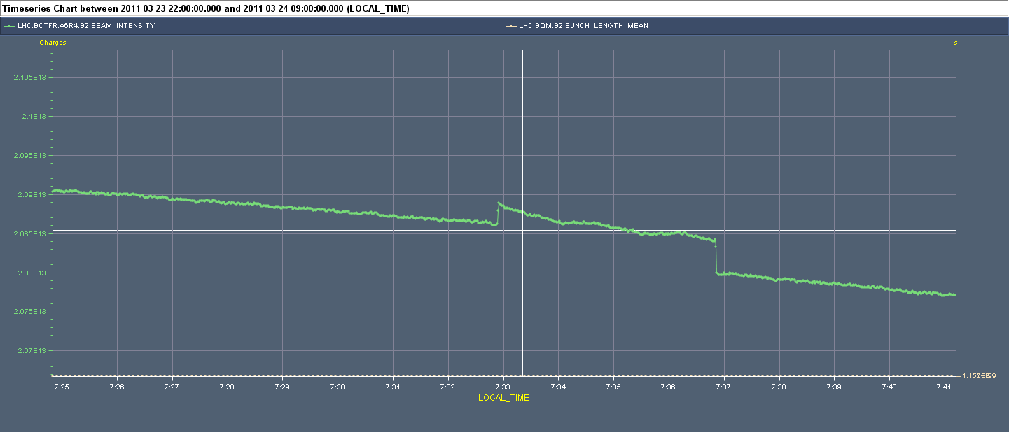
March 23-24.
200 bunches per ring
3 klystron trips B2 in ~ 10 hours of physics, leading to 1/6 voltage reduction each time (9 MV -> 7.5 MV)
The first 2 klystron trips happen at beginning of physics with bunch length 1.16 and 1.17 ns. The abort gap intensity (orange) is not measurable but we see a spike in the BLM in the momentum collimator (BLM_IP3_06.TCP_6R3.B2:LOSS_RS9 in green)
The third trip with a 1.28 ns long bunch, after ~ 8 hours of physics create visible loss (FastBct). ~ 5E10 particles lost out of 2E13 or 0.25 % loss.
Also measurable abort gap intensity peaking at 3.3E9. Compared to the 2.1E13 circulating, that is a peak abort gap intensity equal to 0.45 % total intensity.
Observation 3:
Loosing 1/6 voltage towards the end of physics
we loose 0.25 % out of the buckets
resulting in the equivalent 0.016 % peak abort gap intensity

Slide 18
Summary: Consequences of klystron trip
Loosing 1 out of 6 klystrons at 9 MV, we have observed ~ 0.2 % loss and a peak at < 0.02% total intensity in the abort gap intensity (total 3 microsec)
Calculations are more pessimistic (0.8% loss). This is probably due to a different assumed 2-D distribution in longitudinal phase space. Being studied using bunch profiles during physics
Assuming that the 3.5 TeV dump threshold is at 2E10 total abort gap population (communication J. Uythoven), we can accept tripping a klystron with ~ 1000 circulating bunches
To stand a klystron trip with higher in intensity we could
Just wait… As the bunches will fill the machine more uniformly, the spike in abort-gap-intensity will disappear, bringing the threshold at ~ 1/30 total loss = 0.007 % . This would allow for tripping with nominal LHC intensity! (Not acceptable for the Caivites/Circulators)
Increase the voltage further (12 MV instead of 9 MV) and use all klystrons
Reduce the bunch length to 1 ns
Observations must continue as the intensity is increased. If done parasitically it would be nice to keep the Abort Gap Monitor on a scale that can see a bit below 1E9 p/abort gap, that is the population seen when tripping 1 klystron with ~ 50 nominal bunches

Slide 19
Statistics on klystron trips

Slide 20
Klystrons/Cavity problems over the last 4 weeks
C3B2 was disconnected on March 27th due to a problem preventing to switch the driver back on. This is fixed but this cavity has many problems: Several HOM power interlocks, mainly at higher voltage. “Hard” quench at ~ 2 MV during conditioning. Much more X-rays emitted in operation. All this was already observed in 2010. We will not operate it much above 1.3 MV.
C4B2 has suffered from a series of Arcs in the waveguide, close to the RF Main Coupler. The waveguide is being opened to check the reality of these arcs.
C5B2 was switched off line following a series of interlocks concerning the High Voltage (50 kV). Believed to be caused by a poor HV connector. Investigating now.
C8B2 has been off because its electronics was used to “spy” on C4B1 that showed noisy in 2010 and again in 2011 start-up. C4B1 has been OK since we spy on it. The C4B1 problem most likely rests in one cable that was touched. C8B2 will be back on Thursday.
A few interlocks were not recorded because the Laser alarm system was not configured correctly on the RF side. Solved. Will be checked on Thursday.

Slide 21
Next weeks…

Slide 22
Plans for intensity increase after scrubbing
All cavities both rings
Capture both rings with 6 MV
Ramp to 12 MV, steady 12 MV in Physics
Reduce bunch length to 1 ns?
Discuss with the experiments first.
Design report is σ=75.5 mm or 250 ps @ 7 TeV
That gives a 53 mm Luminous Region σ, close to what is measured.

Slide 23
Thank you for your attention…

