Slide 1
Beam Commissioning after LS2
Global plan
IN WORK
J. Wenninger

Slide 2
Injection commissioning
Sequence
Closed orbit & capture
Ref orbit probe
Coarse collimator
Aperture inj & dump region
Nominal bunch injection
Flat reference orbit
Orbit with bumps and spectrometers
ADT setup
Injection protection validation
Collimator alignment
TDI, TCDI, TCDQ alignment
Injection loss maps
Injection 12b trains
AGK and injection cleaning
Nominal train injection

Slide 3
Ramp squeeze commissioning
Sequence
Ramp probe
11T compensation
Optics at FT
Squeeze commissioning
Linear optics in squeeze
Non-linear optics in squeeze
Ballistic optics
Collisions
Collimator alignment FT
Ramp and squeeze with bumps - probe
Ramp and squeeze with bumps - nominal
Collimator alignment collisions
Cycle loss maps
Optics corrections to collisions

Slide 4
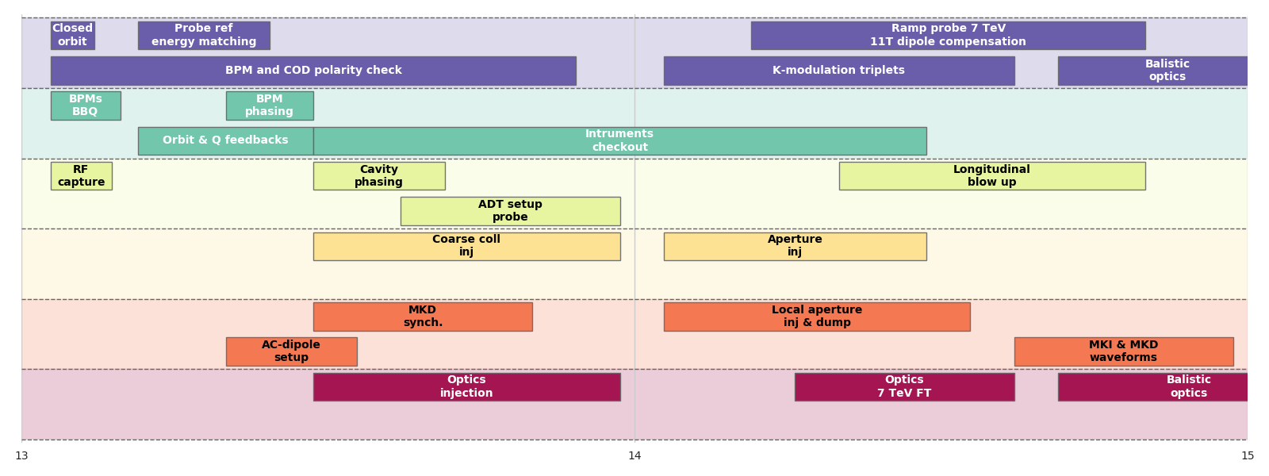
Overview - 2021
Week 1
Week 2
OP
BI
RF
Coll/MPS
Inj/Dump
OMC

Slide 5
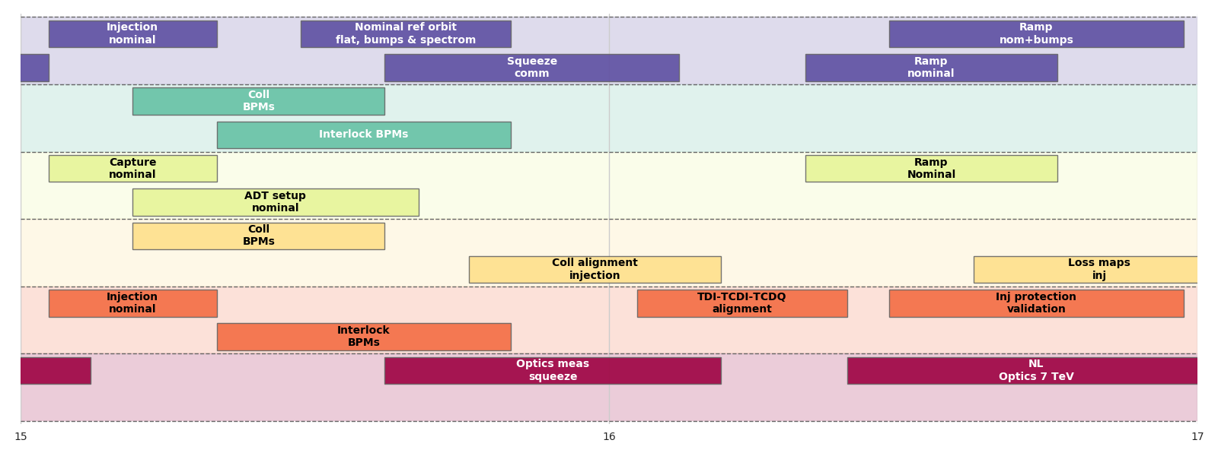
Overview - 2021
Week 3
Week 4
OP
BI
RF
Coll/MPS
Inj/Dump
OMC

Slide 6
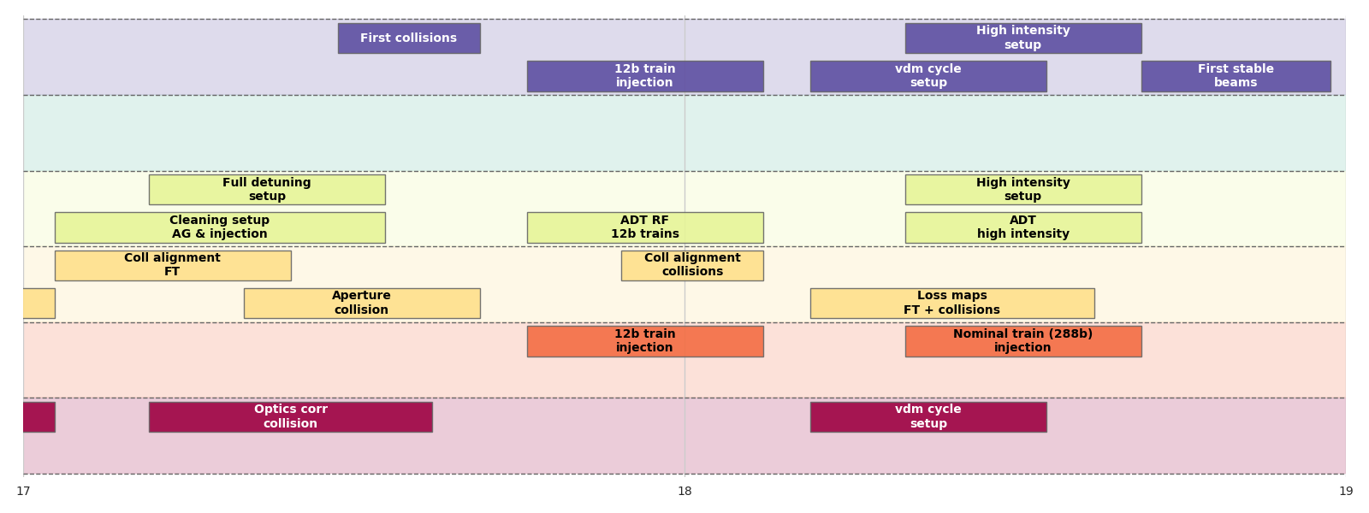
Overview - 2021
Week 5
Week 6
OP
BI
RF
Coll/MPS
Inj/Dump
OMC

Slide 7
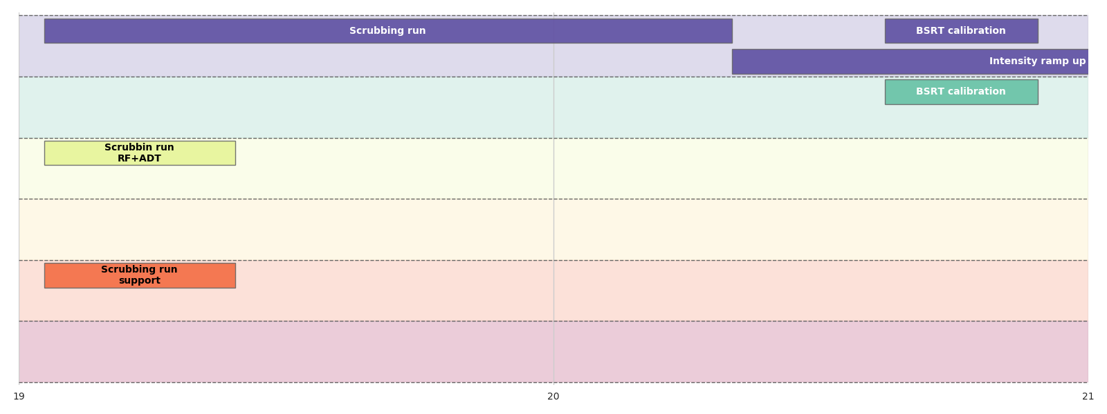
Overview - 2021
Week 7
Week 8
OP
BI
RF
Coll/MPS
Inj/Dump
OMC

Slide 8
Restart after LS1

Slide 9
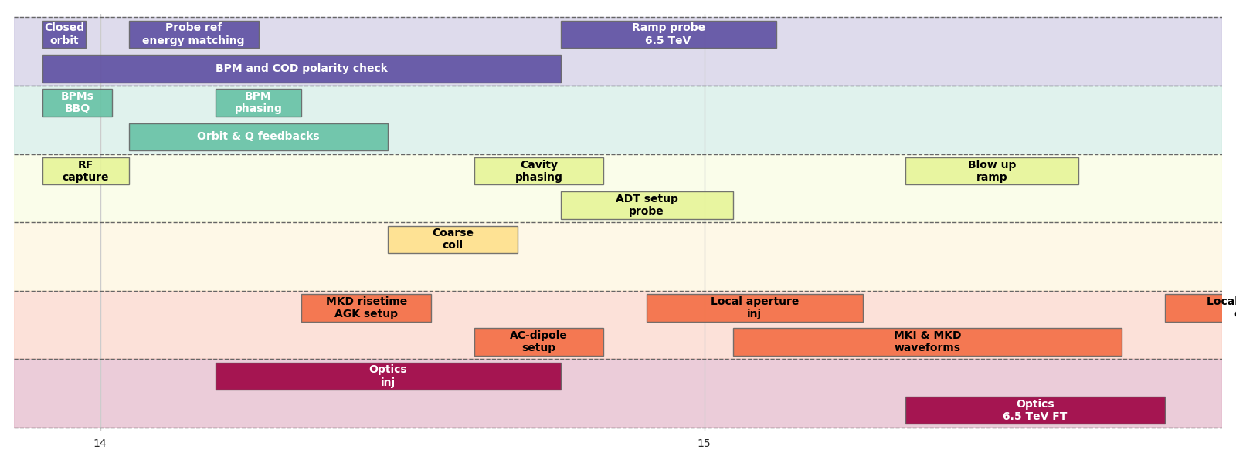
Overview – restart 2015
Week 1
Week 2
OP
BI
RF
Coll/MPS
Inj/Dump
OMC

Slide 10
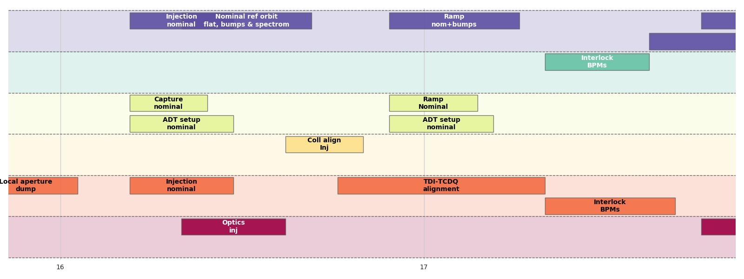
Overview – restart 2015
Week 3
Week 4
OP
BI
RF
Coll/MPS
Inj/Dump
OMC

Slide 11
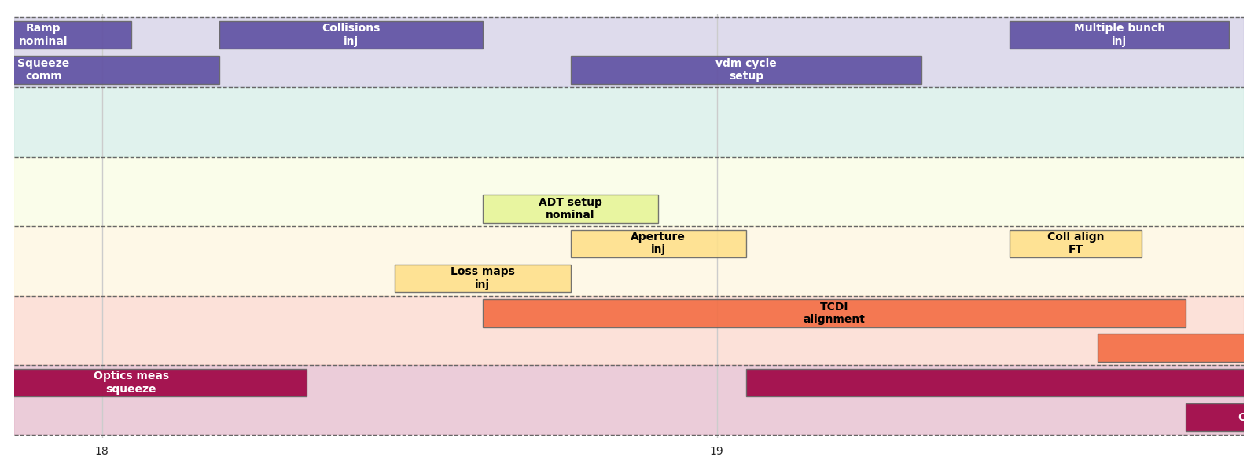
Overview – restart 2015
Week 5
Week 6
OP
BI
RF
Coll/MPS
Inj/Dump
OMC

Slide 12
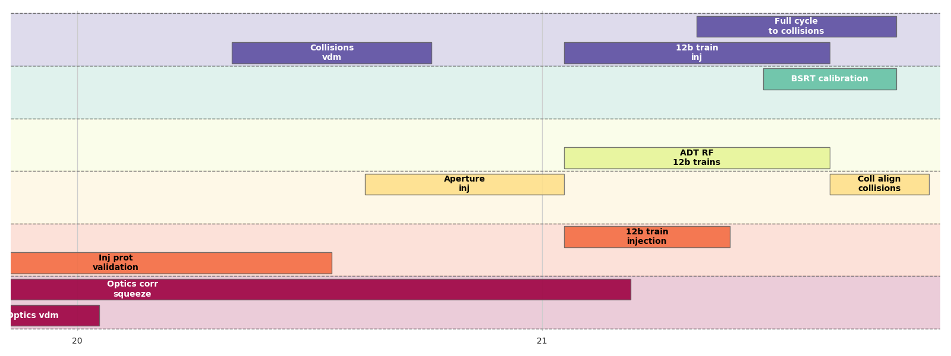
Overview – restart 2015
Week 7
Week 8
OP
BI
RF
Coll/MPS
Inj/Dump
OMC

Slide 13
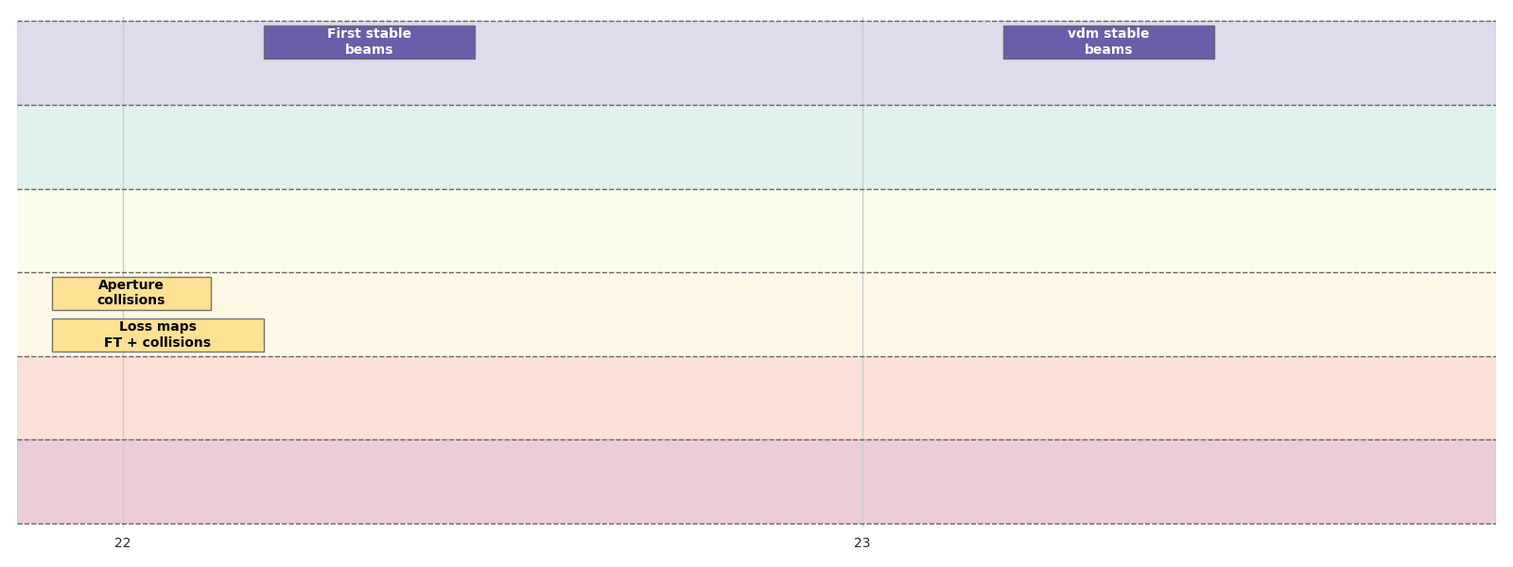
Overview – restart 2015
Week 9
Week 10
OP
BI
RF
Coll/MPS
Inj/Dump
OMC

