Slide 1
ALICE and LHCb
Crossing angle and polarity first aid

Slide 2
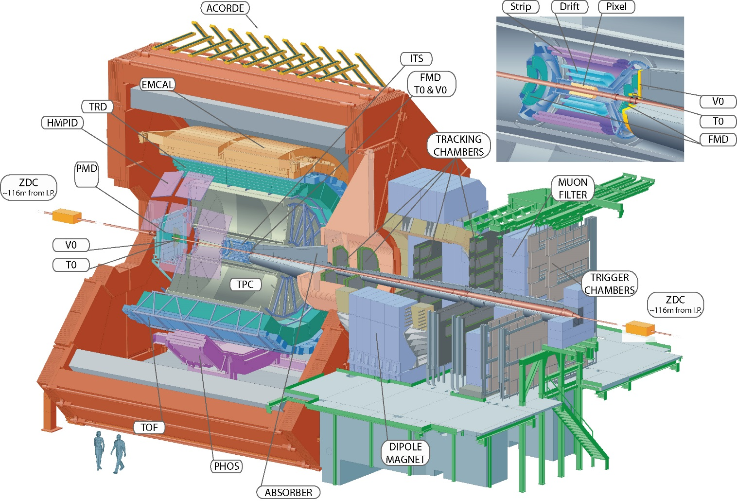
ALICE
ALICE spectrometer and solenoid.
Spectrometer bending in the vertical plane = plane of crossing.
Spectrometer is on the R-side of experiment.

Slide 3
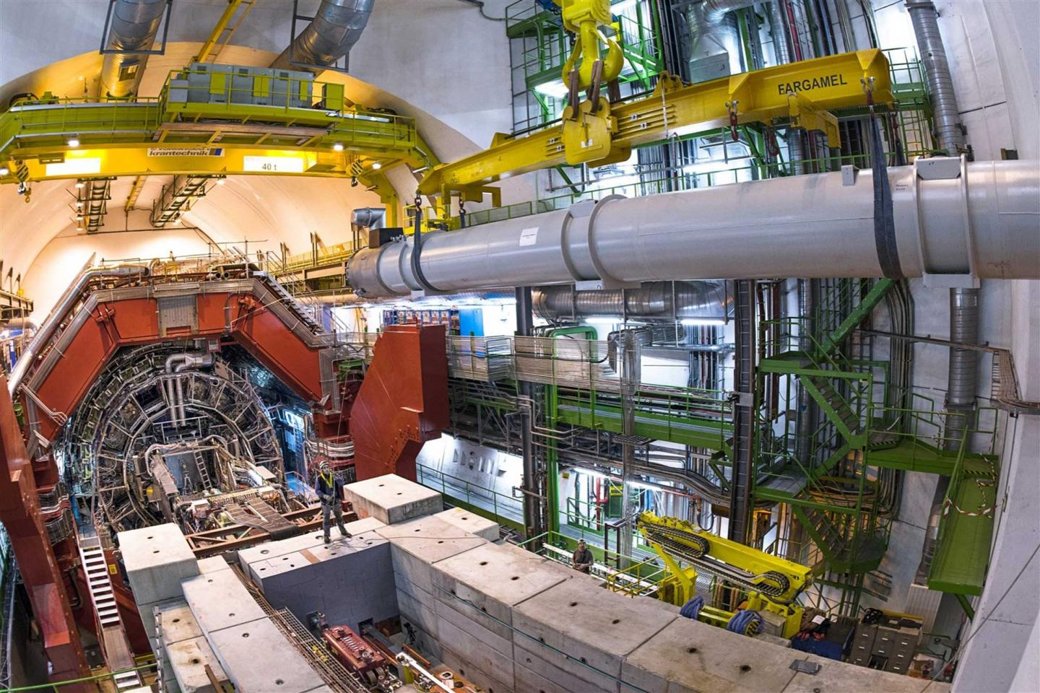
ALICE solenoid
The ALICE solenoid is a normal conducting solenoid with a peak field of ~ 0.5 T @ 30 kA.
Former L3 (@LEP) solenoid.

Slide 4
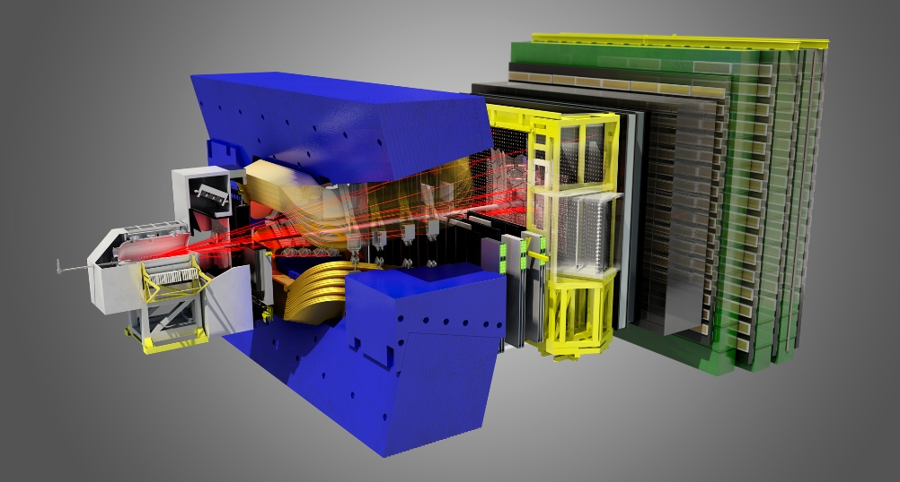
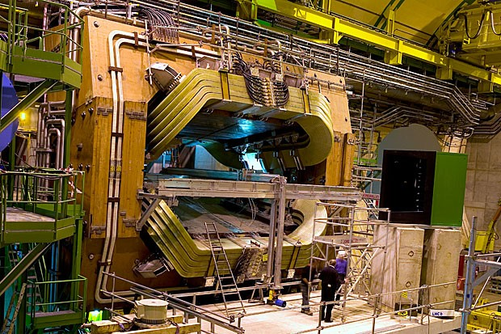
LHCb
Spectrometer dipole installed left of the VELO / IP.
Downstream of IP in B1 direction – R-side of IP.

Slide 5
Spectrometer bumps
The orbit perturbations due to the spectrometer magnets are closed between the IT on the R- and L-sides using 3 NC compensator dipoles.
Closed 4 corrector bump.
No BPM in that region → ‘invisible bump’.
No magnetic element: bumps closed independently of optics and energy.
Ideal case broken (slightly) by ALICE solenoid.
Contrary to initial design assumptions, the spectrometers are not ramped.
This generates very large internal crossing angles (~ mrads) at injection.
At high energy the internal and external crossing angles are of similar magnitude (100’s urad).
Experiment | Spectrometer bump ½ xing angle (μrad) | External bump ½ xing angle (μrad) | energy (GeV)
ALICE | ±1077 | 170 | 450
ALICE | ±75 | 200 | 6500
LHCb | ±2106 | -170 | 450
LHCb | ±146 | -250 | 6500

Slide 6
Polarities and crossing angles
The polarity convention of the spectrometer PCs:
For PC polarity +, the B field points down, see slide 7.
Experiment | PC Polarity | Sign of internal Xing angle
ALICE/LHCb | Positive | Negative*
(*) B1 sign convention.
The superposition of the external and internal xing bumps leads to compensation (opposite signs) or addition (same signs).
External crossing angles are + for ALICE (flexible) and – for LHCb (fixed – H plane constraints, interference with separation scheme).
External Xing | Polarity | Internal Xing | Net effect
Positive | Positive | Negative | Compensation
Negative | Positive | Negative | Addition
Positive | Negative | Positive | Addition
Negative | Negative | Positive | Compensation

Slide 7
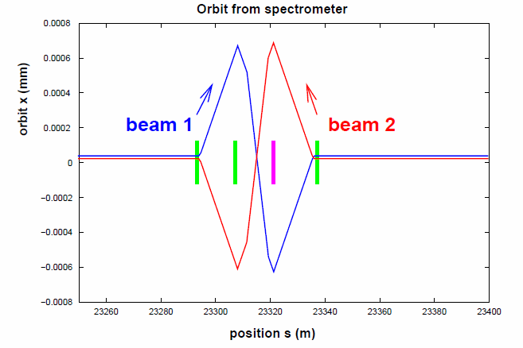
LHCb
Spectrometer
Example of the LHCb spectrometer bump corresponding to:
NEGATIVE internal Xing angle (B1 moving inwards),
POSITIVE spectrometer kick (B1 kicked outwards),
POSITIVE spectrometer PC POLARITY.
B field points down.

Slide 8
Polarity and settings
The nominal settings of the PCs are:
ALICE spectrometer: 6’000 A,
ALICE solenoid: 30’000 A,
LHCb spectrometer: 5’850 A.
The spectrometer and compensator settings are combined into 2 knobs that correspond to 4 corrector bumps.
Knobs:
LHCBEAM/IP2-ALICE-V-MURAD – value = 1077
LHCBEAM/IP8-LHCB-H-MURAD – value = 2106
Corrections are added to knobs to close the spectrometer bumps based on beam measurements – in the absence of solenoid for the case of ALICE.
Corrections of few microrads on outer compensators.
It is not possible to ramp up the bumps with beam in the machine – the TFs of the spectrometer have too large errors (not known !!) at intermediate settings.
For LHCb there is no magnetic element within the bump, closure does not depend on optics or energy (no ramp !).
But for ALICE the solenoid breaks the closure slightly.
~ vanishes at high energy due to 1/E scaling.

Slide 9
Flipping polarity
Both ALICE and LHCb like to flip polarity from time to time…
Systematic error control.
Due to overlap with external crossing angle, the two polarity configuration are actually different – not the same effective crossing angle (int + ext).
For Run 2 we use a scheme to operate the spectrometer for both polarities without flipping the external crossing angles (not even possible for LHCb due to H plane) proposed by S. Fartoukh.
The separation is increased to ±3.5 mm (from the default ±2 mm) at injection.
An IP angle bump of -40 μrad is added in the separation plane to optimize the aperture.
For LHCb this scheme renders polarity flips transparent for operation.
But still possible impact on beam dynamics due to different LR separations.
For ALICE this scheme would render polarity flips transparent in the absence of the solenoid.

Slide 10
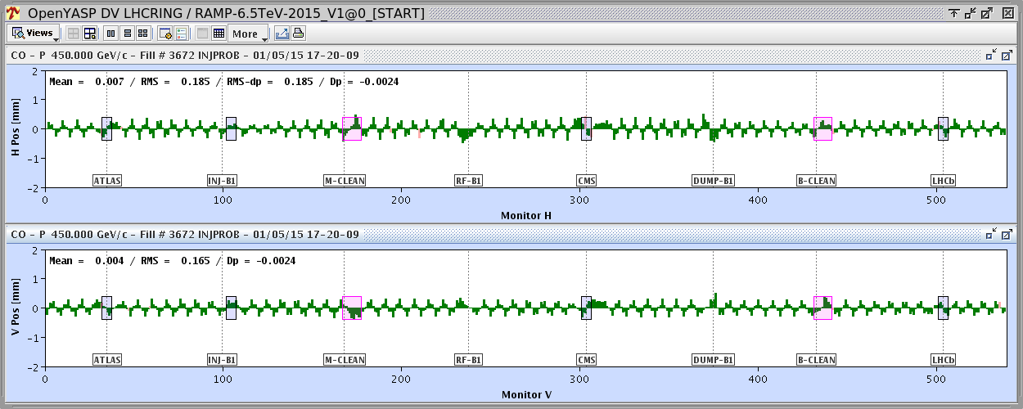
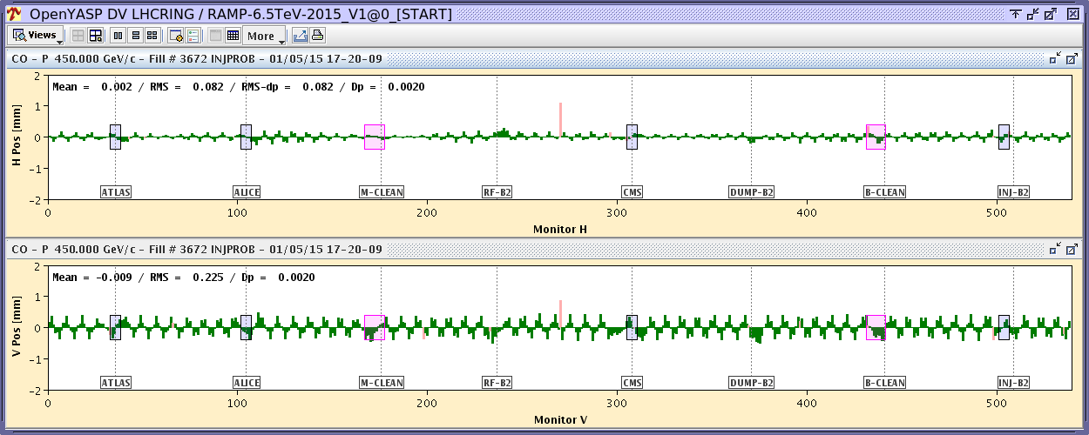
ALICE solenoid ramp
Orbit change during the ramp up of the ALICE solenoid to 30 kA for positive polarity and external crossing bump of -170 μrad (B1).
Correction should be as local as possible.
r.m.s. orbit change ~0.2 mm

Slide 11
ALICE solenoid
The solenoid:
couples the vertical spectrometer bump into the horizontal plane where a kick appears at the IP,
uncloses the vertical bump, again by a kick at the IP.
The impact of the solenoid ~ vanishes at high energy, mainly relevant at injection (and during injection).
In the horizontal plane the only solution is to correct the orbit locally with the MCBX and IR CODs.
Packaged into a knob based on an empirical correction.
In the vertical plane there are 2 solutions:
Correction with MBCX and IR CODs – similar to H plane.
Re-matching / empirical closure of the spectrometer knob with compensator magnets → completely local, function of polarity and external angle.
This requires however to ramp the compensator magnets. Possible, but not done currently.
Empirical corrections with MCBX/IR CODs is the currently used solution for both planes.
Correction is packaged into a knob that is taken out in the ramp.

