Slide 1
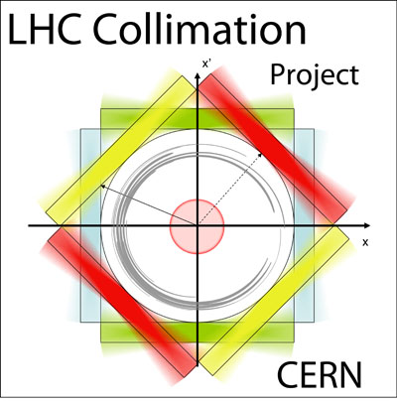
Improving Collimator Setup Efficiency
G. Valentino,
R.W. Assmann, R. Bruce, F. Burkart,
M. Cauchi, D. Deboy, S. Redaelli, A. Rossi,
D. Wollmann.
LHC Beam Operation Committee, 17.05.2011
Notes:
1

Slide 2
Acknowledgements
Collimation Team: R. Assmann, R. Bruce, F. Burkart, M. Cauchi, D. Deboy, A. Rossi, D. Wollmann.
BE/OP: A. Macpherson, S. Redaelli, E. Veyrunes
University of Malta: N. Sammut

Slide 3
Outline
Introduction
LHC collimation system setup method
Summary of collimation setups performed in 2011
Collimator Setup in 2011
Collimator Control software in 2010
Modifications to the software for 2011
Comparison of Collimator Setup Performance in 2010 and 2011
Measured beam size and gap offsets
Time required for collimator setup
Conclusions and Future Work

Slide 4
Collimator Setup Procedure
1
Reference collimator
Collimator i
2
Reference collimator
Collimator i
BLM
BLM
Beam
Beam
3
Reference collimator
Collimator i
Define beam edge by hor, ver or skew reference collimator
Center collimator i
Re-center reference collimator Beam size:
Open collimator to
BLM
Beam
Collimator i
4
Reference collimator
BLM
Beam
D. Wollmann

Slide 5
Collimator Setups Performed
Injection (450 GeV): 25/02/2011 – 01/03/2011
86 collimators
3.5 TeV Flat Top: 06/03/2011 – 08/03/2011
80 collimators
3.5 TeV after squeeze to beta* 1.5m / 10m / 1.5m / 1.5m: 11/03/2011
16 collimators
3.5 TeV during collisions: 11/03/2011
16 collimators

Slide 6
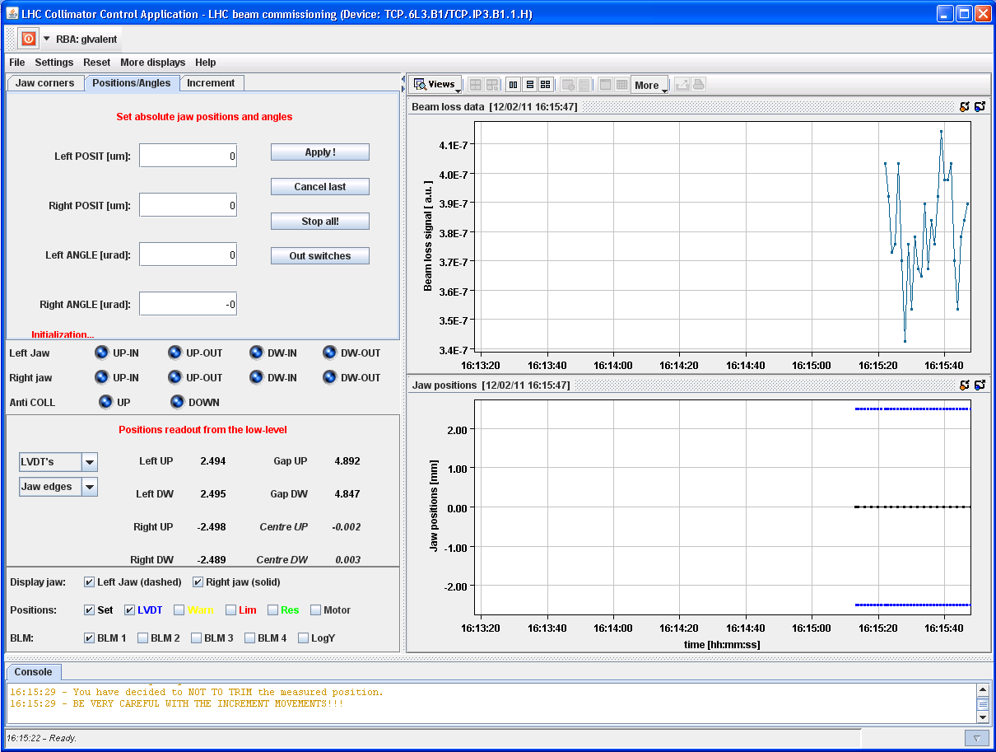
Collimator Control Application in 2010
Increment Jaw Position by clicking Apply!
BLM Signal Chart (1 Hz, 1.3 sec running sum)
Collimator Motor Positions Chart (1 Hz)
S. Redaelli

Slide 7
Collimator Setup in 2011
Modifications to original application from S. Redaelli done by G. Valentino, with input from R. Assmann, R. Bruce, S. Redaelli, and D. Wollmann.
Main goals:
Guarantee high quality of setup (independent of user)
Reduce risk for human errors during the setup (unnecessary beam dumps)
Optimize total setup time
Reduce stress on users

Slide 8
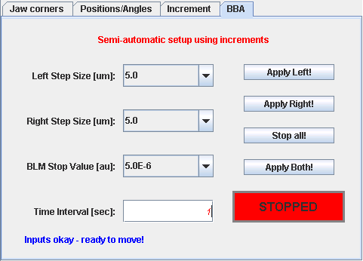
Semi-Automatic Feature
Introduction of a semi-automatic feature:
Automatic step-wise movement of collimator jaws (can choose from 5 – 100 µm steps)
The software automatically moves in the collimator until the resulting BLM signal exceeds a user-defined threshold.

Slide 9
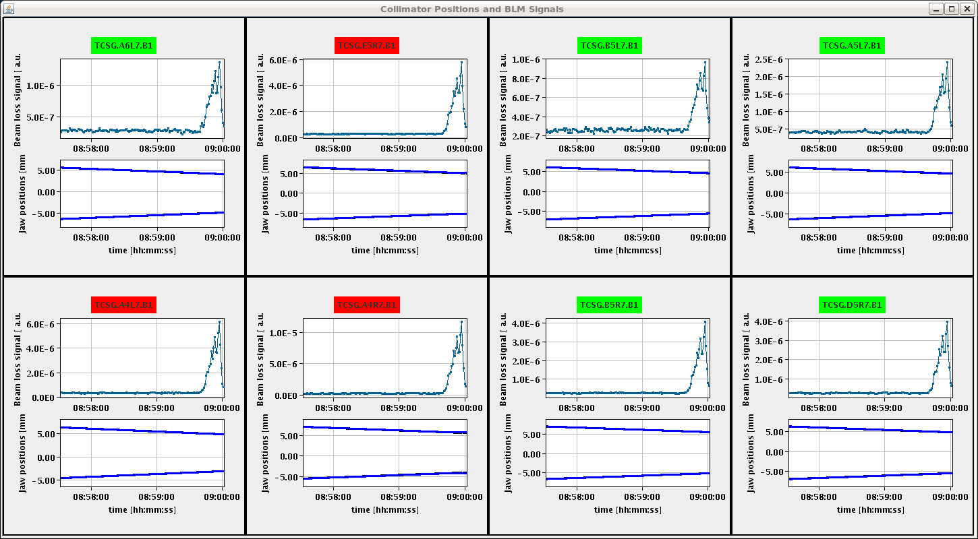
Initialization Procedure
Move collimators in parallel to the beam by class (TCSG, TCLA, TCT) and plane
Limitation: Multiple Collimators stop moving!

Slide 10
Setup Procedure
Setup each collimator in sequence (define reference edge using TCP in plane)
Threshold
Interesting:
See 40s decay of loss spike!
Fine adjustment after initialization
Automatic stop after crossing BLM threshold
D. Wollmann

Slide 11
Automatic Logging of Setup Data
Automatically log collimator setup data to file
All user-generated events (initialization procedure, collimator movements) are saved
No need for manual filling in of excel sheets

Slide 12
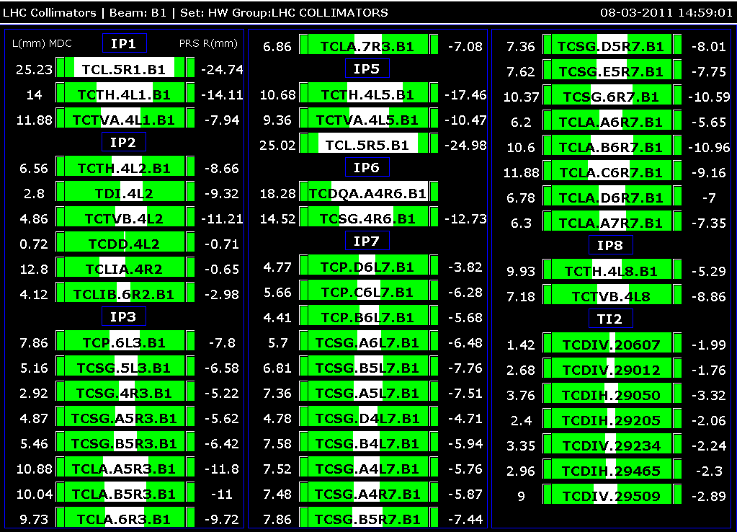
Collimation Vistar
Improved Collimator fixed status display (available in the CCC and online)
Modifications of the collimator status display by E. Veyrunes and S. Redaelli done by G. Valentino with input from collimation team and BE/OP
Left Jaw Position in mm
PRS
status
Right Jaw Position in mm
MDC status
Jaw Gap shown to scale

Slide 13
Difference in Beam Offset: B1 2010 and 2011

Slide 14
Difference in Beam Offset: B2 2010 and 2011

Slide 15
Beam Size Ratio: 450 GeV B1 2010 vs 2011
2010 Average: 1.20
2010 Std Dev: 0.28
2011 Average: 1.10
2011 Std Dev: 0.11
TCLA.B5R3.B1
TCSG.B5R3.B1
TCSG.5L3.B1
TCSG.A5R3.B1
TCSG.4R3.B1
TCSG.B5R3.B1
TCP.6L3.B1
σ_{meas.} / σ_{nominal}

Slide 16
Beam Size Ratio: 450 GeV B2 2010 vs 2011
2010 Average: 1.13
2010 Std Dev: 0.24
2011 Average: 1.10
2011 Std Dev: 0.18
TCP.6R3.B2
TCSG.A5L3.B2
TCSG.A5L3.B2
TCSG.B5L3.B2
σ_{meas.} / σ_{nominal}

Slide 17
Beam Size Ratio: 3.5 TeV B1 2010 vs 2011
2010 Average: 1.21
2010 Std Dev: 0.22
2011 Average: 1.22
2011 Std Dev: 0.24
Tilt in TCLA.A7R7.B1
Tilt in TCTH.4L2.B1
σ_{meas.} / σ_{nominal}

Slide 18
Beam Size Ratio: 3.5 TeV B2 2010 vs 2011
2010 Average: 1.10
2010 Std Dev: 0.24
2011 Average: 1.12
2011 Std Dev: 0.24
Tilt in TCSG.A5L3.B2
σ_{meas.} / σ_{nominal}

Slide 19
Collimator Setup Time Comparison
The time taken to set up collimators is the most important indicator of the efficiency of a set up algorithm.
Data from the logbook cross-checked with Timber.
Average Time per Collimator = Time used for set up / Number of collimators
Total Shift Time = Time used for setup + Time taken to get the LHC back to the operating point in case of a beam dump*.
* For 2010, these values were taken from S. Redaelli’s Chamonix 2011 talk on “Optimization of the Nominal Cycle”.

Slide 20
Collimator Setup Time Comparison
2010:
2011:
Date | Setup Type | Avg Time / collimator (mins) | Total Shift time (hrs) | #beam dumps
05 – 07 May | 450 GeV | 5.34 | 8.35 | 1
12 – 16 Jun | 3.5 TeV flat top | 9.35 | 27.27 | 4
17 Jun | 3.5 TeV squeeze | 10.8 | 8.26 | 1
20 Jun | 3.5 TeV collisions | 10.8 | 8.48 | 1
Human Error:
Jaws moved in based on rough idea of the orbit
Date | Setup Type | Avg Time / collimator (mins) | Total Shift time (hrs) | #beam dumps
25 Feb - 1 Mar | 450 GeV | 12 | 18.52 | 2
6 –8 Mar | 3.5 TeV flat top | 13 | 17.77 | 0
11 Mar | 3.5 TeV squeeze | 5.5 | 2 | 0
11 Mar | 3.5 TeV collisions | 3.6 | 1.33 | 0

Slide 21
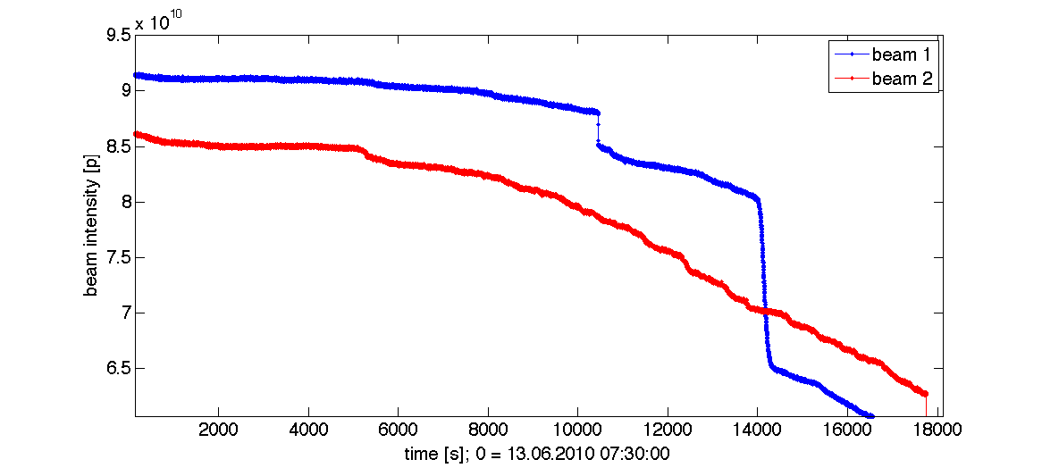
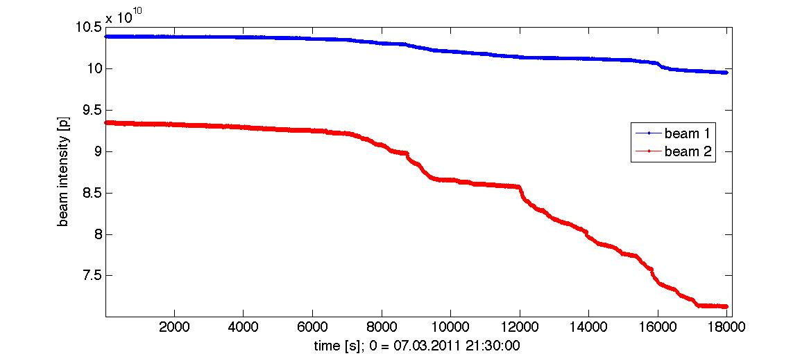
Beam Intensity at 3.5 TeV, 2010 vs 2011
2010: Rapid decrease in beam intensity during setup
2011: Gentle shaving of the beam

Slide 22
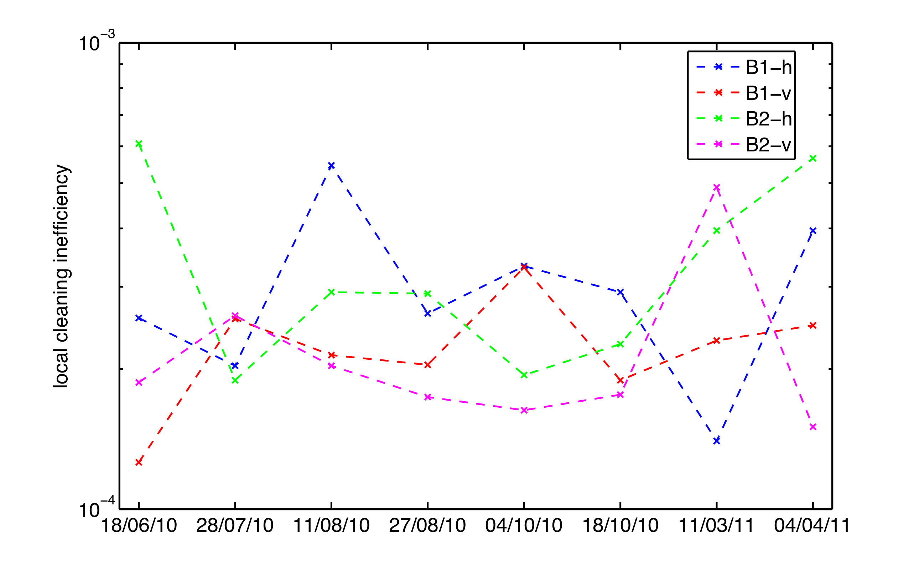
Change of β-tron local cleaning inefficiency (3.5 TeV, 1.3s integration)
D. Wollmann

Slide 23
Conclusions
New semi-automatic collimator setup tool works.
Quality of collimator setup compares well with last year.
Improvement by factor ~1.5 in setup time at flat top.
Improvement by factor ~5 in setup times for after squeeze and collisions.
No dumps with new software.
Ongoing work to improve the system, particularly setup time per collimator.

Slide 24
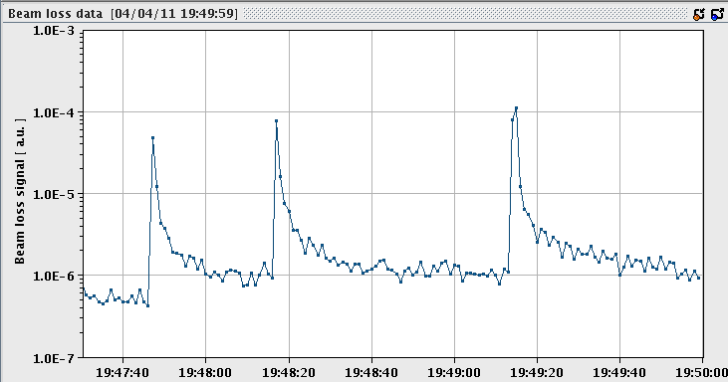
Future Work: 30 Hz BLM Signal
Next year: 30 Hz BLM signal should increase the setup speed further.
How can we exploit this as much as possible?
This is related to ongoing work by F. Burkart on halo population studies.
40 seconds loss decay

Slide 25
Other Future Work
Identify automatically the collimator causing the loss signal during setup.
Dynamic variation of step size, possibly helped by also obtaining feedback from other BLM running sums and other BLM locations.
“Real-time” BLM signal loss simulator to test future setup algorithms.
LHC MD time requested for testing new algorithms.

Slide 26
END

