Slide 1
Problems after the last technical stop
Mike Lamont
Culled from the logbook

Slide 2
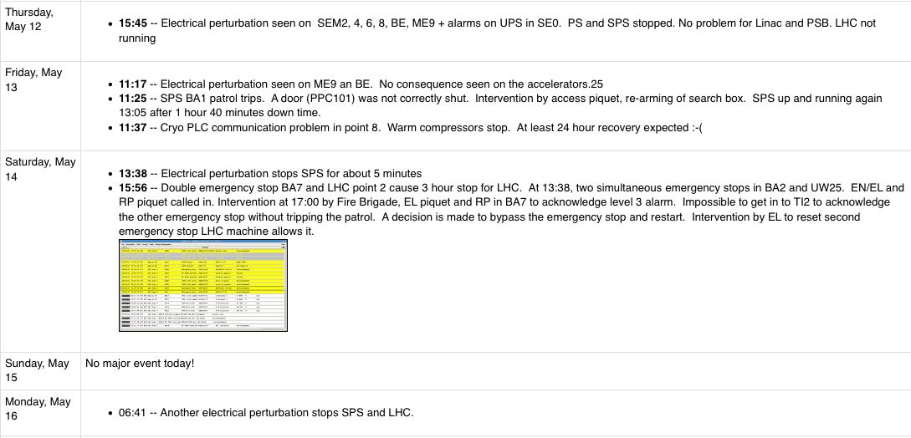
Not TS related
Cryogenics: Schneider PLC crash – warm compressor (26 hours lost)
Lost sectors 12 and 23 – AUG TI2 : First USR_PERMIT change: Ch 14-FMCM_RBXWTV.L2

Slide 3
Not TS related
HTS quench RD3.LR4
Temperature measurement problem… indirectly invoked following technical stop
Interlock on TCLIB.6R2.B1.
Alessandro Masi found a broken sensor, it would dump at random - disabled it
LDBS faulty power trigger power supply*2
After installation of some Siemens software on the access console CWO-CCC-D8WS we finally managed to connect to the WInCC machine "cwe-cce-pc2" to see the status of the LBDS-B1.

Slide 4
RF
Synchro loop way off on first injection – needed recalibration
B2 capture: remove 2 buckets in bucketOffsetRing2 (RF SYNCHRO system), re-adjust injection phase @ -220 deg B1 capture: remove 2 buckets in bucketOffsetRing1 and re-adjust inj phase to -230 deg
Who can fathom the actions of the dark wizards from the kingdom of the RF?

Slide 5
Knock-on
QPS updates – not fully successful – lost quench loop S23
A relay on a QPS card was broken. It happens.
RF conditioning not finished – cryogenics availability
DFB level adjustment (CM loss during manipulation)
The ion pumps are switched off around the LHCb Velo.
Default vacuum configuration?
We can't load the precycle for the RD34 because the PLEP acceleration is set to 1 whereas the limit is 0.5.
Shouldn’t we be setting these to database values at some point
Closing the LHC has the whole RF trip to power ready / LL off, as usual.
Access system logic?

Slide 6
Debugging the ensemble…
FBCT,
Noise?
BCTFR for XPOC is ok again after Lars did a power off reboot of the BCTFR
IQC
We called Lene to investigate the problem of wrong bucket on the IQC and she checked with Denis.
Apparently, something was changed in the database during the TS and things have been messed up. He is working on that.

Slide 7
Handshakes
Problem with DIP/handshake. TI2/8 setup out of comm, cannot start normal injection handshake. Tried to restart CMW-DIP-LHC-EXP on cmw 1, no effect. Also CMW-DIP-EXP-PROXY, no effect. Tried many others, cannot get comm back. In the meanwhile the injection handshake seems to be running - even if slowly. Masking ALICE_HSH_TI2_OFF and LHCB_HSH_TI8_OFF in SIS
The injection handshake parameters that had to be masked in SIS and that had also been lost for the handshake this morning are back to normal. It seems that during the TS, the parameters were accidentally changed (from 'i' to 'I' in 'Ti2' and 'Ti8').
A capital offence

Slide 8
Feedbacks
Ralph Steinhagen
Updated OFC, as announced earlier the new version includes: 1) Tune-FB 'off', if the dQ/dt stability exceeds 0.005 frev/s for more than 10 seconds (rejects noise that would trip the QPS). 2) Tune-FB 'off', if the Q FB reference is outside the tune fitter range (catches BQBBQLHC vs. OFSU synchronization errors) 3) the 'Reset's switches also to the default orbit and tune response matrices (mitigates MD effect of mysterious left-in optics) Both Tune- and Orbit-FB should be checked w.r.t. closed-loop convergence (via LSA COD, tune trims) before starting the next ramp.

Slide 9
Orbit feedback controller
Tested new OFC sanity checks (see yesterday's entry for details): Presently the thresholds are set very conservatively but could/will be tightened in case of problems. Validated Tune-FB and Orbit-FB responses, good for ramping..
RS to re-modify the OFC because there was a 'mismatch' with the FEC version for the BBQ. He had to disable the automatic switch off when the Q reference is not inside the tune fitter window because the FEC version is not updated. OFC restarted.
Clearly announced
Testing’s good
Version control/compatibility is good too

Slide 10
Tune feedback
Feedback display keeps crashing
Feedback off in ramp, not noticed, went through squeeze with QFB off (pilots – so no problem)
Long standing non-critical bug – to be fixed
QFB check in sequencer on flat-top?

Slide 11
SPS set-up
Prepared for injection of 50 ns beams. The injectors had to re-establish beam quality. Many parameters had changed. The scraping and trajectory were not optimum either yet. Dumped the beams immediately at the first 12 bunch injection.
Steered the lines and adjusted the scraping. Injection is good now up to 72 bunches.
HiRadMat
Oscillation down the line in H, TI 2. Same corrector... MCIAH.20804 -10.04
Give the injectors plenty of warning – don’t assume beam quality after a stop…
Magnetic history/powering strategy at start of line

Slide 12
ADT
The rest of the night we spent figuring out the problem with beam 1 36 bunch injection.
We lost each time after a couple of 100 ms. Only one out of 4 BPMs in point 6 triggered in the vertical plane. But it had not triggered for 12 bunches.
We suspected a problem with this pickup. It was the same which had had problems with the bunch count before.
The damper had been driving beam 1 V unstable. The fine delay settings had been lost during the technical stop.
Expert settings not persisted.
Stick them in LSA and check

Slide 13
XPOC
XPOC
Expert reset required every time – vacuum readings & filling pattern
Very frustrating for OP and disturbing for LBDS team
Changes in PM?
Untested changes?
Slow reaction to problem…

Slide 14
FIDEL
Fidel:
Chromaticities - not very stable.
Stable being a relative term
"calculate Fidel ramp settings" did not prepare b3 correctly in the ramp function. Manual incorporation required
Bug in ‘prepare ramp’
Model coefficients to be checked – powering history now taken in account

Slide 15
Usual stuff
N times (CMW) is down or unreachable
Crate show green in Diamond

Slide 16
Scheduling
Planning special physics runs in the weekend after a technical stop is probably not the best idea
Fully debug machine before trying anything clever.
Plan for re-optimization in injectors
Plan for re-optimization/checks of transfer and injection

Slide 17
Conclusions
Lot of “transparent” changes taking place
There are holes in settings management
De-bugging and testing is unavoidable, necessary and to a certain extent desirable:
Fully justifies slow ramp back up in intensity
Pilots, 2*nominal, 50, 200….
Don’t blame normal acts of gods and the machinations of the RF dark wizards on the technical stop

