Slide 1
Frequency characteristics of
damper versus growth rates
450 GeV – part 1
W. Hofle
Acknowledgements:
N. Mounet, E. Metral, D. Valuch

Slide 2
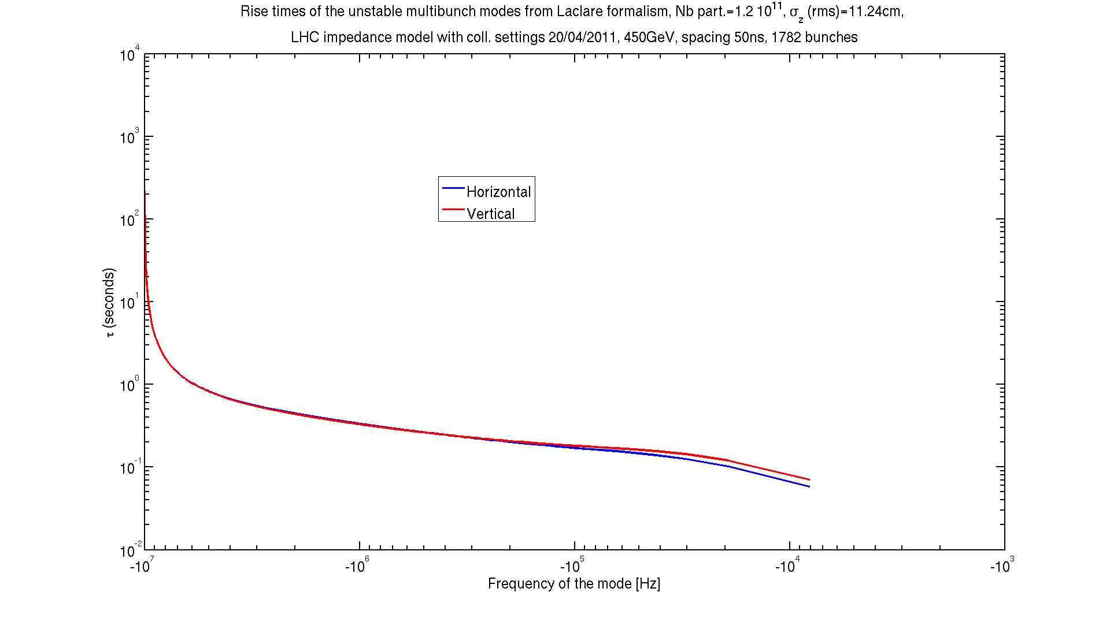
Rise-times computed for full machine @50 ns bunch spacing
10 MHz
N. Mounet

Slide 3
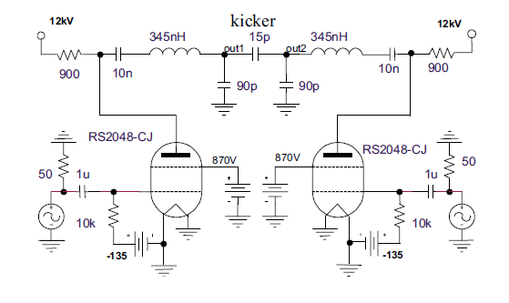
Damper gain versus frequency (1)
Capacitances and resistor determine 3 dB point
power amplifier / kicker simplified model, PAC 2001
detailed simulations see LHC Project-Note-259, 2001

Slide 4
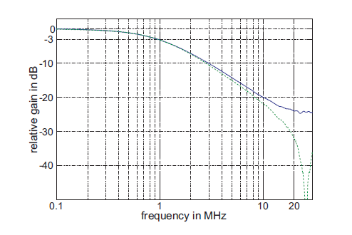
Damper gain versus frequency (2)
1-pole roll-off at 1 MHz, with phase compensated by a digital filter
30% less gain at 1 MHz than at 3 kHz …
some tuning of phase compensation needed when we go to 25 ns spacing, i.e. → 20 MHz
quality of compensation of cable losses by analog filter recently checked (D. Valuch)
further checks can be done in next technical stop, no surprises expected
kick @ 10 MHz,
10% left
measured on power amplifier
(blue curve on kicker,
green on anode of tetrode)
LHC-PROJECT-REPORT-1148

Slide 5
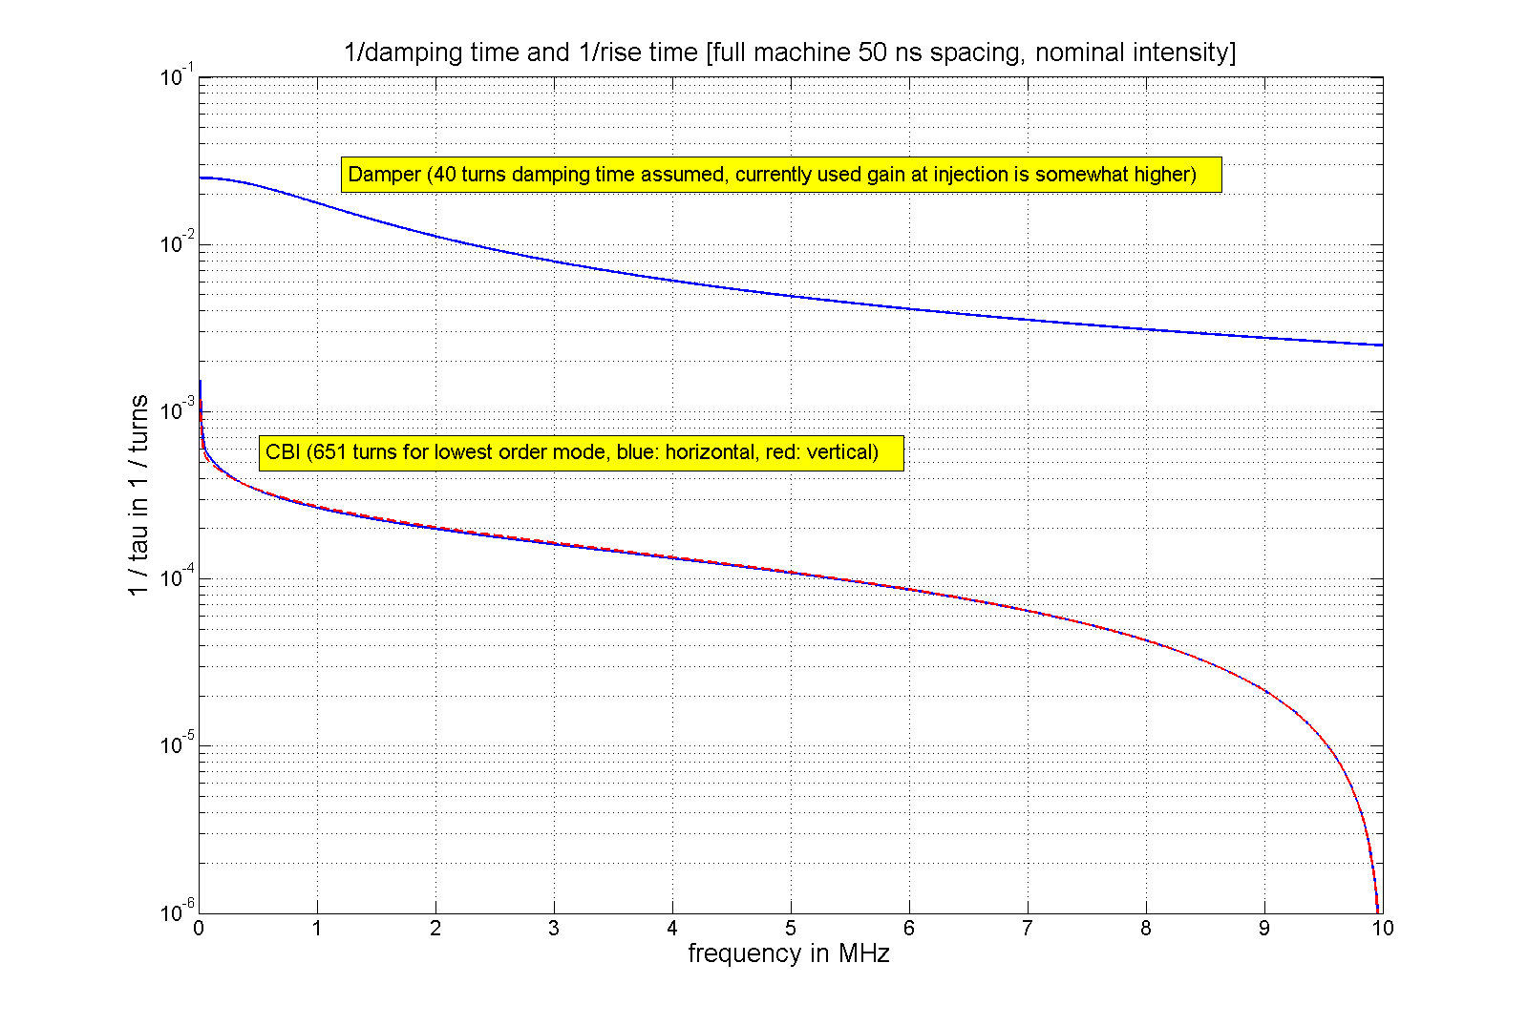
40 turns, 1/40 = 0.025

Slide 6
Conclusions (450 GeV)
sufficient damper gain available at 450 GeV to damp all coupled bunch dipole modes
growth-rate of instabilities has zero @10 MHz (half bunch repetition frequency)
should we put a notch here for the damper gain, too ?
computed growth rates do not support increase of “damper gain versus frequency”
concerning observation: individual bunches seem to be not stable sometimes:
→ here a flat gain of the damper with frequency might help,
but the implementation is only possible at an expense of signal/noise ratio possible
should we pursue this in a test/MD ?

