Slide 1
LHC Longitudinal Blow-up
Acknowledgments to:
T. Mastoridis
for the analysis of the many bunch profiles and for preparing the corresponding slides
M. Jaussi
for the quick modifications to the RF Controls involved in the blow-up
D. Jacquet
for the RF functions needed for the blow-up
LHC Longitudinal Blow-up
Reported by P. Baudrenghien CERN-BE-RF

Slide 2
Longitudinal blow up, why
Longitudinal blow up, how
Performances
Improvements

Slide 3
Longitudinal blow-up. Why?

Slide 4
Single-bunch longitudinal stability
Broadband stability criteria
The RHS is proportional to
Without blow-up the threshold quickly decreases during the acceleration ramp
With a blow-up that keeps bunch length constant (for example), the threshold increases linearly with the RF voltage
See: E. Shaposhnikova, Longitudinal Beam Parameters during acceleration in the LHC, LHC Project Note 242, Dec 2000

Slide 5
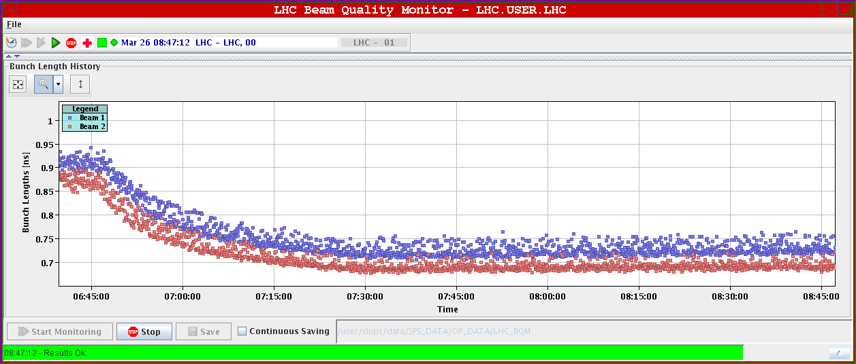
Winter 2010. Ramping pilot without blow-up
March 26th 2010: Single bunch pilot in both rings, ~ 0.2 eVs. 8 MV at injection (f_{s0}=65.3 Hz), increased to 12 MV before ramp (f_{s0}=80 Hz), constant 12 MV during acceleration ramp (f_{s0}= 28.9 Hz @ 3.5 TeV) . BQM was not calibrated.

Slide 6
Ramping nominal bunch intensity without blow-up
Inject 1.1E11, 1.2-1.3 ns long, 0.3-0.4 eVs
Capture with 5 MV (matched voltage ~ 3 MV)
Raise voltage to 8 MV before start ramp. Ramp with constant 8 MV
Very unstable. The bunch shrinks down to < 0.5 ns and we lose Landau damping
May 15th2010. First attempt to ramp nominal intensity single bunch. Bunch length during ramp. The longitudinal emittance is too low (<0.4 eVs). The bunch becomes unstable

Slide 7
Longitudinal blow-up. How?

Slide 8
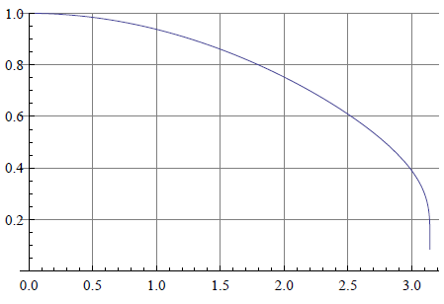
Longitudinal emittance blow up
Phase noise spectrum
Inspired from the method used in the SPS (see reference below)
We apply Phase noise in the cavity field
We use a Rectangular Phase Noise Power Spectral density that excites only the core
hit: 6/7 f_{s} < f < 1.1 f_{s}
corresponds to a 1.20 ns window in the core
and follow f_{s} along the ramp
from Hz to Hz
Algorithm to adjust the amplitude of the excitation x_{n} from a measurement of the instantaneous bunch length (mean) L_{n} and comparison to target L₀
Target bunch length L₀ originally set at 1.2 ns
Part of the bunch excited
J. Tuckmantel et al., Study of Controlled Longitudinal Emittance Blow-up for High Intensity LHC beams in the Cern SPS, EPAC 08, Genoa

Slide 9
Functions
Excitation spectrum, algorithm gain and target length are functions in the ramp
Synchrotron freq plus lower and upper frequency limits of the flat noise PSD
Algorithm gain g during ramp
Target bunch length during ramp

Slide 10
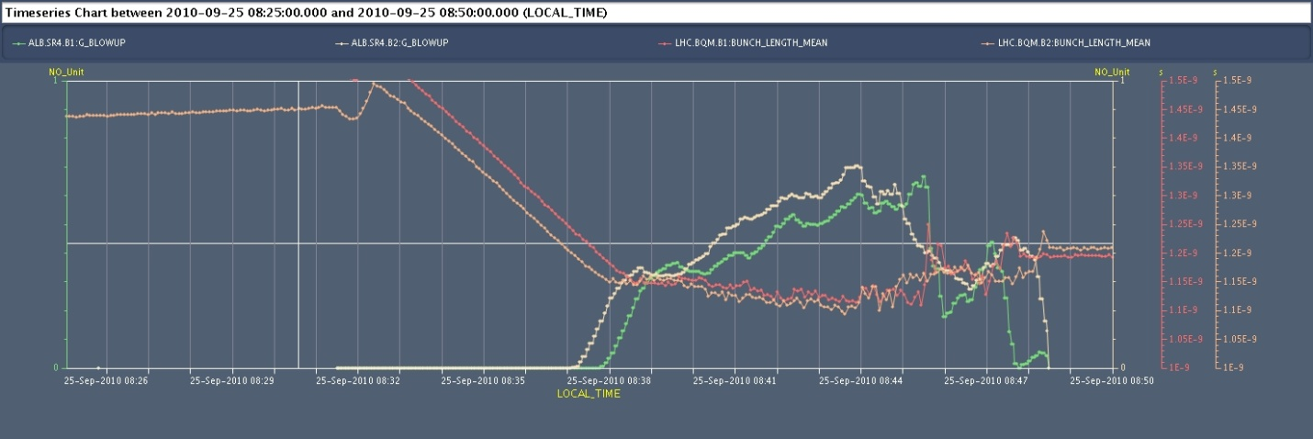
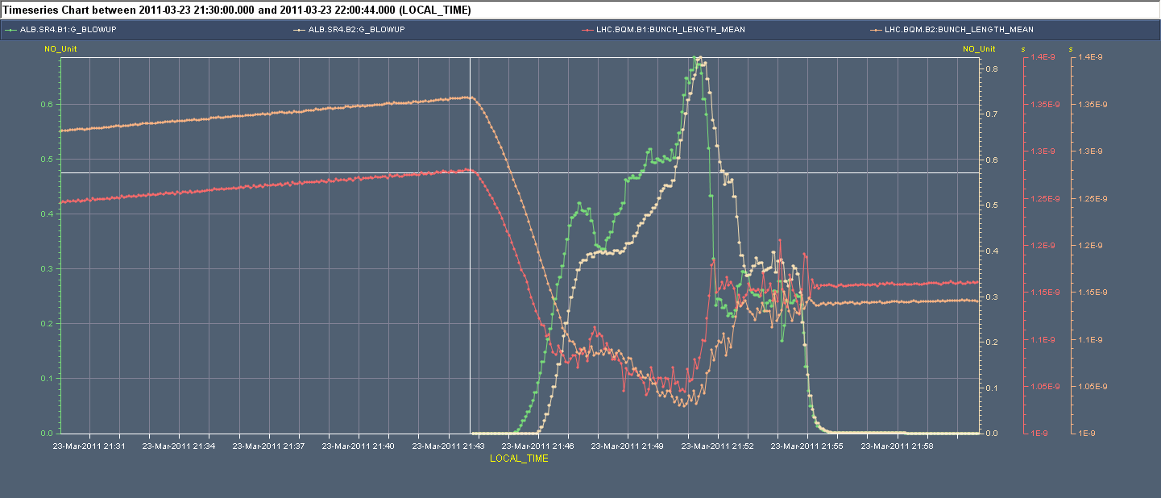
Why more tricky in 2011?
Situation 2010: Thanks to the matched capture the bunch shape is not changed much at injection. It is ~1.5 ns at the start of the ramp. The first part of the ramp proceeds smoothly without blow-up, with adiabatic bunch length reduction till it reaches the demanded 1.2 ns.
Bunch Length Mean and Noise Amplitude during Ramp
Situation 2011: Because the capture voltage is mismatched, the 1.5 ns long SPS bunch shrinks to ~1.20 ns after capture. With a 1.2 ns target value for bunch length, excitation must start immediately as soon as the ramp starts. We typically end-up a bit short of the demanded 1.2 ns and observe “jumps” in bunch length measurements when bunch profile changes (non-adiabatic)

Slide 11
Performances

Slide 12
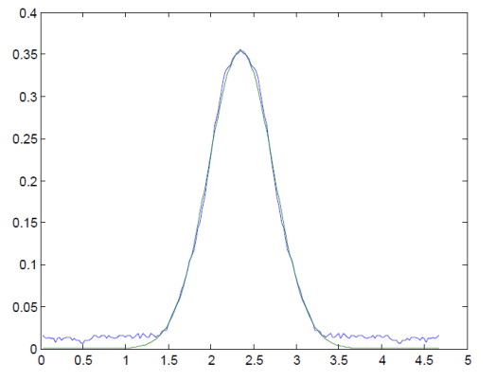
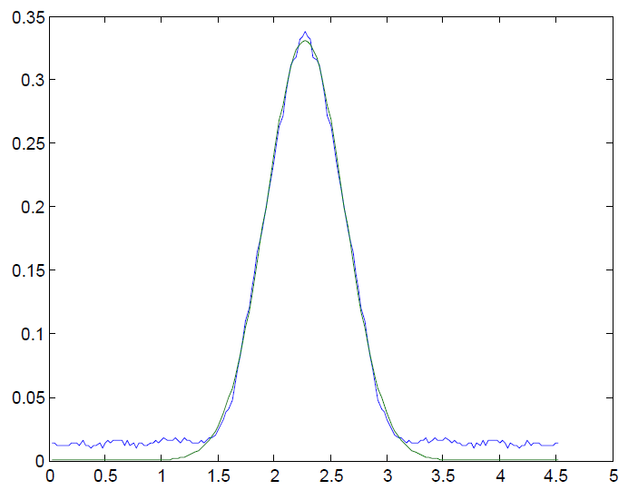
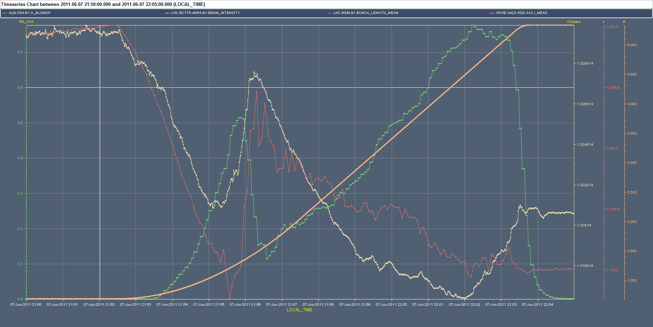
Example: Fill 1856 (June 7th)
Before “jump”
After “jump”
Increasing excitation but bunch keeps shrinking
We start ramp at 1.3 ns
We finish ramp at 1.1 ns

Slide 13
Movie. Fill 1856.
First bunch of 12b batch B1, from t=0 at start ramp to t=1000 with t=650 at end ramp
Start at 1.3 ns, ends at 1.1 ns

Slide 14
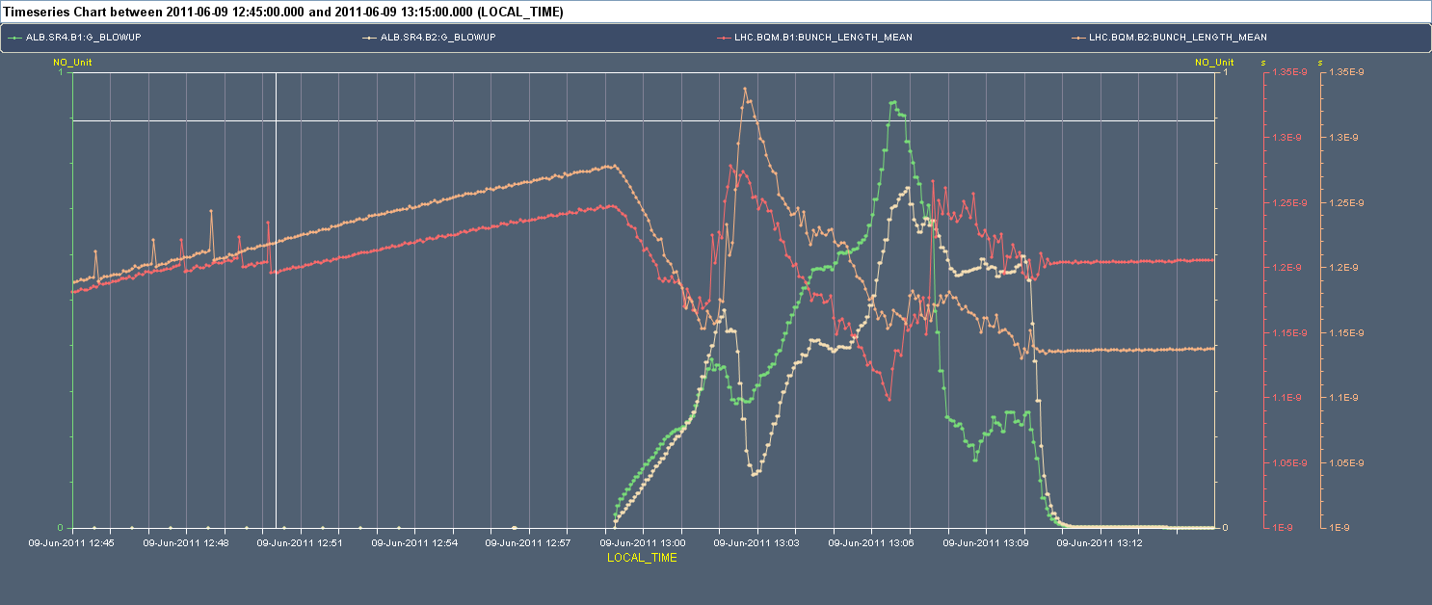
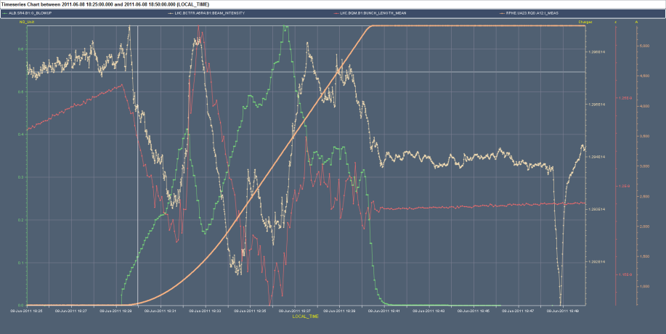
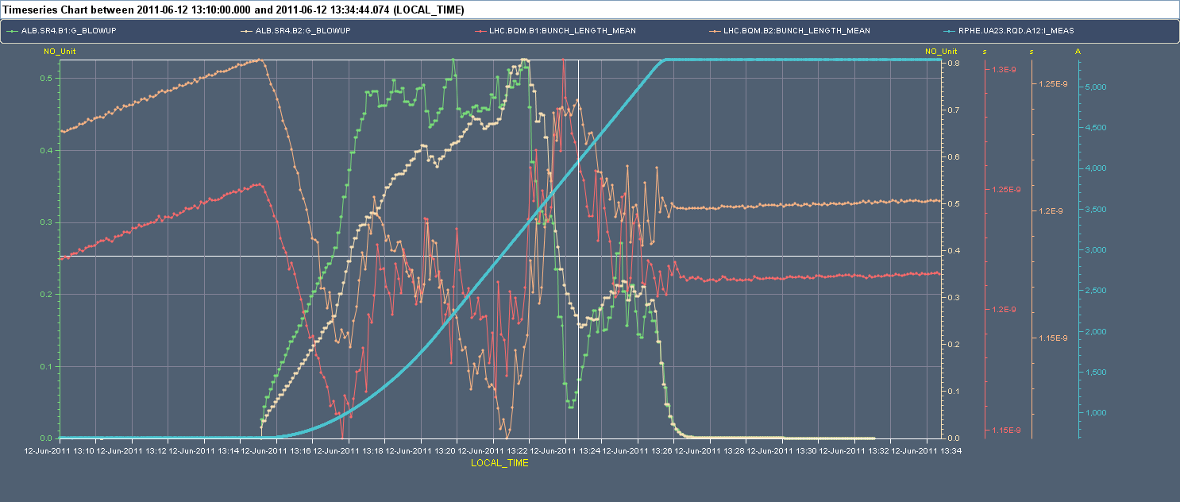
Trimming various functions.
Original
1.1 ns B1, 1.2 ns B2
Frequency max trim
1.2 ns B1, 1.14 ns B2
Changing target along ramp
Frequency min trim
1.21 ns B1, 1.2 ns B2
B1 only, 1.18 ns

Slide 15
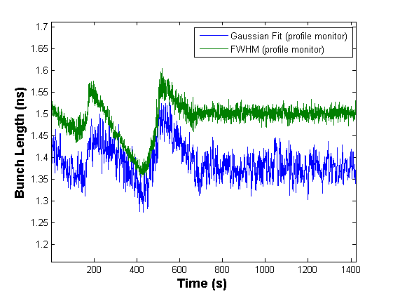
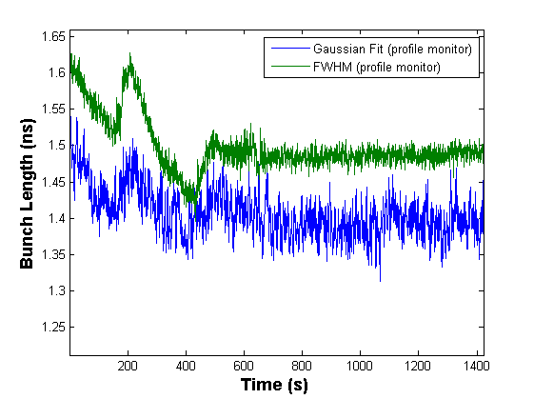
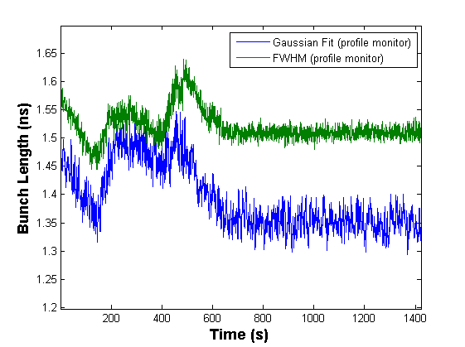
FWHM vs. 4-sigma Gaussian Fit
Original
Frequency max trim
New blow-up function
Frequency min trim
Comparison of FWHM sqrt[2/ln 2] and Gaussian Fit 4-sigma length from profiles at 40 Gsps. Not clear whether a Gaussian Fit would help

Slide 16
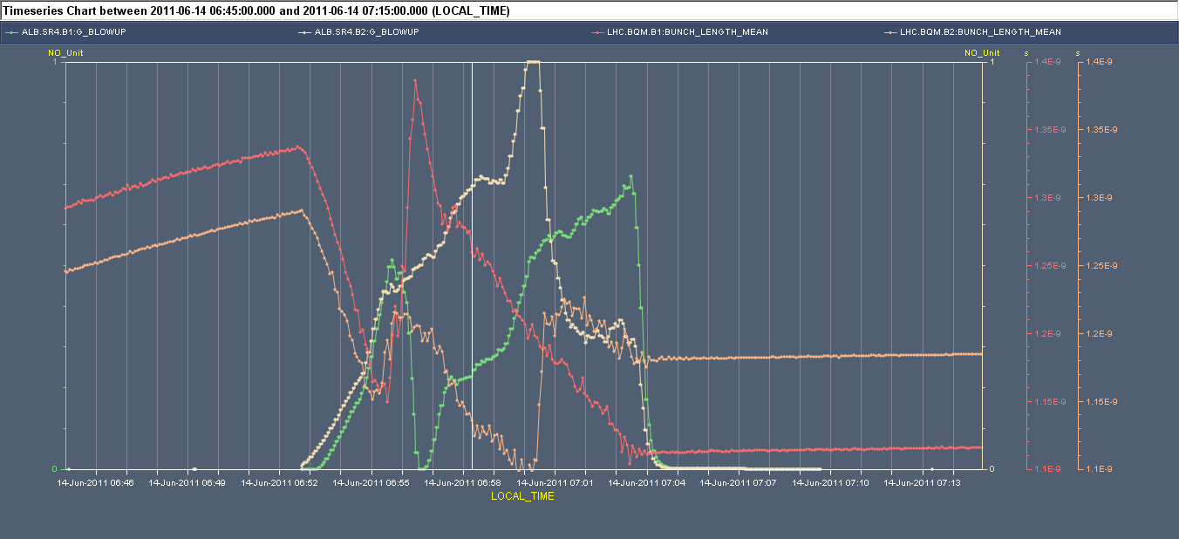
Last 4 ramps
June 12th ramp started at 13:15
June 13th ramp started at 9:55
June 13th ramp started at 12:50
June 14th ramp started 06:45. We end-up with 1.12 ns B1 and 1.18 ns B2
Looks OK
Not that great…
1.12 ns B1 1.18 ns B2

Slide 17
Improvements

Slide 18
Improvements
Increase the bunch length measurement rate (presently 5 s between samples). The gain of the excitation control can then be increased to give more precision
Make blow-up more “gentle” to keep close to adiabatic (no change in bunch profile). Side-effect: length will go down to ~ 1 ns before rising back to 1.25 ns. Trial ramp.
Gaussian fit or brute force computation of variance in place of FWHM. Not sure it brings a decisive improvements when the evolution is not adiabatic
Installation of a second BQM crate in SR4 for developments
Keep observing/studying bunch profiles, cavity phase noise spectra and LLRF signals during blow-up

Slide 19
Thank you for your attention…

