Slide 2
MPS relevant changed during TS
CHANGES:
Increased BPF threshold
Logic change in SMP for calculation of BPF
PIC configuration – Inclusion of a few new circuit types into MASKABLE BIS signal
RF interlocks – tbc
LBDS modifications – BIS connection of slow monitoring
QPS updates –new firmware in busbar detectors, additional upgrades for SEU mitigations,…. -> See Reiner
Additional Monitoring:
Mobile BLMs in injection region + Additional QPS instrumentation in IR8 and IR6 (for quench + injection/UFO MD)
DIDT connection – New beam intensity interlock of BI – connection to new CIBU (in monitoring mode)

Slide 3
BPF thresholds
The current threshold are (intensity measured from the FBCT on 27th of May)
• Beam 1 : threshold between 8E8 and 1E9
• Beam 2: threshold between 9E8 and 1.2E9
-> Marek will install additional attenuators to increase another factor of 2, to be close to 2E9
Courtesy of B.Todd

Slide 4
BPF – calculation logic
Data for a typical day (example of 30th of May)
Experience with new pickup-based system extremely good (reliable and faster for critical transition)
Dependability of BPF calculation is decreased by glitches on FBCT (happening in both directions!)
Courtesy of B.Todd

Slide 5
BPF – calculation logic
Disconnect FBCT
BIS team will disconnect the FBCT inputs from the BPF calculation, to only rely with a 2oo2 logic on new pickup system
Allows at the same time for (long asked) flexibility for BI to upgrade FBCT firmware,…
Courtesy of B.Todd

Slide 6
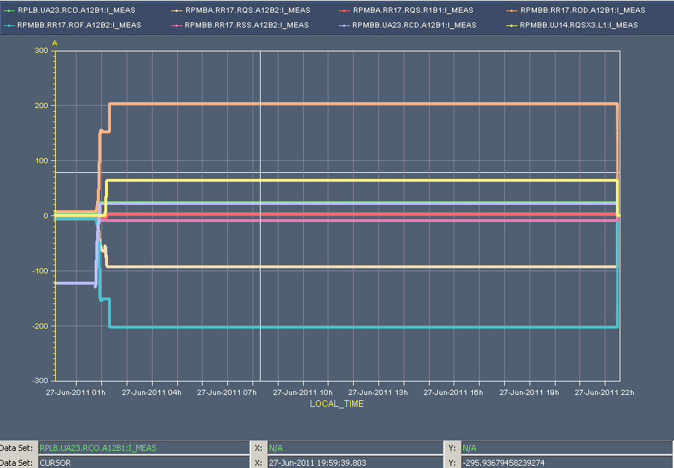
PIC configuration
To allow for some flexibility during startup and low intensity beam operation, not all circuit trips will directly request a dump of the beams:
    RB, RQD, RQF, RQX, RD1-4, RQ4-RQ10 into UNM BIC input
    Above list+ RCS, RQT%, RSD%, RSF%, RCBXH/V and RCB% (except RCBCHS5.L8B1) into MSK BIC input
    RCD, RCO, ROD, ROF, RQS, RSS no impact
Trip of RQSX3.L1 on 10th of June dumped by BLM in IR7 -> Additional circuit types to be included apart from RQSX3? -> OP feedback appreciated!
ROD
RQSX3
RQS.A
ROF
Fill 1900

Slide 7
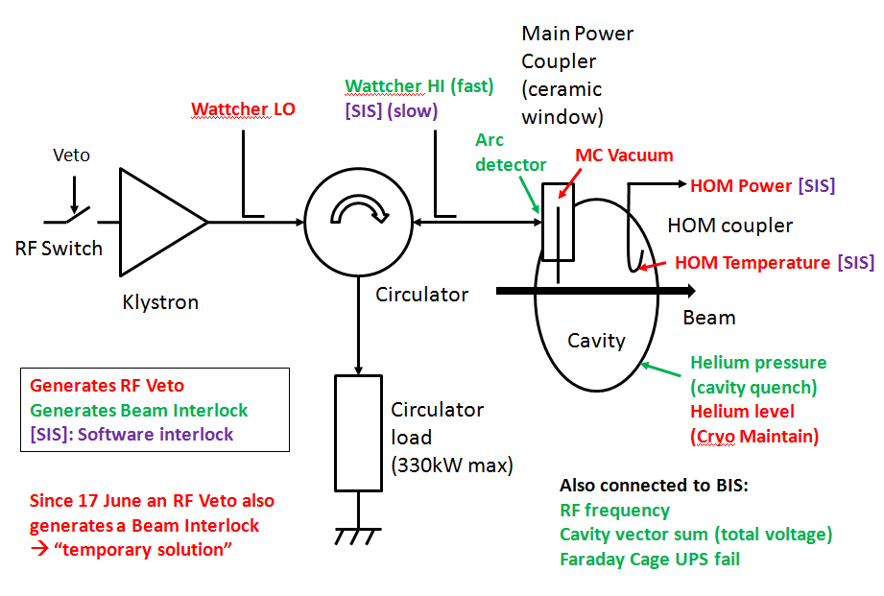
RF power distribution & critical interlocks
Courtesy of A.Butterworth

Slide 8
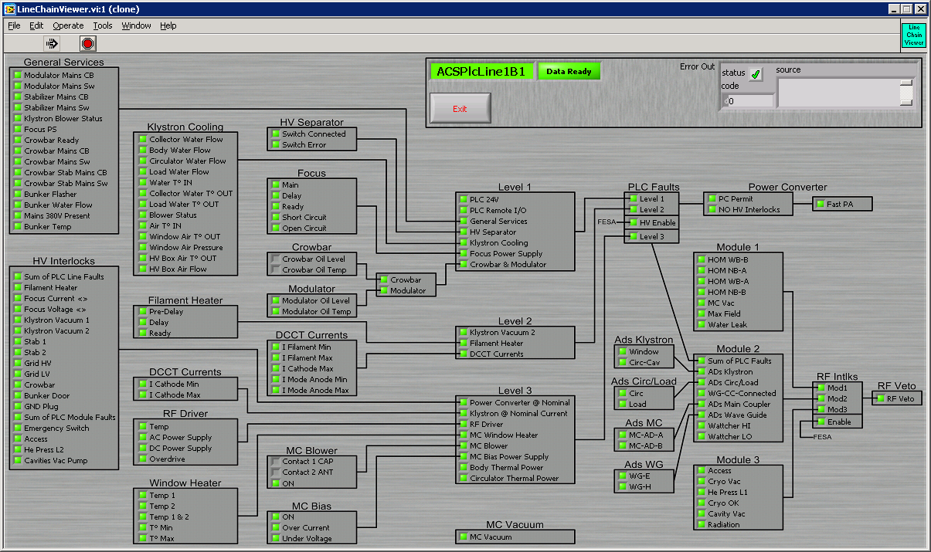
Proposed modification for tech. stop
Reprogram Module 0 (sum of RF interlocks):
  all Module 1 interlocks to BIC + RF Veto
  Module 2 & 3 interlocks to RF Veto only
  reduce the probability of false positives
  MC Vacuum generates Beam Interlock
  Wattcher LO, Cryo OK, Cavity Vacuum no longer generate beam interlock
Still under study, no decision taken yet for Technical Stop
Longer term: reorganize interlock inputs to group RF and Beam interlocks by module
Module 0
BIC
Courtesy of A.Butterworth

Slide 9
LBDS modifications
Verify TCDQ remote displacement mechanics, and drift of regulation loop.
Replace TMR on one MKI in Pt 2, after verification
Change main switch on MKI Pt 2 PFN_C – turn-on jitter.
VSC to install coils MKI on interconnects in LSS8 to suppress e-cloud
Remove unused MKI RCPS diagnostics crate (transformer oil level) from interlock chain (Pt 2, 8), and connect interlock directly.
Make 4 MKI PFN in Pt 8 water tight.
Verification and HV tests of MKI in Pt 2, 8.
Remove 2 entry boxes on MKB tanks in RA67 (requires opening of shielded door).
Replace one entry box on MKD in RA67 (idem).
Replace 2 MKD generators in UA63 and/or 67. Decision after low energy scan. If no clear “bad” candidates sticking out prefer to do both interventions in same UA (draft planning provided by Alain for both cases).
Attention: energy scan during verification program requires ADC cards to work. As these are more likely to fail, the ADC work (if it can be organized for this TS) has priority over the generator exchange.
Cable pulling in LBDS zones in UA63/67, for faster BIS triggering, and more precise BLM time stamping of dump.
Recalibrate generator MKDGA.JUA67 (was exchanged few weeks ago).
Check few incorrect measurement signals in in MKD generators.
Verification and HV tests of LBDS system.

Slide 10
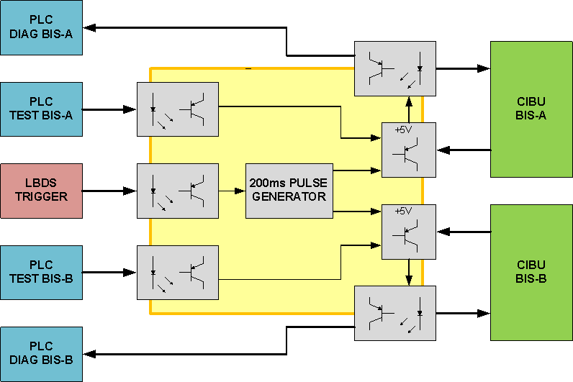
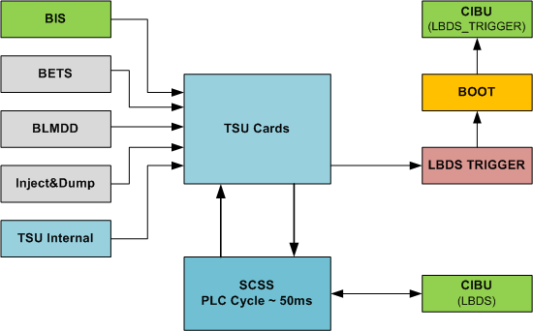
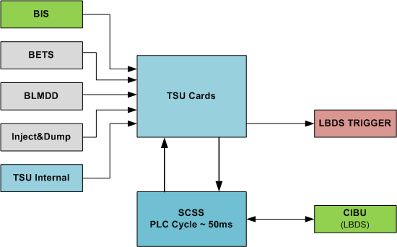
LBDS modifications
Problem in data acquisition chain for XPOC in case of internal LBDS triggers (SCSS opens BPL only some 50ms after the LBDS trigger) -> No data in short BLM/BPM buffers…
1st proposal to daisy chain with SCCS output was not approved (and in the end did not work)
Improved hardware fully compliant to BIS spec + dedicated CIBUs to be installed to directly break BPL after LBDS trigger
Courtesy of N.Magnin

Slide 11
MPS relevant changed during TS
Additional Monitoring

Slide 12
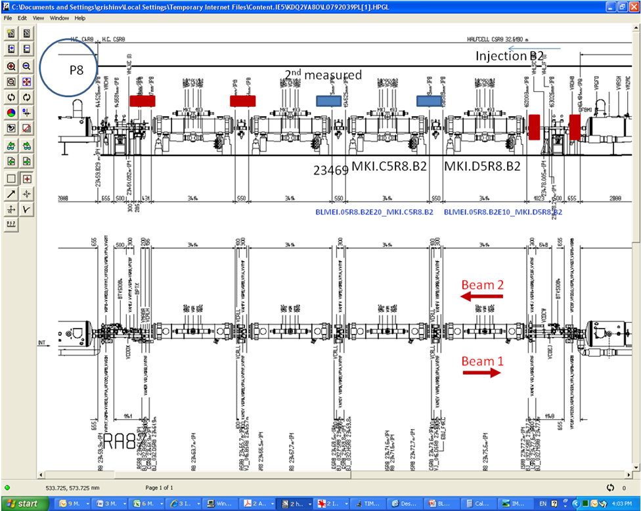
Additional BLM monitors + QPS instrumentation
Additional movable BLMs (red boxes) have been installed nearby the MKIs in point 8. Existing MKI BLMs (blue boxes) are also shown
One monitor with a big filter next to the TCLIB monitor in 06L8 (always saturated during the tests from last year and during MKI failures and quenches.
Additional QPS instrumentation on RQ6.L8 and RQ4.L6
All additional monitors remain in place after the MD (at least until TS of August)
Detailed EDMS docs: https://edms.cern.ch/document/1149841/1 & https://edms.cern.ch/document/1149844/1
Courtesy of C.Bracco

Slide 13
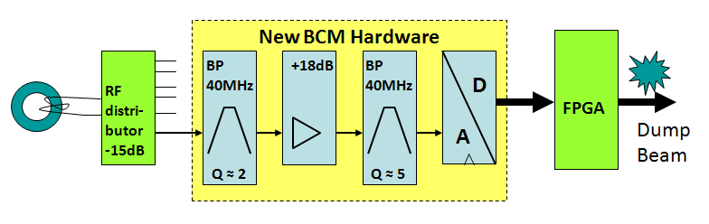
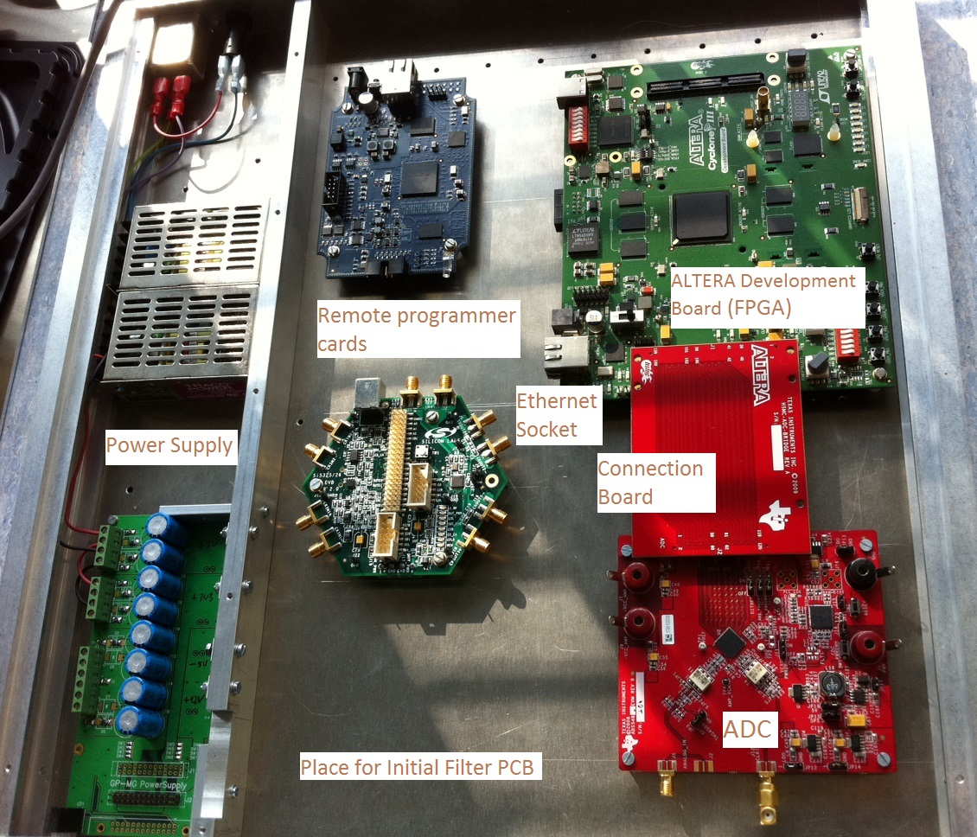
Beam Current Change Monitor – DIDT
First prototype of a Beam Current Change Monitor to be installed in IR4
First proof of principle -> Connected to CIBU in monitoring mode
Aiming initially at detection of changes in the order of 0.1% in beam current in 1 ms
Tbc…
Courtesy of D.Belohrad/M.Werner

Slide 14
Thanks a lot for your attention
Fin
14

