Slide 1
Schottky System
STATUS & RESULTS
Mathilde FAVIER BE/BI-QP
With the help of Rhodri Jones & Tatiana Pieloni
Schottky STATUS, LBOC Meeting, Tuesday 5 July 2011

Slide 2
OVERVIEW
WHAT IS THE SCHOTTKY NOISE ?
  Longitudinal Schottky Noise
  Transverse Schottky Noise
THE LHC SCHOTTKY SYSTEM
  Analogue Signal treatment Chain
  Schottky Spectra
MEASUREMENTS & RESULTS
  The SNR and Schottky band Study
  The TUNE measurements
ISSUES & LIMITATIONS
CONCLUSION

Slide 3
INTRODUCTION
Beam = Vast number of individual particles acting only approximately together.
Schottky noise is based on the statistical fluctuations of these finite charge carriers.
LHC has Bunch Beam:
  Look at the individual motion of particules inside a bunch
Non destructive way to determine parameters such as: Tune, Chromaticity, Emittance and Momentum Spread.

Slide 4
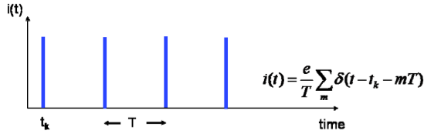
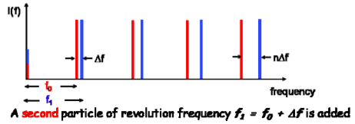
The Longitudinal Schottky Noise
Single Particle Rotating in a circular accelerator with Energy E and velocity ʋ and a revolution frequency f_{0.}
Let’s add a second particle with a slightly different energy and hence revolution frequency f₁. With f₁ = f₀ + Δf
Fig 1: Time of Revolution for a single Particle = Series of Dirac pulses in the frequency domaine.
Fig 2: two particles with a slight frequency offset Δf .

Slide 5
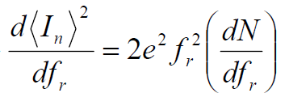
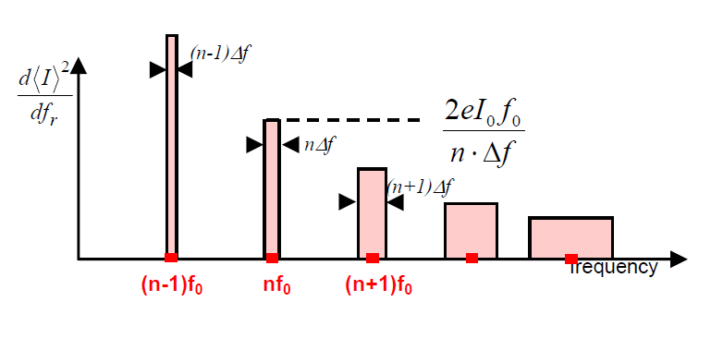
The Longitudinal Schottky Noise
For a subgroup of particles with random initial phase and with a distribution of revolution frequency : f0 + Δf/2.
The spectral density of the noise in the n-th band returns as:
Fig3: A schematic picture of longitudinal Schottky bands
Notes:
As an immediate implication we see that the total noise power in each “Schottky” band is constant. But we also know that the width of the Schottky band is increasing proportional to the harmonic number, and thus the height must decrease with 1/n. It is very clear from Fig 7 that when we continue increasing the harmonic number and thus the frequency, that at a certain point there will be Schottky band overlap.

Slide 6
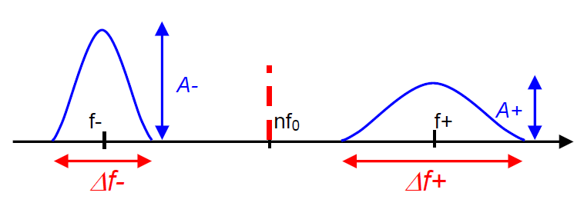
Transverse Schottky Noise
Each Schottky band has a finite width which results from the spread of revolution frequencies and betatron frequencies:
  Δf_{i}/f₀ =η Δp/p and Δq_{i} (related to the machine chromaticity)
The line width of the 2 Schottky bands (n ± q) is given by:
Δf± = f₀ Δp/p [(n±q)η ± Qξ]
~ 136
Varies from 1 to 10

Slide 7
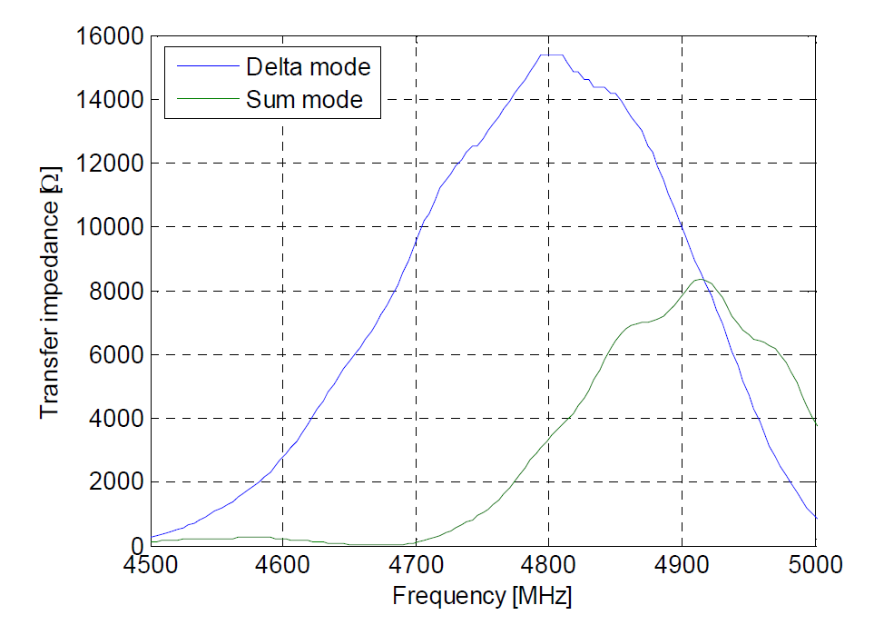
Which frequency can we detect it?
  To High in frequency -> Overlap of the signal
  To low in frequency -> To much Coherent Signal
      Simulated transfer impedance for LHC Schottky Monitor

Slide 8
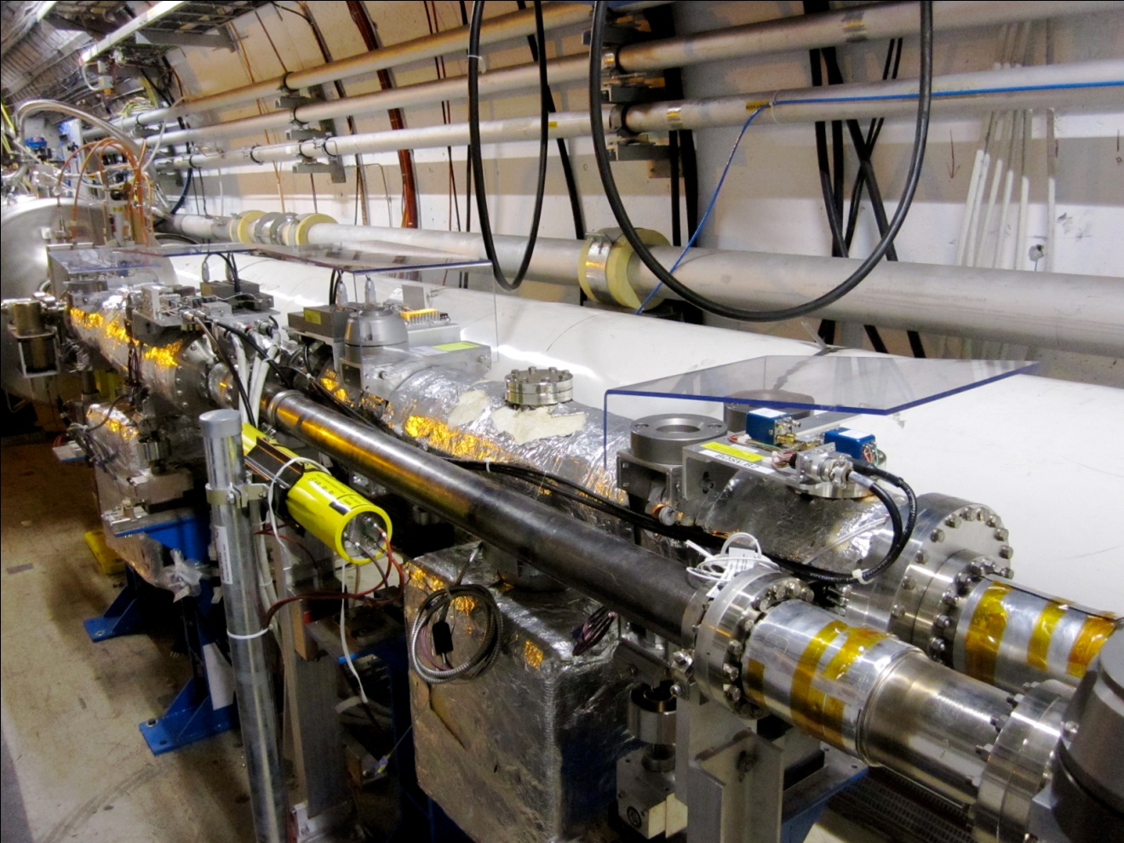
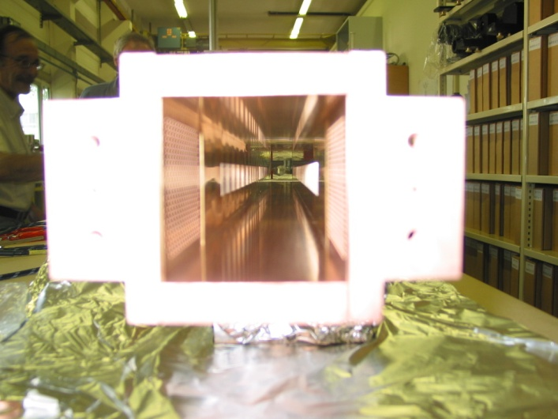
The LHC Schottky System
A high sensitivity pickup operating at 4.8 GHz, which corresponds to the 427000 harmonic of the revolution frequency.
4 Monitors were installed at Point 4, one for each plane of the 2 beams.

Slide 9
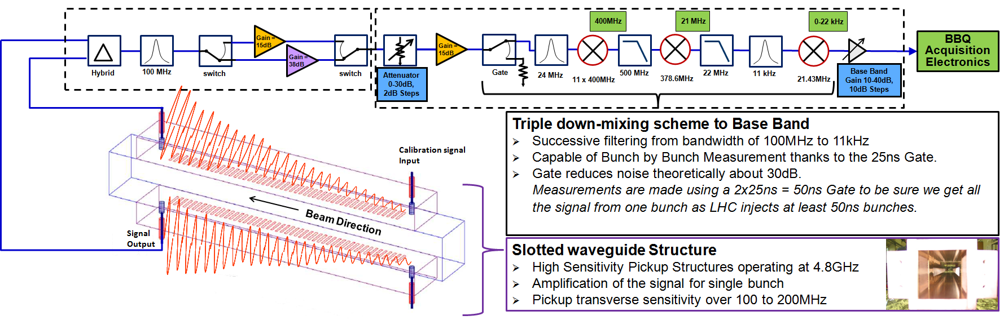
Analogue Signal Treatment Chain
Slotted Wave Guide Structure operating at 4,8 GHz.
Gate to allow bunch by bunch measurements
Triple down mixing chain + band pass filtering converting the 4.8GHz signal to a baseband frequency.

Slide 10
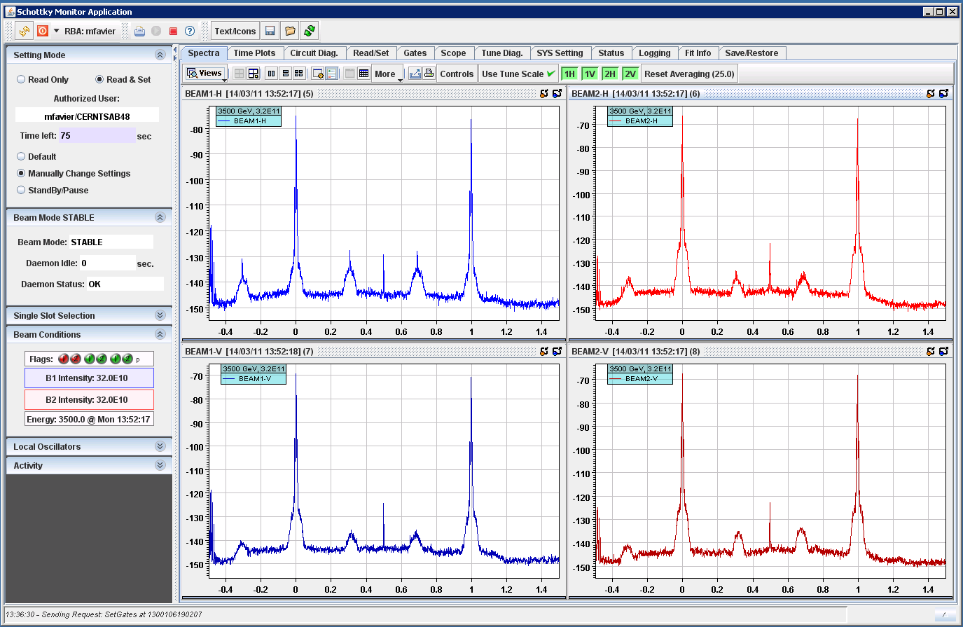
Schottky Spectra from B1 & B2
Revolution Frequency
Schottky bands

Slide 11
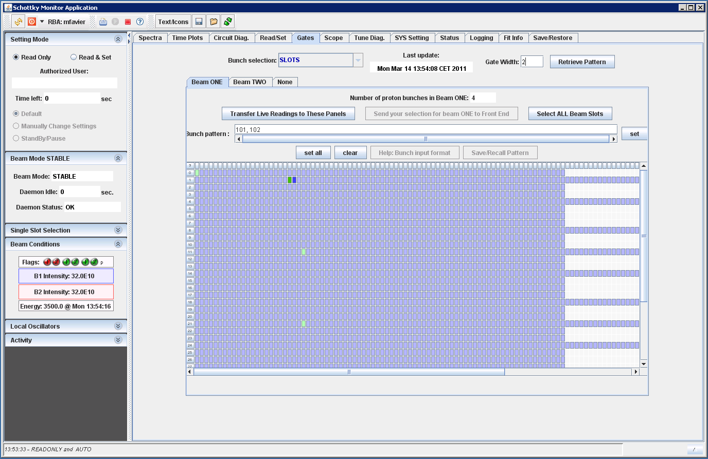
GUI Screen shot: Gate Selection

Slide 12
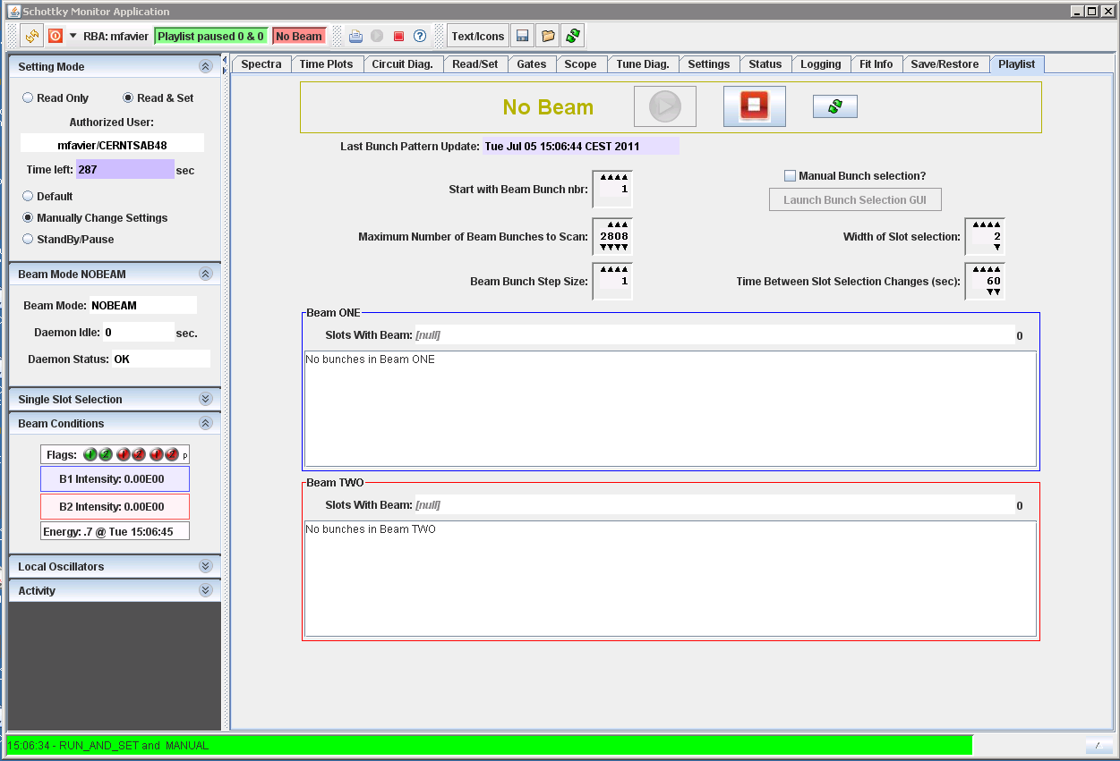
GUI Screen shot: Playlist

Slide 13
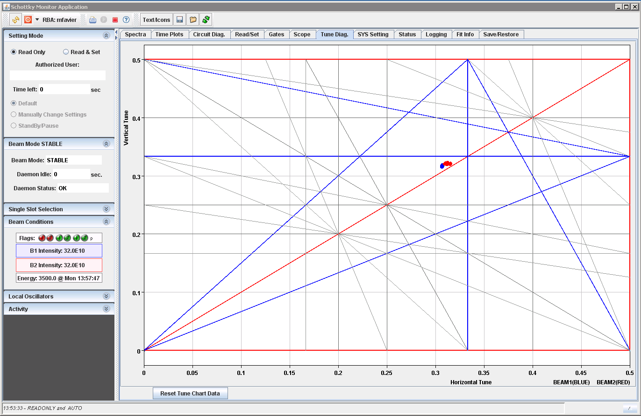
GUI Screen shot : Tune Diagram

Slide 14
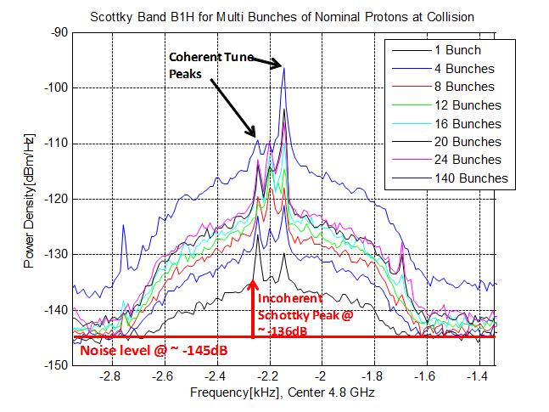
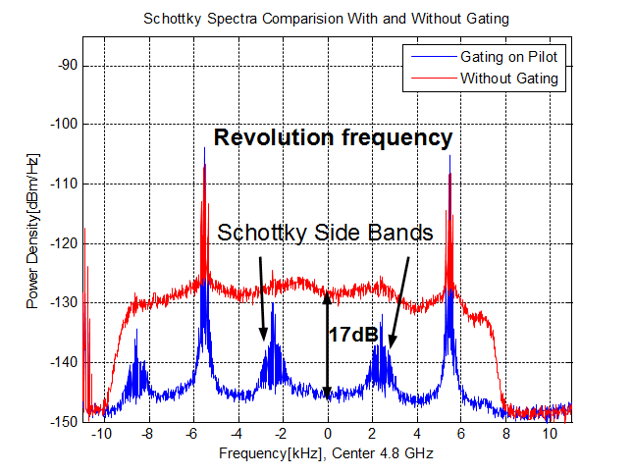
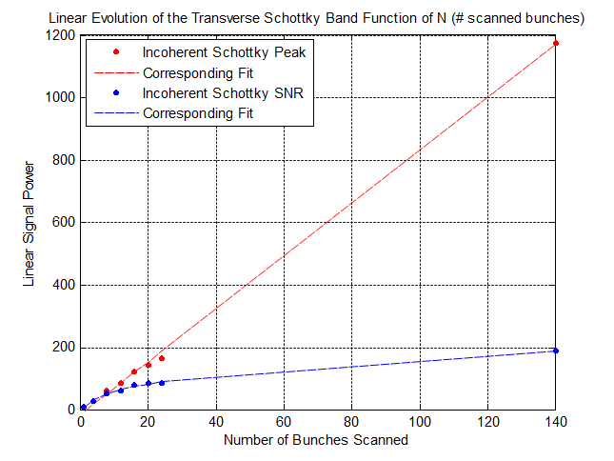
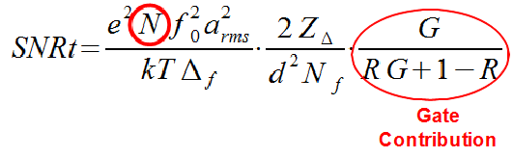
Measurements & Results
Gating Effect
Transverse Schottky signal

Slide 15
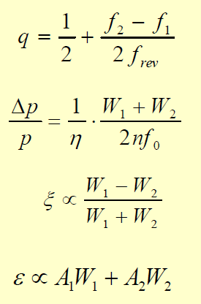
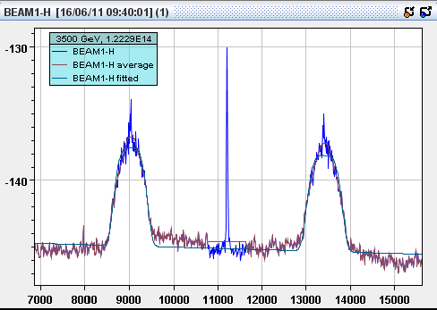
Measurements & Results
Spectra -> Fit -> Beam parameters :
A1
A2
W1
W1
f1
f2

Slide 16
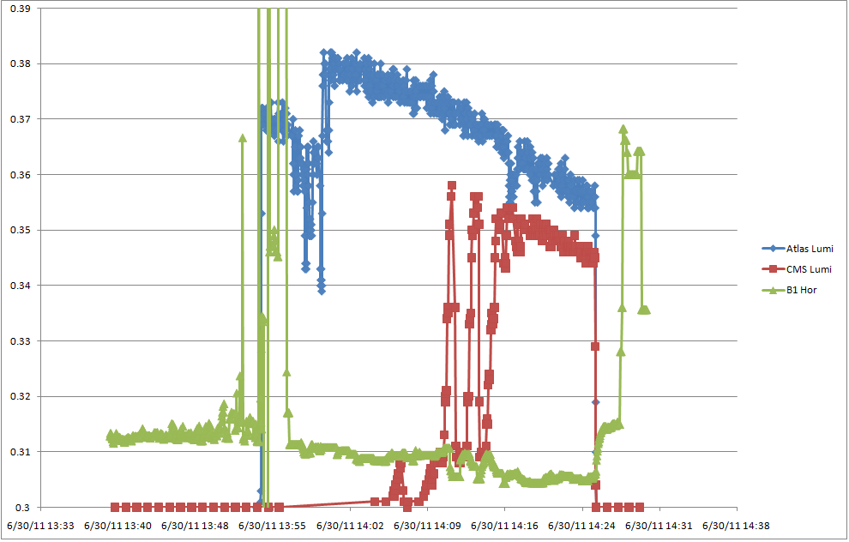
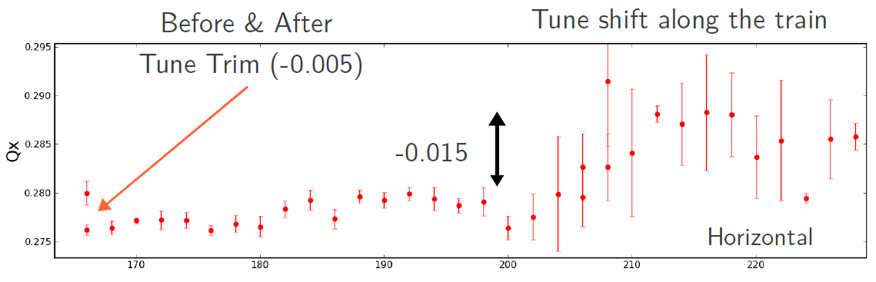
Measurements & Results
Tune Measurements
  Tune shift measured fro single bunch measurement (MD)
Tune shift along the train
for multi bunches measurement

Slide 17
Issues & Limitations
Schottky devices are really sensitive to:
  Coherent longitudinal oscillations
    Longitudinal blow-up during ramp
    No more signal right after the Ramp and Squeeze
      30 MINS BEFORE SIGNAL APPEARS
  Coherent transverse Signal
    System has 100dB dynamic range but still sensitive to:
      Bunch position.
      Bunch Intensity -> Saturation of the Electronic
    B1H always nice, investigation still ongoing to improve the symmetry of the signal before taking the difference.

Slide 18
Schottky Signal during the Ramp

Slide 19
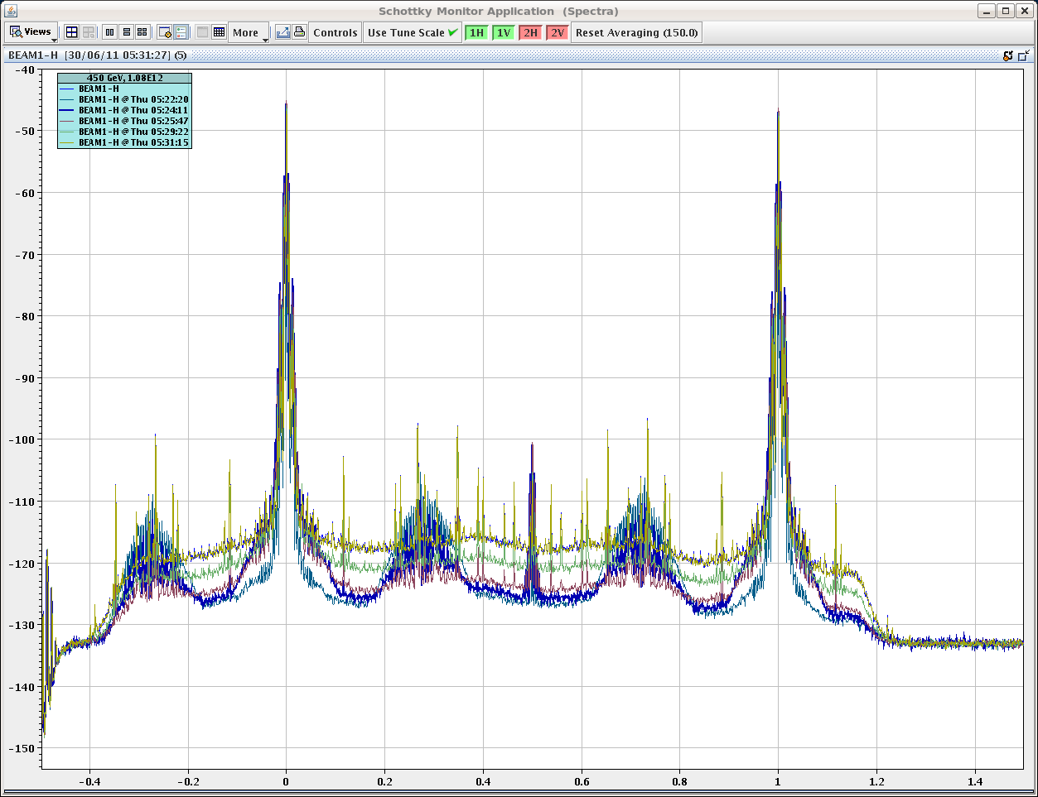
Beam Position dependency

Slide 20
CONCLUSION
  Good Schottky Spectra observed with favourable conditions.
    Specially with the ions (spectra)
    Also for Protons once stabilized in coast
  Possibility to measure bunch to bunch tune with a resolution of 1e-4
  Chromaticity measurement demonstrated but needs to be cross checked.
  Need to keep working on the fit to improve the measurements of the other parameters.
  PRIORITY : to bring all the signals to the equivalent level of B1H.
    Not many optimisation parameters
    Mainly dependent on varying beam conditions
    Working to make it less dependent & more operational

Slide 21
SOME REFERENCES
Linnecar, T, Schottky Beam Instrumentation, CERN- PE-ED 001-92, Geneva, CERN, 1992.
Boussard, D, Schottky Noise And Beam Transfer Function Diagnostics, CERN, Geneva, Switzerland.
Fritz Caspers, Jocelyn Tan, Shottky Signal for Longitudinal and Transverse Bunched Beam Diagnostics, CERN, Geneva, Switzerland.
The 4.8 GHZ LHC Shottky Pick-up System, Proceedings of PAC07, Albuquerque, New Mexico, USA.

