Slide 1
Longitudinal Density Monitor Status
E. Bravin (A. Jeff)
6 September 2011

Slide 2
Description of LDM
The LDM is based on precise time-stamping of single synchrotron light photons
The LDM is part of the BSRT and shares most of the elements with the transverse SL monitors
The LDM active detector is an avalanche photo-diode (2 brands idQuantique and MDP)
The time stamping is done using an Agilent cPCI TDC and uses the LHC turn clock from the BOBR as reference

Slide 3
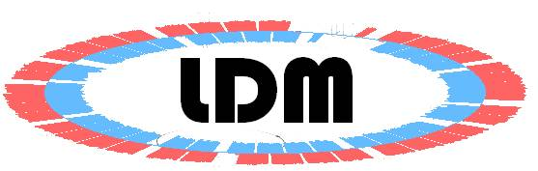
LHC turn clock
Arrival time
TDC
synchrotron light
APD
Electrical pulse
Single photon counting system used for high dynamic range
LDM is located at point 4 alongside the BSRT.

Slide 4
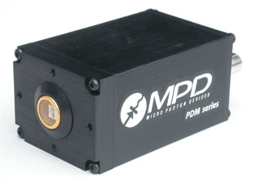
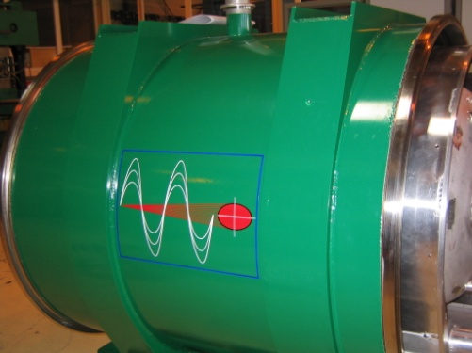
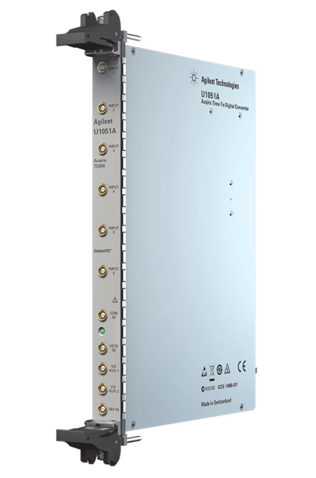
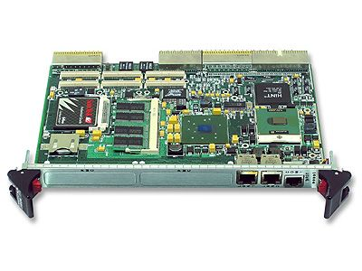
LDM components
Geiger-mode Avalanche photodiode converts photon to electrical pulse
(about 50x50μm²)
Synchrotron light from undulator and dipole
Time to Digital converter records pulse arrival time
cPCI computer makes histogram and corrects for APD dead-time and afterpulsing

Slide 5
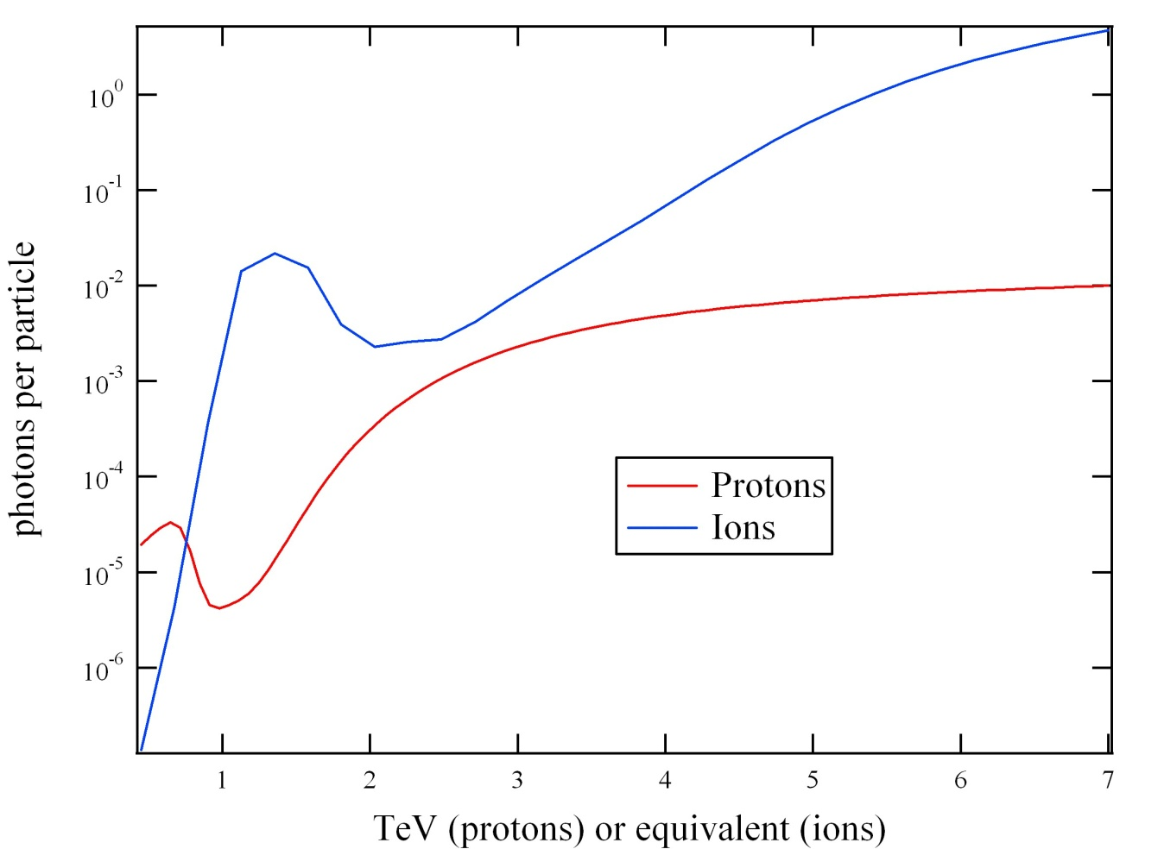
LHC synchrotron light sources
Synchrotron light yield versus beam energy, from simulations. Only visible photons within the geometric acceptance of the telescope are counted. The LDM receives approximately 7% of the available light.

Slide 6
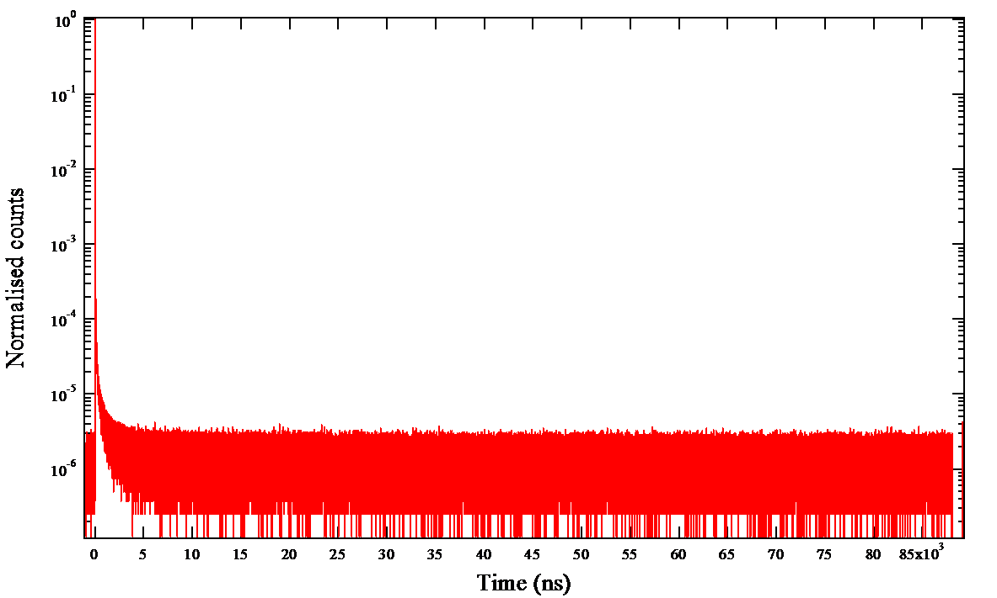
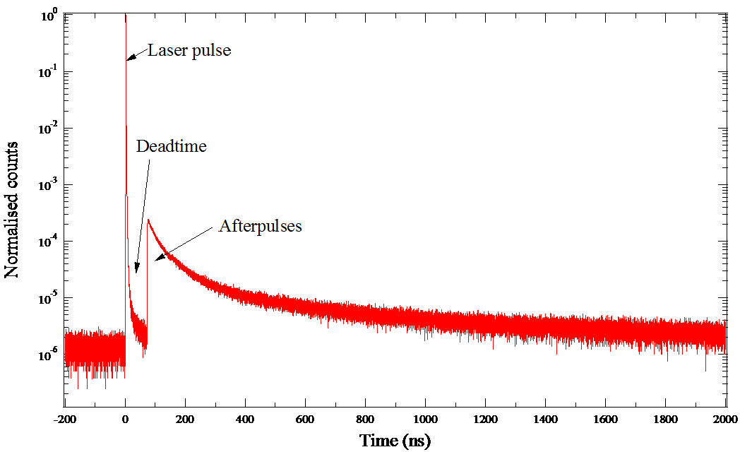
Laser pulse response of APD

Slide 7
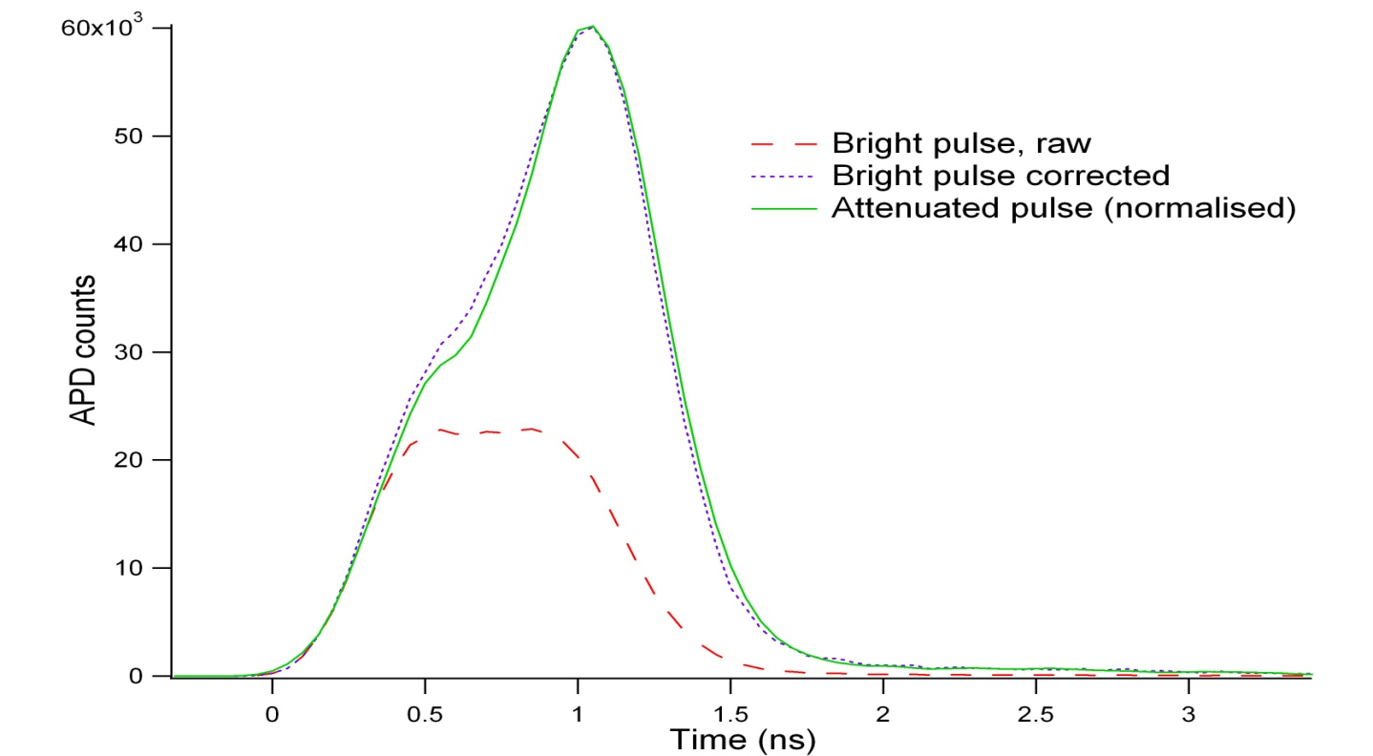
Dead time correction
Demonstration of the deadtime correction algorithm with a pulsed LED. The bright pulse (>2 photons per pulse) is flattened and skewed to earlier time because of the detector deadtime. After correction, the true shape is restored, as shown by the close match to the pulse shape measured with strong attenuation.

Slide 8
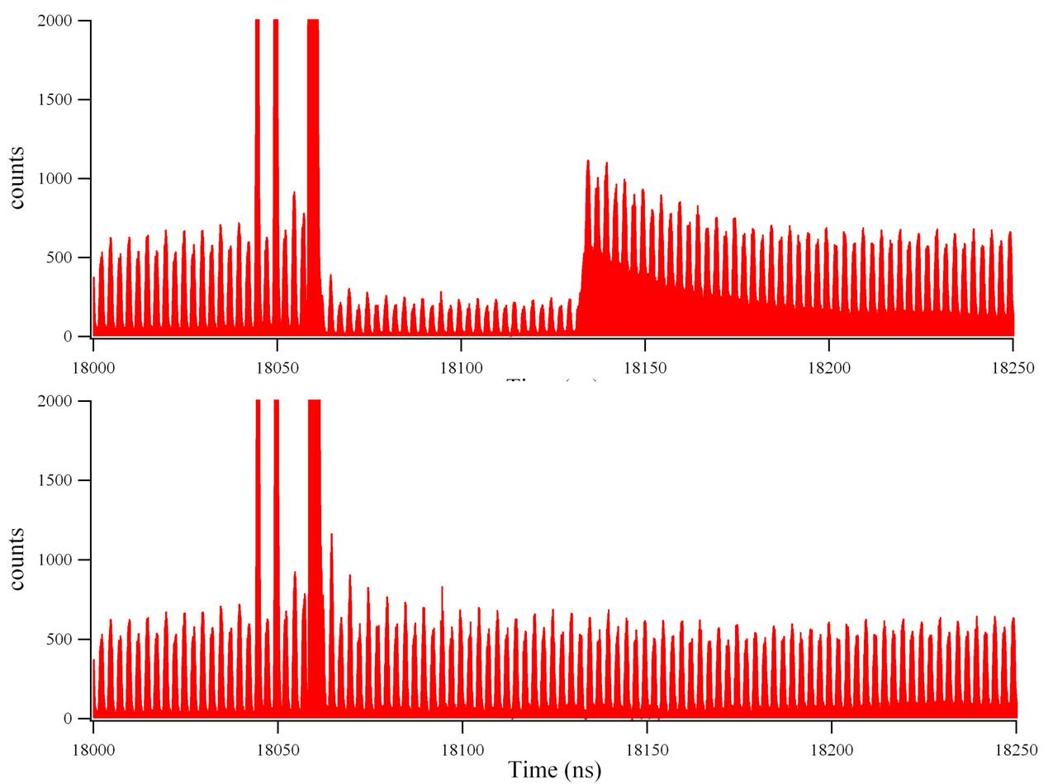
Correction on real data (ions 2010)
Bunch peak at 1e6
(protons 2011)
3
150x10
100
Bunch peak at 1.3e6
Proton density (arb.units)
FWHM = 750 ps
50
0
10.378
10.379
10.380
10.381
10.382
Time (µs)
Example profile before and after correction. The effects of deadtime and afterpulsing are clearly seen on the upper plot.

Slide 9
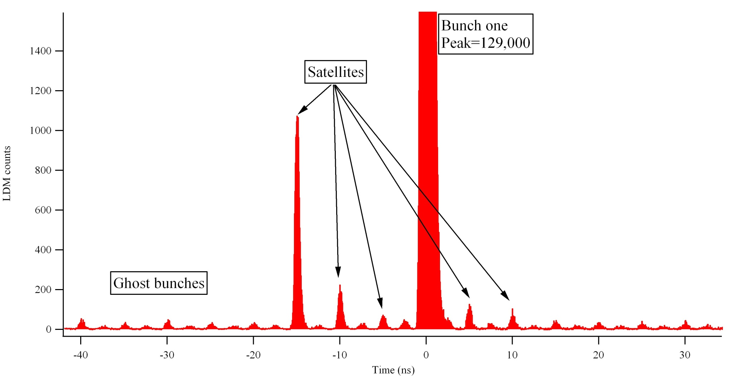
Satellites (ions 2010)
~10 minute acquisition with ions at flat top. Ghost and satellite bunches can be distinguished with a dynamic range of up to 10⁵

Slide 10
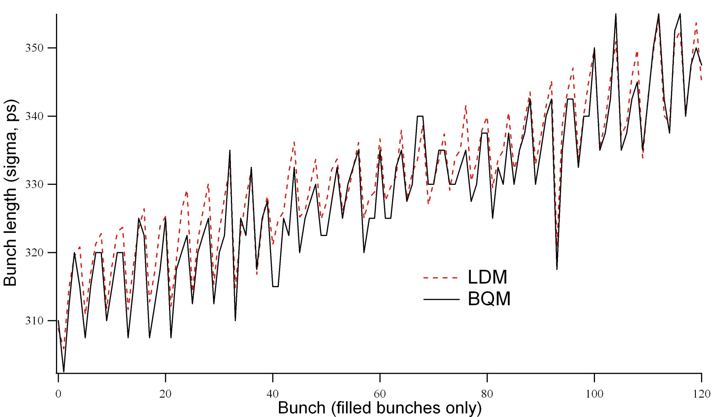
Bunch lengths
Bunch lengths measured by a Gaussian fit to the LDM profile, and subtracting in quadrature the LDM temporal resolution of 90ps, compared to the same measure on the Beam Quality Monitor.

Slide 11
Relative/Absolute calibration
Bunch populations measured by the LDM and the fast BCT. Due to the dependence of the LDM coupling efficiency on very precise steering of the light, no absolute calibration factor has been established, so only relative bunch populations can be compared.

Slide 12
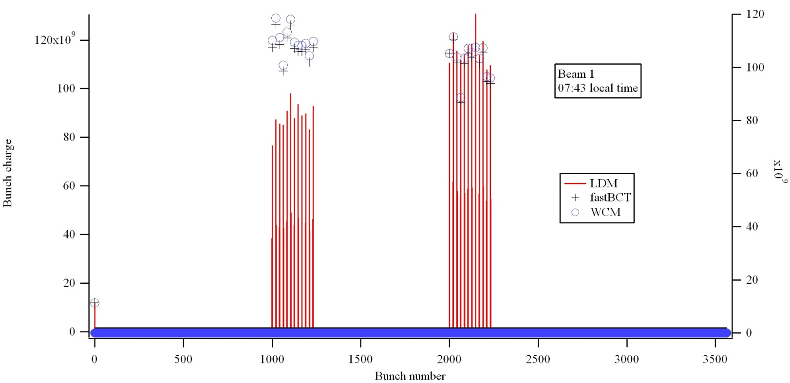
Emittance dependence
MD with one batch of low-emittance bunches and one batch with large emittance
Spot size at the detector is ~200μm (1 sigma)

Slide 13
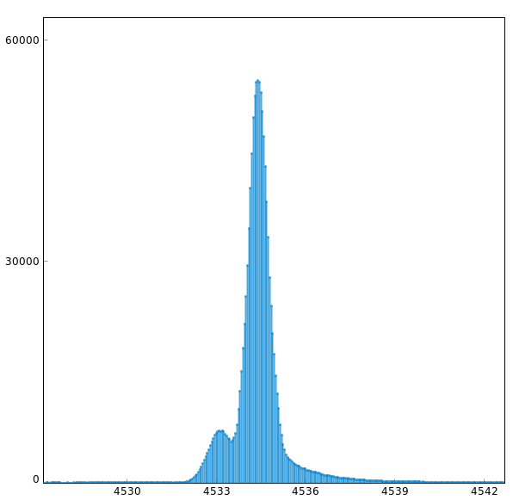
Quirks of APD on B1
Detector on B1 shows long tails after the main bunch making difficult to identify ghosts right after the bunch (detector replaced during last TS)
Dead time of detector on B1 ~50ns creates weird distortion (hump in front of the bunch)

Slide 14
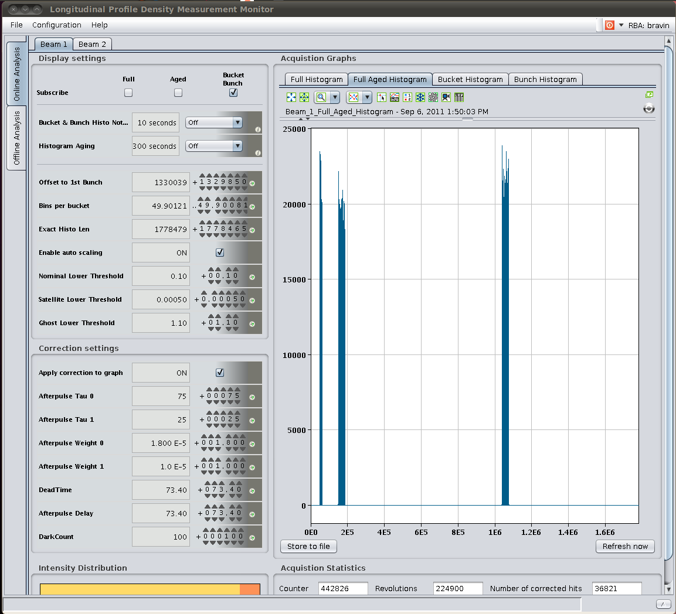
Software
Lab/Development application existing since a while
FESA class + application presently being developed and already available from BI applauncher

Slide 15
Next steps (optics)
Modify optical system in order to reduce dependence on spot position and size

Slide 16
Next step (corrections)
Study APD behaviour in the lab with pulsed laser
  Measure precisely the after pulse time shape
  Investigate the different quirks observed so far with the detectors
Improve the correction algorithms based on the lab measurements
Investigate other detectors (ex. Fast PMTs)

Slide 17
Summary
Both B1 and B2 detectors are installed and providing data (logged)
A FESA class and the relative application are being developed and are already “usable”
Correction of dead time and after-pulses to be refined (mainly base line definition)
Need to implement an automatic control of APD position and filters setting
Need to modify the optics to reduce the effect of spot position and size

Slide 18
People
Adam Jeff (M.C. Fellow until June 2012): the one that does most of the work!
Enrico Bravin and Andrea Boccardi: helping Adam with the design/improvement/analysis
Maxim Andersen and Serkan Bozyigit: FESA class and java application
Federico Roncarolo and Aurelie Rabiller: BSRT integration/help

