Slide 1
Injection status
W. Bartmann, C. Bracco, B. Goddard, V. Kain, A. Macpherson, M. Meddahi, S. Redaelli, J. Uythoven, J. Wenninger
LBOC Meeting, 20th Sept. 2011

Slide 2
Outline
TCLIA issues after ALICE polarity flip
B2 injection oscillations pattern
TL trajectory drift
Supercycle management
Options for improvement
Follow up

Slide 3
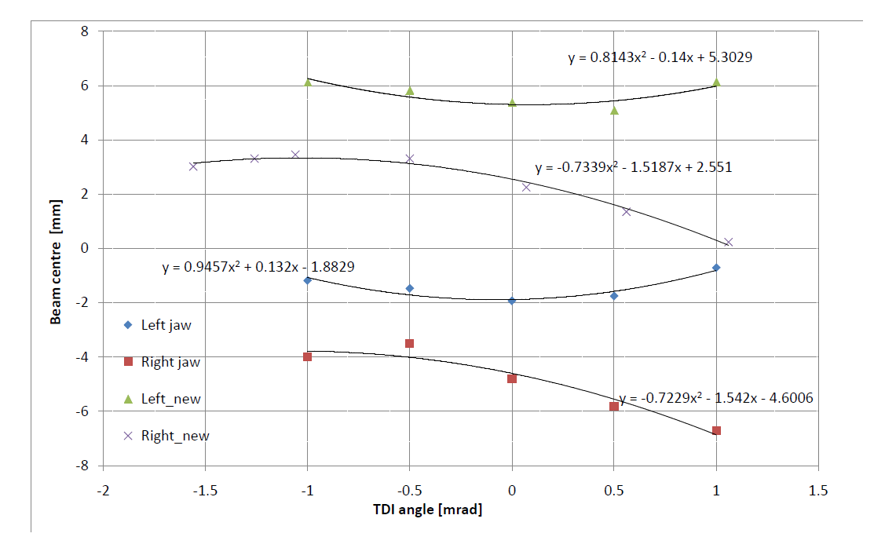
Polarity flip and inj prot setup I
Sunday, 4th Sept 11
Injection and orbit checked before polarity flip with 12 b - very good
Alice polarity flip
LHC orbit re-established
TDI tilt/center alignment
TCLI center alignment
Consistent results wrt last setup

Slide 4
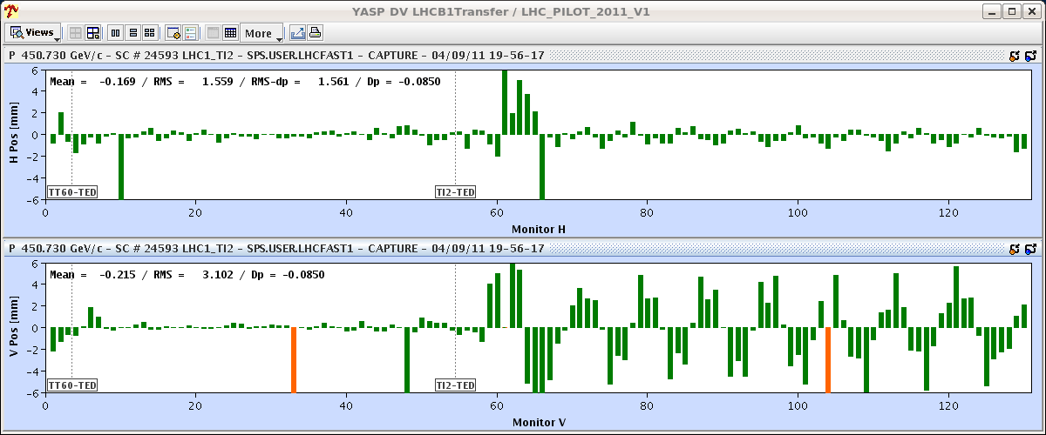
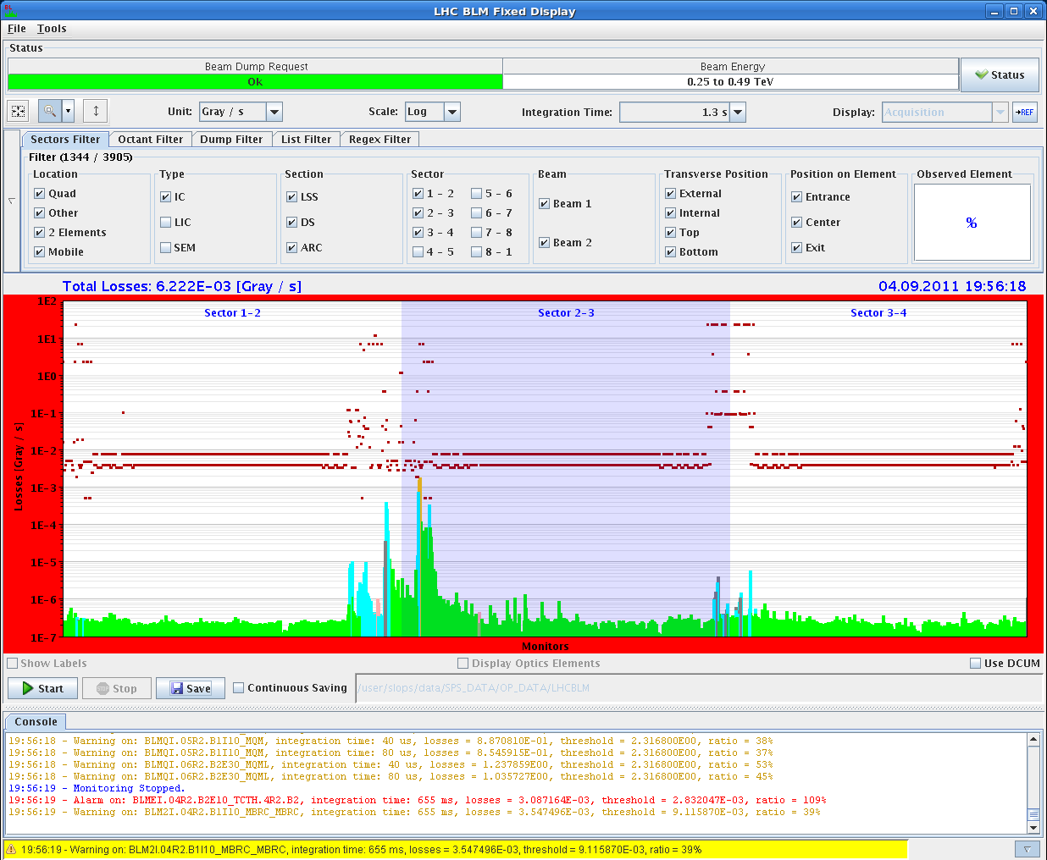
TDI Validation
Validation of TDI/TCLI settings
create open oscillation at the TDI
scan from -11 to +10 sigma at TDI
Validation test results:
grazing losses start at +4 sigma and -6 sigma oscillation at TDI
for last TDI grazing measurements (8-March-11, before angular adjustment of TDI) grazing losses started at +/- 6 sigma

Slide 5
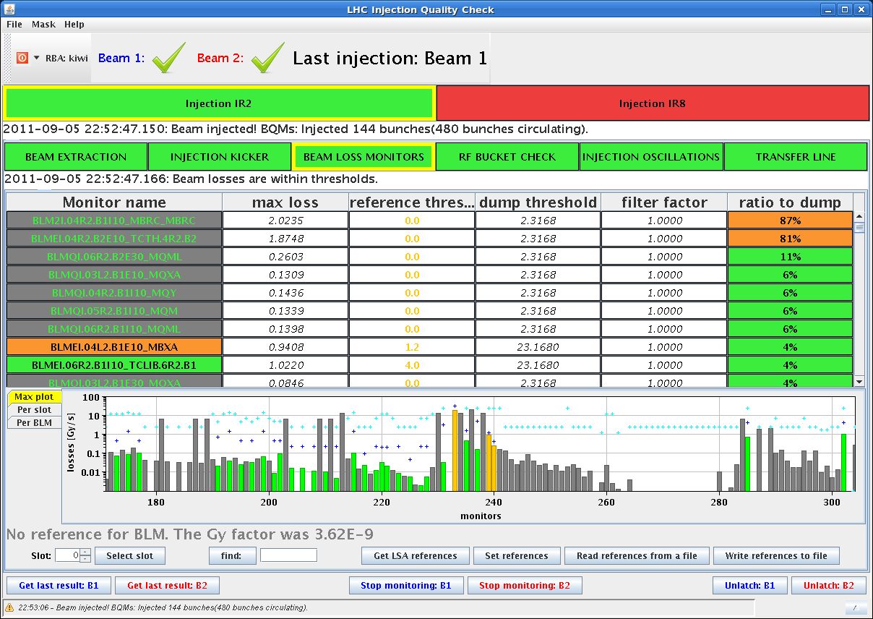
72b and 144b
72 b
losses look good from line
144 b
losses look good from line
TCTH losses stay rather constant wrt to # inj bunches

Slide 6
Area sketch
ALICE
Joerg Wenninger
TDI
TCLIA
TCTH.B2
triplet
triplet
Q4
TCLIA.B1 in common beam pipe region
TCTH.B2 BLM is internal

Slide 7
TCTH.4R2 losses already before
threshold: 2.3 Gy/s
Setup
0.5 - 1 Gy/s loss level over August-11
now 1 – 1.8 Gy/s

Slide 8
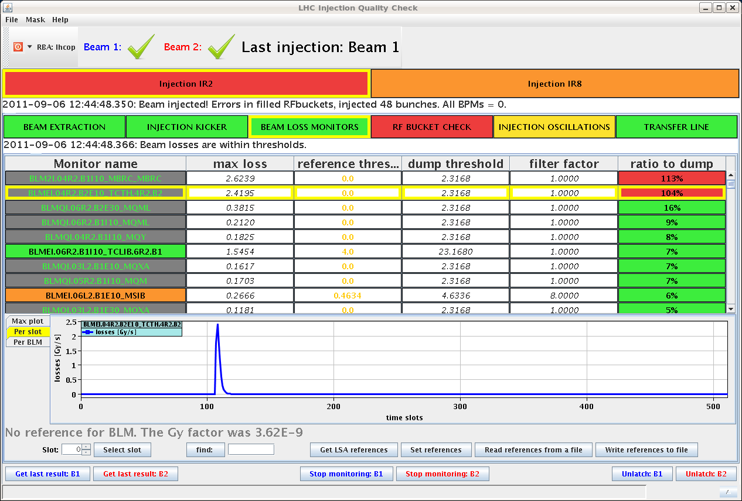
Dumps due to TCTH losses
First dump on TCTH losses on Tuesday morning
Shower losses from the line got worse compared to the injections the day before

Slide 9
Re-check the TCLIA center
shift in center of -140 um (towards lower jaw)
increase the settings from nominal to measured beam size (difference of 0.4 nominal sigma per jaw)
no MCS collimator role → opened the TCLIA.4R2 as much as possible within the thresholds (0.25 sig)

Slide 10
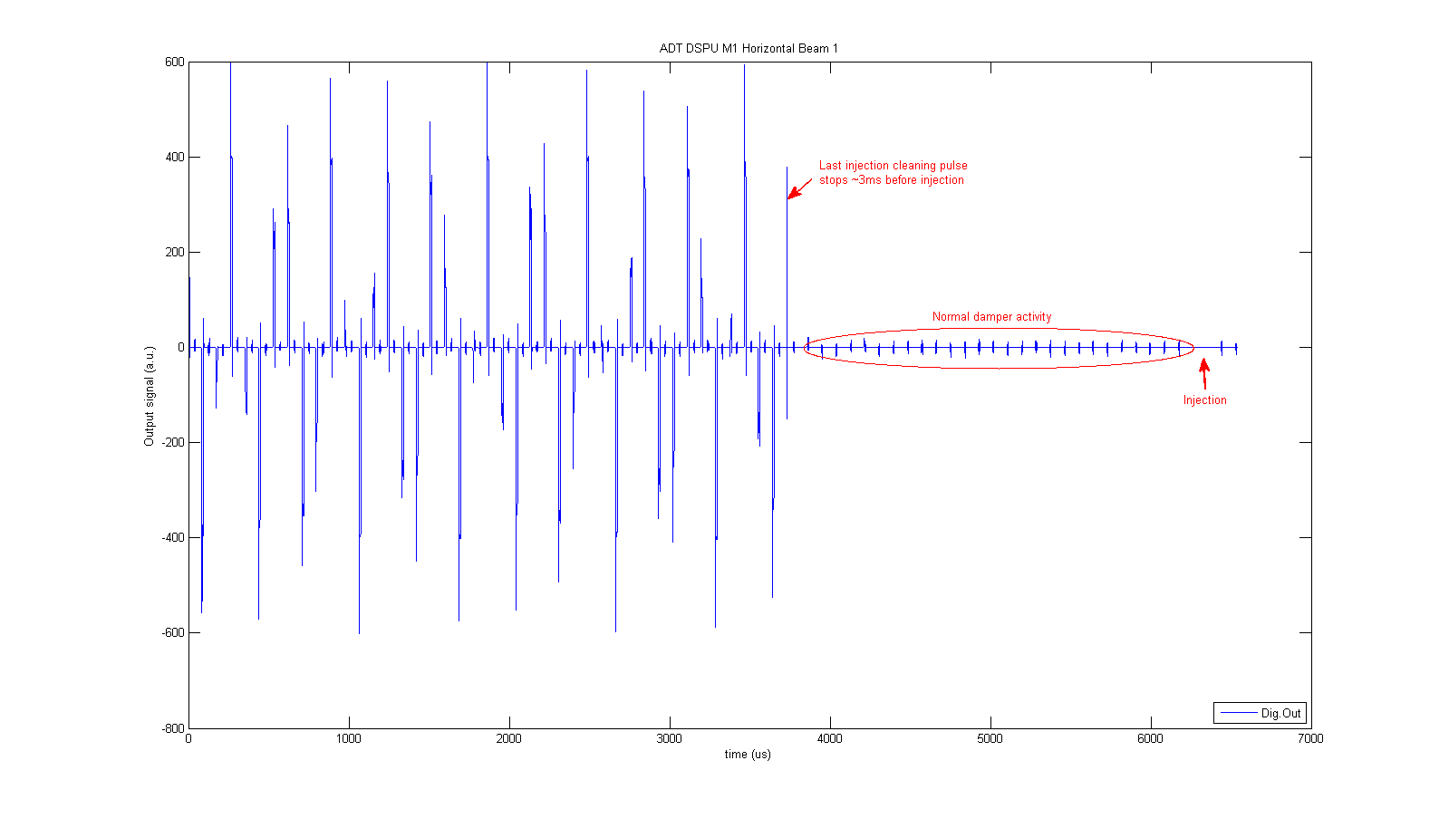
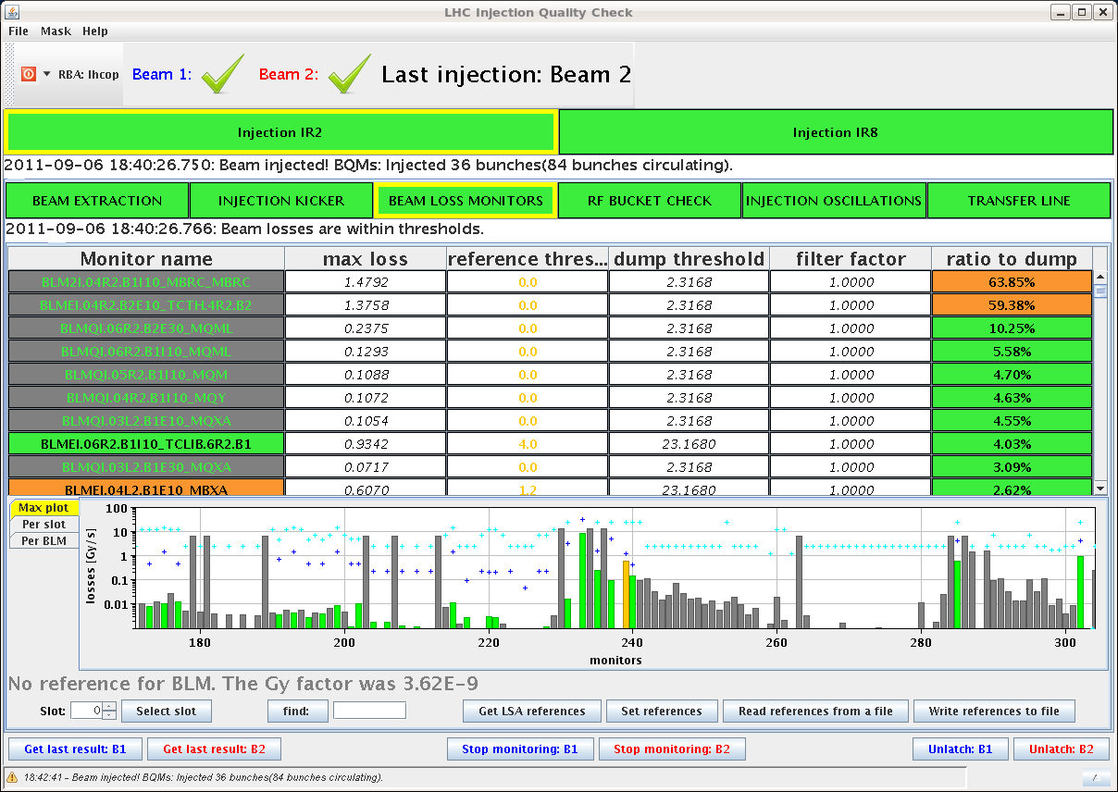
Injections after TCLIA check
with TCLIA settings at about ~7 sig still dump with 103% on 36 b
asked Daniel to check inj cleaning → OK
Daniel Valuch
ask for more SPS scraping
bring the 2x36b eventually in
probably scraping helped since shower losses from the line look very clean again

Slide 11
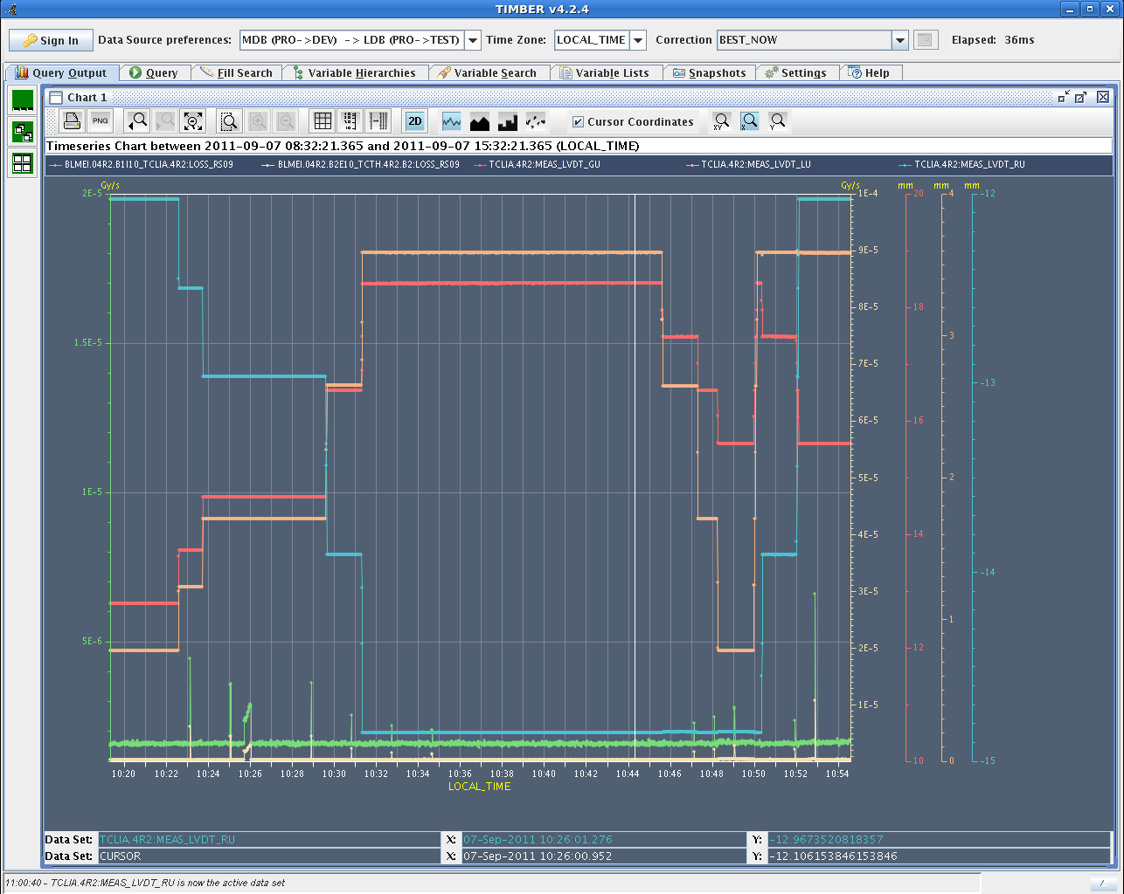
Open TCLIA jaws separately
Losses rather insensitive to upper jaw movement
but sensitive to lower jaw movement

Slide 12
Losses vs jaw movement
Lower jaw losses
Upper jaw losses

Slide 13
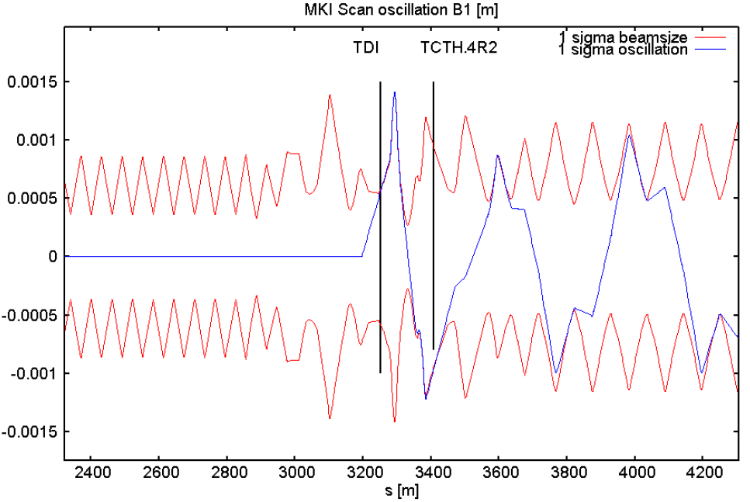
Asymmetry of TDI validation
TDI grazing losses start at +4/-6 sigma oscillations
Positive oscillation at the TDI peaks on the lower jaw of the TCTH and seems to cause the asymmetric losses of the grazing scan
Loss peaks at the TCTH.4R2
Asymmetry of grazing losses seems to be correlated to injection losses on the lower TCTH jaw

Slide 14
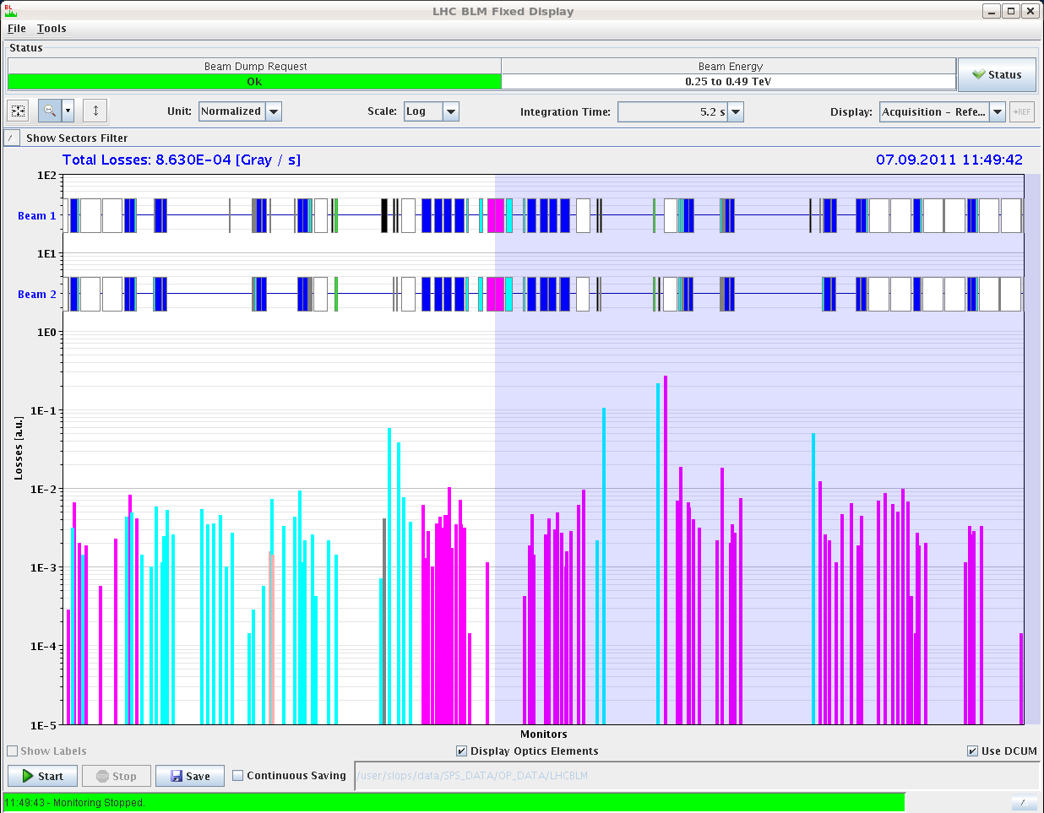
Scanning TCLIA area with circ beam
TCLIA.B1
Changing the crossing bump angle to scan vertically
Use an orbit bump to scan horizontally
losses appear for symm. bump amplitudes
TCTH.B2
Scans with circulating beam don’t show jaw asymmetries or apparent obstacles

Slide 15
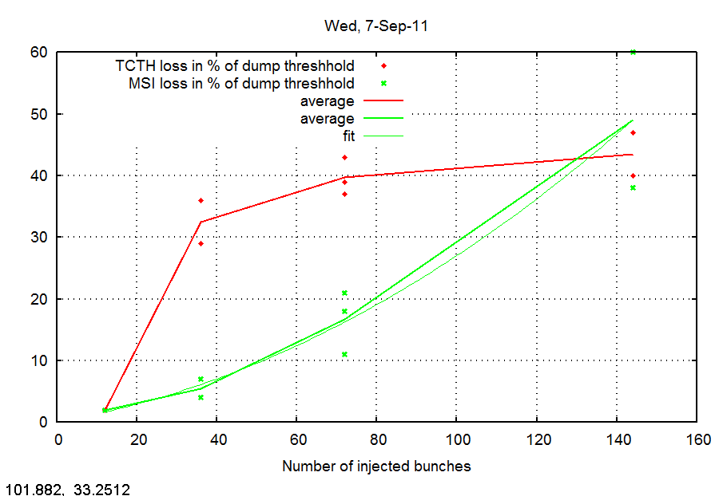
Open lower jaw by 1 sig
Upper jaw at old setting
Taking into account measured beam size the total gap is 2 x 6.8 sig → total gap OK
Center shifted towards lower jaw by 400 um
TCTH losses reduced by 50% to about double of normal level
TCTH losses rather constant for 36-144 b injections
“normal” injection losses scale linearly with # inj b
These TCLIA settings are currently used

Slide 16
Conclusions: TCLIA
Smooth setup after polarity flip
could measure the change in vertical angle of the beam and mechanical offset for both TDI jaws (upper is parallel, lower has -900 urad angle offset)
straighforward TCLI centering
validation with MKI knob scan gave asymmetric grazing losses (+4/-6) which seems to be consistent with a lower jaw problem at TCLIA.4R2
Injections for 12-144 b after setup
in the beginning losses from the line and MSI/MKI look very good, however degrading over the next fills, trajectory steering improves losses from the line
TCTH.B2 sees shower from TCLIA.B1, not new but factor 3 stronger than before setup
strong effect from lower jaw
no obstacle found when scanning the area with circulating beam – difference injected/circulating beam losses not understood
opening the gap to measured beam size and shifting the center by 400 um towards the lower jaw reduces the losses by about 50% and allows to inject up to 144 with loss levels < 50% at the TCTH.4R2
TCTH losses increase from 12 b to 36 b injections, but stay then constant for injections with more bunches (72, 108, 144)
effect which affects only part of the injected bunches?

Slide 17
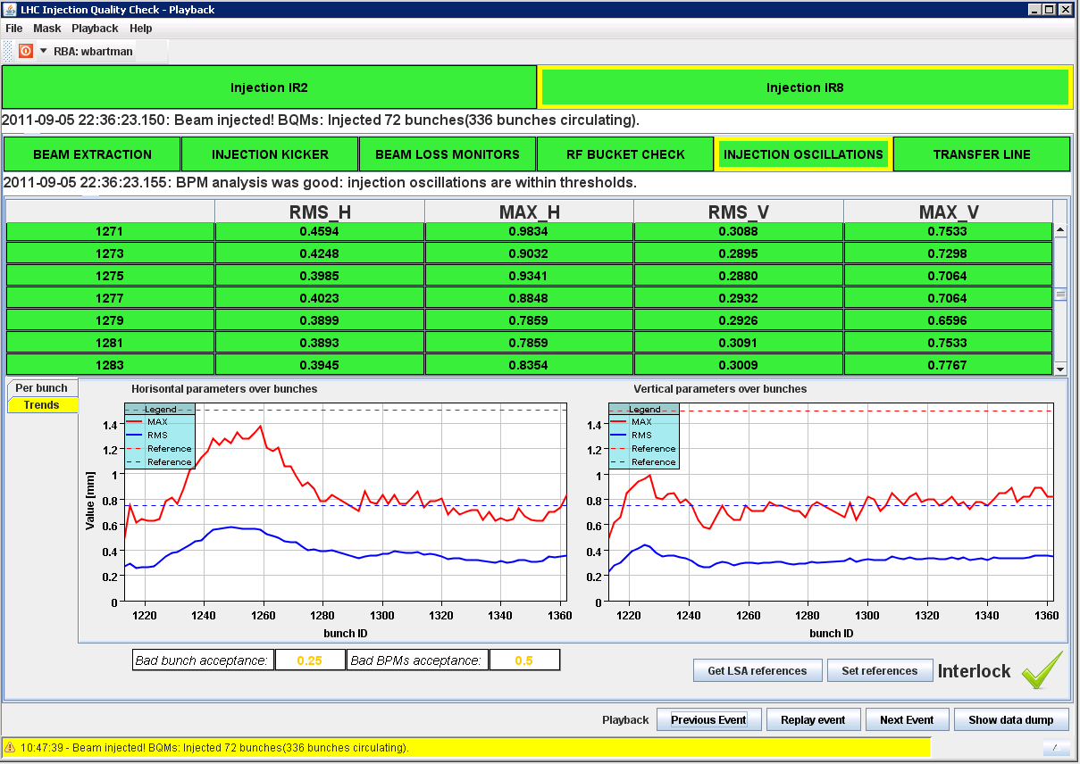
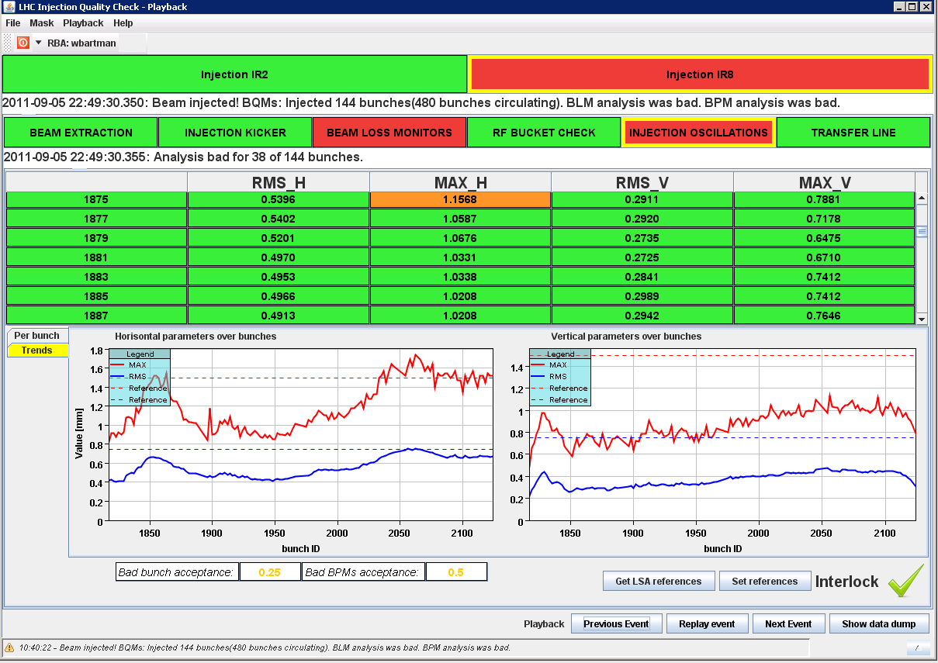
B2 injection oscillations
Bunches 15-25 experiencing increased horizontal oscillations
Check dependency on kicker delay
Check if maximum excursions have always the same phase
72 b
144 b

Slide 18
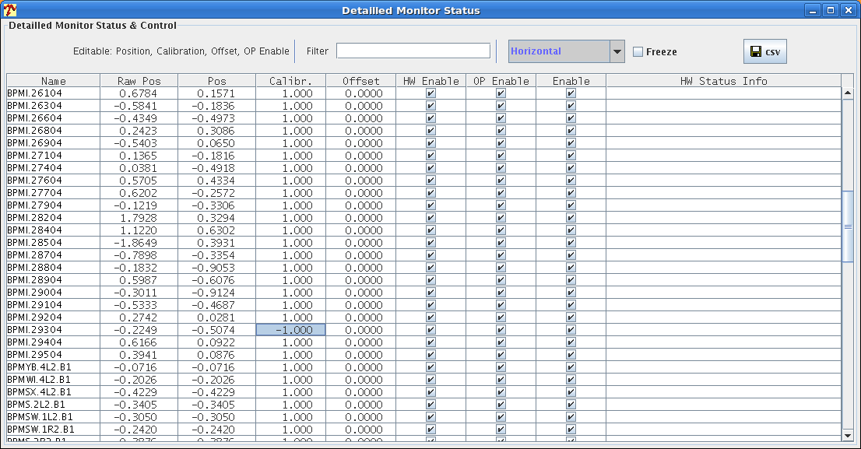
Steering issues
Shot-to-shot trajectory differences caused by MSE
average 335 um, maximum of 1mm
see this for both lines, but more sensitive for B1
Trajectory seems to be dependent on cycle composition (ion cycle in/out)
Had to flip BPMI.29304 sign to steer around collimators in TI2
to be verified with kick response measurement
Steering is not yet straight forward
AutoYasp

Slide 19
TL trajectory drift
Checked centering of 3 TCDIs with pilot and for two TCDIs again with 12 b
Maximum shift of 0.3 sigma measured
Same order as shot-to-shot variation
Measured beam center is consistent with BPM readings from trajectory
Good agreement between pilot and 12 b cycle
 | Beam centre shift [um] | Beam centre shift [um]
 | Pilot | 12 b
TCDIH.29050 | -240 (-0.3 sig) | ---
TCDIH.29205 | +20 (0.03 sig) | +20 (0.03 sig)
TCDIV.29509 | -400 (-0.3 sig) | -200 (-0.15 sig)

Slide 20
Options to improve injection losses
Full re-setup of TL collimators
only small trajectory drift → will not gain a lot
Increased scraping
rather low emittances and stable scraping → will not gain a lot
Open TI 2 TCDIs from 4.5 to 5 sig
small drifts in TL trajectory → validation for 5 sig still OK
should gain about factor 3 loss reduction
Open TI 2 TCDIs to 5 sigma and observe loss situation

Slide 21
Conclusions: TL trajectory
Small drift of TI 2 trajectory measured
Biggest effect on trajectory from MSE instability
Cycle composition affects trajectory
one dedicated filling super cycle
Opening TI 2 TCDIs to 5 sig to improve shower losses
keep scraping as now
B2 injection oscillations
Bunches 15-25 and last 50 bunches have increased injection oscillations
Check phase of excursions
Check with MKE4 delay scan

Slide 22
Follow up
Make sure injection cleaning is on
TCLIA jaw asymmetry needs further investigation
TCTH.4R2 dump thresholds to be re-visited
BPM polarity to be checked with kick response
MKE waveform scan
AutoYASP
MSE stability
specification
Automatic loss pattern recognition
short term
long term

