Slide 1
Mirko Pojer on behalf of the Powering tests coordination
HWC summary with list of remaining issues/non-conformities
DISCLAIMER: only electrical non-conformities are treated and only those
relevant for machine operation

Slide 2
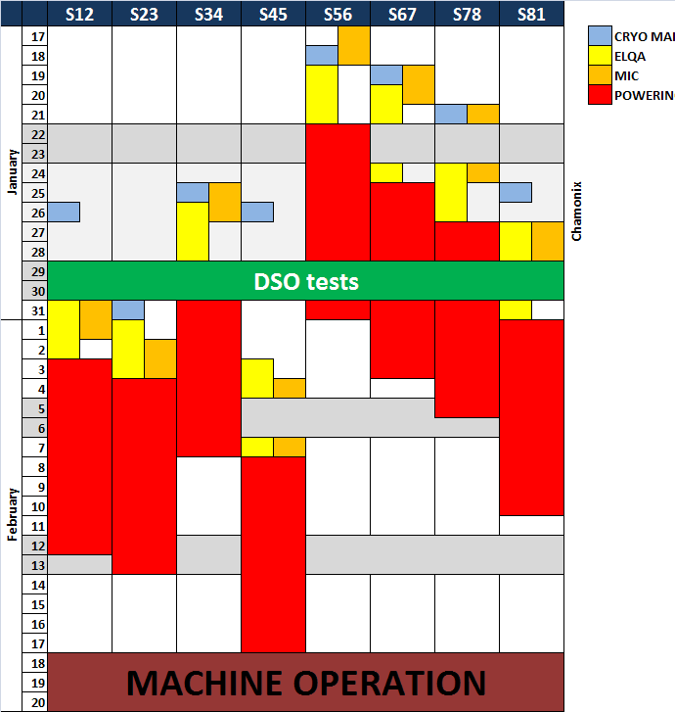
Planning evolution
November 11,2010
February 16, 2011
 |  | S12 | S23 | S34 | S45 | S56 | S67 | S78 | S81
January | 17 |  |  |  |  |  |  |  |  |  |  | CRYO MAINT.
 | 18 |  |  |  |  |  |  |  |  |  |  | ELQA
 | 19 |  |  |  |  |  |  |  |  |  |  | POWERING
 | 20
 | 21
 | 22
 | 23
 | 24 |  |  |  |  |  |  |  |  | Chamonix
 | 25
 | 26
 | 27
 | 28
 | 29
 | 30
 | 31
February | 1
 | 2 |  |  |  |  | LASS UPDATE
 | 3
 | 4
 | 5
 | 6
 | 7
 | 8
 | 9
 | 10
 | 11
 | 12 | DSO TESTS
 | 13
 | 14
 | 15
 | 16
 | 17
 | 18
 | 19
 | 20
MACHINE CHECK-OUT

Slide 3
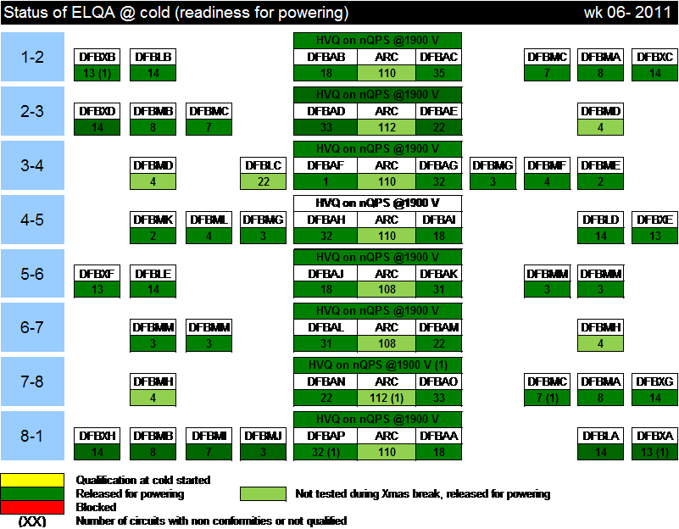
ElQA: no new non-conformities
Completed on February 9

Slide 4
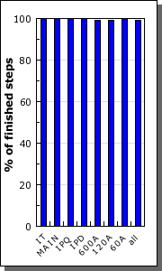
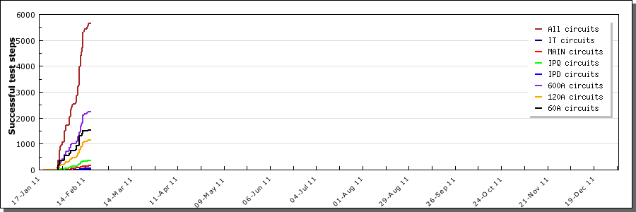
2011 powering tests campaign
1565 over 1572 circuits commissioned
About 6000 test steps executed in less than 3 weeks

Slide 5
Circuits not commissioned
This year we commissioned even more circuits than last year (some non-conformities were fixed and circuits validated)
Only really problematic cases are left
It did not change much from last year
Step successfully done
Step failed
Excluded step
Missing step
RCBXH3.L5 | PIC2 FAST ABORT REQ VIA PIC | 6 / 9 (66%) | PCS | N/WPM | 1 | _ | PIC2 CRYO-OK | PCL | PCC.5 | PIC2 | PCS | PNO.d3 | PNO.a3
RCO.A78B2 | 24 HOUR HEAT RUN | 0 / 9 (0%) | _ | _ |  | _ | PIC2 CRYO-OK | PCL | PCC.5 | PIC2 | PCS | PNO.d3 | PNO.a3
RCO.A81B2 | 24 HOUR HEAT RUN | 0 / 9 (0%) | _ | _ |  | _ | PIC2 CRYO-OK | PCL | PCC.5 | PIC2 | PCS | PNO.d3 | PNO.a3
RQS.R3B1 | 24 HOUR HEAT RUN | 0 / 9 (0%) | PCC.5 | N | 1 | _ | PIC2 CRYO-OK | PCL | PCC.5 | PIC2 | PCS | PNO.d3 | PNO.a3
RCBH31.R7B1 | PNO.d1 | 0 / 2 (0%) | _ | _ |  | _ | PCC.1 | PNO.a1 | PNO.d1
RCBCHS5.L8B1 | 24 HOUR HEAT RUN | 0 / 6 (0%) | _ | _ |  | _ | PIC2 CRYO-OK | PCL | PCC.1 | PIC2 | PNO.a1 | PNO.d1 | PNO.e1
RCOSX3.L1 | 24 HOUR HEAT RUN | 0 / 6 (0%) | PCC.1 | N | 1 | _ | PIC2 CRYO-OK | PCL | PCC.1 | PIC2 | PNO.a1 | PNO.d1 | PNO.e1

Slide 6
Circuit non-conformities
RCO.A78B2 - NC 1029807 - the circuit "quenched" always (three times) while ramping up the current from 55 A; possible splice problem
RCO.A81B2 - NC 955048 - CL1, CL2 and coil resistance too high
RCBH31.R7B1 - NC 1017094 - The Hi current lead resistance (DFLDS.31R7.2) is too high (1.14e-3 Ω) and coil seems to be too resistive
RQS.R3B1 - ECR 992709 - Following the incident of 19/09/2008 in LHC Sector 3-4, it was necessary to substitute several SSS. For 4 slots, the limited availability of spare Arc-SSS cold masses has not permitted to install SSS compatible with the LHC baseline layout 2008
RCBCHS5.L8B1 - NC 831927 - superconducting circuit shows high resistance (around 22 mΩ) on the cold side at 4.5 K; replaced by warm magnet installed in the vicinity
RCOSX3.L1 - NC 948545 - circuit found open below the cold v_taps of the 120 A current leads; this circuit is isolated from ground and from the other circuits
RCBXH3.L5 – Problem with the QPS (might be a missing tap); interventions carried out several times, but problem not fixed.

Slide 7
The other main ‘limitations’
RCBYV5.L4B2 - NC 1049055 – 3 quenches w.o. training (63.3, 65.7 and 64.7 A); limited to 50 A
RCBYH4.R8B1 - NC 1051795 - The circuit failed to pass successfully the PNO.a1 test with I_PNO of 72A; limited to 50 A
RCBYHS4.L5B1 - NC 1053709 - Circuit can not handle di/dt : weak magnet known since 2008; limited to 50 A
RCBYHS5.R8B1 - NC 1063839 - Circuit quenches when coming down from +-nominal current to zero. The control of the current also shows high instability; limited to 20 A
RQT13.L7B1 – NC 1131822 - Resistance at 400 A is 350 E-9 Ohms. Requested value is <200 E-9 Ohms. Last year measurement was 90 E-9 Ohms. Limited to 50 A (powered in 2010 to 2-3 A)

Slide 8
Parameters for this year

Slide 9
120 A correctors of the ITs
The cooling (heating feedback) of the 120 A leads has been problematic since the beginning of HC
During 2010, several circuits had to be super-locked and could not be used because of problems in keeping the right temperature
These circuits have not even powering functions generated (never used)
This year we might need some of them when going to low β*; in particular (M. Giovannozzi and R. Thomas) only the RCSXs will be needed
To avoid losing CRYO-START AND CRYO-MAINTAIN signals in operation (and thus dumping the beam) we suggest condamning all120 A circuits of the DFBXs, apart the RCSXs.
All of them have been
nevertheless commissioned
for future use, also those
not commissioned in 2010
RCOSX3.L2 | PIC2 PC PERMIT | 0 / 4 (0%) | PIC2 POWERING FAILURE | N | 1 | _ | PIC2 CRYO-OK | PCL | PCC.1 | PIC2 PC PERMIT | PIC2 POWERING FAILURE | PNO.a1 | PNO.d1 | PNO.e1
RCOSX3.R1 | PIC2 PC PERMIT | 0 / 4 (0%) | PIC2 POWERING FAILURE | N | 1 | _ | PIC2 CRYO-OK | PCL | PCC.1 | PIC2 PC PERMIT | PIC2 POWERING FAILURE | PNO.a1 | PNO.d1 | PNO.e1
RCOX3.L1 | PIC2 PC PERMIT | 0 / 4 (0%) | PIC2 POWERING FAILURE | N | 4 | _ | PIC2 CRYO-OK | PCL | PCC.1 | PIC2 PC PERMIT | PIC2 POWERING FAILURE | PNO.a1 | PNO.d1 | PNO.e1
RCSSX3.L1 | PIC2 PC PERMIT | 0 / 4 (0%) | PIC2 POWERING FAILURE | N | 2 | _ | PIC2 CRYO-OK | PCL | PCC.1 | PIC2 PC PERMIT | PIC2 POWERING FAILURE | PNO.a1 | PNO.d1 | PNO.e1
RCSSX3.R8 | PIC2 PC PERMIT | 0 / 4 (0%) | PIC2 POWERING FAILURE | N | 2 | _ | PIC2 CRYO-OK | PCL | PCC.1 | PIC2 PC PERMIT | PIC2 POWERING FAILURE | PNO.a1 | PNO.d1 | PNO.e1
RCTX3.L5 | PIC2 POWERING FAILURE | 1 / 4 (25%) | PNO.a1 | N | 1 | _ | PIC2 CRYO-OK | PCL | PCC.1 | PIC2 PC PERMIT | PIC2 POWERING FAILURE | PNO.a1 | PNO.d1 | PNO.e1
RCTX3.L8 | PIC2 PC PERMIT | 0 / 4 (0%) | PIC2 POWERING FAILURE | N | 2 | _ | PIC2 CRYO-OK | PCL | PCC.1 | PIC2 PC PERMIT | PIC2 POWERING FAILURE | PNO.a1 | PNO.d1 | PNO.e1

Slide 10
Reference
MP3 Procedure – PARAMETERS TO BE USED FOR THE 2011 COMMISISONING CAMPAIGN OF THE LHC SUPERCONDUCTING CIRCUITS. LHC-MPP-HCP-0095- EDMS 1113965
MP3 Procedure - SECTOR 1-2 - POWERING SPECIFICITIES. LHC-MPP-HCP-0092 - EDMS 1009658
MP3 Procedure - SECTOR 2-3 - POWERING SPECIFICITIES. LHC-MPP-HCP-0040 - EDMS 883231
MP3 Procedure - SECTOR 3-4 - POWERING SPECIFICITIES. LHC-MPP-HCP-0048 - EDMS 883247
MP3 Procedure - SECTOR 4-5 - POWERING SPECIFICITIES. LHC-MPP-HCP-0056 - EDMS 883273
MP3 Procedure - SECTOR 5-6 - POWERING SPECIFICITIES. LHC-MPP-HCP-0004 - EDMS 883295
MP3 Procedure - SECTOR 6-7 - POWERING SPECIFICITIES. LHC-MPP-HCP-0065 - EDMS 883317
MP3 Procedure - SECTOR 7-8 - POWERING SPECIFICITIES. LHC-MPP-HCP-0016 - EDMS 883182
MP3 Procedure - SECTOR 8-1 - POWERING SPECIFICITIES. LHC-MPP-HCP-0024 - EDMS 883200
Chamonix 2011: M. Pojer - “Which systems (except main circuits) should be commissioned/tested for 7TeV operation before the long shutdown?” “http://indico.cern.ch/getFile.py/access?contribId=40&sessionId=1&resId=0&materialId=slides&confId=103957
Chamonix 2011: N. Catalan – “What needs to be done to reach beam energy above 3.5 TeV? Commissioning of essential magnet powering and machine protection systems”
http://indico.cern.ch/getFile.py/access?contribId=53&sessionId=3&resId=2&materialId=slides&confId=103957

