Slide 1
Automatic tune and b3 compensation at injections
CERN, LHC Beam Operation Committee , 22nd February 2011
Nicholas Aquilina
TE-MSC-MDA
Acknowledgements:
E. Todesco, W. Venturini Delsolaro, EIC and operators

Slide 2
Contents
Measurements of tune and chromaticity decay during injection (September-October 2010)
Post-processing of data in order to get the bare tune and chromaticity of the machine removing the effect of the trims
Fitting of the data with FiDeL parametrization
Proposal for the average correction and an estimate of the expected error

Slide 3
The injection plateau
The injection plateau is
the part of the LHC cycle
where the current in the
bending dipoles is kept at
a constant value of 757.2 A
During this time, injection takes place
In most cases injection time takes 1 to 2 hours
During this time a decay in the tune and chromaticity is observed
In 2010 this decay has been corrected manually by applying the necessary trims [E. Todesco, Evian December 2010]

Slide 4
Typical tune decay and tune trim during injection
Measurements taken for ramp 5th Oct 2010 (22h)
“Q_{h}” is the tune as measured by the BBQ, “trim” is the manual trim applied through QTD and QTF circuits
Tune decays by 0.003 units, then it is trimmed back “manually” to its original value (note a trim of 0.003)

Slide 5
Bare tune of the machine
By removing the trims we get the bare tune of the machine, therefore we get the total tune decay during injection

Slide 6
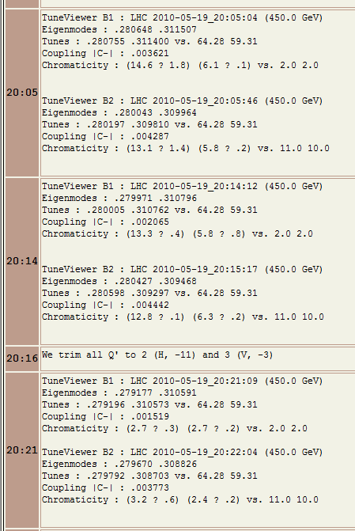
Measurements and trims for chromaticity
The value of the chromaticity is obtained from the logbook (as done by [W. Venturini])
The trims can be obtained:
  from the logbook
  from TIMBER; currents in MSF/MCD
Horizontal chromaticity versus time at injection, beam1 (blue), beam2 (red) [W. Venturini Delsolaro]

Slide 7
Chromaticity decay
The chromaticity measurement was taken from the logbook without taking note of the trims
Instead the trims were obtained from TIMBER
The bare chromaticity of the machine was then obtained by adding the trims to the measurements

Slide 8
Fitting of the data
A double exponential¹ of this form was used to model this decay
This model fits very well the tune and chromaticity decay
¹ N. Sammut, L. Bottura, and J.Micallef. Phys. Rev. ST Accel. Beams 9, 012402 (2006)

Slide 9
Average correction for tune decay
All the fits and the respective correction (in green) for the horizontal and vertical tune (beam 1 in blue, beam 2 in red)
Note how in the vertical plane b1 and b2 start with different values
All the ramps used were taken for 3rd September to 31st October 2010
Horizontal tune not far from the nominal value of 0.28, vertical tune is ~0.07-0.1 smaller than the nominal value of 0.31

Slide 10
Average correction for tune decay
Based on the average fits shown in the previous slide the following average corrections are suggested:
parameter | horiz | vert
c | 0.033 | 0.029
d | 0.305 | 0.292
τ | 2000 | 2000
v | 0.310 | 0.244
max error | 0.016 | 0.018
Where max error is the maximum error during injection time, which occurs at the end of the injection plateau

Slide 11
Pre-cycling sectors individually
End of ramp
Start of ramp
A: Injection energy is reached for all sectors
B: Sectors 12, 23, 34 fall down
C: Injection energy reached for sectors 12,23,34
D:Sectors 67, 78 and 81 fall down
E:Injection energy reached for sectors 67, 78 and 81
B
C
D
E
A
The tune start to decay at A, but for sectors 12, 23 and 34 it starts at C, therefore different sectors contribute in a different way.

Slide 12
Effect of individual pre-cycling
Qh is the tune decay as seen when starting at A
Qh* is the tune decay as seen at C (or any similar point)
In the above example there is a difference of 32000 seconds
Ideally all sector are pre-cycled together such that all the sectors start the injection plateau together

Slide 13
Fitting of the data for chromaticity decay
where Q’h* and Q’v* are the bare chromaticity values of the nominal machine optics
Total amplitude of the decay is ~20 units, i.e. ~0.5 units of b3, as expected
 | Q’h | Q’v
c' | -23 | 18
d' | 0.104 | 0.100
τ' | 1000 | 1000
_{ξ} | -89 | -55
max error | 6.0 (0.9) | 4.6 (0.7)

Slide 14
Average correction for chromaticity decay
Based on the fits shown in the previous slide the following corrections are suggested:
 | Q’h | Q’v | average Q’ | average b₃ | parameters ² | FiDeL DB ³
c' | -23 | 18 | ±20.5 | ±0.5¹ | 2.01 | 1.02
d' | 0.104 | 0.100 | 0.102 | 0.10 | 0.66 | 0.53
τ' | 1000 | 1000 | 1000 | 1000 | 189.04 | 109
_{ξ} | -89 | -55 | n/a | n/a | n/a | n/a
suggested values
¹ taking 1 unit of b₃ = 40 units of Q’
² N. Sammut, L. Bottura, and J. Micallef. Phys. Rev. ST Accel. Beams 10, 082802 (2007) for a 50A/s ramp rate and I_{FT} = 12kA
³ parameters in FiDeL database since 2008, for a 10A/s ramp rate and I_{FT} = 12kA, in fact c = 0.5 was used instead (since I_{FT} = 6kA)

Slide 15
Measurements taken last Sunday (20th February) by L. Ponce – Preliminary results
Comparing the measured tune (in blue) to the average from the previous analysis (in red)
Comparing the fit of the measured tune (in red) to the fits obtained from the previous analysis
It can seen that the tune decay is flatter and therefore faster

Slide 16
Measurements taken last Sunday (20th February) by L. Ponce – Preliminary results
Comparing the chromaticity measurements with the average fit from the previous analysis
Not how the chromaticity decay is also flatter and faster
Need more measurements in order to understand better what is happening

Slide 17
Conclusions (Tune)
Tune decay during injection is clear, operators are correcting this decay manually
The total measured variation of tune, including decay and reproducibility from fill to fill over 10000 s is 0.04
  Since trims of the previous run are used, this can drive tune on resonances
A double exponential fit was used to model this decay
If the suggested average correction is used, the residual error will be reduced to less than 0.02

Slide 18
Conclusions (Chromaticity)
Chromaticity measurements during injection can be used to understand better the b₃ decay behaviour
From this analysis it can be seen that the b₃ decay is a factor of 5 slower than the expected value from the measurements done at SM18, however the decay amplitude is in line with these measurements
Injecting the beam as soon as possible once at injection will help to get a better model of the chromaticity during the first moments of the decay
Having more measurements of the chromaticity both during injection and ramping logged in TIMBER will be very helpful for further analysis

