Slide 1
Preparation for 2011
Ions run
CONTENT:
Beam characteristics and parameters
Filling schemes
Operational settings
OP procedure and COLL setting
Planning
Shift breakdown
To define the way and the strategy…
Thanks to: C.Carli, J.J.Gras, J.Jowett, D.Manglunki, J.Wenninger
M.Solfaroli

Slide 2
Beam Characteristics
Bunch intensity:
10x10⁷ if 2 bunches from PS (200 ns)
7x10⁷ if 4 bunches from PS (100 ns)
Transverse normalized (nominal) emittance in collisions 1.5 μm
Energy of the beam:
~ 1.84 MJ - (572b – 100 ns)
~ 1.65 MJ - (358b – 200 ns)
SBF for Ions ~7E9 (the normal one has probably to be used for the setup phase to allow 2 bunches to be safe)

Slide 3
Squeezing
Squeeze ATLAS and CMS to 1.0 m (already done for p)
Squeeze ALICE to 1.5 m (first with p)
Squeeze ALICE to 1.0 m (first with p)
This will be the most “squeezed” LHC optics so far…
Most sensitive to errors
Need good beta-beat measurements (ie with protons) to achieve good corrections
Must commission squeeze first with protons

Slide 4
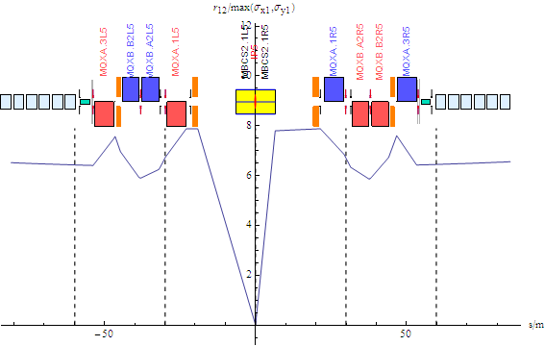
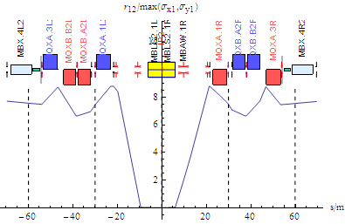
Xing angles
ATLAS/CMS
Zero crossing angle impossible (unless we go back to 500 ns (2010 filling scheme))
Low-β optics already commissioned for p-p
Proposal: use same crossing angles as p-p
Already commissioned, saves time
Caveat: beam sizes may be larger with Pb
ALICE
Polarity change during run
Try to have zero crossing angle - large external Xing angle to compensate spectrometer
Assuming full field, Xing angle is ±140 μrad
N.B. separation good for 100 ns
J.Jowett

Slide 5
ALICE - ZDC + polarity
TCTVs need to be fully open as last year:
Principle approved by rMPP
BLM thresholds on triplet to be lowered by a factor 10 (ending to the same configuration as last year)
Procedure being written and circulated in EDMS
TCDD has to be moved out after injection
Alice polarity flip can be tried with beam at the end of one fill (reviewing whether they really want the polarity flip):
As the intensity is smaller, luckily the beams survive
No TCTVs to be re-aligned
Avoid changing all the settings throughout the cycle
Sensible gain in time

Slide 6
Filling schemes
2 filing schemes are foreseen:
 | NOMINAL | INTERMEDIATE
Total number of bunches | ~572 | ~356
PS bunch spacing | 100 ns | 200 ns
SPS bunch spacing | 200 ns | 200 ns
PS bunch splitting | YES | NO
Bunch intensity | ~7E7 Pb/bunch | ~10E7 Pb/bunch
Colliding bunches in ATLAS/CMS | ~572 | ~356
Colliding bunches in ALICE | ~536 | ~336
SPS long injection plateau may cause blow-up and/or intensity loss – MD of Sept. 29th – alternatively injections of 12 bunches
Alternative schemes with 150ns spacing (no bunch splitting) in the PS has been studied, but the luminosity improvements is marginal with respect to 200 ns

Slide 7
Settings management
A dedicated Hypercycle has been created (3.5TeV_10Aps_IONS_1m)
Most settings identical to protons but:
RF (→ functions to be prepared)
Xing angles in collisions
Collimation
To minimize the changes, Xing settings maintained as for p throughout INJECTION, RAMP and SQUEEZE:
Xing angle to be set at:
120 μrad for IP1 and IP5
-140 μrad (external angle) for IP2. If ALICE’s polarity is flipped during the run the external angle must be set at +140 μrad
Same Xing angle as for protons and parallel separation for IP8 (no collision required)

Slide 8
OP procedure + COLL setting
No changes to IP7 and IP3 settings all over the cycle
Cross calibration of orbit reading with protons, as last year (can be done before!?):
Inject high intensity p bunch (LOW BPM sensitivity)
Correct against reference orbit
Inject low intensity p bunch and record orbit (HIGH BPM sensitivity)
Inject an Ions bunch and check that orbit is the same
Define it as Ions reference orbit
Test ramp with safe Ions beam (2b) to establish reference orbit up to high energy
During squeeze use same orbit reference as for protons and measure the optics

Slide 9
OP procedure + COLL setting
Ramp with the same collimator settings as for p till the end of the squeeze, then:
Keep IP8 separation and Xing angle
Change Xing angles as required in IP1, IP2 and IP5
Set-up of TCTs (not V for IP2) around new collision orbit
As a result only one collimator set-up to be done at top energy
Loss maps:
Last year the following loss maps were performed for Ions:
Condition | Betatron H | Betatron V | Dp/p + | Dp/p - | Dump
Injection | V | V | V | V | V V
Flat top | V | V | V | V | V
Squeezed | V | V | X | X | V
Collisions | V | V | V | V | V

Slide 10
p/Pb feasibility studies
Aim
Inject and ramp with unequal RF frequencies to demonstrate feasibility
Beam 1: 100 ns proton beam
Beam 2: Pb beam
If we succeed in ramping and manually re-phasing the RF, this could give 1 (or 0) collision/turn in each experiment
2 dedicated MDs and some time when p are still available should be allocated to this exercise

Slide 11
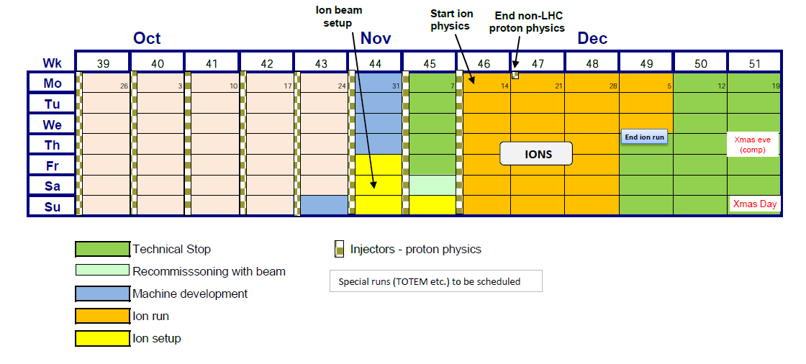
Planning
Recover Pb beams stable beams declaration
2 MD for Pb injection, test injection of Pb on p
Test ramp of p-Pb, while p still available from injectors
Set up ALICE squeeze with p, then Pb beam, ramp, squeeze, crossing angles, collimation
J.Jowet

Slide 12
Shift Breakdown
ACTION | Species | No. OF BUNCHES/BEAM | TIME (shift) | COMMENT | GROUP
ALICE polarity flip + LHCb switch off (if not done before the MDs) |  |  | 0.5 | ACCESS and recovery |  | Friday
ALICE squeeze to 1.0 m, beta beating measurement | p | 2 | 2
Aperture measurement | p | 2 | 0.5 | Done with protons for accuracy | ABP, OP
Checking/setting injection (with p) | p | 2 | 1.5 | Calibrate BCTs | OP | Saturday
 |  |  |  | Injection of high intensity proton bunch
 |  |  |  | Injection of low intensity proton bunch
 |  |  |  | switch injector chain to ions
Injection and circulating beams (already done for Beam 2 in p-Pb MD) | Pb | 1 (non colliding) | 0.5 | Injection of Ions (to establish the reference orbit) | OP
 |  |  |  | BI check | BI
 |  |  |  | Resteering of transfer lines (if needed) | ABT
 |  |  |  | RF capture (at -5 kHz frequency shift) | RF
 |  |  |  | check injection oscillation | OP
 |  |  |  | check 450 GeV dump ok | ABT
 |  |  |  | Wire-scanner for 1 beam | BI
 |  |  |  | BGI

Slide 13
Shift Breakdown
ACTION | Species | No. OF BUNCHES/BEAM | TIME (shift) | COMMENT | GROUP
450 Z GeV optics checks with two beams | Pb | 1 (non colliding) | 0.5 | beta-beating. > 0.4 nominal bunch intensity | ABP | Sunday
Ramp, squeeze, collision setup | Pb | 2 colliding | 1.5 | Blowup off - TFB off - OFB on - QFB on - Collimators ramp if no issues at injection, then squeeze, optics check, find collisions and transition to zero real crossing angle in ALICE | OP
Loss Maps | Pb | 2 colliding | 1 | Loss maps (450 GeV) + Async dump | OP, COLL
TECHNICAL STOP |  |  | 15 |  |  | Mon-Fri
Recommissioning | Pb |  | 3 |  |  | Saturday
Setup for collisions | Pb | 2 | 1 | Collimation setup. | COLL | Sunday
Loss Maps | Pb | 2 colliding | 1 | Loss maps (end of squeeze) + Async dump | OP, COLL
Loss Maps | Pb | 2 colliding | 1 | Loss maps (collisions) + Async dump | OP, COLL
First collisions + PHYSICS | Pb | 2 colliding | 1 | Ramp with two beams, squeeze, checks, Stable beams. | OP | Monday
Increase intensity (1) | Pb | ~150 | 1 or 2 | Increase bunch number | OP
p-Pb injection, ramp | p,Pb | (2,540),2 | 3 | Details depending on MD experience, may try some collisions, if time agreed | OP | Tuesday
Increase intensity (2) | Pb | 358 | 1 | Increase bunch number | OP | Wed
Physics | Pb | 358 |  | Steady physics | OP

