Slide 1


Vacuum Observation
G. Bregliozzi (27/09/11)
CERN TE-VSC, Geneva
ALICE Background
ID 800: ZDC Detector
TDI2L & TDI8R
ATLAS, CMS and LHCb
Summary
G. Bregliozzi - LBOC – 27th of September 2011

Slide 2
ALICE: Vacuum layout

Slide 3
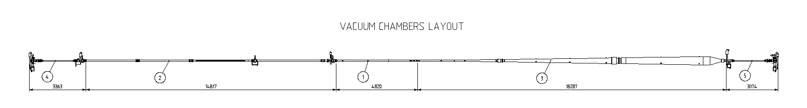
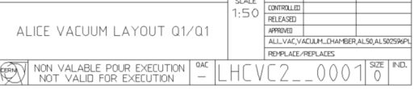
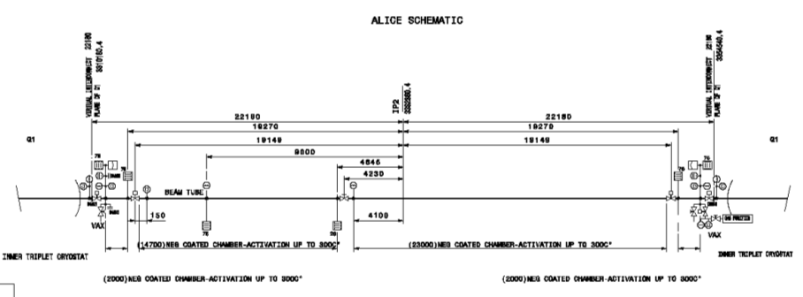
ALICE Cavern Layout: Q1 – Q1
B1L2.X
A1L2.X
A1R2.X
VGI.220.1L2.X
IP2.X
VGI.220.1R2.X
VGPB.190.1L2
For the installation drawing layout: https://lhc-div-miwg.web.cern.ch/lhc-div-miwg/Main_Pages/new_frame%20miwg_icl.htm
ALICE Vacuum Instrumentations: Drawings
A1L2.X
IP2.X
B1L2.X
A1R2.X

Slide 4
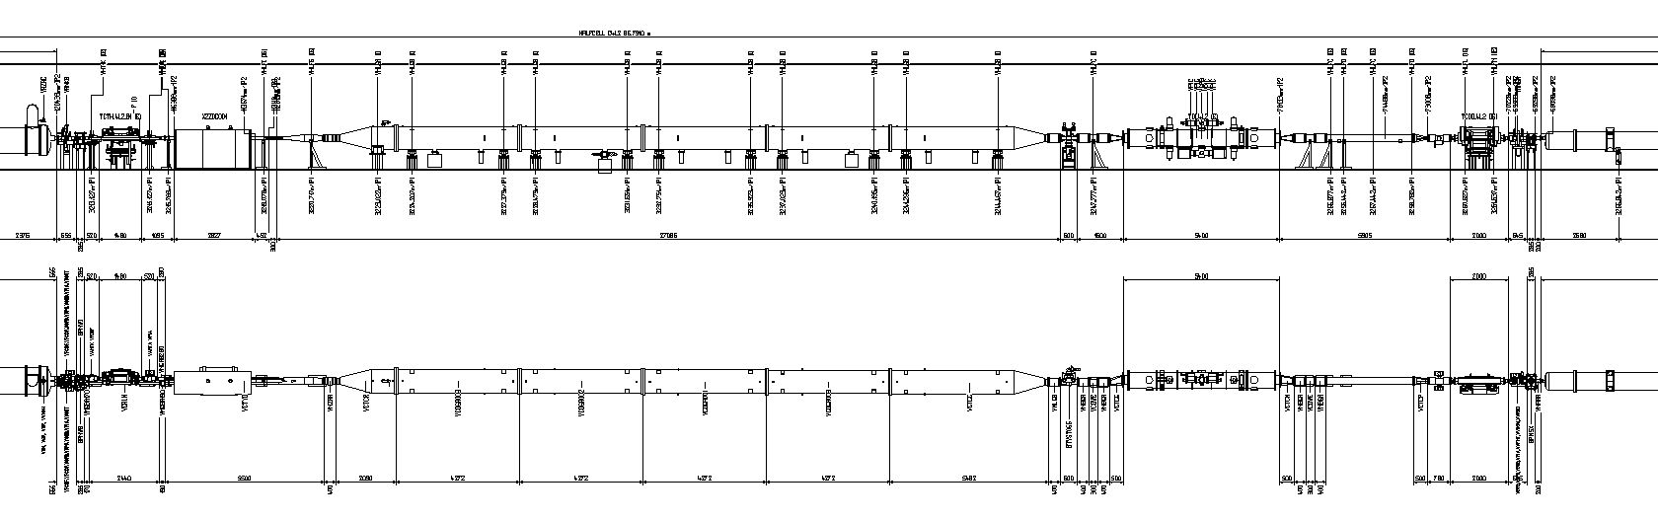
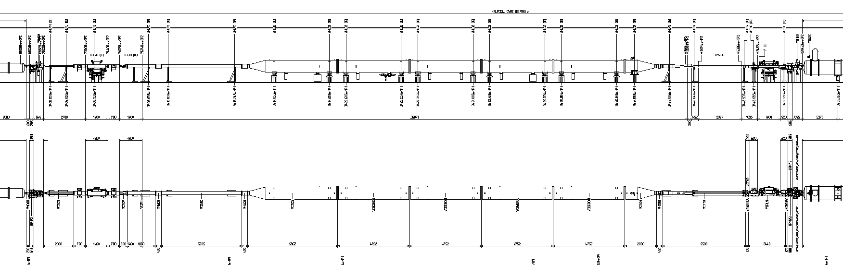
ALICE Extended Tunnel Layout: D2 – D1
Vacuum Sector A4L2.X
D2
TDI
ITL2
VGPB.231.4L2
VGPB.123.4L2
VGI.514.4L2
Recombination chamber
ID 800 mm Vacuum Chamber
Vacuum Sector A4R2.X
ITR2
D2
TCT + TCL
VGI.514.4R2
VGPB.123.4R2
ID 800 mm Vacuum Chamber
Recombination chamber

Slide 5
Pressure history

Slide 6
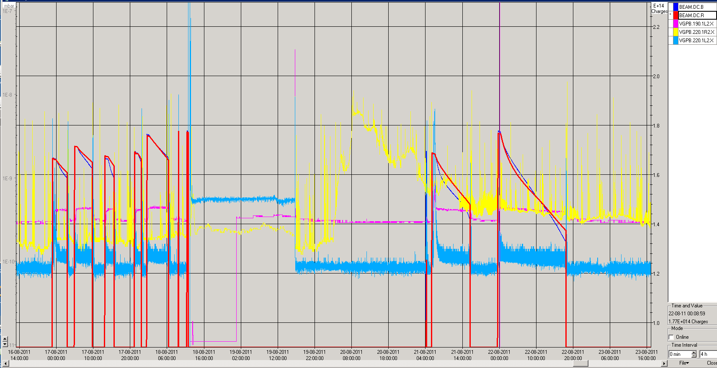
ALICE Cavern Pressure Distribution
Before Technical Stop 4
10⁻⁷ mbar
Cryo loss
10⁻¹¹ mbar
IP: Maximum Pressure VGPB.190.1L2.X: 5·10⁻¹⁰ mbar

Slide 7
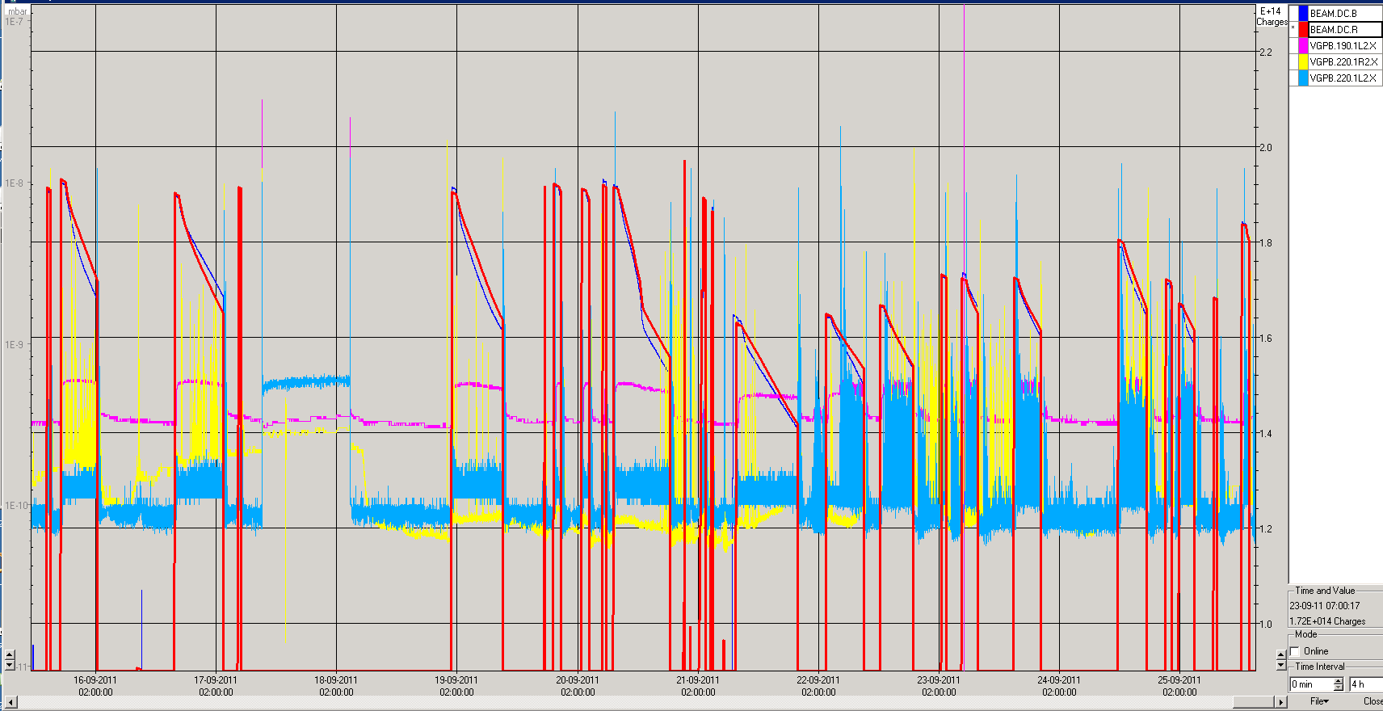
ALICE Cavern Pressure Distribution
After Stop 4
10⁻⁷ mbar
10⁻¹¹ mbar
IP: Maximum Pressure VGPB.190.1L2.X: 5·10⁻¹⁰ mbar

Slide 8
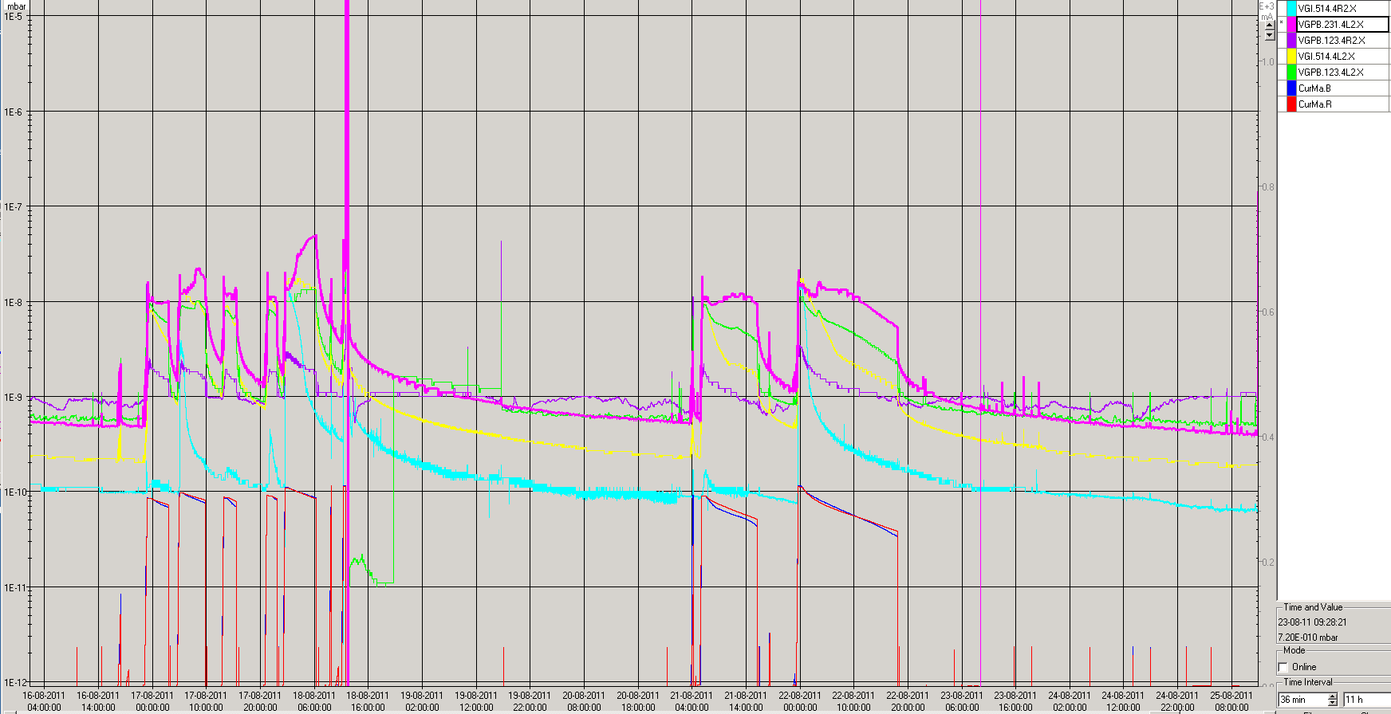
Summary D2- D1: Pressure Distribution
Before Technical Stop 4
10⁻⁵ mbar
Highest pressure recorded at 80 m left from the IP in the TDI: VGPB.231.4L2.X
5·10⁻⁸ mbar
1·10⁻⁸ mbar
10⁻¹² mbar
Fills with ALICE detector partially ON
Transient in the VGI (Light blue curve) at 108 m from the IP: both side

Slide 9
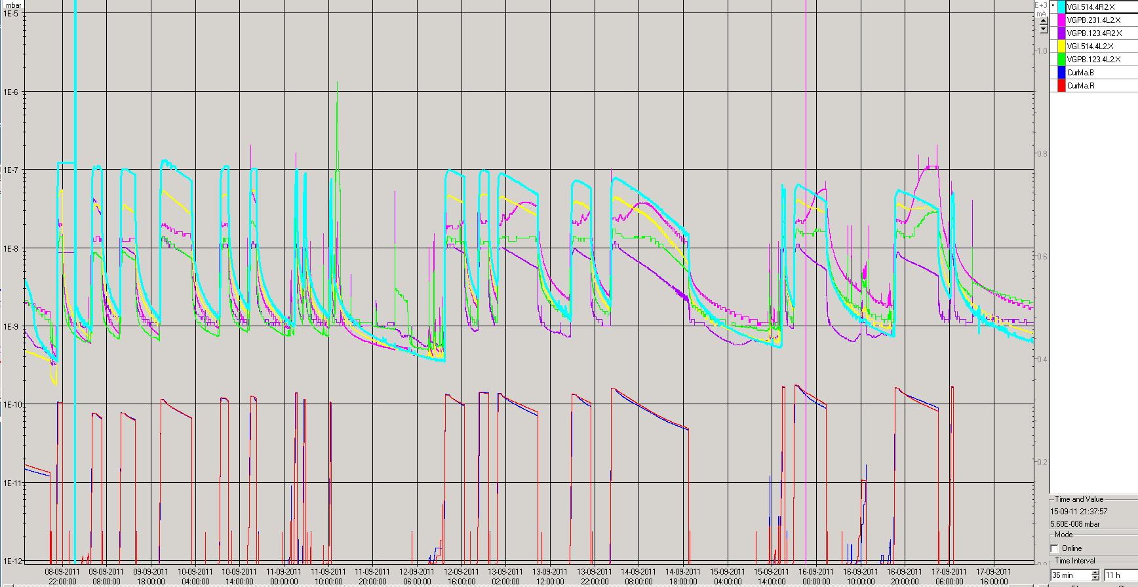
Summary D2- IT: Pressure Distribution after Technical Stop
10⁻⁵ mbar
Highest pressure recorded at 108 m right from the IP in the ID800 Chamber: VGPB.514.4R2.X
Pressure dominated by the TDI
Fills with ALICE detector ON
10⁻¹² mbar
Pressure in the TDI is equal as before the technical stop

Slide 10
Pressure at 3.5 TeV before collision:
Before and After technical stop 4
 |  | ALICE IP |  |  | Inner Triplets – D1 |  | TDI | Q3-Q4
 | Average Bunch Intensity p/b | D1L2 RT VGPB.190.1L2 | VAX.L2 VGI.220.1L2 | VAX.R2 VGI.220.1R2 | D1.L2 VGPB.123.4L2 | D1.R2 VGPB.123.4R2 | TDI VGPB.231.4L2 | Recombination Chamber L2 VGI.514.4L2 | Recombination Chamber R2 – ZDC VGI.514.4R2
Before TS Fill 2025 | 1.35e11 | 4.5e-10 | 2e-10 | 1.2e-10 | 2.5e-8 | 1e-8 | 3.5e-8 | 4e-8 | 5.5e-8
Before TS Fill 2040 | 1.28e11 | 4E-10 | 2e-10 | 1.3e-10 | 1.1e-8 | 3e-8 | 1.5e-8 | 1.5e-8 | 1.5E-8
After TS Fill 2092 | 1.29e11 | 5E-10 | 2E-10 | 1.5E-10 | 1.5E-8 | 1.5E-8 | 2E-8 | 5E-8 | 1.3e-7
After TS Fill 2105 | 1.37E11 | 6E-10 | 2E-10 | 1.5E-10 | 1.7E-8 | 1.2E-8 | 2.5E-8 | 4E-8 | 7.5E-8
After TS Fill 2117 | 1.38e11 | 5.5E10 | 2E-10 | 1.5E-10 | 1.6E-8 | 8E-9 | 2E-8 | 3.5E-8 | 5.5E-8
Ratio 2117/2025 |  | ≈1.2 | ≈1 | ≈1.25 | ≈0.65 | ≈0.8 | ≈0.6 | ≈0.85 | ≈1
Distance from IP2 |  | 19 m | 22 m | 22 m | 70 m | 70 m | 82 m | 108 m | 108 m
Practically no pressure variation before and after the technical stop

Slide 11
ID800 Pressure Variation

Slide 12
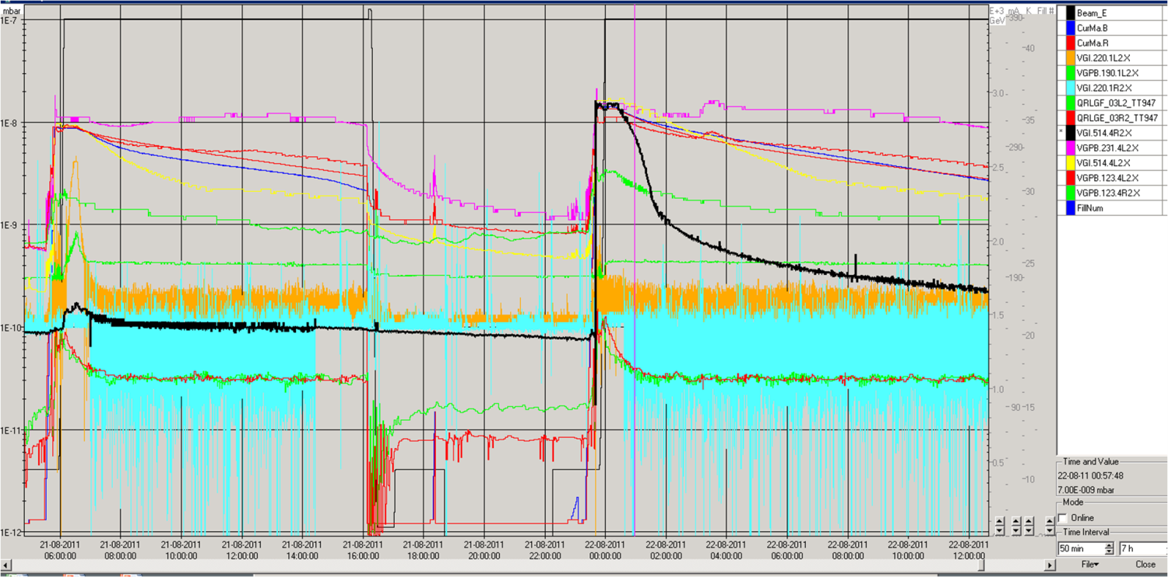
ID800 vacuum Chambers
Intensity Threshold for Electron Cloud
Transient in the VGI at 108 m from the IP: both side
304 mA
321 mA
304 mA
Fill 2037
Fill 2040

Slide 13
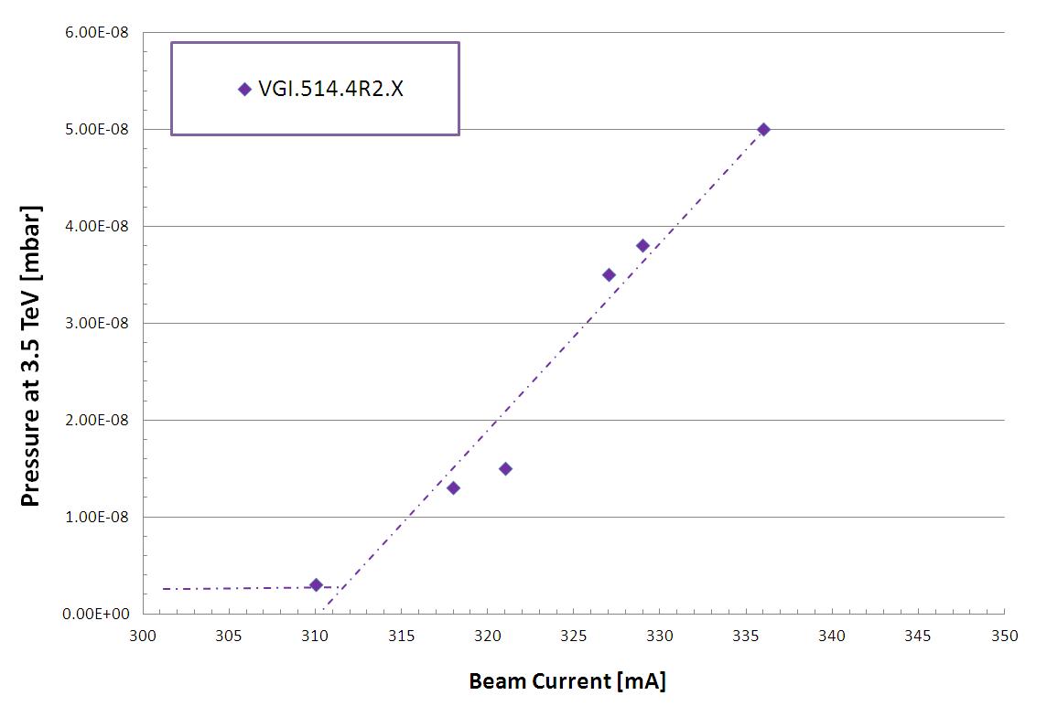
Pressure in the ID800 Vacuum Chambers
Before Technical Stop 4
Pressure taken (max) at 3.5 TeV before starting collision
Linear dependence with the beam current: Electron cloud symptom

Slide 14
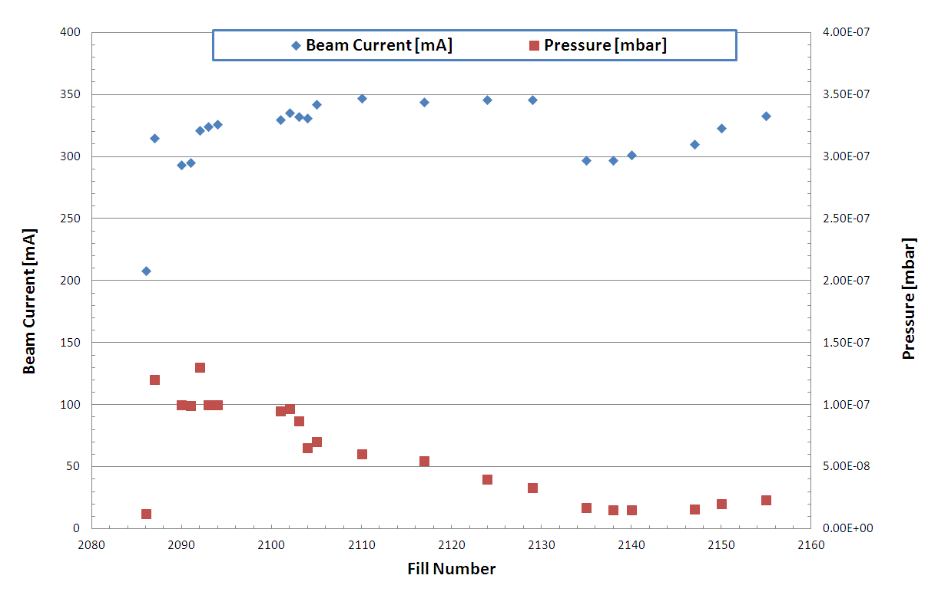
Pressure in the ID800 Vacuum Chambers
After Technical Stop 4
Constant Increase of Bunch Intensity
form 1.3E11 up 1.38E11 p/b
Despite increase in beam current (bunch intensity)
Decrease of Pressure

Slide 15
Normalized Pressure to Beam Current
ID800 Vacuum Chambers
Conditioning Effects

Slide 16
Comparison of Beam Scrubbing
ID 800 mm and LSS7 during April 2011
Both gauges decrease of factor 4 after 30 h
Pressure decrease in LSS2 is behaving the same as the pressure decrease due to beam scrubbing performed during MD in April in LSS7

Slide 17
Electron Cloud Build Up Mechanism
LOST
LOST
Photoelectron 200 eV
Secondary electron 10 eV
Photoelectron 200 eV
Photoelectron 200 eV
+
+
+
Secondary electron 5 eV
Secondary electron 5 eV
KeV
5 ns
Beam direction
7.5 m
25 ns
After F. Ruggiero, Chamonix X workshop

Slide 18
Electron cloud: Vacuum pressure rise
Vacuum pressure rise
  Electron stimulated desorption (ESD)
  Multipacting length
  Effective pumping speed
Vacuum cleaning:
  Dose effects due to the electron bombardments which produce a decrease of the electron desorption yield, η, the number of gas molecules desorbed from the surface of the beam vacuum pipe by the primary electron.
Beam Scrubbing:
  Dose effects due to the electron bombardments which produce a reduction of the secondary electron yield, δ, the number of secondary electron generated by the primary electron.

Slide 19
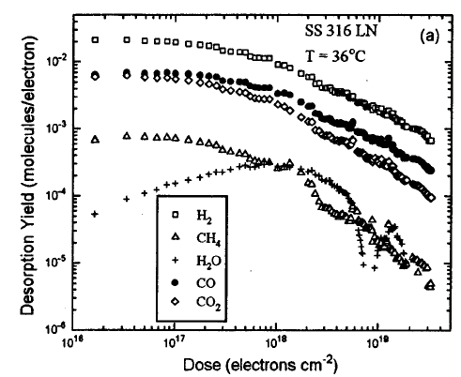
Vacuum Cleaning and Beam Scrubbing:
Electron Dose
J. Gómez-Goñi and A.G. Mathewson. J. Vac. Sci. Technol. A, vol. 15, No. 6, Nov/Dec 1997, p 3093

Slide 20
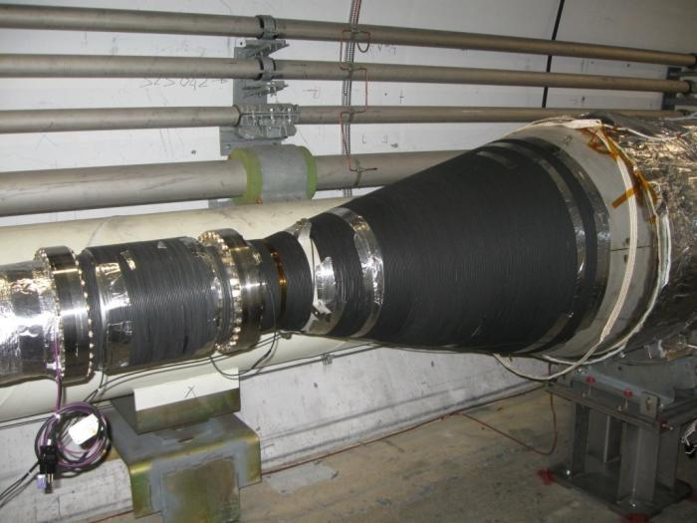
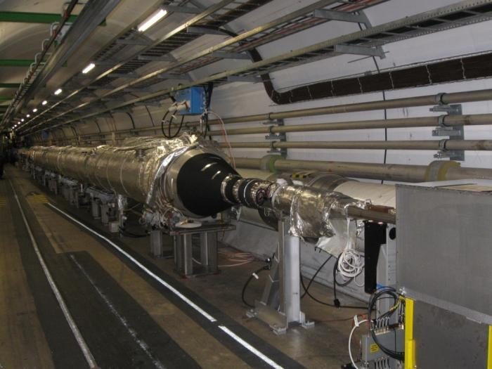
Installation of Electron Cloud Suppressor in Conical Transition of ZDC Vacuum Chambers
This week end 950 m of cable around the conical chambers located at the extremity of the ID800 mm vacuum chambers of vacuum sector A4R2.C were installed: 1 layer
The solenoid in LSS2R are powered to 5A: Apparently not sufficient magnetic field to suppress the formation of secondary electrons.

Slide 21
TDI2R Pressure Variation

Slide 22
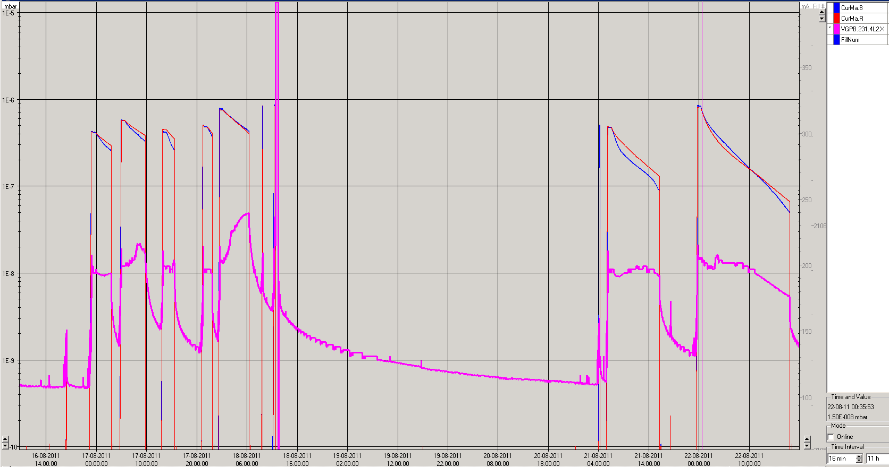
TDI LSS2L before Technical Stop
5·10⁻⁸ mbar
1.0·10⁻⁸ mbar
Maximum pressure increase was 5·10⁻⁸ mbar.
Pressure increase during the injection due to electron cloud
After about 2 h of stable beam, pressure increase due to heating effects.

Slide 23
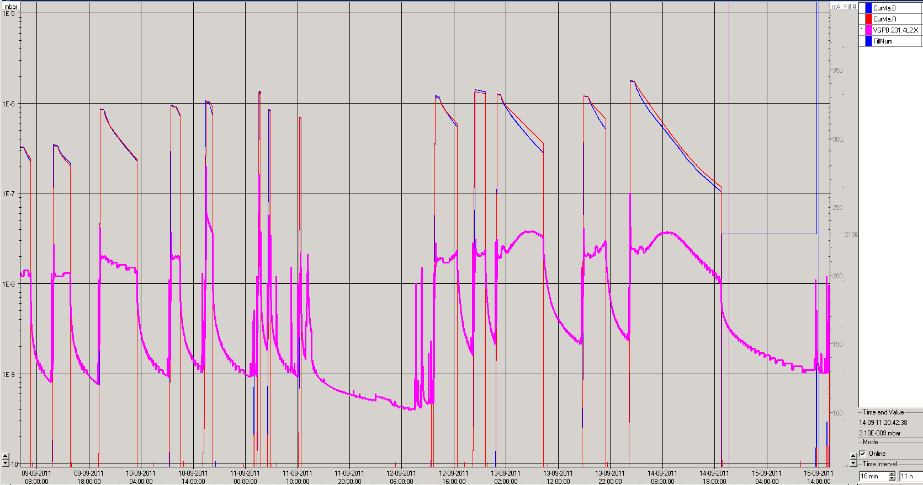
TDI LSS2L after Technical Stop
3.5·10⁻⁸ mbar
1.0·10⁻⁸ mbar
Maximum pressure increase was 3.5·10⁻⁸ mbar.
Pressure increase during the injection due to electron cloud
After about 2 h of stable beam, pressure increase due to heating effects.

Slide 24
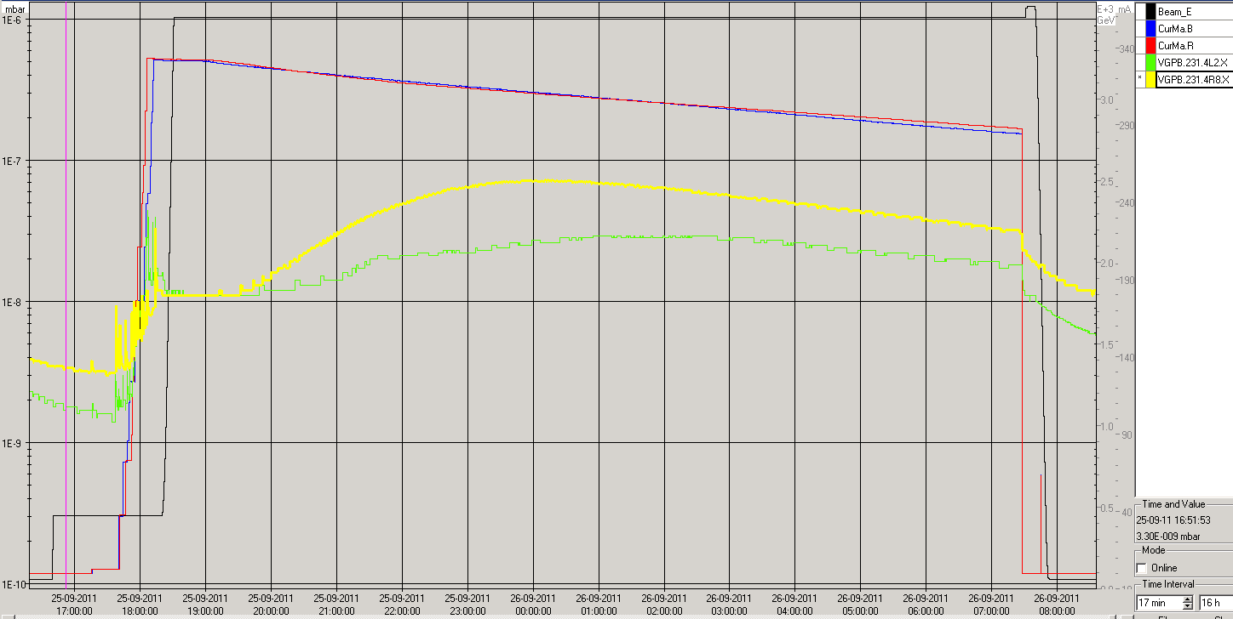
TDI LSS2L and LSS8R
Both TDIs have the same behavior

Slide 25
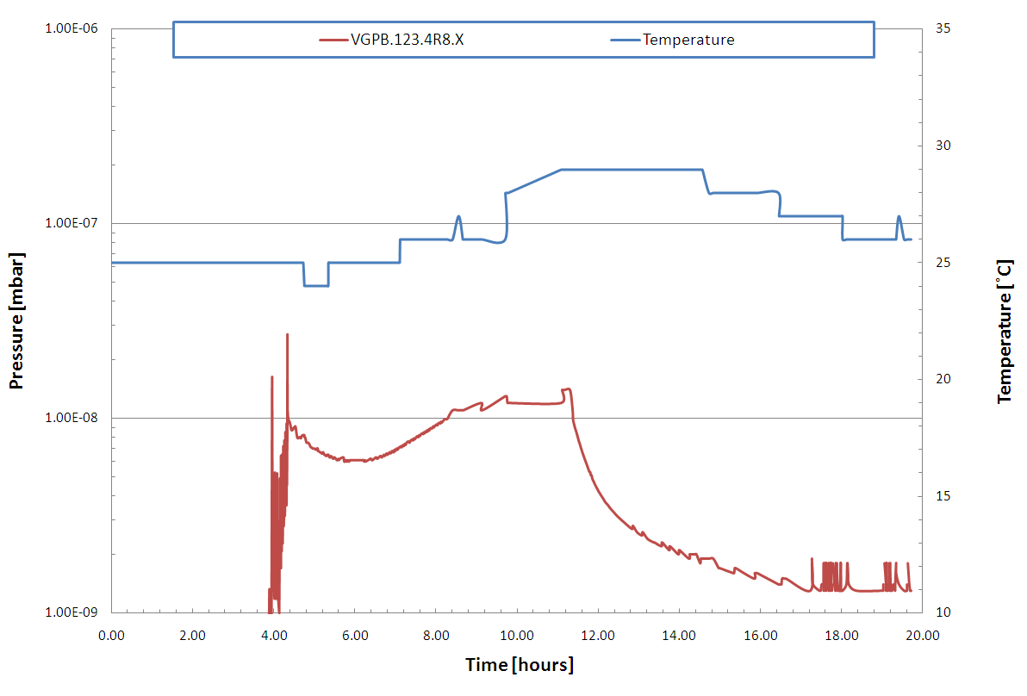
Example of TDI in LSS8R
Starting from fill 2092 (1.29E11 p/b) a pressure increases are seen at TDI about 1h-2h after machine full
Temperature increases from 8 to 17 deg are observed at TDI extremities: measurements done externally. The temperature internally is higher.

Slide 26
What is the effects of the heating in the vacuum?
20h
From room temperature to 100˚C the outgassing increase of factor ≈100
From room temperature to 50˚C the outgassing increase of factor ≈10
Data from P. Chiggiato
The constant increase of bunch intensity before and after the technical stop are producing an heating effect in the TDI: HOM.
Possible mitigations:
1) Add ventilator externally: reduce outgassing (possibly not sufficient)
2) Increase bunch length and/or decrease bunch intensity (to be defined by impedance experts)

Slide 27
Vacuum Observations:
ATLAS, CMS and LHCb

Slide 28
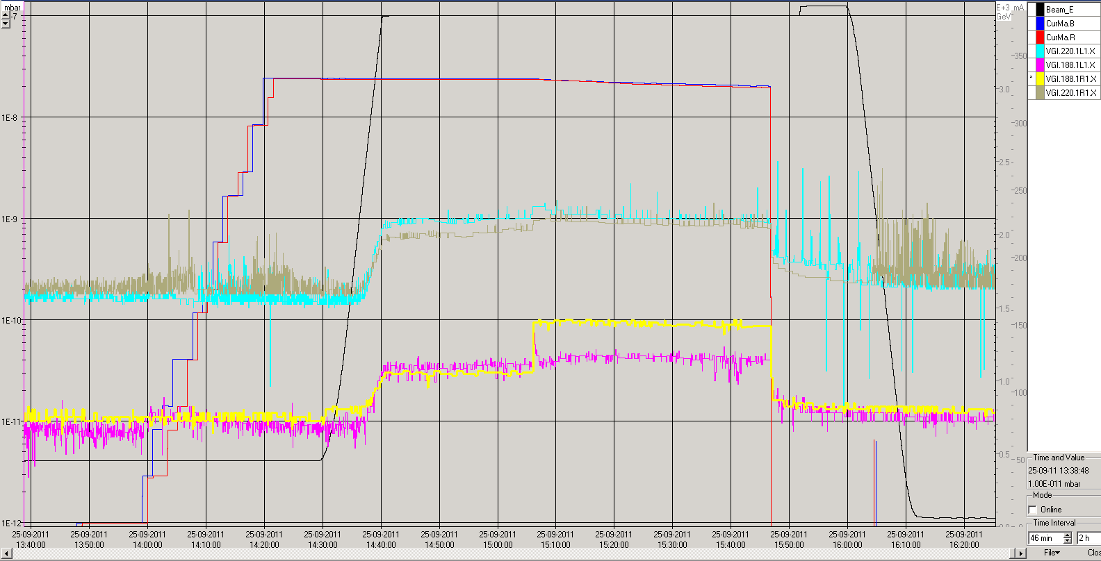
ATLAS Cavern : Q1 – Q1
Synchrotron Radiation
Q1
At 18 m from IP
Beam Collision
Maximum Pressure at Q1: 1·10⁻⁹ mbar
Maximum Pressure at 18 m from IP: 5·10⁻¹¹ mbar
Fill 2155

Slide 29
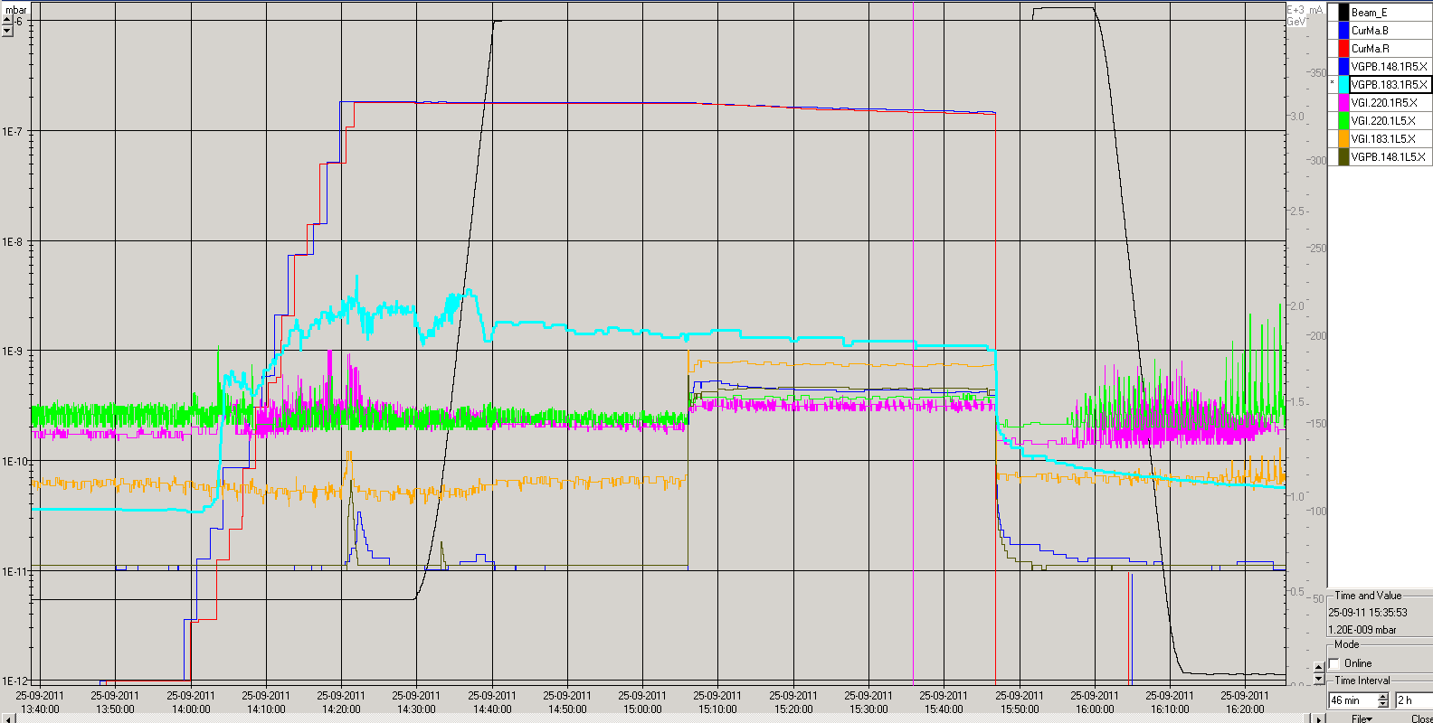
CMS Cavern: Q1 – Q1
Electron Cloud
At 18m from IP
Beam Collision
During collision pressure quite constant in all IP: 5·10⁻¹⁰ mbar
At 18 m right: pressure function of beam parameters: orbit, emittance,…
Fill 2155

Slide 30
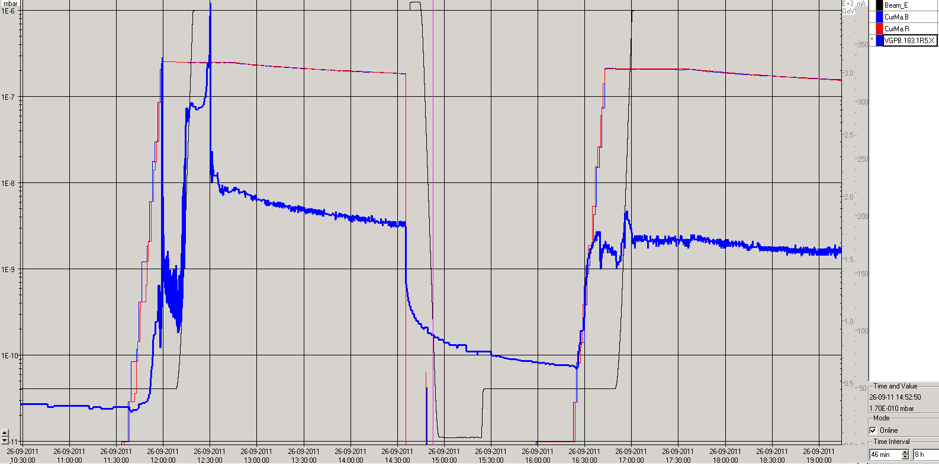
CMS Cavern: Q1 – Q1
The pressure reading at 18 m right of the IP is very sensitive to beam parameters variation
Same bunch intensity – Same filling patterns
1·10⁻⁶ mbar
2·10⁻⁹ mbar
Fill 2157
Fill 2158

Slide 31
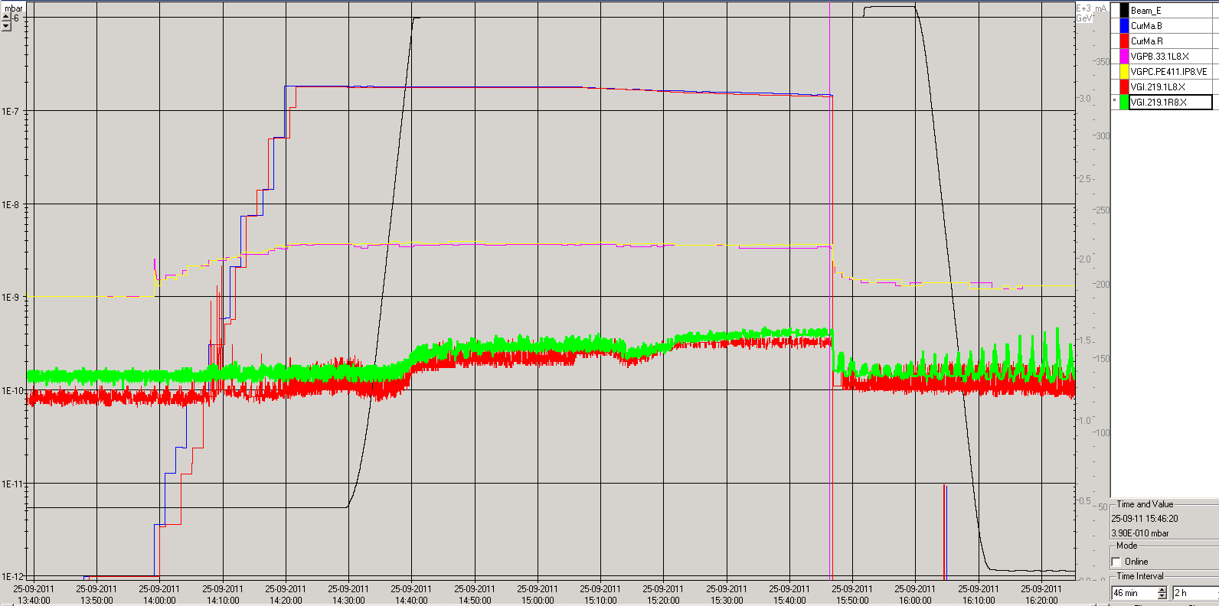
LHCb Cavern
Electron Cloud
VELO
Synchrotron Radiation
Q1
Maximum Pressure in the VELO: 4·10⁻⁹ mbar
Maximum Pressure at the Q1: 4·10⁻¹⁰ mbar
Fill 2155

Slide 32
Summary

Slide 33
Vacuum Observation Summary
In ALICE Experiments: from Q1 to Q1:
    No variation compared to the technical stop.
    All the vacuum gauges are in the 10⁻¹⁰ mbar range.
    LSS2: From Q4 to Inner Triplet:
  The pressure in the ZDC vacuum chambers is decreasing: Vacuum cleaning and scrubbing is effective to decrease the effects of electron cloud.
TDI LSS 2 and LSS8:
  During beam injection pressure increases due to electron cloud and then a further pressure increase is registered: Thermocouples installed externally to the TDI shows an increase of temperature up to ΔT of 17˚C: thermal outgassing is responsible for this pressure increase
In CMS at 18m right of the IP:
  Pressure level variation is sensitive to beam parameters: few order of magnitude.

