Slide 1
Orbit stability in the squeeze
J. Wenninger
S. Redaelli, N. Ryckx, R. Steinhagen, D. Romano, M. Terra Pinheiro

Slide 2
Orbit in squeeze
Setup of squeeze to 1.5/10/1.5/3 m was performed in March 2011.
Stepping through matched points.
Real-time (RT) corrections of the orbit FB incorporated into corrector functions at the matched points.
Orbit stability at the level of 0.1 mm – left like this as no problem and no dedicated time to improve.
Orbit excursion spikes could clearly be observed in the squeeze all along the year, gave no problem until…
Commissioning of β* 1m with tight collimator settings (TCP at 4σ instead of 5.7σ) was rough:
Significant losses in the squeeze due to the orbit excursions.

Slide 3
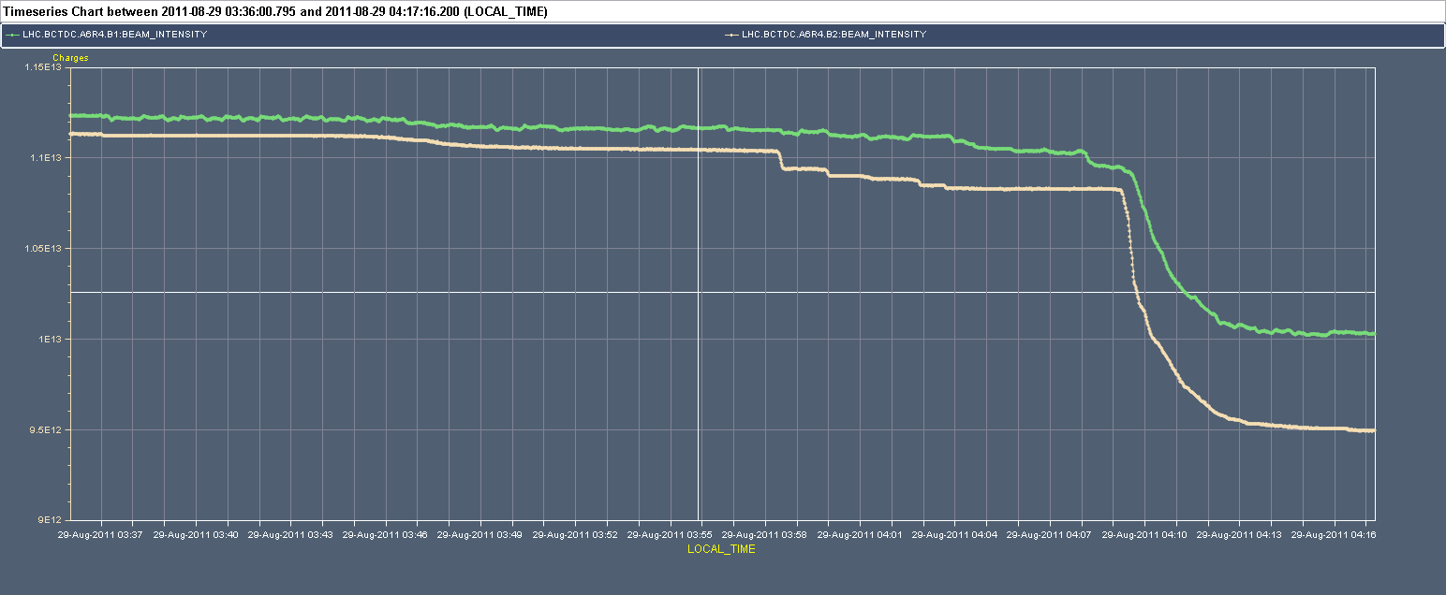
β* 1m with tight collimators
With tight collimators the orbit excursions lead to measurable losses (~%):
Peak orbit excursions correspond to ~0.5σ (nominal emittance).
More densely populated tails at the TCP edges…
Instability
at 1 m
BCT
1%
Orbit ‘excursions’
Ramp
Squeeze

Slide 4
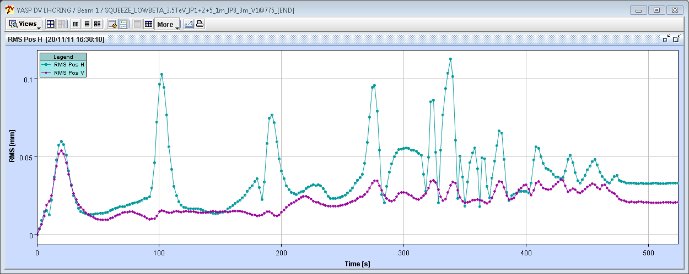
Orbit excursions in the squeeze
Excursions along the squeeze (here first squeeze to 1.5m) are:
Localized near the matched points. Spikes of 0.1 mm r.m.s. developing over ~10 seconds: 10 μm/s.
More pronounced in H plane.
Reproducible from fill to fill.
Beam1
H
50 μm
V
Fill 2306, r.m.s wrt first orbit (BPMs in Xing and separation bumps excluded)

Slide 5
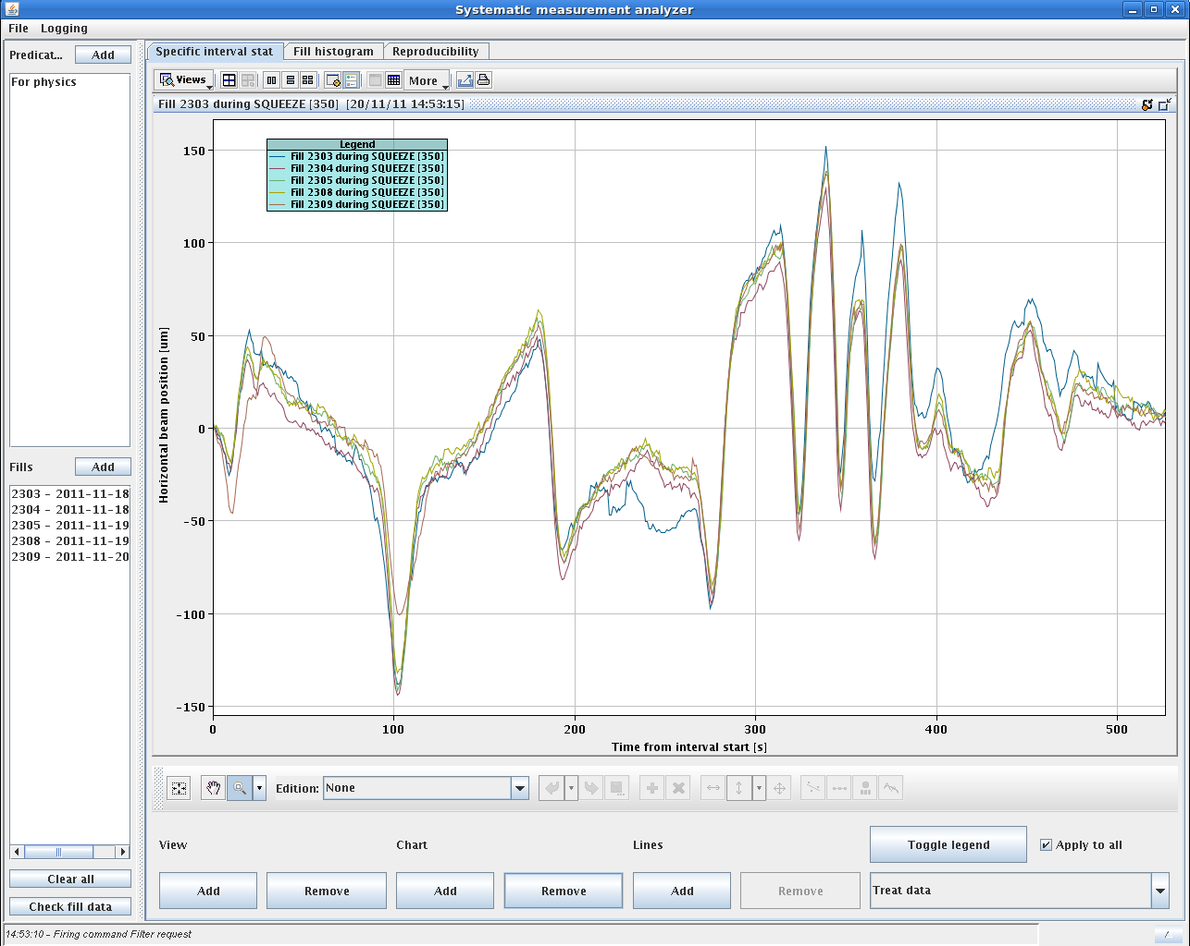
Reproducibility
Orbit at a selected BPM for a couple of fills.
Very reproducible, sharp transients at the matched points.
Manual feed-forward attempt
S. Redaelli

Slide 6
Fill 2306 – spike @ 103 s / first squeeze
97 s
Evolution of the H orbit excursion at second matched point (99 s)

Slide 7
Fill 2306 – spike @ 103 s / first squeeze
99 s

Slide 8
Fill 2306 – spike @ 103 s / first squeeze
103 s

Slide 9
Fill 2306 – spike @ 103 s / first squeeze
107 s

Slide 10
Fill 2306 – spike @ 103 s / first squeeze
111 s

Slide 11
Fill 2306 – spike @ 103 s / first squeeze
115 s
Phase of perturbation is ~constant,
dominant source is located in IR8

Slide 12
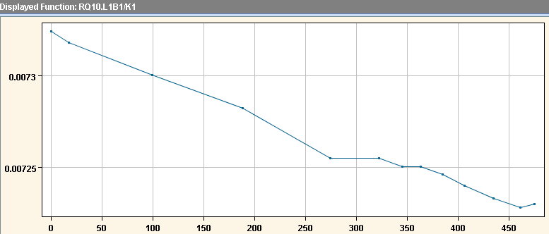
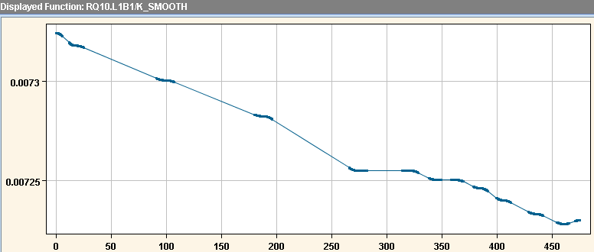
Squeeze settings
Matched optics at selected discrete points.
No. of matched optics points adjusted for ‘optimum’ squeeze duration (see S. Redaelli, LBOC 8th Feb 11).
Interpolation and parabolic round-off between points.
K
K-smooth(ed)

Slide 13
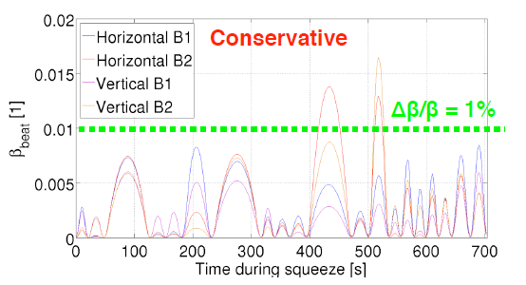
Optics errors
By construction there are optics (beta-beat) errors between matched points in the squeeze.
Optics errors affect the IRs that are squeezed.
Squeeze length and no. matched points ‘optimized’ wrt beta-beat (among other things).
Not the final squeeze to 1.5 m!
S. Redaelli,
LBOC 8th Feb

Slide 14
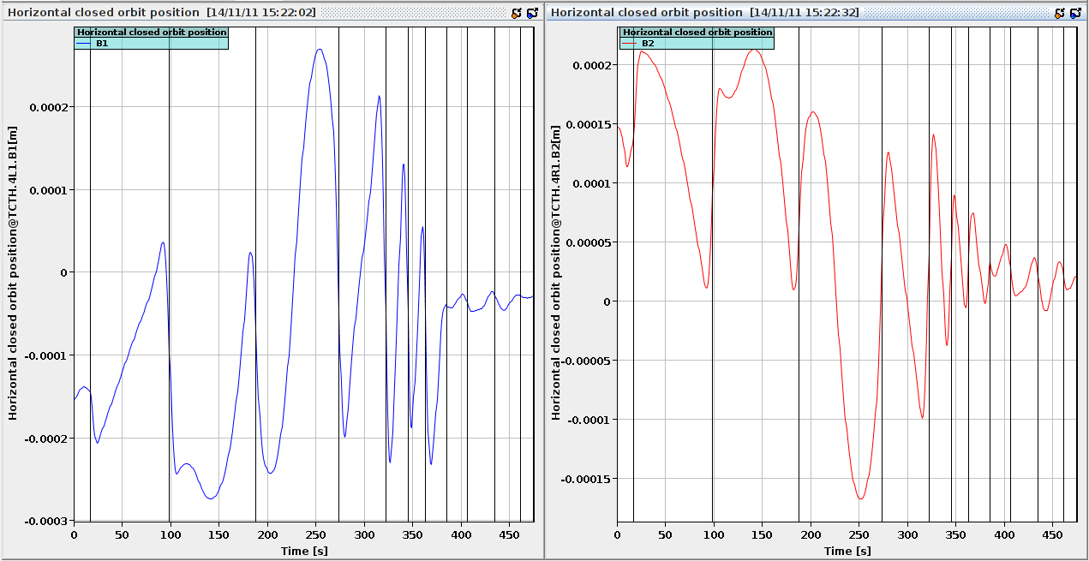
Local optics and bumps
The local optics errors induce a non-closure of the crossing and separation bumps in the IRs: orbit oscillations propagate into ring…
Below: simulation of the Horizontal orbit at a TCT during the squeeze to 1.5m based on the generated settings.
Vertical lines = matched points.
N. Ryckx
0.2 mm
0.2 mm

Slide 15
Dominant source
The perturbations are strongest while IR8 is squeezed (model and observation match).
Large crossing angle in IR8 dominates during first squeeze. Plus largest optics errors?
IR8 at 3 m (385 s)
N. Ryckx

Slide 16
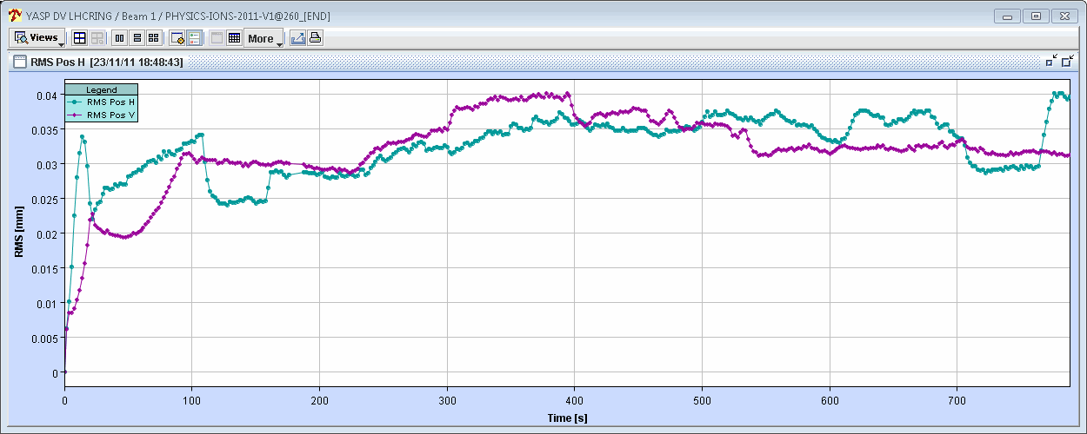
Flashback – 2010 squeeze
The squeeze to 3.5 m used in 2010:
More intermediate matched points.
Longer: 1040 seconds to 3.5 m versus 475 seconds to 1.5 m.
No/smaller orbit transients in 2010 squeeze !
V
H
Beam1
40 μm
2010
Fill 1440, r.m.s wrt first orbit (BPMs in Xing and separation bumps excluded)

Slide 17
Squeeze settings
Investigations on reducing the orbit transients due to the settings structure are ongoing (N. Ryckx, S. Redaelli).
Mitigation by applying parabolic round-off to bump knobs etc.
Combined ramp and squeeze exhibits similar, but slower transients.
Other cures:
Slow down squeeze – not very popular !
Generate perturbed orbits from the model at N seconds interval, compute corrections (e.g steering application) and feed-forward the model corrections into the squeeze settings. Similar ideas on the table for the beat-beating/optics error → which could also cure the problem !
One could of course do the same from measured orbits…

Slide 18
Cures – orbit feedback
With the default gain used in 2011, the orbit feedback (OFB) is evidently not capable of correcting the fast orbit transients (see R. Steinhagen).
An attempt to increase the gain by a significant factor was very successful for the squeezes to 1.5m and 1m in IR1+5 (next slide).
But instability developed in the vertical plane of B2 during the IR2 squeeze to 1m (instability below 3 m).

Slide 19
IR1+5 to 1.5 m with x10 gain
H
40 μm
V
40 μm
Gain x 10

Slide 20
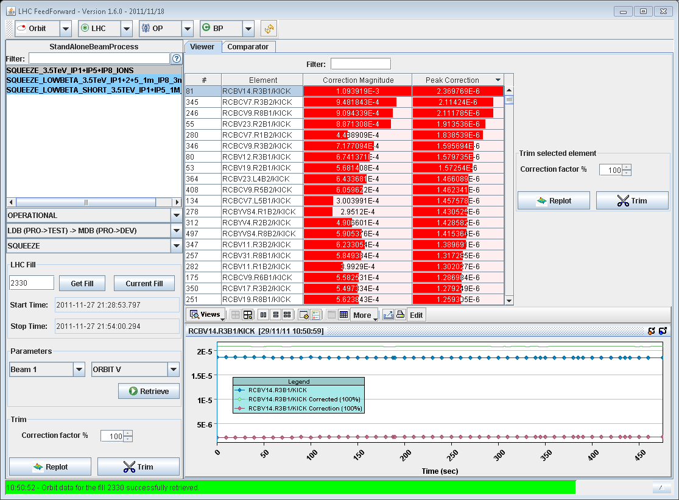
Feed-forward on RT trims
A feed-forward (FF) application for orbit RT trims was written by M. Terra Pinheiro. It is now being extended and improved by D. Romano.
Feed-forward RT corrections into the corrector functions.
The FF works only for perturbations that are damped by the OFB.
Successful in reducing the strength of vertical RT trims form ~10 to 3 μrad (test in ions period).

Slide 21
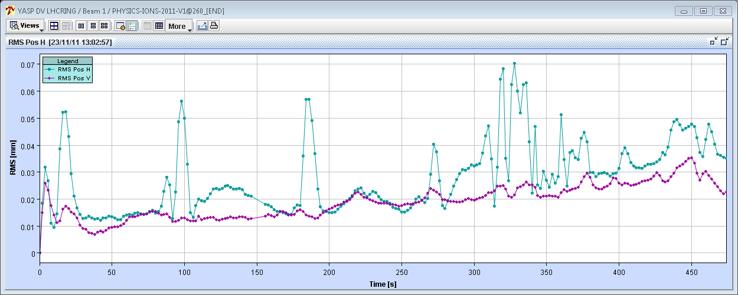
FF on x10 gain squeeze test
H
100 μm
FF
V
Applied 50% of the RT corrections
Rather successful
60 μm

Slide 22
FF on OFB
The high gain test and subsequent FF indicates that it may be feasible to transfer the corrections of the transients into the corrector functions.
Some issues though with point density and smoothing – must be able to apply transient kicks (dI/dt etc).
It is then possible to envisage the following sequence (to avoid running with high OFB gain):
Perform a test squeeze with high gain and limited intensity,
Apply FF based on the high gain test,
If successful operate the OFB with lower gain for high intensity.

Slide 23
Summary
The origin of the orbit transients in the squeeze is now localized.
A number of cures are available or under investigation (may be used in combination):
Mitigation at the level of settings generation.
Correction and FF based on the modeled perturbations.
Higher OFB gain.
FF on OFB corrections.
Correction and FF based on measured perturbations.

