Slide 1
Vacuum Activities during Xmas Break:
CMS and LSS2,8
V. Baglin (17/1/12)
CERN TE-VSC, Geneva
1. CMS issue
2. LSS2 and LSS8 issues
3. Summary

Slide 2
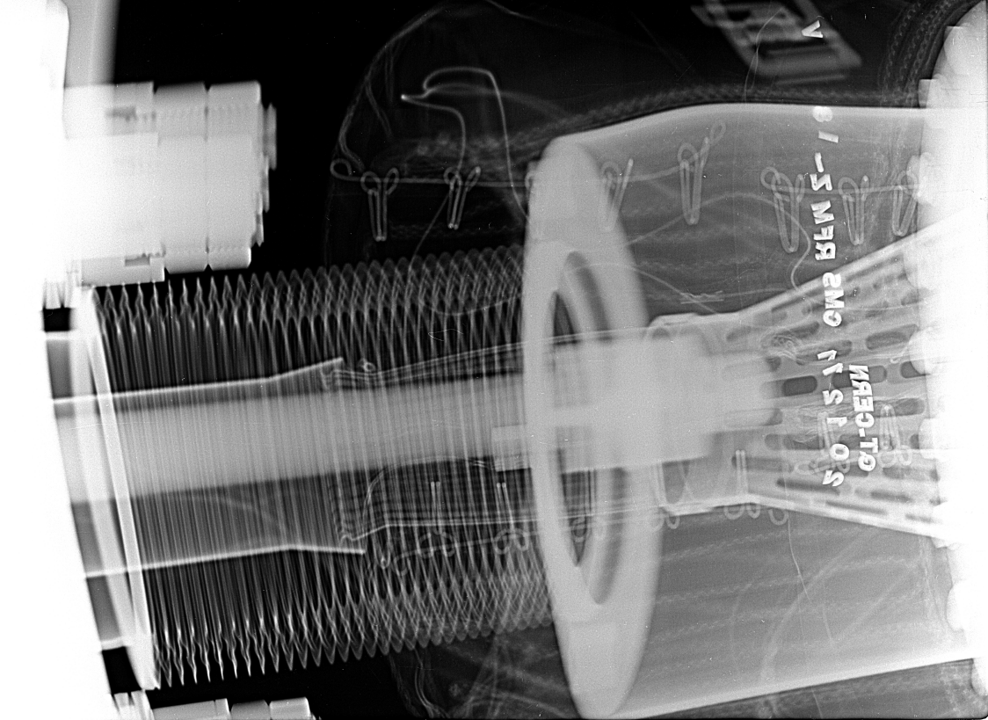
X-rays the 20-12-2011, 18 m right (z-)
Location where pressure spike were observed during the LHC 2011 run
Overlap of ~ 6 mm, RF fingers INSIDE RF insert. Estimated aperture reduced to 36 mm (TAS is 34 mm)
Non Conform with risk of aperture reduction
~ ID 36
ID40
Vertical view
LBOC - 17th January 2012
Other RF fingers inside CMS vacuum sector are conform

Slide 3
Layout CMS : IP5.X
The layout is symmetric wrt to the IP
CMS minus side
TAS
ID34
Q1R5
IP5
HF
chamber
CT2
chamber
CMS forward chamber
16 m
18 m
500 mm nominal
(LHCVC5—0006)
511 mm (9-1-2012)
CMS forward chamber
RF fingers at 16 m
RF fingers at 18 m
LBOC - 17th January 2012

Slide 4
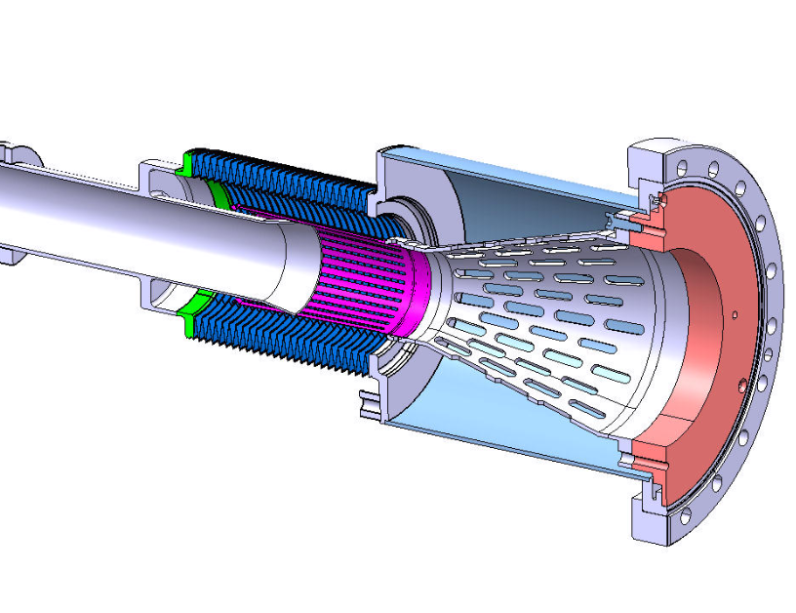
Repair under Ne atmosphere
The 10/1/2012, it was proposed to repair the RF insert under Ne atmosphere in order to avoid a full bake out of the CMS vacuum sector. The proposal was accepted by the CERN and CMS managements
A detailed vacuum procedure which assembles the agreements, preparation, safety aspects and work sequence is written (EDMS 1179993)
During the intervention:
VACSEC IP5.X is pressurised to 1.2 bar with Ne
Flanges upstream and downstream to the forward chambers are opened while Ne flushing
RF insert in exchanged by a NEW one
Flanges are closed and sector pump down for leak detection
X-rays are taken
Vacuum modules, CT2, Forward and TAS chambers are re-activated
X-rays are taken following bake out
VACSEC IP5.X is vented back to Ne to resume CMS activities (tentative 30/1/2012)
Intervention is foreseen the 18th of January, NEG reactivation wk 4.
RF contact with additional 20 mm thick copper ring
LBOC - 17th January 2012

Slide 5
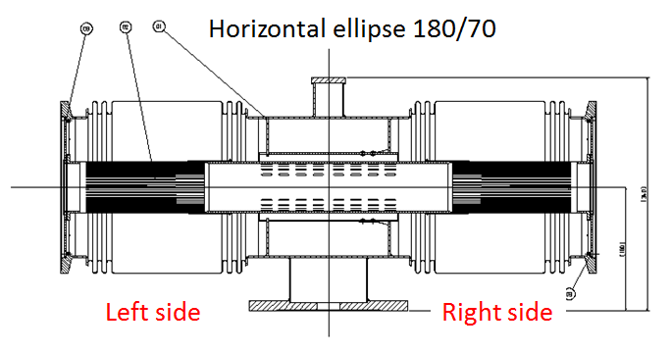
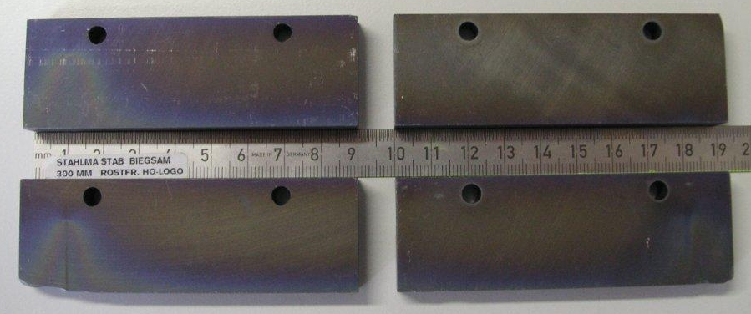
LSS2-LSS8
During LHC 2011 run, pressure spikes were observed in the vicinity of D1s in LSS2 and LSS8
The origin was due to lose springs in VAMTF components induced by beam heating (LMC 9-16/11/2011)
During Xmas break, the VAMTF was studied by RF experts (E.Metral, F. Caspers, B. Salvant, J-L Nougaret)
Their recommendations:
Decrease the length of RF fingers from 170 to 50 mm
Insert ferrites in each cavity (i.e. 4 per module)
Vacuum tested ferrites
There are a total of 8 such modules in LHC in VACSEC A4L2, A4R2, A4L8 and A4R8
All modules will be modified and another one produced for RF qualifications in the laboratory
Today: new RF inserts and ferrites and under production or test, first modified module should be delivered this week
The vacuum sectors will be reactivated in the following weeks according to the Xmas break schedule
An ECR is written, circulates and is updated (EDMS 1179000)
LBOC - 17th January 2012

Slide 6
Summary
Pressures spikes were observed at CMS and in LSS2, LSS8 during LHC 2011 run
The origin is attributed to bad or absence of contact between RF insert and RF finger
Repair of all these NCs are under way
CMS default is due to longer in-situ length than foreseen .
It is corrected by a modified RF insert
The RF insert is replaced under Ne atmosphere
LSS2 and LSS8 defaults are due to HOM inside VAMTF modules
Modules are modified following RF experts recommendations (RF contact length + ferrites) and will be qualified in the laboratory
Vacuum sectors will be reactivated according to the Xmas break schedule.
LBOC - 17th January 2012

