Slide 1
New IR6 optics with optimized phase between MKD and TCSG S. Fartoukh
Motivations
Comparison between present & new IR6 optics
Aperture at injection & other considerations
Conclusions

Slide 2
Motivations
Present situation:
→ 94.7⁰ between MKD and TCDQ
→ S = 9.3 (2011) → 7.3 (2012)
for the TCSG settings.
For a 3σ beam (n=3), the
effective protection degrades
by ΔR (90⁰→ 94.7⁰) ~ 0.2-0.25σ
Courtesy of B. Goddard

Slide 3
Building a new IR6 optics with Δμx=π/2 between MKD and TCSG
Usual constraints:
- Quadrupole gradients,
- Aperture: n1~6.5-7 calculated with the baseline, very conservative, budget for beam tolerance (20% β-beat, 4 mm CO, δ=0.0015, … and γε=3.75 μm).
Specific constraints:
- Preserve as much as possible β’s at the dump target
(beam density) and therefore α’s and β’s at IP6.
- Keep Q4 strictly unchanged on the MKD side

Slide 4
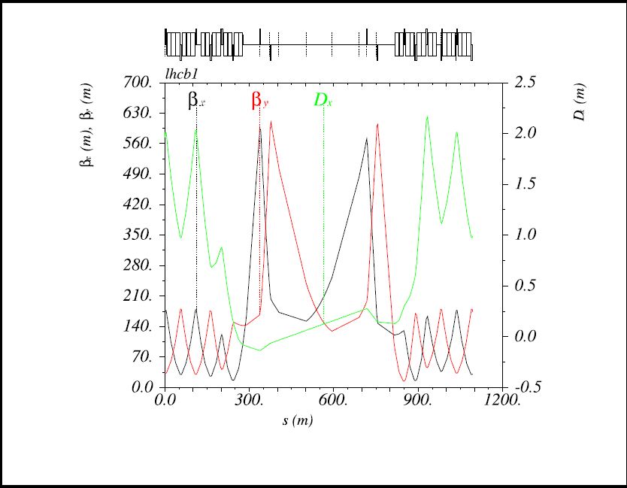
Present IR6 optics (Beam1)

Slide 5
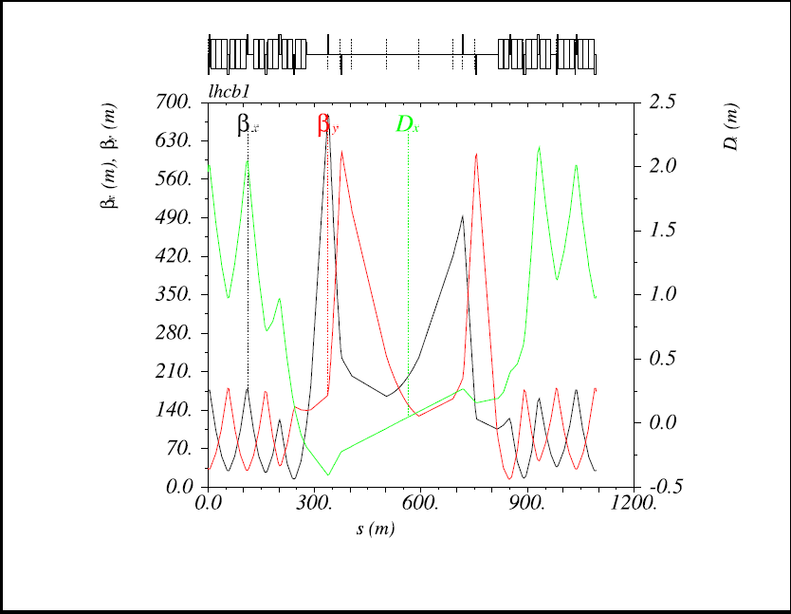
New IR6 optics (Beam1)

Slide 6
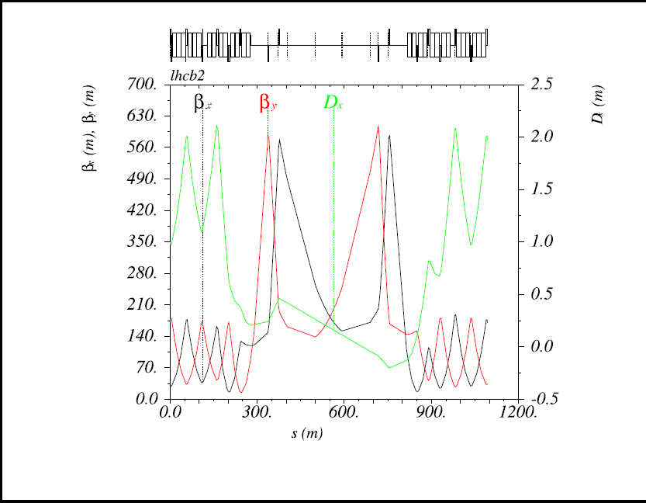
Present IR6 optics (Beam2)

Slide 7
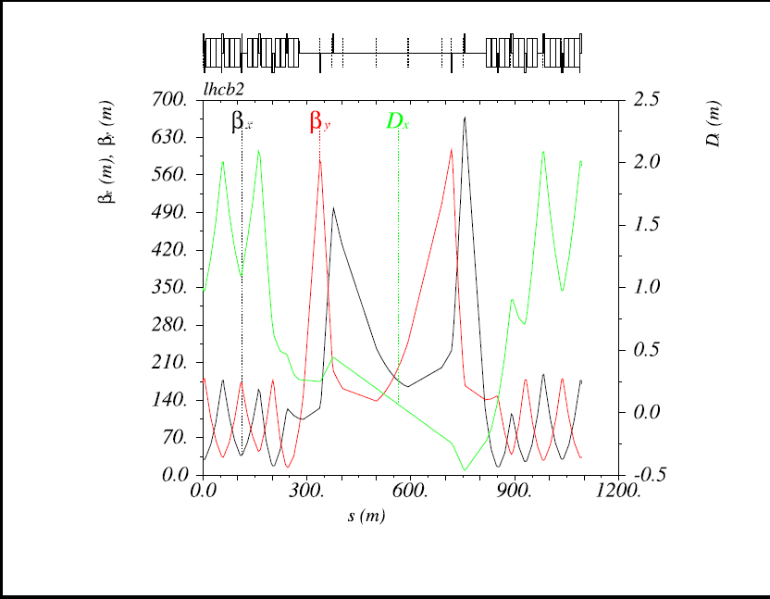
New IR6 optics (Beam2)

Slide 8
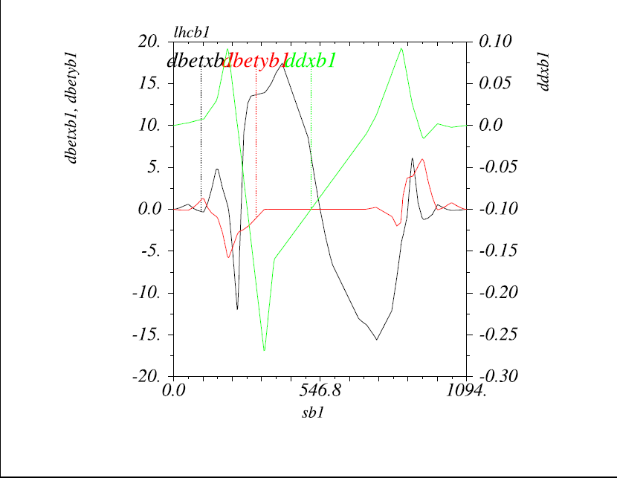
Relative changes for B1: β’s [%] and Dx [m]
25 cm peak for dispersion
Marginal changes for β_{y}
+ 17% for β_{x} at Q5.L6 (MKD side) and -17% at Q4.R6 (TCSG side)

Slide 9
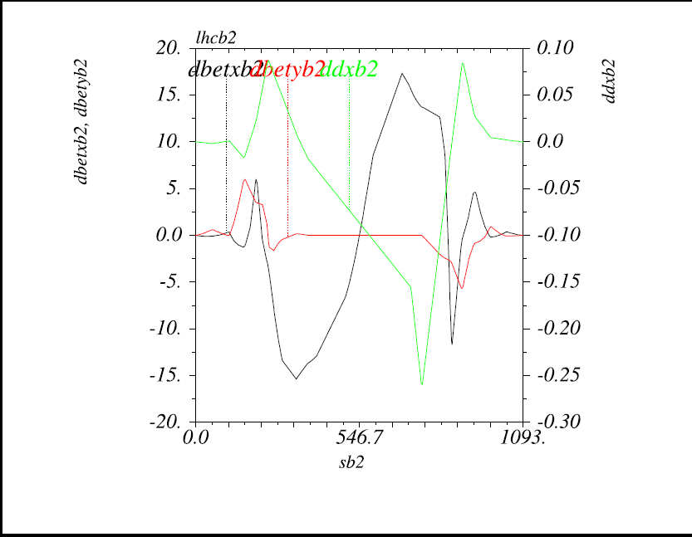
Relative changes for B2: β’s [%] and Dx [m]
25 cm peak for dispersion
Marginal changes for β_{y}
+ 17% for β_{x} at Q5.R6 (MKD side) and -17% at Q4.L6 (TCSG side)

Slide 10
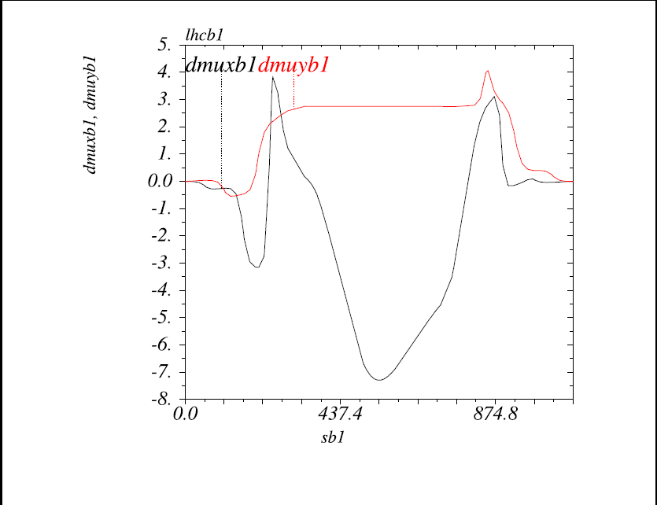
Relative changes for B1: Phases [degree]
MKD
TCSG
Δμ_{x}= 90.0 - 94.7=-4.7⁰ from MKD to TCSG
Total Phase kept constant across IR6

Slide 11
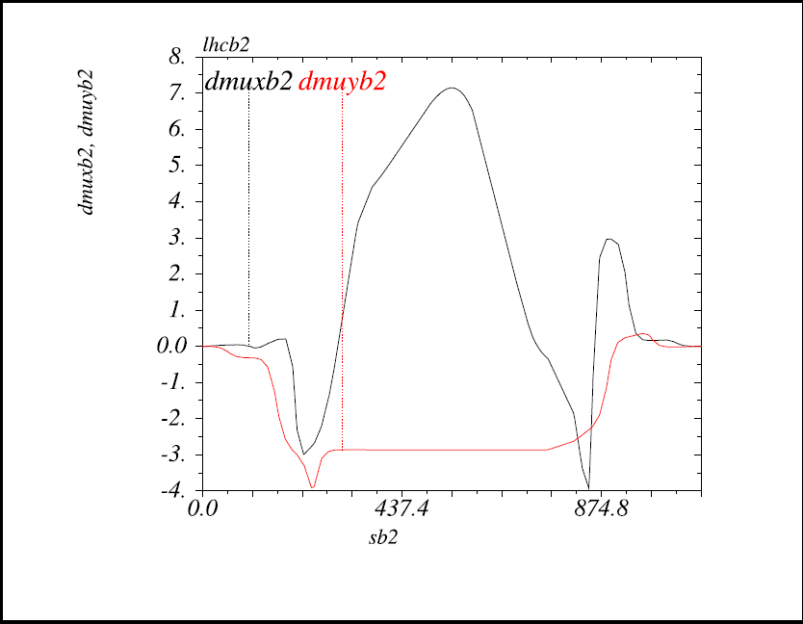
Relative changes for B2: Phases [degree]
TCSG
MKD
Δμ_{x}= 90.0 - 94.7=-4.7⁰ from MKD to TCSG
Total Phase kept constant across IR6

Slide 12
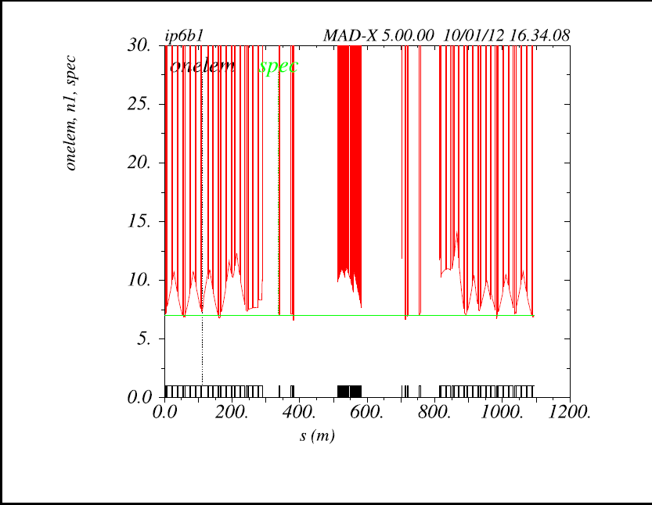
Aperture for B1: Present optics

Slide 13
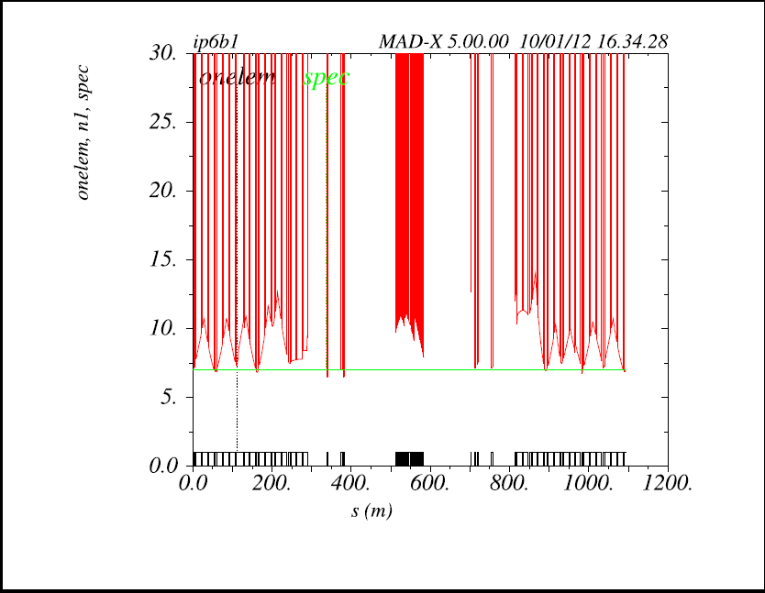
Aperture for B1: New optics
Δn1 ≈ - 0.5 at Q5.L6
Δn1 ≈ + 0.5 at Q4.R6

Slide 14
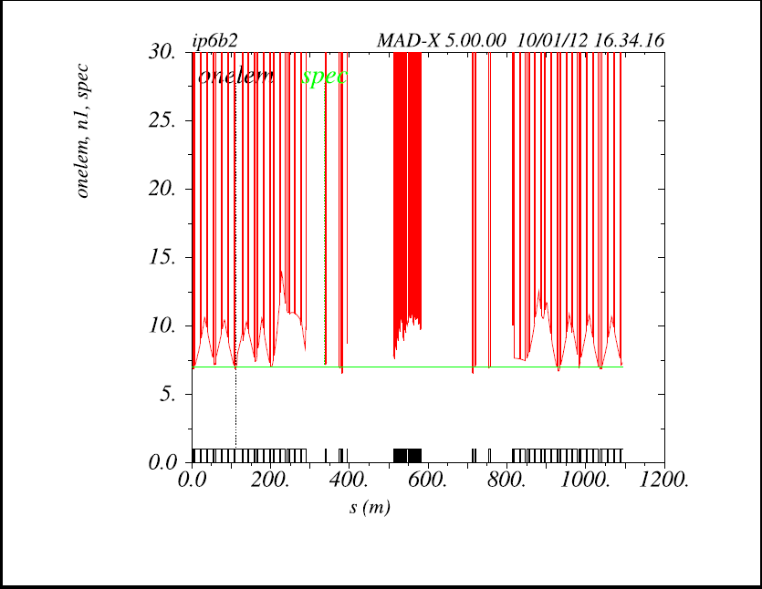
Aperture for B2: Present optics

Slide 15
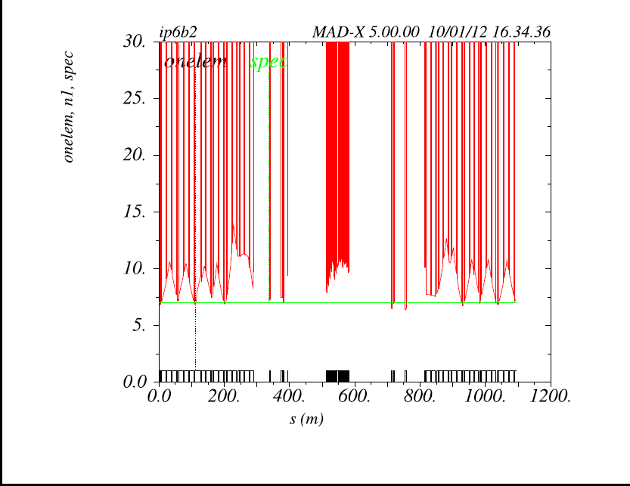
Aperture for B2: New optics
Δn1 ≈ + 0.5 at Q4.L6
Δn1 ≈ - 0.5 at Q5.R6

Slide 16
Other considerations
β’s (beam density) at the dump target
 | Nominal IR6 | New IR6
Beam1
β_{x} /β_{y} [m] | 5012/3955 | 4301/3955
(β_{x}β_{y} )^{1/2} [m] | 4453 | 4125 ↓ (-7.4%)
Beam2
β_{x} /β_{y} [m] | 5052/3698 | 4335/3698
(β_{x}β_{y} )^{1/2} [m] | 4322 | 4004 ↓ (-7.4%)
Room for (big) improvements if needed, by retuning the vertical Twiss parameters at IP6
(but to some extent in order to preserve the aperture at injection).

Slide 17
Conclusions
→ With aperture margins at injection (based on LHC present experience), modifications of the IR6 optics can be envisaged.
Possible gain of 0.2-0.25σ in the effective protection of the TCSG, and therefore the TCDQ/TCT retraction, and therefore the normalized IT aperture, and finally a β* gain of about 4-5%
… but first the TCxx settings could be adjusted based on measured beam-sizes (β’s) to gain much more in protection and/or β*
Should the beam density at the dump become a limitation (after LS1 or HL-LHC), further IR6 optics modifications could also be studied with increased β_{y} at the TDE.

