Slide 1
RF Status Feb 20th- March 1st restart
P. Baudrenghien
with much help from
D. Glenat, G. Hagmann, D. Jaquet, J. Lollierou, P. Maesen,
T. Mastoridis, J. Molendijk, J. Noirjean, D. Valuch

Slide 2
Longitudinal parameters 2011
SPS beam (same as in 2010)
1.5 ns (±0.1 ns) , 4σ length
Capture
Higher capture voltage than 2011 ( try 5-6 MV compared to 3.5-4 MV in 2010). Consequence on capture loss? Setting-up time needed (set at 6 MV B1 and 5.25 MV B2, Feb 2011)
Ramping
Linear voltage rise to 14 MV through the ramp (set at 12 MV B1 and 10.5 MV B2, Feb 2011)
Emittance blow-up to 1 ns (bunch length σ_{t} = 260 ps in design report). We used 1.2 ns in 2010. Note: Physicists mention that this may increase pile-up. Their preference goes towards longer bunches. They also question the bunch length calibration. Strategy: start with same 1.2 ns setting as 2010. Measure bunch length (exp, BQM, Synchrotron Light Monitor). Make plans...
Physics: Fixed 14 MV @ 3.5 TeV (set at 12 MV B1 and 10.5 MV B2, Feb 2011)
In 2011 with 1 ns, 14 MV, we have 1.5 eVs bunch emittance in a 4.9 eVs bucket
In 2010 with 1.2 ns, 8 MV we had 1.6 eVs bunch emittance in a 3.7 eVs bucket

Slide 3
Klystron/cavity settings. March 2011
Klystrons: DC settings 50 kV, 8 A cathode current -> 400 kW DC power and ~ 200 kW RF power at saturation
Injection plateau: Cavity Q=20 k, 0.75 MV/cav, ~ 80 kW RF power
Start ramp: move coupler to Q=60k
Ramping: Q=60k, voltage rises linearly from 0.75 MV/cav to 1.5 MV/cav
Physics: Q=60k, 1.5 MV/cav, ~104 kW RF power

Slide 4
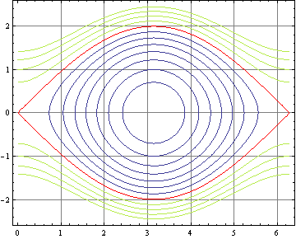
SPS-LHC Capture why increase the voltage?
SPS longitudinal parameters at transfer with 7.2 MV RF @ 200 MHz :
bucket: 3.0 eVs, +-10.6E-4 Δp/p
bunch: 4σ bunch length 1.5 ns, 0.51 eVs, +- 4.5E-4 Δp/p
Matched LHC capture voltage: 2.5-3.1MV @ 400 MHz.
LHC longitudinal parameters at transfer with 3.5 MV @ 400 MHz
Bucket: 0.94eVs, +-6E-4 Δp/p
Loss are small (< 1 %) but cannot be zero because
13.5 % of particles are outside the 2-D 4σ core
the SPS bucket is twice longer and 70% taller than the LHC bucket
4σ bunch
momentum
spread
4σ bunch length
Phase space trajectories in normalized phase space (φ, 1/Ω_{s} dφ/dt), 3.5 MV
SPS bunch length (4σ) 3.8 radian @ 400MHz (dark blue horiz. arrow)
SPS bunch height +- 1.5 in normalized
1/Ω_{s} dφ/dt unit
(dark green vert. arrow)
Capture loss is unavoidable because the SPS bucket is so much larger than the LHC bucket (3.0 eVs compared to 0.94 eVs) and a significant part of the bunch falls outside the 4σ region.
1 % capture loss confirmed by Theodoros Argyropoulos calculations

Slide 5
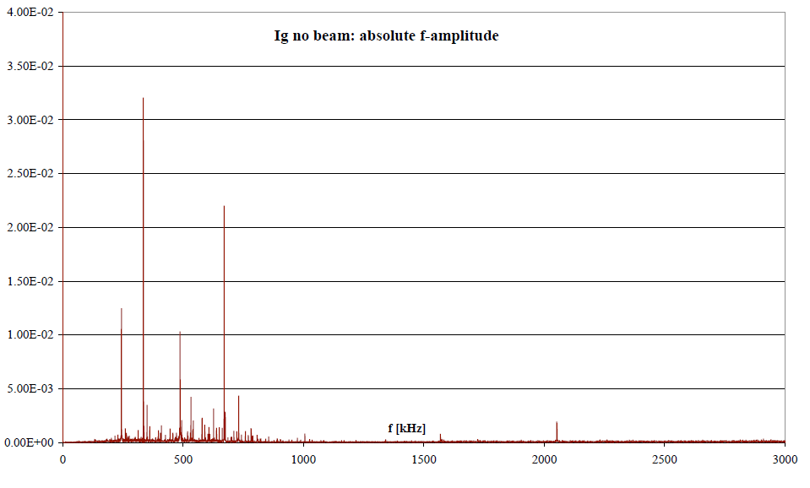
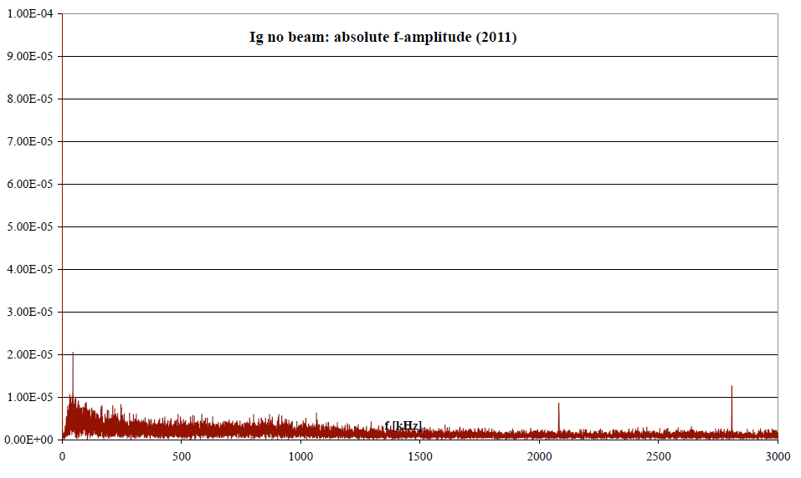
Problems and … some solutions
In 2010 we had observed spurious lines at 170 kHz, 340 kHz, 510 kHz and 680 kHz in the drive of all klystrons. It had no effect on the beam and was present without beam. But it required significant klystron power
Begin 2011 this was traced to a pollution of the +5 V PS on the VME backplane coming from the CPU (saw tooth 70 mVpp @ 170 kHz, CPU card probably not EMC compliant...). With the fibre optic TX-D used to transmit the 400 MHz RF1/2 from SR4 to UX45, that created sidebands at +- n. 170 kHz. The fibre optic TX-D was replaced by a TX-A model that uses the clean +12 V supply and that solved the problem
Note: the problem is present in all clock distributed on fibre from the RF. A global solution is being looked at.
Cav3B1. Spectrum of the klystron output amplitude. Left: 2010. Right: 2011. Courtesy J. Tuckmantel

Slide 6
Cav4B1
Became noisy on Sept 26th 2010. Injected noise with/without beam. Not operational for rest of 2010 run.
Noisy again during hardware commissioning 2011. But intermittent. Replaced a cable on the Cavity Antenna and left on for start-up
Both beams captured on Sunday Feb 20th. Cav4B1 injects noise again -> off
Switch back On, Thursday Feb 24th. External monitoring implemented using unused inputs from Cav3B1 Cavity Controller plus a used input from Cav8B2. That is why 8B2 is OFF
In operation since. No more problem...But now ready to diagnose if problem is back. Call us...
SMC cable issue
Several SMC cables in the Baseband part of the Cavity Controllers (UX45 Faraday Cage) have been damaged. Rigid stickers have been added at the time of installation and caused sharp bends that finally damaged the cables.
Will all be replaced during the second technical stop.
SMA cables used for RF signals look OK

Slide 7
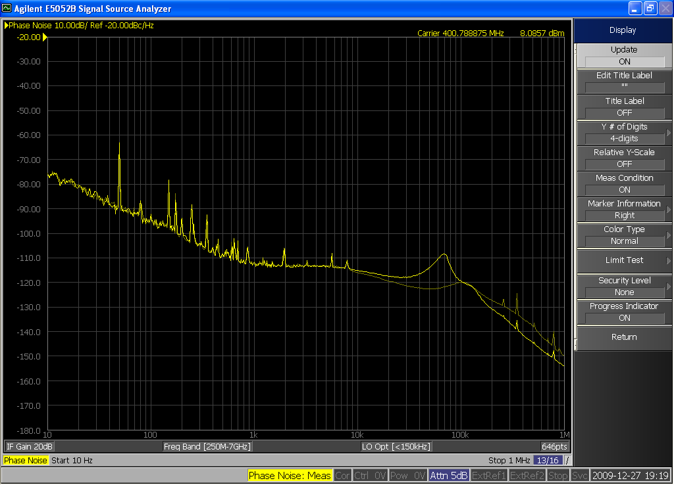
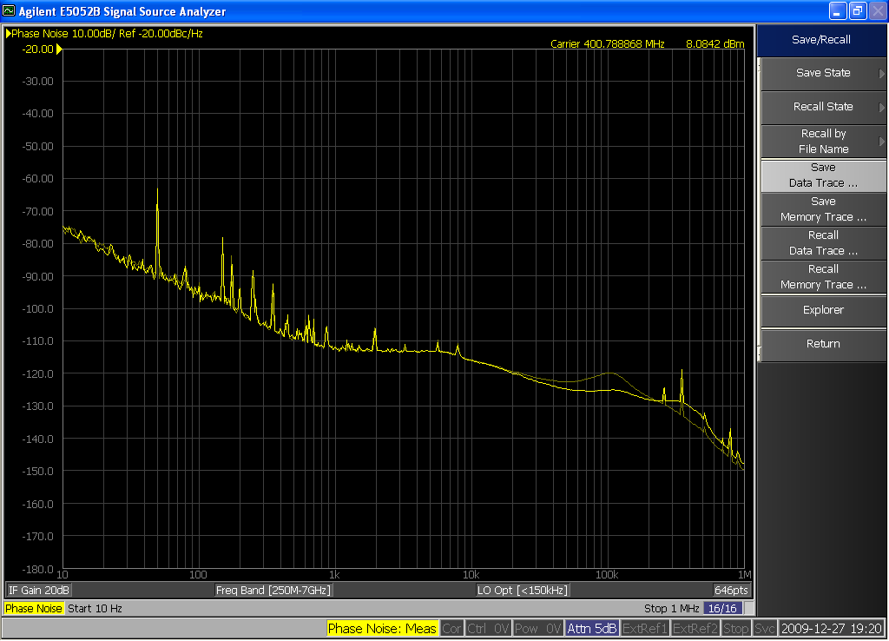
Cav2B2
While the RF ON sequence works most of the time, it would, on rare occasions, leave klystron 2B2 stuck at saturation level!
To be studied during first technical stop
Cav3B2
Excess cavity phase noise around 100 kHz offset from carrier (8 dB above normal)
Noise level decreases when increasing feedback gain: The problem is not in the feedback but in the driver/TX chain
To be studied during first technical stop
Cav3B2. SSB phase noise spectra. Left: Analog gain REDUCED by 10 dB (Memory trace= nominal). Right: Analog gain INCREASED by 10 dB (memory = nominal)

Slide 8
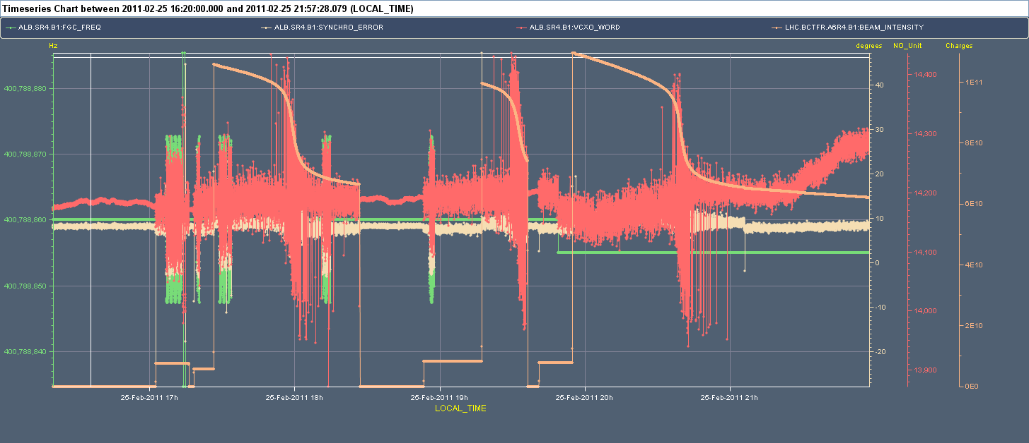
Nominal single bunch … debunching
After setting-up capture on Feb 20th, a threshold value was set too low for the nominal intensity bunch B1 resulting in strong debunching observed on Thursday and Friday
Solved on Saturday Feb 27th
B1. Fast BCT (orange) and VCXO input (redish) showing that the frequency is strongly modulated resulting in debunching

Slide 9
Feb 28th: Phasing the cavities
Each cavity has its individual voltage Amplitude/Phase function
With identical values for these functions, we want the field probed by the bunch passage to be identical over all cavities
Phase settings for the cavities B1 over the last 4 years. Drifts are reasonable.

Slide 10
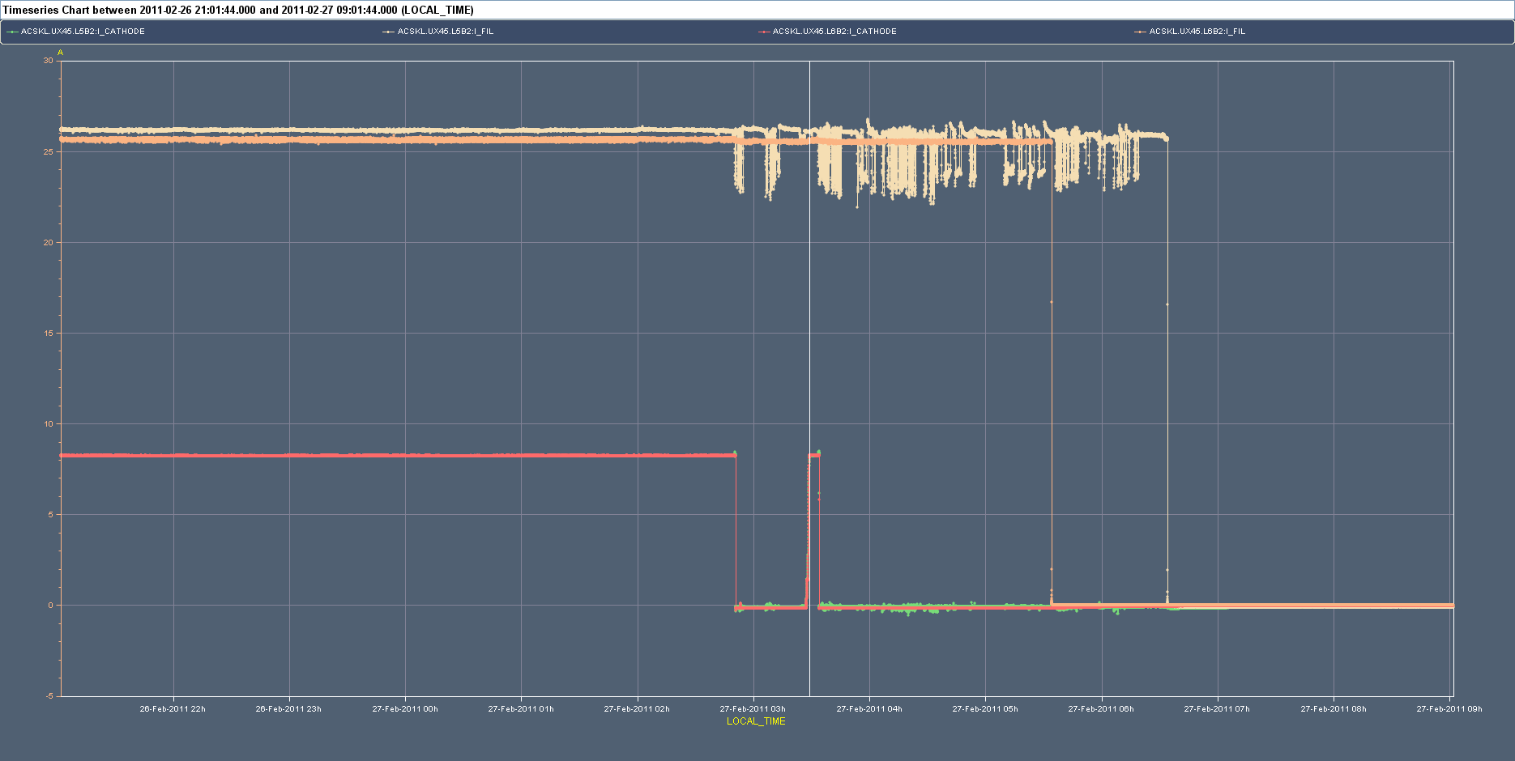
Klystron 5B2
Filament heat current started oscillating on Sunday 2:45 causing an interlock that switched HV off (full Module 2 B2 OFF)
RF restarted around 3:20 but problem came back after 5 min
Klystron switched back ON, Monday morning. OK since.
Last year we have had a similar problem on K2B1, finally traced to a poor HV connector. Access to UX45 needed to confirm.
Beige trace: filament heater current on Sunday morning

Slide 11
Thank you for your attention
Special message for our BI friends…
Please, minimal access to IP4 during next technical stop…
Thanks

