Slide 1
BE-CO work for the TS
23 – 28 Apr 2012

Slide 2
BE/CO work (1/5)
Planned intervention on the DB service Tuesday 24th April
8:00 – 8:15 – Restart of the ACCCON cluster in order to change the 10g compatibility mode
ALL db accounts on the ACCCON cluster (dbabco & acc_settings) will not be available for a period of ~ 15 min.
8:15 – 9:45 – Upgrades of the APEX repositories on ACCCON and LASERDB clusters
All APEX-based applications running on both clusters
8:15 – 9:00 – Upgrade of the Oracle application service running on cs-ccr-oas1
Controls Configuration ADF Editors
Remove of the symbolic link "/user/pcrops/data -> /user/slops/data" as LSA will redeploy the SDDS_BROWSER

Slide 3
BE/CO work (2/5)
There will be an intervention on the network Faraday cage in BA6 24 Apr 2012 all day which will impact the technical network in BA6.
See https://indico.cern.ch/getFile.py/access?resId=0&materialId=0&confId=187026
CANCELLED by IT/CS
New version of the DIAMON agent deployed in order to detect faster a lost agent
BE/CO/IN will try to reboot as many Linux and Windows Consoles, Vistars, CCC Wall Screens, Web Servers (CS-CCR-WWW1/3) and General Purpose Samba Servers (CS-CCR-SAMBA1/GWPC) during the week and/or Tuesday (Injector related)). This is for the usual Operating System updates.
Cu/Cu Wfip repeater changed in RE38
It broke last Thursday

Slide 4
BE/CO work (3/5)
Change of the ROOT password policy in the FrontEnd
No direct root access anymore (password has been changed and will be kept secret)
Users shall login to the FECs with their personal login, they must do a first hop to a CO trusted machine. No password is required in the FECs, authentication is based on a public/private DSA keyset
Root privileges can be obtained using sudo, which is automatically enabled for everyone in the dscdev group. Root privileges can be restricted with a sudoers list.
Install 24Gb or RAM in CS-CCR-COLSA (was 12Gb)
Samba server upgraded to prevent the https://www.samba.org/samba/security/CVE-2012-1182 security hole (see list next slide)
Herve Milcent is announcing the upgrade to his users who may prefer certain times during the LHC Technical Stop week.
The update can be performed in a few seconds and no reboot is required. In rare cases PVSS clients on Windows Terminal may have difficulty reconnecting.

Slide 5
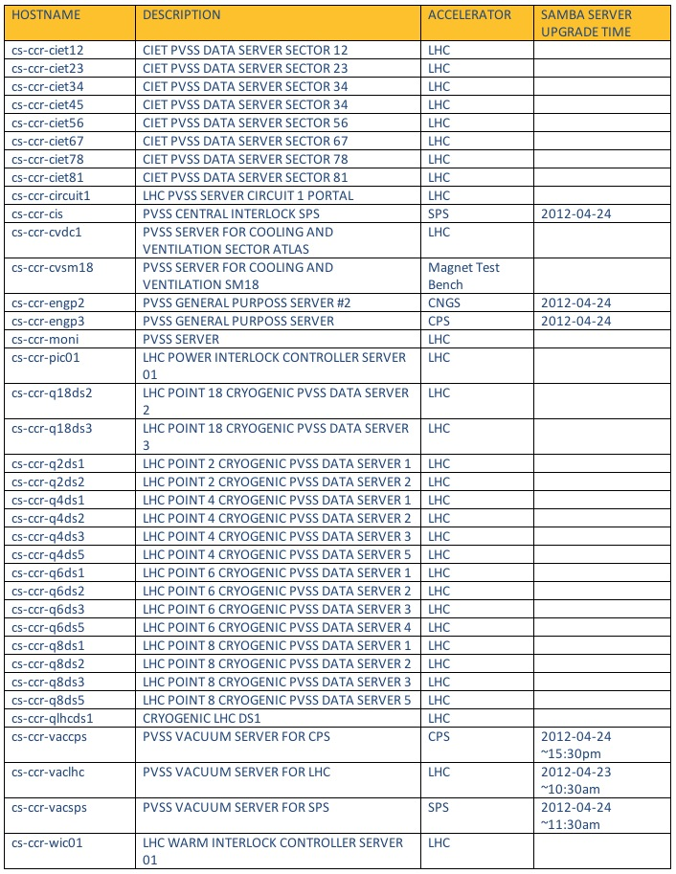

Slide 6
BE/CO work (4/5)
BE/CO/HT will perform a CTR firmware upgrade intervention on the machines listed next slide.
This has already been agreed upon with Lars Jensen. This is to solve a bug and introduce new features.
As to the modifications this firmware introduces, there are mainly:
1. bug fix of a potential loss of 1ms bug.
2. fix of MEN-A20 compatibility in the VME core.
3. support of additional HPTDC functionality.
All the CTRs in the field were upgraded in Apr 2011 to the new version of the firmware. The ones that are quoted here were overlooked during that campaign. It is likely that those CTRs were in lab machines and silently sneaked into operation during the last year.
The expected time per machine is about 20'. It can be done mostly concurrently, so each machine can be scheduled at a (coincident) given time. BE/CO/HT will arrange with Lars for this.

Slide 7
CTR upgrade list
ade cfv-193-bctft
cps cfc-358-rpsa
ctf cfv-2010-bpmtl2tbts
lei dleirf
psb cfv-361-cbaos8
lhc cfc-ba4-esyncdau
lhc cfc-ba7-esyncdau
lhc cfc-ccr-bct
lhc cfv-sr1-bpmb2la
lhc cs-ccr-alhc
sps cfc-ccr-ctxsps
sps cfv-ba5-bws2

Slide 8
BE/CO work (5/5)
Upgrade of all CMW Proxies for LHC & Injectors
Logging System, many client GUIs, WorkingSets
New Proxy version was running since start-up on two instances: LHC BBQ, PS CTM. No problems were reported/observed. In case of problem, it can be quickly rolled-back to the previous version.
Upgrade of one JMS node in CO-PRO cluster
Many systems depending on JMS (e.g. Logging, LSA, InCA, PM, …)
New JVM setting are being tested now on other JMS instance (CMW Log). In case of problem, it can be quickly rolled-back to the previous JVM settings.
Upgrade of CMW Configuration Server due to a fixture in data retrieval procedure
All operational LHC front-ends.
Service was operational during 2011 run and worked without any problems. The current change has to reflect changed db connection string and new deployment procedure.

