Slide 1
Update on plans for the first p-Pb run
John Jowett
With input from: R. Alemany, S. Hancock, M. Lamont, D. Manglunki, S. Redaelli, M. Schaumann, R. Versteegen J. Wenninger
For more information see pA@LHC workshop 4-8 June 2012
https://indico.cern.ch/conferenceDisplay.py?confId=182223

Slide 2
Main questions
Clarification of physics priorities from LPC
Any p-p reference data at 1.38 TeV/beam etc ?
Commissioning schedule
Now moved into January 2013
MD and possible pilot physics fill
Optics
see Reine’s presentation
Filling scheme 100 ns or, now most likely, 200 ns
LHCb
p-Pb and Pb-p
Beam switch in middle of run (~ 1 day)
ALICE polarity reversals in each beam direction ARE wanted (~ 1 day more)

Slide 3
MD and pilot physics
RF synchronisation test with protons
To be scheduled in regular MD time
Once we have Pb beam from SPS, we can do MD again
Minimal goal: ramp many bunches (probably only a few Pb with many p)
Pilot physics (in physics time? ~16 h soon after MD?)
Similar to what we planned last year
No squeeze, few bunches to minimise set-up time and machine protection/collimation requirements

Slide 4
Reminders!
This is a new mode of operation of LHC, almost unprecedented at any hadron collider.
Based on one very successful 16 hour MD
Injection of some Pb in presence of many p bunches, with unequal revolution frequencies, without losses and enhancement of emittance growth
Ramp of a few bunches, re-lock of frequencies
First successful RF re-phasing (slow, not yet final system)
CERN-ATS-Note-2012-051 (when fulltext available …)
Still to demonstrate (2nd MD cancelled last year)
Injection and ramp of many bunches in both beams
Faster RF-rephasing after RF frequency lock
Optics with low β* in 3 experiments
Off-momentum collision configuration
All this integrated into efficient operational cycle

Slide 5
Chamonix target p-Pb performance in 2012
Main choice: | Units | 200 ns |  | 100 ns
Beam energy/( Z TeV) | Z TeV | 3.5 | 4 | 3.5 | 4
Colliding bunches |  | 356 | 356 | 550 | 550
β* | m | 0.7 | 0.6 | 0.7 | 0.6
Emittance protons | µm | 3.75 | 3.75 | 3.75 | 3.75
Emittance Pb | µm | 1.5 | 1.5 | 1.5 | 1.5
Pb/bunch | 10⁸ | 1.2 | 1.2 | 0.8 | 0.8
p/bunch | 10¹⁰ | 1.15 | 1.15 | 1.15 | 1.15
Initial Luminosity L₀ | 10²⁸ cm⁻² s⁻¹ | 6.2 | 8.3 | 6.4 | 8.5
Operating days |  | 22 | 24 | 22 | 24
Difficulty (subjective) |  | 0.9 | 1 | 0.9 | 1
Integrated luminosity | nb⁻¹ | 15.4 | 22.4 | 15.9 | 23.1
Nucleon-nucleon | pb⁻¹ | 3.2 | 4.7 | 3.3 | 4.8
Integrated luminosity by scaling from 2011 (c.f. ~7 pb⁻¹ NN in Pb-Pb) Average Pb bunch intensities from best 2011 experience. Proton bunch intensities conservative, another factor 10 ??? Proton emittance conservative, another factor 1.37 ?
Should reduce by 0.6/0.8 m for recent change of β*
Untested moving encounter effects, possible reduction factor 0.1 ??

Slide 6
Filling Scheme
Basic choice between 100 ns and 200 ns
Construct same pattern for p and Pb
Similar luminosity expectations
200 ns better for separation around ALICE at this energy
Priority for ALICE
Now that we are doing RF re-phasing, it should finally be possible to make bunch 1 collide with bunch 1 at IP2
Maintain machine protection constraints on numbering
Beam instrumentation and logging system (FBCT, BSRT, …) – will it all be transparent ?
Non-colliding bunches
Presumed needed by ALICE, ATLAS, CMS
LHCb
Lower priority – but we must take some collisions away from the others. How much? Displace one out of 15 batches?

Slide 7
p-Pb 200ns scheme in 2012
D. Manglunki, Chamonix
Nb of bunches
1.5 10¹⁰
Harmonic number / Frequency
PSB
(3 10¹⁰ protons)
2
2+1
9-10
PS batch compression bunch spacing = 200ns
2
20-21 -84
1.2 10¹⁰
SPS at extraction, after 12 transfers from PS,
Batch spacing = 225 ns minimum
24
200 MHz
note: minimum batch spacing of 225ns dictated by protons injection at 26GeV/c
Nb of bunches
Harmonic number / Frequency
LEIR
(9 10⁸ Pb ions / 3.6 s)
2
2
16–14-12-24
PS batch expansion bunch spacing = 200ns
2
24-21 -169
1.4 10⁸
SPS at extraction, after 12 transfers from PS,
Batch spacing = 225 ns minimum
24
200 MHz

Slide 8
p-Pb 100ns scheme in 2012
D. Manglunki, Chamonix
Nb of bunches
3 10¹⁰
Harmonic number / Frequency
PSB
(6 10¹⁰ protons )
2
9-10
PS batch compression +splitting ; bunch spacing = 100ns
4
20-21 -84
1.2 10¹⁰
SPS at extraction, after 12 transfers from PS,
Minimum batch spacing = 225 ns
48
Note: minimum batch spacing of 225ns dictated by protons injection at 26GeV/c
Nb of bunches
4.5 10⁸
Harmonic number / Frequency
LEIR
(9 10⁸ Pb ions / 3.6 s)
2
2
PS batch compression +splitting ; bunch spacing = 100ns
16–14-12-24
4
24-21 -169
1.4 10⁸
SPS at extraction, after 12 transfers from PS,
Minimum batch spacing = 225 ns
48
200 MHz

Slide 9
Optics for p-Pb operation – see talk by R. Versteegen
Small β* in IR1, IR2 and IR5 ?
Need more aperture in triplet quadrupoles
Greater sensitivity to perturbations
Stronger chromatic effects (e.g., change of betatron oscillation frequency across the energy spread in the beam)
For p-Pb, centre of energy distribution of beams have opposite sign shifts: chromatic variation (β-beating) of central optics
Heavy ion runs generally push optics further by adding lower β* at ALICE to preceding p-p optics.
In 2011 the additional squeeze to β*=(1,1,1,3)m was only just possible because of a still unidentified aperture restriction on the left of IP2.
M., Giovannozzi, et al, IR2 aperture measurements at 3.5 TeV, CERN-ATS-Note-2012-017 MD, 2012.
We now propose baseline β*=(0.8,0.8,0.8,3)m with p-Pb
Try to validate β*=(0.6,0.6,0.6,3)m during set-up phase.
Possible request from LHCb for 1-2 m ?
Try to get closer to parallel squeeze in all IPs – Jorg W et al

Slide 10
Collimation set-up
Locking frequencies before squeeze means going through squeeze off-momentum
Adjust collimator set-up throughout squeeze (IR3, TCTHs, …)
Do it again after beam switch
How much do we really need to do
Secondary collimators not so important for Pb beam
Pre-calculate shifts for others ?
How many loss maps really needed to validate ?
Consider locking after squeeze ?
Why does it sound so scary ?

Slide 11
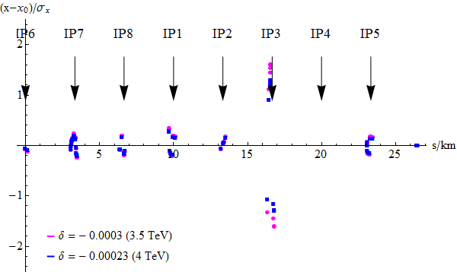
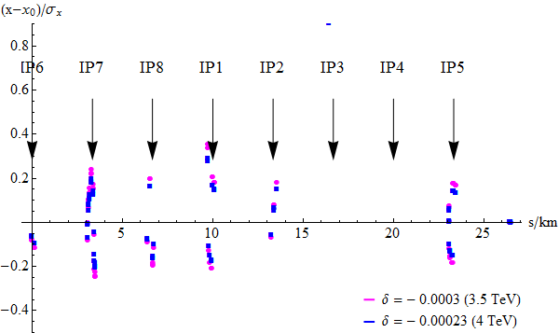
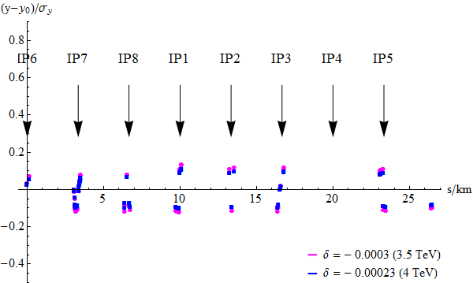
Horizontal plane
Orbit at collimators,
3.5 TeV vs. 4 TeV
Additional collimator set-up will be required in squeeze
x = orbit with δ offset,
x₀= orbit with zero offset
Horizontal plane, zoomed in
Vertical plane
R. Versteegen

Slide 12
More predictions for p-Pb (no detail)
Bound-free pair production rate will be reduced to a few % of the Pb-Pb rate
Luminosity losses in dispersion suppressors around experiments reduced, only on one side at a time
Less irradiation, R2E, etc.
Similar scaling for electromagnetic dissociation
Same equivalent photon spectrum of proton
Somewhat reduced Pb beam losses in IR3
Contributions from Pb collimation same as in Pb-Pb
Luminosity lifetime better than Pb-Pb
Dominated by IBS of Pb beam or, maybe, beam-beam

Slide 13
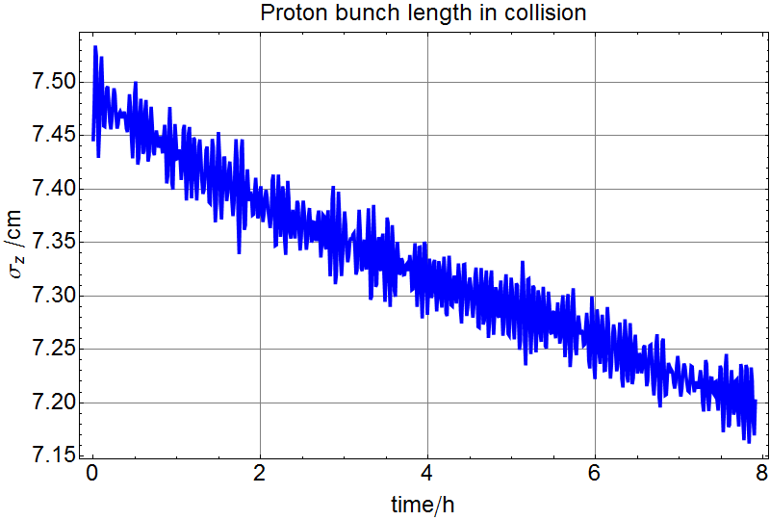
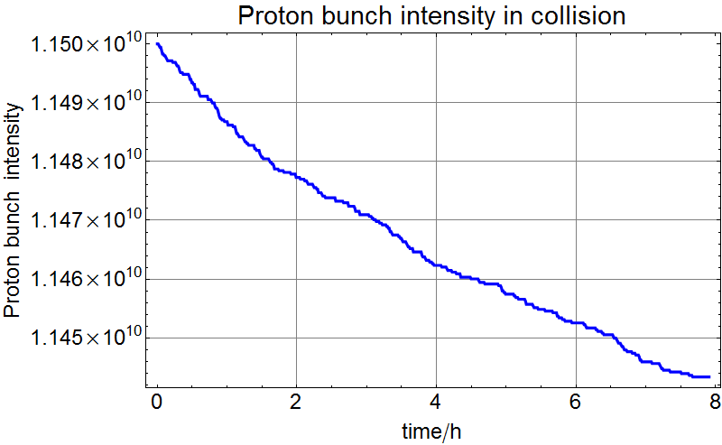
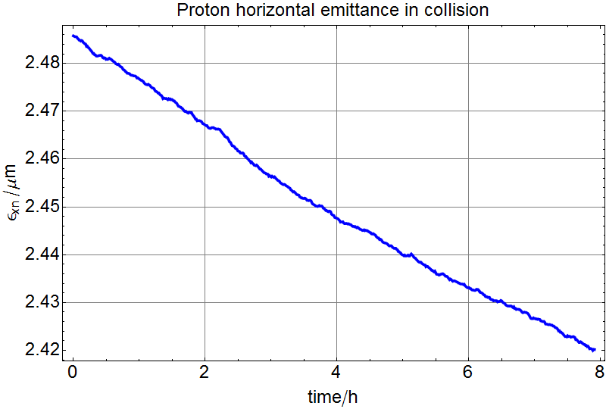
Proton beam evolution in collision (preliminary)
Other noise sources not in simulation.
Few % loss in several hours
Low intensity (10% of nominal) proton bunches have very weak IBS so shrink slowly due to synchrotron radiation damping.
Intensity loss from luminosity (cross section with Pb ~2 barn) is also small.
Vertical also shows damping.
M. Schaumann

Slide 14
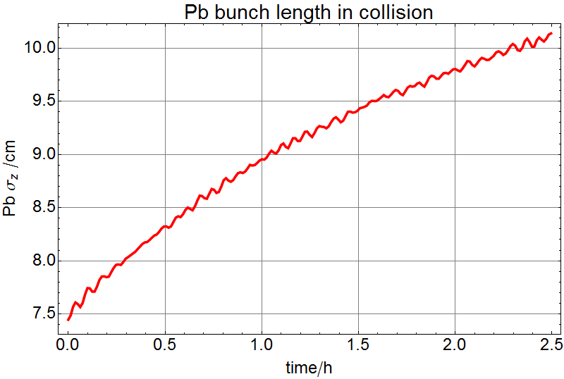
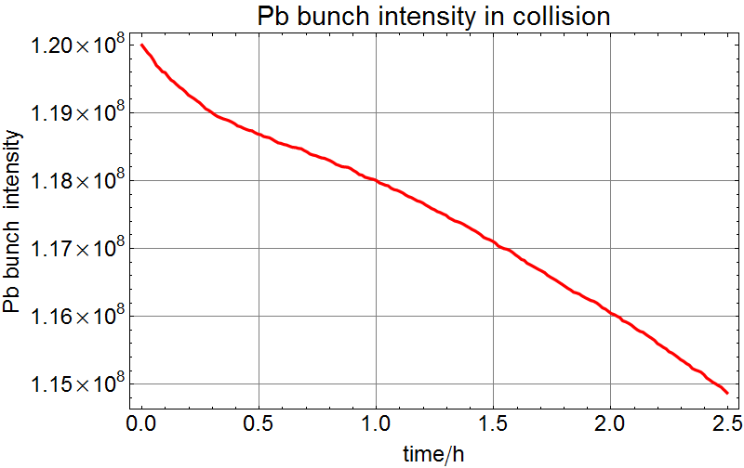
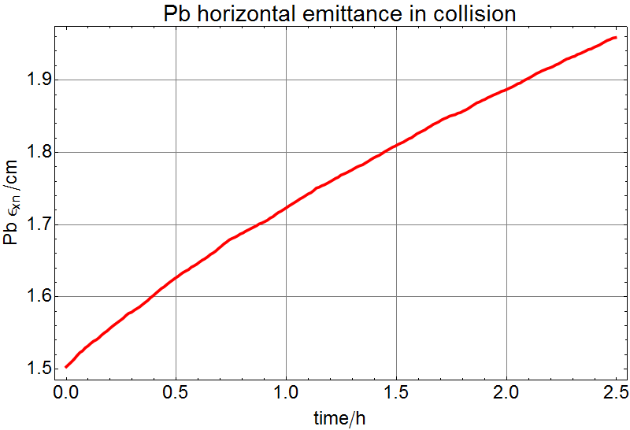
Pb beam evolution in collision (preliminary)
Few % loss in only 2.5 hours
High intensity (150% of nominal) Pb bunches have strong IBS growth (as in 2011) despite having twice the synchrotron radiation damping of protons.
Fractional intensity loss from luminosity (cross section on Pb ~2 barn) is more significant, but much less than in Pb-Pb. Losses also from IBS debunching.
Vertical shows damping.
M. Schaumann

Slide 15
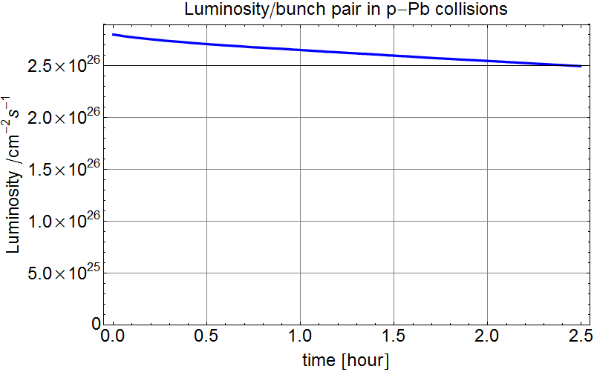
Luminosity evolution (preliminary)
Luminosity made by the bunches shown on previous two slides.
Slower decay than in Pb-Pb or even p-p fills.
We can hope for long fills which will increase the ratio of average to peak luminosity!
Good, since set-up will be longer than usual.
N.B. this is the worse case for luminosity decay, the higher intensity Pb bunches from the 200 ns filling scheme.
Caveats:
Unequal beam sizes may give beam-beam problems (but tune-shifts are still small).
This is still the conservative proton bunch intensity.
Not all physics in this simulation.

Slide 16
Luminosity evolution during the run
Initial proton bunch intensity (10% nominal) is comparable with Pb in terms of bunch charge
Unequal emittances …
Step up to full filling scheme with fixed bunch intensity as usual
Pace may be determined by experiments’ requests
If all goes well, we will then try to increase luminosity by increasing proton bunch intensity
Experiments should preferably be prepared for wide range in luminosity – less or more!
Peak luminosity limits ? Adapt filling scheme?

Slide 17
Conclusions, (some of) the actions needed
Continue with studies for optics, squeeze, etc.
Possible optics corrections
BI, Experiments, Logging:
Check that the shift of 1-1 collision point will not cause problems
Define filling schemes according to LPC priorities
Items to be scheduled (not today)
RF synchronisation MD with p-p
Many bunch p-Pb ramp MD
Pilot physics fill
Detailed commissioning plan
LHCb will have much less luminosity than other experiments (factor 60?)

Slide 18
BACKUP SLIDes

