Slide 1
Luminosity-calibration systematics from non-linear x-y correlations in the 3-d L distribution
W. Kozanecki
for the LHC Luminosity Calibration & Measurement Working Group
Introduction: why we (ATLAS, CMS, LHCb…) have a problem
A fundamental assumption underpinning the L-calibration method: x-y factorization of L distribution
L factorization tests using off-axis vdM scans
Luminous-region evolution during vdM scans
  What we observe in the data
  Luminous-region simulations
Correlated fits to vdM scan curves
Summary of observations
Where you (the accelerator physicists) could help…

Slide 2
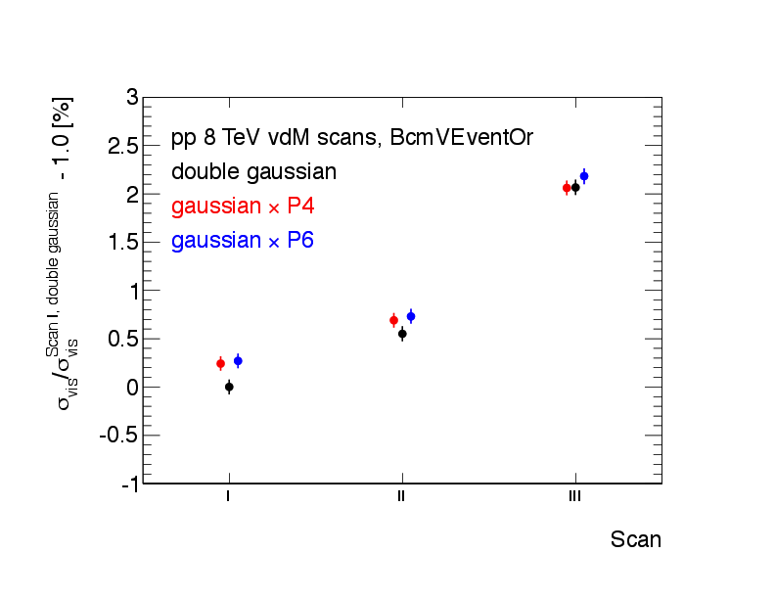
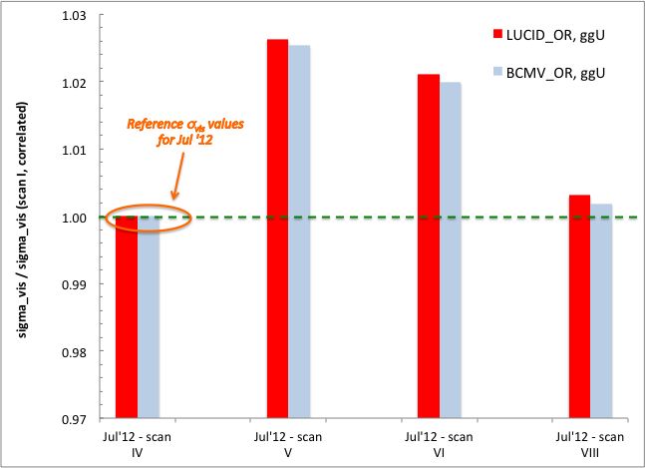
Introduction: a problem? but…where? why?
The vdM-based calibrations for 2011 reached a level of precision unprecedented at hadron colliders (except for the ISR)
  ΔL / L = 1 .8 % [May’11 vdM scans, ATLAS-CONF-2012-080, ICHEP 2012]
  LHCb/CMS: comparable/slightly larger uncertainties (LumiDays ‘12)
Two very challenging issues surfaced in 2012
  the ‘rising visible cross-section’ problem (April + July 2012 vdM scans)
  breakdown of x-y factorization in the 3-d L distribution (Jul ’12 scans)
~ 2.5 %
Rising σ_{vis} also observed by CMS
Apr’12 vdM scans
Jul’12 vdM scans

Slide 3
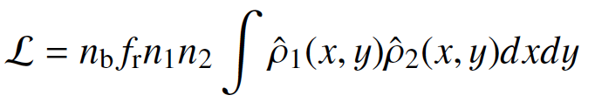
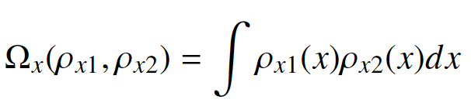

A fundamental assumption: x-y factorization of L (Δx, Δy)
A key assumption of the vdM scan method as currently applied is that the luminosity
factorizes in x & y:
This is equivalent to assuming that the shape of the scan curve during an x (y) scan is independent of the separation Δy (Δx) in the orthogonal plane
  if this is the case, the combination of 1 x-scan and 1 y-scan is sufficient to characterize the entire distribution L (Δx, Δy)
  if this is violated at a “significant” level, the vdM formalism can be generalized to 2 dimensions by performing a grid scan (impractical!)
Although linear x-y coupling does violate this assumption, the induced bias is typically very small (ΔL/L ~ 0.1%) with present LHC optics (small x-y coupling coeff., ε_{x} ~ ε_{y}, β∗_{x} ~ β∗_{y})

Slide 4
The “beam size” and its avatars
Name | Symbol | Measurable using | 1-Gaussian limit | Comments
Single-beam size | σ_{x,b} , σ_{y,b} b = B1, B2 | BSRT, WS LHCb SMOG | - | Projections only 2-d; but Δφ ?
Transverse convolved beam size | Σ_{x} , Σ_{y} | vdM scans | Σ²_{x} = σ²_{x,1} + σ²_{x,2} Σ²_{y} = σ²_{y,1} + σ²_{y,2} | Very precise: ΔΣ/Σ < 1%
Transverse luminous size | σ_{x,L} , σ_{y,L} | 3-d vertex distribution | σ ⁻²_{x,L} = σ ⁻²_{x,1} + σ ⁻²_{x,2} σ ⁻²_{y,L} = σ ⁻²_{y,1} + σ ⁻²_{y,2} | Aka ‘beamspot width’ Resolut’n-limited for β* < 5 m
Bunch length | σ_{z,b} | BQM
Luminous length | σ_{z,L} | z-vertex distribution | σ²_{z,L} = 0.5 * f(β*) ∗ (σ²_{z,1} + σ²_{z,2}) | Aka ‘beamspot length’
The assumption that the luminosity distribution contains no x-y correlations, can be tested by performing off-axis vdM scans (x-scan with y offset, y- scan with x offset)

Slide 5
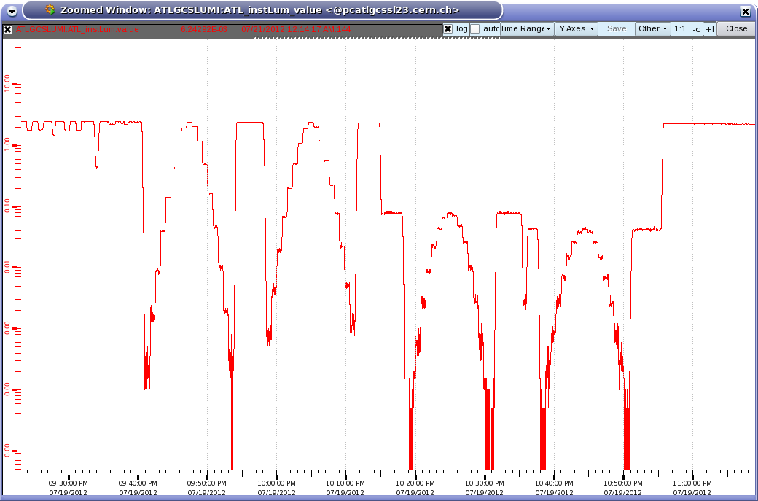
Off-axis scans in F 2856 (ATLAS Jul ‘ 12 vdM scan)
F 2856
~1/30
~1/50
Scan VIII:
x , y
Scan IX:
x w/ y offset, y w/ x-offset
Partial beam separation for ATLAS offset scans: 344 (369) μ for scan VII (IX) (adjusted to correspond to Δ_{x,y} ~ 2.6 - 2.8 Σ_{x} and to an integer # steps)

Slide 6
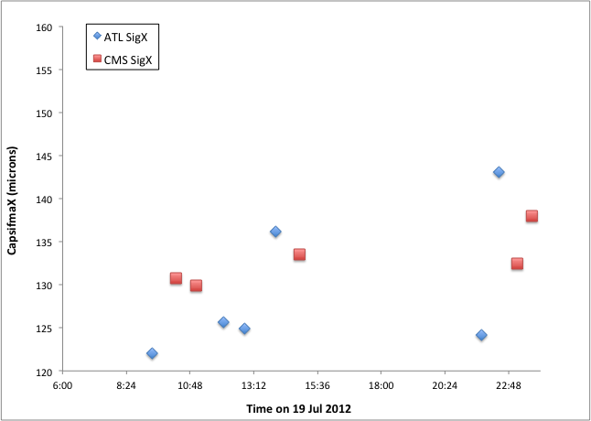
On-/off-axis scans in ATLAS & CMS: Σ_{x} comparison (BCID average)
Note that CMS used a significantly smaller partial separation (1Σ) in off-axis scans than ATLAS did (2.4-2.8 Σ)
Effect also seen in LHCb (~ 4% on Σ, for Δ ~ 1.4 Σ )
Scans VII, IX (offset)
15 %
4 %
9 %
Scans VI, VIII (centered)

Slide 7
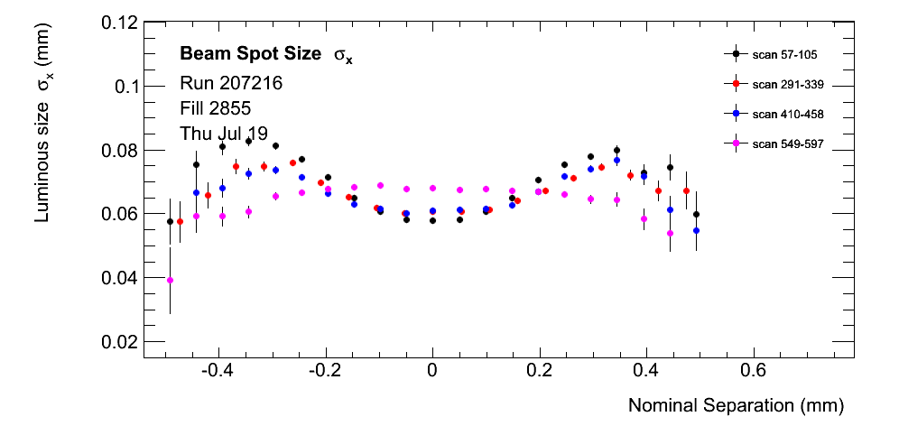
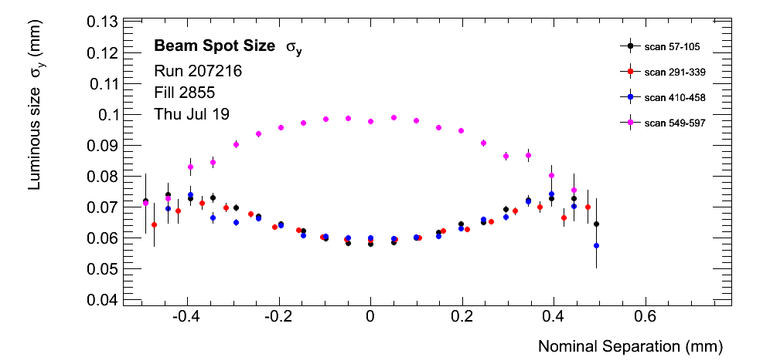
Luminous-region evolution in Jul ’12 (BCID-av): widths, x-scans
Centered scans
10 %
Offset scan
y-width during x-scan depends on y offset!
Centered scans
Offset scan
60 %

Slide 8
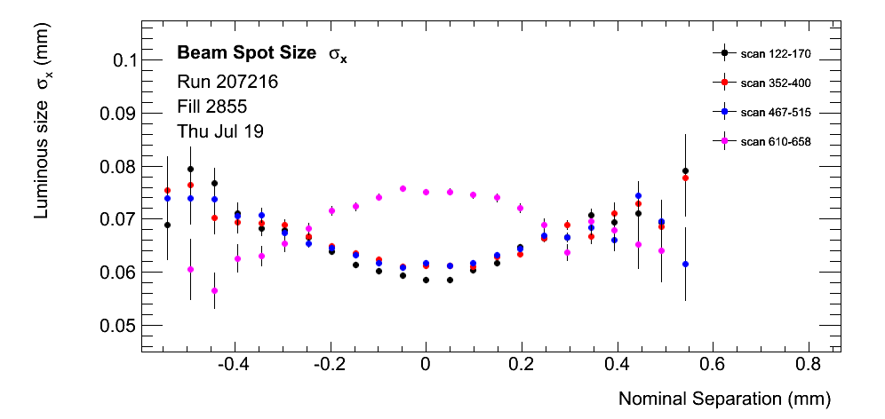
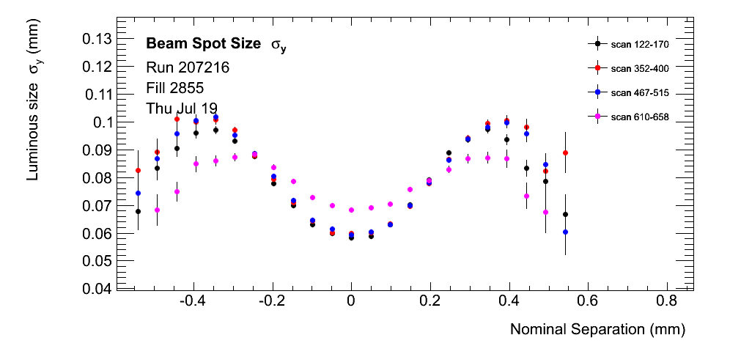
Luminous-region evolution in Jul ’12 (BCID-av): widths, y-scans
Centered scans
x-width during y-scan depends on x offset!
Convincing evidence for non-linear correlations
… so are the earlier (7 TeV) calibrations valid ?
Offset scan
and how large is the ultimate uncertainty on the 8 TeV calibrations?
y-width during y-scan depends on x offset!

Slide 9
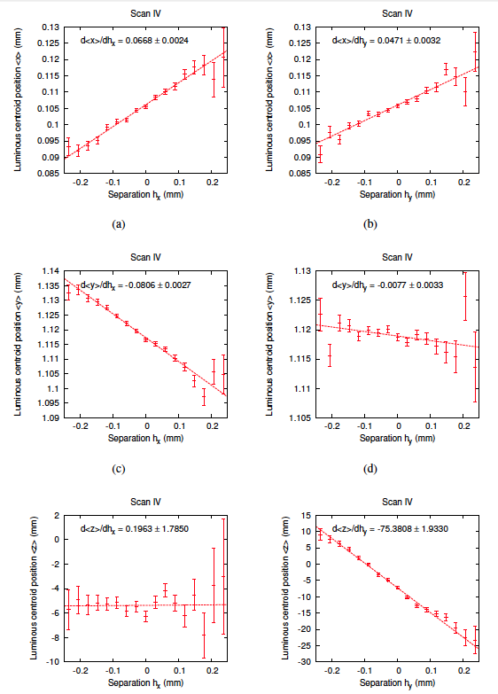
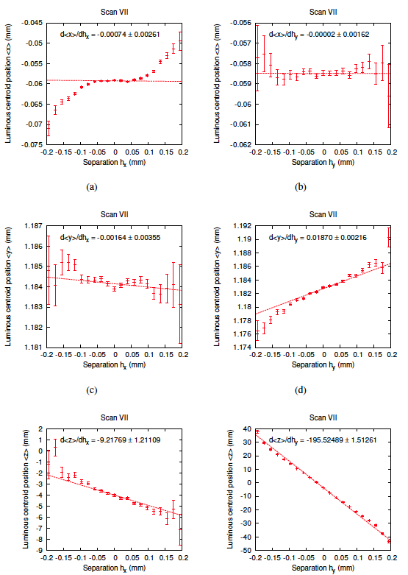
Luminous-centroid evolution during vdM scans: Oct’ 10 vs. May ‘11
Oct 2010
May 2011
x-displacement
→ σ_{x}/σ_{y}
Non-gaussian tails!
→ σ_{x,1}/σ_{x,2}
x-scans
y-scans
x-scans
y-scans
y-displacement
Non-gaussian tails!
→ σ_{y}/σ_{x}
→ σ_{y,1}/σ_{y,2}
z-displacement
→ α_{x,z}
→ α_{y,z}

Slide 10
Luminous-centroid evolution during vdM scans: Oct’ 10 vs. May ‘11
Oct 2010
May 2011
x-displacement
→ σ_{x}/σ_{y}
Non-gaussian tails!
→ σ_{x,1}/σ_{x,2}
x-scans
y-scans
x-scans
y-scans
y-displacement
Non-gaussian tails!
→ σ_{y}/σ_{x}
→ σ_{y,1}/σ_{y,2}
Note that for strictly gaussian beams (even if unequal in x v.s y and B1 vs. B2, and even with linear x-y coupling), the transverse luminous sizes are independent of the beam separation during vdM scans.
z-displacement
→ α_{x,z}
→ α_{y,z}

Slide 11
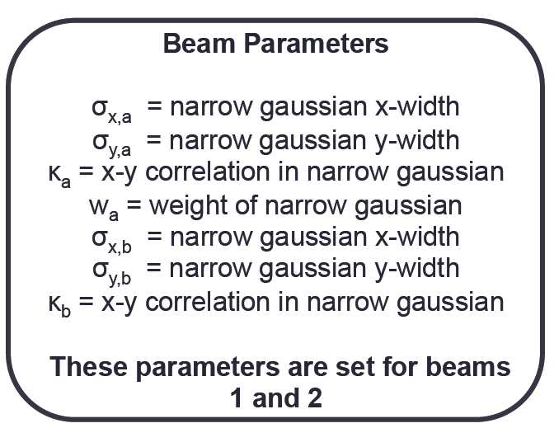
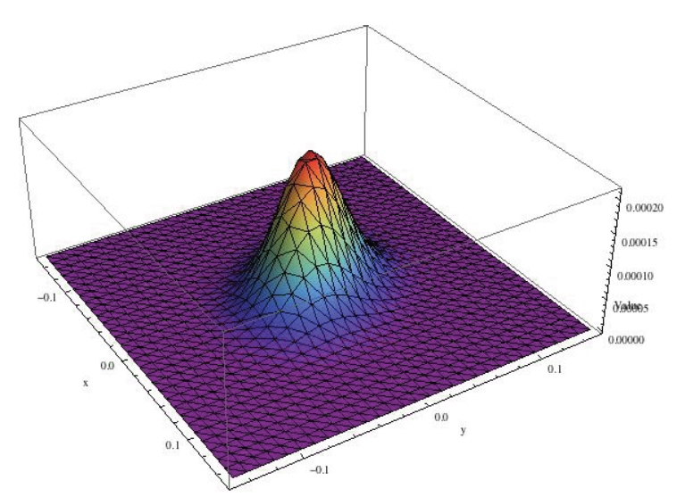
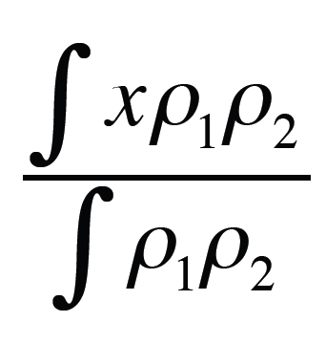
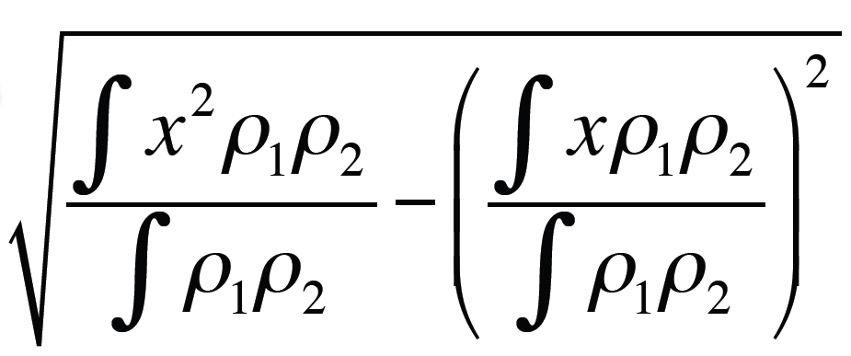
Luminous-region simulations
Aim: try & reproduce beam spot displacement & changes in luminous widths observed during vdM scans
Procedure
  Use a simple simulation written in Mathematica to gain an intuition for the required beam parameters
  Assumptions
    double-Gaussian beam profiles
    ignore crossing angles (for now)
  Quantitative interpretation of luminous-region parameters
    real data: max. likelihood fit of resolution-corrected, 3-d single-gaussian to reconstructed-vertex distribution
    this simulation (so far)
      luminous centroid = mean
      luminous width = RMS
L
x
y

Slide 12
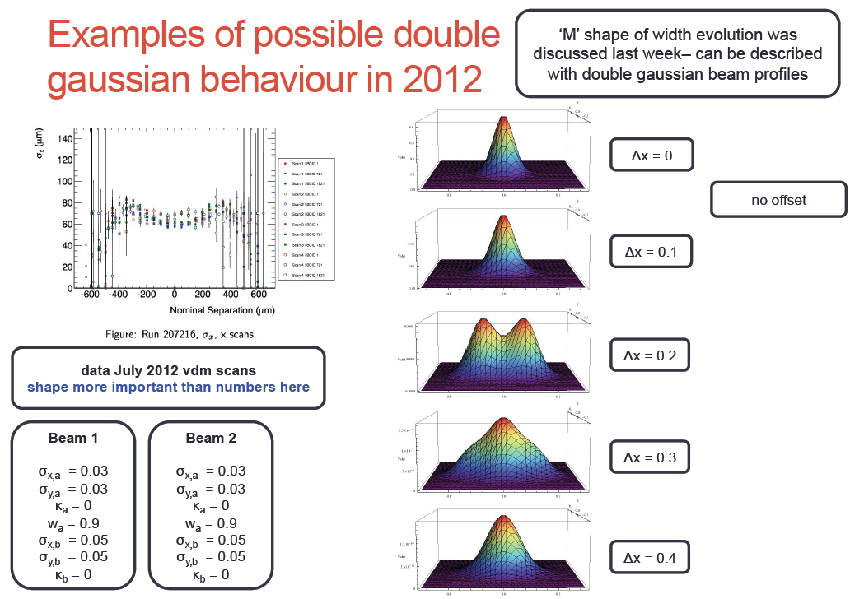
Luminous-region simulations: examples
σ_{Lx} (mm)
Δx (mm)

Slide 13
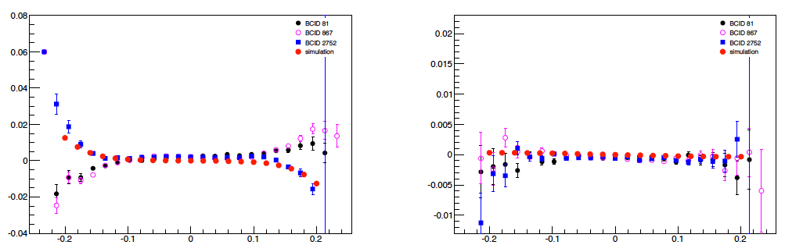
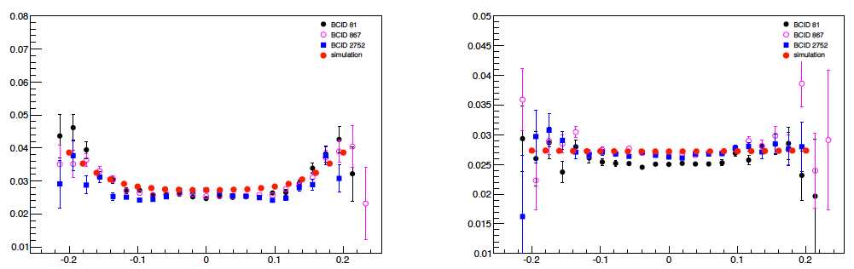
Luminous-region evolution: model 2b, x-scan, y-centered (May’11 vdM)
x-centroid
y-centroid
<x>_{L} (mm)
<y>_{L} (mm)
Δx (mm)
Δx (mm)
x-width
y-width
σ_{xL} (mm)
σ_{yL} (mm)
Δx (mm)
Δx (mm)

Slide 14
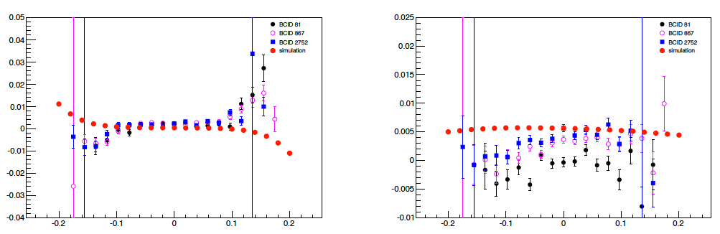
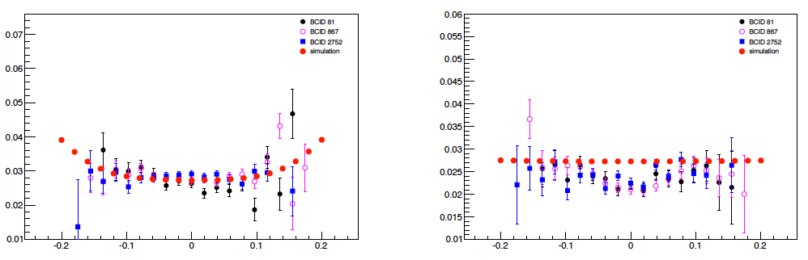
Luminous-region evolution: model 2b, x-scan, y offset (May’11 vdM)
x-centroid
y-centroid
<x>_{L} (mm)
<y>_{L} (mm)
Δx (mm)
Δx (mm)
x-width
y-width
σ_{xL} (mm)
σ_{yL} (mm)
Δx (mm)
Δx (mm)

Slide 15
A complementary approach: correlated fits to vdM scan curves
To estimate (roughly) the magnitude of a potential NLC-induced bias, ATLAS routinely compared the visible cross-sections (i.e. the L calibration scales) obtained by fitting the x- & y- vdM-scan curves using either
  an uncorrelated model (= baseline): g+g (can simplify to g, or to g+p0)
  a correlated double-gaussian model (naïve & by no means unique)
  that reduces to the uncorrelated model at Δx = Δy = 0 (but with f_{x} = f_{y})
Observed impact on visible cross-sections at √s = 7 TeV (ATLAS)
  Δσ_{vis} / σ_{vis} ~ 3%, 2%, 0.9%, 0.5 % for Apr ’10, May ’10, Oct ’10, May ’11
  The more single-gaussian the scan curves, the smaller the potential bias (a property of this model – but probably not a general property?)
  As the effect looked small for the two main 7 TeV scan sessions, and for lack of manpower, we didn’t look much further until …
L(x, y)
L(x, y)

Slide 16
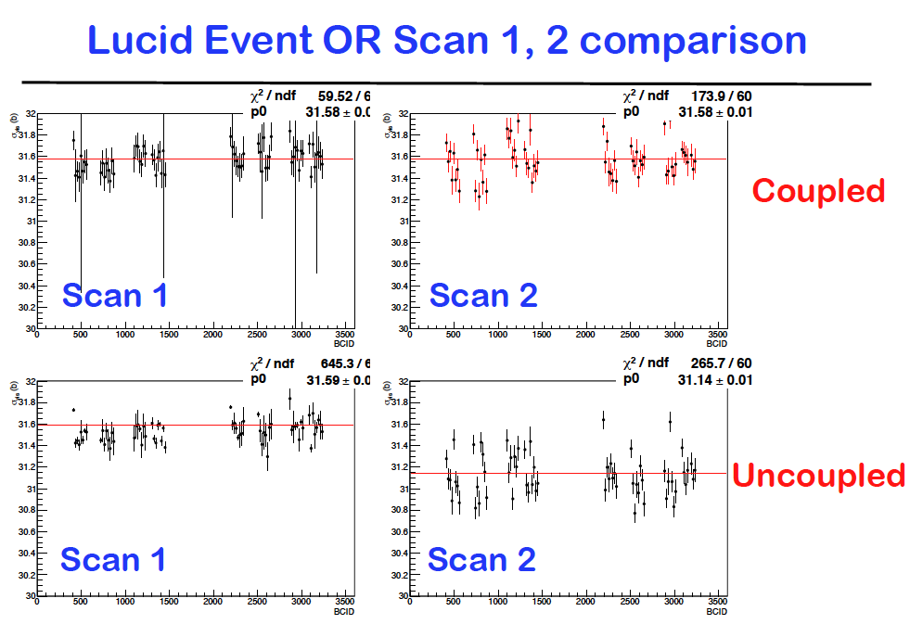
Correlated fits to vdM scan curves: Mar ’11 scans (2.76 TeV pp)
LUCID_OR

Slide 17
Correlated fits to vdM scan curves: Mar ’11 scans (2.76 TeV pp)
LUCID_OR

Slide 18
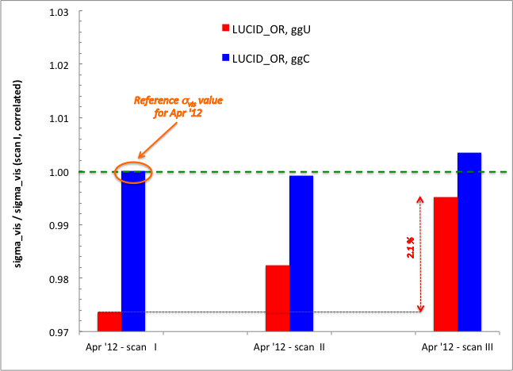
Correlated fits to vdM scan curves: Apr ’12 scans (8 TeV pp)

Slide 19
Correlated fits to vdM scan curves: Apr ’12 scans (8 TeV pp)
Notes
the true bias may be larger than the difference between uncorrelated & correlated fits (coupling model dependence!)
there may be other coupling models which also yield a stable central value, but significantly different from the present one. To be studied.
The same analysis is being applied to May’11 & Jul’12 vdM scans

Slide 20
Summary (1)
Assumption that L distribution factorizable in x, y appears violated
  as manifested by
    differences in fitted Σ_{x,y} values in centered & off-axis vdM scans
    differences in luminous-width evolution during centered & off-axis scans
    sensitivity of the visible cross-sections to an x-y correlated fit model
  to a different degree in different scan sessions
  in a manner that is only partially correlated with the amplitude of non-gaussian tails in the x- and/or y- luminosity-scan curves
Compelling evidence that this is caused by the beams themselves
  never considered at other colliders
  → urgent (and still ongoing) review of the potential impact of NLC’s in the systematic uncertainty affecting the ATLAS vdM calibrations of May’11 (7 TeV) and March ‘11 (2.76 TeV)
  → evaluation of
    the impact on the precision of the absolute L scale in 2012 (all 4 expts!)
    the potential need for an additional vdM scan in 2012. Prerequisites:
      understand how large the L uncertainty may be without it
      convincing arguments that we can do better – and how (→ LBOC)

Slide 21
Summary (2)
An analytical framework is now in place for the linear analysis of the luminous-region evolution during vdM scans.
  Assumptions
    each beam = single-gaussian
    x-y [can be] linearly correlated
  Deviations from this linear model (observed at large beam separation) → clear signature for the non-gaussian character of the L(x, y,z) distribution (info independent from / complementary to L-scan curves)
Simulations have started for the analysis of luminous-region evolution during scans, under more general assumptions:
    each beam = double gaussian w/ common mean
    the 4 gaussians (B1/B2, x/y) [can] have different x-y correlations
These simulations
  allow a 3-d visualization of the L(x,y) distribution, making it possible to develop a physical intuition for the complex structures that result from some beam-parameter configurations
  not (yet) successful in setting upper limit on the May’11 uncertainties

Slide 22
Summary (3)
Allowing for non-linear x-y correlations (NLC) in vdM fits improves the scan-to-scan σ_{vis} consistency (one specific, naïve model tried!) in the March ‘11 and Apr’12 vdM scans. To do: May ’11, Jul ’12
  may explain large scan-to-scan inconsistencies in Apr & Jul vdM calibs
  but NLC-induced bias may be larger than the observed inconsistencies
Next steps
  ATLAS ‘to-do’ list
    Correlated vdM fit → May ‘11 & Jul ‘12 scans; more coupling models!
    Luminous-region simulation of Jul’12 scans (stronger signals -> easier?)
    The present characterization of the (measured or simulated) L(x,y) distribution is oversimplified (mean+RMS, or 1G fit); a more sophisticated parameterization/fit of the beam spot is needed
    Combined fit to the luminosity-scan and luminous-region data (a significant investment!) [as suggested in 2011 by A. Messina & G. Piacquadio]
  CMS, LHCb, ALICE now in the loop, starting to
    perform correlated vdM fits to available 2011 & 2012 scans
    compare luminous-region evolution in centered & offset scans
  LHCb
    provide both 1-d and 2-d (x-y) single-beam profiles (SMOG, July’12 scans)

Slide 23
Where you (accelerator physicists) could help…
The more gaussian the beams, the smaller the potentially harmful correlations. The vdM scan curves were
  almost perfectly single Gaussians in May 2011 (F 1783)
  imperatively require g+g (or more complex) fits in other scan sessions
    wire scans in 2012 (F 2520, 2855, 2856) highly non-gaussian; F1783 ??
      limited dynamic range (< x 10)
      projections only
    what other techniques can be used to characterize x-y beam shapes?
  what was special about May 2011 ?
  what can be done to make the beams more gaussian (during vdM scans)?
    did the improvements on injected ε_{inv} during Aug 2012 make the beams more gaussian?
      Could be tested by end-of-fill scans

Slide 24
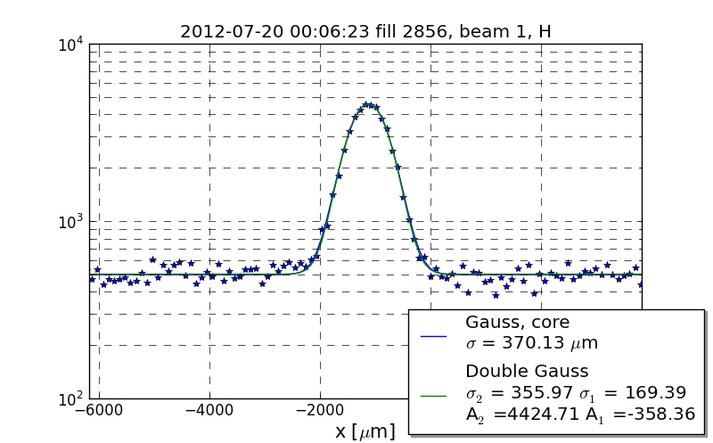
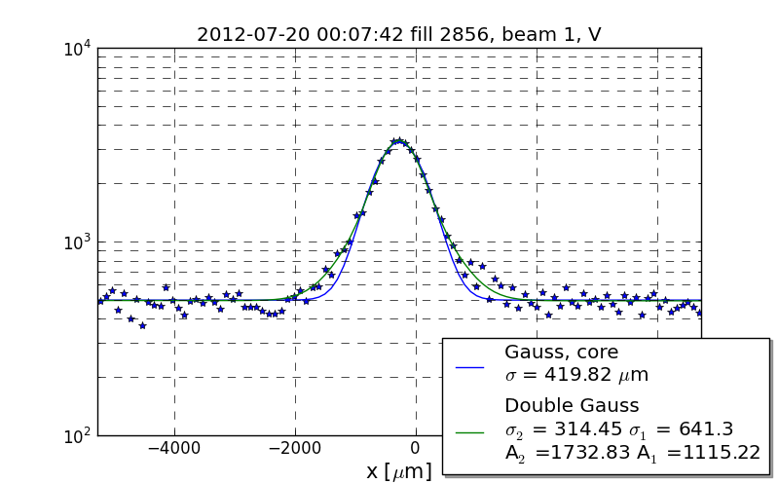
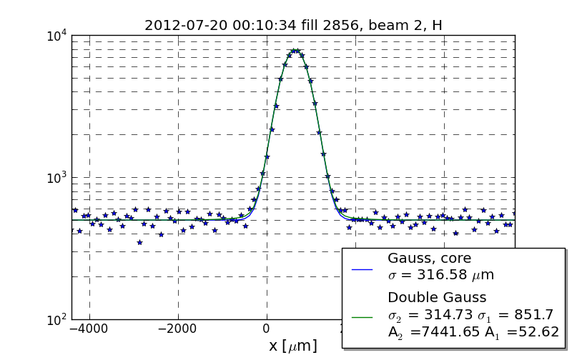
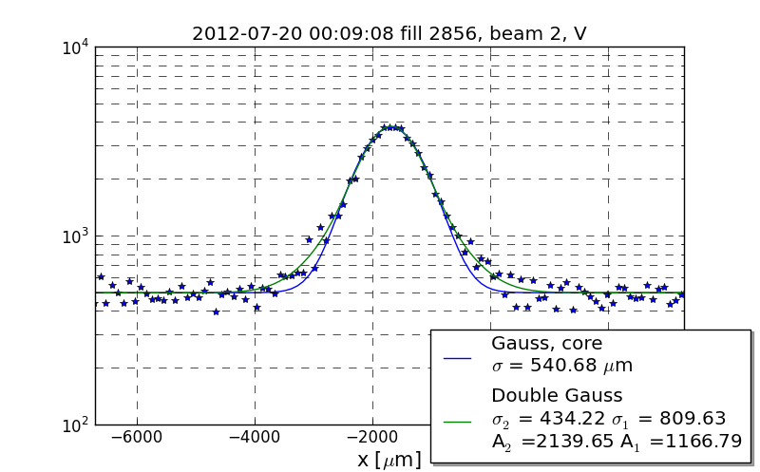
Wire scans during Jul ’12 ATLAS/CMS scans (F 2856)
V. Kain

Slide 25
Wire scans during Jul ’12 ATLAS/CMS scans (F 2856)
V. Kain
Observations
2nd-gaussian more prominent in the vertical (in this fill only – or is this typical?)
large 2nd gaussian in both H & V at injection (previous fill)
dynamic range < factor of 10; L sensitive way beyond this)

Slide 26
Where you (accelerator physicists) could help…
The more gaussian the beams, the smaller the potentially harmful correlations. The vdM scan curves were
  almost perfectly single Gaussians in May 2011 (F 1783)
  imperatively require g+g (or more complex) fits in other scan sessions
    wire scans in 2012 (F 2520, 2855, 2856) highly non-gaussian; F1783 ??
      limited dynamic range (< x 10)
      projections only
    what other techniques can be used to characterize x-y beam shapes?
  what was special about May 2011 ?
  what can be done to make the beams more gaussian (during vdM scans)?
    did the improvements on injected ε_{inv} during Aug 2012 make the beams more gaussian?
      Could be tested by end-of-fill scans
What could be the source(s) of the observed non-factorization?
  beam-beam probably excluded (WH @ LumiDays: dynamic β ~ 0.5%)
  large bunch-by-bunch differences => caused (only partly?) by injectors
  octupoles? (stronger now than in May’11 ?)
  impedance?
skew quad term?

Slide 27
Where you (accelerator physicists) could help… (2)
Related observations (may or may not be relevant to today’s problem)
  “shape” of luminosity distribution region evolves during fill
    does not just ‘scale’ with ε growth
    fraction of wider gaussian increases
    relative centers of the wide & narrow gaussians movefurther apart
  strong left-right asymmetry in scan curves (also seen by CMS)
    cannot be accomodated by linear optics (betatron oscillations)
    can be tested by scanning in one direction and then immediately in the other

Slide 28
Supplementary material

Slide 29
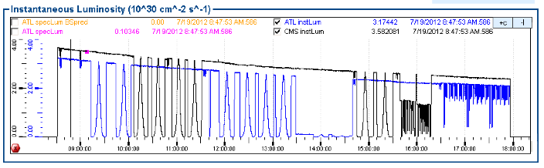
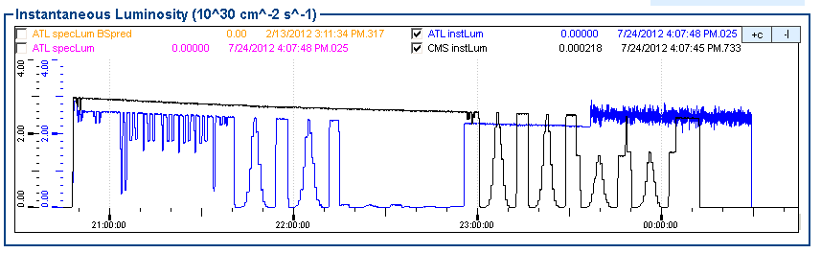
Overview of July ‘12 scan program at IP 1 & 5
Apr’12 scans are labelled scans I-III
F 2855
BI checks
IV: x -y
V: x -y
VI: x -y
VII: x –y
w/ offset
DSC:
B1X, B2X, B1Y
F 2856
DSC: B2Y
VIII: x -y
IX: x –y
w/ offset

Slide 30
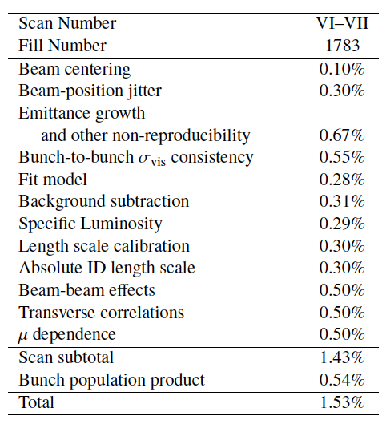
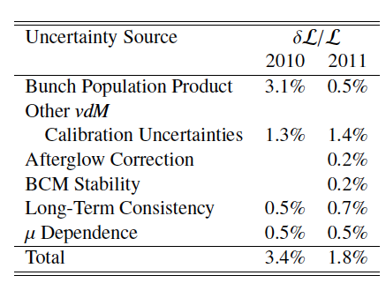
Systematic uncertainties on absolute L at 7 TeV
The vdM-based calibrations for 2011 reached a level of precision unprecedented at hadron colliders (except for the ISR)
ATLAS example (May’11 vdM scans, ATLAS-CONF-2012-080)
LHCb/CMS: comparable/slightly larger uncertainties (LumiDays ‘12)
vdM-calibration uncertainties
Total L uncertainty
BUT… are these uncertainties RIGHT?

Slide 31
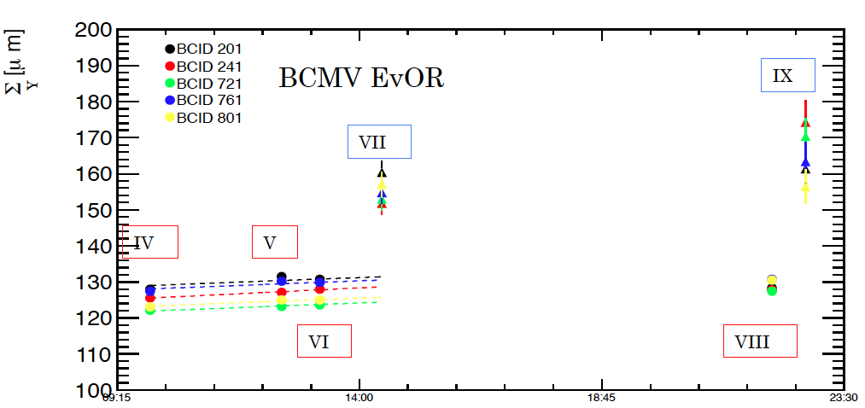
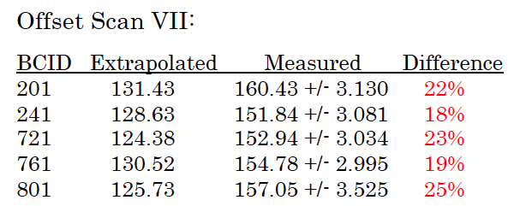
On- and off-axis scans in ATLAS (Jul ‘ 12 vdM): Σ_{y} comparison

Slide 32
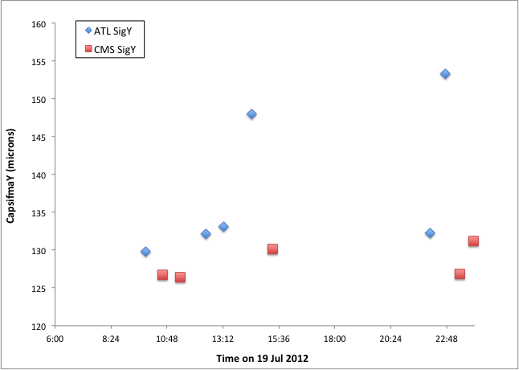
Online fits to BCID-blind scan curves: Σ_{y} (g+p0[B])
Note that CMS used a significantly smaller partial separation in off-axis scans than ATLAS
Effect also seen in LHCb
Scans VII, IX (offset)
Scans VI, VIII (centered)

Slide 33
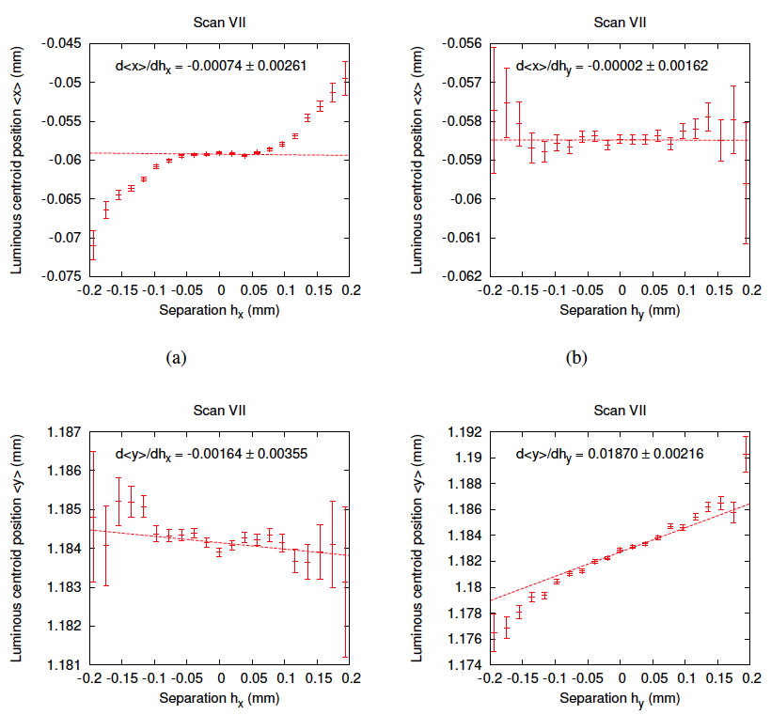
Luminous-centroid evolution during May ‘11 vdM (centered) scans
These plots show the position of the luminous centroid during the first set of x and y scans in
May 2011. A linear fit, based on an analytical description of x-y coupled, single-gaussian beams, has been made to the central scan data (separation |h| < 0.05 mm).
The linear fit gives the gradient of the movement, and corresponds to the extraction of the observables
in Table 1.
The diagonal plots (a), (d) clearly indicate the presence of non-gaussian tails.
x-scan
Hor. displacement
y-scan
Hor. displacement
x-scan
Vert. displacement
y-scan
Vert. displacement

Slide 34
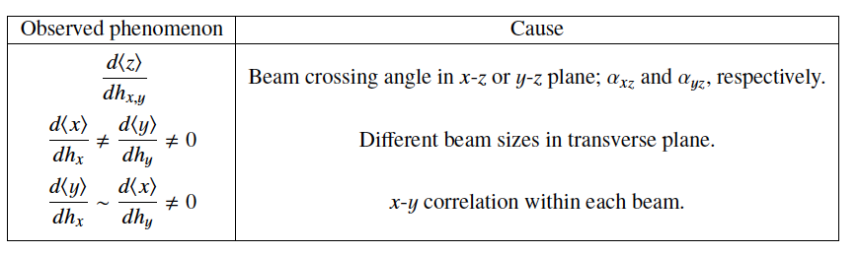
Luminous-centroid evolution during vdM scans: interpretation
(assuming each beam is Gaussian)
The plots on the preceding page show the position of the luminous centroid during the first set of x and y scans in Oct 2010 &May 2011. A linear fit, based on an analytical description of x-y coupled, single-gaussian beams, has been made to the central scan data (separation |h| < 0.05 mm).
The linear fit gives the gradient of the movement, and corresponds to the extraction of the observables in the Table below
(Linear)
Note that for strictly gaussian beams (even if unequal in x v.s y and B1 vs. B2, and even with linear x-y coupling), the transverse luminous sizes are independent of the beam separation during vdM scans.

Slide 35
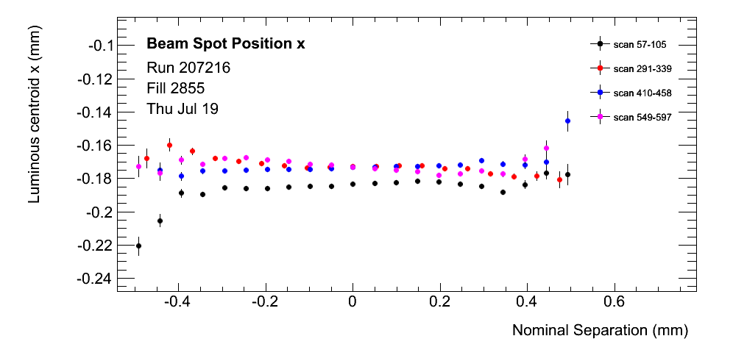
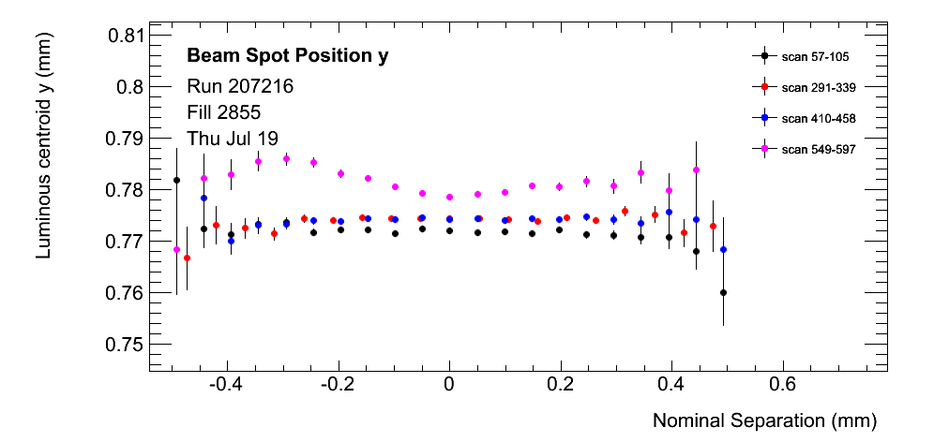
Luminous-region evolution in Jul ’12 (BCID-av): centroids, x-scans
Centered scans
Evidence for
non-gausssian tails!
Offset scan

Slide 36
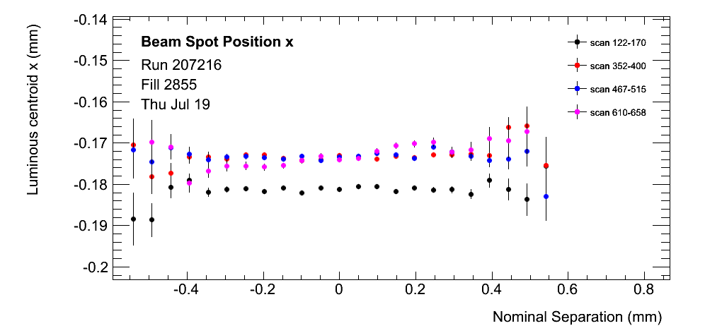
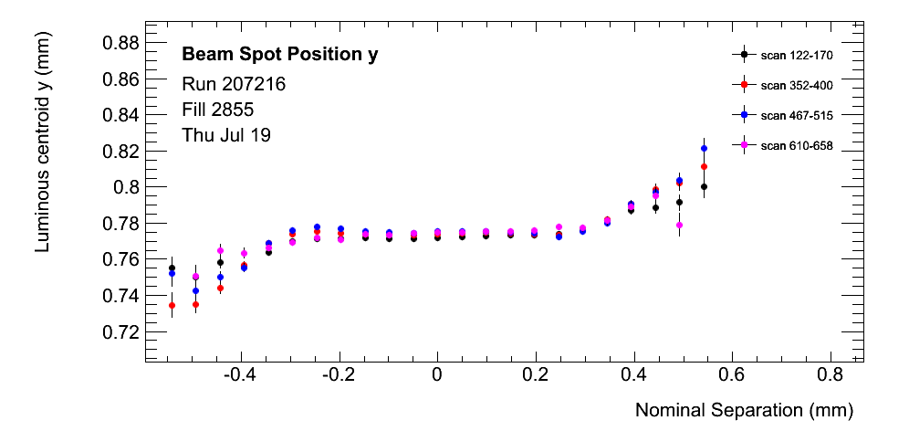
Luminous-region evolution in Jul ’12 (BCID-av): centroids, y-scans
Centered scans
Offset scan
Clear evidence for non-gausssian tails!

Slide 37
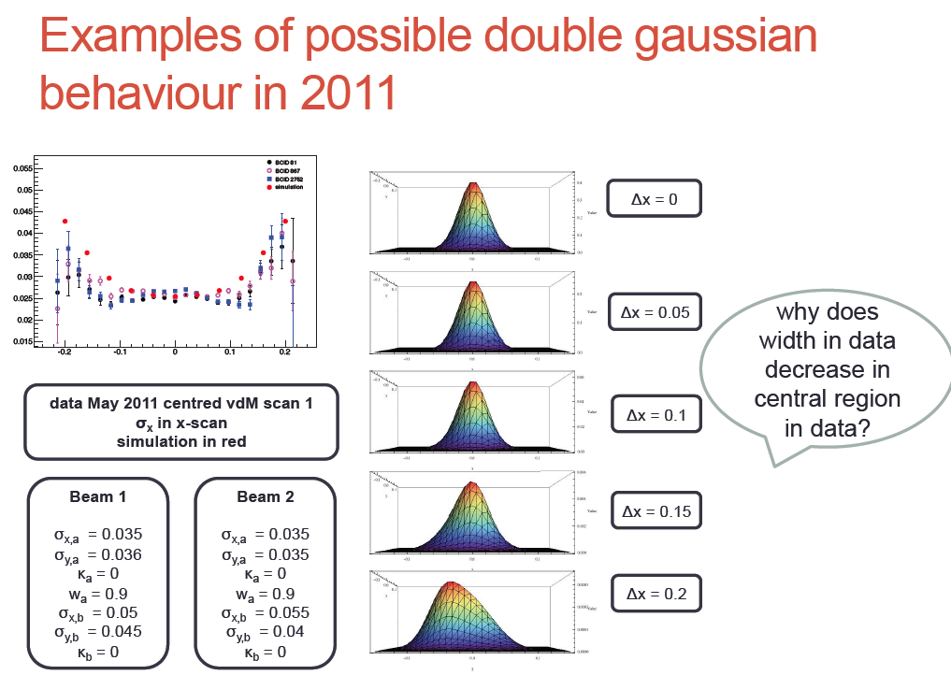
Luminous-region simulations (2)
σ_{Lx} (mm)
Δx (mm)

Slide 38
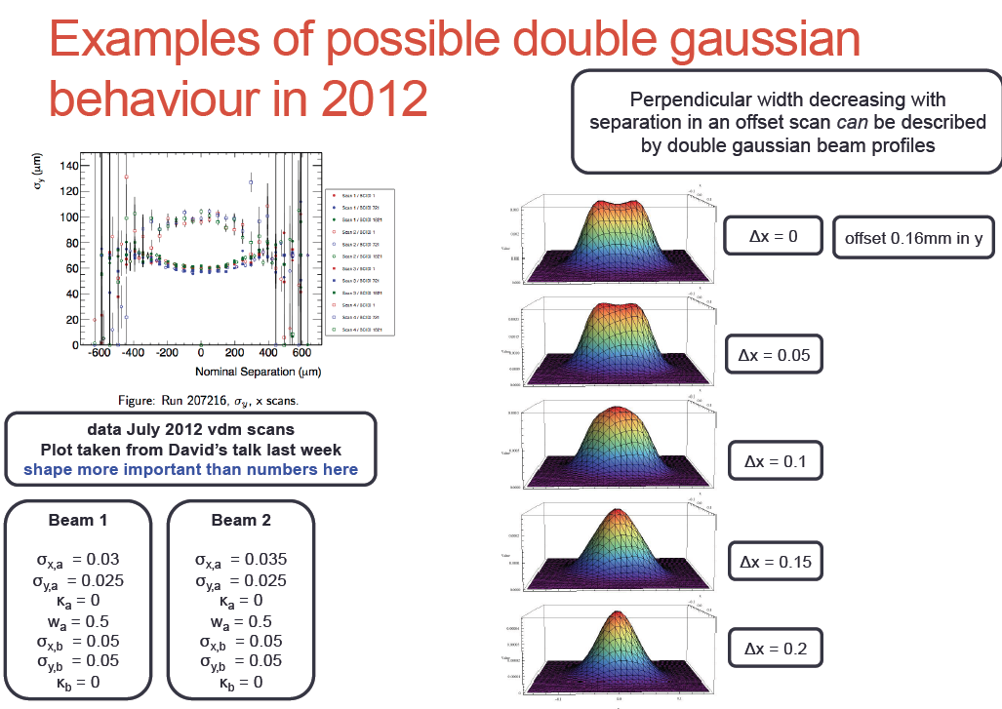
Luminous-region simulations (4)
σ_{Ly}(mm)
Δx (mm)

Slide 39
Modelling of luminous-region evolution during May’11 vdM scans
Goal
  determine a set of beam parameters (each beam = double gaussian) that reproduce both
    the beam-separation dependence of luminous-region parameters (centroid position, luminous width)
    the luminosity variation (i.e. Σ_{x,y} )
  during the May ‘11 vdM scans (both centered and offset scans)
  for this parameter set, compute the fractional difference between
    the luminosity computed from the values of Σ_{x,y} as fitted to the simulated centered scans (as is done with real data)
    the ‘true’ luminosity, obtained by integrating the 2-d or 3-d L distribution
Procedure
  estimate first-order parameters (core gaussians) from the results of the linear analysis
  adjust (by hand, guided by physical intuition) the other parameters to reproduce the separation-dependence of the beamspot parameters, respecting (to some degree) the constraints from measured Σ_{x,y} values
  iterate…

Slide 40
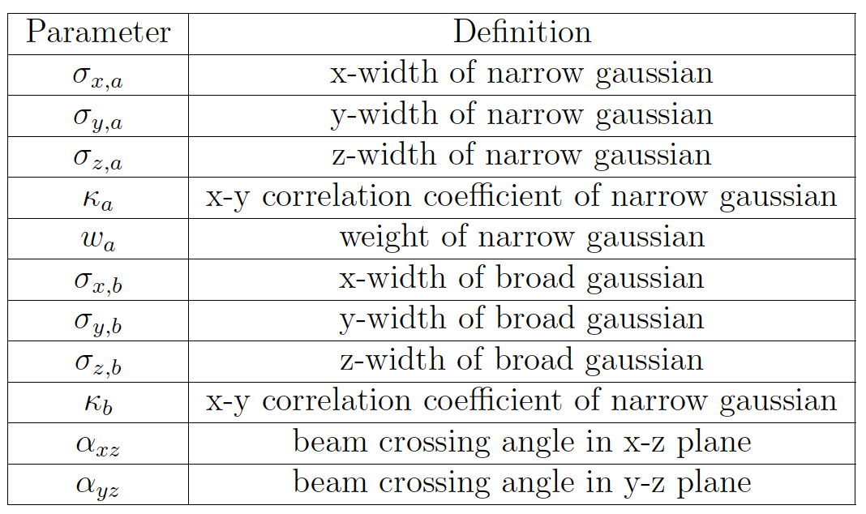
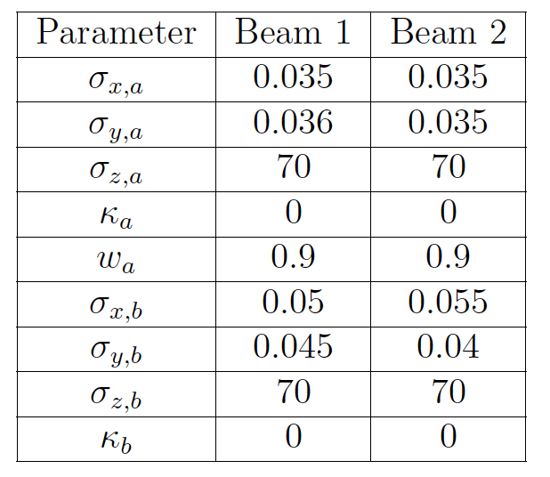
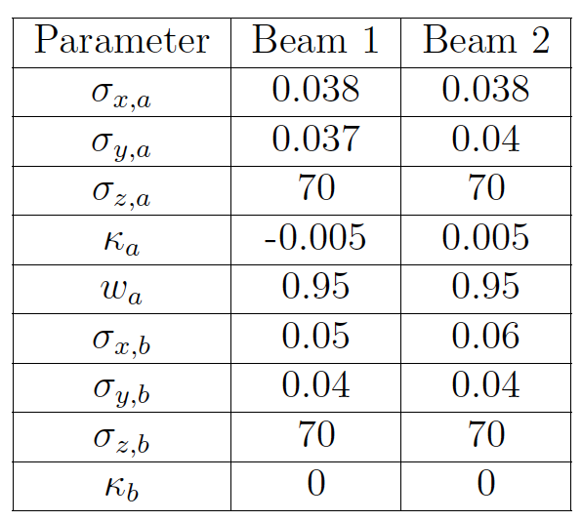
Modelling of May ’11 vdM scans: parameter sets
Model 1
Model 2b
Xing angle neglected
Xing angle = 240 μrad
Note that
the coupling terms of the core gaussians (κ_{a}) are either 0 or very small
the coupling terms of the tail gaussians (κ_{b}) are both 0
so that in practice, both of these luminosity models are (almost) totally uncorrelated.
Whether this is
serendipitous, and reflects the limitations inherent to a manual procedure
imposed by the data themselves,
remains to be determined.

Slide 41
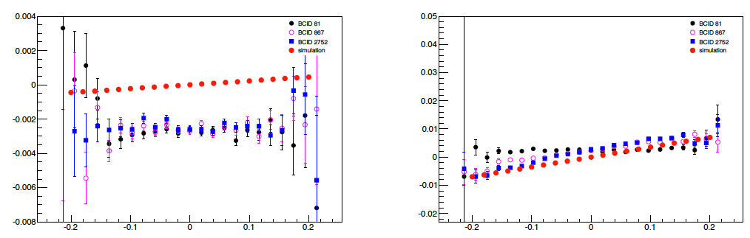
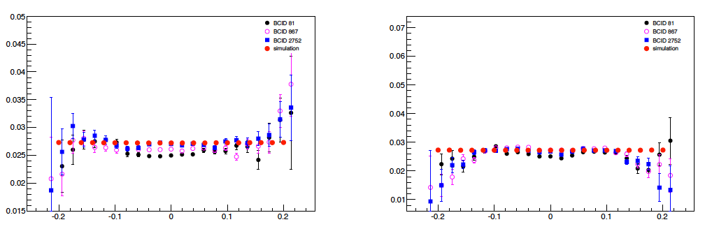
Luminous-region evolution: model 2b, y-scan, x-centered (May’11 vdM)
x-centroid
y-centroid
<x>_{L} (mm)
<y>_{L} (mm)
Δy (mm)
Δy (mm)
x-width
y-width
σ_{xL} (mm)
σ_{yL} (mm)
→ α_{y,z}
Δy (mm)
Δy (mm)

Slide 42
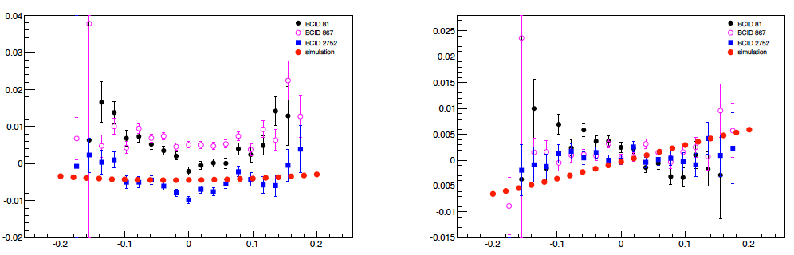
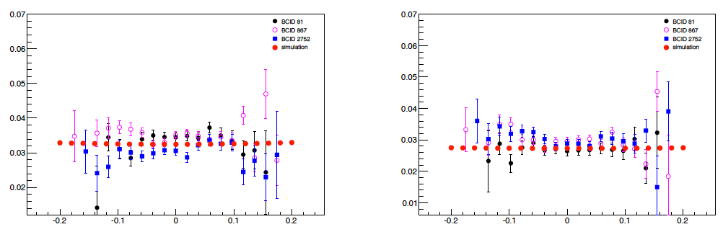
Luminous-region evolution: model 2b, y-scan, x offset (May’11 vdM)
x-centroid
y-centroid
<x>_{L} (mm)
<y>_{L} (mm)
Δy (mm)
Δy (mm)
x-width
y-width
σ_{xL} (mm)
σ_{yL} (mm)
Δy (mm)
Δy (mm)

Slide 43
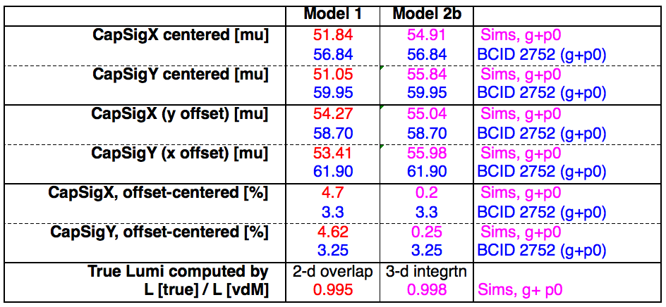
vdM parameters: modelled vs. measured
Observations
Large (several %) differences between both models and the data, in terms of Σ and therefore of predicted L_{sp}
For centered scans, model 2b typically reproduces the measured Σ’s better. However the ~ 6% difference between Σ_{x} and Σ_{y}, expected from the crossing angle, is not reproduced.
For offset scans, model 1 reproduces better the offset/centered Σ ratio
Both models predict a small (0.2 -0.5%) bias on reference L – but this doesn’t (yet?) mean much in view of the large inconsistencies in (a) predicted Σ and (b) separation-dependence of luminous-region variables

Slide 44
Summary: May’11 studies
This simulation tool has been applied to a (manual) exploration of the beam-parameter space in an attempt to model the May’11 vdM beamspot data, both centered and offset. Main conclusions:
  each BCID behaves differently, so at least part of the non-linear correlations arise in the LHC injector chain
  the simulation can reproduce the centered scans reasonably well, but did not succeed (so far) to reproduce the offset scans simultaneously
  whether the crossing-angle effects are correctly modelled needs to be checked
  because the vertexing-resolution effects are large, constraining the input beam parameters with the measured Σ’s is essential. This has not been achieved yet – at least at the required level of precision

Slide 45

Correlated fits to vdM scan curves: Mar ’11 scans (2.76 TeV pp)

Slide 46

(Un)correlated fits to vdM scan curves: May ’11 & Jul ’12
Uncorrelated fits
Correlated fits: to be done!
Jul ‘12 (8 TeV, 4 centered scans)
May ’11 (7 TeV, 2 centered scans)
~ 2.5 %
~ 0.5 %
Note that the true bias may be larger than the scan-to-scan inconsistency

