Slide 1
UPDATE ON FIELD MODEL: TUNE AND CHROMATICITY
CERN, 8th March 2011
N. Aquilina, M. Lamont, E. Todesco
CERN, Geneva Switzerland

Slide 2
TUNE DECAY
Decay of tune looks 70% of last year
Amplitude: 0.020-0.025 units Time constant: 4000 s
We can try the dynamic correction when we want
Tune decay during several injections in 2011 and 2010 (N. Aquilina)

Slide 3
CHROMATICITY DECAY
Decay of chromaticity looks similar to last year
Amplitude: about 20 units Time constant: 1000 s
We can try the dynamic correction when we want
Chromaticity decay during several injections in 2011 and 2010 (N. Aquilina)

Slide 4
RECONSTRUCTION OF CHROMATICITY DURING RAMP
At the end of the ramp the model is perfect (within a few units of chroma)
At injection chroma is undercorrected of about 10-20 units
Chromaticity w.r.t. nominal during ramp on 28 February (E. Todesco)

Slide 5
UNDERCORRECTION AT INJECTION
At injection chroma is under corrected of about 10-20 units
The hysteresis of MS can be the cause:
Their setting at injection are about 5 A and 8 A
At 5 A the hysteresis is about 10%
Natural chroma is 82-86
Nearly 10 units not corrected
Including MS hysteresis we should bring down injection values of about 8 units
Values are ready
Chromaticity w.r.t. nominal during ramp on 28 February
Measured hysteresis of the MS (V. Remondino, W. Venturini)

Slide 6
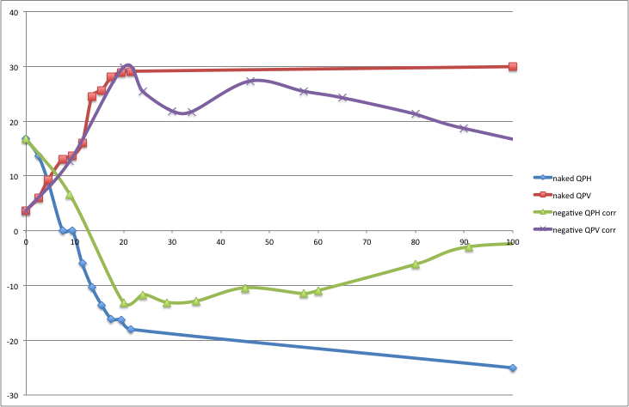
SNAPBACK ESTIMATE
Analysis of two ramps: 25-30 units of chroma during snapback
Today we correct 18 units – are we undercorrecting?
Chromaticity during snapback in two ramps (M. Lamont)

Slide 7
CONCLUSIONS
New cycle at 100 A implemented in 2011
And no preinjection porch
Decay:
Same decay of chroma as last year
Smaller decay of tune
Dynamic corrections can be tried
Systematic offeset of about 20 units of chroma at injection
A good fraction can be due to MS hysteresis – added in the model
This should reduce the error in chroma at injection
Model at 3.5 TeV very good (within a few chroma units)
Some uncertainties on the amplitude of snapback
In the range 20-30 units of chromaticity – more analysis needed

