Slide 1
Status of Orbit Feedback Reference Orbit Handling
Kajetan Fuchsberger
On behalf of and thanks to…
J. Wenninger, L. Ponce, R. Steinhagen, M. Andersen, T. Baer, S. Redaelli, X. Buffat, G. Mueller, …

Slide 2
Content
Basic Concepts and mode of operation
Orbit differences to ref-orbit.
Manual correction and Incorporation.
Summary

Slide 3
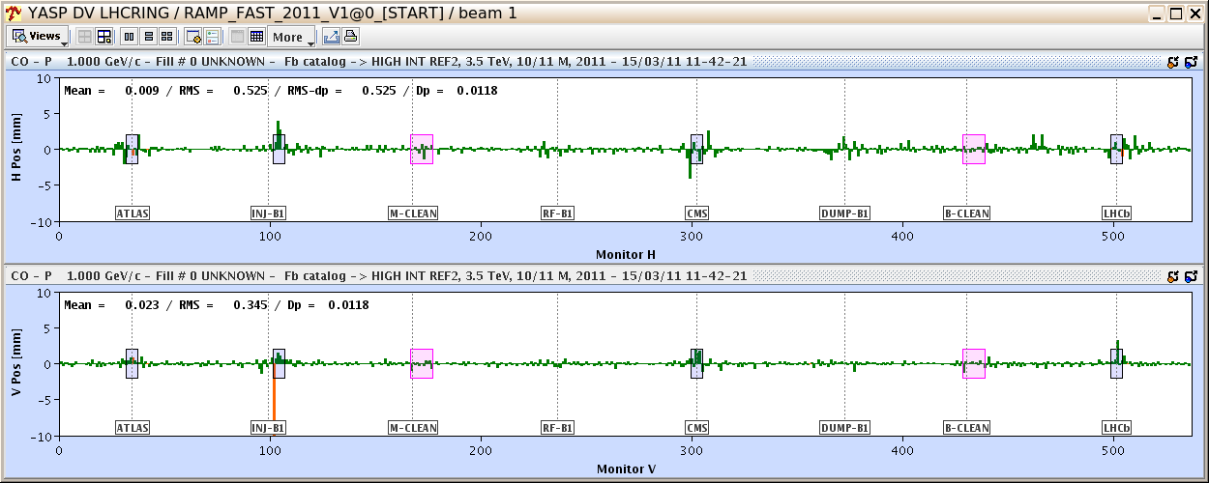
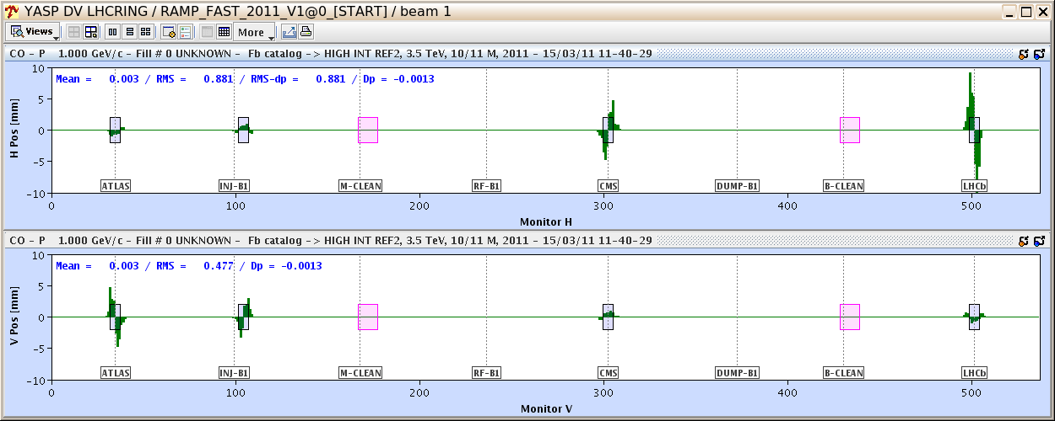
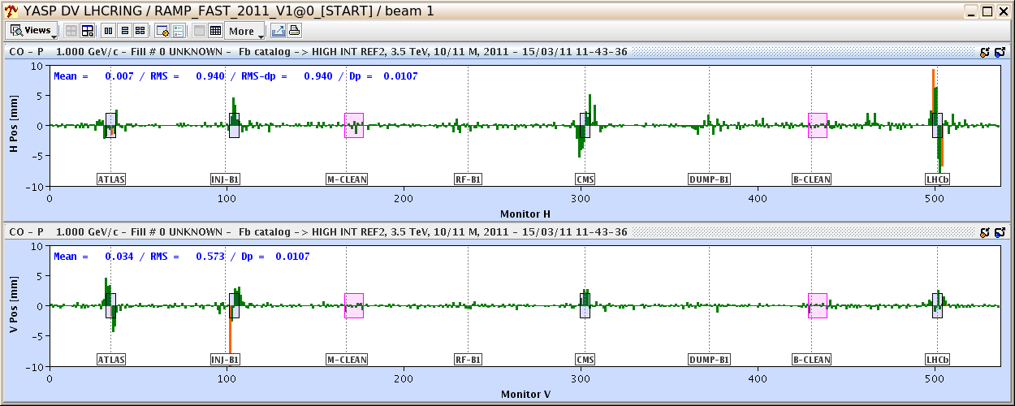
Base Orbit and overlays
1 Base-Orbit (!)
+ Overlays
= Reference Orbit

Slide 4
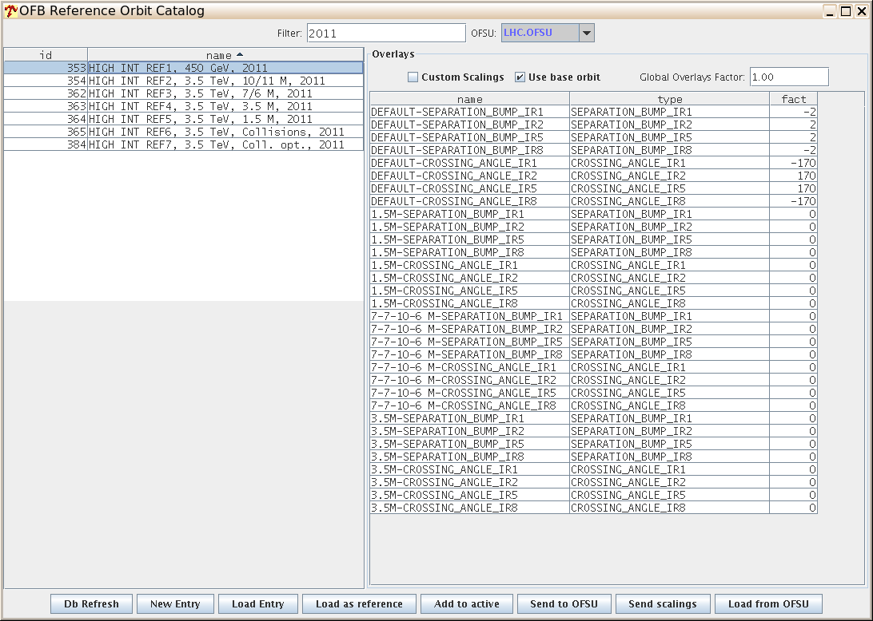
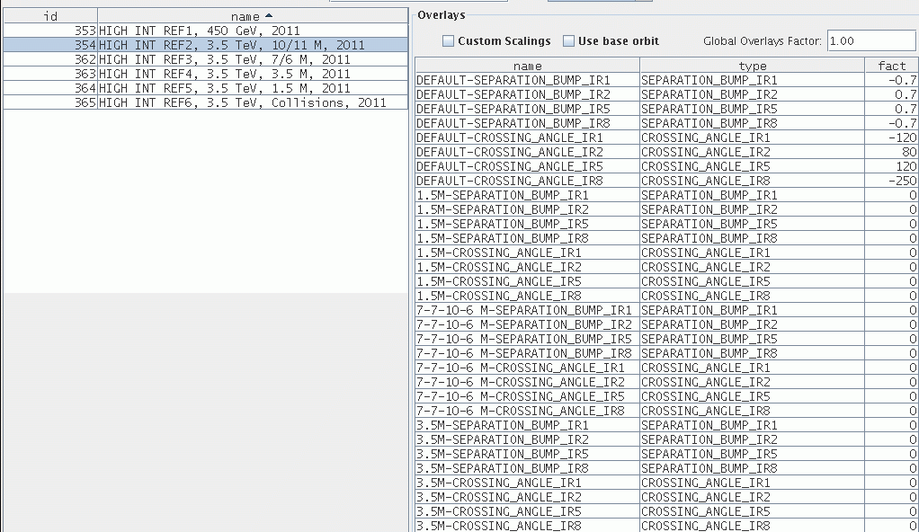
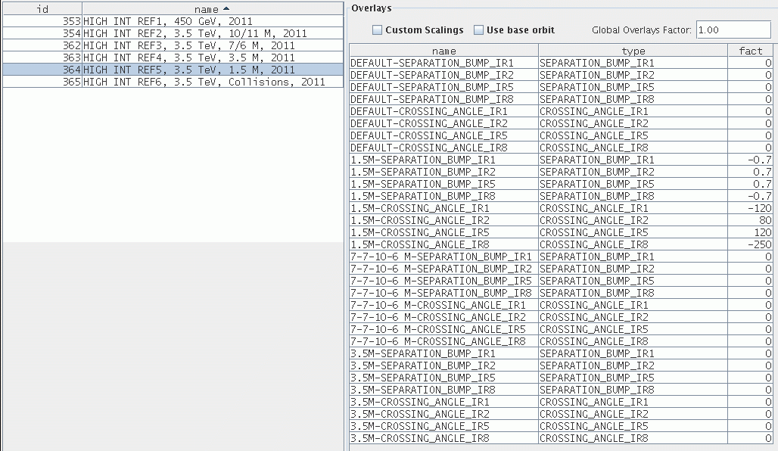
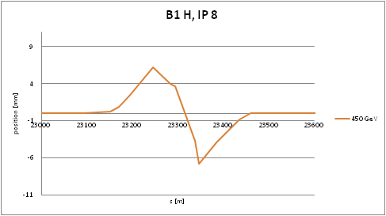
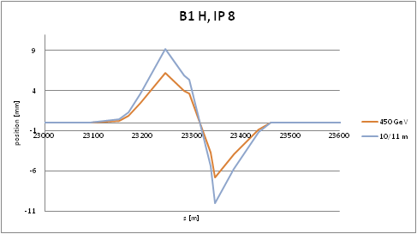
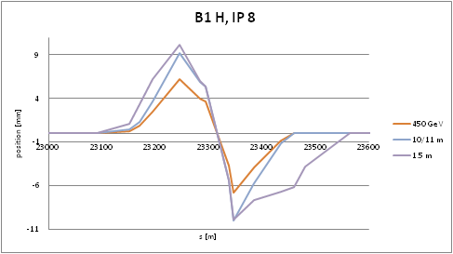
Squeeze (in one step)
Ramp
Squeeze

Slide 5
Current mode of operation
Prepare Ramp: Load Injection reference orbit.
Before Ramp/Squeeze: Check overlay shapes.
Start orbit change at same time as PC timing event.

Slide 6
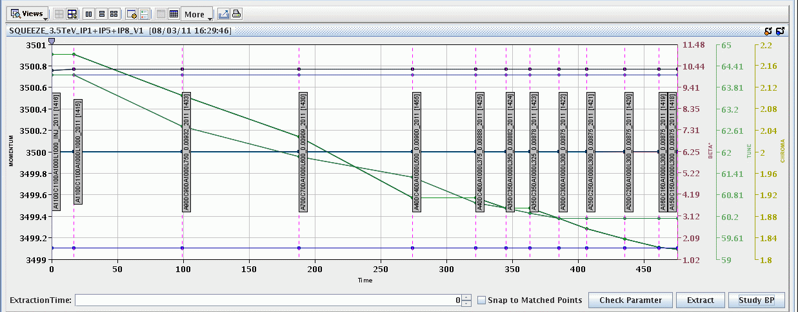
Squeeze Beam Process
Courtesy: G. Mueller
When squeezed in steps: Reference orbit for stop point is used.

Slide 7
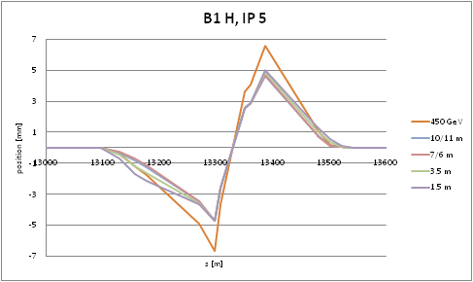
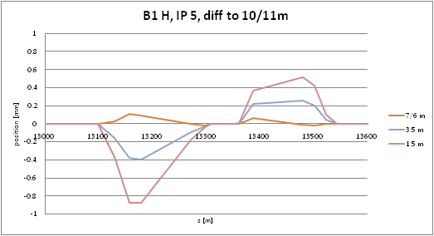
Bump shape example IP5
Max Orbit change < 1 mm

Slide 8
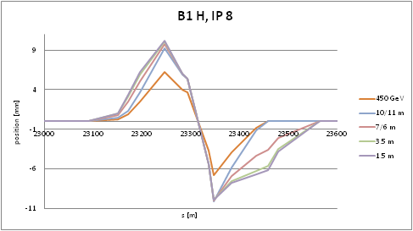
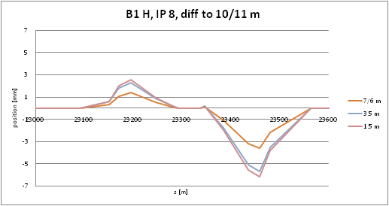
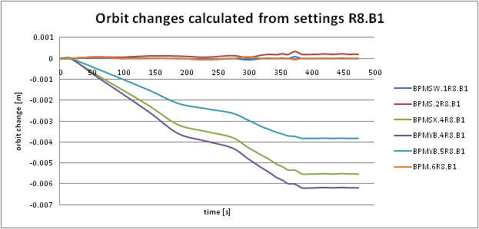
Bump shape example IP8
Max Orbit change > 6 mm
(BPMYB.4R8.B1)
Notes:
6mm error dazuschreiben

Slide 9
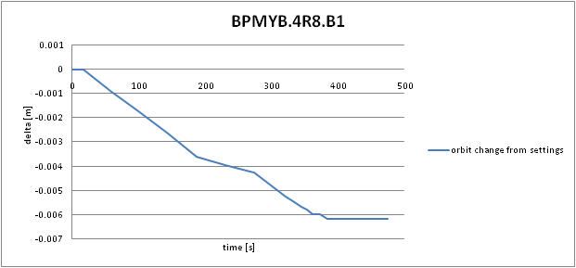
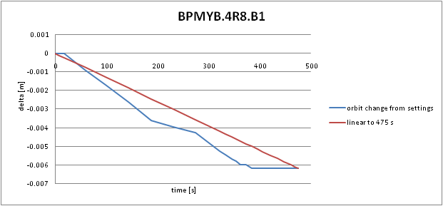
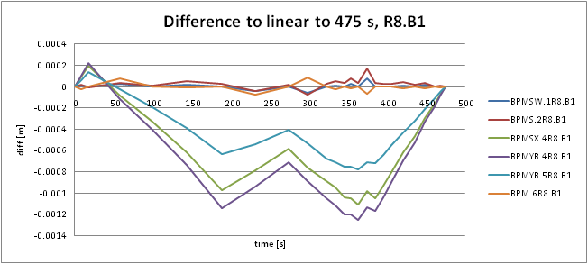
Max Orbit changes R8.B1
How to reproduce the best reference orbit, using our current available mechanisms?
Max Error > 1.2 mm
Data Courtesy: X. Buffat
Notes:
Simulated! (Xavier)

Slide 10
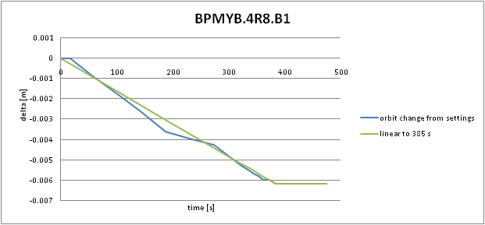
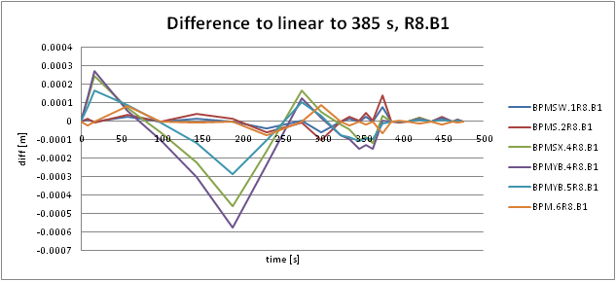
Max Orbit changes R8.B1
Max Error < 0.6 mm
Data Courtesy: X. Buffat
Notes:
Simulated! (Xavier)

Slide 11
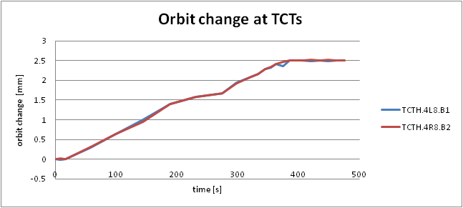
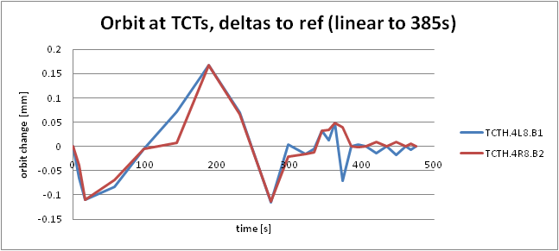
Orbit changes at TCTs
Max Error < 0.17 mm

Slide 12
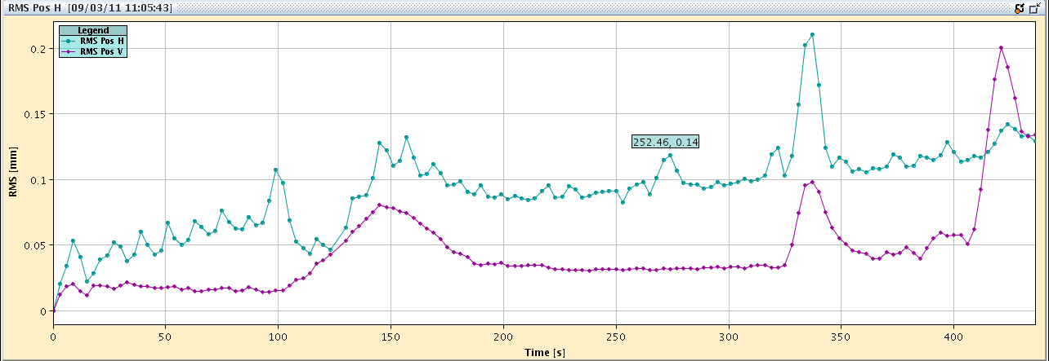
Incorporation-effect
188
345
435
Part of this effect: Due to incorporation of orbit correction to last optics point
Was redone from scratch and incorporated back to last stop point.

Slide 13
Issues & Next Steps
NaN in reference orbit:
Fixed with next OFSU release
Work in progress:Trigger of scaling changes by timing event:
Timing event already in database.
Sequencer tasks + sequences to be done.
Work in progress: Optics changes by timing event:
Done. To be tested and put operational.
Consistent correction strategy necessary!
(Feed Forward)

Slide 14
Summary
Orbit change during squeeze was originally not foreseen. Nevertheless, we have now a strategy which is operational.
Max. Diff from settings to linearely interpolated reference orbit < 0.6mm.
Some TODOs:
Ref-orbit changes through timing
Optics changes during squeeze

Slide 15
Thank you…

Slide 16
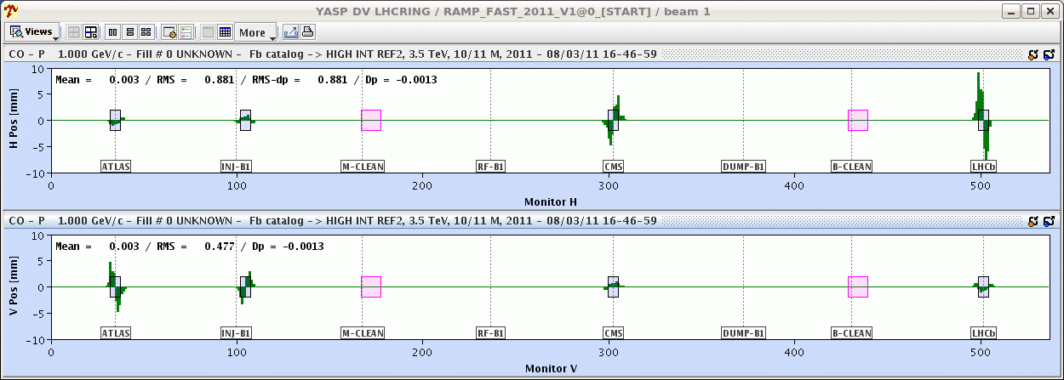
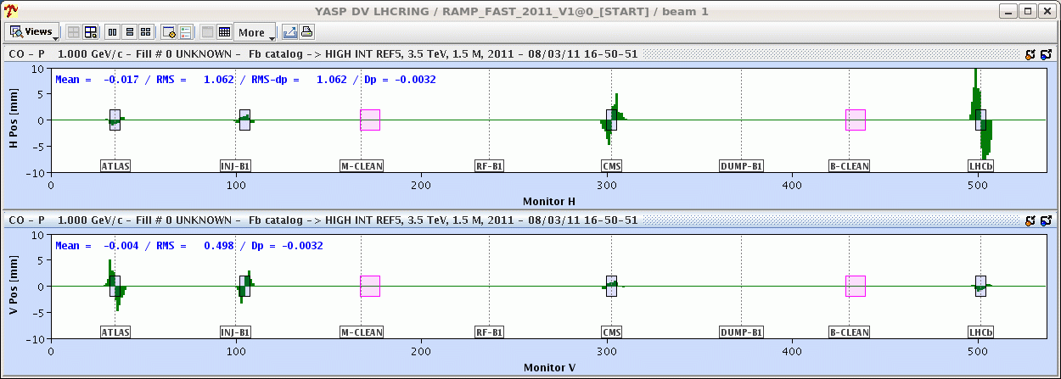
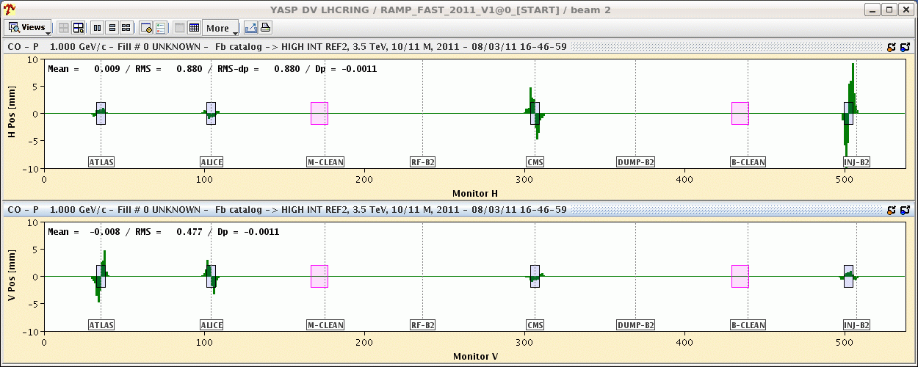
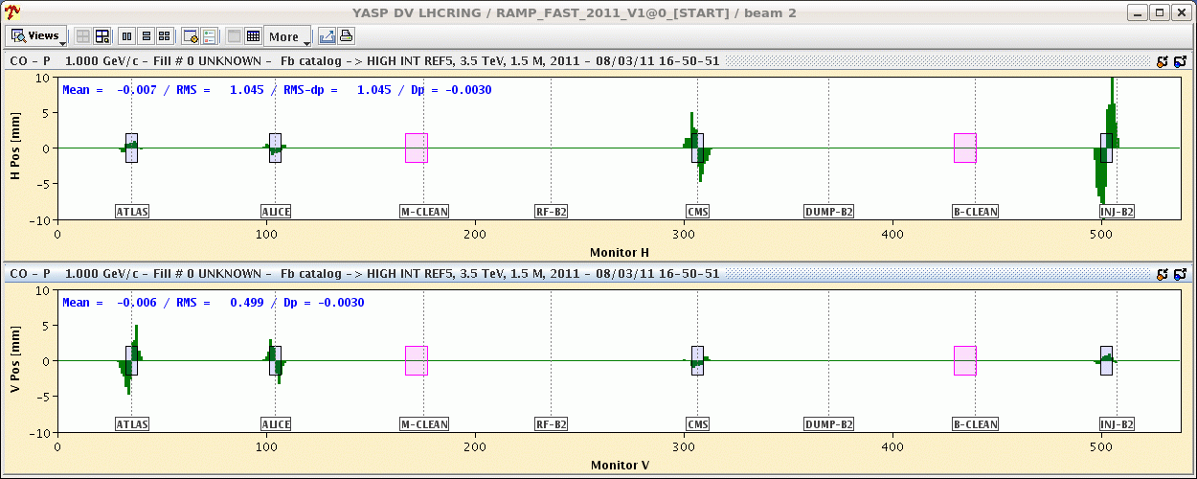
Orbit Overlays 10m/1.5m

Slide 17
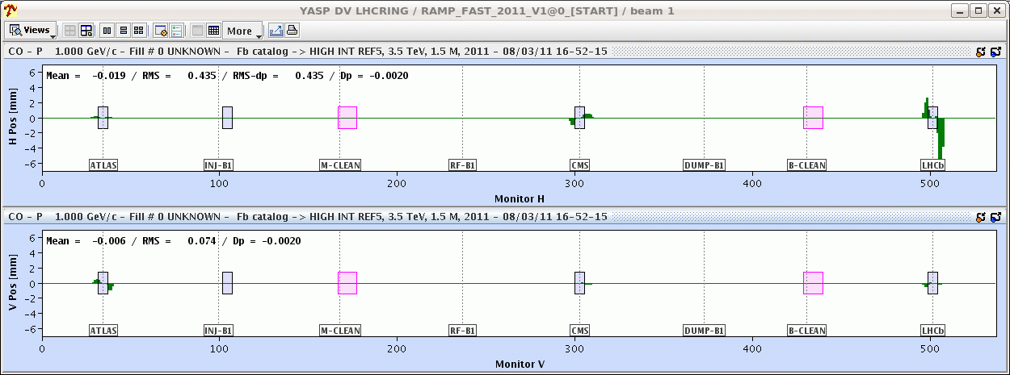
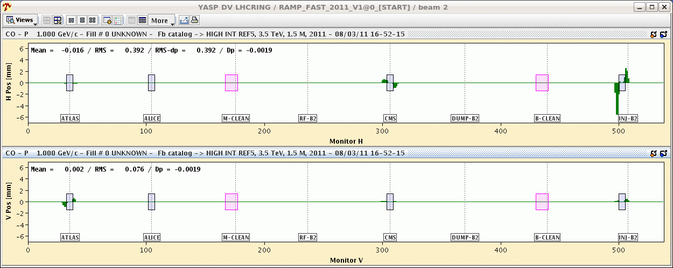
Orbit overlay difference
Difference 1.5m – 10m

