Slide 1
Stability of Luminosity Optimizations
J. Wenninger

Slide 2
Introduction
In 2011, with smaller bunch population and a more relaxed collimator hierarchy, there have been little (no?) problems of beam instability due to offsets at the IPs (IR1/5).
In 2012 we have observed that beam instabilities and beam dumps due to losses (in IR7) can be triggered by
arriving in collision with large offsets (‘few’ sigma),
applying large coolision offsets in IR1/5.
After LS1 we consider squeezing with colliding beams as a possible option to stabilize the beams.
In particular if we run out of octupole strength.
And at 7 TeV the beams will become smaller...
➔ Analysis of the stability of the luminosity offsets in 2012

Slide 3
L optimization trims in IR1 and IR5
All luminosity knob trims were extracted from the DB.
If for given trim, no other entry in the following 5 minutes → optimum set by L scan application.
Plus exclude regenerated settings.
For each fill, identify the first optimum.
We are interested in the reproducibility when we arrive in collision.
Select only 50 ns beam fills (BPM calibration):
No. bunches = ~80 and > 400.

Slide 4
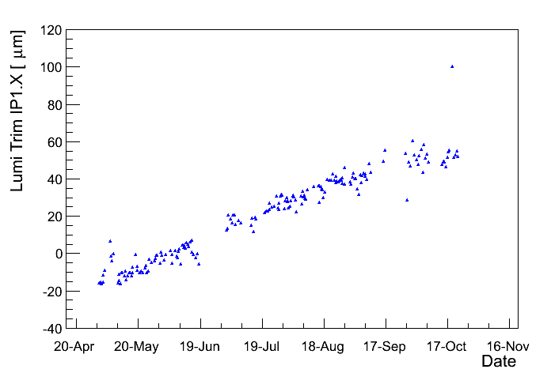
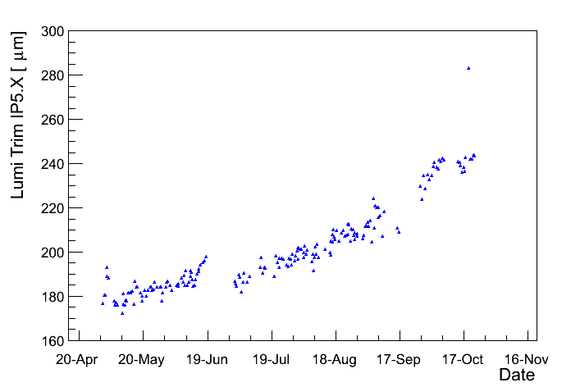
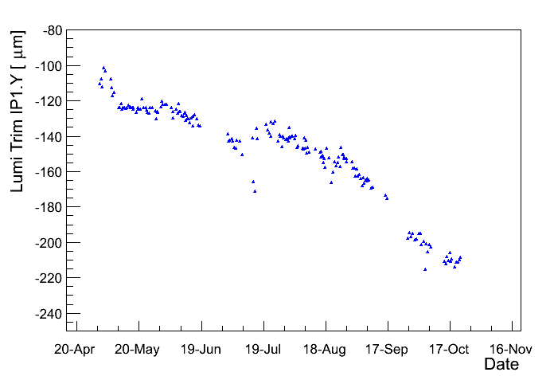
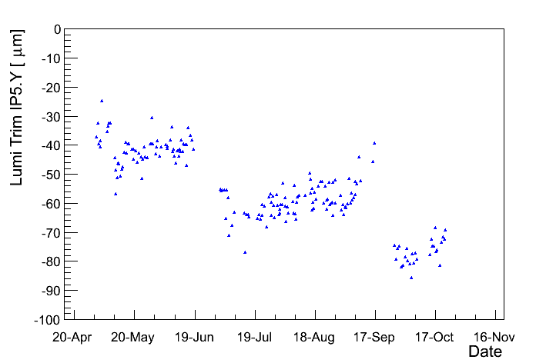
Evolution of L optimization trims in IR1/5
Orbit correction @ injection
B1 trims (B2 – opposite sign)
80 μm
60 μm
IR1 H
IR5 H
IR1 V
IR5 V
100 μm
50 μm
5 σ / beam !

Slide 5
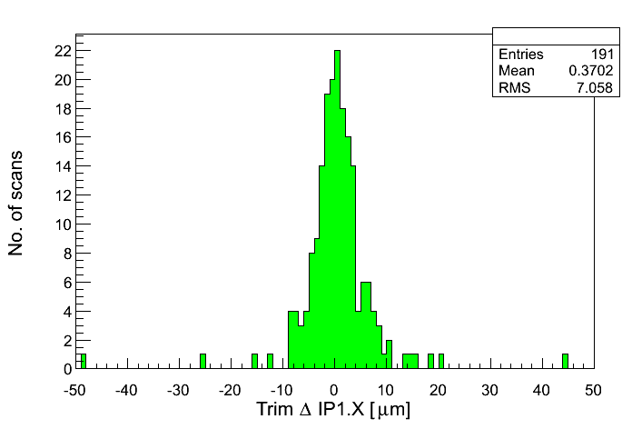
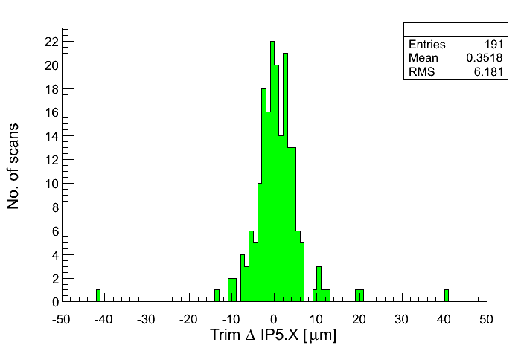
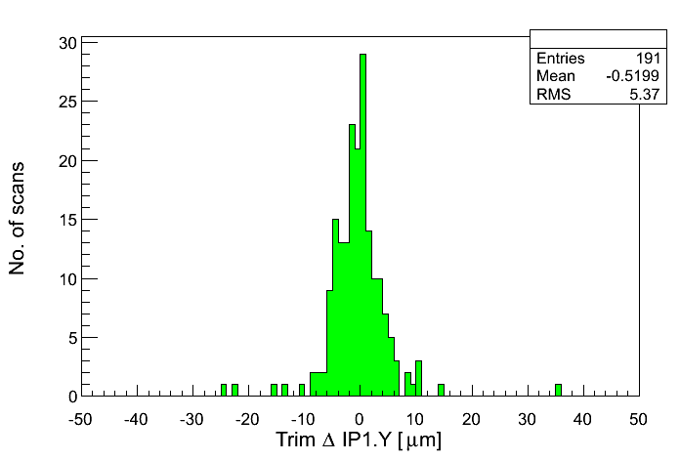
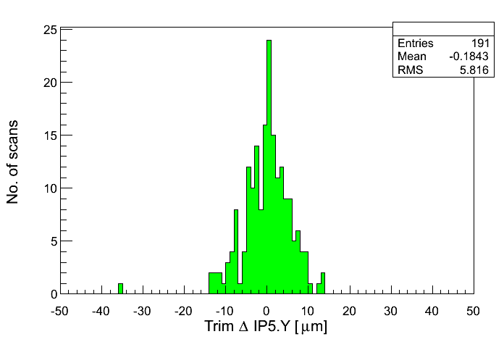
Fill-2-fill changes IR1/5
B1 trim changes from one fill to the next
The large majority of changes are ≤ ½ σ ≈ 10 μm per beam.
IR1 H
IR5 H
IR1 V
IR5 V

Slide 6
Comments IR1/5
The absolute values of the corrections drift with time, but the fill-2-fill reproducibility corresponds to a separation of 1σ between the 2 beams (per plane and per IP).
Good enough for 2012.
The largest drift is ≥ 5σ, but it still within the orbit tolerances for TCTs and triplets.
We have used up to ½ of the total margin of 1.5σ.
If the offsets remain the same in μm at 7 TeV, the fill-2-fill reproducibility will correspond to a separation of ~1.7σ between the 2 beams (per plane and per IP, assuming β* = 0.4 m).
The reduction of β* may not apply, since the effect of corrections also scales ~ β*.
➔ At 7 TeV we may have to control the orbit better than now !!

Slide 7
Comments – orbit correction
The orbit correction from injection to collisions is entirely in the ‘hands’ of the orbit FB.
Ensures that the algorithm / logic is reproducible from fill-2-fill (no human ‘fantasy’ adding extra entropy).
The OFB uses SVD (Singular Value Decomposition) as algorithm.
Correction ‘strength’ and granularity (fine structures) are controlled by selecting the number of eigenvalues (ordered from largest to smallest).
Currently (max no. eigenvalues ~500):
H plane : 400 eigenvalues, limited by issues with energy offsets.
V plane : 440 eigenvalues.
→ No significant difference in H and V Lumi optimization reproducibility.
Increasing the number of eigenvalues would increase the granularity of the corrections in the IRs (where the small eigenv. are ‘located’).
Could be beneficial as finer control at IR,
Could be counter-productive as more sensitive to bad BPMs.
→ Not obvious…

Slide 8
Luminosity optimization trims in IR8
All IR8 luminosity optimization trims were extracted from the DB.
Excluded the manual trims (to find collisions) and the initial regeneration settings from the analysis.
Fill selection:
Select only 50 ns fills: no. bunches = ~80 and > 400.
Tilting procedure (now in second collision BP with IR1/5 colliding):
1- Reduce IR8 V separation to ~ 0.1 mm / beam.
B1 is located below B2.
2- Ramp up vertical crossing angle to 90 μrad.
3- Ramp down horizontal crossing angle to 0.
Ensure that B1 does not drift up to much over time to avoid cross-over in V plane.

Slide 9
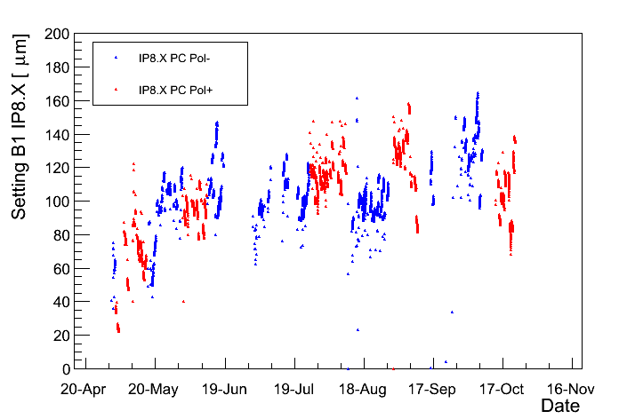
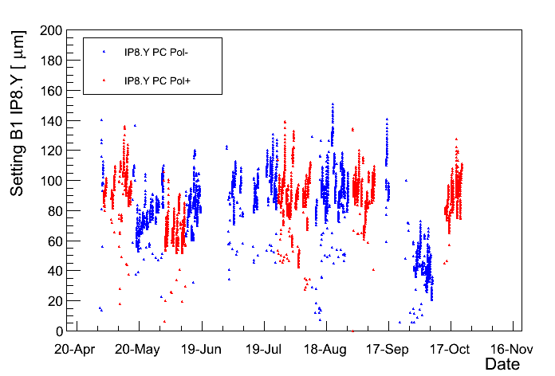
Evolution of IR8 luminosity trims
Shown here in X and Y plane for beam1 (for beam2 change the sign).
Scatter due to the leveling.
Little / no dependence on polarity of the average offset.
Beam1
H
V

Slide 10
IR8 separation knob trims
On few occasions, the target of the IR8 separation knob (V plane) was adjusted to ensure that beam1 is always moving upward during the tilting beam process.
Numbers indicate CHANGE wrt previous setting.
+37 μm
+6 μm
-3 μm
-70 μm
Beam1 V
2-step collision BP,
Global V orbit correction

Slide 11
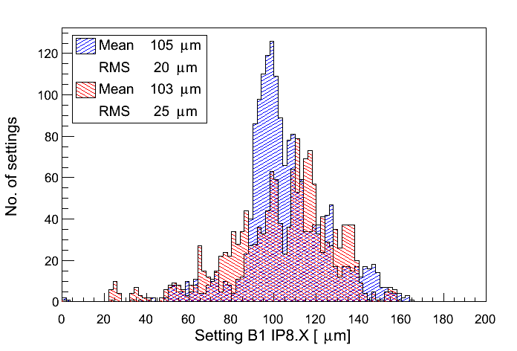
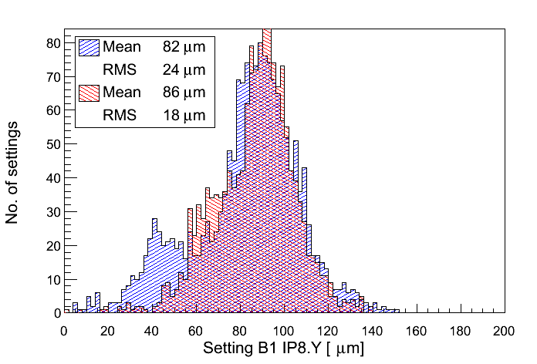
Trim distribution
Distributions rather similar (as already visible from time evolution). Same mean & rms.
Color code:
PC POL+
PC POL-
H
V

Slide 12
Tilted versus standard knobs
The leveling knobs used to optimize IR8 in the tilted plane when we are in collision ‘change sign’ with LHCb polarity.
X ↔ -X
y
Polarity change
y
Crossing knob
Crossing knob
Leveling knob
Leveling knob
x
x

Slide 13
Tilted versus standard knobs
The leveling knobs should be applied relative to the ‘typical’ collision point offset.
Average offset in X/Y is predictable (see history) with sufficient accuracy to skip the test cycle.
For the last polarity flip the pre-trimmed offsets worked very well !!
Polarity change
y
Crossing knob
Crossing knob
Leveling knob
Leveling knob
x
Typical coll. offset
Typical coll. offset
y
y
x
x

Slide 14
Summary
So far we are doing well in IR1 and IR5 in terms of L optimization reproducibility.
But the reproducibility may be insufficient for 7 TeV operation.
Test OFB correction with more (or fewer?) eigenvalues in view of post LS1 operation?
For IR8 it is possible to predict the offset quite well. We could stop doing test ramps (unless of course we profit to do other things in //).

