Slide 1
Collimation after LS1: cleaning and β* reach
R. Bruce, S. Redaelli on behalf of the collimation team
Acknowledgements:
S. Fartoukh, W. Herr, M. Giovannozzi, R. de Maria, R. Tomas

Slide 2
Outline
Introduction: Influence of LHC collimation system on β*
Recap of 2012 run: collimator settings, achieved β*, orbit
Changes in LS1 – BPM button collimators
Collimator settings and beta* after LS1.
Conclusions

Slide 3
Collimation system
σ calculated with emittance = 3.5μm
TCLA7
TCS6/
TCDQ
TCT
Aperture
TCP
TCS7
Kicked
beam
5.7 σ_{n} 8.5 σ_{n} 17.7 σ_{n} 9.3 σ_{n} 15.0 σ_{n} 17.5 σ_{n}
5.7 σ_{n} 8.5 σ_{n} 17.7 σ_{n} 9.3 σ_{n} 11.8 σ_{n} 14.1 σ_{n}
4.3 σ_{n} 6.3 σ_{n} 8.3 σ_{n} 7.1 σ_{n} 9.0 σ_{n} 10.5 σ_{n}
6.0 σ_{n} 7.0 σ_{n} 10.0 σ_{n} 7.5 σ_{n} 8.3 σ_{n} 8.4 σ_{n}
2010, β*=3.5m, 3.5 TeV
2011, β*=1.0m, 3.5 TeV
2012, β*=0.6m, 4 TeV
Nom, β*=0.55m, 7 TeV
Primary halo
beam
Secondary
halo
Tertiary
halo
Multi-stage collimation system
Collimation hierarchy has to be respected in order to achieve satisfactory protection and cleaning
Some margins are more critical for machine protection (IR6-TCTs-aperture), others matter mainly for cleaning (IR7, IR7-IR6, IR3)

Slide 4
Calculation of margins in hierarchy
In IR7, non-critical margins in 2010 and 2011 calculated by keeping the same retraction in mm as at injection (intermediate collimation scheme) in order to provide sufficient room for imperfections (optics / orbit stability)
In 2012, we reduced margins in IR7 based on empirical studies: MD on tight settings
Critical margins: If margins IR6-TCTs-aperture are violated, sensitive equipment (TCTs or aperture) might be exposed during the unlikely case of an accident
Critical margins calculated based on in-depth analysis of previous runs
Components of critical margins: orbit, β –beat, lumi scans, positioning errors and setup errors
Philosophy: Margins should be respected more than 99% of time => risk of damage < 1 in ~300 years for TCTs, less than 30000 years for triplet (see Evian 2010-2011)

Slide 5
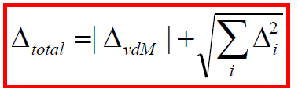
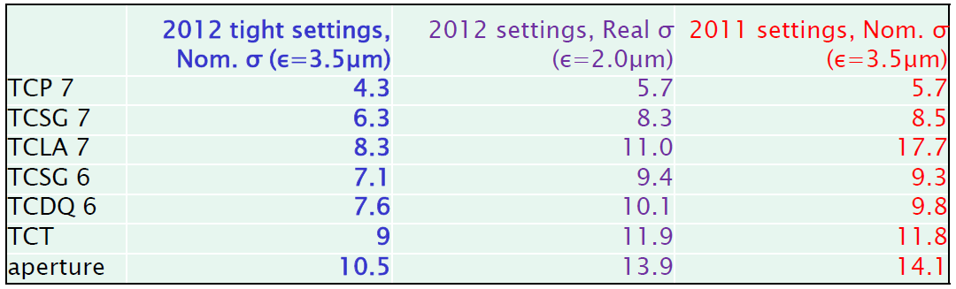
Collimator settings in 2012
Collimator settings calculated using square sum of errors except van der Meer scans (see Evian 2011 and Chamonix 2012).
Proposed tight settings based on 2011 MDs
in for improved cleaning and β*-reach.
2012 tight settings similar to 2011 settings accounting for the real emittance!
Proposed β*=60cm as baseline. Successfully put into operation!

Slide 6
Measured aperture 2012
Aperture measured using a collimator scan and losses provoked by the transverse damper
Collimator moved in steps
while provoking losses.
Monitoring BLMs at
collimator and aperture
bottleneck.
Significant improvement in
measurement speed since
last year!
Result: triplet aperture
measured to 11 – 12 σ
depending on IP and plane
Predicted: >10.8 σ
S. Redaelli et al.
in IPAC12

Slide 7
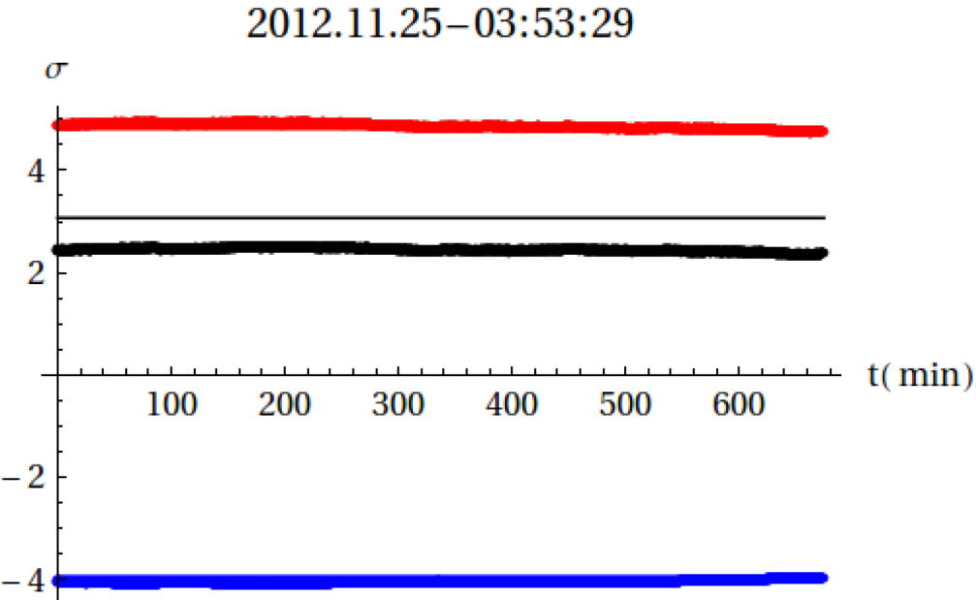
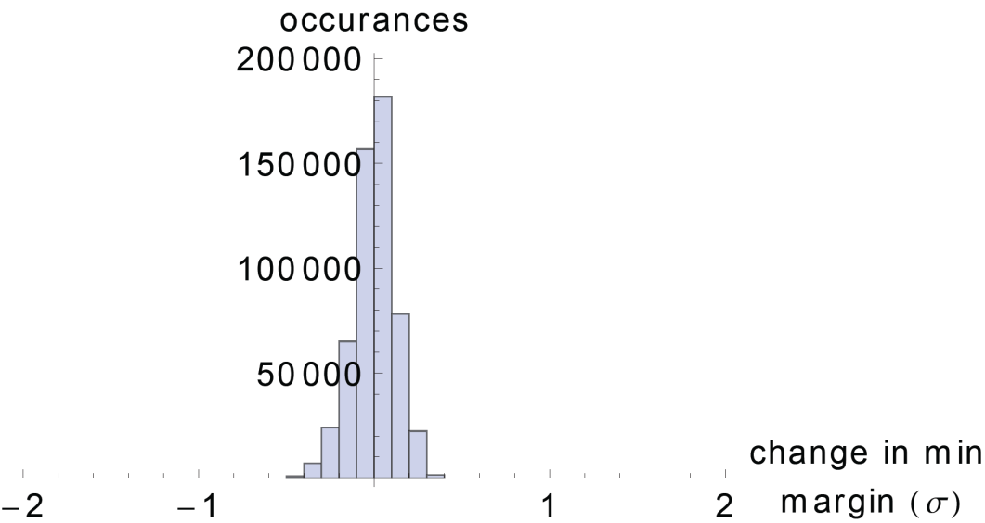
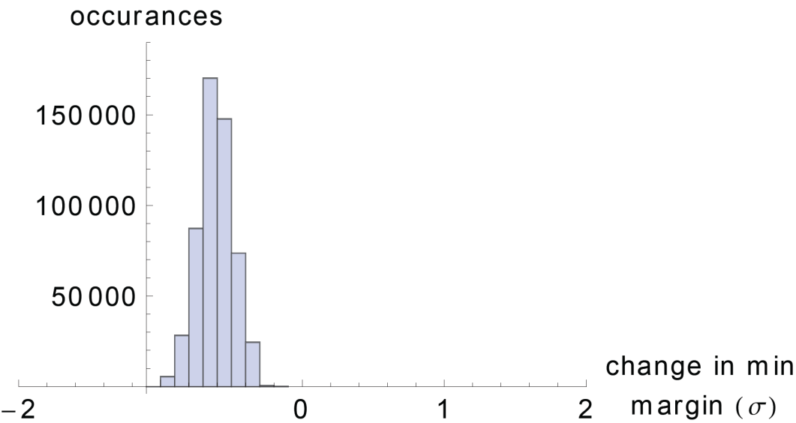
2012 orbit stability in stable beams
Very good stability within fills, almost better than before
But sometimes orbit is off wrt reference during whole fill. Example: IR1 V B2
B1 V looks better – centered around zero
IR1 V B2
Upstream
triplet
TCT
Reference from
collimation setup
Downstream
triplet
IR1 V B1, reduction in margin
IR1 V B2, reduction in margin

Slide 8
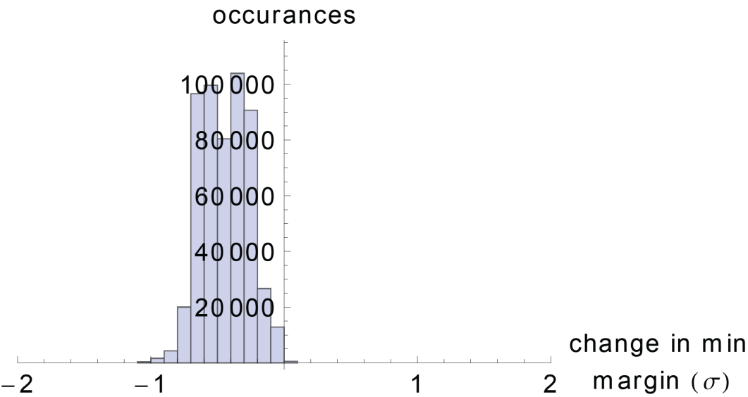
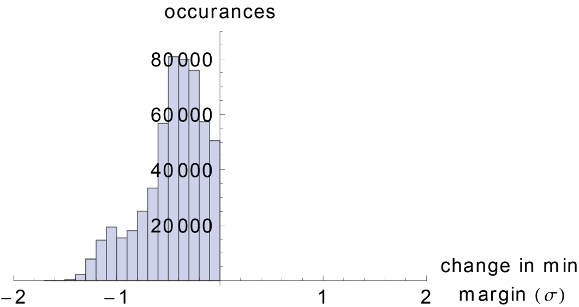
2012 orbit stability in stable beams
IR5 better than last year
Worst case is 0.9 σ for a 99% coverage between TCT/triplet (was 1.1 σ in 2011).
Compatible with change of beam size from β* and energy
1.3 σ needed for 99% coverage IR6/TCTs
(was 1.1 σ in 2011)
Slightly worse than expected from change in beam size
IR5 H B2, reduction in margin
reduction in margin IR6 – IR1 B2 H

Slide 9
Outline
Introduction: Influence of LHC collimation system on β*
Recap of 2012 run: collimator settings, achieved β*, orbit
Changes in LS1 – BPM button collimators
Collimator settings and beta* after LS1.
Conclusions

Slide 10
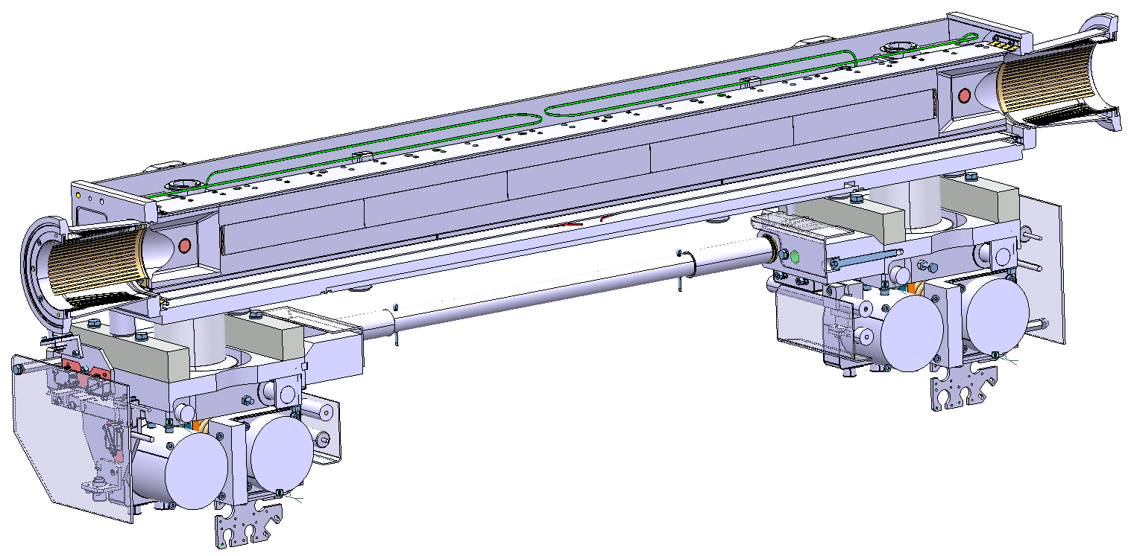
LS1 improvements – integrated BPMs
The 16 TCTs (industrial production) in all IRs and the
2 TCSGs in IR6 (in-house production)
will be replaced by new
collimators with
integrated BPMs.
Tests in the SPS
with mock-up
collimator very
successful
(see D. Wollmann et al., IPAC11, HB 2012)
Gain: can re-align dynamically during standard fills. No need for special low-intensity fills
  Drastically reduced TCT setup time (gain of a factor ~100) => more flexibility in IR configuration
  Reduce orbit margins in cleaning hierarchy => more room to squeeze β*
BPM buttons
Courtesy O. Aberle, A. Bertarelli, F. Carra, A. Dallocchio, L. Gentini et al.

Slide 11
Preliminary scenarios after LS1
Beam assumptions:
  6.5 TeV
  25 ns (beam-beam separation needs to be increased to 12 σ, the emittance from injectors can increase up to 3.75 μm but could also be as small as 1.9 μm) or 50 ns (we can keep today’s beam-beam separation and same emittance or 1.6 μm)
Machine assumptions:
  Same excellent aperture, orbit, beta-beat as today
  No drifts of aperture due to e.g. ground motion included
Collimator assumptions
  We can not move in the TCPs further than today in mm (impedance, orbit)
  BPM button collimators: assume pessimistically 50 μm precision of orbit at TCTs and TCSG6 as upper limit from SPS tests – in reality better precision expected.
  reduce to 0.1 σ margin for orbit between dump protection and TCTs
  reduce to 0.7 σ margin for orbit TCTs/triplet – orbit can still move in triplet

Slide 12
Preliminary collimator settings after LS1
Including increased margin from BPM button collimators
Using same philosophy for calculating margins IR6-TCTs-triplets as in 2012
No constraints from impedance accounted for
New iteration of needed margins will be done when HiRadMat test results on TCT damage limit are fully analyzed
 | Case 1: relaxed settings, no BPM buttons | Case 2: same as today in mm, no BPM buttons | Case 3: Keeping retractions in σ, no BPM buttons | Case 4: same as today in mm, BPM buttons | Case 5: Keeping retractions in σ, BPM buttons,
TCP 7 | 6.7 | 5.5 | 5.5 | 5.5 | 5.5
TCSG 7 | 9.9 | 8.0 | 7.5 | 8.0 | 7.5
TCLA 7 | 12.5 | 10.6 | 9.5 | 10.6 | 9.5
TCSG 6 | 10.7 | 9.1 | 8.3 | 9.1 | 8.3
TCDQ 6 | 11.2 | 9.6 | 8.8 | 9.6 | 8.8
TCT | 12.7 | 11.1 | 10.3 | 10.0 | 9.1
aperture | 14.3 | 12.6 | 11.7 | 11.2 | 10.3
Should work for cleaning hierarchy
Might require more frequent setups to keep hierarchy

Slide 13
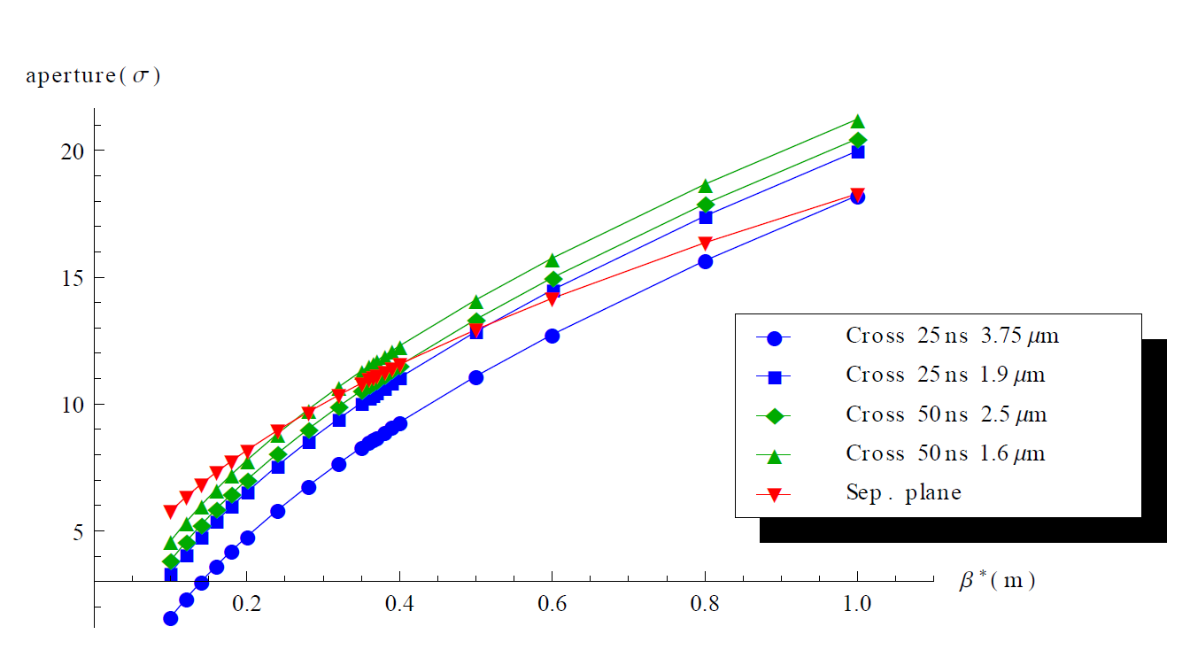
Preliminary β*-reach
Crossing plane aperture scaled from most pessimistic 2011/2012 measurements (11 σ at 4 TeV, 60cm, 145 μrad) to 6.5 TeV configurations
Given aperture that is protected gives β*
Reach between ~31cm and ~55cm in crossing plane with BPM buttons
Mm kept
σ kept

Slide 14
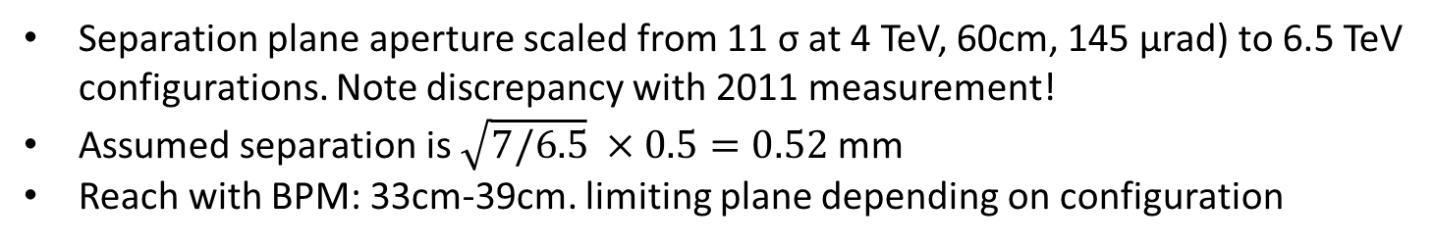
Preliminary β*-reach
Separation plane aperture scaled from 11 σ at 4 TeV, 60cm, 145 μrad) to 6.5 TeV configurations. Note discrepancy with 2011 measurement!
Assumed separation is $\sqrt{7/6.5} ×0.5=0.52$ mm
Reach with BPM: 33cm-39cm. limiting plane depending on configuration
Mm kept
σ kept

Slide 15
Summary: β*-reach
50 ns, 2.5 um | beta* crossing (cm) | beta* separation (cm) | Half crossing angle (urad) | BB sep (sigma)
mm scaled, no BPM | 47 | 49 | 129 | 9.3
mm scaled, BPM | 39 | 39 | 141 | 9.3
2 sig retraction, no BPM | 42 | 43 | 136 | 9.3
2 sig retraction, BPM | 35 | 33 | 150 | 9.3
50 ns, 1.6 um | beta* crossing (cm) | beta* separation (cm) | Half crossing angle (urad) | BB sep (sigma)
mm scaled, no BPM | 43 | 49 | 108 | 9.3
mm scaled, BPM | 35 | 39 | 119 | 9.3
2 sig retraction, no BPM | 38 | 43 | 115 | 9.3
2 sig retraction, BPM | 31 | 33 | 127 | 9.3
25 ns, 3.75 um | beta* crossing (cm) | beta* separation (cm) | Half crossing angle (urad) | BB sep (sigma)
mm scaled, no BPM | 60 | 49 | 180 | 12
mm scaled, BPM | 52 | 39 | 194 | 12
2 sig retraction, no BPM | 55 | 43 | 189 | 12
2 sig retraction, BPM | 46 | 33 | 205 | 12
25 ns, 1.9 um | beta* crossing (cm) | beta* separation (cm) | Half crossing angle (urad) | BB sep (sigma)
mm scaled, no BPM | 49 | 49 | 141 | 12
mm scaled, BPM | 42 | 39 | 154 | 12
2 sig retraction, no BPM | 45 | 43 | 149 | 12
2 sig retraction, BPM | 37 | 33 | 163 | 12
Updates after MD?

Slide 16
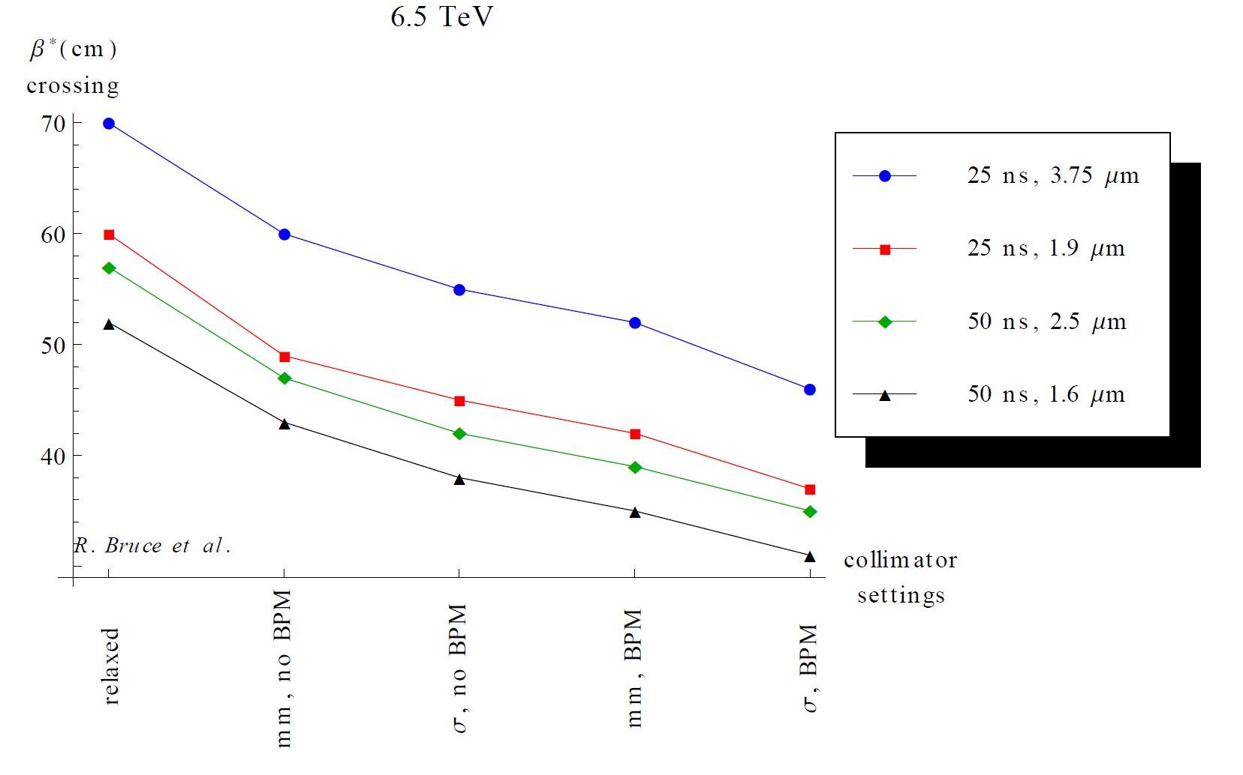
Summary: β*-reach in crossing plane

Slide 17
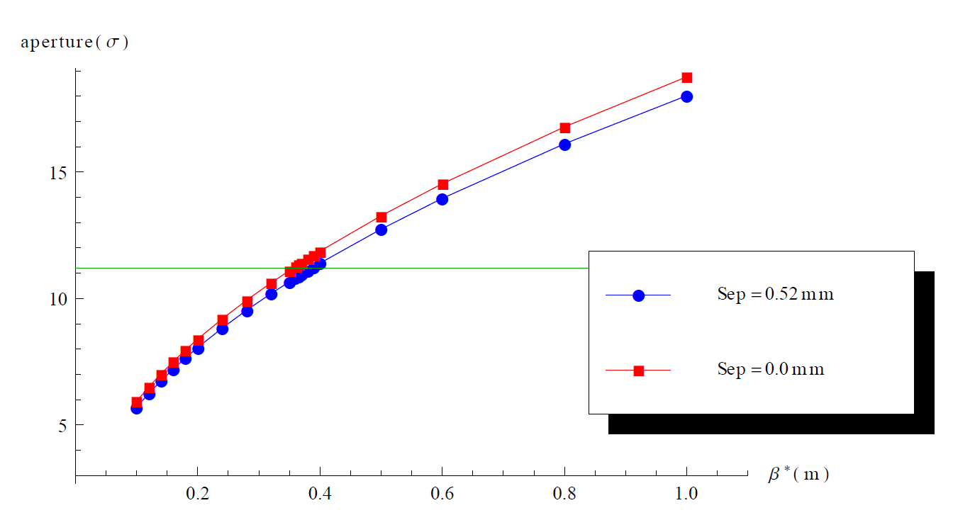
Collapsing separation earlier?
Discussion (R. Tomas, S. Fartoukh) can we collapse the separation earlier and gain aperture at end of squeeze?
Separation of 0.52mm gives ~830 μm orbit in triplet. At β*=0.55m, 6.5 TeV, corresponds to about 0.5σ. Smaller gain for smaller β* as σ in triplet grows
  Could gain us a few centimetres in β*, but nothing dramatic

Slide 18
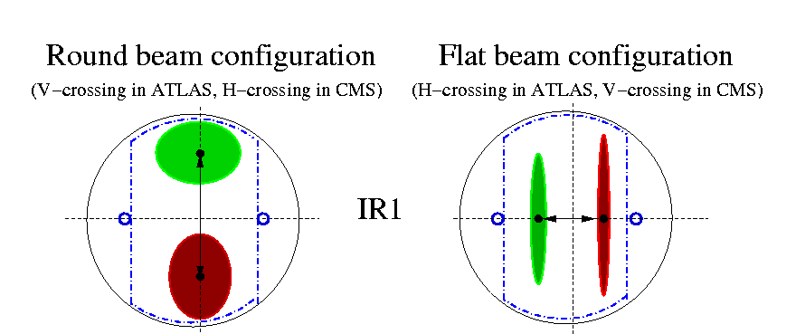
Flat beams: crossing vs separation plane
Results shown here assume keeping the present crossing and separation planes
If using flat beams, maybe advantageous to squeeze more in plane with larger beam screen (present crossing plane) and have crossing angle in present separation plane (see for example S. Fartoukh in LHC-MAC 2006)
Aperture calculation for this case could in principle be done with scaling in the same way, but we should make sure that no other aperture bottlenecks become critical
(e.g. TAN, Q5). Also we should watch out if the limiting aperture is no longer in the mid-plane.
Once beam parameters are chosen we should choose the solution with max luminosity
S. Fartoukh, LHC-MAC 2006

Slide 19
Can we achieve these settings?
Octupoles: today running at about 500A, max current is 550A. Possibly we will be limited in octupole strength at 6.5 TeV
  Ongoing work in impedance team and beam-beam team to explore limit and optimize octupole settings. Beam-beam could possibly be used to stabilize colliding bunches (W. Herr, E. Metral et al.)
  With present octupole polarity, possibly not enough strength at 6.5 TeV for too small emittance. With opposite polarity, need larger crossing angle or squeeze in flat mode
  (S. Fartoukh)
  If we do not manage stabilize the beam, we might have to open collimators and increase β*.
No optics constraints treated: We know that off-momentum β-beat and spurious dispersion are more important for smaller β* (S. Fartoukh et al.). Will the aperture be worse? If so, we might have to step back in β*. ATS?
Careful aperture measurements required as part of commissioning before final decision on β* is taken.
Operational procedures to be established for BPM collimators – possibly startup period required to gain operational experience before full gain in margin is exploited

Slide 20
Conclusions
The collimation system must protect the machine and constrains β*
Calculation of collimator settings for maximizing luminosity performance without compromising protection and cleaning
Tight settings introduced in 2012 based on 2011 performance and MDs. β*=60cm made possible and successfully put into operation
TCTs and TCSG in IR6 to be replaced in LS1 by collimators with integrated BPMs. Operational experience needed after startup before going to the limit in β*
Preliminary performance estimates: 30cm<β*<60cm, depending on plane at 6.5 TeV provided octupole strength and impedance do not cause trouble. Collimator settings could be limited by impedance.
Might consider flat optics options – crossing and separation planes treated separately.
Might not want to go to the limit in β* for other reasons:
(pileup, intensity vs β* in case of instabilities)

Slide 21
Backup

