Slide 1
Proposed physics filling schemes for intensity ramp-up
75ns and 50ns
Aim: define a "handy" sequence of schemes for the intensity ramp-up (to maximum) that takes into account "learning" parameters

Slide 2
What will define the "handy" sequence ?
efficient use of bunches for physics
no trains crossing void => requires four-fold symmetry (one trains comes with its "companions", one per quadrant)
studies of beam-beam effects
trains always in the same "box"
for a given train, HO and LR collisions does not depend on total intensity of the day => requires four-fold symmetry (one trains comes with its "companions", one per quadrant)
studies of e-cloud effects ?
what space between trains ?
progressive increase of injection batch intensity ?
how to introduce 2*24b, 3*24b, 4*24b (or 2*36b, 3*36b, 4*36b) ...
expts' monitoring of: bkg (including satellites), pile-up/spillover, etc.
again, keep each train at same position with same collision pattern

Slide 3
75 and 50 ns filling schemes
I use these boundary conditions
AGK window: hardcoded last injectable bucket to be used: 31181
Start with an intermediate batch: 8 or 12 bunches (after the probe)
sequence: 1 probe, 1 short train, followed by the full batches
Can inject SPS batches up to 4 x 24 (4 x 36) bunches.
LHC Injection kicker gap: 925 ns.
With this => can make 920b@75ns and 1380b@50ns

Slide 4
Overview
Building blocks
8b train 12b train for 50ns
n*24b batch where n=1,2,3,4 n*36b for 50ns
small individual bunch
Nomenclature
a “ * ” stands for multiple trains in an SPS batch, like in 3*24b (72b in one transfer)
a “ 4x ” stands for a 4-quadrant LHC structure,
NonColl means shifting a pattern such as to make non-colliding bunches at IP1/5
75ns: (similar for 50ns)
From 200b to 776b: use 8b+4x(m*24b+n*24b), where m, n = 1,2,3,4
increase k=m+n by +1 at every step
keep fixed the positions of all 24b trains
shifts for non-colliding beam1 and beam2 bunches in IP1/5 (keep same shifts all the time)
Max 920b: 4x(2*24b+4*24b+4*24b) , but replace first 2*24b by 8b
optimize the 4*24b for IP1/5 first and then IP8, while introducing non-colliding bunches for IP1/5

Slide 5
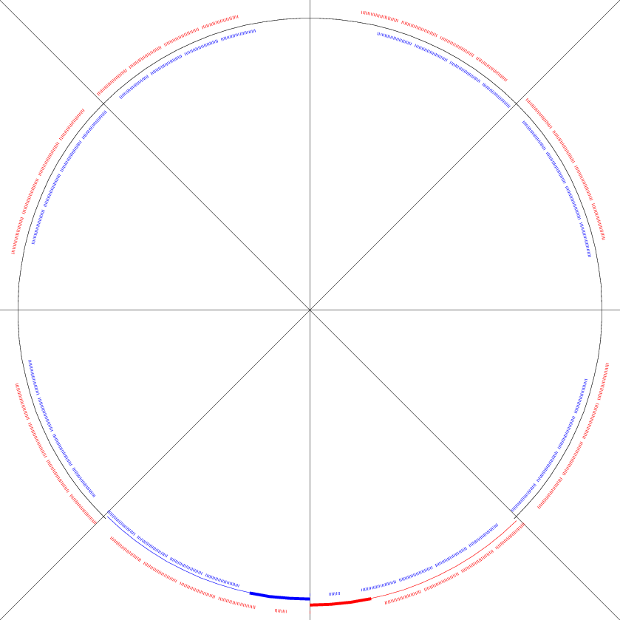
illustrative reminder: 776b - 75 ns
17821
Beam1 "m-pattern"
Beam1 "n-pattern"
Beam2 "m-pattern"
Beam2 "n-pattern"
26731
8911
1
for 920b , fill in the gaps with 3x (2*24b)

Slide 6
the shifts
The exact four-fold pattern would be
Q1 Q2 Q3 Q4
RF buck X +0 +8910 +17820 +26730
Maximizing IP8 after IP1/5 is done by adding on top of the above and to both rings (not really needed for 75ns, but crucial for 50ns)
beam1 +0 +30 +60 -30
beam2 +0 +30 +60 -30
To give non-colliding bunches to IP1/5 while optimizing number of collisions in IP8, one adds (instead of previous)
beam1 +0 +30 +60 -30
beam2 +0 +30 -60 -30
LHCb: beam1-beam2 = +30 (ATLAS/CMS: beam1=beam2)
ALICE: isolated collisions when |beam1-beam2| ≥ 90
no change for IP1/5
change in IP1/5

Slide 7
What's happening at IP2 with 50ns spacing & 225ns gaps ?
225 ns
IP2
if using 225 ns spacing between two PS batches in the SPS, then collisions will occur between the last bunch of a train and the 1st bunch of subsequent train of other beam
corollary: there must be at least 2 trains in the batch
Note: 225ns = 9*25ns (90 RF buckets)
PRO: gives isolated collisions (spaced by at least ~2us)
CONTRA: only few of these (~13 with 1380 bunches)

Slide 8
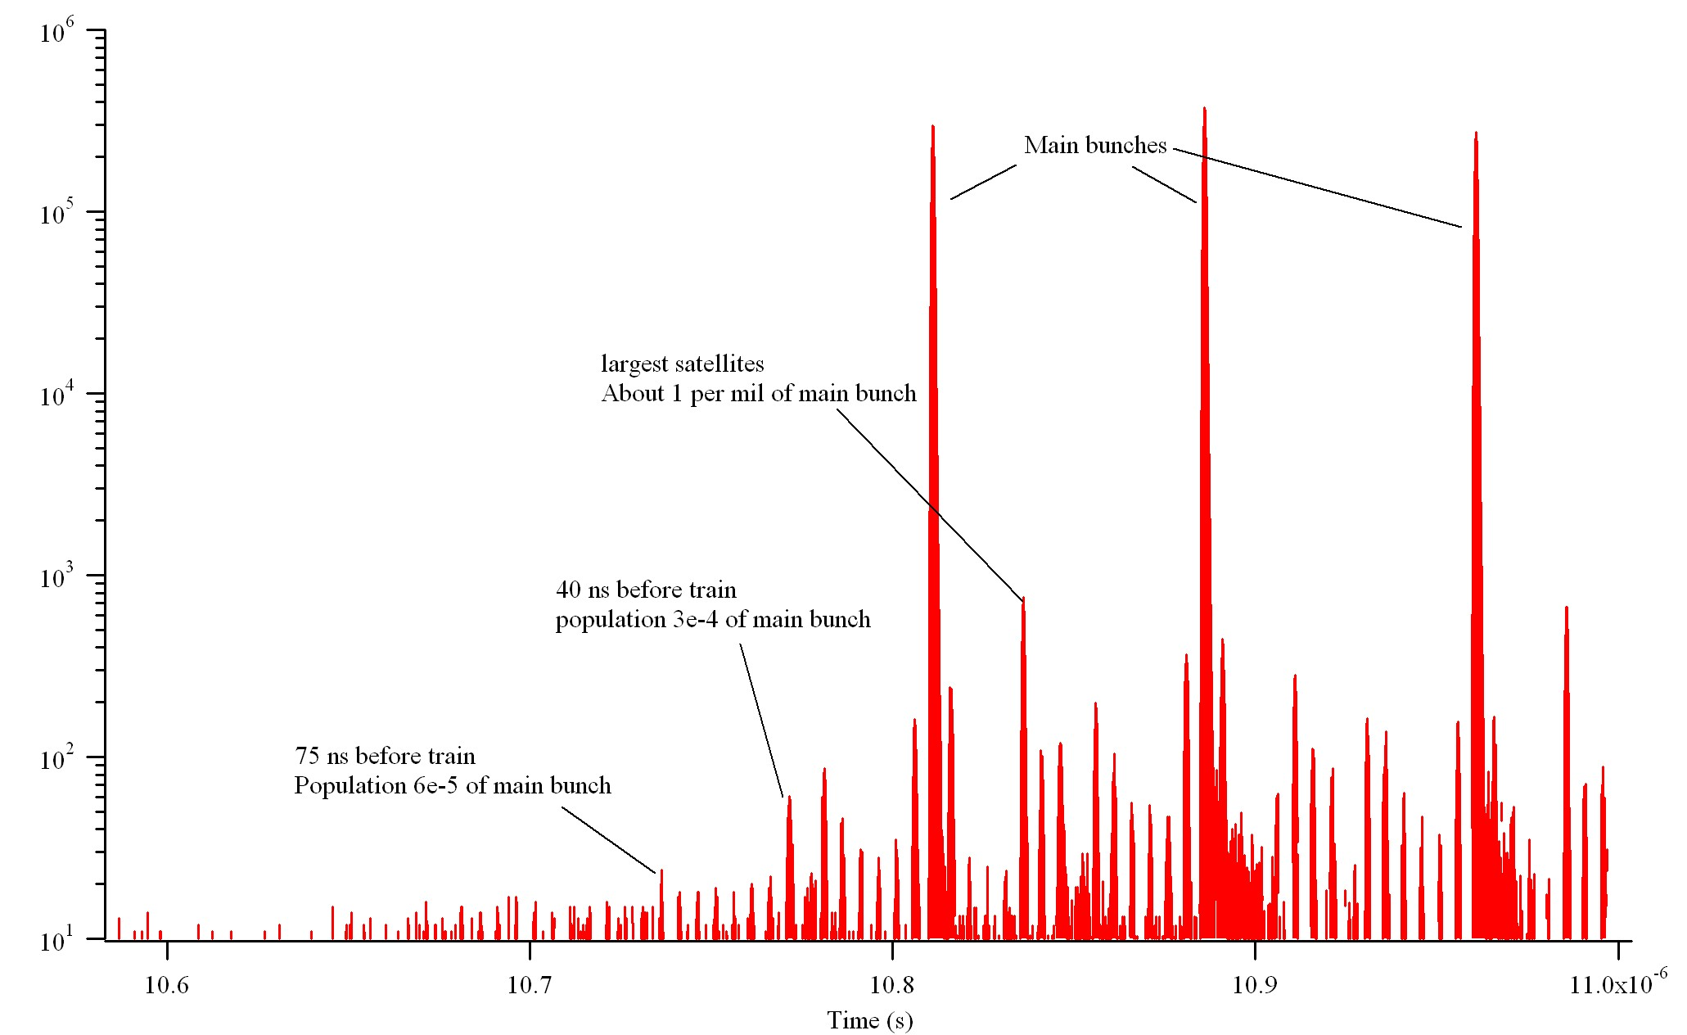
leading satellites...
75 ns
150ns before train isn't much better than 75ns

Slide 9
75ns schemes: overview
repeat x4 (4 Quadrants)
a possible path
AGK*
Tot IP1/5 2 8
00 empty
1 probe injection
8 8b injection
24 24b injection
24 24 48b injection
24 24 24 72b injection
24 24 24 24 96b injection
1 8 24 00 00 00 24 00 00 00 200b+1s 194 178 188
1 8 24 24 00 00 00 00 00 00 200b+1s 193 178 192
1 8 24 00 24 00 24 00 00 00 296b+1s 287 266 284
1 8 24 00 00 00 24 24 00 00 296b+1s 291 269 282
1 8 24 24 00 00 24 00 00 00 296b+1s 289 268 284
1 8 24 24 24 00 00 00 00 00 296b+1s 287 268 288
1 8 24 00 24 00 24 24 00 00 392b+1s 383 357 378
1 8 24 24 00 00 24 24 00 00 392b+1s 385 359 378
1 8 24 24 24 00 24 00 00 00 392b+1s 383 358 380
1 8 24 24 24 24 00 00 00 00 392b+1s 381 358 384
1 8 24 00 24 24 24 24 00 00 488b+1s 477 447 474
1 8 24 00 24 00 24 24 24 00 488b+1s 479 448 472
1 8 24 24 00 00 24 24 24 00 488b+1s 481 450 472
1 8 24 24 24 00 24 24 00 00 488b+1s 479 449 474
1 8 24 00 00 00 24 24 24 24 488b+1s 483 451 470
1 8 24 24 24 24 24 00 00 00 488b+1s 477 448 476
1 8 24 00 24 24 24 24 24 00 584b+1s 573 538 568
1 8 24 24 24 00 24 24 24 00 584b+1s 575 540 568
1 8 24 00 00 24 24 24 24 24 584b+1s 575 539 566
1 8 24 24 24 24 24 24 00 00 584b+1s 573 539 570
1 8 24 00 24 24 24 24 24 24 680b+1s 669 629 662
1 8 24 24 24 00 24 24 24 24 680b+1s 671 631 662
1 8 24 24 24 24 24 24 24 00 680b+1s 669 630 664
1 8 24 24 24 24 24 24 24 24 776b+1s 765 721 758
Tot = nominal bunches per beam
*AGK last injectable bucket for Q4 (bucket 31181)
370 buckets (925ns) between last circulating bunch and first bunch of injected batch
"m-pattern"
small shifts to provide non-colliding bunches to IP1/5 (and it increases collisions in IP8)
first 24b always present
"n-pattern"
maximizes collisions in IP1/5

Slide 10
75ns schemes: 920b is special
00 empty
1 probe injection
8 8b injection
24 24b injection
24 24 48b injection
24 24 24 72b injection
24 24 24 24 96b injection
First Quadrant (Q1)
repeat x3 (Q2-Q3-Q4)
Tot IP1/5 2 8
1 8 24 24 24 24 24 24 24 24 00 00 24 24 24 24 24 24 24 24 776+1s 765 721 758
1 8 24 24 24 24 24 24 24 24 24 24 24 24 24 24 24 24 24 24 920+1s 903 822 870
AGK last
bucket (Q4)
NOTE: this last scheme is not necessarily THE scheme we will use for routine lumi production
It is only the last scheme of the intensity ramp-up, through which it would be nice to have some sort of coherence

Slide 11
more SPS batch patterns ?
repeat x4 (4 Quadrants)
AGK*
Tot IP1/5 2 8
00 empty
1 probe injection
8 8b injection
24 24b injection
24 24 48b injection
24 24 24 72b injection
24 24 24 24 96b injection
1 8 24 00 24 00 24 00 00 00 296b+1s 287 266 284
1 8 24 00 00 00 24 24 00 00 296b+1s 291 269 282
1 8 24 24 00 00 24 00 00 00 296b+1s 289 268 284
1 8 24 24 24 00 00 00 00 00 296b+1s 287 268 288
EXAMPLE: 296b
1 8 24 00 00 00 24 00 24 00 296b+1s 291 269 282
1 8 24 00 00 00 24 00 00 24 296b+1s 291 269 282
More patterns possible from SPS:
Useful to fill the "n-pattern" in different ways (constrained by AGK)
Would allow using more spacing in the "n-pattern"
24 00 24 48b injection
24 00 00 24 48b injection
24 00 24 24 72b injection
24 24 00 24 72b injection

Slide 12
50ns schemes: overview
repeat x4 (4 Quadrants)
AGK*
Tot IP1/5 2 8
00 empty
1 probe injection
12 8b injection
36 24b injection
36 36 48b injection
36 36 36 72b injection
36 36 36 36 96b injection
1 12 36 36 00 00 00 00 00 00 300b+1s 286 2 288
1 12 36 00 00 00 36 00 00 00 300b+1s 292 0 282
1 12 36 00 36 00 36 00 00 00 444b+1s 430 0 426
1 12 36 00 00 00 36 36 00 00 444b+1s 436 1 420
1 12 36 00 36 36 00 00 00 00 444b+1s 424 2 432
1 12 36 36 36 00 00 00 00 00 444b+1s 424 4 432
1 12 36 00 36 00 36 36 00 00 588b+1s 574 1 564
1 12 36 36 00 00 36 36 00 00 588b+1s 574 3 564
1 12 36 00 00 00 36 36 36 00 588b+1s 580 2 558
1 12 36 36 36 36 00 00 00 00 588b+1s 562 6 576
1 12 36 00 36 00 36 36 36 00 732b+1s 718 2 702
1 12 36 00 36 36 36 36 00 00 732b+1s 712 3 708
1 12 36 00 00 00 36 36 36 36 732b+1s 724 3 696
1 12 36 36 36 36 36 00 00 00 732b+1s 706 6 714
1 12 36 00 36 36 36 36 36 00 876b+1s 856 4 846
1 12 36 00 36 00 36 36 36 36 876b+1s 862 3 840
1 12 36 00 00 36 36 36 36 36 876b+1s 862 3 840
1 12 36 36 36 36 36 36 00 00 876b+1s 850 7 852
1 12 36 00 36 36 36 36 36 36 1020b+1s 1000 5 984
1 12 36 36 36 00 36 36 36 36 1020b+1s 1000 7 984
1 12 36 36 36 36 36 36 36 00 1020b+1s 994 8 990
1 12 36 36 36 36 36 36 36 36 1164b+1s 1138 9 1128
1 12 36 36 36 36 36 36 36 36 1380b+1s 1342 13 1296
Similar to 75ns, except that less collisions for IP2
actually, difficult to give >10 collisions to ALICE
would help if could dynamically switch from 12b to 36b
a possible path with smooth increase of injection but not many IP2 collisions
a possible path with transiently more IP2 (& IP8) collisions (but less IP1/5)
fill

Slide 13
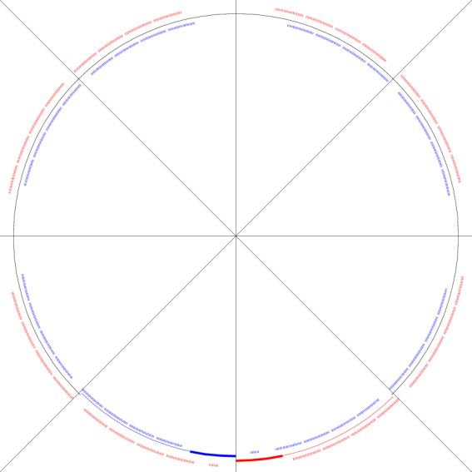
Notable difference of 50ns vs 75ns
75ns: the natural step size for physics (four-fold symmetry) is 4x24b, i.e. 96 bunches extra
50ns: the natural step size for physics (four-fold symmetry) is 4x36b, i.e. 144 bunches extra
If not 144, then some of the 36b trains will not be used at best
will cross 1 or 2 high lumi IR(s) without encountering any counter train
Could consider alleviating this for the first 2 steps by using the two extra "gap-filling" 36b trains
add 3x36b = 108b for these two steps, e.g.
12b+3x36b+4x36b = 264b
12b+3x(2*36b)+4x36b = 368b
then +144b per step
to be investigated...

Slide 14
Lumi integration prospects: 50 ns
bunches | IP1/5 pb⁻¹/20h | IP1/5 pb⁻¹ cumul. | IP8 pb⁻¹/20h | IP8 pb⁻¹ cumul.
300 | 18 | 18 | 6 | 6
444 | 27 | 45 | 8 | 14
588 | 36 | 81 | 10 | 24
732 | 44 | 125 | 14 | 38
876 | 53 | 178 | 16 | 54
1020 | 62 | 240 | 19 | 73
1164 | 71 | 311 | 21 | 94
1380 | 84 | 395 | 25 | 119
based on fill 1647, 12h, 200b @ 75ns

Slide 15
50ns test ramps during scrubbing
If possible (without affecting the priority test purposes):
declare STABLE BEAMS for ~20minutes
use machine/beam modes: PROTON PHYSICS / STABLE BEAMS
make collisions
and non-colliding bunches
Main purpose of this request:
check bkg conditions and compare with possible second test ramp after additional scrubbing ?
see any difference ? (could be important for future scrubbing runs)

