Slide 1
RF observations: Stable phase measurements
P. Baudrenghien, J. Esteban-Müller,
G. Papotti, E. Shaposhnikova, D. Valuch
LHC BOC 12th April 2011
Acknowledgements: G. Arduini, C. Bhat, W. Venturini Delsolaro, LHC OP shifts

Slide 2
Outline
Measurements of synchronous phase:
Experimental set-up
Average of all the bunches
Phase shifts
Bunch by bunch
Phase shifts
Oscillations
Summary

Slide 3
Introduction
Beam loses energy due to:
synchrotron radiation
resistive impedance
electron cloud
Energy loss is compensated by RF system
In absence of acceleration, synchronous phase is: Wn is the energy loss per turn and per particle V is the amplitude of the RF voltage

Slide 4
Experimental set-up
Measurement of the phase error:
Difference between the phase in the pick-up and the phase of the RF system
Beam
PU
Cav. voltage
BPF
Phase Meas.
Δφ + offset!

Slide 5
Average phase measurements

Slide 6
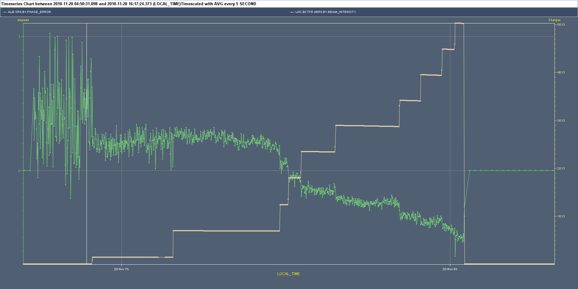
Example of measurements
Beam 1: Shift in phase error after each injection
Average (all bunches) phase after or before each injection (during 40 s)

Slide 7
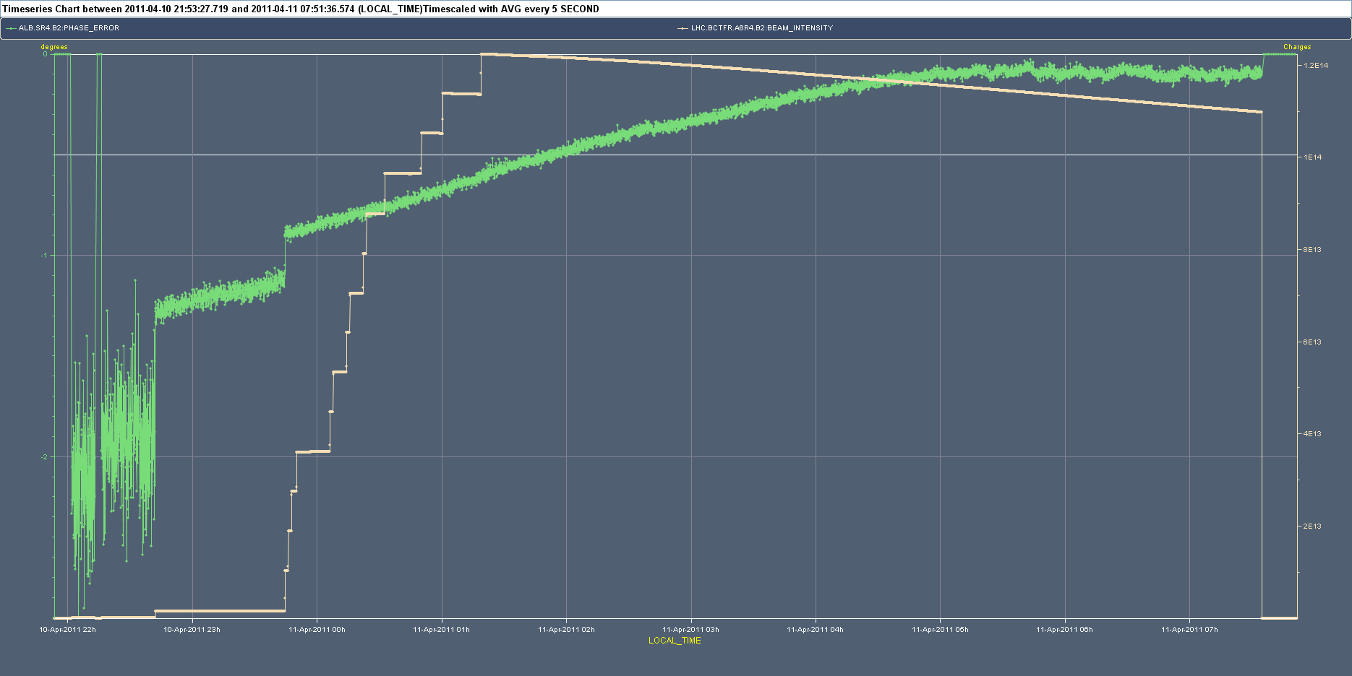
Example of measurements
Beam 2: Drift of phase error

Slide 8
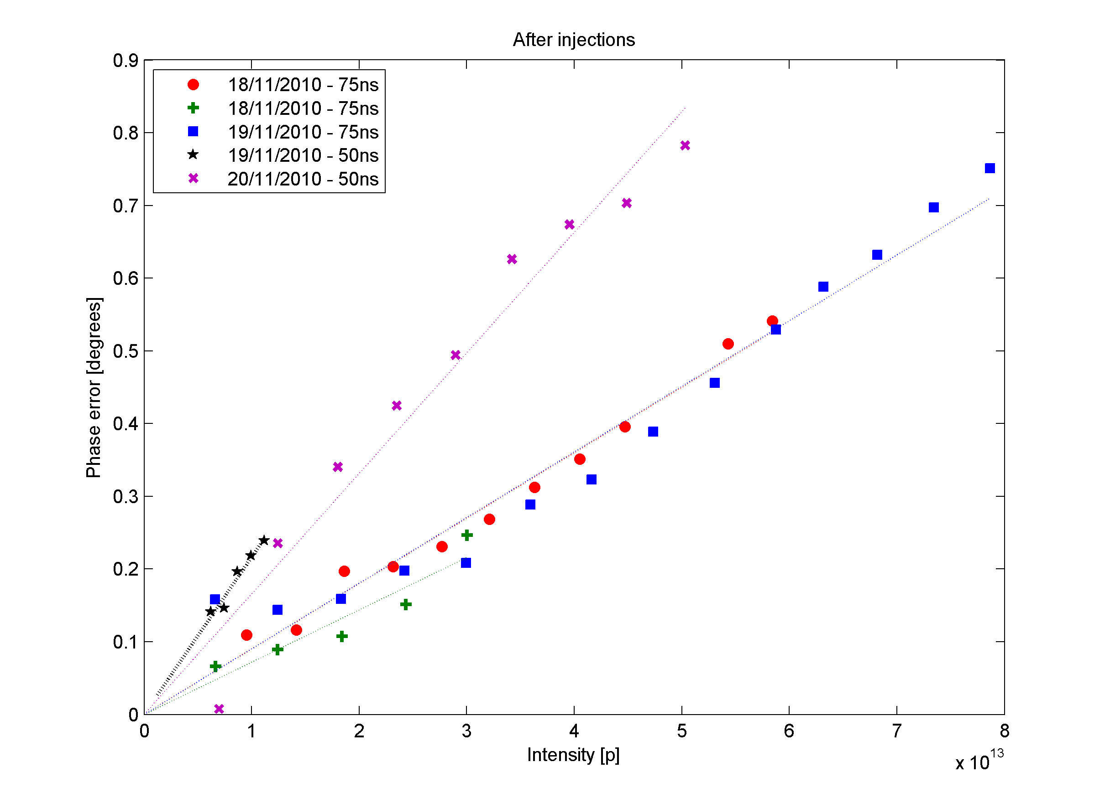
Results from 2010
Beam 1
50 ns and 75 ns beams
Voltage 3.5 MV
50 ns
75 ns

Slide 9
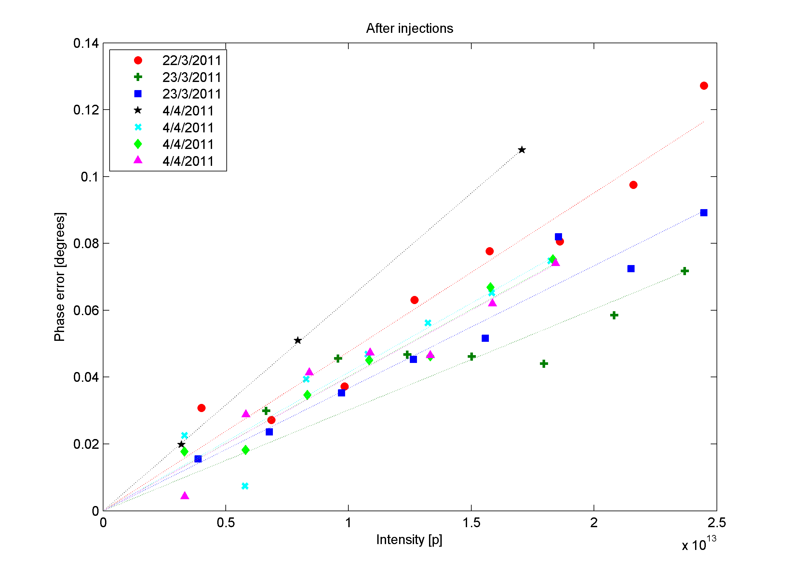
Results from 2011: 75 ns beam
Beam 1
Voltage 6 MV

Slide 10
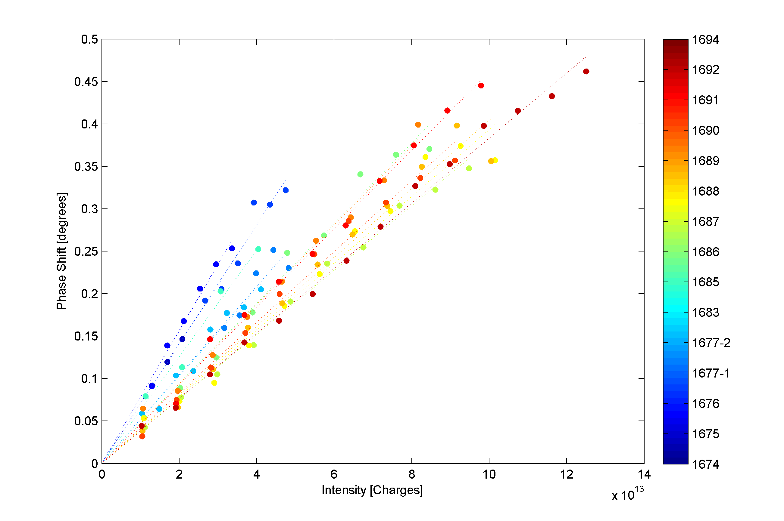
2011: 50 ns beam
Scrubbing run
Slope of the phase shift decreased during the scrubbing run

Slide 11
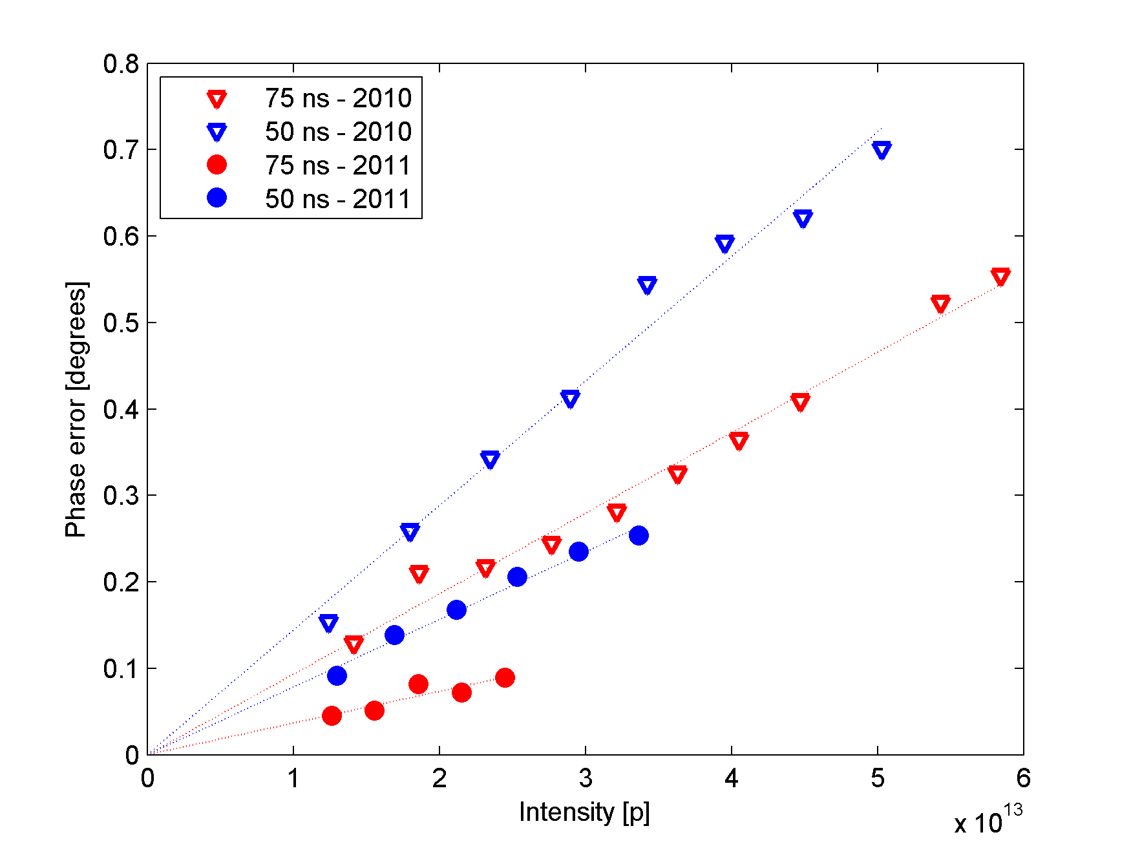
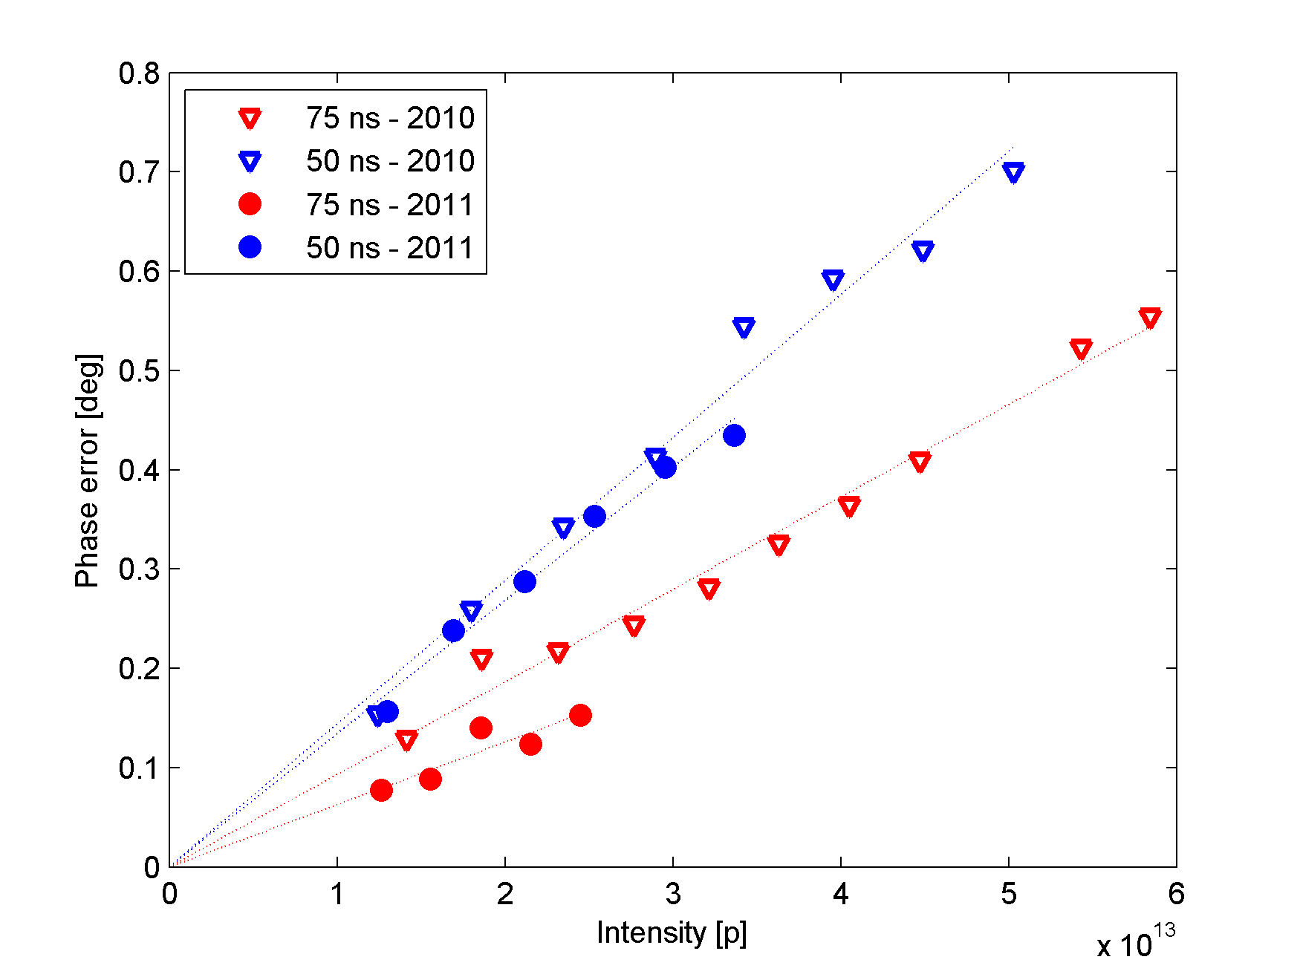
Comparison 2010 & 2011
Scaling 2011 results by factor 6/3.5 (Voltage)

Slide 12
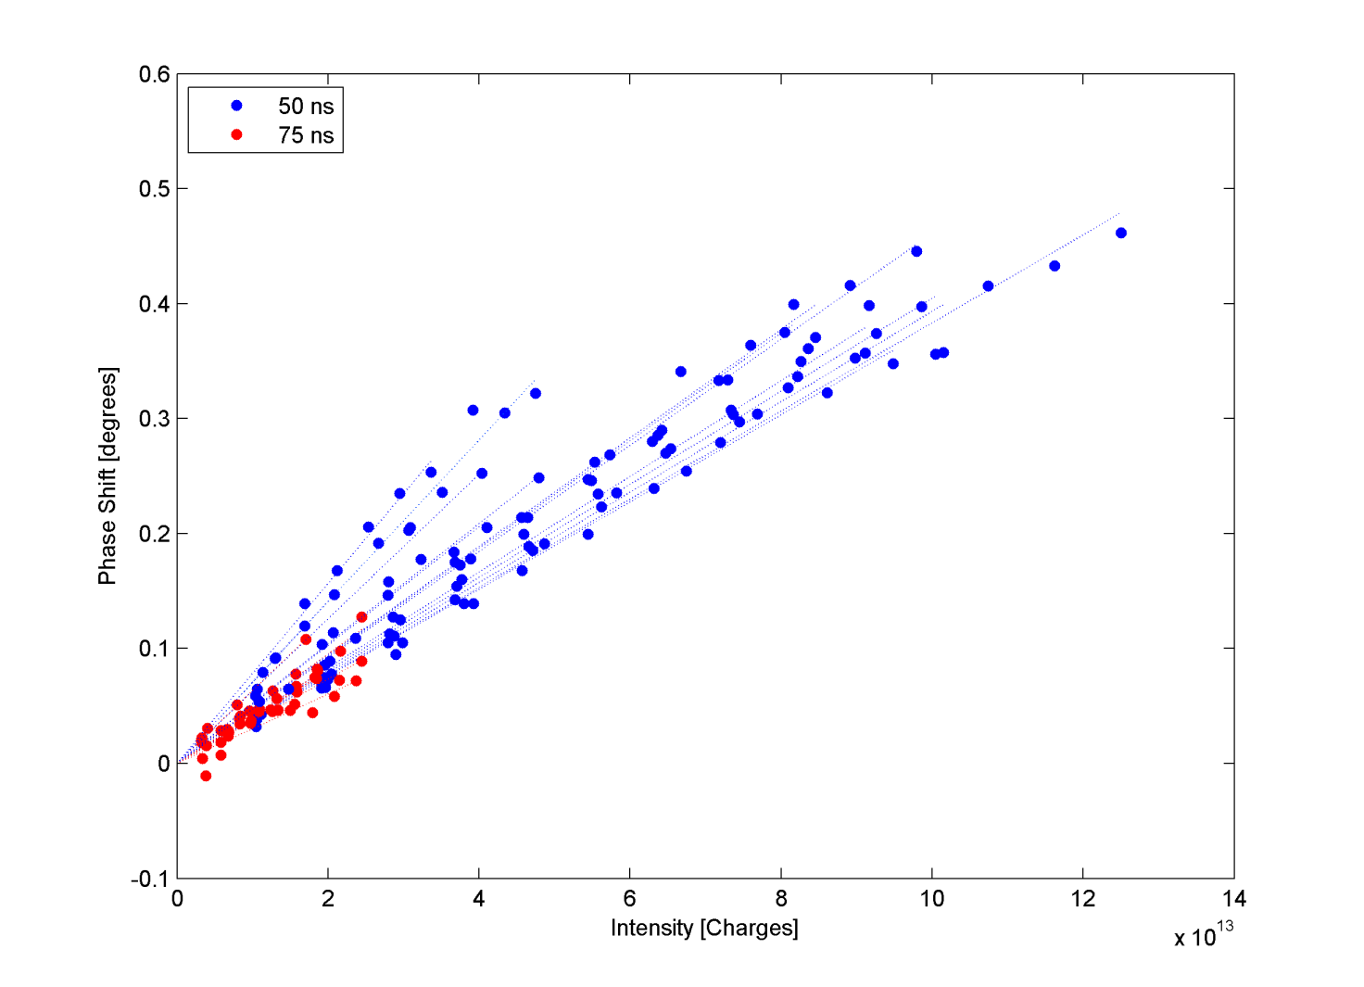
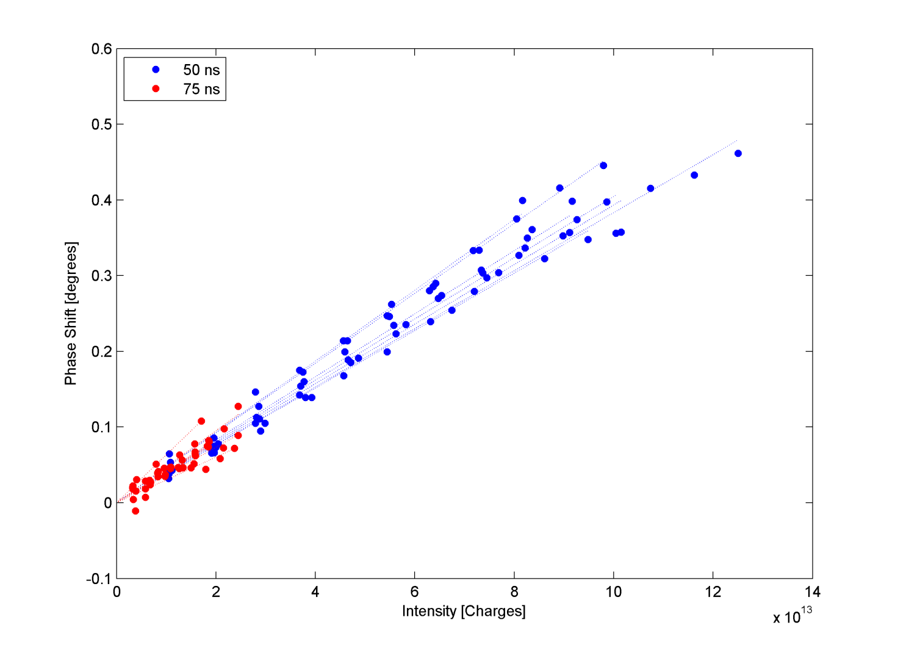
2011: comparison 50ns & 75ns
75 ns beam and last fills of scrubbing run for 50 ns beam with similar slopes

Slide 13
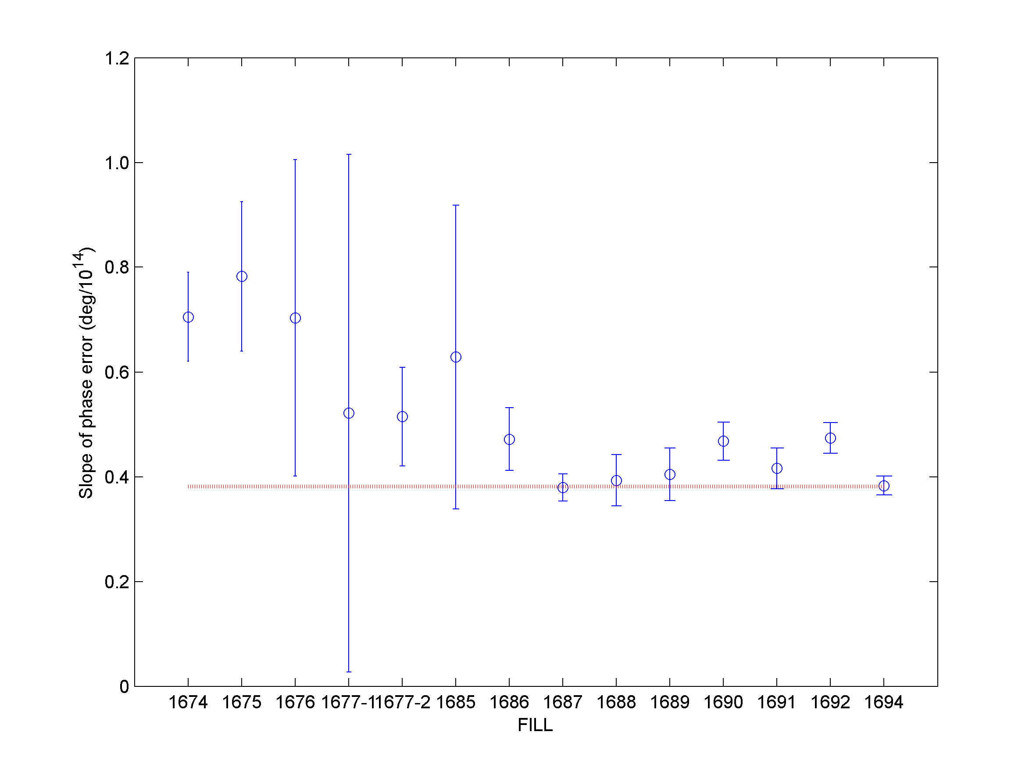
2011: 50 ns beam
Scrubbing run
gaps>2 μs
Average for 75 ns
Slope of the phase shift decreased during the scrubbing run

Slide 14
Bunch by bunch measurements

Slide 15
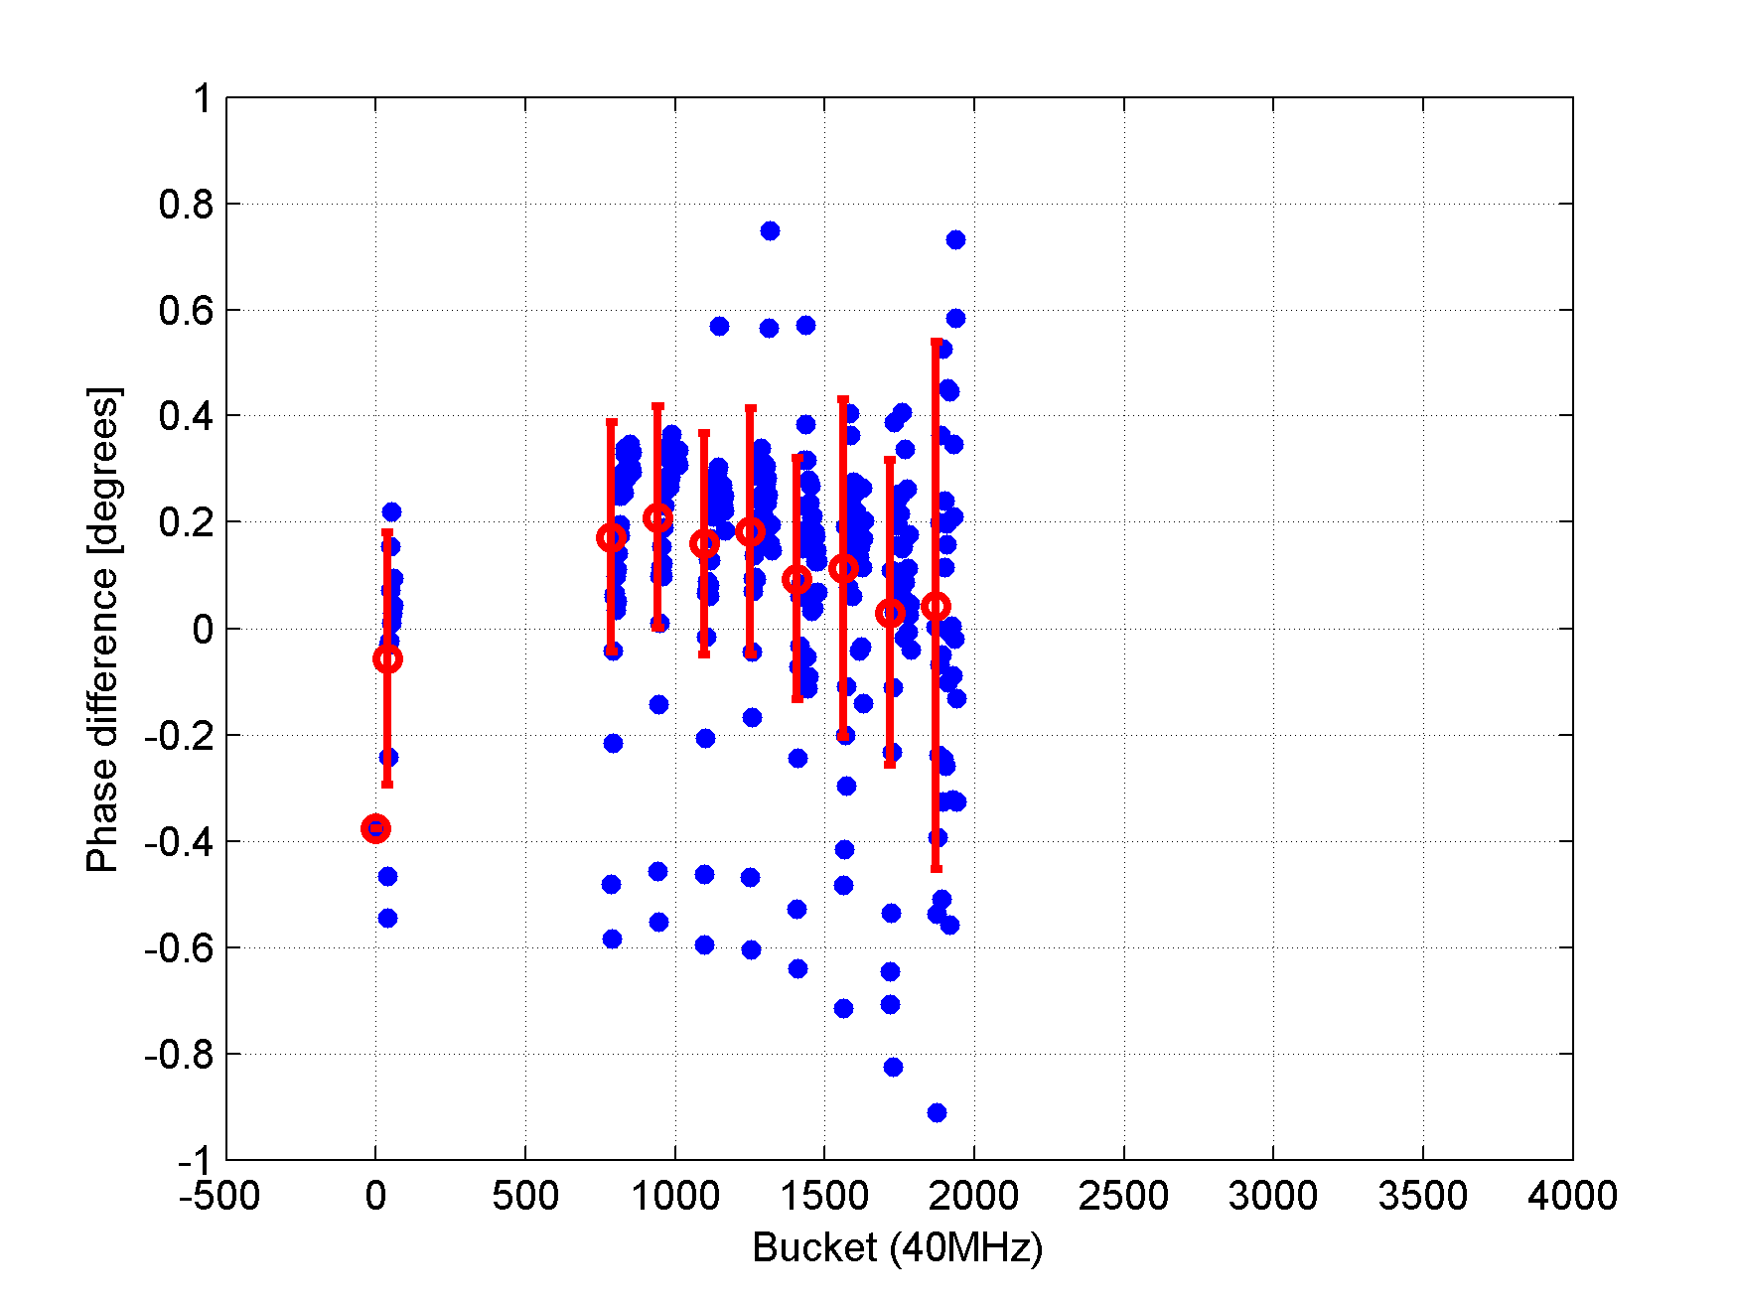
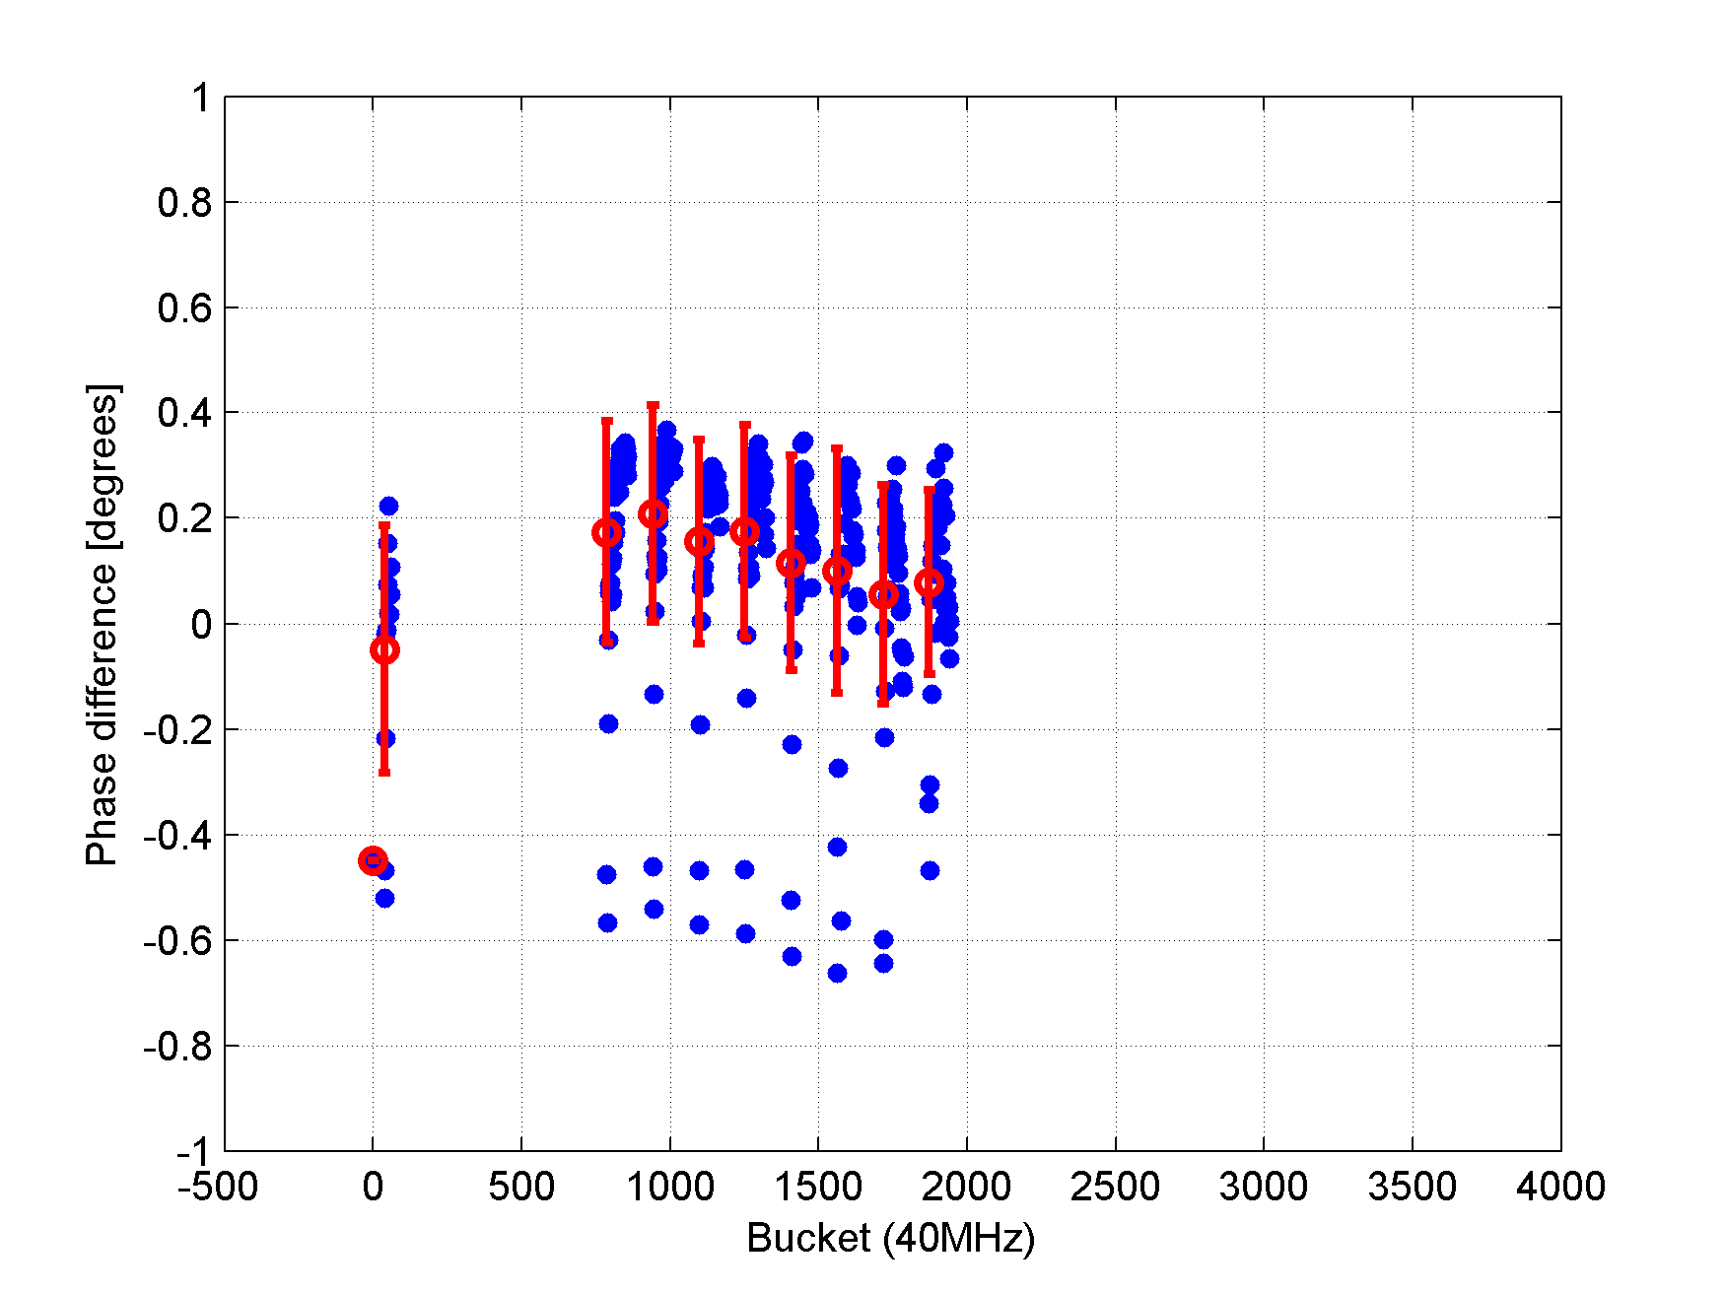
Bunch by bunch
FILL 1675 - 6/4/2011 - 7:50
50 ns beam – 300 bunches
Batch spacing around 2.1 μs
After injection
20 min later

Slide 16
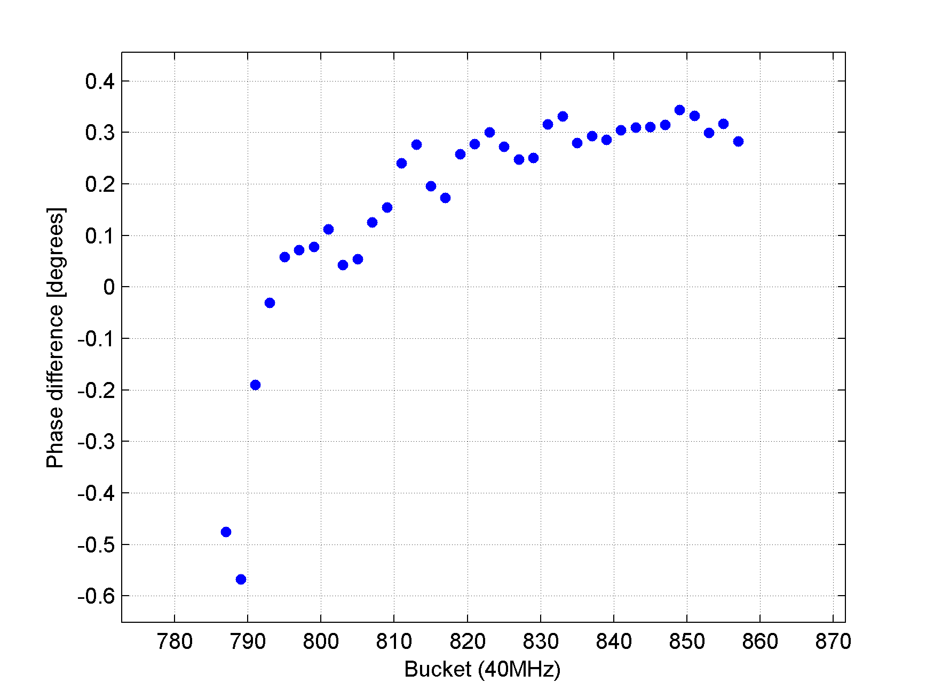
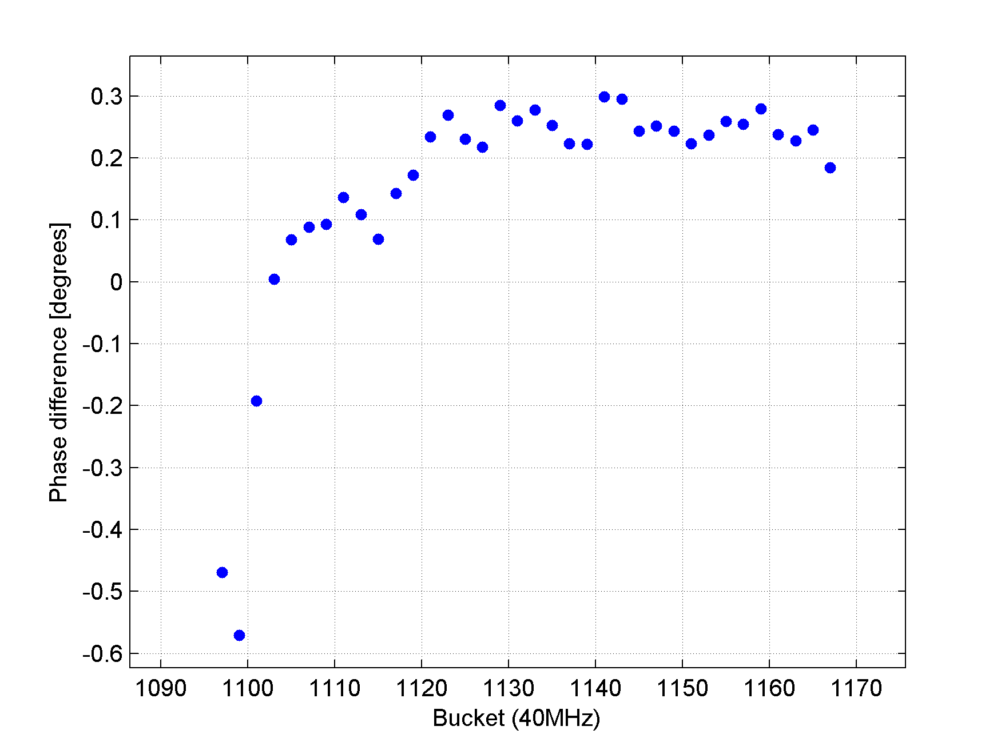
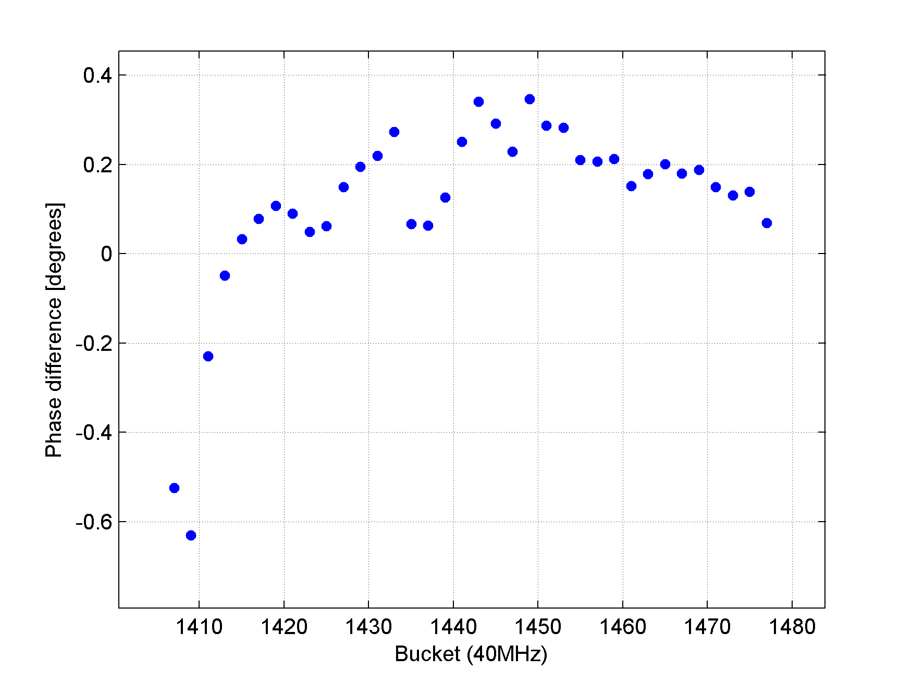
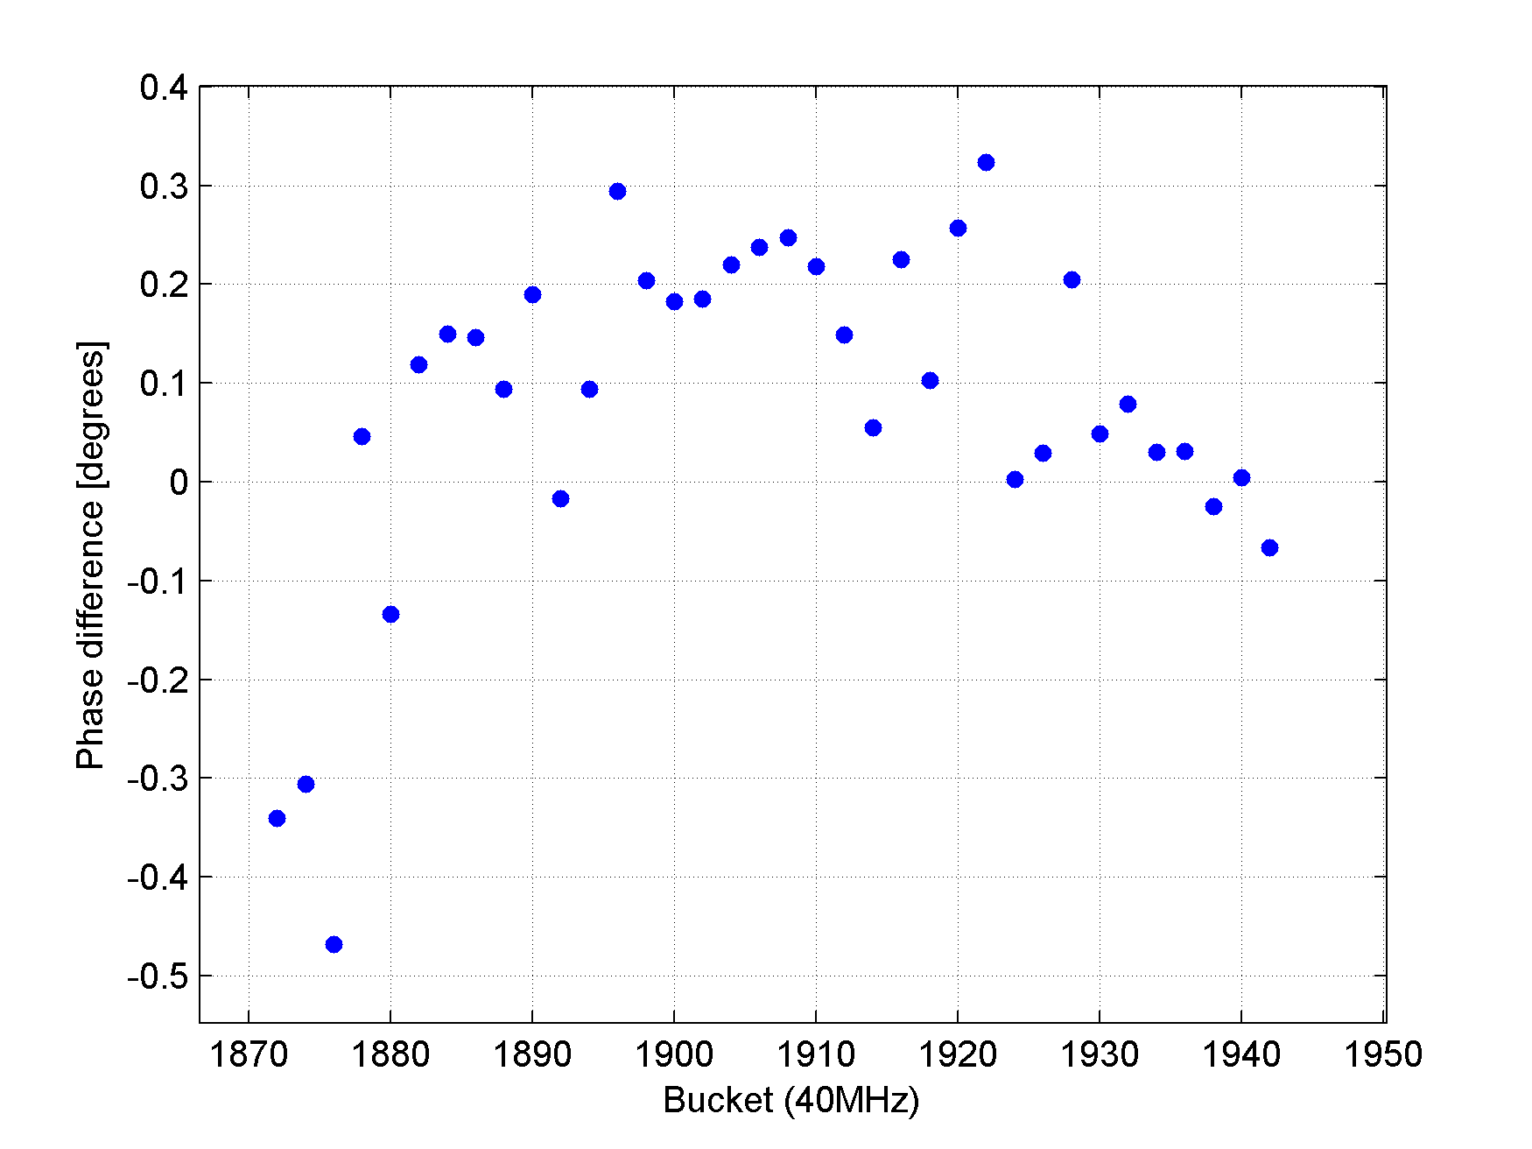
Phase shift in different batches
FILL 1675 - 6/4/2011
20 min after last injection
1st Batch
3rd Batch
5th Batch
Last Batch

Slide 17
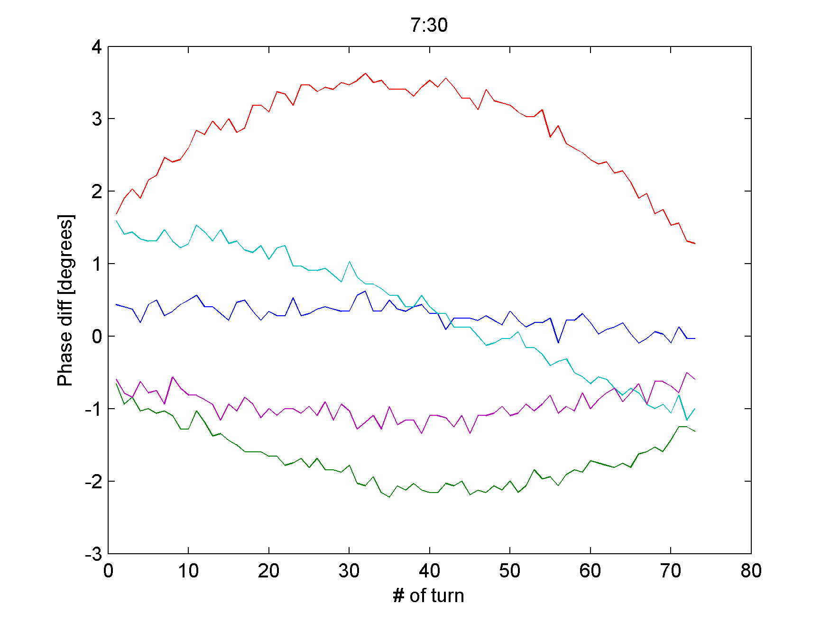
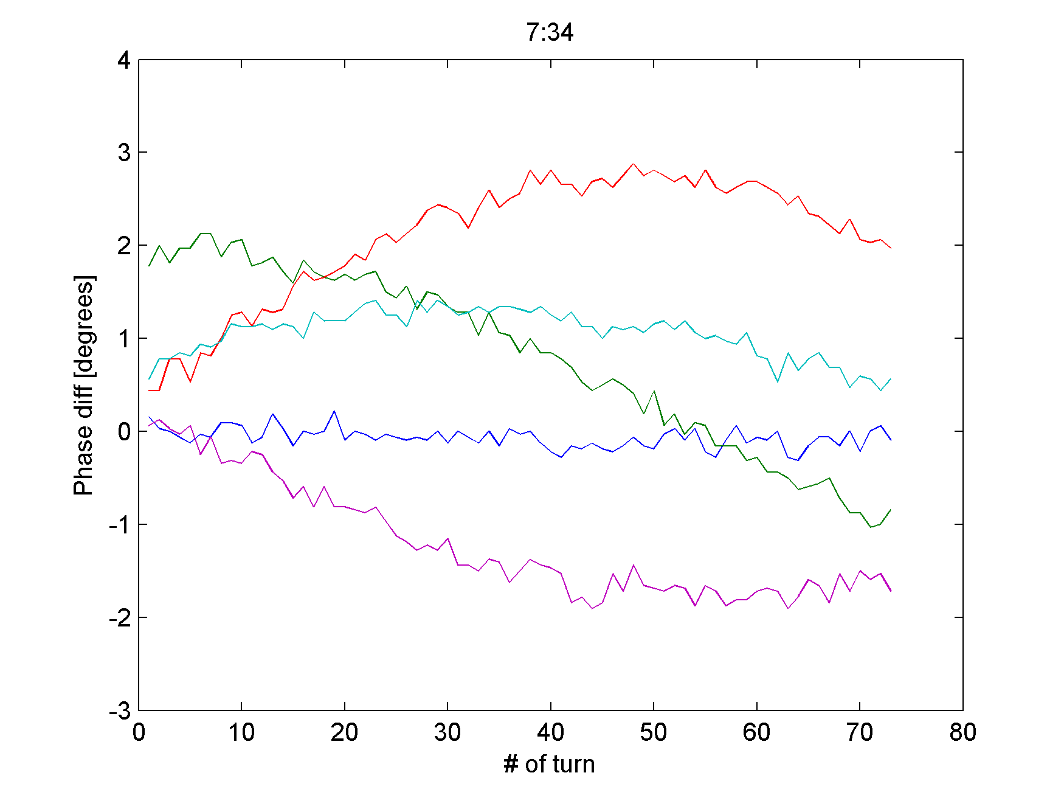
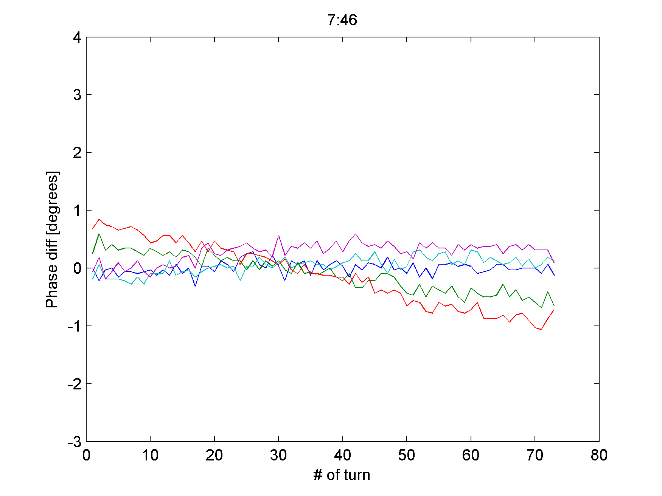
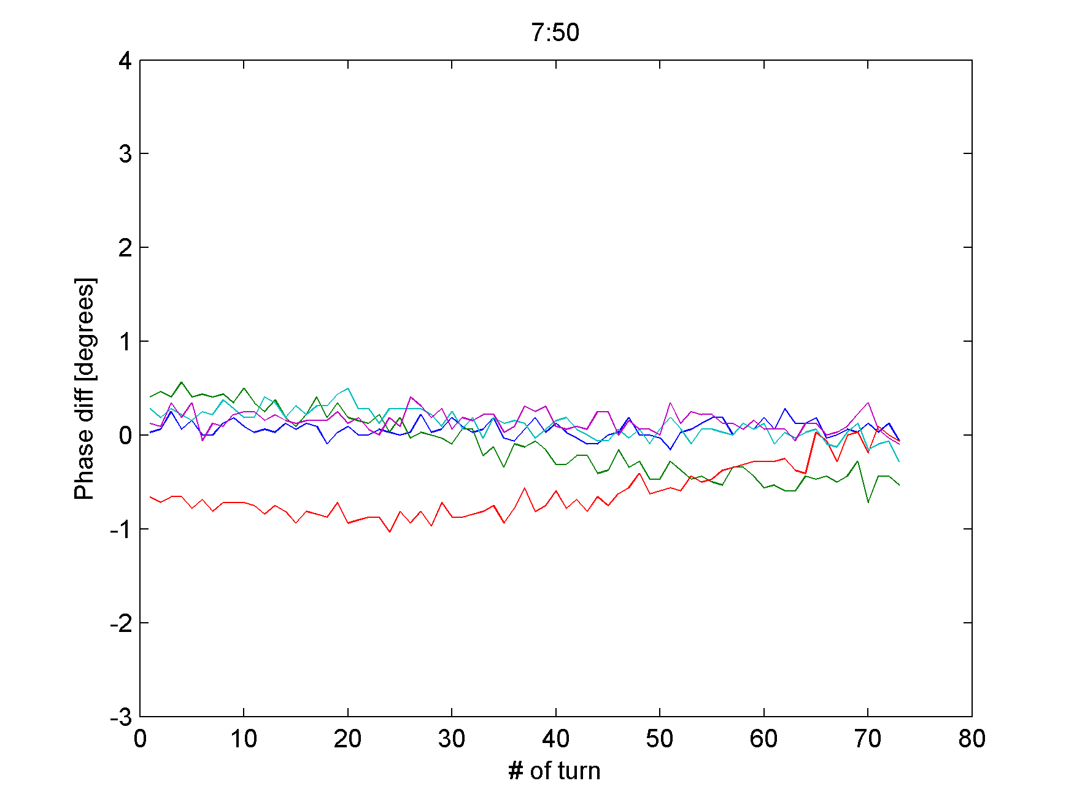
Synchrotron oscillations
5 last bunches in the last batch after all injections

Slide 18
Summary
Initial measurements in 2011 are similar to the results from 2010 for both 50 ns and 75 ns beam (after voltage scaling), showing significantly higher phase shift for 50 ns beam than for 75 ns (for the same total intensity)
Evolution of average stable phase shift during the last week clearly shows effect of scrubbing, with final values for 50 ns beam approaching 75 ns beam slope
After each injection bunches perform synchrotron oscillations damped at the time scale of 10-15 min – limit of stability?
Bunch-by-bunch structure probably also reflects transient beam loading and needs more analysis

Slide 19
Next steps
Would be interesting to have measurements for 75 ns beam now
Increase bunch-by-bunch acquisition length to study synchrotron oscillations and measure their (bunch-by-bunch) frequency and phase
Beam 2 data analysis with drift or without
(if possible)
Comparison of stable phase measurement with bunch positions (from bunch profiles)

