Slide 1
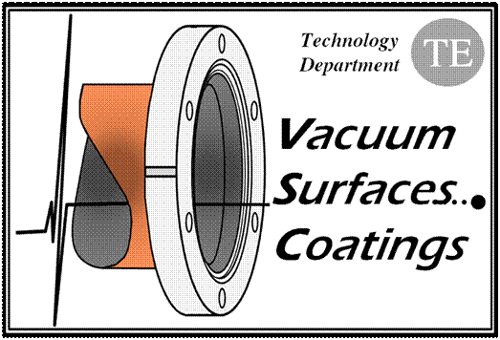
Some Vacuum Observation with
50 ns beams
V. Baglin, G. Bregliozzi, P. Chiggiato,
P. Cruikshank, B. Henrist, J.M. Jimenez,
G. Lanza (12/4/11)
CERN TE-VSC, Geneva
1.
2.

Slide 2
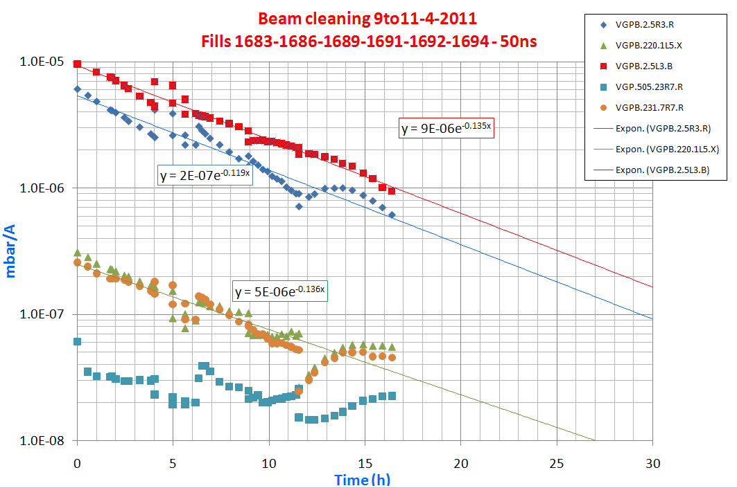
Beam cleaning with 50 ns
Reduction of one decade in about 17h
Cleaning is about constant throughout the period

Slide 3
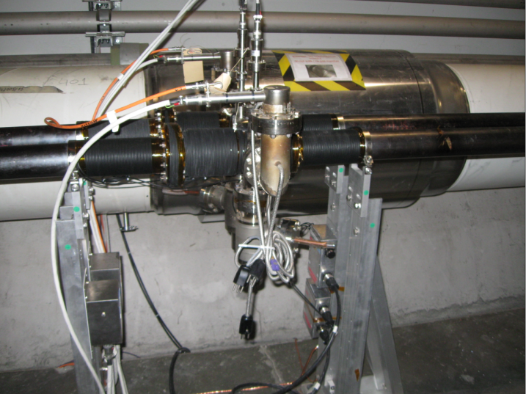
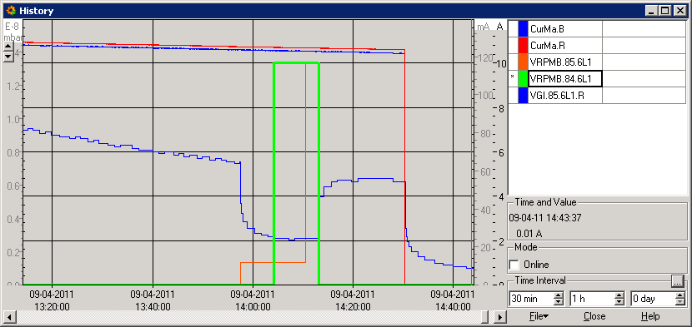
No multipacting in NEG chambers : ID80
Switching ON (to 10 A) the solenoids around NEG beam pipe has no effect on the pressure reading (VRPMB.84.6L1)
Switching ON to 1 A (~6 G) the solenoid around the warm module decreases the pressure from 7 to 3 10⁻⁹ mbar (VRPMB.85.6L1).

Slide 4
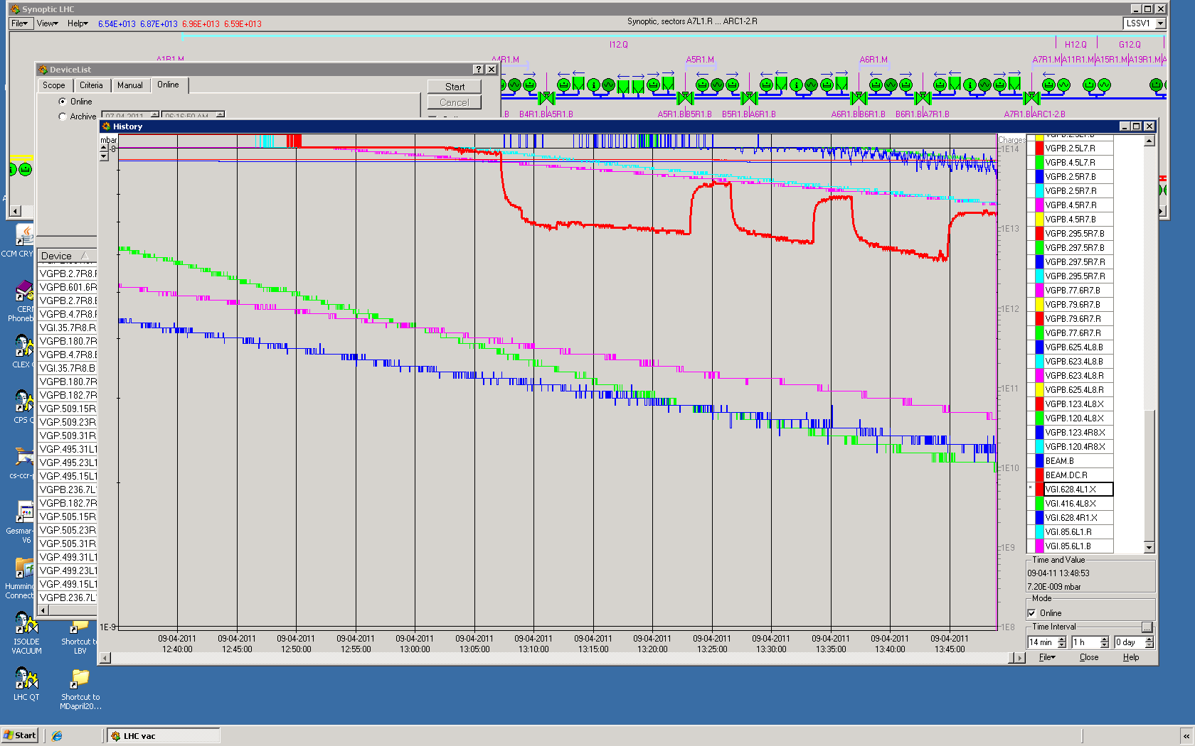
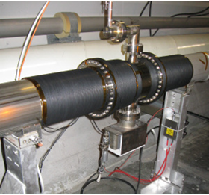
No multipacting in NEG chambers : ID212
Switching ON the solenoids around NEG beam pipe has no effect on the pressure reading
Switching ON to 1 A the solenoid around the warm module decreases the pressure from 9 to 6 10⁻⁹ mbar.

Slide 5
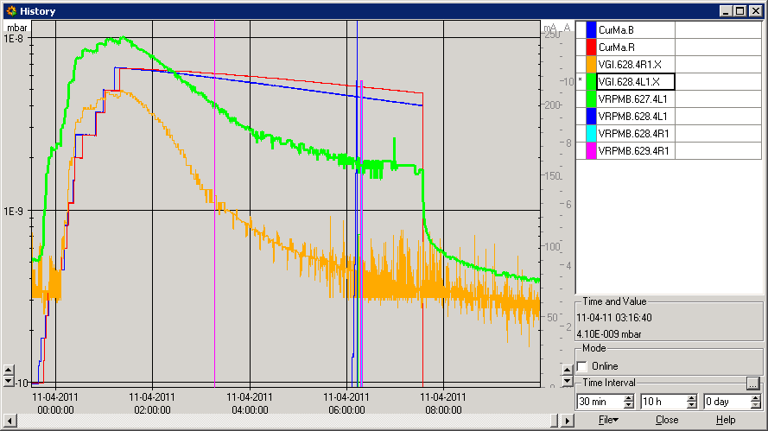
No more multipacting in vacuum modules : ID212
A4L1.X and A4R1.X
Switching ON the solenoids up to 10 A, around warm modules does not affect the pressure i.e. no more multipacting
At 6h, the observed pressure increase at 4L1 is due to CH4 or primary desorption. No signal is seen on the right side
Fill 1694 – 1020 b

Slide 6
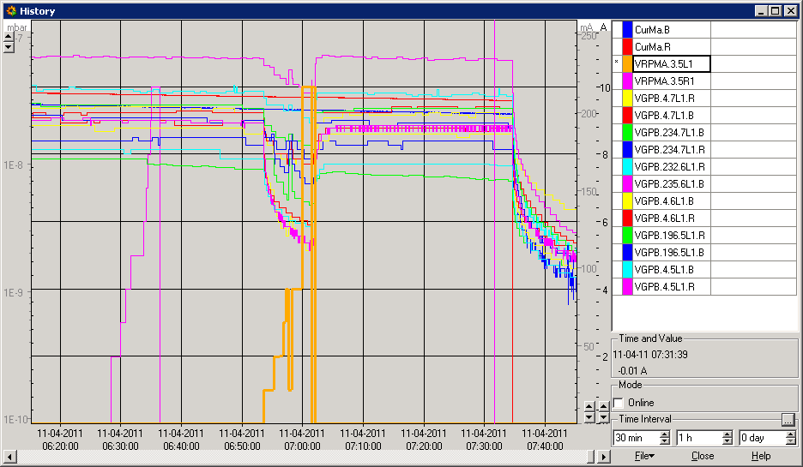
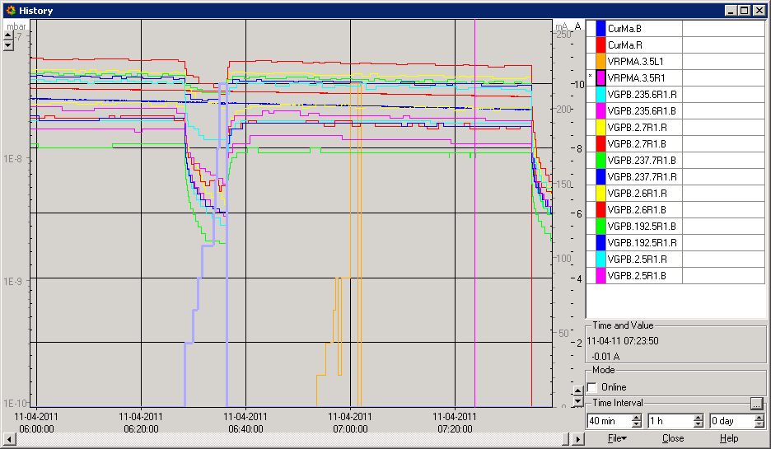
LSS1 Quads (except IT) : still multipacting
At 7h, switching ON the solenoids located at the left side quadrupoles decrease the pressure i.e. still multipacting
Fill 1694 – 1020 b
At 6h30, switching ON the solenoids located at the right side quadrupoles decrease the pressure i.e. still multipacting

Slide 7
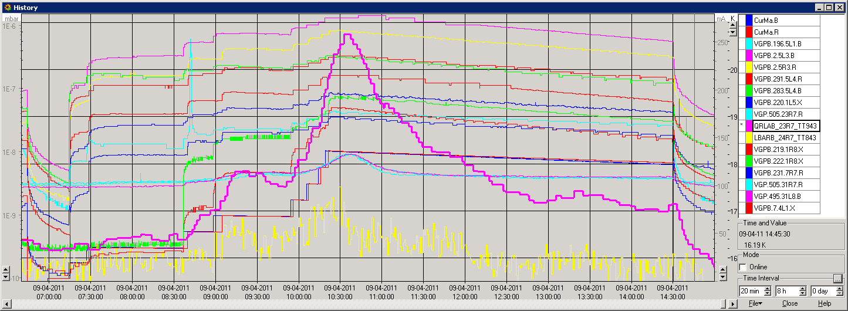
Pressure increases inside the arcs
Example of fill 1683, 588 bunches both beams
Pressure increase simultaneously with temperature of beam screen
ΔT ~ 3.5 K out of which 2.3 is due to image current
3.5 K
Image
current
23R7 – 31L8

Slide 8
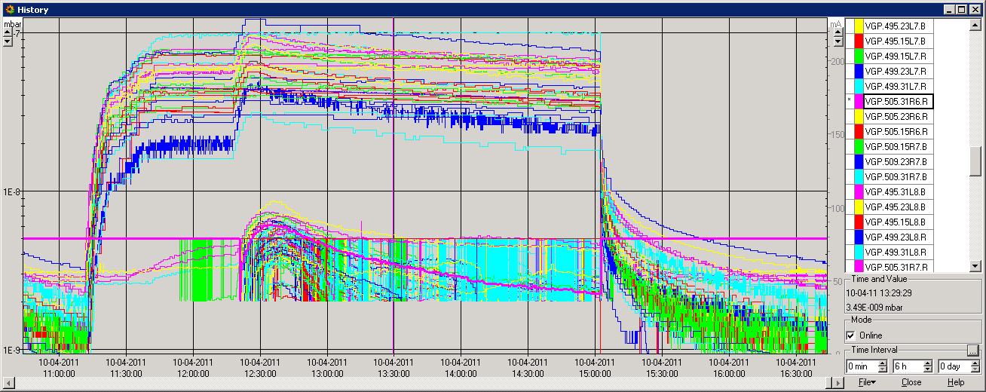
Extremity and inside arcs pressures
Example of fill 1691, 804 bunches both beams
Pressure at arcs extremities is about 1 order of magnitude larger than inside the arcs
Extremity
Inside arcs

Slide 9
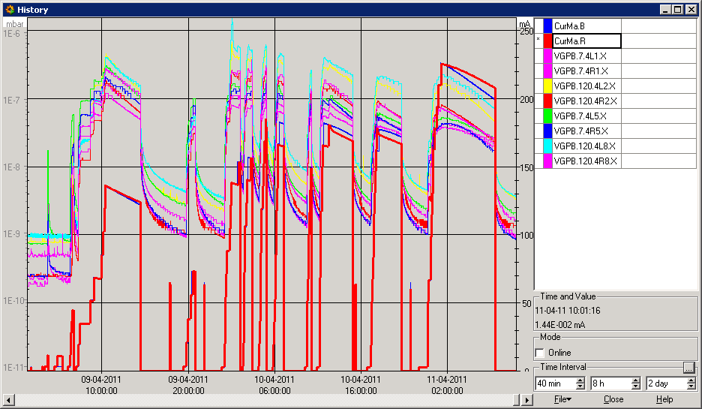
Pressures at Q3
Pressure levels below 3 10⁻⁸ mbar in LSS 1, 5, 2R and 8R
Pressure level equals 7 10⁻⁸ mbar in LSS 8L
Pressure level equals 5 10⁻⁸ mbar in LSS 2L
588b
800b
800b
1020b

Slide 10
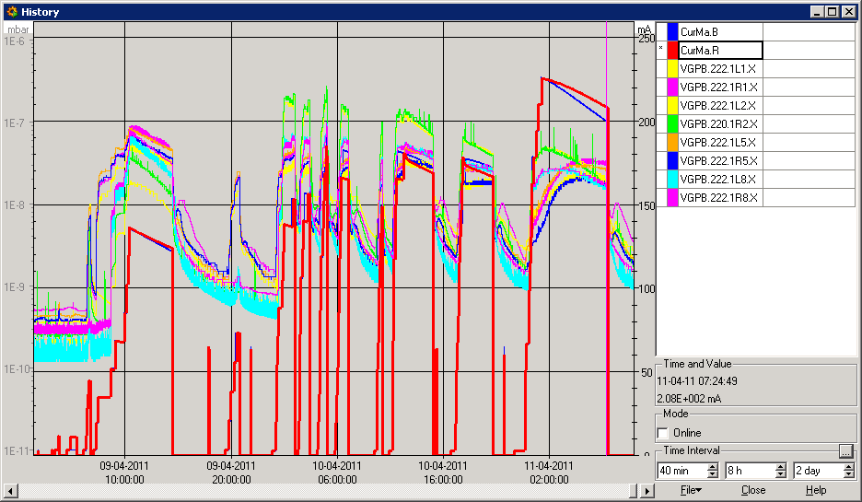
Pressures at Q1
All pressure levels below 3 10⁻⁸ mbar
588b
800b
800b
1020b

Slide 11
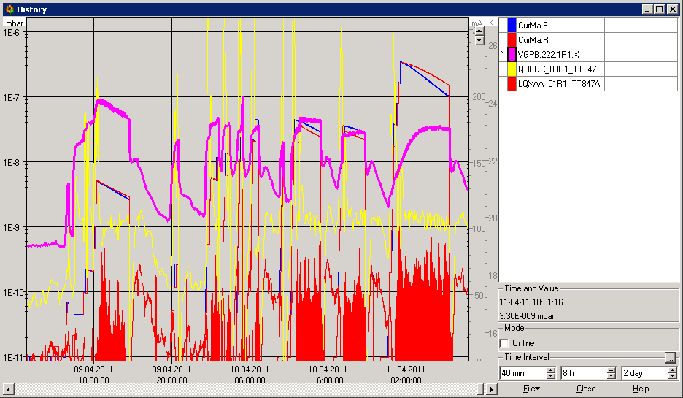
Pressures at Q1 after beam dump
After beam dump, pressure increase due to behaviour of BS temperature
588b
800b
800b
1020b

Slide 12
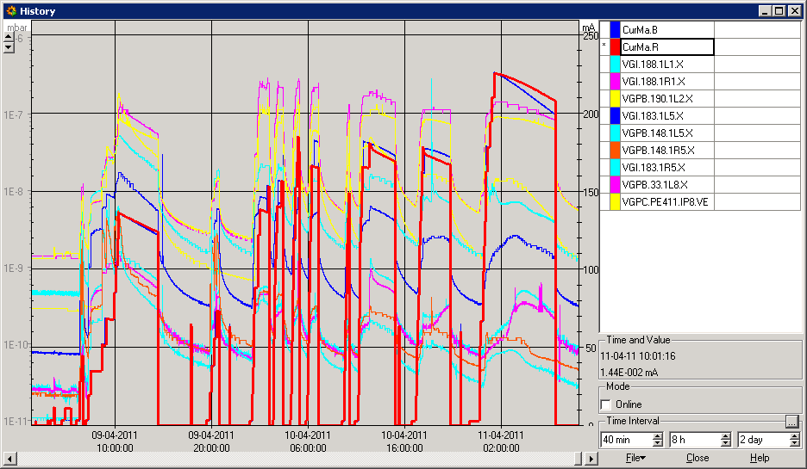
Pressures in experiments
ATLAS < 2 10⁻¹⁰ mbar
ALICE and CMS < 4 10⁻⁹ mbar
LHC-B < 8 10⁻⁸ mbar
588b
800b
800b
1020b

Slide 13
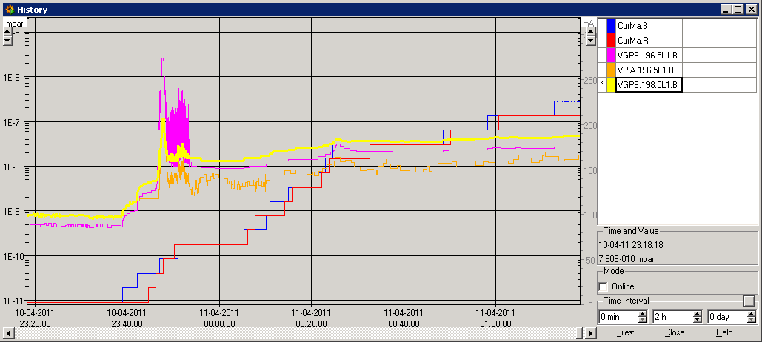
Pressures around Q5L1.B
We observed, regularly, a singulary of the vacuum behavior in Q5L1.B
Is it a vacuum gauge or a malfunctioning ion pump which produce outgassing ?
Switching off VGPB.196.5L1.B did not change the picture
1020b

Slide 14
Summary
A reduction of 1 order of magnitude in 17h
So pressure with 1020 b less than with 588 b !
No multipacting is observed in NEG coated vacuum chambers
Multipacting is still observable in quadrupoles cold warm transitions
A slight pressure increase was observed inside the arcs together with a temperature increase of the beam screen.
Pressure levels in the 10⁻⁸ mbar range at triplets
ATLAS a few 10⁻¹⁰ mbar
ALICE, CMS a few 10⁻⁹ mbar
LHC-B a few 10⁻⁸ mbar

Slide 15
Back up slides

Slide 16
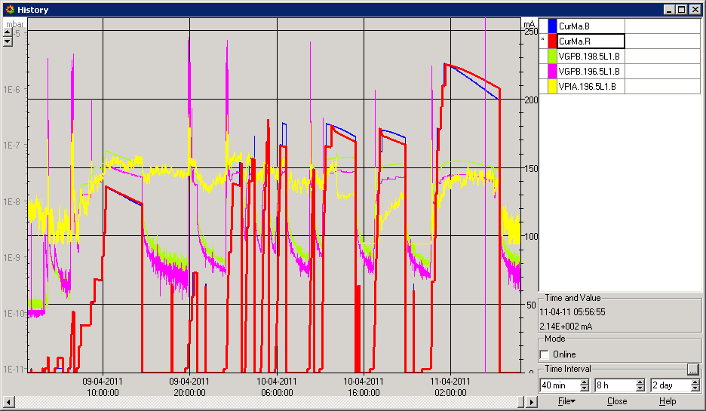
Pressures around Q5L1.B
We observed a singulary of the vacuum behavior in Q5L1.B
588b
800b
800b
1020b

