Slide 1
What do we need in the CCC for mastering the 50 ns high intensity beams
Walter Venturini Delsolaro
Thanks to G. Arduini, G. Lanza, T. Pieloni, F. Roncarolo, B. Salvant, U. Wagner, M. Zerlauth
LHC Beam Operation Committee 3.5.2011

Slide 2
Topics
Q, Q‘ monitoring
Bunch by bunch online diagnostics
Emittances
ADT pickups
Vacuum and heat loads
Post mortem

Slide 3
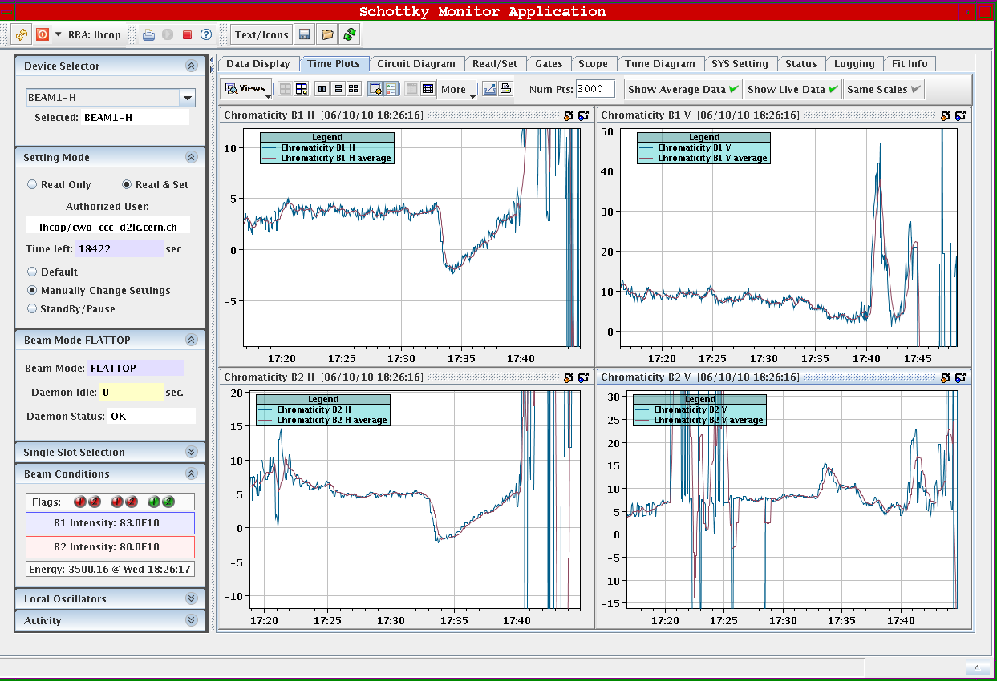
Q and Q’ monitoring and control
Q’ control turns out to be essential to preserve beam quality
FIDEL dynamic correction is deployed, and seems to work.
Still … expect some fill to fill variation
Q’ monitoring with radial modulation has to be switched off before injection of high intensity beams.
Q reading gets lost as well
(intensity dependent shift is invisible)
Schottky monitoring of average
Q’ was done last year.
Use bbb acquisition in collision
and averaging at injection?

Slide 4
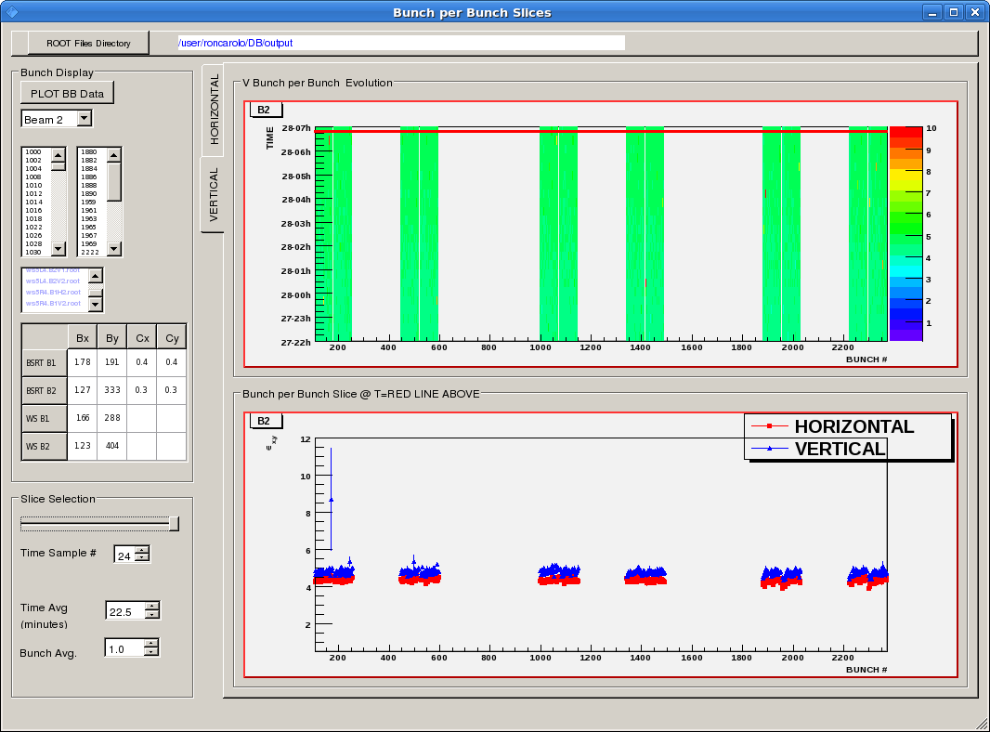
BBB diagnostics: BSRT emittances
Values not calibrated yet
BI expert application to set gates for the bunch scan
Ongoing improvement: manage the acquisition at server level (VK)
Results from TIMBER via another application
Need fixed display with online update of bbb emittances
Volunteers from ex LARP collaboration

Slide 5
BBB diagnostics: ADT pickups
Can give early warnings before ε-blow up
Fixed buffer length: (all bunches) x 73 turns
Looking only at filled slots requires a FESA modification
Presently 2 modes: all slots or any 8 bunches
Now relying on expert apps.
A fixed display could be done, refreshing with > 30 s frequency
PM data for fast growing instabilities would be valuable

Slide 6
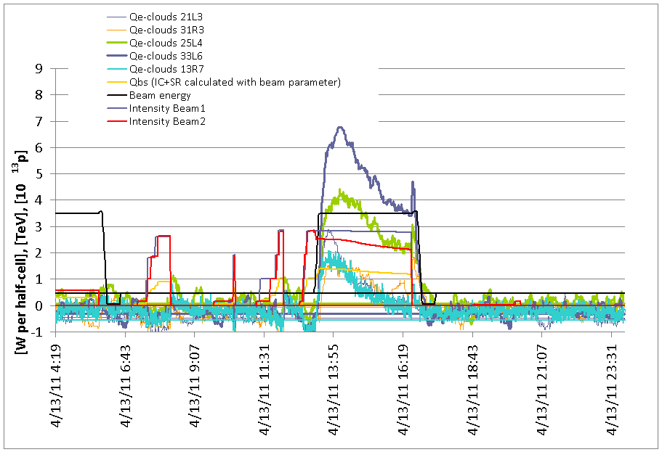
Heat loads
5 calibrated half cells give off line (absolute) values of beam induced heat loads on the beam screens.

Slide 7
Heat loads
Could calibrate more cells, but… need to run with blocked JT valves for that
Valves have minimum openings → will not move for T_{out} < 20 K → T_{out} ~ HL, until the valve moves
PID regulation on T_{out} , after a transient CV [%] ~ HL
Surveying ΔT and valve opening gives an overview of the heating
If the valve has moved, then look only at valve opening, if not look at T_{out}.

Slide 8
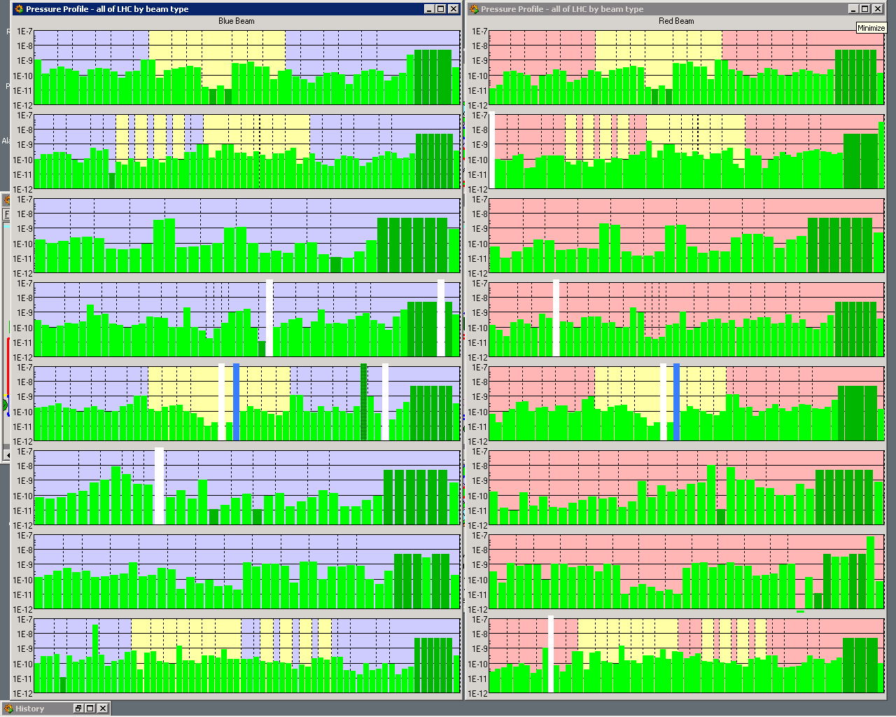
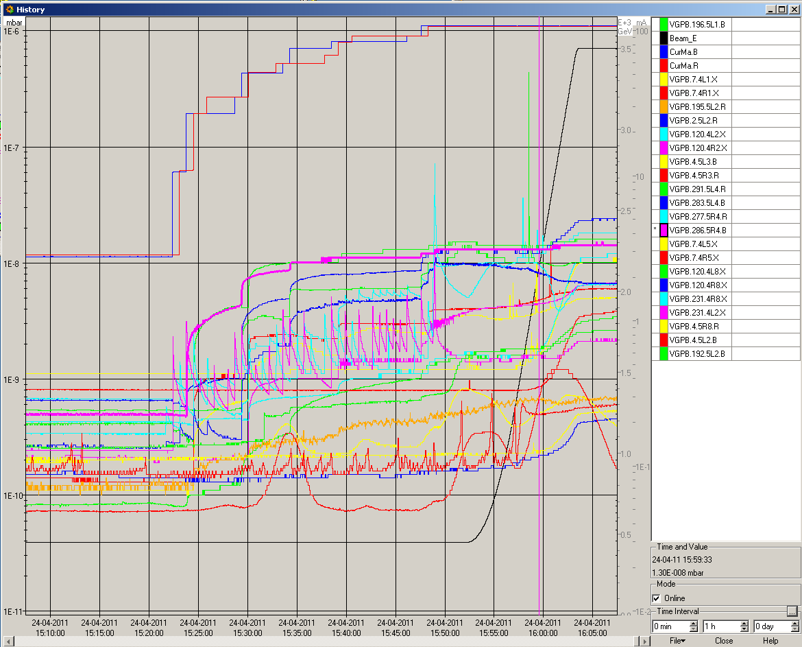
Vacuum synoptic (wrt reference?)

Slide 9
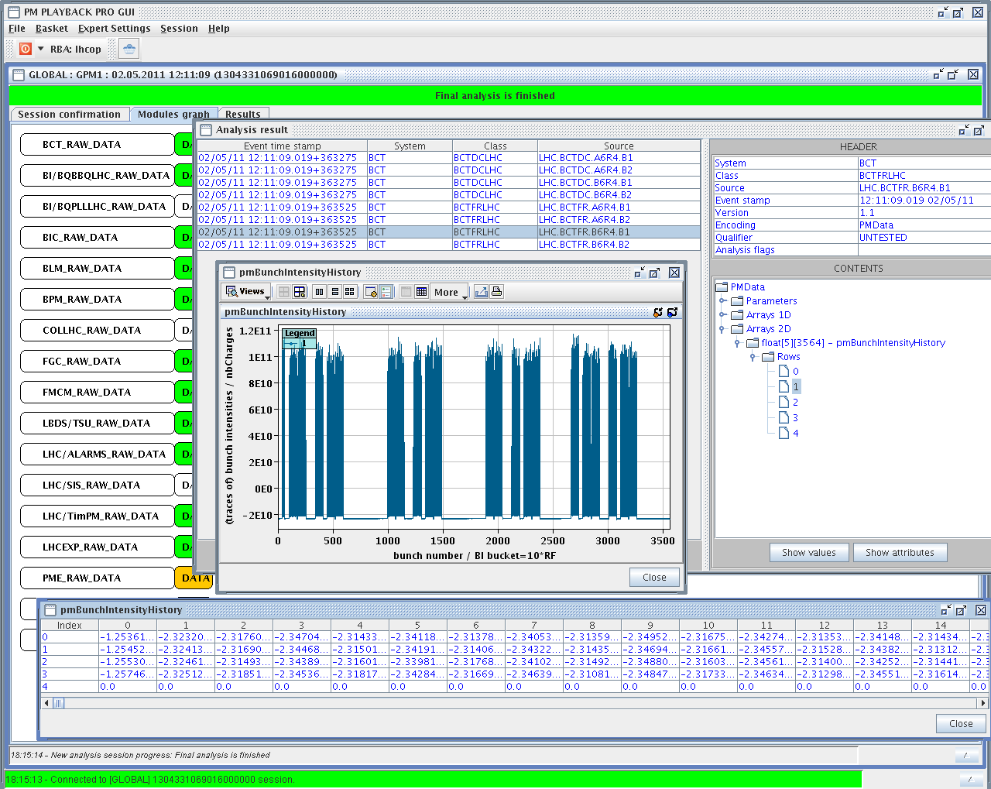
BBB Post Mortem
So far only the FBCT
Wish list:
ADT pickups
Interlocked BPM?
RF ?
…?

Slide 10
Summary
Schottky monitoring of ΔQ, ΔQ’ at injection
Fixed displays for BSRT and ADT pickups
Vacuum and Heat loads from PVSS?
Missing in the PM: ADT, (RF, BPM in IR6 ?)

