Slide 1
Possible impact of longitudinal oscillations
on transverse plane
W. Hofle
Acknowledgements:
S. Redaelli, E. Chapochnikova, T. Bohl, J. Wenninger, G. Arduini

Slide 2
Observations
transients at injection and longitudinal oscillations present for
minutes after injection
→ see MD results (P. Baudrenghien et al.)
occasionally some bunches blow-up transversely
→ looks rather like single bunch effect
chromaticity setting known to be very critical with high number of bunches
Question:
can spread of chromaticity over time, between bunches and
even within a single bunch explain the transverse blow-up ?

Slide 3
Longitudinal parameters at 450 GeV
General parameters (450 GeV):
beam at injection:
LHC voltage not really matched
with higher voltage this year
with respect to incoming bunch
→ numbers to be checked

Slide 4
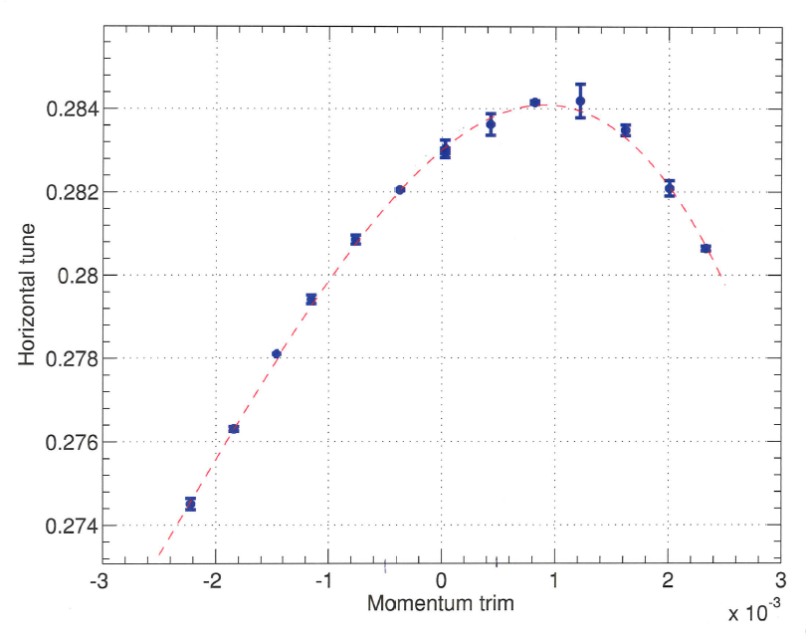
Non-linear chromaticity in 2010
measurements done 02.03.2010, 25.03.2010, 05.05.2010, not measured in 2011 (?)
bunch
horizontal
beam 1
02.03.2010
center moves due to
energy oscillations
+ tides + …
S. Redaelli, 2.3.2010
some changes since March 2010, I understand, in the way
field errors are compensated, need to re-measure these curves

Slide 5
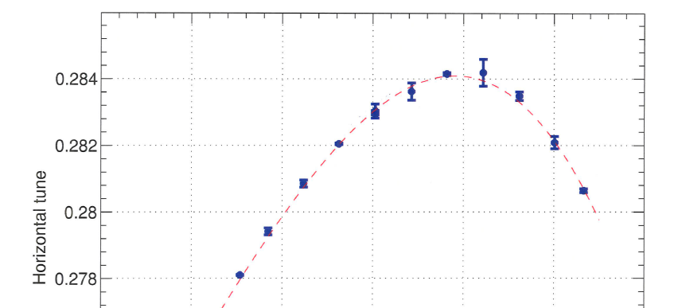
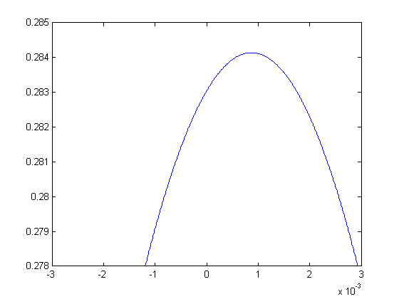
tune versus momentum, details
Parabolic
(quadratic)
looks more linear
quadratic parabolic model
only correct for this case
in vicinity of Q’=0
higher terms needed
(for good fit)
positive Q’
negative Q’

Slide 6
Longitudinal dipolar oscillations
@450 GeV :
+/- 10 degrees phase oscillation
corresponds to +/- 0.76x10⁻⁴ in
momentum excursion
excursions small compared to bucket height
but could bring part of bunch in regions
of non constant Q’

Slide 7
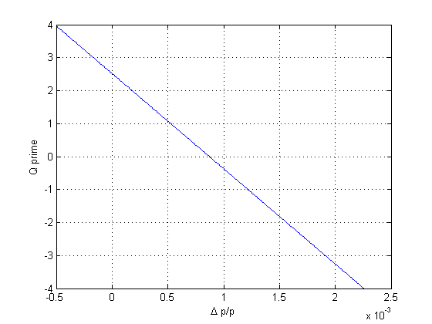
(if) quadratic dependence of tune on momentum
10 degrees
phase oscillation
leads to momentum
excursion resulting
in Q’ modulation
of +/- 0.22 units
“back-of –the-envelop” curve
need new measurement
bunch
with 10 degrees phase oscillation
today machine is operated with a set-point Q’=1 for mean of bunch
but bunch covers: 3-4 units of chromaticity if chromaticity
really as non-linear as in 2010

Slide 8
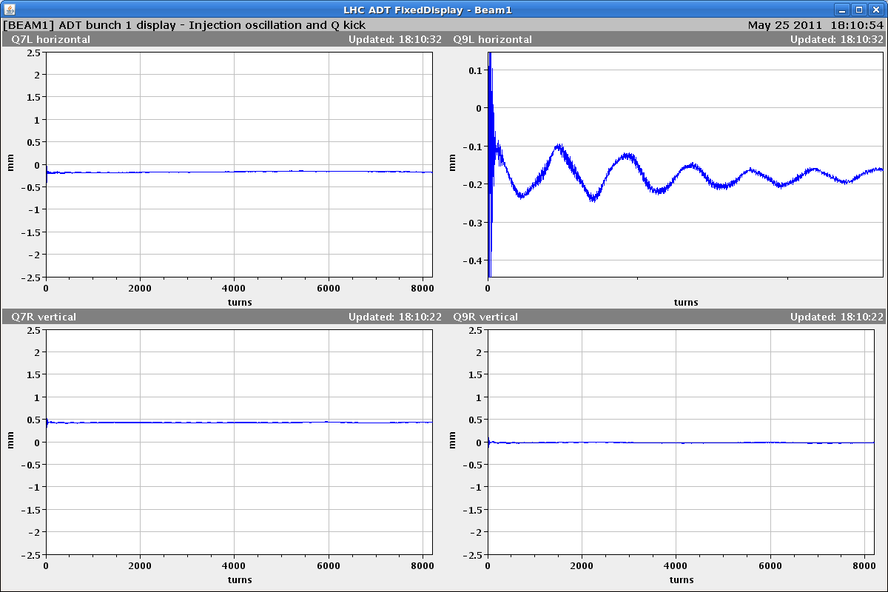
example: horizontal beam 1 injection (last batch)
Q9LH.B1 +/- 0.07 mm @ D=1.1 m
→ dp/p = +/- 0.064e-3
+/- 8.4 degrees
Q’ = +/- 0.18
first bunch of a train injected, data logged, need automatic tool to analyse
fill 1806
912 bunches

Slide 9
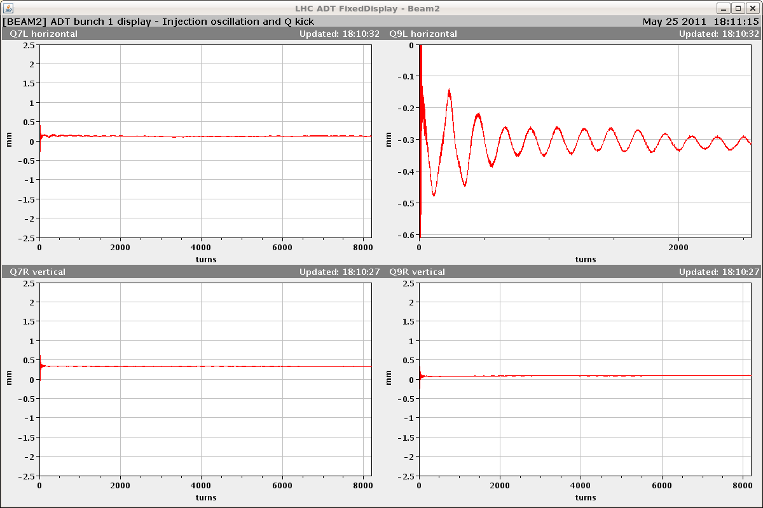
example: horizontal beam 2 injection (last batch)
Q9RH.B2 +/- 0.18 mm @ D=0.9 m
→ dp/p = +/- 0.2e-3
+/- 26.3 degrees
first bunch of a train injected, data logged, need automatic tool to analyse
fill 1806
912 bunches

Slide 10
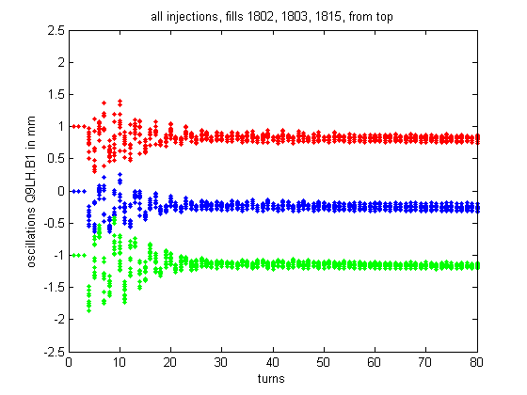
A look at fills 1802, 1803 and 1815 (1)
→ transverse injection oscillations well damped
damping times of less than 20 turns for first bunch of trains
[offset -1 mm, 0 mm, 1 mm added to display curves separately]

Slide 11
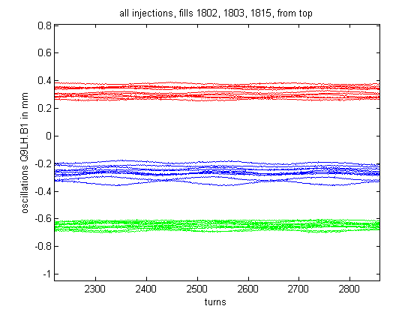
A look at fills 1802, 1803 and 1815 (2)
#1802
#1803
#1815
more longitudinal activity for fill #1803 (bad fill), significant correlation ?
[offset added, -0.5 mm, 0 mm, 0.5 mm to display curves separately]

Slide 12
Recommendation
re-measure non-linear part of chromaticity
check if correlation between transverse blow-up and longitudinal oscillations
also re-visit compensation of tides (?)
damper data from first bunch of every train available in logging,
but only for 8192 turns after injection → to be looked at, improve logging ?
if chromaticity cannot be made flat → theory of stability needs to take this into account
check how procedure of compensating tides moves operating point in non-linear
part of Q vs momentum curve (same for tune and chromaticity adjustments)

