Slide 1
Radiation Induced Faults in QPS Systems during LHC run 2011
R. Denz
TE-MPE-CP

Slide 2
Outline
Introduction
Radiation induced fault statistics 2011
Fault analysis, mitigation and consolidation measures
Summary

Slide 3
Introduction
Due to functional requirements a significant amount of QPS and EE equipment is exposed to radiation during LHC operation
Radiation load depends on location and LHC exploitation
QPS and EE equipment locations
LHC tunnel
Main magnet protection, nQPS, some 13kA EE systems (e.g. point 3)
Partly shielded areas (RR13,17,53,57,73,77, UJ14, 16, 56)
IPQ, IPD, IT, 600 A protection, EE 600 A, EE 13 kA
Protected areas (UA23, 27, 43, 47, 63, 67, 83, 87, UJ33)
IPQ, IPD, IT, 600 A protection, EE 600 A, EE 13 kA
LHC exploitation and expected radiation load
t < LS1: radiation load still below design levels but effects noticeable
LS1 < t < LS2: radiation load at design levels → preparation has to start now
t > LS2: radiation load above design levels
… left to the reader as a homework ;-))
Relocation during LS1

Slide 4
Radiation induced fault statistics 2011 – summary (25.06.2011)
Total events | 48 | %
Destructive events | 0 | 0
Events in unshielded areas (LHC tunnel) | 45 | 93.7
Events in partly shielded areas (UJ14, UJ16, RR53) | 3 | 6.3
Events in shielded areas | 0 | 0
Events causing beam dump | 3 | 6.3
Events causing loss of QPS_OK | 22 | 45.8
Events recorded but transparent to OP | 25 | 52.1
Events affecting DAQ systems only | 43 | 89.6
Events affecting detection systems | 5 | 10.4
Events causing total loss of magnet and/or circuit protection | 0 | 0
Events requiring access to LHC | 18 | 37.5

Slide 5
Radiation induced fault statistics 2011 – fault types
Equipment | Events | Electronic component | Remarks
DQAMC (DAQ system) | 41 | ISO150™ digital isolator | Capacitive transmission path upset causing permanent DAQ trigger
DQAMC (DAQ system) | 2 | uFIP™ fieldbus coupler | Old version, one event confirmed, the other could be as well due to a faulty circuit board (exchanged)
DQQDG (quench detection system 600 A) | 2 | SDRAM or DSP | Firmware stalled, system reset by watchdog causing circuit trip (UJ14 and UJ16)
DQQDI (quench detection system IPQ) | 1 | SDRAM or DSP | Not confirmed as also non radiation induced problems seen in concerned area (RR53)
DQQBS (nQPS splice protection) | 2 | ADuC834™ internal RAM | Firmware stalled. No immediate action required, possible firmware updates in DS areas

Slide 6
The main problem: permanent trigger on DAQ systems type DQAMC

Slide 7
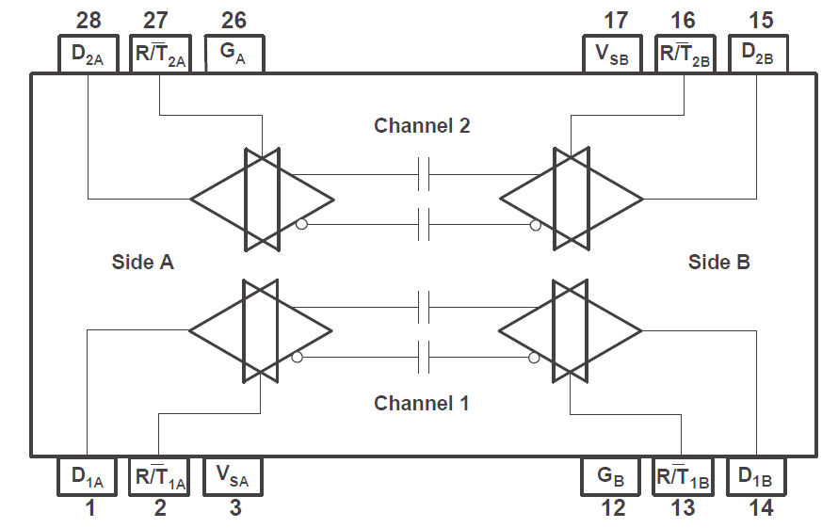
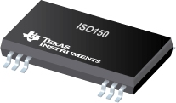
Fault analysis, mitigation and consolidation measures I
Permanent trigger on DAQ systems type DQAMCMB and DQAMCMQ (main magnet protection)
See TE-MPE-TM 14-04-2011 http://indico.cern.ch/getFile.py/access?contribId=0&resId=0&materialId=slides&confId=135289
Fault caused by a SEU in a digital isolator (capacitive isolation)
BiCMOS, isolation strength 2.4 kV rms (partial discharge during 1s)
5V operation, critical charge estimated to Q_{C} ≈ 2 pC,
Significantly (at least a factor 10) higher as for SRAM
RADMON uses SRAM for SEU counting
0.4 pF

Slide 8
Fault analysis, mitigation and consolidation measures I
Firmware upgrade for DQAMCMB and DQAMCMQ as first mitigation measure
Development and testing concluded, deployment started
Change from level to falling edge trigger
Prevents DAQ system from stalling and avoids access
Fault indicated by a status flag (ST_DQAMC_BUS) not part of the QPS_OK signal
Add secondary software trigger to keep post mortem functionality
Trigger associated to U_HDS_1 signal (< 800 V)
Additional benefit: records as well all quench heater discharges triggered only by nQPS
Solves a known nQPS problem
Additional upgrade: 3 out of 4 condition for MB quench heater power supply availability (no injection inhibit in case of loss of 1 power supply)

Slide 9
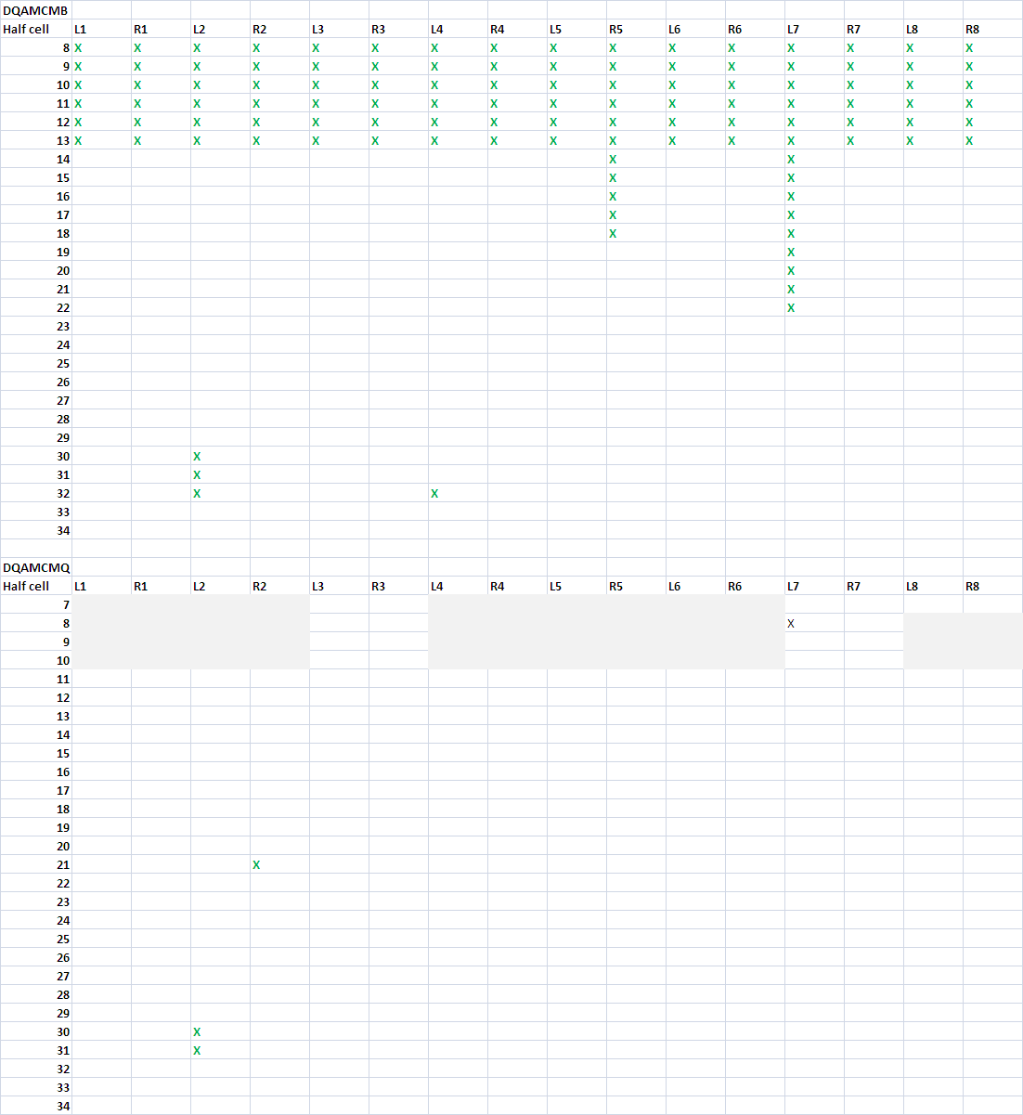
Fault analysis, mitigation and consolidation measures I
Progress of deployment
22% of DQAMCMB
1% of DQAMCMQ
To be continued during upcoming technical stops and other downtimes; to be completed during winter technical stop 2011/2012
No remote firmware update possible

Slide 10
Fault analysis, mitigation and consolidation measures II
Loss of fieldbus communication of DAQ systems type DQAMC
Failure of the fieldbus coupler chip (MicroFip™)
So far only two cases observed concerning the old version of the chip
Radiation tests performed by QPS in CNRAD 2009 and 2010 showed this kind of problem with both versions of the chip
Fault state can be cured by a power cycle, an auto power cycle option has been already successfully tested in CNRAD 2009
Version | Technology | QPS Equipment | Qty
VLSI Technology 9838 N363921 / Philips 0246 Y42350Y1 | 0.6 µm | DQAMC, DQAMG, DQAMS | 2098 (1624 inside LHC tunnel)
ON Semiconductor 0907LNP 15016-530 / AMI Semiconductor 0839LXT 15016-530 | 0.5 µm | DQAMGS (nQPS) | 436 (all inside LHC tunnel)
By far more problems due to bad electrical connections and power losses.
On the long term MicroFip™ will be superseded by the “hopefully” radiation tolerant NanoFip^{CERN}.

Slide 11
Fault analysis, mitigation and consolidation measures III
Spurious trigger of 600 A digital quench detection systems (type DQQDG)
2 events observed so far, both during stable beam conditions
Concerned systems installed in relatively exposed areas UJ14 and UJ16
Event analysis shows that at least in one case the system has been reset; the circuit trip occurred during restart of the device with powered magnets
Without human or sequencer intervention the device can only be reset by the onboard watchdog chip in case program execution is stalled (watchdog not refreshed)
During operation code is stored in external SDRAM (3.3 V)
The circuit trip during reset with powered circuits is a known problem, which could probably be overcome by a modified firmware version
A spurious trigger possibly related to a SEU has also been observed with an IPQ quench detection system (type DQQDI)
Detector hardware is almost identical to DQQDG but different firmware and detection algorithm used
One suspicious case observed during squeeze – all other cases due to EMC

Slide 12
Summary
During LHC run 2011 so far 48 (46 confirmed, 2 very likely) radiation induced faults have been observed
Fault analysis to be done very carefully before coming to conclusions
In general poor statistics ;-))
Non radiation induced faults may show similar symptoms
None of the observed events caused a total loss of magnet and/or circuit protection
Redundancy of the protection systems is essential
Solutions for mitigation and consolidation have been elaborated and deployment has started in some cases
Priority is given to events requiring access to LHC or causing beam dumps
Maintenance of radiation tolerant electronics requires a continuous effort
Discontinued electronics is a major problem especially for all digital parts

