Slide 1
Analysis of MD on IR1 and IR5 aperture at 3.5 TeV – progress report
C. Alabau Pons, R. Assmann, R. Bruce,
M. Giovannozzi, G. Müller, S. Redaelli F. Schmidt, R. Tomas, J. Wenninger, D. Wollmann
Introduction
Method for 3.5TeV and summary of results
Checks of assumptions with MAD-X
Preliminary conclusions
Acknowledgements: S. Fartoukh, M. Lamont

Slide 2
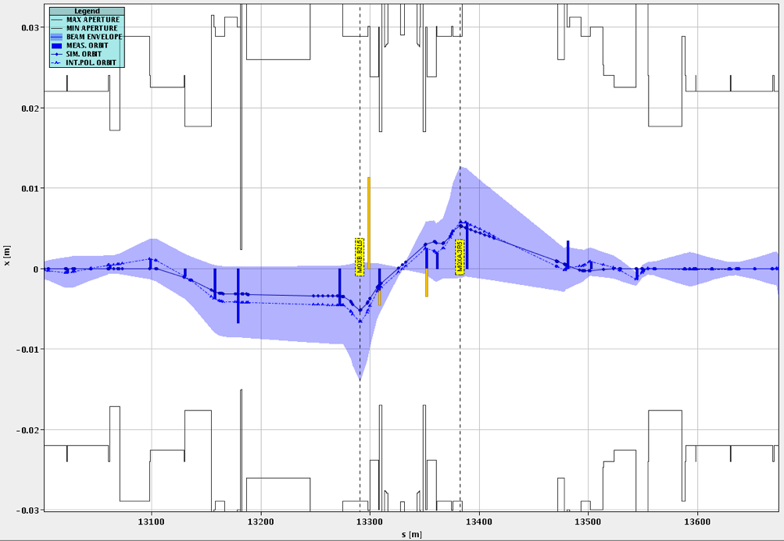
Proposal for 3.5 TeV measurements
TCTH.4L1
6 sigma envelope
IP5
Unlike at injection, we cannot lose the full beam!
We have to be very careful with damage and quenches, even with pilot beam!
Idea: local bumps in the triplet with safe, blown-up pilot bunch and tertiary collimators to protect the triplet
Even if we planned to work with safe beam, a detailed planning was submitted to rMPP for approval.
Selective emittance blow-up tested in the MD with the ADT: looks very promising and opens the path for efficient measurements at top energy.
Thanks to ATLAS, CMS: special BCM settings

Slide 3
Example of 3.5 TeV measurement
Procedure for “gentle” measurements:
1. Open TCT by 0.5 sigma (250-320μm in H-V)
2. Increase bump by 0.25 sigma 3. Check relative height of BLM spikes: TCT vs MQX (Q2)
Start from initial settings: TCTs at 11.8 sigmas.
Orbit at TCT and Q2
TCT positions [mm]
18.8 σ
18.3 σ
17.8 σ
Q2 losses [Gy/s]
Loss spikes while the orbit is increased, touching TCT or MQX
TCT losses [Gy/s]

Slide 4
Summary of IR1/5 scans (preliminary)
Figures quoted in the eLog, from online estimate: http://elogbook/eLogbook/eLogbook.jsp?lgbk=60&date=20110826&shift=1
IR1 - H (Sep) -> 19.8 - 20.3 sigmas
IR1 - V (Xing) -> 18.3 - 18.8 sigmas
IR5 - H (Xing) -> 19.8 - 20.3 sigmas
IR5 - V (Sep) -> > 20.3 sigmas
Resolution: 0.5 sigmas from TCT step size
The quoted results are the TCT opening!
This means that we had to open the TCT by 6.0-7.5 sigmas to “see” the triplet aperture. Present assumptions: 2 sigma retraction.
Results in logbook relying on assumption:
(“TCT opening in  when triplet is touched corresponds to triplet aperture
around reference orbit in ”)
Seems reasonable, since
and
(phase advance small).
But the phase advance is not exactly zero.
Check with MAD-X how well this assumption holds!

Slide 5
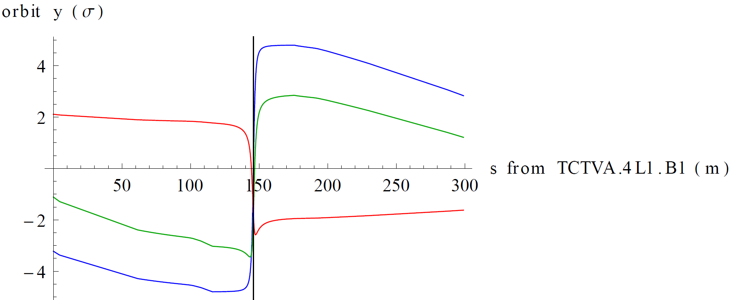
Checks with MAD-X
Example: closed orbit in IR1 V from crossing angle only (blue), random kicks in IR6 (red), both (green)
Orbit in  roughly constant as assumed when kicks are far away, but not for crossing bump
IP1

Slide 6
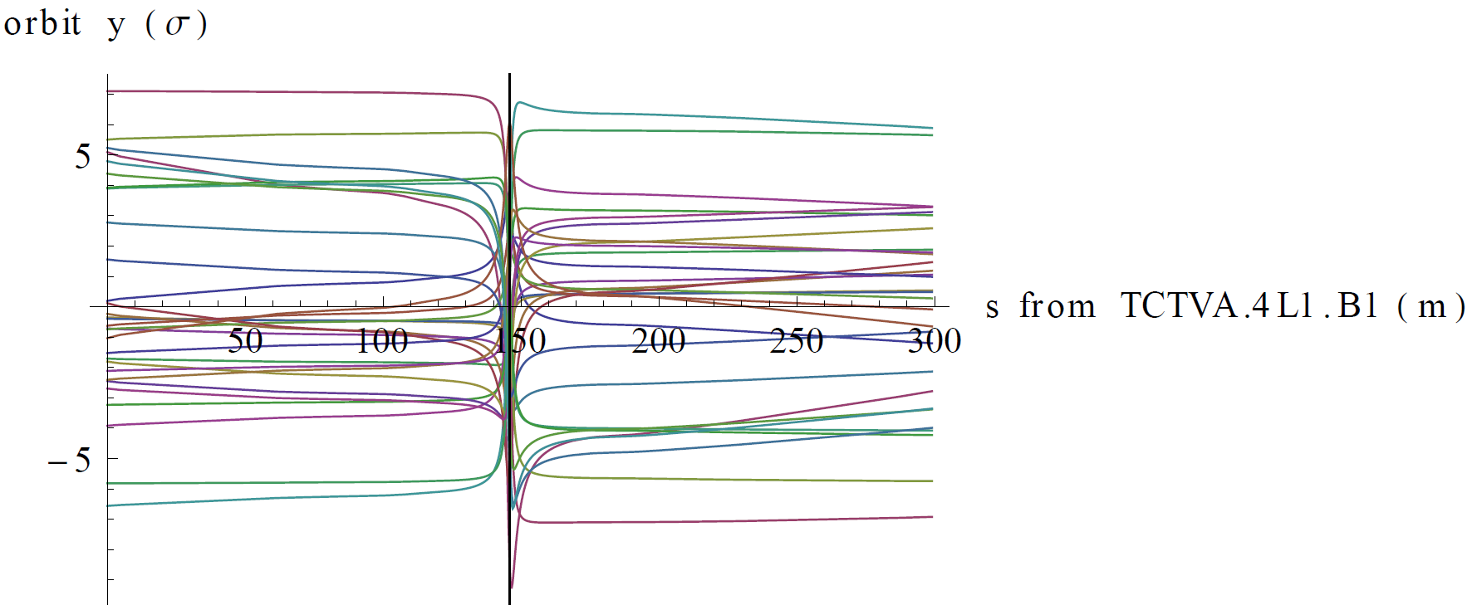
Closed orbits from random kicks
Several cases simulated with kicks distributed around ring (no crossing angle)
Orbit approximation very good in most cases, but not all
Explanation: if is also small (modulo pi) it can give quite different contributions at TCT and triplet

Slide 7
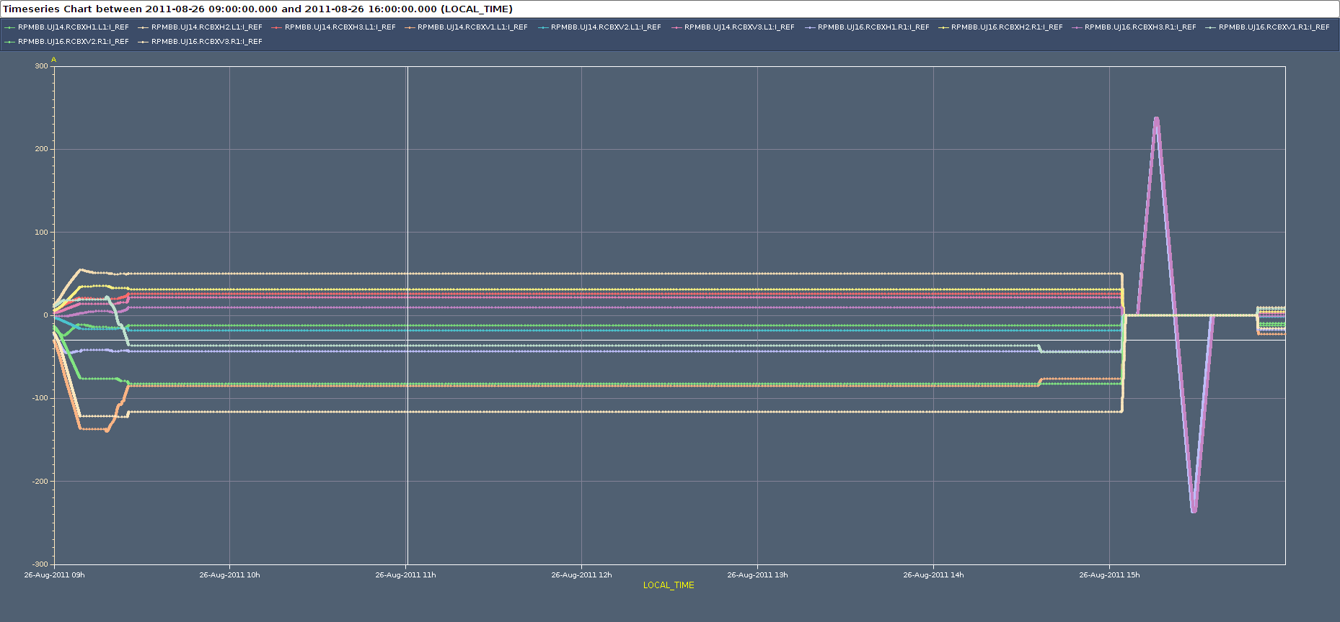
MCBX contribution
In addition, kicks between TCT and triplet can change the retraction
MCBX correctors powered (but constant) during measurements

Slide 8
Intermediate conclusions
The assumption that the triplet aperture equals the TCT opening when triplet is touched is only true when phase advance to kicks is large
In particular, this is introduces an uncertainty when applied to the crossing bump
Furthermore, it assumes no kicks between TCT and triplet. This is not true – MCBXs used for global correction (although constant during measurement)
Therefore, the TCT opening when triplet is touched could be slightly different with a different bump shape and/or MCBX settings.
Safer to calculate the triplet aperture locally, using the orbit in the triplet and not the TCT

Slide 9
Comparison: a few numbers in mm
Model BPM (COXing+ ΔCObump)
450 GeV IP5-H (crossing) COXing = 8.0 mm (170 μrad) ΔCObump = 8.3 mm 14. mm nσ x σ = 16.0 mm 16. mm Amm = 32.3 mm 30 mm
Model BPM (COXing+ ΔCObump)
3.5 TeV IP5-H (crossing) COXing = 5.8 mm (120 μrad) ΔCObump = 17.7 mm 24.4 mm nσ x σ = 4.8 mm 4.8 mm (nσ = 4) Amm = 28.3 mm 29.2 mm
Mechanical aperture: 28.9 mm (30 mm without tolerance)
The aperture around the reference orbit is ~18.5 . In this case we lose ~1 compared to estimate from TCT opening.
Ongoing work: detailed data analysis from C. Abalau

Slide 10
Preliminary conclusions
We measured gently the aperture in the triplet region at 3.5 TeV.
Triplets in the shade of the TCT
We introduce an uncertainty when inferring the triplet aperture from the TCT opening, except for the used bump shape and MCBX settings.
Aperture better estimated from local data (orbit and beam envelope) in the triplet. Ongoing work (C. Abalau)
Comparison with previous injection measurements show that figures in IR5 are consistent with a few millimeters. Other IRs under way.
Triplet aperture compatible with a well-aligned machine, a well centered orbit and a ~ design mechanical aperture (small tolerance).

