Slide 1
LHCb External V Crossing Angle
J. Wenninger, D. Jacquet, R. Alemany
B. Holzer, W. Herr
R. Bruce

Slide 2
LHCb External V Crossing Angle
Reminder:
HOR: Ext H Crossing Angle + LHCb dipole
VER: Separation plane
Issues:
For LHCb dipole negative polarity, the beams at the 1st 25 ns parasitic encounters are not separated enough and therefore when running at 25 ns this polarity is forbidden.
Different total crossing angles = f( LHCb polarity)
Different machine settings
Systematic uncertainty in the vertex determination
First proposal for a solution ➔ W. Herr and Y. Papaphilippou, LHC Project Report 1009 (Jan 2007) & Also MD4 2011

Slide 3
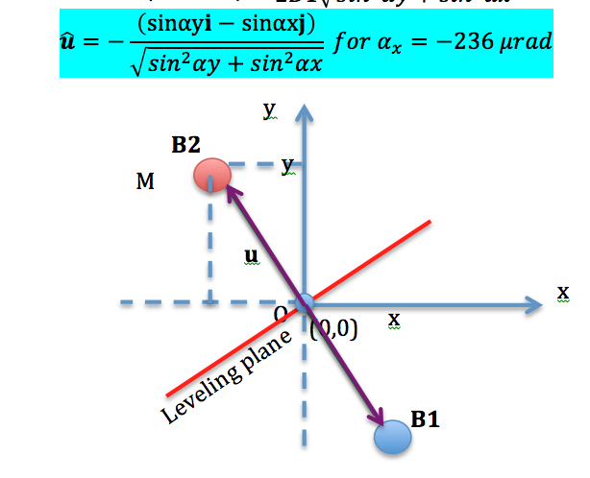
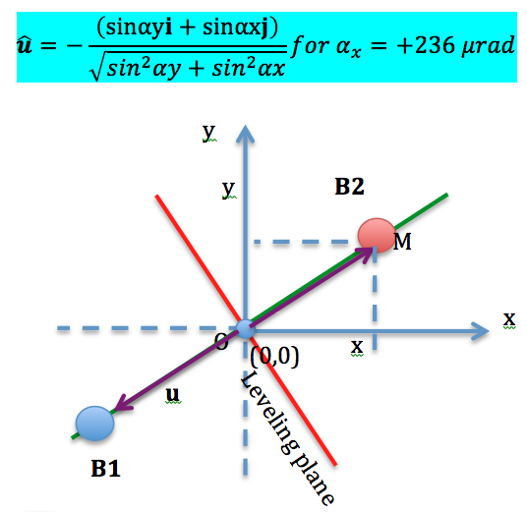
Proposed Solution:
Eliminate the External H crossing angle
Introduce an External V crossing angle

Slide 4
GOALS:
Determine if different tertiary collimators (TCT) settings are needed as a function of the LHCb polarity;
Identify a method that satisfies the following requirements:
No head-on collisions are built up during the process;
The beam separation at the 50 ns encounters is ≥12σ in at least one of the planes or in the tilted plane.
Be to be able to keep the ≥12σ separation at the first 25 ns parasitic encounter.

Slide 5
Operational scenarios analyzed
The following three methods have been investigated:
METHOD 1:
Reduce the vertical separation in IP8 to 2x100 μm between both beams.
Separate the beams horizontally to 2x42 μm. In this way the beams lie already along the leveling direction.
Build up the vertical crossing angle as fast as possible (dI/dt=0.667 A/s d²I/dt²= 0.25 A/s² ➔ commissioned parameters). If only the orbit correctors for lumi-scans are used, the minimum time is 50 to 60 s (if the parabolic part is taken into account)
“At the same time” reduce the external horizontal crossing angle from 250 μrad to 0 μrad.
METHOD 2:
Reduce the vertical separation in IP8 to 2x100 μm between both beams.
Build up the vertical crossing angle as fast as possible.
Separate the beams horizontally to 2x42 μm. In this way the beams lie already along the leveling direction.
Reduce the external horizontal crossing angle to 0 μm.
METHOD 3:
Build up the vertical crossing angle as fast as possible.
Reduce the external horizontal crossing angle to 0 μm.
Bring both beams to the leveling direction for a vertical separation of 2x350 μm and a horizontal separation of 2x148 μm.

Slide 6
Conclusions
No dependence on the TCT settings as a function of the LHCb dipole polarity is observed.
During the collapsing of the external horizontal crossing angle and the building up of the vertical crossing angle, the TCTs will have to follow the beams accordingly.
At the end of the process due to the effect of the LHCb dipole polarity, there is a < 1σ beam position difference for each polarity which would have to be absorbed within the same collimators settings.
The methods analyzed satisfy the requirement of not having head-on collisions .provided the polarity of the vertical crossing angle is properly chosen (in this study B1: 100 μrad & B2: -100 μrad) There is always a moment during the procedure when the beams collide at some point along the s coordinate during some seconds.
For small vertical separation of the beams, it can be guaranteed that the smallest beam separation at the first 50 ns encounter is never lower than 10 σ.
Only method 2 guarantees a separation ≥ 8σ during the whole process EVEN FOR 25 ns.

Slide 7
No TCT settings dependence with LHCb polarity

Slide 8
< 1σ beam position difference for each polarity which would have to be absorbed within the same collimators settings.

Slide 9
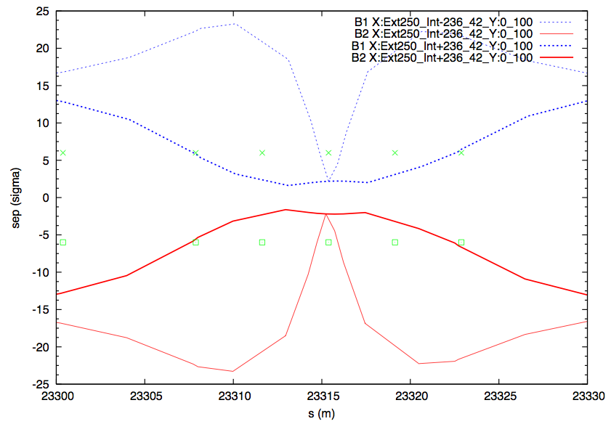
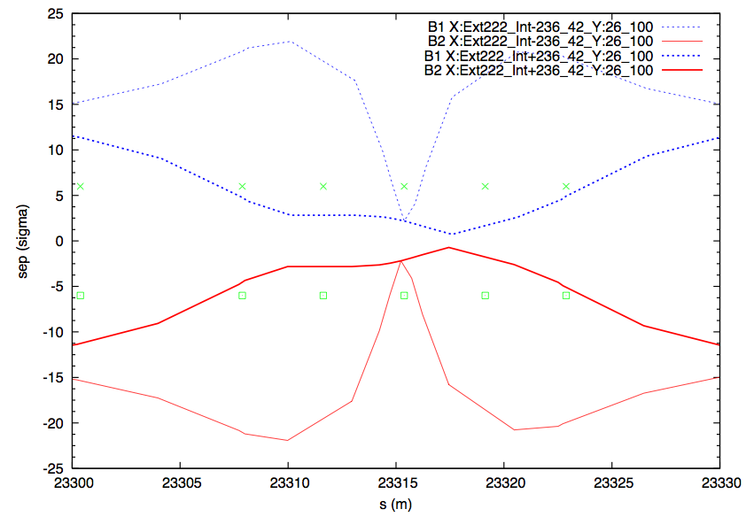
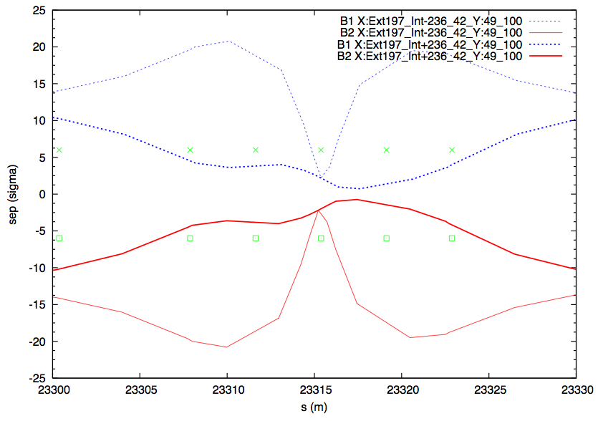
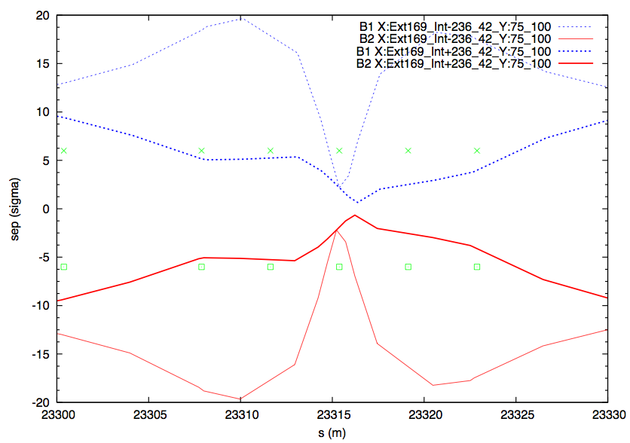
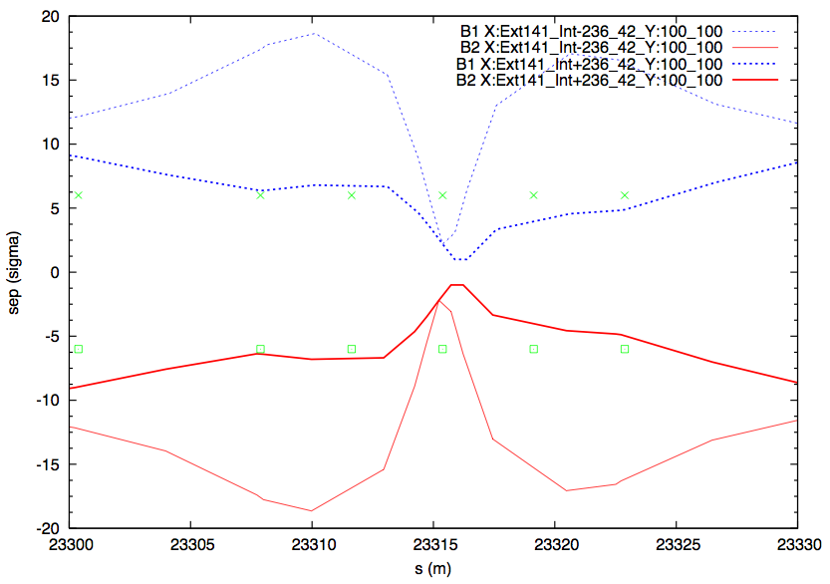
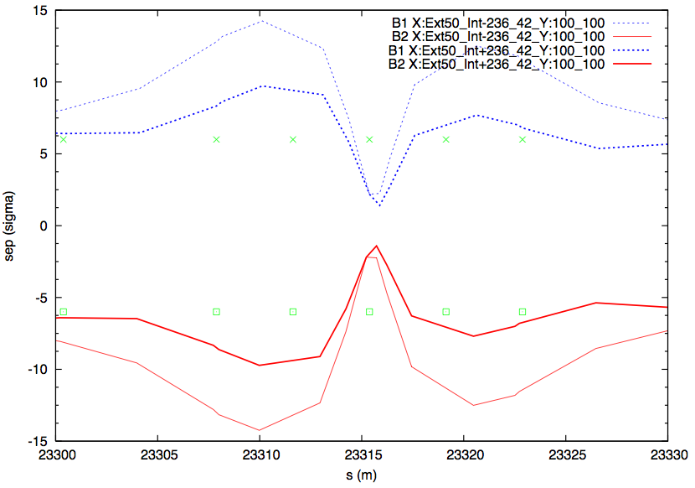
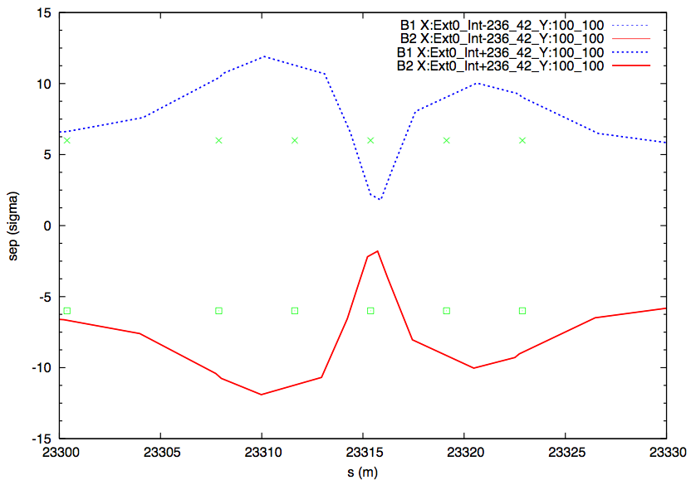
METHOD 1
±6σ

Slide 10
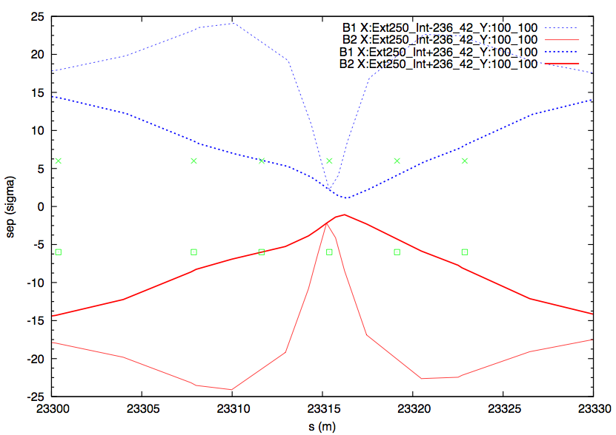
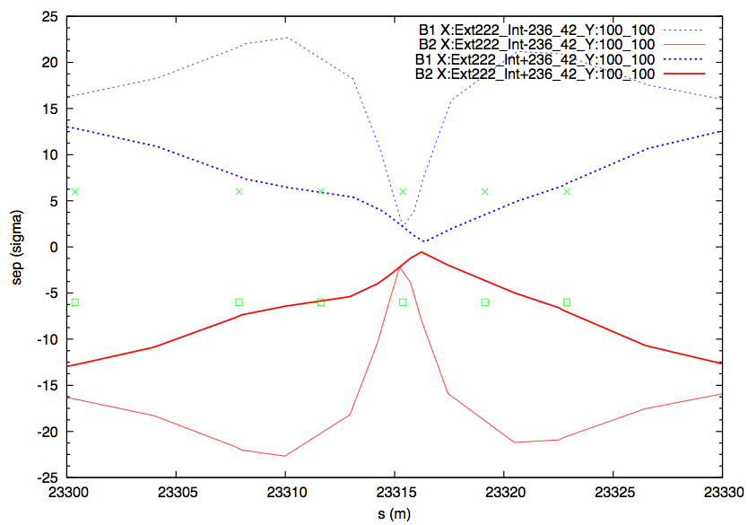
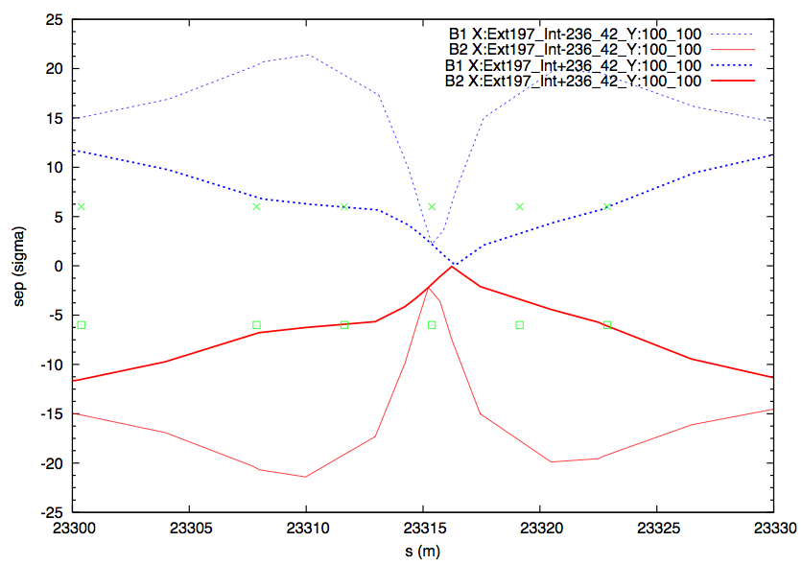
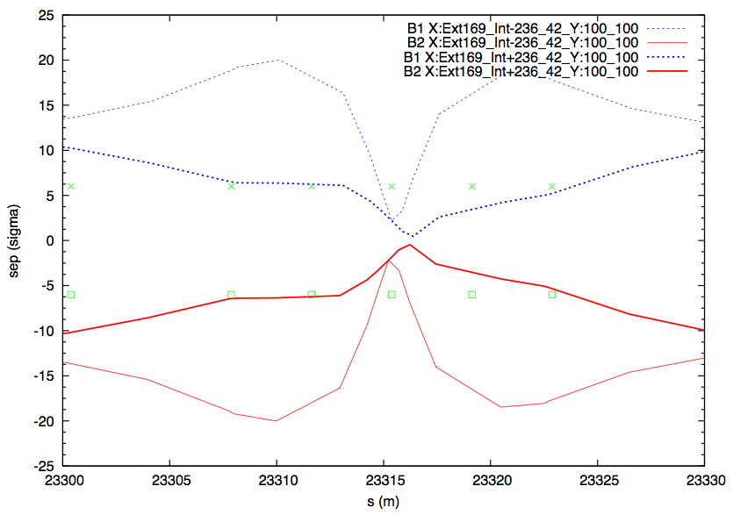
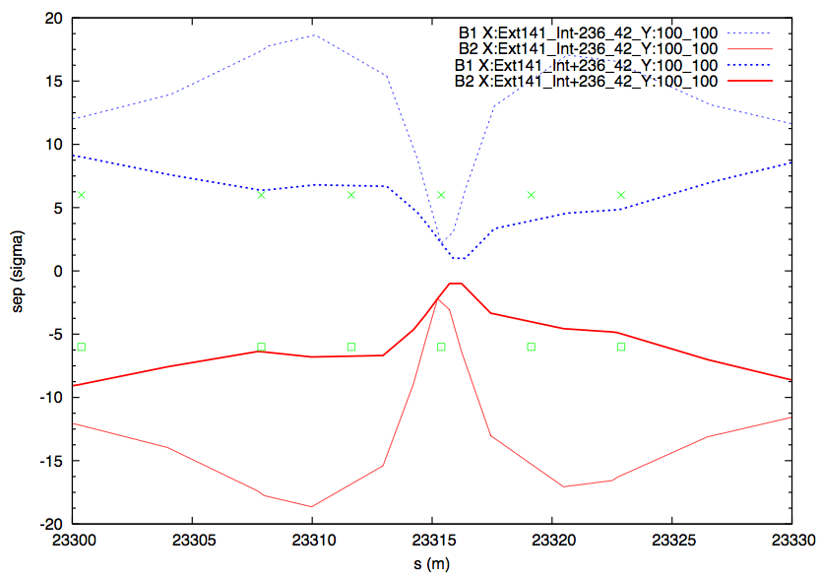
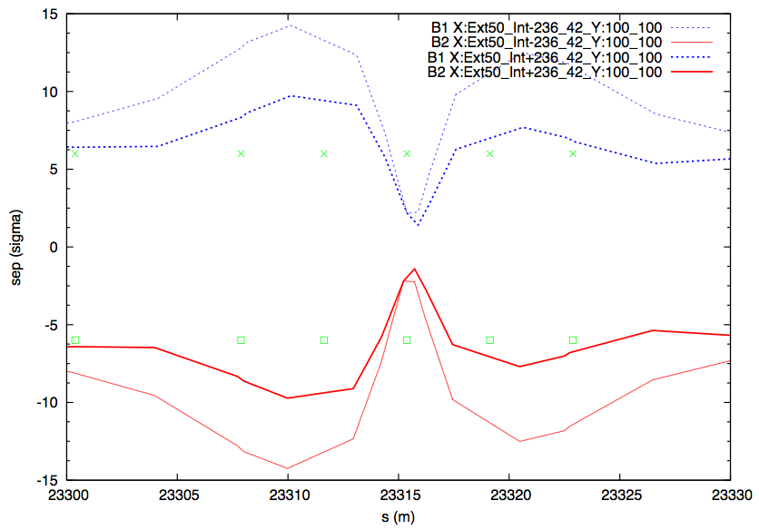
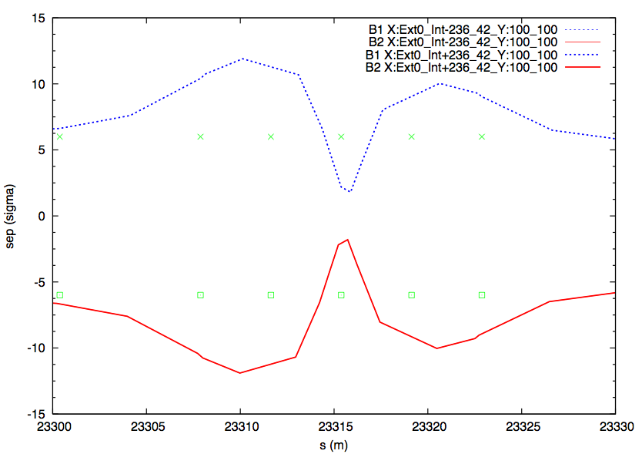
METHOD 2
±4σ

Slide 11
Current status
The procedure works if:
We accept a max of 8σ beam separation at the 1st 25 ns encounters.
Collimators accept an asymmetry of < 1σ in the TCT settings w.r.t. beam position
Time estimate is 3 to 4 minutes ➔ fits in the 393 s from IP8 β*=3 m to end of collision BP
However, the functions will have to adapt to the stopping points during the squeeze of IP1/5
Vertical Crossing angle created in madx
KNOBS under construction
Lumi-scan application being adapted
The best solution (to our knowledge) is if aperture available at injection ➔ do this at injection

