Slide 1
Ramping faster?
Mike Lamont
Ralph Steinhagen

Slide 2
Parabolic
I’(t) = 0 to avoid a voltage discontinuity
“it has been shown that if I’(t) is kept low at the end of the snapback, the bandwidth of the control system required to dynamically correct this error can be substantially reduced.”

Slide 3





Exponential (from PN172)
the magnetic field error produced by inter-strand coupling current (and by other types of eddy currents) is proportional to the ramp rate B’ (t). Therefore, at a constant ramp rate the relative field error i cpl b is highest at low fields.
The magnitude of this error can be optimized to be constant if the magnetic field ramp function B(t) is an exponential while ramping in such a way that with
In fact: .. negligible for all harmonics

Slide 4

Linear & parabolic round-off
Linear – dictated by MB maximum ramp rate of 10 A/s
Plus parabolic round off

Slide 5
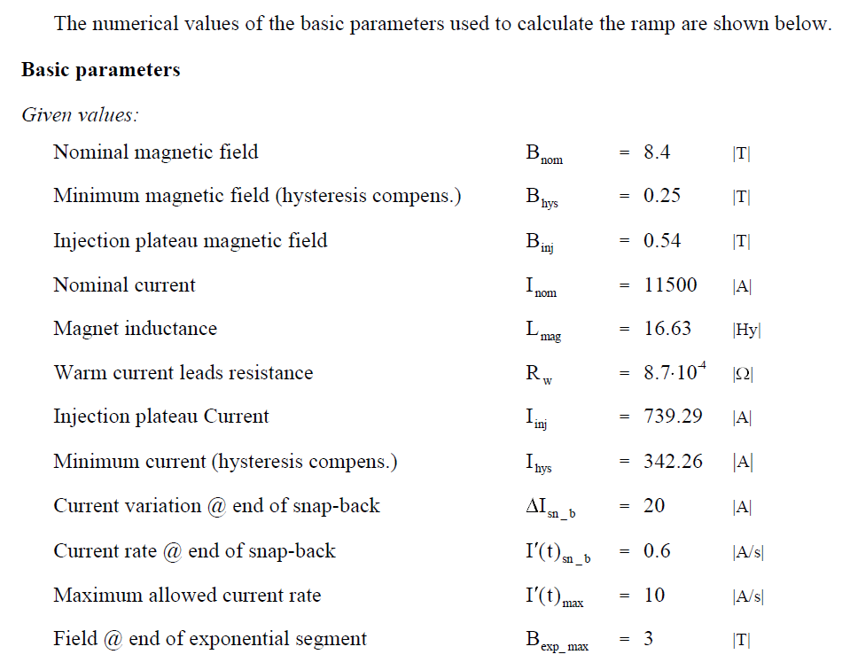
Ramp parameterization

Slide 6
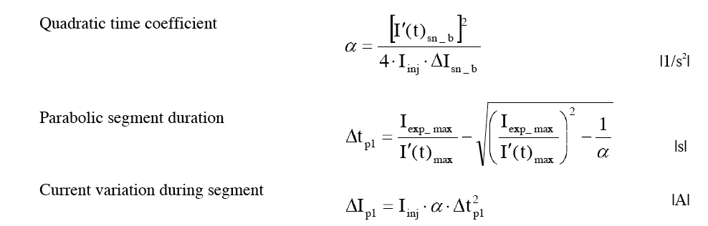
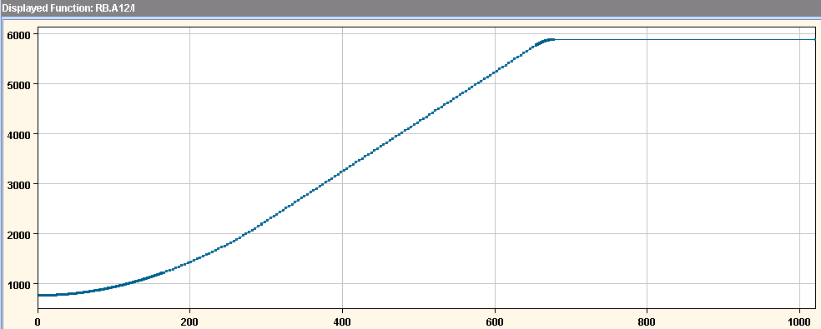
Snuggly fit the bits together

Slide 7
Faster?
 | ΔI_{sb} | didt end snapback | B@end exp | alpha | Length Ramp [s]
design | 20 | 0.6 | 3 | 5.9e-6 | 1095
2011/2012a | 12 | 0.9 | 1.6 | 2.2e-5 | 760
2012b | 6 | 1.2 | 0.9 | 7.9e-5 | 653
2012c | 4 | 1.4 | 0.8 | 1.6e-4 | 632
 | alpha | I@20s [A] | didt@20s [A/s]
Design | 5.9e-6 | 762 | 0.18
2011/2011a | 2.2e-5 | 767 | 0.675
2012b | 7.9e-5 | 784 | 2.4
2012c | 1.6e-4 | 809 | 4.9

Slide 8
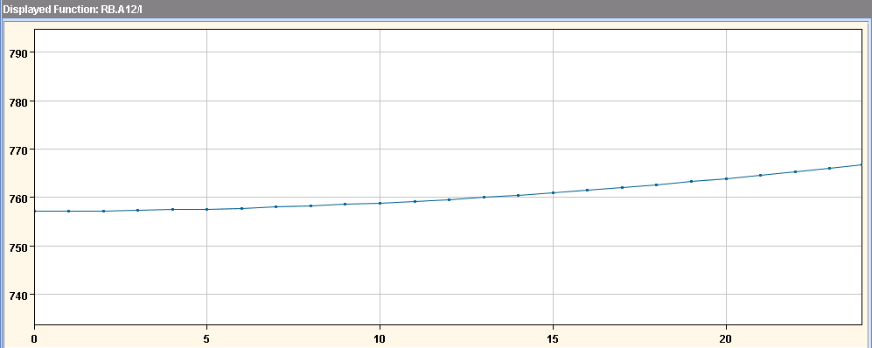
2011
6.7 A

Slide 9
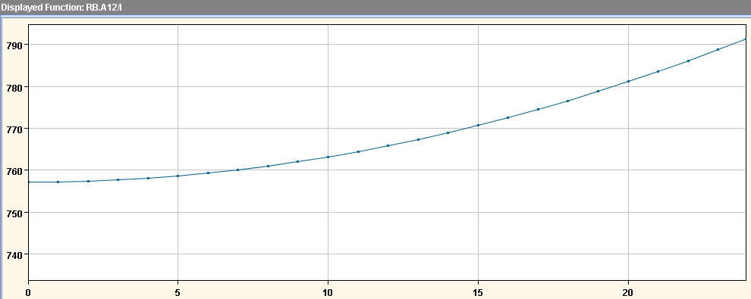
2012b
23.9 A

Slide 10
Snapback
Bottura & Sammut – Cham XIV

Slide 11
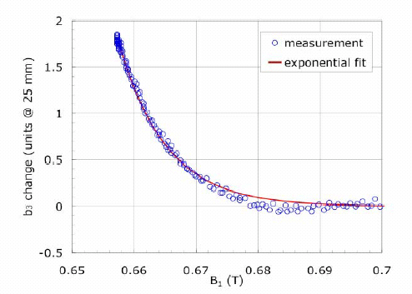
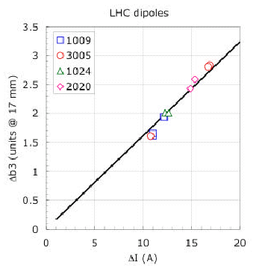
Snapback – Q’
Fit snapback:
I(t) – MB current at time t
I_{injection} – injection value of current
Δb₃ and ΔI are fitting constants
Δb₃ and ΔI are correlated
Sextupole compensation during snap-back in collaboration with FNAL – Luca Bottura

Slide 12
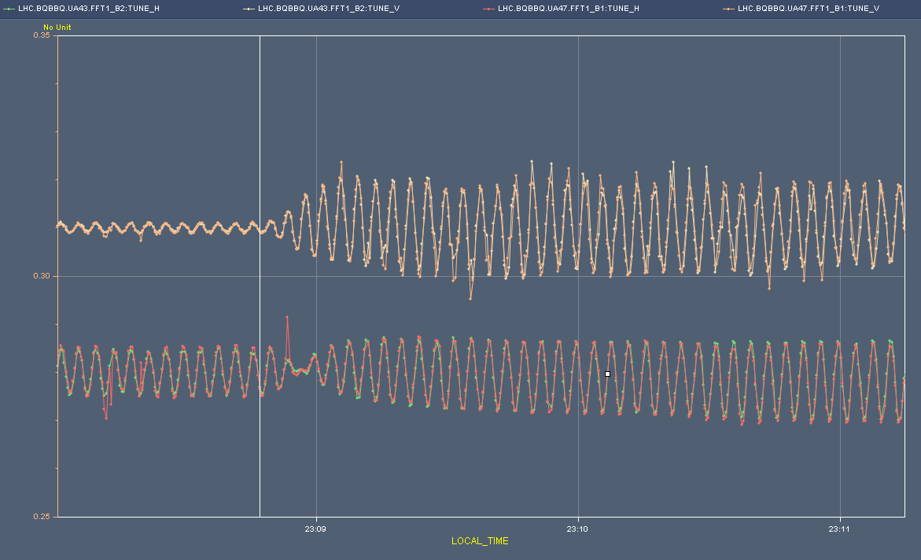
1545 – no corrections(t)
Tune modulation up ramp

Slide 13
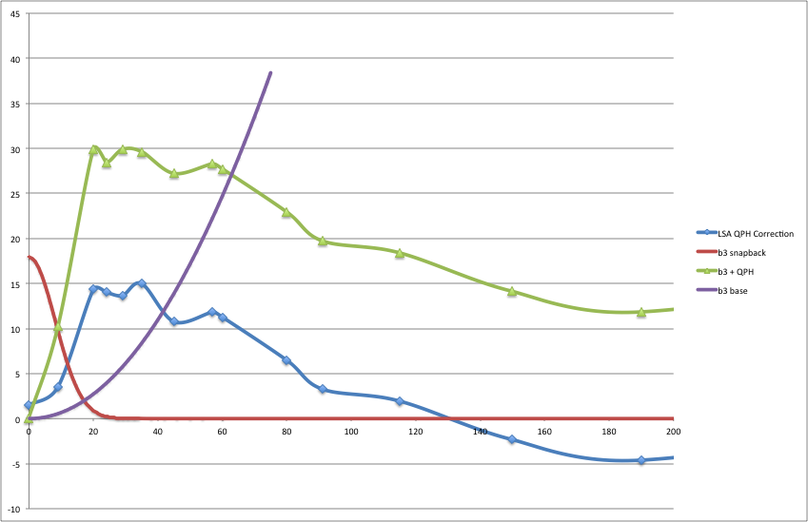
1580: QPH correction
Faster ramp, faster snapback -
less well compensated by model

Slide 14
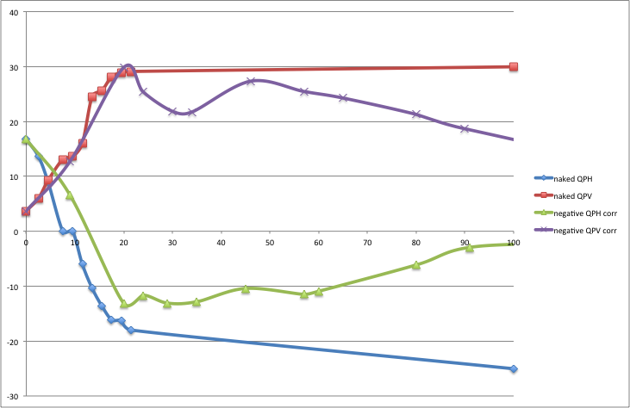
Naked versus correction

Slide 15
Conclusions
Could save a couple of minutes by aggressive parabolic start
Might worry about:
  b3(t) – effective correction
    Could measure and adjust model
  Ability to accurately measure Q’
  Bandwidth of tune feedback
  Other systems – RF…

