Slide 1
Sources of Orbit Perturbations in the Squeeze
M. Solfaroli Camillocci, S. Redaelli,
M. Lamont, G. Kruk,
J. Wenninger

Slide 2
Outline
Recap from 2011
See also LBOC on 29.11.2011
Simulations for the 2012 squeeze
Conclusions

Slide 3
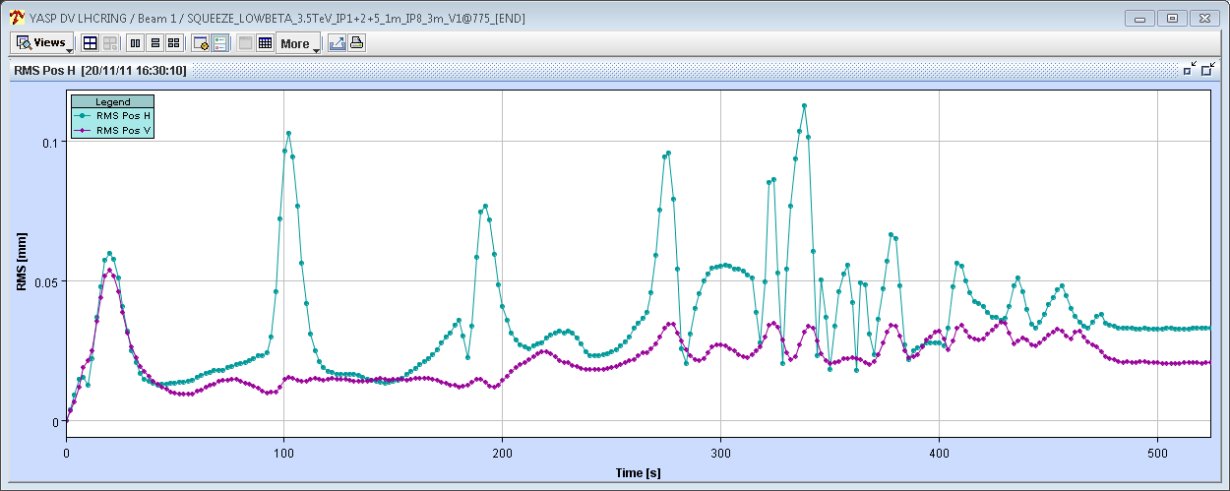
Recap 2011 : Orbit excursions in the squeeze
Observed excursions along the squeeze (here squeeze to 1.5m):
Localized near the matched points. Spikes of 0.1 mm r.m.s. developing over ~10 seconds.
More pronounced in H plane.
Reproducible from fill to fill.
Beam1
H
50 μm
V
Fill 2306, r.m.s wrt first orbit (BPMs in Xing and separation bumps excluded)

Slide 4
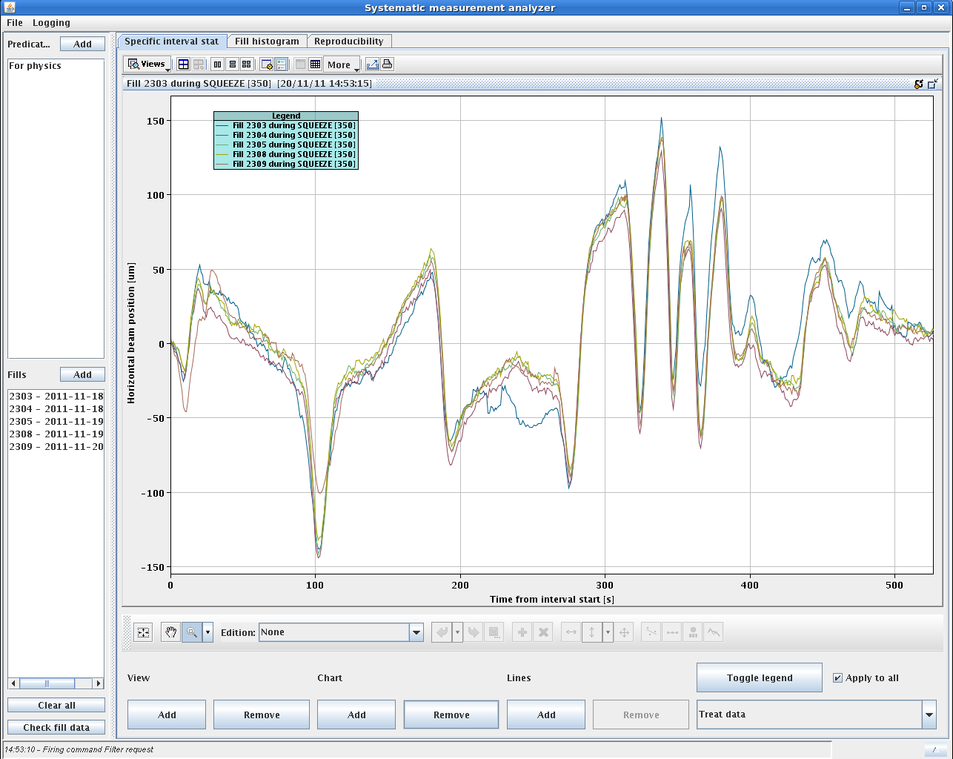
Recap 2011 : reproducibility
Orbit at a selected BPM for a couple of fills.
Very reproducible, sharp transients at the matched points.
Manual feed-forward attempt
S. Redaelli

Slide 5
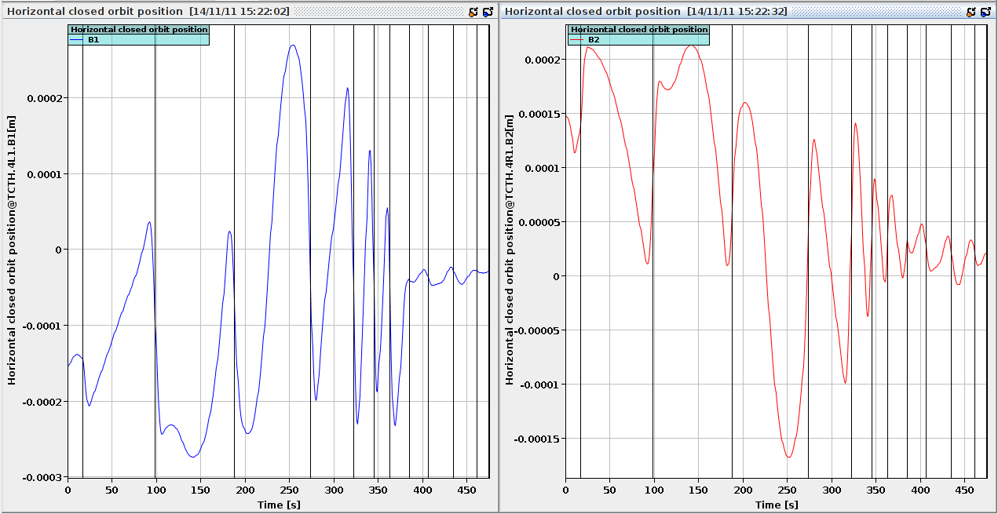
Recap 2011 : dominant source
The perturbations are PREDICTED by the simulations based on the machine settings (N. Ryckx & S. Redaelli)
The perturbations are strongest while IR8 is squeezed (model and observation match).
IR8 at 3 m (385 s)
Orbit @ TCTH.IR1
N. Ryckx

Slide 6
Recap 2011 : OFB bandwidth increase
40 μm
Ion run test:
Transients can be eliminated with higher bandwidth (x10) of the orbit FB.
H
V
Gain x 10
40 μm

Slide 7
Simulation of the 2012 squeeze
Since orbit perturbations were already seen in simulation, a campaign was launched on the 2012 squeeze (with 2011 Xing and separation bump settings) to assess the effect of the settings generation.
In particular the influence of the smoothing algorithm was looked at in more details.
Xing and separation bump settings were generated with different smoothing algorithms (G. Kruk).
Simulations of the settings with a granularity of 1 second were performed using Xavier’s BP scanning program (M. Solfaroli).

Slide 8
Smoothing in LSA
From gradients (K) to smoothed gradient (K_smooth):
Spline.
Used in 2011 for orbit correctors.
Parabolic fraction.
PLP between matched points with fixed fraction of the time allocated to parabolic rounding – matched to dI/dt = 0.
This algorithm is used in the squeeze for the quadrupoles (excluding RQTF/D).
No trim allowed between matched points.
PLP.
New algorithm for 2012 from Greg.
PLP between each pair of points (based on ramp rate and acceleration of the circuit) .

Slide 9
Raw kick
Gradient / K

Slide 10
Smoothed – spline (2011 way)
Splined K

Slide 11
Smoothed - parabolic
Parabolic fraction K

Slide 12
Squeeze BP 2012 to 0.6/3/0.6/3 m

Slide 13
2012 squeeze simulation - spline
Orbit RMS versus time in squeeze – 2011 bump settings.
Separation ± 0.7 mm.
Xing -120/-80/120/250 μrad.
Perturbations vanish in last part of the squeeze when the density of matched points is high(er).
Beam1
H
0.3 mm
V

Slide 14
2012 squeeze simulation – parabolic fraction
Orbit RMS versus time in squeeze .
Separation ± 0.7 mm.
Xing -120/-80/120/250 μrad.
Important reduction of the orbit perturbation (same V scale) with the parabolic round off – factor 5-6 improvement !
Beam1
0.3 mm

Slide 15
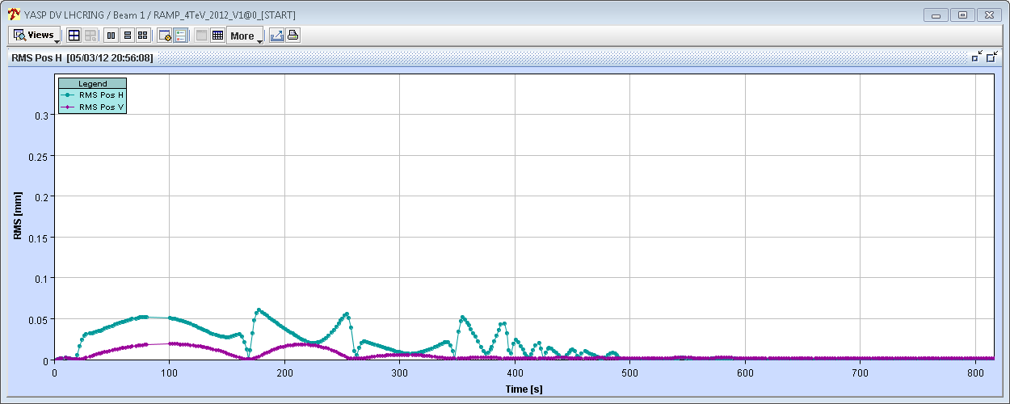
2012 squeeze simulation – comparison
‘Spline’
0.3 mm
Beam1
‘Parabolic round off’
0.3 mm

Slide 16
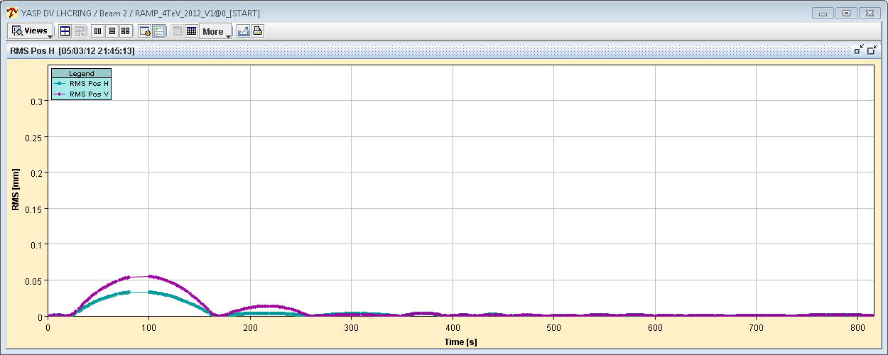
2012 squeeze simulation – comparison
‘Spline’
0.3 mm
Beam2
‘Parabolic round off’
0.3 mm

Slide 17
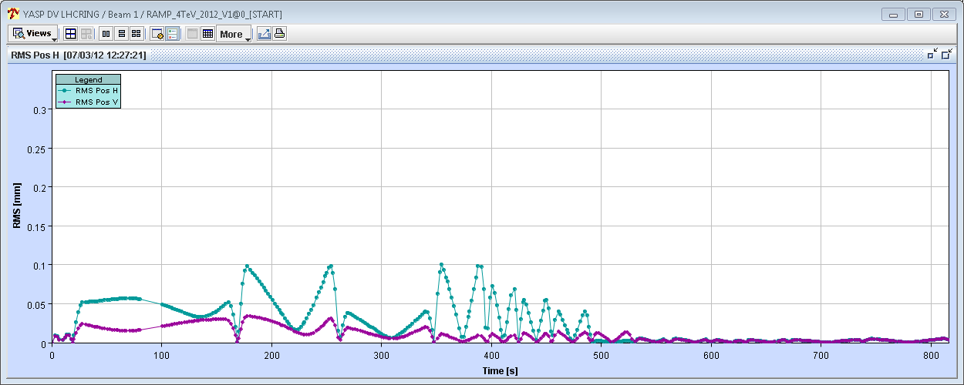
2012 squeeze simulation – PLP versus parabolic fraction
‘PLP smoothing’
0.3 mm
Beam1
‘Parabolic round off’
0.3 mm

Slide 18
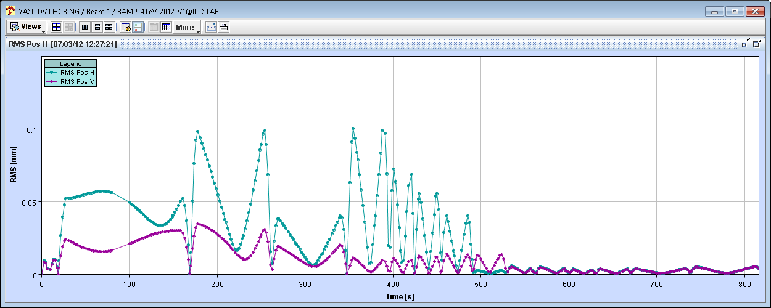
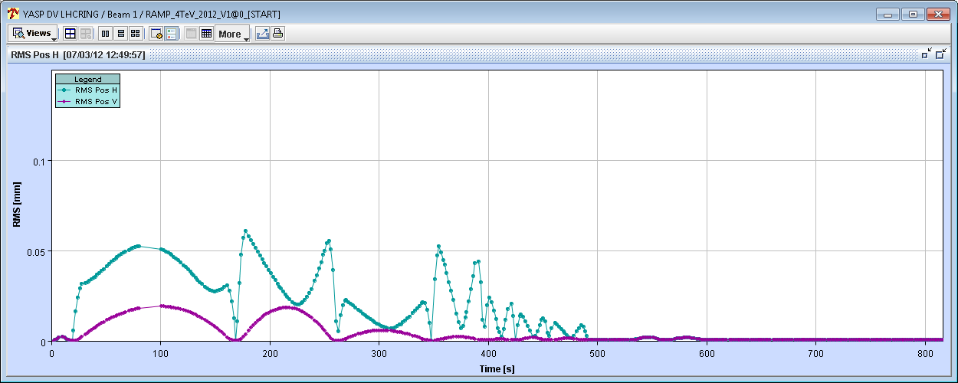
2011 sep and Xing bump values - zoomed
‘PLP smoothing’
0.1 mm
Beam1
‘Parabolic round off’
0.1 mm

Slide 19
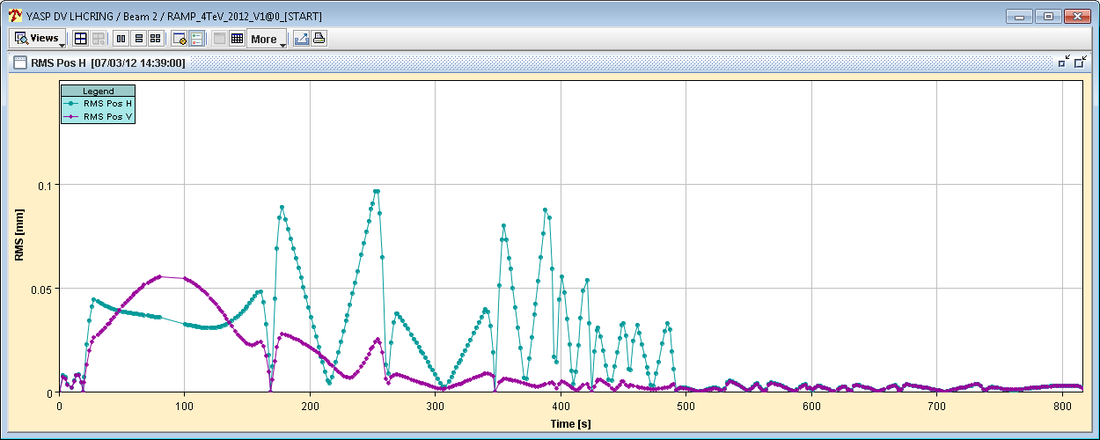
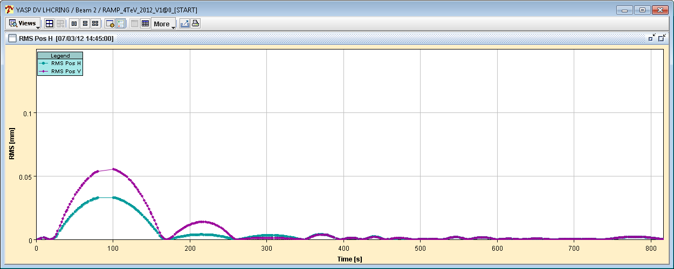
2011 sep and Xing bump values - zoomed
‘PLP smoothing’
0.1 mm
Beam2
‘Parabolic round off’
0.1 mm

Slide 20
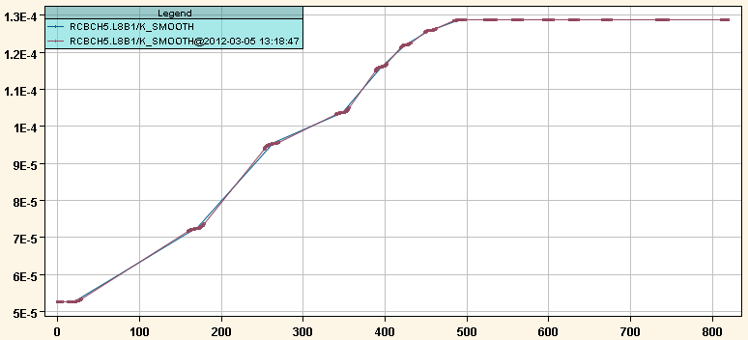
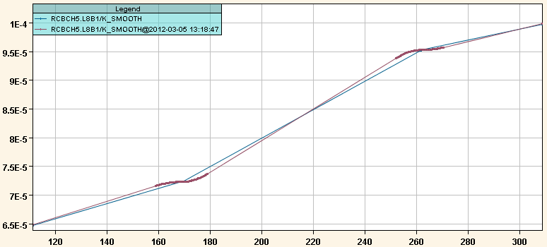
Smoothed function comparison
Spline-PLP
The spline algorithm is much too rounded - correctors are not in synch with qaudrupoles !!
Parabolic-PLP

Slide 21
Summary
Parabolic fraction is clearly the best algorithm.
Best synchronization between quads and correctors.
Best closure of the bumps between the matched points.
Loose ability to trim between matched points.
PLP is slightly worse than parabolic fraction.
But correctors are slightly out of synchronization with quads.
Introduces some sharp spiked in the orbit.
Spline should be avoided.
Introduced ‘too large’ distortions of the functions of the correctors.

Slide 22
Smoothing for startup 2012
PLP used for:
CHROMATICTY, TUNE-TRIM.
ORBIT-H, ORBIT-V.
Except for IP_SEPARATION, IP_XING and ORBIT-TRIPLET.
Parabolic fraction used for:
All other (magnet) systems.
Orbit correctors in systems IP_SEPARATION, IP_XING and ORBIT-TRIPLET – to keep correctors in synch with quads.
Applies to squeeze-type beam-processes only.
Not used for ramp, ramp-downs etc

Slide 23
Conclusions
The smoothing algorithm applied to the functions in 2011 introduced significant orbit perturbations due to leakage of separation and crossing bumps.
By adapting the smoothing algorithm the orbit perturbations in the squeeze should be reduced significantly.
We may be able to control the orbit well without bandwidth increase of the OFB – for the tight collimators.
We should nevertheless check the FB bandwidth limits to asses the stability margin and to be prepared for surprises…
And we will used (much improved) feed-forward from the beginning.

