Slide 1
Losses in ramp and squeeze
Jorg Wenninger
With input from Giulia, Rudiger, Mike, Gianluigi etc

Slide 2
Losses in the squeeze
After TS1 observe losses in ramp and squeeze that are similar qualitatively (time structure) to before TS.
But the losses are a good factor ~3-4 higher than before.

Slide 3
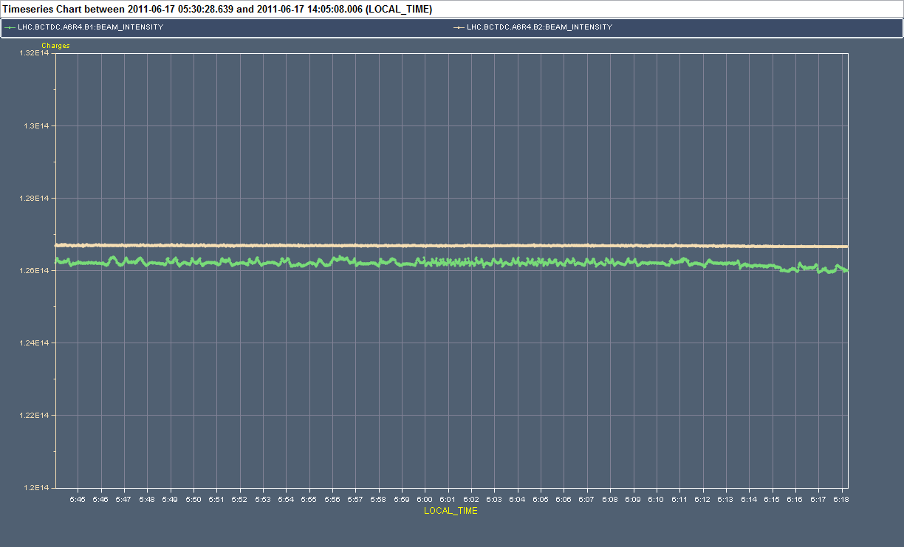
Fill 1875 – 2011 – 1092b
R. Schmidt
06:15:01
end adjust
05:48:22 end ramp
05:49:11
start squeeze
05:59:41
end squeeze
Loss <<1%

Slide 4
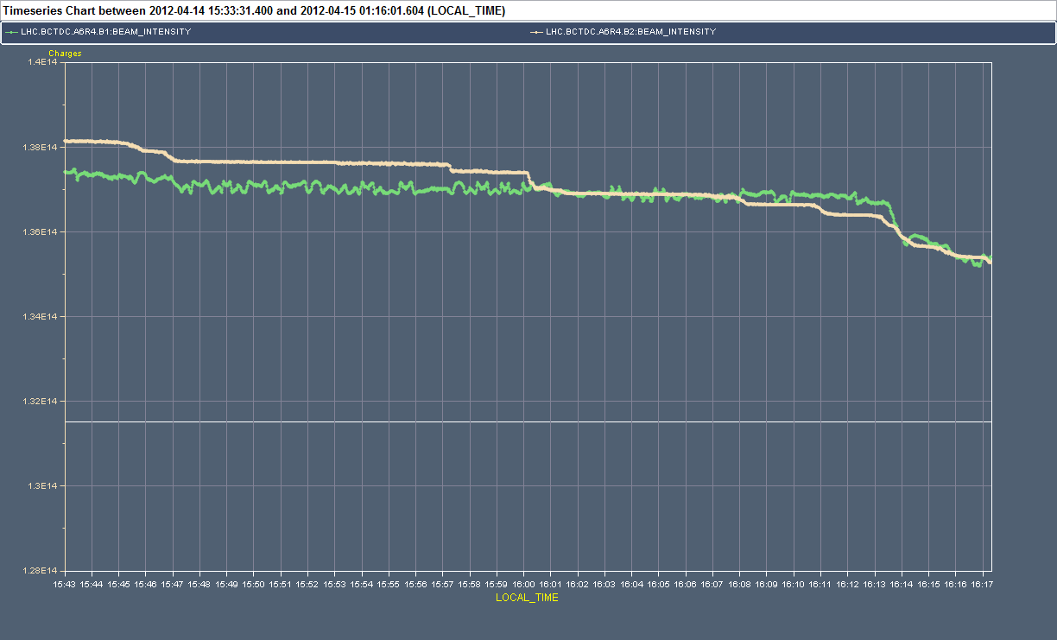
Fill 2514 – before TS1 – 1092b
R. Schmidt
Loss spikes on B2
16:15:58
end adjust
16:10:00
start adjust
Loss 1.6%
15:47:10 end ramp
15:52:50 start squeeze
16:09:59 end squeeze
Loss 2.0%

Slide 5
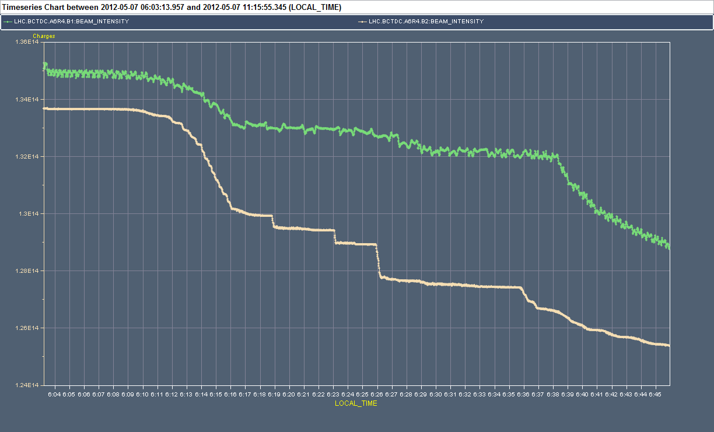
Fill 2593 – After TS1 – 1092b
R. Schmidt
Loss 2.2%
Larger loss spikes on B2
6:34:52 start adjust
6:16:10 end ramp
6:39:11
end adjust
6:18:40 start squeeze
Loss 6.1%

Slide 6
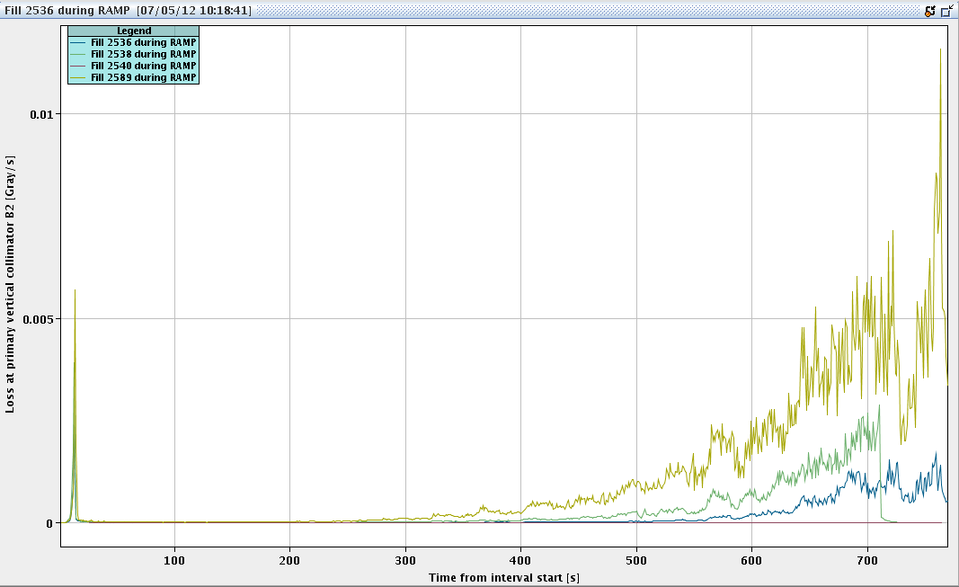
Ramp losses
Increased losses already visible in the ramp.
Tails are more populated…

Slide 7
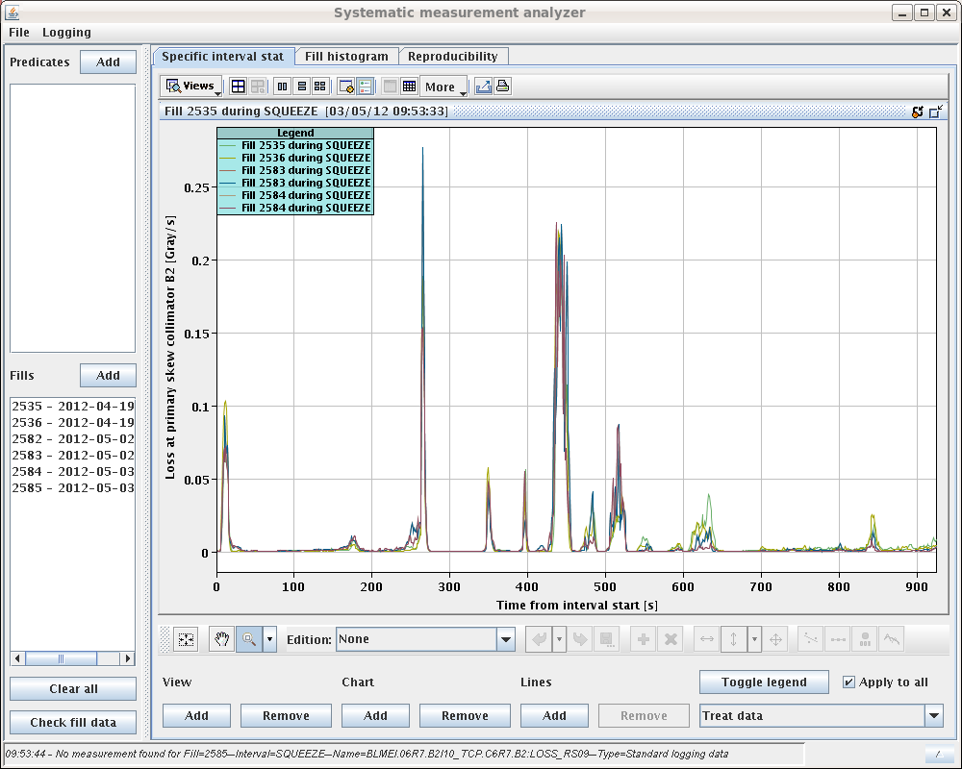
Losses in squeeze
‘Qualitatively’ similar before and after TS, higher after TS.
M: Losses at/close to a matched point.
I : Losses between matched points.
Losses @ TCP B2
M
I
2.5m →2m (I/5)
I
I
M
M
I
M

Slide 8
Squeeze and collisions
During the TS the orbit corrector functions of the squeeze were smoothed (‘de-spiked’) in between 3m and 1m.
Hope to reduce losses in that part of the squeeze.
But mainly for V correctors.
After the TS, tune and chromaticity were corrected in the squeeze.
The tune was actually lowered a bit towards the end (~0.002).

Slide 9
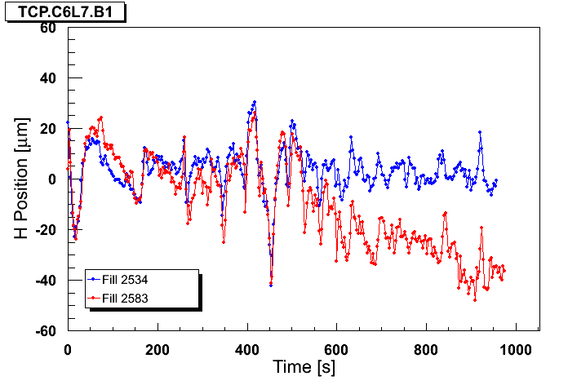
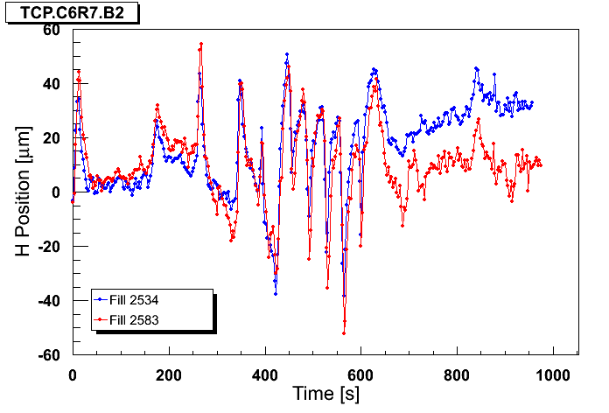
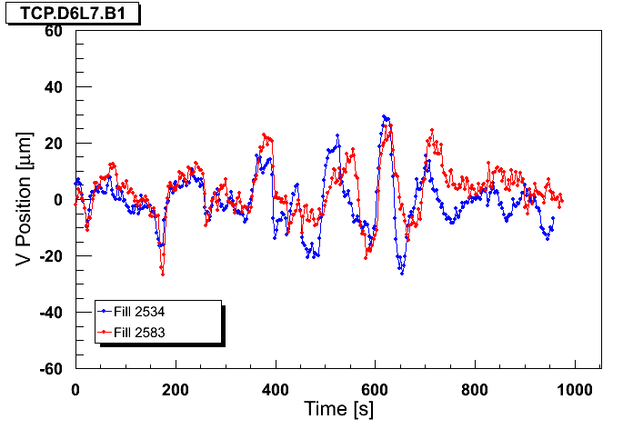
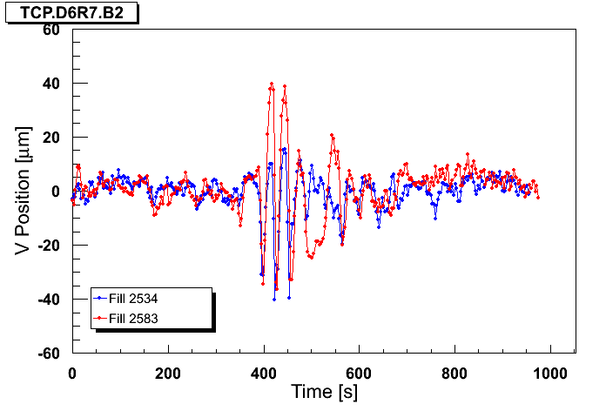
TS function cleaning
Blue : ref fill before TS1, Red : fill after TS1
B1H
B2H
B1V
B2V

Slide 10
Orbit
B2: Losses and H TCP orbit well correlated

Slide 11
Orbit
Correlation with V orbit not ‘strong’

Slide 12
Sensitivity
Observations from squeeze and collisions (orbit correction etc) indicate that with present conditions:
Orbit shift of 50 um at TCP → > 30% of BPM dump threshold.
Orbit shift of 100 um at TCP → high risk of beam dump by BLMs.
For losses on time scales of few seconds.
Corresponds to 5-10% of collimator ½ gaps.
Together with the increased tail population the orbit excursions now push the losses towards/above threshold.

Slide 13
Transient beta-beat
Transient beta-beat (from the model) too small to explain losses – 2% only (and not at right time).
Beta versus squeeze time for BPM close to TCP B2.
β_{x} (m)
β_{y} (m)

Slide 14
Reverting…
Last Friday it was decided to revert both tune in collision and orbit functions in the squeeze to pre-TS settings.
Possibly small improvement, but change is not very significant.

Slide 15
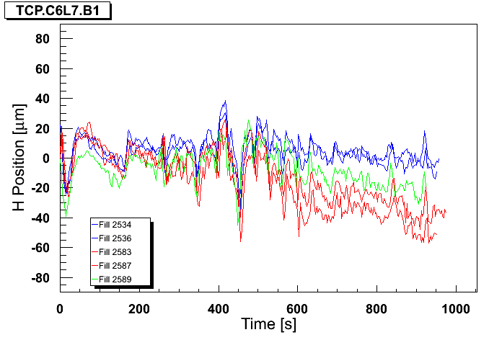
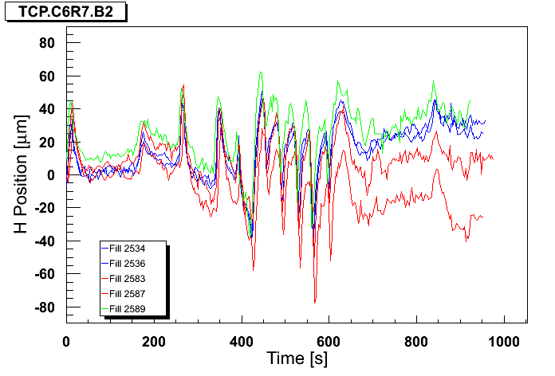
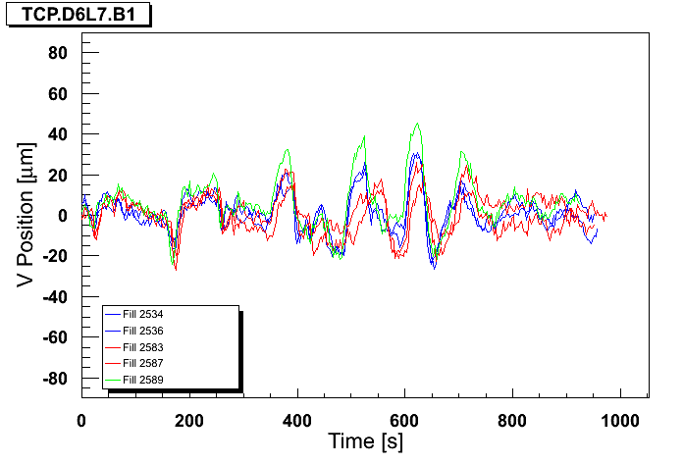
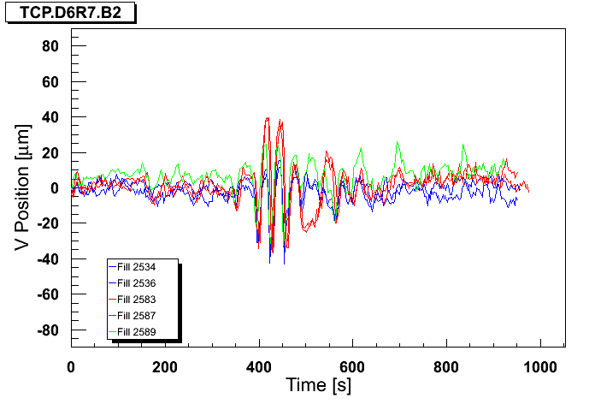
Back to pre-TS
Blue : ref fill before TS1, Red : fill after TS1, Green : revert
B1H
B2H
B1V
B2V

Slide 16
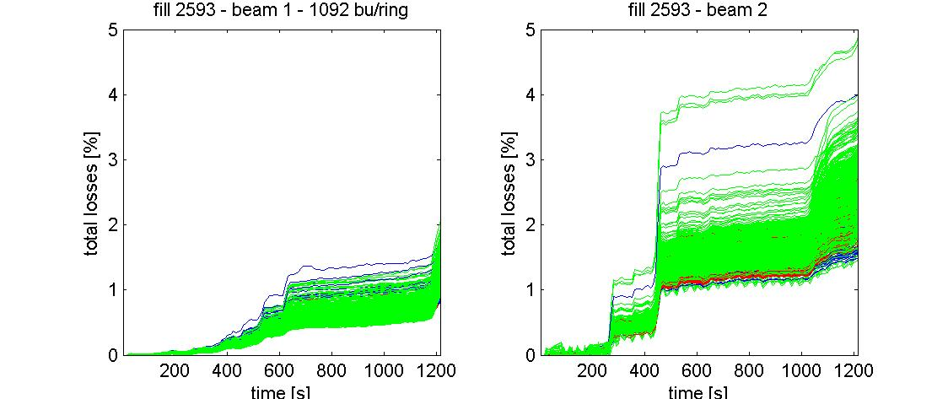
Fill 2593 – bunch-by-bunch losses
G. Papotti

Slide 17
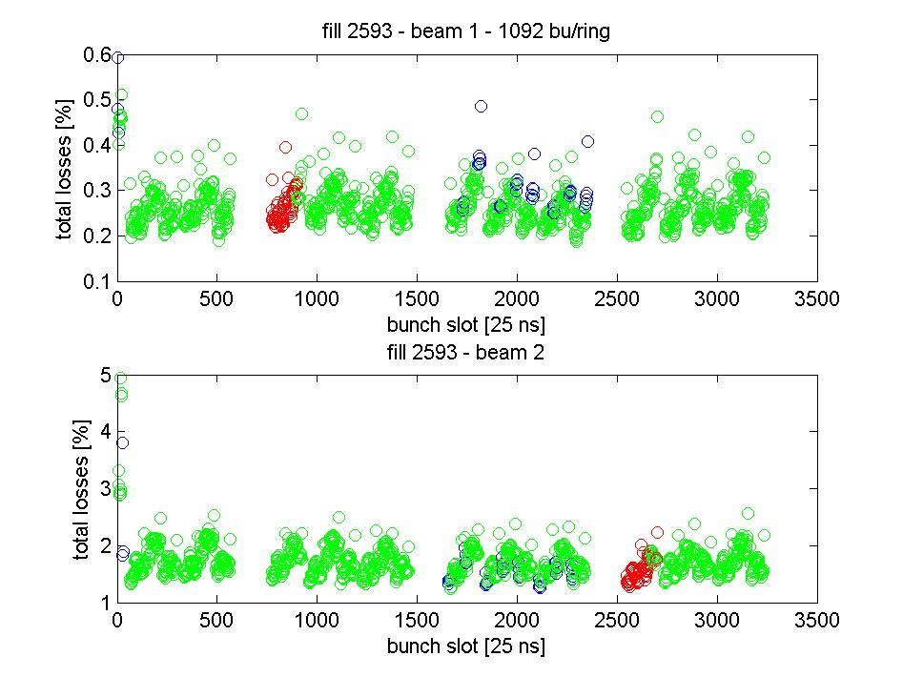
Fill 2593 – bunch-by-bunch losses
Loss at 500 s wrt start of squeeze
G. Papotti
Enhanced losses on first 12b → ADT gain modulation

Slide 18
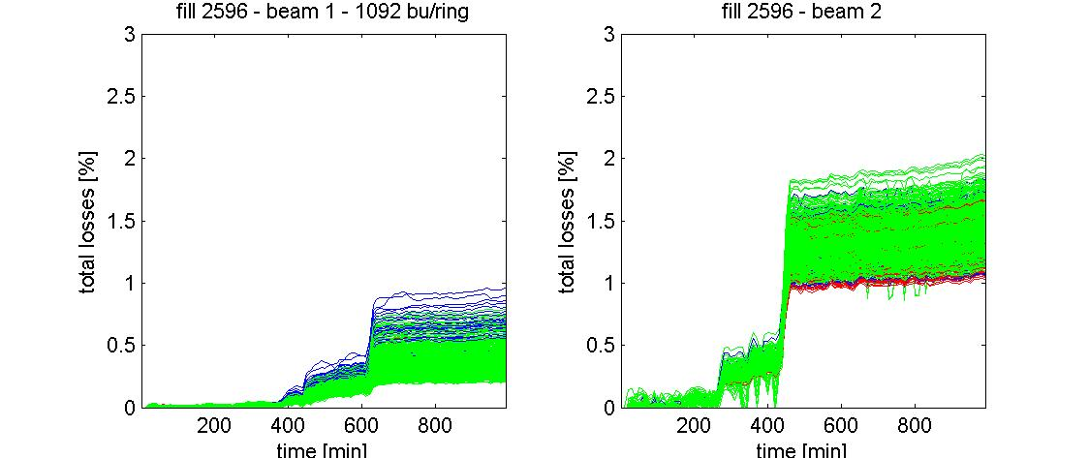
Fill 2596 – bunch-by-bunch losses
Gain modulation now off, ADT settings back to pre-TS1
Slight overall improvement.
12b behaving now ~like all others.
Enhanced losses on first 12b → ADT gain modulation
G. Papotti

Slide 19
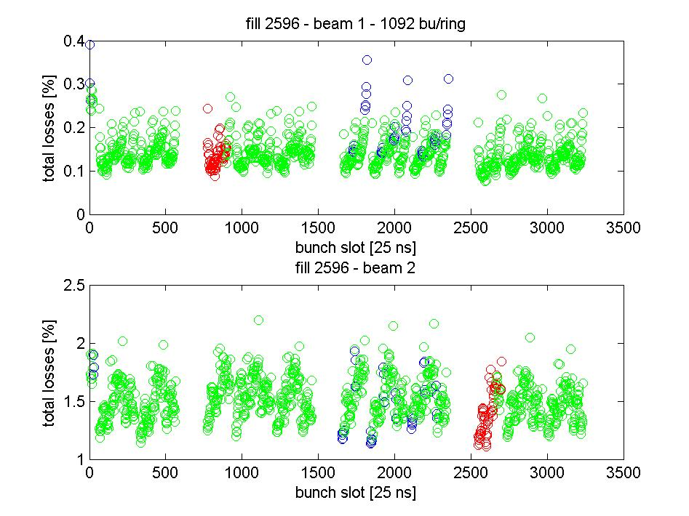
Fill 2596 – bunch-by-bunch losses
Loss at 500 wrt start of squeeze – no difference for first 12b.
G. Papotti

Slide 20
TCP IR7 and TCSG IR6 BB Centre checks
Summary (G. Valentino): ------------------------------------------------ Collimator OLD (mm) NEW (mm) TCP.C6R7.B2 0.520 0.430 TCP.D6R7.B2 0.770 0.690 TCP.B6R7.B2 -0.235 -0.292 TCP.C6L7.B1 -0.178 -0.235 TCP.D6L7.B1 0.240 0.202 TCP.B6L7.B1 -0.320 -0.415 TCSG.4R6.B1 0.125 -0.035 TCSG.4L6.B2 -0.188 -0.093
Comparable with the orbit variations observed during the squeeze.

Slide 21
Working on the orbit
The loss spikes are clearly correlated to orbit (in particular H) excursions ➔ try to cure with OFB.
Fill 2595 (2b / beam) test ramp/squeeze with OFB bandwidth increased by a factor 10.
Very good correction of the transients.
At a smaller level observe spikes (~10 um) increasing along the squeeze, possibly due to the optics mismatch (OFB works with injection optics).

Slide 22
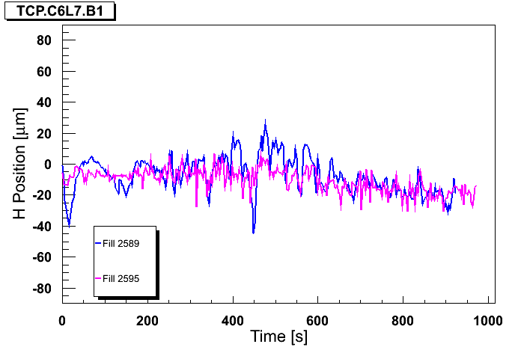
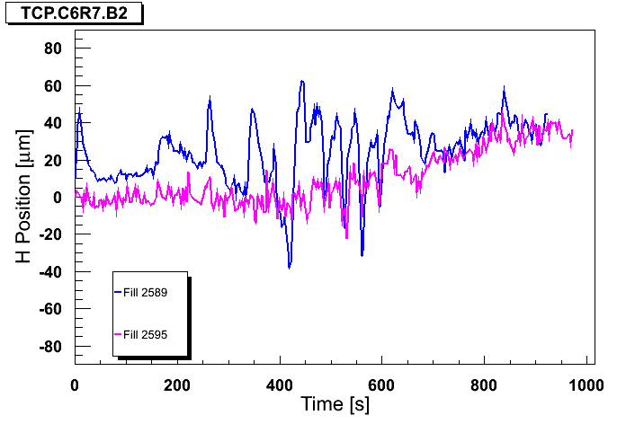
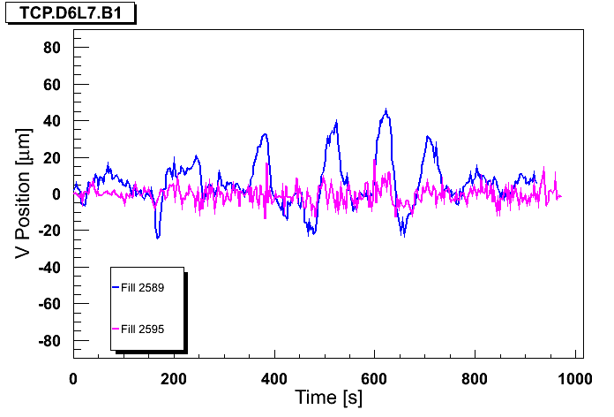
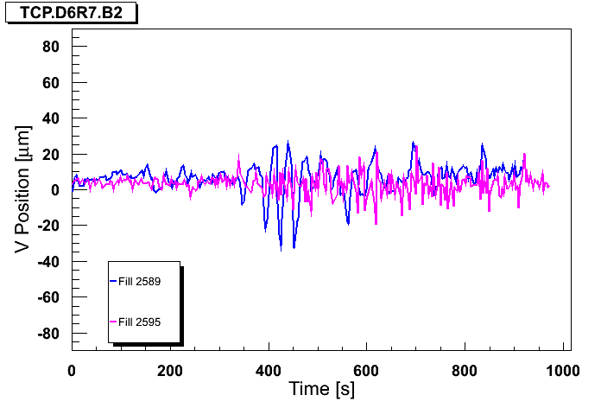
High bandwidth OFB test
Blue : standard BW, Magenta: OFB BW x10
B1H
B2H
B1V
B2V

Slide 23
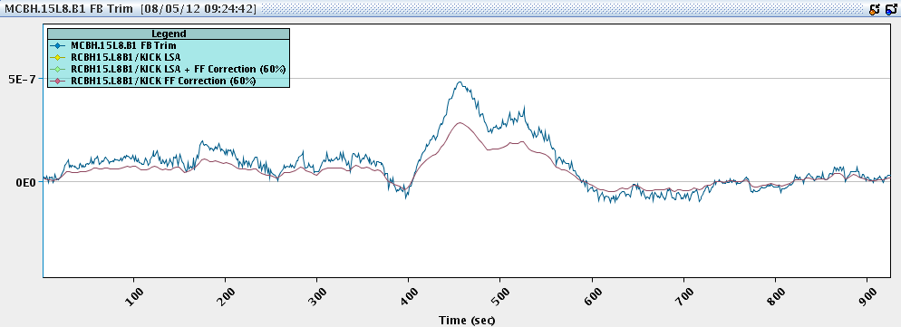
Feed-forward
Feed-forward of 60% of the correction (high BW fill), smoothed, one point every 3 seconds.
Active for the next fill. 100% FF is good result.
Could also consider running routinely with slightly higher OFB bandwidth (x 2-3).

Slide 24
Further work / actions
Injectors working on beam quality. Correlated to the losses in the squeeze, we also had poor injections (despite good steering).
But why does it affect B2 so much more?
rMPP proposes to set consistent BLM thresholds to allow losses of 200 kW (present losses ~50-100 kW).
Monitor factors for the most critical Q4’s BLM will be increased by a factor 2 (0.1 to 0.2).
Not an excuse to make routinely high losses, but provides some room for operating the machine

Slide 25
Further work / actions
Test of tail scrapping with TCP at injection (5.7 → 4.3… 4 sigma) will be performed.
Could be turned into operational way of removing (and diagnosing) the tail population. Possibly done through the ramp functions.
What is wrong in the region between β* 2.5 and 2 m?
Just a coincidence of factors?

