Slide 1
LHC Transverse feedback
W. Höfle, D. Valuch
Special thanks to:
E. Montesinos, G. Cipolla, F. Killing, F. Dubouchet, A. Pashnin, M. Jaussi, V. Zhabitsky, B. Lojko, V. Kain, D. Jacquet, N. Mounet, B. Salvant, S. Redaelli, M. Zerlauth, R. Leszko

Slide 2
The transverse damper in general
The transverse damper is a feedback system: it measures the bunch oscillations and damps them by fast electrostatic kickers
Key elements:
Beam position monitor(s)
Signal processing system
Power amplifiers
Electrostatic kickers
T_{beam}
T_{signal}
Key parameters:
Feedback loop gain, phase and delay
Kick strength
Bandwidth

Slide 3
LHC transverse damper (ADT)

Slide 4
Bunch by bunch observation post mortem data

Slide 5
Available PM data
Beam Position module
Last 73 turns, Bunch by bunch data
Raw Sum and Delta I-Q data for expert diagnostic
Digital Signal Processing Unit (DSPU)
Last 73 turns, Bunch by bunch data
2x “Serdes data”: Normalized, intensity independent bunch position (at Q7 and Q9)
2x “Notch” actual bunch motion at pickups in Q7 and Q9 after processing
“Bunch masking” total correction kick calculated by the ADT → best signal for user to observe the potential instability
“DAC output”: pre-distorted signal sent to the power system, including cleaning/blowup pulses

Slide 6
Bunch by bunch observation post mortem data
Beam Position module
Sent to the post mortem database
Digital Signal Processing Unit
Multiturn application
gets this buffer
Injection oscillations
fixed display

Slide 7
Status of the post mortem data
PM data are being sent to the PM database since mid 2011
User interface available since 2012 (thanks to Rafal Leszko & Markus Zerlauth)

Slide 8
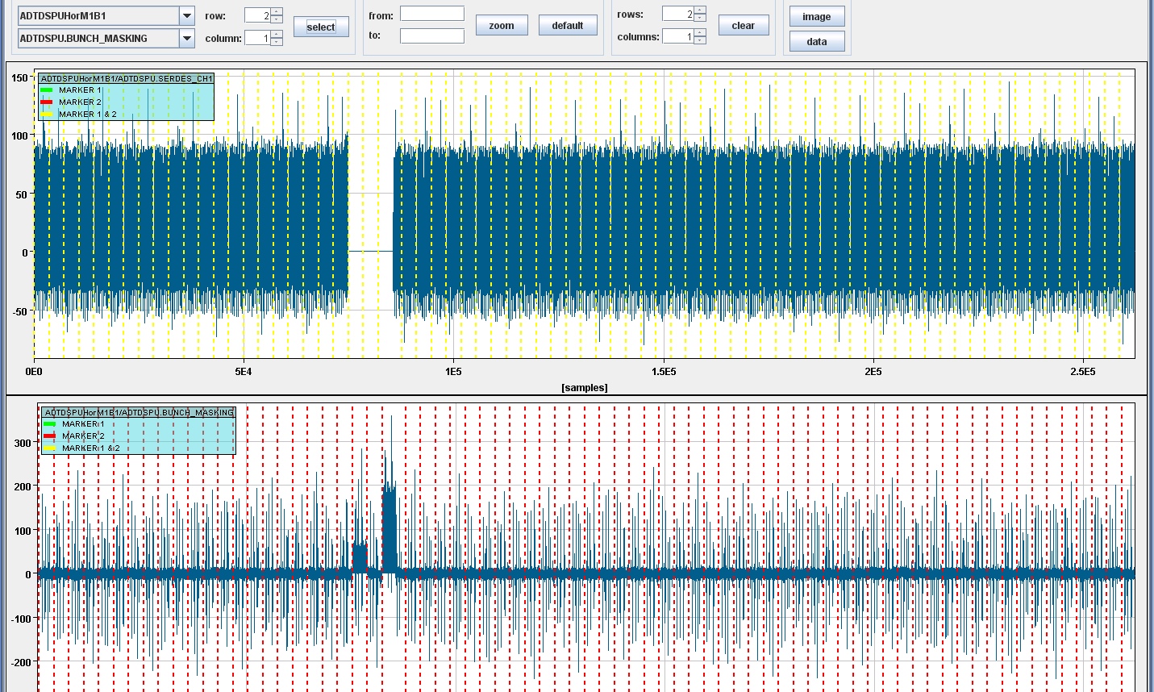
Available PM data
Signal selection and placement
“Serdes CH1” (normalized bunch position)
“Bunch masking” (correction kick)

Slide 9
Available PM data
Last turn
Dashed lines – revolution frequency marker
After-dump transient
(3-5 turns)

Slide 10
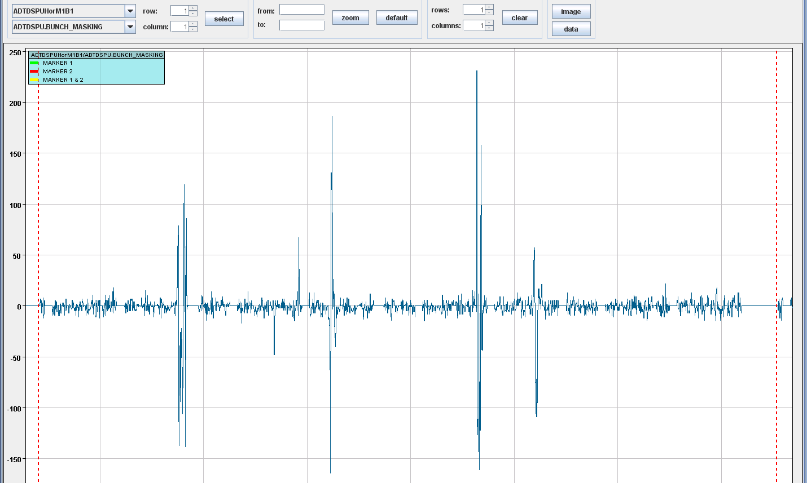
PM data example – dump fill #2668
Instability within the train
End of train unstable
Abort gap
Note: the Y scale is in artificial units, not microns!

Slide 11
BBQ “Instability trigger”
BBQ can freeze the ADT observation memory if an instability develops
Software packet, under commissioning
Data acquisition controlled by the “multi-turn” application
User can select 1, 2, 4, 8 or all bunches to record
1 for 262144 turns, 2 for 131072 turns, 4 for 65536 turns, 8 for 32768 turns or all for 73 turns
When an instability develops the buffer is frozen and data saved automatically for offline analysis

Slide 12
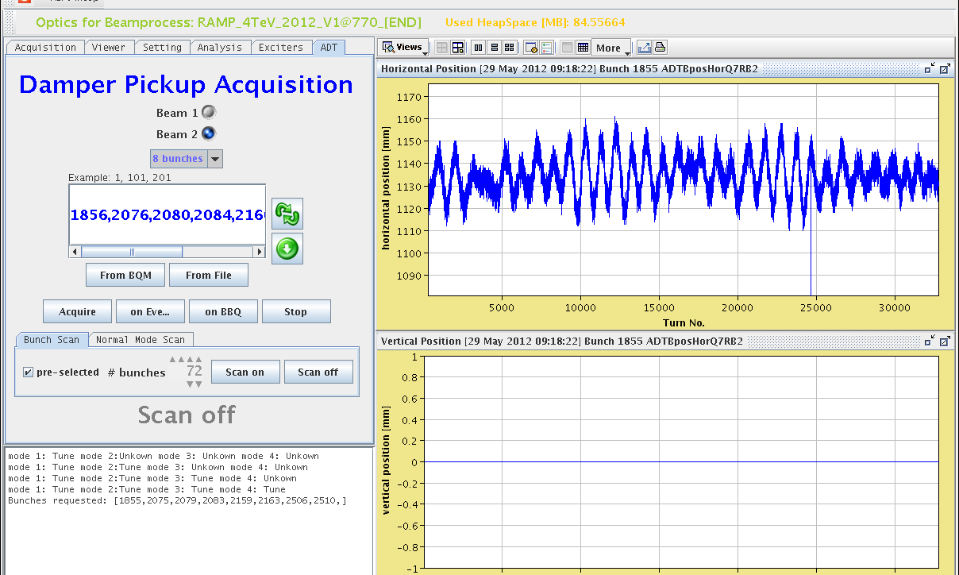
BBQ “Instability trigger”
Manual acquisition
BBQ trigger
Acquisition
synchronized by timing

Slide 13
Gain settings in collisions
double w.r.t. last year

Slide 14
Gain settings in collisions
Concept of the Normalized gain
Parameter independent of the optics and hardware performance
Injection - High gain (0.25), damping times 8-15 turns
Prepare for ramp, low gain (0.02H/0.04V)
Kept low through the ramp (0.02 H/0.04→0.01 V)
Squeeze increase to double (0.04 H/0.02 V)
Physics (0.04H/V), double w.r.t. last year, damping time <50 turns

Slide 15
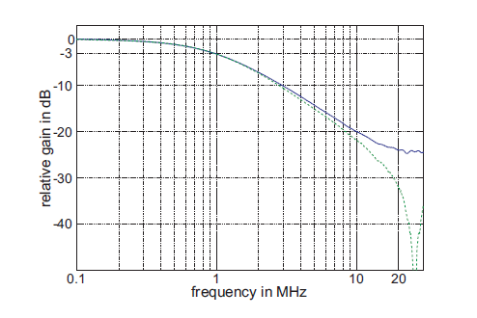
Frequency response ADT
Power amplifiers, -3 dB @ 1 MHz
Power amplifier phase response compensated by digital filter (flat)
Cable response compensated by analogue filter (flat)
kick @ 10 MHz,
10% left
measured on power amplifier
(blue curve on kicker,
green on anode of tetrode)
LHC-PROJECT-REPORT-1148

Slide 16
Frequency response ADT
Power amplifier without phase compensation
approximately
e^{-(t-tg)/τ1} for t>t_{g}
B. Lojko

Slide 17
Frequency response ADT
Power amplifier phase response compensated by digital filter
SYMMETRIC!
i.e. equal treatment of bunches on both sides of the train
approximately
e^{-|t-tg|/τ2}
B. Lojko

Slide 18
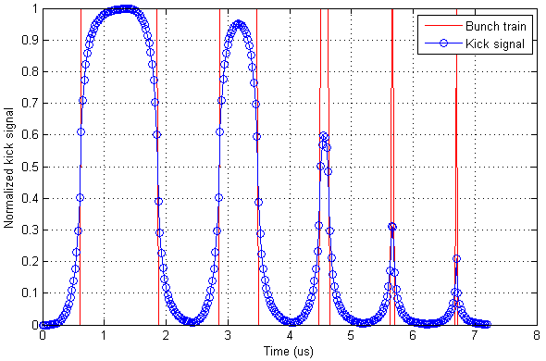
Frequency response/damping time
Available kick strength for trains of different length (“injection oscillation” type damping)
1250ns
625ns
150ns
50ns
25ns

Slide 19
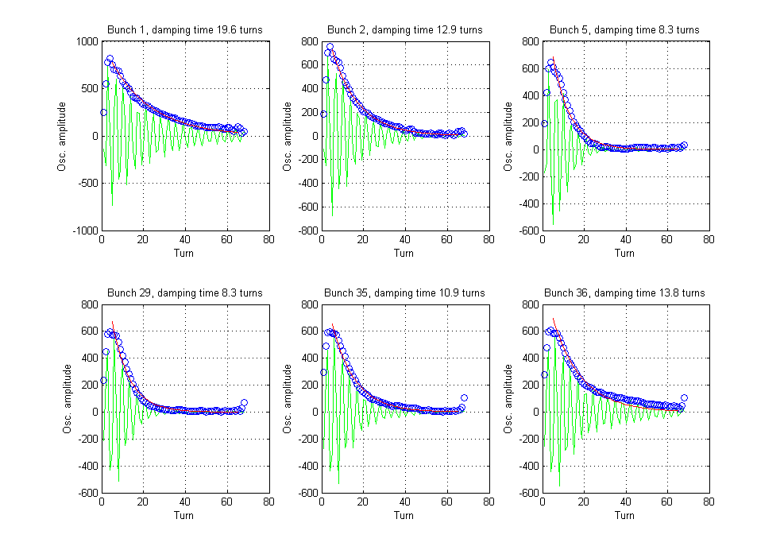
Frequency response/damping time
Injection oscillations, 2nd injection of the fill 2676

Slide 20
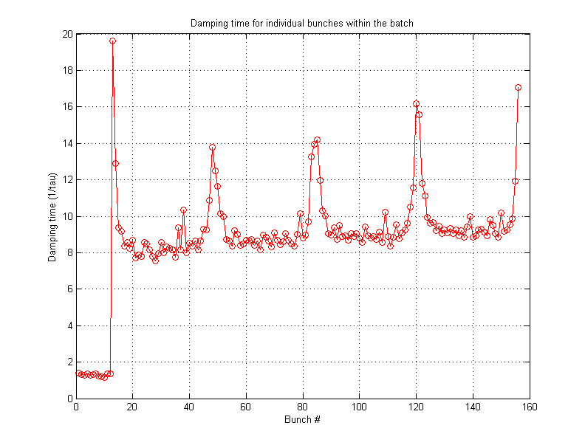
Frequency response/damping time
Damping time for individual bunches within the 144b train. Injection oscillation fill 2676, 2nd injection
New injection 144b
12b already circulating

Slide 21
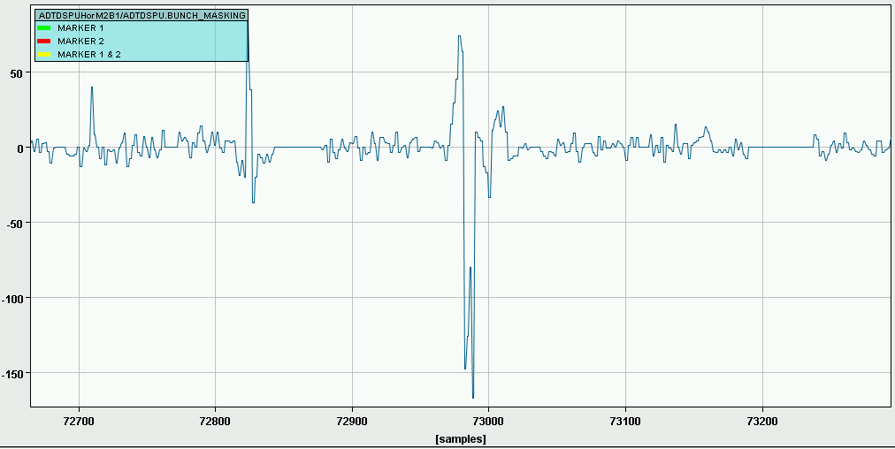
Frequency response/damping time
Damping of individual bunches in case they become unstable however still follows the system frequency response:
-3 dB point at 1 MHz
i.e. 10% strength available at 10MHz if two adjacent bunches oscillate in anti-phase

Slide 22
Damping of single bunch instabilities
Impulse response of damper spreads oscillation to adjacent bunches
Simulation with simplified damper model (no delays, ideal system)
Feedback gain 0.05 (40 turns damping time) as in horizontal plane for beam 1 in Physics
Train of 48 bunches with random initial condition (bunch-by-bunch amplitude, phase)

Slide 23
Damping of single bunch instabilities
Case 1:
only one bunch is unstable
center of train is worse than edge !
Edges symmetric (no preference for trailing edge), due to symmetric response

Slide 24
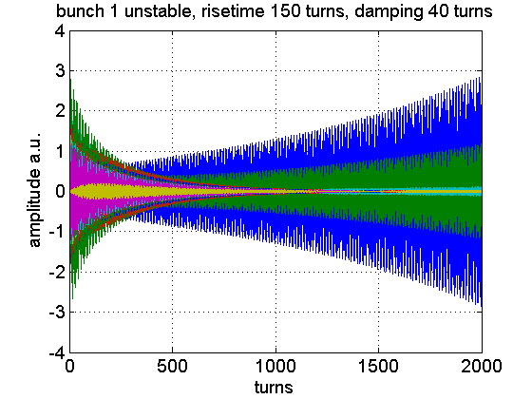
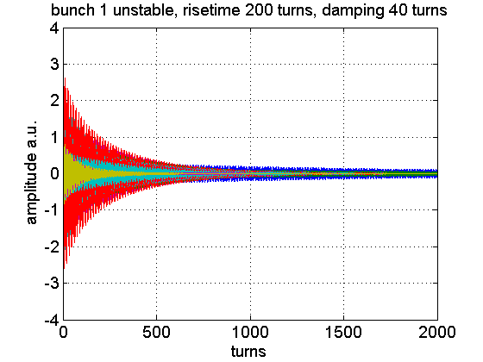
Damping of single bunch instabilities
Edge bunch unstable (bunch 1), 200 turns risetime under control

Slide 25
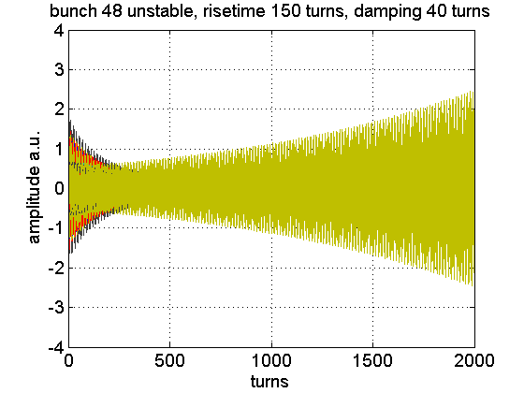
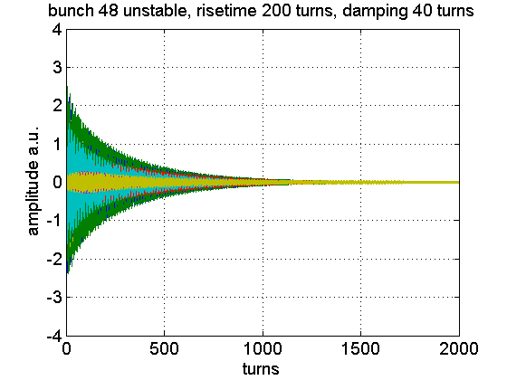
Damping of single bunch instabilities
Edge bunch unstable (bunch 48), 200 turns risetime under control
Due to symmetric impulse response same behavior as for case with bunch 1 unstable

Slide 26
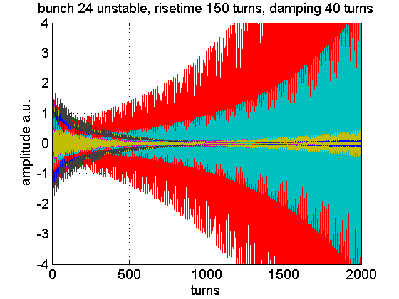
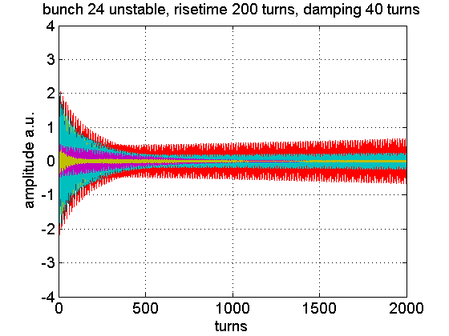
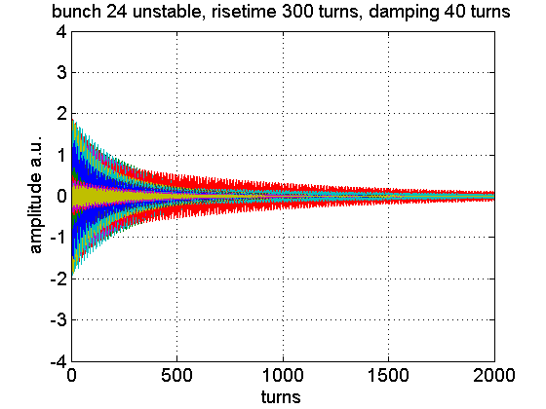
Damping of single bunch instabilities
Edge
Center of batch (bunch 24) is more critical than edge if one single bunch unstable.
300 turns risetime under control but 200 turns not!

Slide 27
Damping of single bunch instabilities
Case 2: All bunches unstable with same risetime and tune, but random initial condition → harder to control with damper

Slide 28
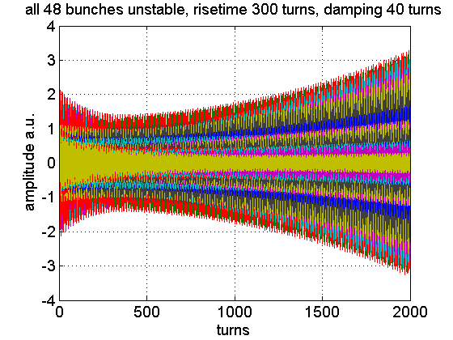
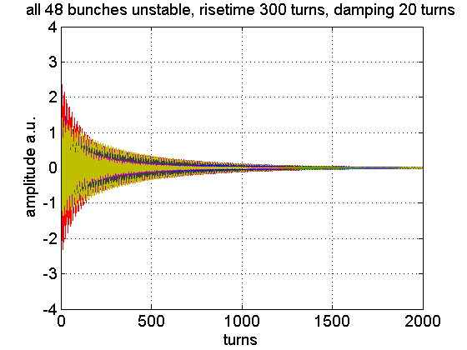
Damping of single bunch instabilities
All bunches of train unstable
300 turns risetime not under control, but increasing gain (40→ 20 turns) brings it under control

Slide 29
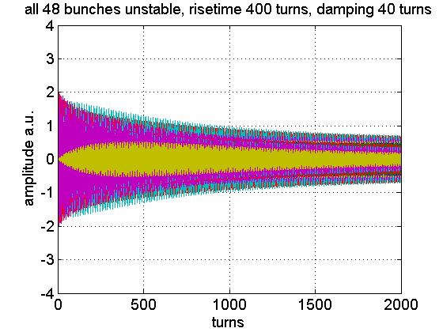
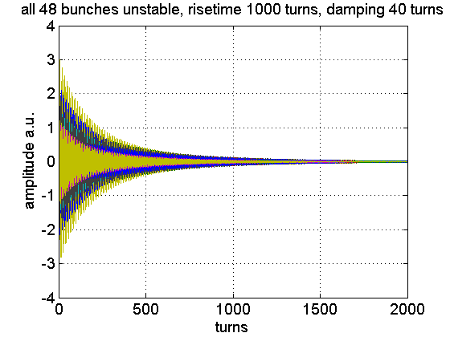
Damping of single bunch instabilities
All bunches of train unstable but slower risetime, lower gain (40 turns)
Risetimes of 1000 turns under control, but not 400 turns

Slide 30
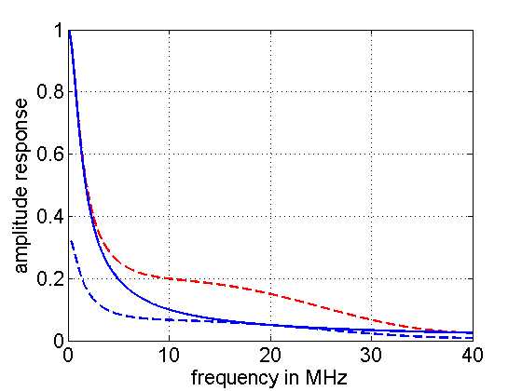
Enhancement of the frequency response
The full power is needed only for efficient injection oscillation damping
An amplitude compensation filter is foreseen in the ADT’s digital signal processing
Once commissioned it should provide faster damping of high frequency modes
Potential drawback – increase of noise injected through the damper

Slide 31
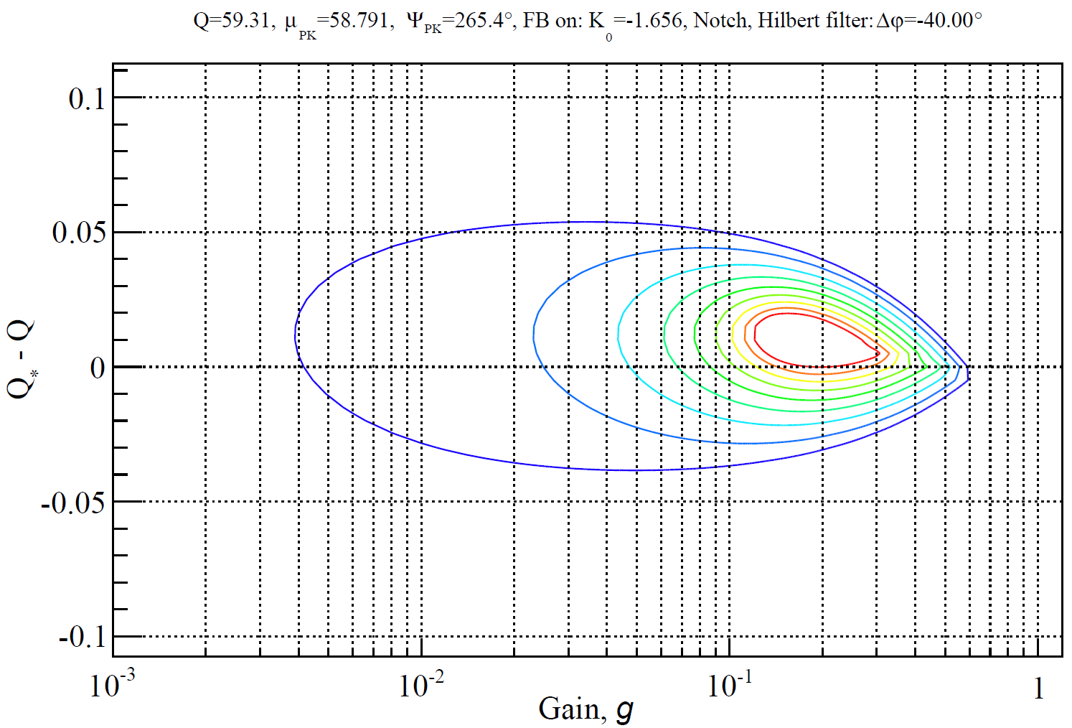
Damping – variation with tune
Circles of equal damping time
Faster than 10 turns damping
No active damping
Design value 40 turns damping
Contour lines at n/80 turns n=1…8
and 0.002 (1/τ)
Gain is the fraction of detected oscillation amplitude that is corrected in a single turn
V. Zhabitsky et al.

Slide 32
Damping – variation with tune
Tune variation ±0.02 no problem, at injection more critical ±0.01
Range of operation:
1: Injection (10 turns)
2: Prepare ramp,
Ramp (100-200t)
3: Squeeze (100t)
4: Physics (50t)
2
3
4
1
Range of operation (gain)
V. Zhabitsky et al.

Slide 33
Damping – variation with tune
Two modes of ADT operation available:
With phase shifter, using each pickup individually. Introducing additional 3.5 turn delay but better in terms of noise and reliability → used since 2008
Vector mode, direct combination of two pickups. No additional delay, worse in noise, more difficult to set-up → not commissioned yet
Shall very high gain at 4 TeV be needed we may study use of the vector mode. Lower processing delay will provide wider tune acceptance range. All implications to the operation need to be carefully studied.

Slide 34
Damping – variation with tune
Xavier Buffat et al. 31.5.2012:
“The variation between bunches that they expect is 0.308 -> 0.322, so plus 0.002 and minus 0.012”
The normal center for the vertical plane at collision is 0.32, we can eventually better center our settings for this case

Slide 35
Measurements at 4 TeV, 31.5.2012
Goal – verify the gain (damping time) of all systems at 4 TeV
3 batches of 12 bunches, 1 batch non colliding
Used the Q kicker to excite whole batch

Slide 36
Measurements at 4 TeV, 31.5.2012
1st bunch of the non-colliding batch
7th bunch of the non-colliding batch

Slide 37
Measurements at 4 TeV, 31.5.2012
Non-colliding bunches
Colliding bunches – damping time is in general slightly faster, analysis not finished
1st bunch | 1st bunch | 7th bunch | 7th bunch
Q7HB1 98.7 turns, Q9HB1 98.4 turns | Q7VB1 126.6 turns, Q9VB1 122.8 turns | Q7HB1 64.4 turns, Q9HB1 60.0 turns | Q7VB1 69.8 turns, Q9VB1 64.9 turns
Q7HB2 56.9 turns, Q9HB2 62.0 turns | Q7VB2 97.0 turns, Q9VB2 96.5 turns | Q7HB2 38.1 turns, Q9HB2 33.0 turns | Q7VB2 55.5 turns, Q9VB2 53.4 turns

Slide 38
Normalized gain limits
As the beam gets stiffer with rising energy we have to increase the electronic gain to obtain constant effective gain (damping time)
Concept of the normalized gain makes this transparent to the user
Electronic gain is calculated using the desired damping time, energy and a calibration constant (measured at 450 GeV)
When the electronic gain reaches the available maximum it saturates and does not follow the energy anymore
Damping time then gradually increases with energy

Slide 39
Normalized gain limits
Updated limits from 31.5.2012. Maximum available normalized gain at 4 TeV
H.B1 0.05
H.B2 0.0402
V.B1 0.05
V.B2 0.09
Asking for higher normalized gain does not harm, but it does not have any effect either

Slide 40
ADT status in 2012
Hor. B2 unit recabled during the winter TS → visible improvement in terms of noise
An extra 1-turn delay was removed from the loops after the winter TS (5 vs. 4) → improved tune range acceptance
Beam Position front ends properly set-up for 1.3-1.5-1.7e11 ppb operation during the start-up
The loop parameters were precisely set-up by measuring the beam transfer function during the start-up, both for injection and collision tunes

Slide 41
ADT status in 2012
Comprehensible post mortem data available to all users
About half tetrodes replaced during the last TS → back to the full design kick strength (>14000 filament hours)
Apparent 50-100% increase in strength w.r.t. start up 2012
Conclusion: The ADT is at nominal design performance

Slide 42
ADT follow up in 2012
Enhancement of the frequency response
Commission the digital pre-distortion filter to compensate for the low-pass character of the power amplifier to improve the single bunch damping capability
Preparation of massive re-cabling campaign during the LS1
Preparation of new Beam Position front end for 7 TeV operation
Lower noise, increased observation capabilities

Slide 43
Summary
The ADT is believed to be in the best shape since the LHC start up in 2008 thanks to sufficient time provided for precise setting up and fine tuning
ADT post mortem: bunch-by-bunch data on dipolar motion, but no information on head tail motion (which could be important to have)
Dipole oscillations observed when the beam is lost seem to be small, 10s of um, machine seems to be very “intolerant”
BBQ triggered ADT acquisition becoming available, will provide additional diagnostics

Slide 44
Summary
Damper impulse response cannot be responsible for difference observed in fills with oscillations towards end of trains for symmetry reasons (supported by simulation)
Frequency characteristics of damper not well adapted to the type of single bunch instabilities observed now, some margin to improve with signal processing
Need to better understand instabilities to see if a different kind of kicker/power amplifier could help in the more distance future (after LS2)

Slide 45
Summary
Damping time measurements at 4 TeV showed expected design performance.
Shall a very high gain at 4 TeV be needed we may study use of the vector mode. Lower processing delay will provide wider tune acceptance range. All implications to the operation need to be carefully studied.
A systematic, automatic, performance analysis (fill by fill) using the observation or Timber data needs to be implemented to monitor the system parameters.

Slide 46
Thank you…
Many thanks to
The operations for the time given to set up the system
E. Montesinos, G. Cipolla, F. Killing and the power team for all the care about the power system
F. Dubouchet, A. Pashnin, M. Jaussi for their massive effort in the software domain
V. Zhabitsky and B. Lojko for calculations and simulations which allow us to improve the system

