Slide 1
Restart after TS2
J. Wenninger

Slide 2
Outline
List of special tests and intensity ramp up.
ALICE polarity change.
Possible plan.

Slide 3
BPMS IR6 attenuators
The attenuators for the interlock BPMs in IR6 will be tuned to have a lower threshold ~2E10 p on all channels.
Scrapping exercise to be scheduled rapidly to ensure everything is correct. Could do it on Saturday.
Depending on the readings with 50ns, an alignment check of the TCSG in IR6 will have to be done.
To avoid spurious SIS interlocks.
Alignment if error larger than ~0.2 mm wrt current situation.

Slide 4
Leap second
Saturday 30th June at 23:59:59 a leap second will be added to the UTC time.
In fact at 02:00 local time Sunday.
This will shift NTP time distributed over the network from the UTC time distributed by the timing systems.
A stop of all machines is required to adjust the timings systems.
The intervention on the timing system will be made around 02:00 AM on Sunday morning.
For the LHC we should be at injection without beam.

Slide 5
SMP-MTG cross-checker test
The SMP-MTG cross-checker is a system that ensures that the MTG transmits what the SMP system (energy, beta*, SBF) is feeding into the timing system.
Never triggered !
The SMP team would like to test the triggering, including full post-mortem (for PM module development).
Timing expert can inject a wrong energy event.
Propose to do it in the week after the restart.
Arm the BIS loops after the update and inject wrong event.
15 minutes should be enough.

Slide 6
Intensity ramp up
Steps of 84, 480 840 and 1380 bunches.
2 hours of stable beams min per step.
From 840b can be consider a production fill.
Possibly some requests to extend fills on request of experiments – tbc.
Roman pot alignment for low beta.
TBC.

Slide 7
ALICE polarity change
On Monday ALICE announced that they would like to switch the polarity of their solenoid and spectrometer.
Implies a flip of the external crossing angle.
Implications of the polarity change:
Re-alignment and validation of injection protection. Concerns TDI and TCLIs – last time the line was not affected.
Realignment of the vertical TCTs in IR2 at injection, on flat top, at the end of the squeeze and in collision.
Validation of the configuration with loss maps at injection, flat top, end of squeeze and in collisions.
Do we need off-momentum loss maps in all cases since the change is only in the vertical plane?
Update of settings, orbit reference, SIS references.

Slide 8
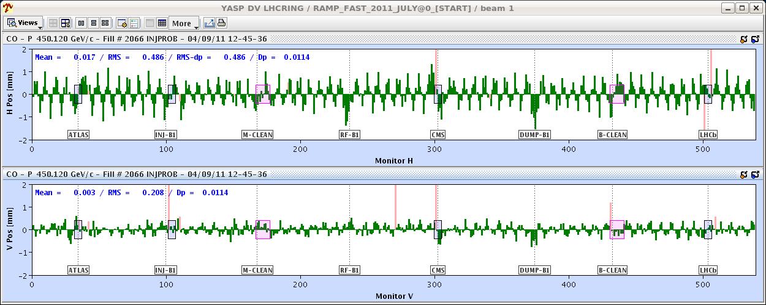
ALICE polarity reversal
From 2011 08:30 meeting
Main (side) effects of the ALICE polarity reversal:
Change in coupling ~ 0.002-0.003.
Horizontal orbit change due to coupling of
the large vertical spectrometer + Xing bumps
into the horizontal plane.
Re-alignment of TCTs in IR2 and of injection protection around the inverted external Xing angle.
=> Easy to correct
Orbit change at 450 GeV due to ALICE pol reversal
(excluding expected external Xing angle)

Slide 9
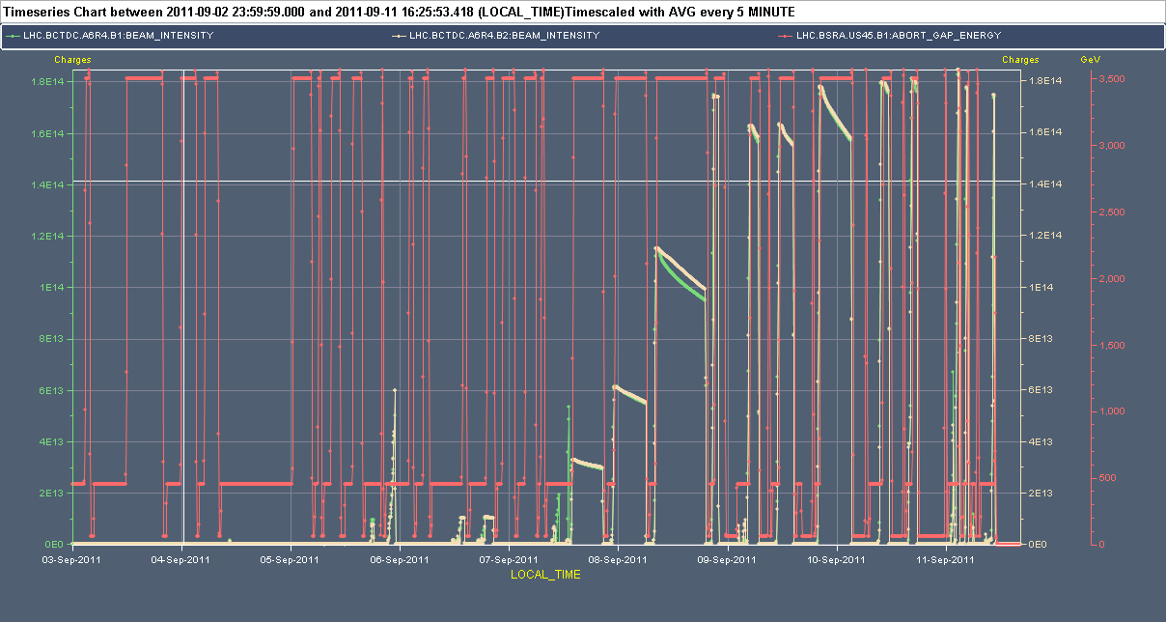
Overview end week 35 & week 36 in 2011
From 2011 08:30 meeting
Power cut
LR BB
test
Ramp up
Setup,
aperture
ALICE
TCTs,
loss
maps
Loss
maps
Loss
maps
1380 bunches
Sat
Sun
Mon
Tue
Wed
Thu
Fri
Sat
Sun
3 days including a LR beam-beam test

Slide 10
Wednesday morning – setup completed !
Validation campaign finished Wednesday morning.
ALFA-ATLAS data taking exercise before last dp/p + loss map.
Small leakage ~1e-5 seen at RPs.
Condition | Betatron H | Betatron V | Dp/p + | Dp/p - | Dump
Injection | OK | OK | OK | OK | OK
Flat top | OK | OK | --- | --- | OK
Squeezed | OK | OK | --- | --- | OK
Collisions | OK* | OK* | OK* | OK | OK*
* : with ALFA and TOTEM RPs.
From 2011 08:30 meeting

Slide 11
ALICE polarity time estimate
Injection protection setup – 1 shift.
Injection protection validation – 1 shift.
Loss maps at injection with/wo injection protection, asynch. dump test – ½ shift.
Ramp, squeeze and collide 3 nominal bunches with new polarity configuration, align TCTs on the way – 1 shift.
Then loss maps & asynch dump tests ‘a gogo’.
4 full cycles if all goes well.
In 2011 it took us 2 ½ days to finish this program (with slight mixture of commissioning to 1 m beta*).
Count ~2 days for the flip-over.

Slide 12
Do not forget…
By changing the bump in the squeeze, the orbit errors may increase again at the collimators.
May need again a high bandwidth OFB cycle.
The settings (orbit and collimators) that have been established for re-usable hyper-cycles:
High-beta,
Beta* leveling,
…
will have to be corrected / re-visited.

Slide 13
Possible scenario
Friday PM / night
Restart with present ALICE polarity.
Test cycle with 1 probe for dump, cycle check, Q’ …
Saturday
Interlock BPM check.
ALICE polarity flip.
Sunday
MTG restart.
Setup and validation ALICE polarity change.
Monday
Setup and validation ALICE polarity change.
SMP-MTG X-checker.
Intensity ramp up around Tuesday…
RP alignment?

Slide 14
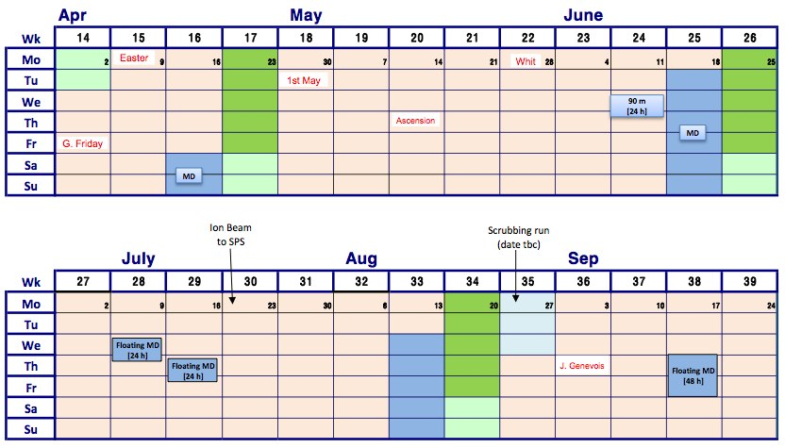
Schedule
90m directly after or even before intensity ramp up ??
Present schedule
VdM
90m
500 m
90m
500 m

