Slide 1
Performance evolution vs. machine parameters in the last 3 weeks
G. Arduini

Slide 2
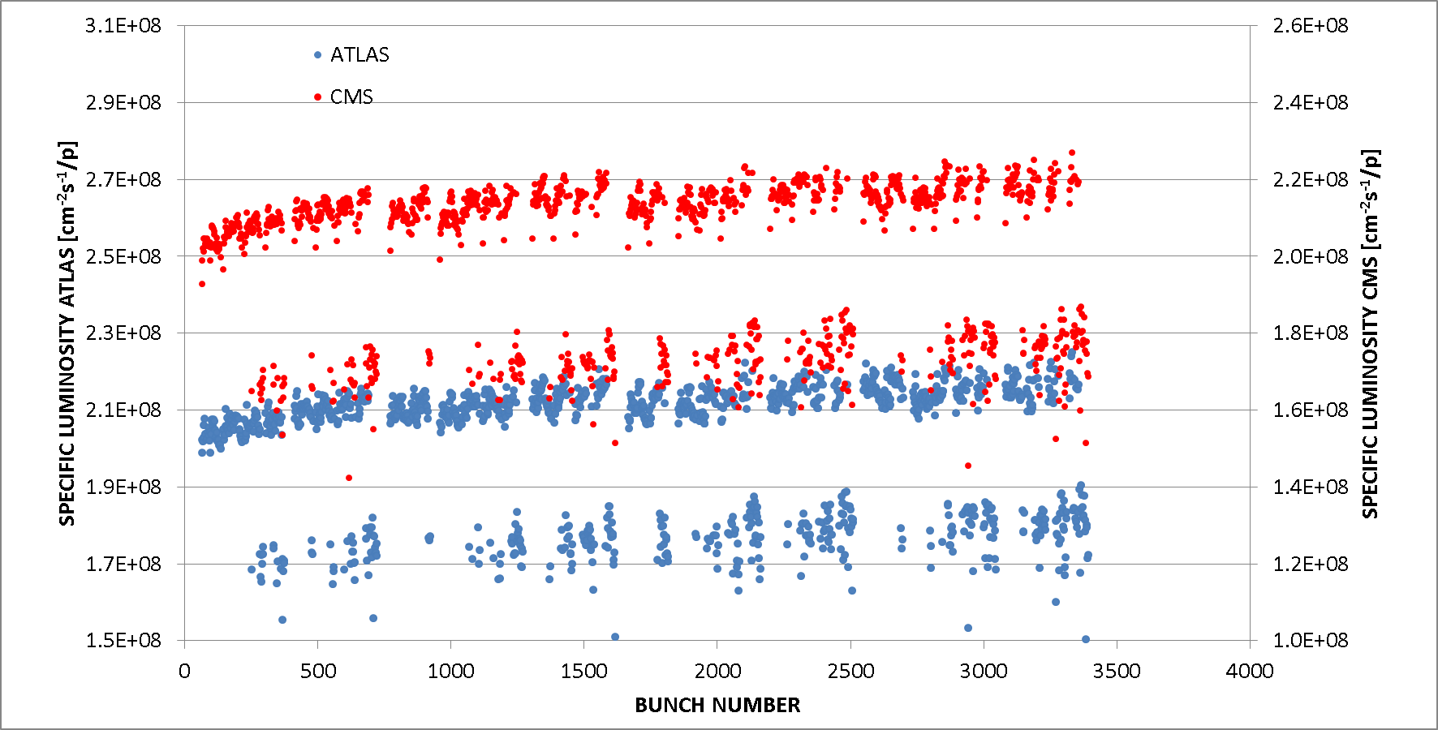

Slide 3
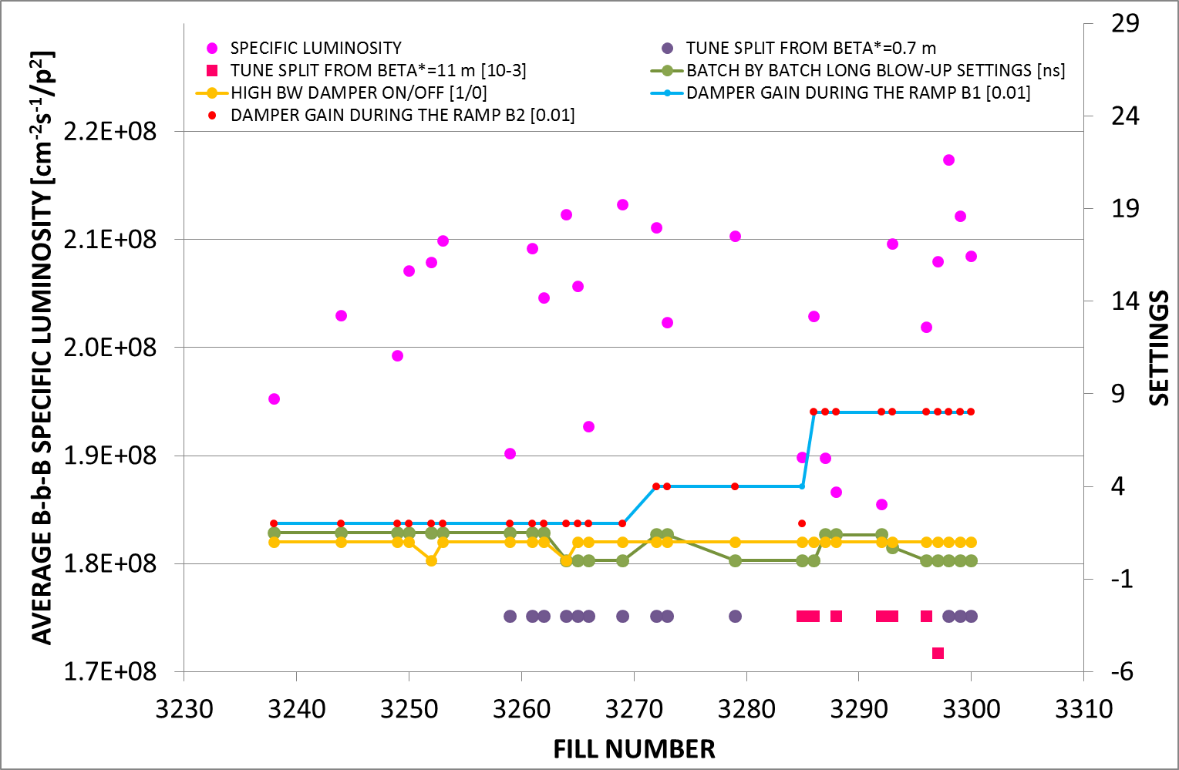

Slide 4
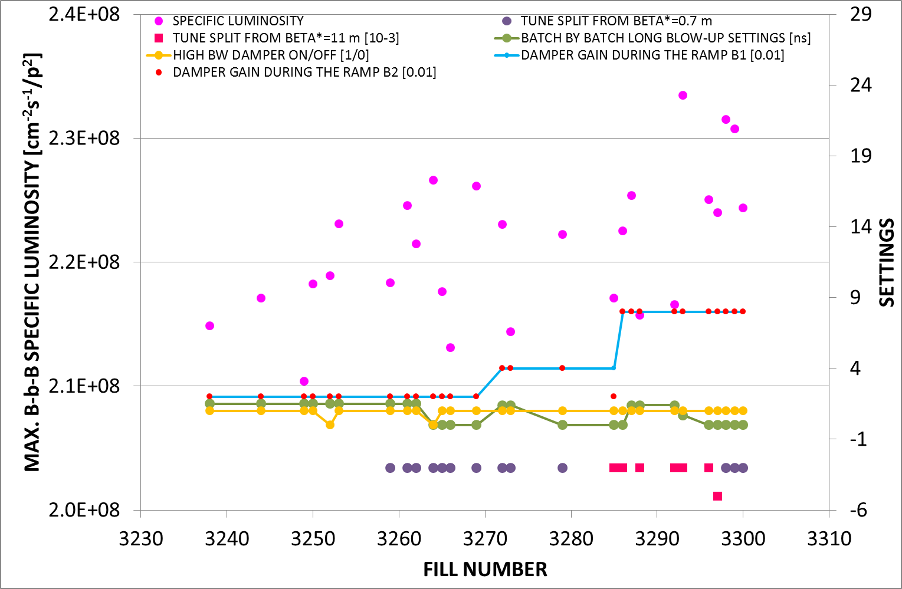

Slide 5
